Slide 1
Security Service, Armed and Unarmed
RFP 99999-SPD0000095
Statewide Contract Webinar – October 23, 2013
SPD-CP031
Revised 02/10/11
Georgia State Purchasing Division
http://statepurchasing.doas.georgia.gov

Slide 2
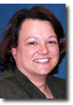
Your Presenter
State Purchasing Division – Statewide Contracts
Lisa Mehalko
Process Improvement Auditor
Experience
20+ years in Contract Management
10+ years with the state of Georgia
Education
MBA, Keller Graduate School of Management
Contact Information
Lisa.Mehalko@doas.ga.gov
404-656-2267

Slide 3

Purpose of this Webinar
State Purchasing Division – Statewide Contracts
1.EXPLAIN
the purpose
2. REVIEW
the benefits
3. LIST
specific details
4. LIST
the benefits
5. FIND
on the website
6. REVIEW
FAQs
7.DESCRIBE
how to
get info

Slide 4
Purpose of this Webinar
State Purchasing Division – Statewide Contracts
Purpose:
  The purpose is to introduce State entities and local governments to a new Statewide Contract which provides Security Service, Armed and Unarmed, for various state entities, at inclusive rates provided for the various regions throughout the state.

Slide 5
Statewide Contract Details
State Purchasing Division – Statewide Contracts
What is the Contract Number?
#99999-001-SPD0000095-0001 - Dynamic
#99999-001-SPD0000095-0002 - Confidential
Is it a Renewal?
No
Does it Replace an Existing Contract?
No
What is the Contract Term?
5 Years
What is the Expiration Date?
October 31, 2015
Does it Allow the Use of the P-Card?
Yes
Who are the Persons to Contact with Questions:
Lisa Mehalko
404-656-2287
Lisa.Mehalko@doas.ga.gov
Matt Taylor
404-657-7728
Matt.Taylor @doas.ga.gov

Slide 6
Key Benefits
State Purchasing Division – Statewide Contracts
Key Benefits:
Average State regional savings of 21.5% of existing entity contracts
Average DBHDD Regional savings of 28.0% of existing entity contracts
Around the clock coverage, all-shifts and dates
Highly qualified and trained guard personnel
All levels of service provided
Competitive pricing
Accepts PeopleSoft purchase orders as well as established entity PO forms
Mandatory contract for state entities; convenience contract for local municipalities
Statewide/Regional Coverage

Slide 7
Regions

Slide 8
Regions 1 -12

Slide 9
DBHDD Regions 1-6

Slide 10
Suppliers
Confidential Security Agency
Dynamic Security, Inc.

Slide 11
1750 PEACHTREE STREET NW
ATLANTA, GEORGIA 30309
(404) 888-0801
An Equal Opportunity Employer Since 1972
#99999-001-SPD0000095-0002

Slide 12

Confidential Security Agency, Inc. (CSA) was Founded in 1972
State of Georgia based Corporation
One of the oldest and most successful minority security guard firms in Southeastern United States
One of Atlanta’s Top Security Guard Firms (Source: Atlanta Business Chronicles)
Mission Statement: “To provide quality security services for the protection of people and property while creating good jobs for qualified citizens in the communities we serve.”

Slide 13
Over the years CSA has enjoyed a rich history as one of the State of Georgia’s leading security service vendors for various
locations including
University of Georgia, Department of Transportation, Gordon State College, Athens Technical College, Georgia Student Finance Commission and many other State entities.

Slide 14
















CSA CLIENT SNAPSHOT

Slide 15
People are people…

Slide 16
CSA Hiring Methodology: The Difference
Screening
Hiring Practices
Training
Customer Service
Pay Rates

Slide 17
Screening
21 Years of age or older
Must Possess High School diploma or GED equivalent
Stable home address and a valid and active telephone number
Have clear criminal history – NO FELONIES
Copy of Form DD214 for any prior military experience
Copy of a valid Georgia Driver’s License or Georgia Issued ID
Proof of Citizenship or US INS Legal Alien Status
Hiring Practices
10 Panel Drug Test
Criminal Background
Employment Verification
Residence Verification

Slide 18
Training
CSA basic training course is tailored to include State of Georgia Board of Private Detective and Security Agencies mandatory training topics
All CSA Officers receive post/orders training
A passing score of 85% on the written exam is required before security personnel are assigned for duty
CSA training coordinators are state certified
Professional uniform appearance is enforced
Customer Service
Client personnel regularly state that they feel more secure on the job
Clientele positively comment on the professional appearance and attitude of our security personnel
Client management, legislators, county representatives and citizens comment on the excellent performance of CSA security personnel
Pay Rates
CSA security officers are paid above the Federal Minimum hourly rate of pay
We value our employees

Slide 19







We care… really…
CSA cares about our clients, our employees and
our communities.
CSA gives…
CSA Employee Benevolence
Local churches and education programs

Slide 20
The CSA Advantage:
CSA is a stable, 41 + year guard firm
CSA hires consciously
CSA takes a long-term view of our personnel
CSA is dedicated and responsive to the needs of each client
CSA provides a cost effective approach to securing your facilities
We look forward to continuing to do positive business for the State of Georgia

Slide 21
1750 PEACHTREE STREET NW
ATLANTA, GEORGIA 30309
(404) 888-0801
An Equal Opportunity Employer Since 1972

Slide 22
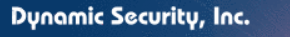
Dynamic Security
Providing elite security solutions for over 70 years for commercial, municipal, state, and federal entities
Headquartered in the southeast serving over 20 states.
GSA schedule contract holder, familiar with the type and nature of this contract
Service based on value, integrity, and client satisfaction
Over 95% client retention

Slide 23
Clientele
Federal Agencies to include the DOD, VA, DHS and ATF
Numerous State agencies to include Public Safety, Health and Human Services, RSA, Department of Labor and Department of Transportation.
County and municipalities, to include City Halls, Libraries, Museums, and judicial facilities
State and Private Colleges and Universities
Private state, and Federal Health Facilities

Slide 24
Armed Solutions
Armed security professionals
Specialized training adapted to customer needs
In-house instructors with diversified national and state certifications
Handguns, long guns, Baton, OC- Spray, and Handcuffing
Standard company issue weapons and tactical gear of law enforcement grade

Slide 25
Unarmed Solutions
Extensive screening process
“Square peg square hole” placement
Highly Trained
Duties include:
  CCTV and Alarm monitoring
  Access Control
  Foot Patrol
  Reporting
  Employee and Visitor Screening

Slide 26
Operations

Slide 27
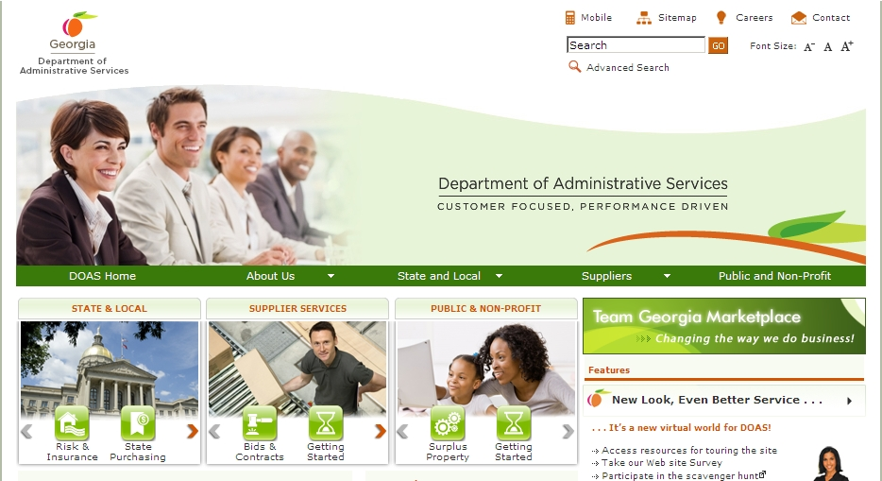
Where to Find this Statewide Contract
State Purchasing Division – Statewide Contracts
1. Visit the DOAS website at www.doas.ga.gov.

Slide 28
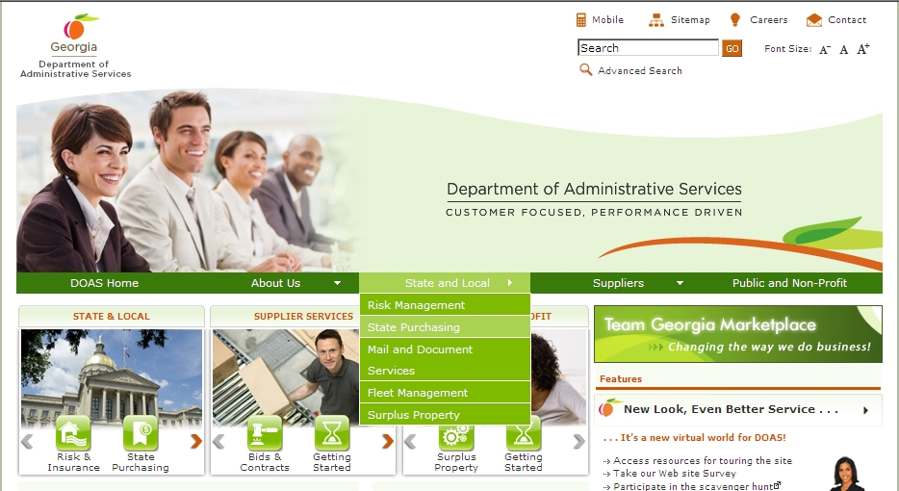
Where to Find this Statewide Contract
State Purchasing Division – Statewide Contracts
From the State and Local section of the screen
2. From the State and Local section of the screen, Click on State Purchasing.

Slide 29

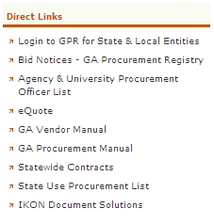
Where to Find this Statewide Contract
State Purchasing Division – Statewide Contracts
Click on Statewide Contracts
4. In the Direct Links section, click on Statewide Contracts.

Slide 30
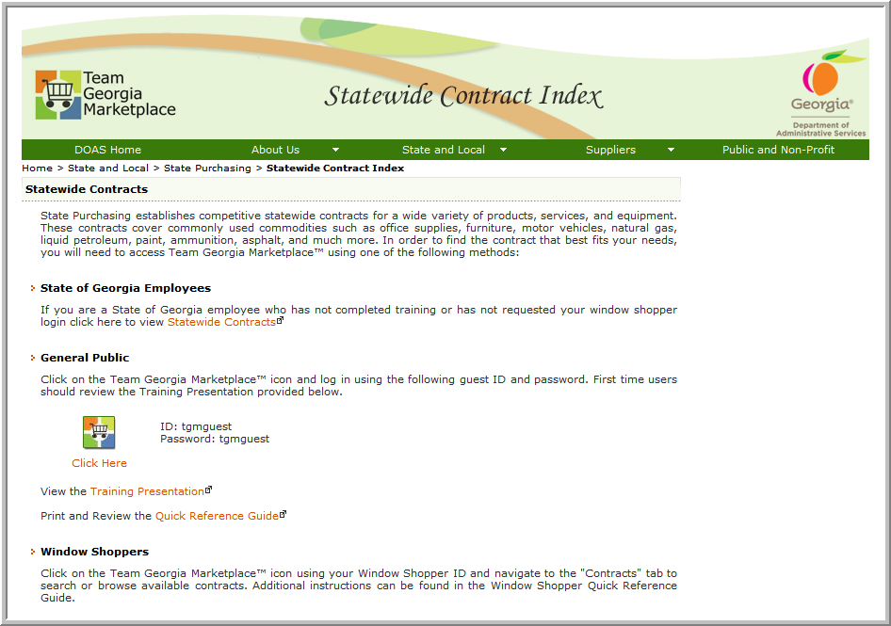
SWC Index for Public
5. To access contract information, click on the Team Georgia Marketplace™ icon to access the Login screen. This User Name and Password is generic and only provides access to contract information.
Use tgmguest
as the User Name and the Password

Slide 31
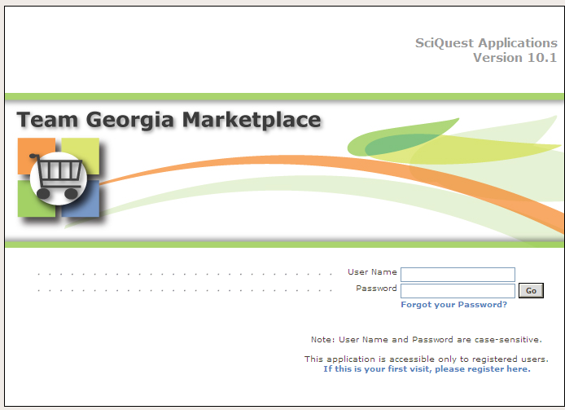
Statewide Contracts Index
6. When the Login screen displays, use tgmguest as the User Name and the Password. This generic ID and Password allows access to contract information only.
Use tgmguest
as the User Name and the Password

Slide 32
SWC Index for Window Shoppers
You can also click on the Team Georgia Marketplace™ icon to access the same Login screen, but enter your personal Window Shopper User Name and Password. This allows you to access the Statewide Contract Index as well as to shop for items available from the Statewide Contracts.

Slide 33
SWC for Window Shoppers
If you are a Window Shopper user, you can access the Statewide Contract Index by entering your personal User Name and the Password once the Login screen displays. Then, click on the Contracts tab.
Use your Window Shopper User Name and Password

Slide 34
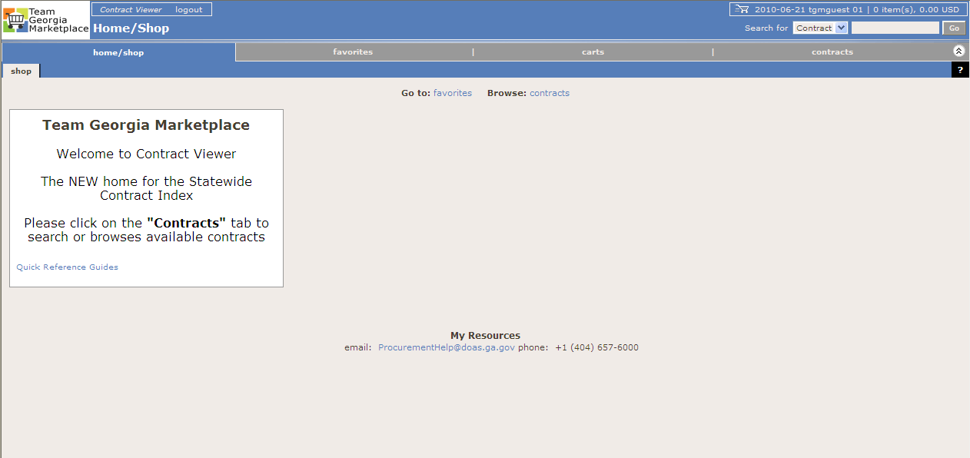
Team Georgia Marketplace Contracts
Once you access the system using the generic or your personal User Name and Password, click on the Contracts tab to access the Statewide Contracts.
Click on the Contracts tab

Slide 35
How to use this contract
State Purchasing Division – Statewide Contracts
Download the Service Request form from TGMP
Complete the form and send (email) to Supplier
Confirmation will be received from Supplier with Statement of Work (SOW)
Work Begins – monitor and track all timesheets
Submit signed/approved timesheets to Supplier
Supplier sends a consolidated invoice bi-weekly for all guards/shifts and areas served

Slide 36
Order Form

Slide 37
Frequently Asked Questions
State Purchasing Division – Statewide Contracts
Question | Answer

Slide 38
For more information
State Purchasing Division – Statewide Contracts
DOAS Contact for Questions:
Email Address:
Matt.Taylor@doas.ga.gov
Person to Contact:
Matt Taylor
Phone Number:
404-656-7728
DYNAMIC Contact Information:
Email Address:
CHargrove@dynamicsecurity.org
Person to Contact:
Chris Hargrove
Phone Number:
(855) 215-9643 (toll free)
Email Address:
Lisa.Mehalko@doas.ga.gov
Person to Contact:
Lisa Mehalko
Phone Number:
404-656-2267
CONFIDENTIAL Contact Information:
Email Address:
Confidentialsa@aol.com
Person to Contact:
Patrice Adams
Phone Number:
404-888-0801
This Webinar
A copy of this webinar will be posted on the State Purchasing Division website.

Slide 39
Questions…
?

Slide 40


