Slide 1
Create a Contract Renewal from a Contract Request
DESCRIPTION
This guide will show Contract Requesters how to Create a Contract Renewal from an approved Contract Request form only.
OVERVIEW
The key steps in the process are below:
Access the Contracts module.
Click Requests > Search Contract Request.
Review required fields.
Click Create Renewal.
Note: Throughout the system, click on the Question Mark to access the help text. In addition, any field with a Gray Star is a mandatory field.
Business Process:
Access Contracts Module
Find Contract Request
Review fields
Contract Created from Contract Request

Slide 2


Create a Contract Renewal from a Contract Request (Part 1 of 6)
INSTRUCTIONS
Click the Global Navigation Menu.
Note: University System of Georgia (USG) users complete local logon and then proceed to Step 4.
Click Sourcing, Contracts & Supplier Management.

Slide 3

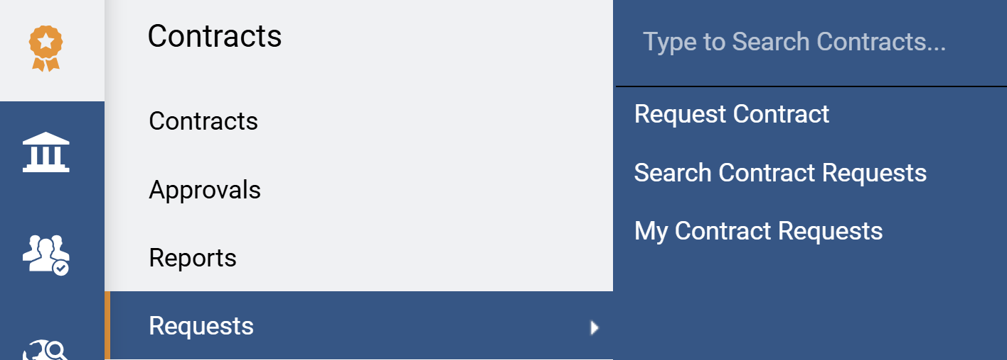
Create a Contract Renewal from a Contract Request (Part 2 of 6)
INSTRUCTIONS
Click Sign On.
Note: The system utilizes Single Sign-On (SSO) capabilities and no log in information is required.
Access the Contracts module.
Select Requests.
Select Search Contract Requests.
4
6
5

Slide 4
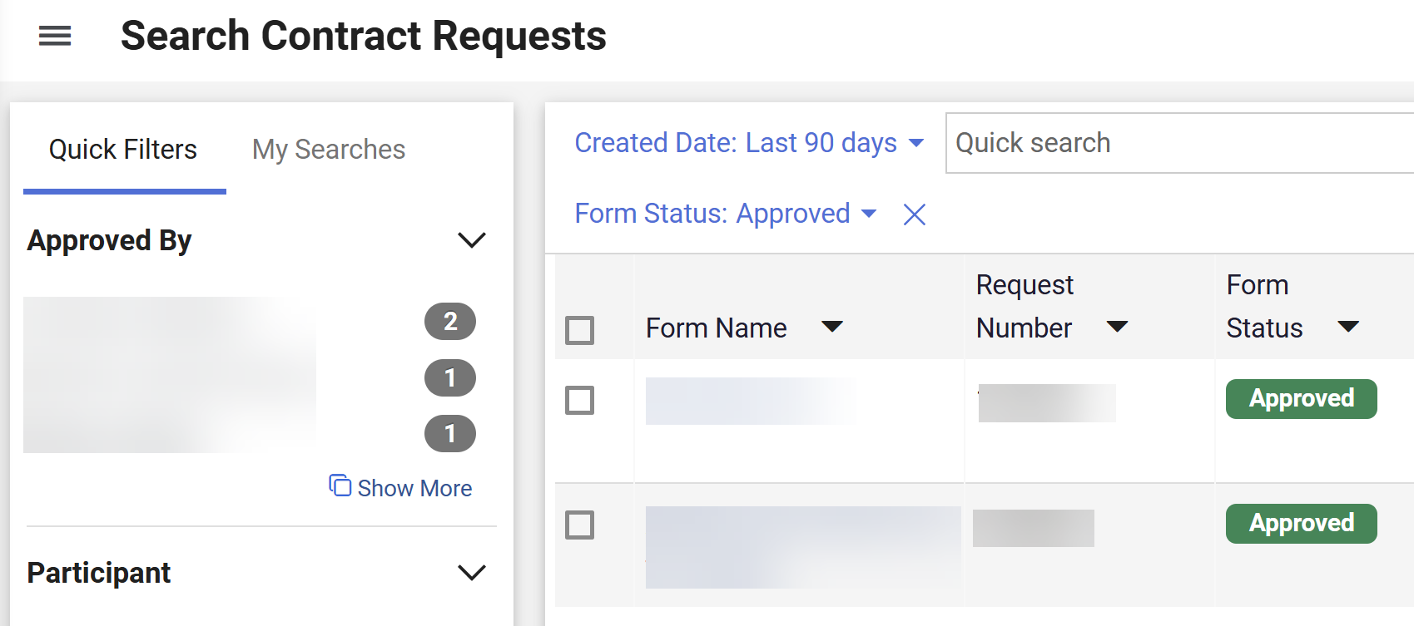
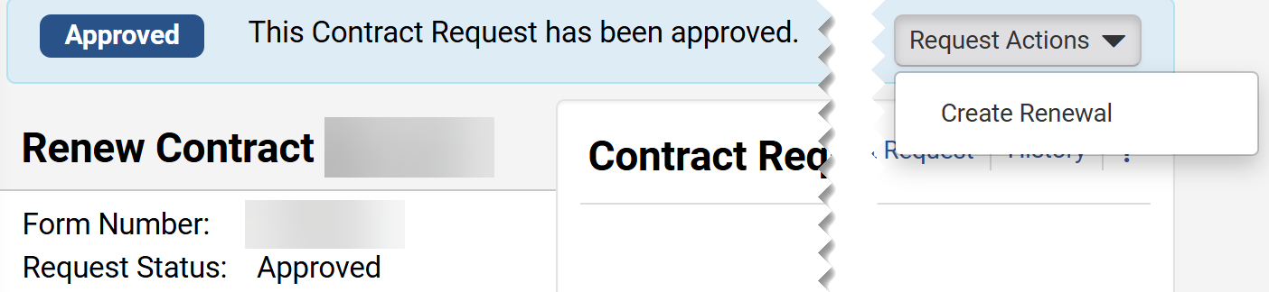
Create a Contract Renewal from a Contract Request (Part 3 of 6)
INSTRUCTIONS
Use the Quick Filters or Quick Search tool to search for Approved Contract Request.
Click the Form Name hyperlink.
7
8
Click Request Actions.
Click Create Renewal.
9
10

Slide 5
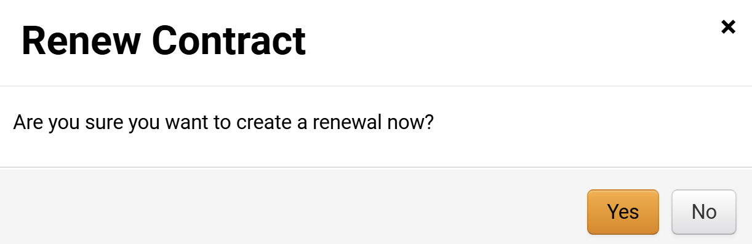
Create a Contract Renewal from a Contract Request (Part 4 of 6)
INSTRUCTIONS
Click Yes.
Note: The Contract Renewal will open only after clicking Yes.

Slide 6
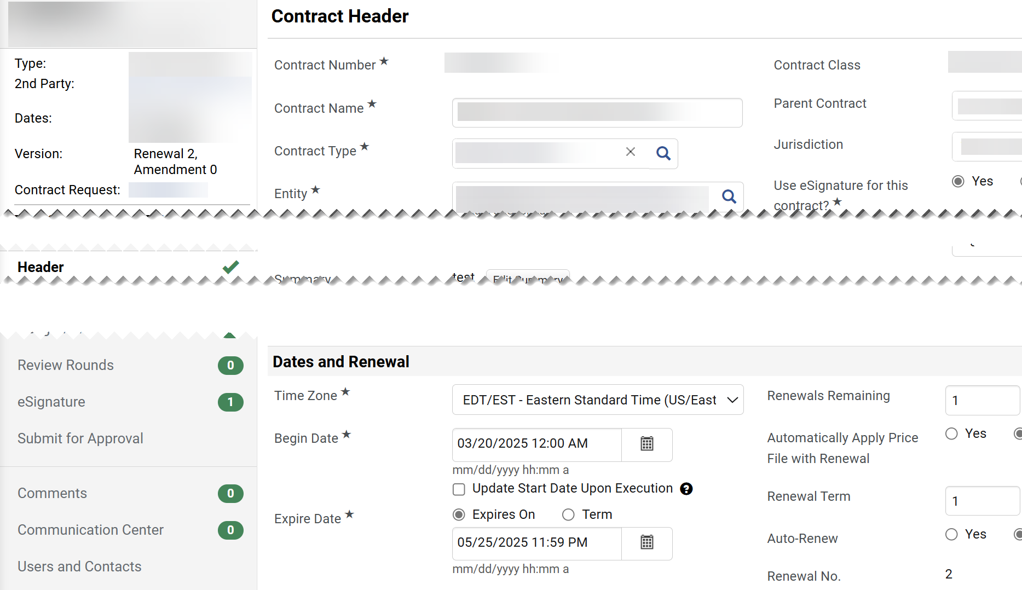
Create a Contract Renewal from a Contract Request (Part 5 of 6)
INSTRUCTIONS
​Dates and Renewal data is auto populated from the Contract Request Form.
​Renewals Remaining.
Note: Renewals remaining will decrease down to the number of remaining renewals.
​Renewal No. read-only field of running renewals.
13
12
14

Slide 7
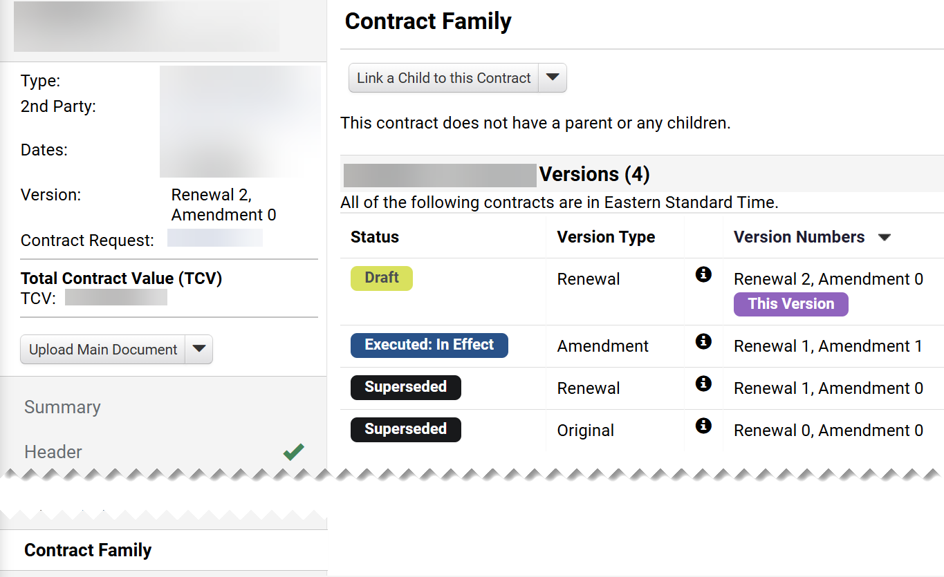
Create a Contract Renewal from a Contract Request (Part 6 of 6)
INSTRUCTIONS
Click Contract Family.​​
The Contract Version includes Status, Version Type and Version Numbers.
The Contract Renewal Request is linked to the Contract.
17
16
15
You have successfully created a Contract Renewal from a Contract Request.

