Slide 1
Find My Procurement Card Transaction Verification for Cardholders
DESCRIPTION
This guide will show P-Card Holders how to locate and analyze their Procurement Card Transaction Verification documents by running the CRPROC - PCARD - My Procurement Card Transaction Verifications report.
OVERVIEW
The key steps in the process are below:
Enter CRPROC - PCARD - My Procurement Card Transaction Verifications in the Search field and select the report.
Note: As an alternative, you may also view the report results from the P-Card Cardholder Dashboard. Select the Credit Card Transactions & Procurement Card Verifications tab.
Specify the desired Search criteria.
Export results to Excel or PDF for analysis, if needed.
Review report results and filter on column headers, as needed.
Business Process:
Run Report
Analyze Report Results
Export Results for Analysis

Slide 2
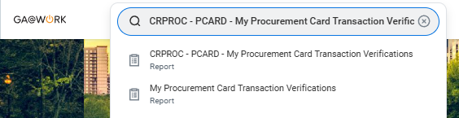
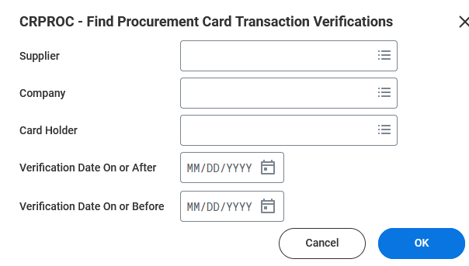
Find Procurement Card Transaction Verifications (Part 1 of 7)
INSTRUCTIONS
Enter CRPROC - PCARD - My Procurement Card Transaction Verifications in the Search field.
Select the report.
Note: As an alternative, you may also view the report results from the P-Card Cardholder Dashboard. Select the Credit Card Transactions & Procurement Card Verifications tab.
1
2
Specify one or more prompts to define your search criteria.
Click OK.
3
4

Slide 3
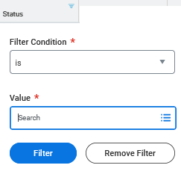
Find Procurement Card Transaction Verifications (Part 2 of 7)
INSTRUCTIONS
Review and analyze results.
Click column headers to filter results (optional) and specify Filter Condition* and specify Value.
Click Filter.
Note: The Procurement Card Transaction statuses are: Approved, Canceled, Draft, and In Progress.
5
6
7

Slide 4
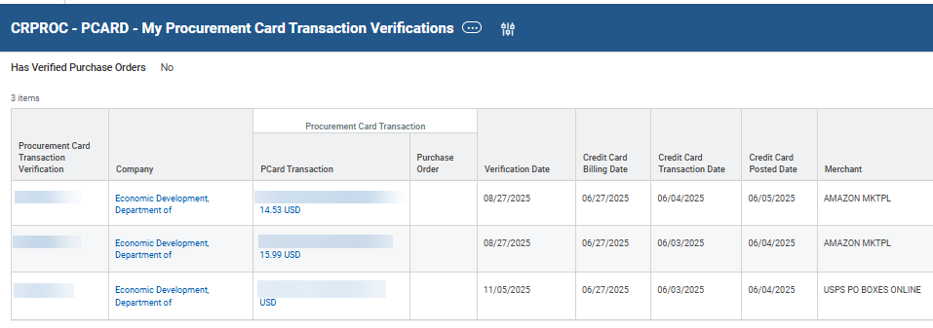
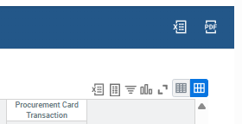
Find Procurement Card Transaction Verifications (Part 3 of 7)
INSTRUCTIONS
Review report results. Filter using column headers, as needed.
Select an export option, as applicable. You may select Excel, PDF or Worksheet.
Note: the remaining steps of this document explain additional report analysis options.

Slide 5
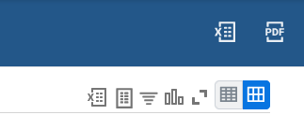
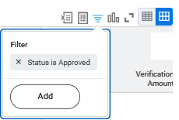
Find Procurement Card Transaction Verifications (Part 4 of 7)
INSTRUCTIONS
Click Filter to create a filter for the grid data.
Note: Steps 10 – 17 provide methods for filtering results as an alternative to using column headers.
Click Add to customize the filter.
  Note: In most cases you also filter report results.

Slide 6
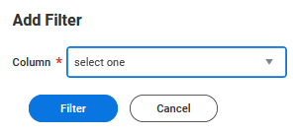
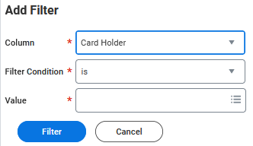
Find Procurement Card Transaction Verifications (Part 5 of 7)
INSTRUCTIONS
Select a Column* filter option.
Select the Filter Condition* and Value*.
Click Filter.
13
14

Slide 7


Find Procurement Card Transaction Verifications (Part 6 of 7)
INSTRUCTIONS
Click Toggle Fullscreen Viewing Mode to enter or exit full screen mode (Optional).
Click Collapse Rows or Expand Rows to change visibility of columns in result rows (Optional).

Slide 8

Find Procurement Card Transaction Verifications (Part 7 of 7)
INSTRUCTIONS
Use the Navigation Bar along the bottom of the report to change the results row view.
  Note: You can increase, decrease, or specify 'All' to control the number of results appearing per page. You also have the option to select or specify a report page number to view.
  Related CRPROC - PCARD Procurement Card Transaction Verification reports are available, including:
  CRPROC - PCARD - Find Procurement Card Transaction Verifications - Summary (detail includes Approvals)
  CRPROC - PCARD - Find Procurement Card Transaction Verifications - Detail
  (detail includes Approvals, Splits, and Worktags)
You have successfully completed the CRPROC - PCARD My Procurement Card Transaction Verification report job aid.

