Slide 1
Find, Analyze & Resolve Credit Card Transaction File Errors
This guide will show SPD P-Card Administrators and Business Analysts how to Find, Analyze, and Resolve Credit Card Transaction File Errors.
Note: The daily bank file that loads contains data related to Cardholders, Credit Cards, and Credit Card Transactions.
The key steps in the process are below:
Receive and review Diagnostic Audit Reports (Credit Cards & Credit Card Transactions) from the technical team.
Based on errors, run the CRPROC – PCARD – Cardholder Listing Files report and/or the CRPROC - PCARD - Find Credit Card Transaction Files report.
Find, analyze, and resolve errors, as appropriate.
Business Process:
Review P-Card Audit Reports
Run CRPROC – PCARD Report(s).
Resolve P-Card File Errors

Slide 2
Receiving Audit Reports (Part 1 of 1)
The support team will receive an email from the Tech Team notifying them of errors resulting from the daily bank file load.
The email will contain or provide access for the (2) Workday Diagnostic Audit reports listed, along with the original bank csv file to reference, if necessary.
  Import Visa VCF4 Scrubbed (Credit Cards) Diagnostic Audit
  Import Visa VCF4 Masked (Credit Card Transactions) Diagnostic Audit
The Audit reports provide detail of the data errors occurring for the bank file loaded into GA@WORK and guide the support analyst on which P-Card report(s) should be run to locate and correct the error in GA@WORK. It is possible for errors to exist on one or both reports.
Based on the diagnostic audit report reviewed and type of error (credit card or credit card transaction), run the related GA@WORK P-Card report to access and correct the error.

Slide 3
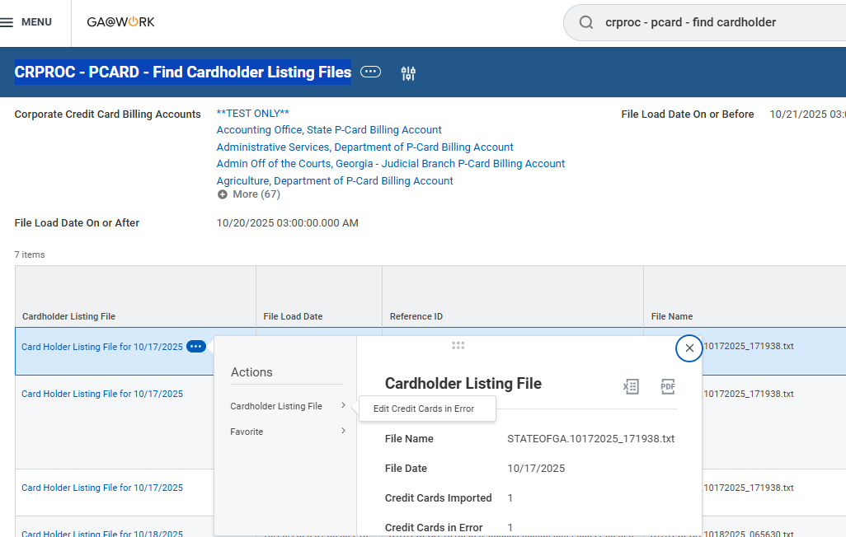
Find, Analyze & Resolve Credit Card File Errors (Part 1 of 2)
Analyze and resolve errors reported on the Import Visa VCF4 Scrubbed (Credit Cards) Diagnostic Audit Report.
Type CRPROC - PCARD - Find Cardholder Listing Files in Search and select the report.
Note the number of Credit Cards in Error.
Select Related Actions (…) next to the Cardholder Listing File.
Select Edit Credit Cards in Error.
2
3
4
5

Slide 4
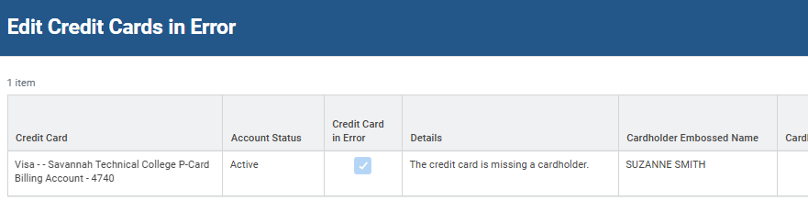
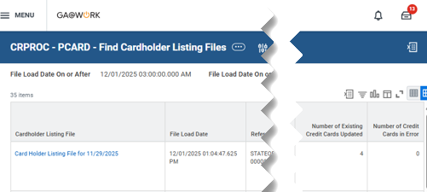
Find, Analyze & Resolve Credit Card File Errors (Part 2 of 2)
Review and make necessary corrections to credit cards in error then click OK.
Re-run the CRPROC - PCARD - Find Cardholder Listing Files report to confirm Number of Credit Cards in Error is zero.

Slide 5
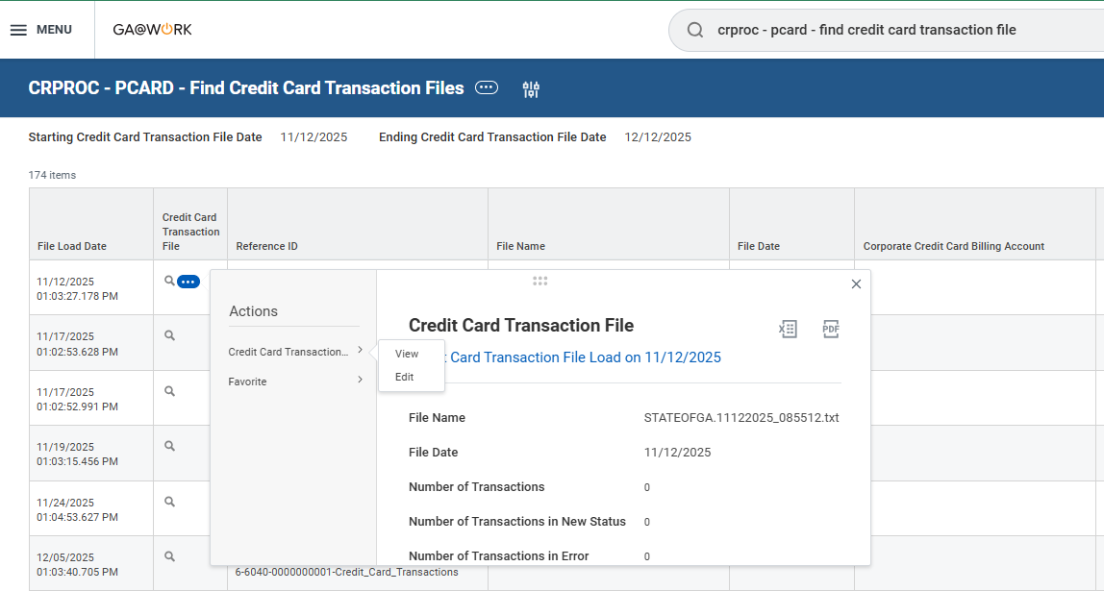
Find, Analyze & Resolve Credit Card Transaction File Errors (Part 1 of 2)
Analyze and resolve errors reported on the Import Visa VCF4 Scrubbed (Credit Card Transactions) Diagnostic Audit Report.
Type CRPROC - PCARD - Find Credit Card Transaction Files in Search and select the report. Specify Dates.
Note the number of Credit Cards in Error.
Select Related Actions (…) next to the Credit Card Transaction File, then select Credit Card Transaction > Edit.
2
3
4

Slide 6
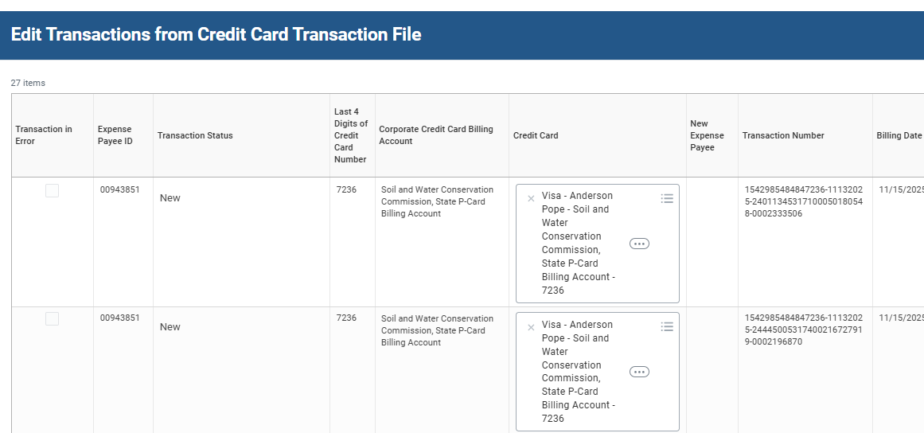
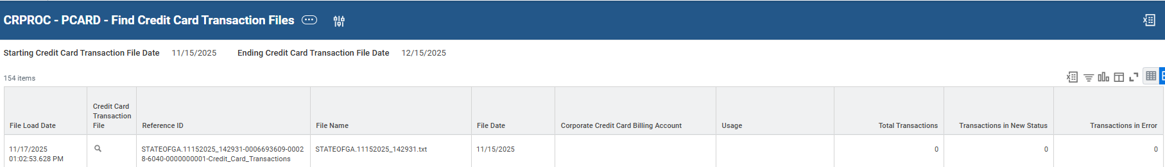

Find, Analyze & Resolve Credit Card Transaction File Errors (Part 2 of 2)
View error Details and make corrections, as necessary to resolve. Then click OK.
Re-run CRPROC - PCARD – Find Credit Card Transaction Files to confirm Number of Credit Cards in Error is zero.
You have successfully found, analyzed, and resolved credit card transaction file errors.

