Slide 1
Assign Substitute Approvers for Contracts Approval
DESCRIPTION
This guide will show Administrator how to Assign Substitute Approvers for Contract Approval only.
OVERVIEW
The key steps in the process are below:
Access the Contracts module.
Click Approvals.
Assign Substitute.
A Substitute Approver is assigned for Contracts Approval.
Business Process:
Access Contracts Module
Click Approvals
Assign Substitute
Substitute Approver Assigned
Disclaimer: Due to regular system updates, the screens and features in GA@WORK may differ slightly from those shown in this job aid. For questions or assistance, please contact the Help Desk.

Slide 2


Assign Substitute Approvers for Contracts Approval (Part 1 of 12)
INSTRUCTIONS
Click the Global Navigation Menu.
Note: University System of Georgia (USG) users complete local logon and then proceed to Step 4.
Click Sourcing, Contracts & Supplier Management.

Slide 3

Assign Substitute Approvers for Contracts Approval (Part 2 of 12)
INSTRUCTIONS
Click Sign On.
Note: The system utilizes Single Sign-On (SSO) capabilities and no log in information is required.
Review Action and follow the steps in the table below to Assign Substitute Approver.
Action | Description | Step Information
 |  | ​
Assign Substitute Approvers - Contracts
Assign a Substitute Approver to a Contract for Approval
5 - 17
Assign Substitute Approves – Contract Requests
Assign a Substitute Approver to a Contract Request for Approval
18 - 30

Slide 4
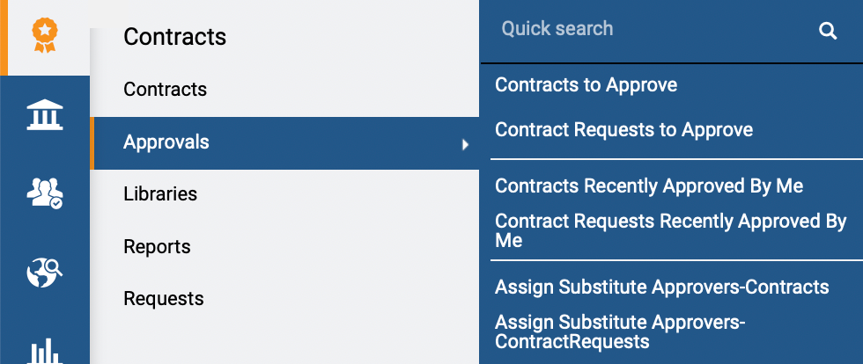
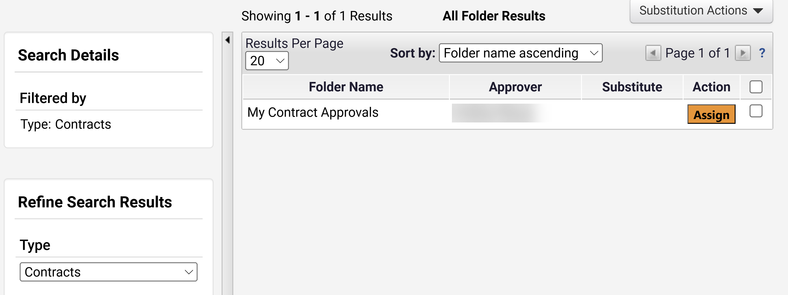
Assign Substitute Approvers for Contracts Approval (Part 3 of 12)
INSTRUCTIONS
Access the Contracts module.
Click Approvals.
Select Assign Substitute Approvers – Contracts.
5
6
7
Review displayed Contract Approvals.
Note: Select Type to refine search results.
Click Assign.
8
9

Slide 5
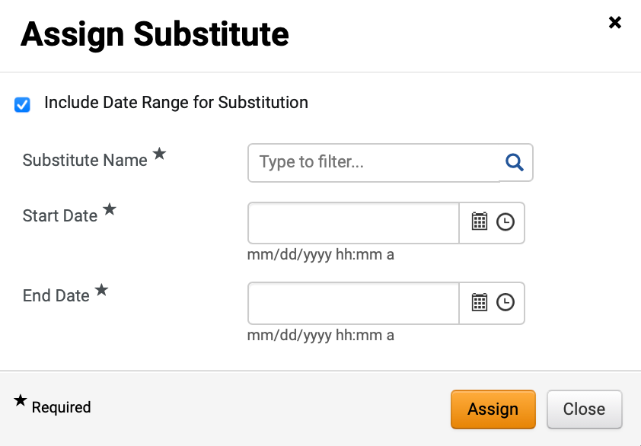
Assign Substitute Approvers for Contracts Approval (Part 4 of 12)
INSTRUCTIONS
Check the Include Date Range for Substitution box, if applicable.
Note: If selecting this option, Start Date and End Date are mandatory fields.
Select Substitute Name*.
Note: Complete all required fields marked with a black star *. Follow Step 12 if clicking magnifying glass to select Substitute or skip to Step 13 if typing Substitute Name. Select the user responsible for approving the specific activity. The selected user should have the same or a higher level of authority.
10
11

Slide 6
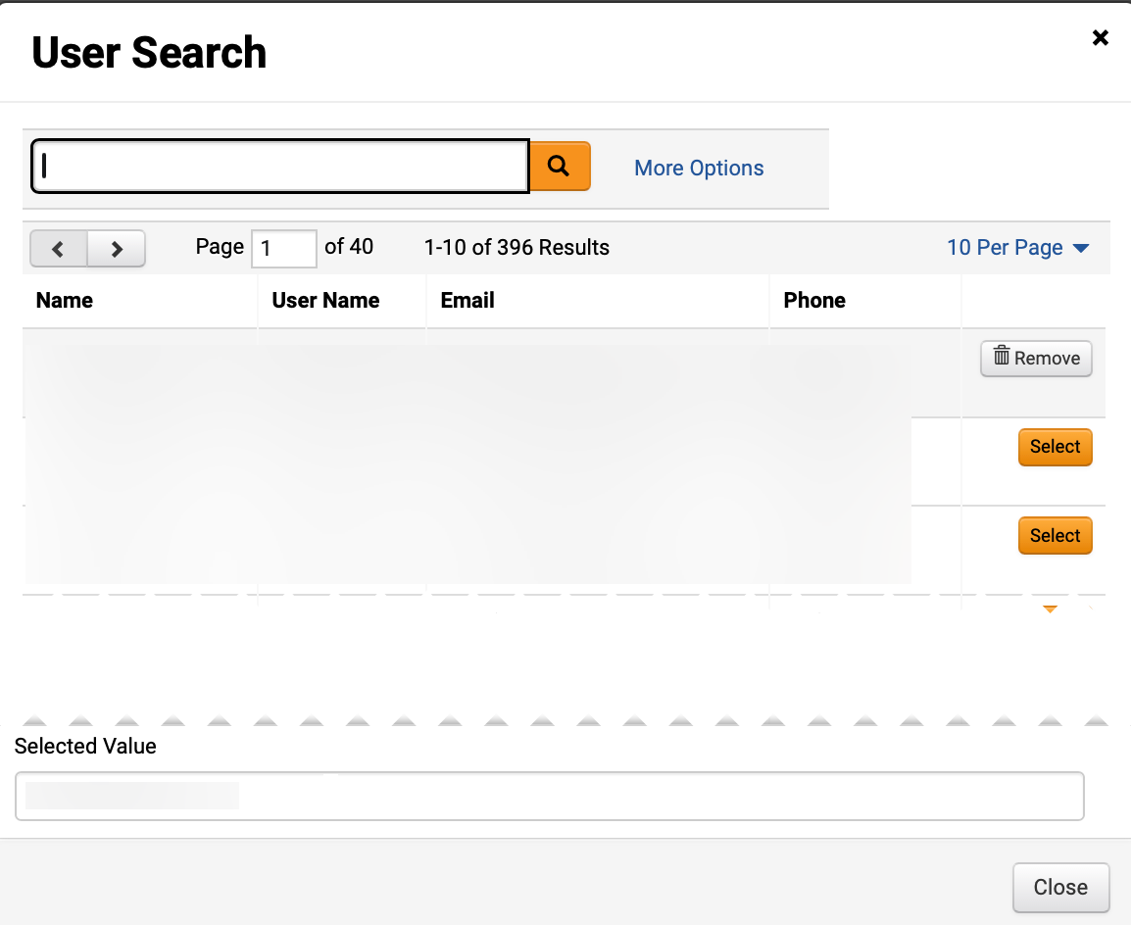
Assign Substitute Approvers for Contracts Approval (Part 5 of 12)
INSTRUCTIONS
To select the user, click Select.
Note: To filter results, type in field, click the magnifying glass to search, or click More Options.

Slide 7
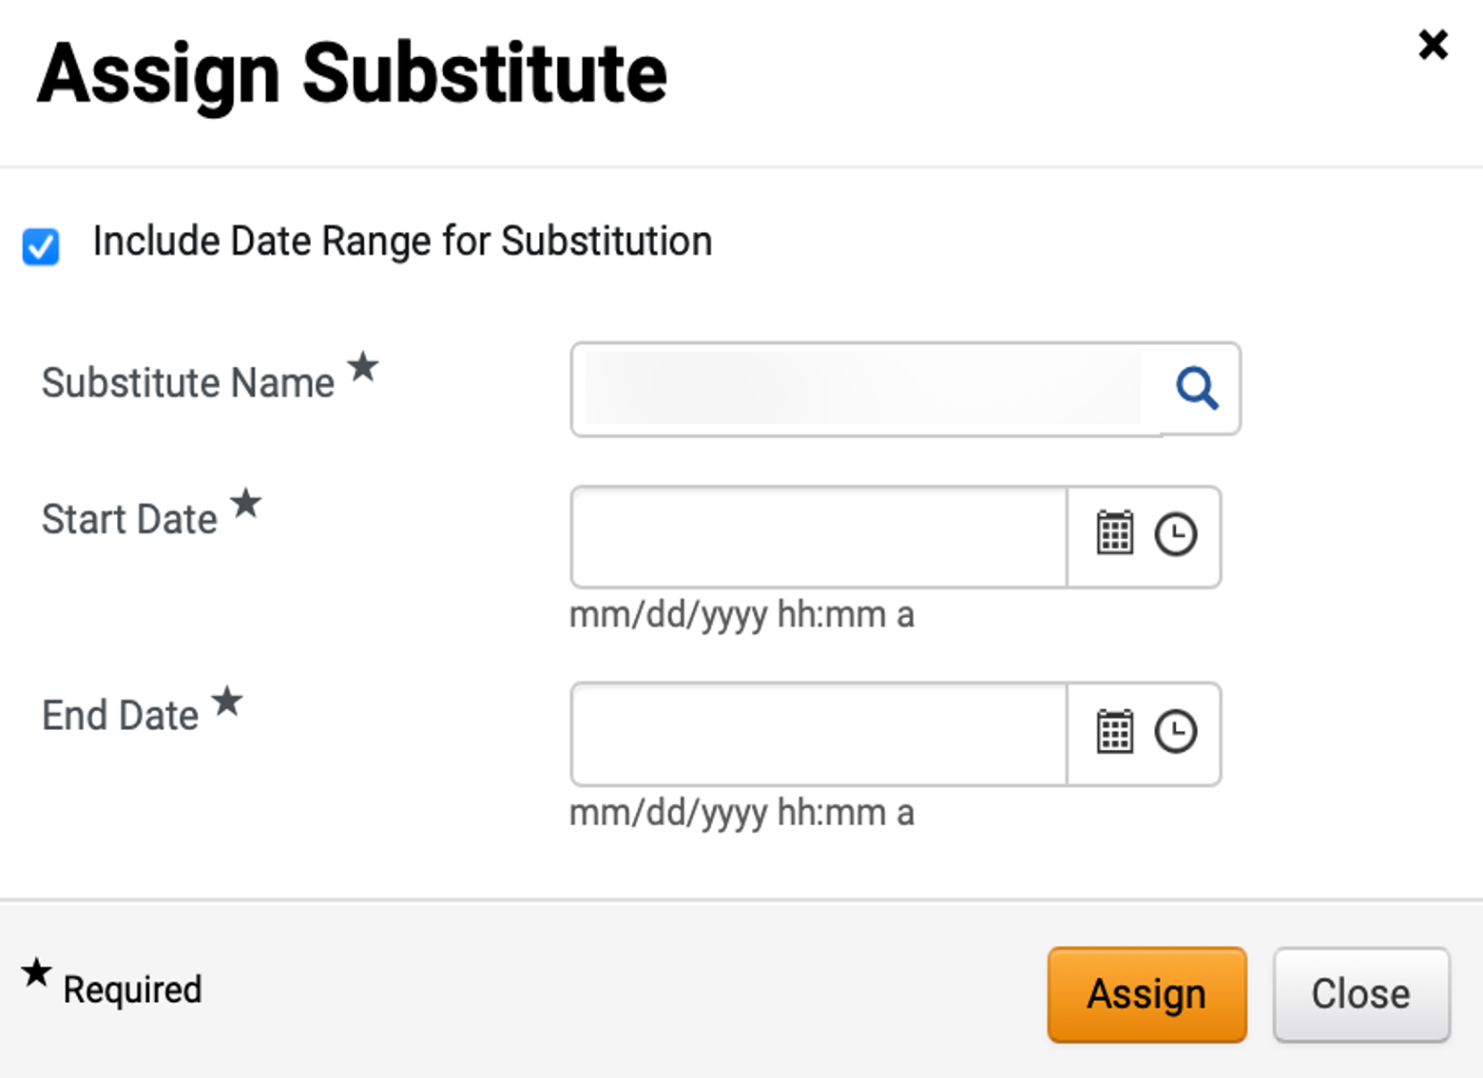
Assign Substitute Approvers for Contracts Approval (Part 6 of 12)
INSTRUCTIONS
Review added Substitute Name*.
Enter a Start Date*.
Enter an End Date*.
Click Assign.
13
14
15
16

Slide 8
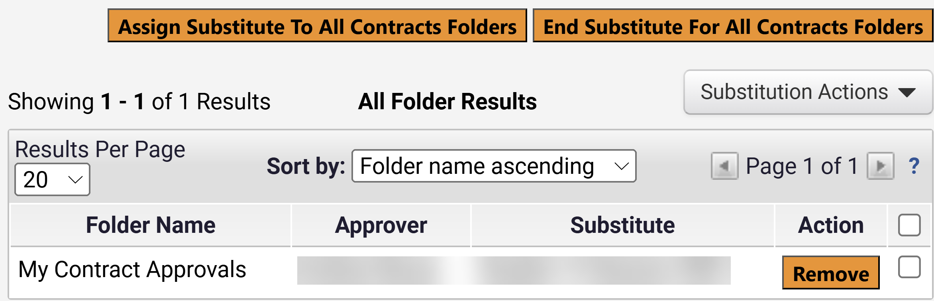
Assign Substitute Approvers for Contracts Approval (Part 7 of 12)
INSTRUCTIONS
Review added Substitute.
Note: To remove Substitute, click Remove.
You have successfully Assigned Substitute Approvers for Contracts Approval.

Slide 9
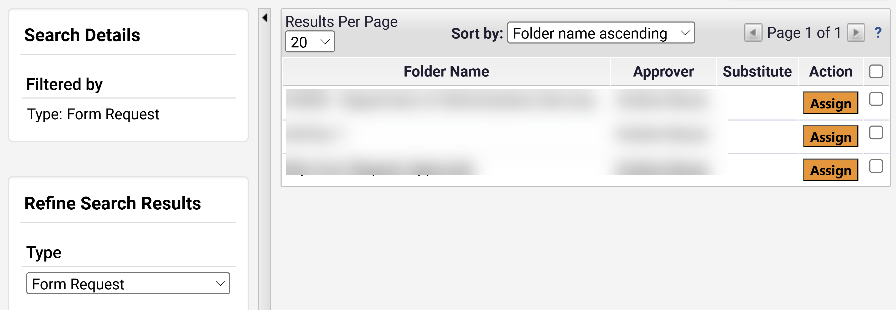
Assign Substitute Approvers for Contracts Approval (Part 8 of 12)
INSTRUCTIONS
Access the Contracts module.
Click Approvals.
To assign a Substitute Approver to a Contract Request, select Assign Substitute Approvers – Contract Requests.
18
19
20
Review displayed Form Request Approvals.
Note: Select Type to refine search results.
Click Assign.
22
21

Slide 10
Assign Substitute Approvers for Contracts Approval (Part 9 of 12)
INSTRUCTIONS
Click Include Date Range for Substitution (Optional).
Note: If selecting this option, Start Date and End Date are mandatory fields.
Select Substitute Name*.
Note: Follow step 25 if clicking the magnifying glass to select Substitute, or skip to step 26 if typing Substitute Name. Select the user responsible for approving the specific activity. The selected user should have the same or a higher level of authority.
23
24

Slide 11
Assign Substitute Approvers for Contracts Approval (Part 10 of 12)
INSTRUCTIONS
To select the user, click Select.
Note: To filter results, type in field, click the magnifying glass to search, or click More Options.

Slide 12
Assign Substitute Approvers for Contracts Approval (Part 11 of 12)
INSTRUCTIONS
Review added Substitute Name*.
Enter Start Date*.
Enter End Date*.
Click Assign.
26
27
28
29

Slide 13
Assign Substitute Approvers for Contracts Approval (Part 12 of 12)
INSTRUCTIONS
Review added Substitute.
Note: To remove Substitute, click Remove.
You have successfully Assigned Substitute Approvers for Contracts Request Approval

