Slide 1
Route a Contract for eSignature
(Internal and External)
DESCRIPTION
This guide will show Contract Administrator how to Route a Contract for eSignature only.
OVERVIEW
The key steps in the process are below:
Access the Contracts module.
Select Contract for signature.
Launch eSignature.
Contract is signed with eSignature.
Note: Throughout the system, click on the Question Mark to access the help text. In addition, any field with a Gray Star is a mandatory field.
Business Process:
Access Contracts Module
Add eSignature Recipients
Launch eSignature
Contract is Signed with eSignature

Slide 2


Route a Contract for eSignature (Part 1 of 11)
INSTRUCTIONS
Click the Global Navigation Menu.
Note: University System of Georgia (USG) users complete local logon and then proceed to Step 4.
Click Sourcing, Contracts & Supplier Management.

Slide 3

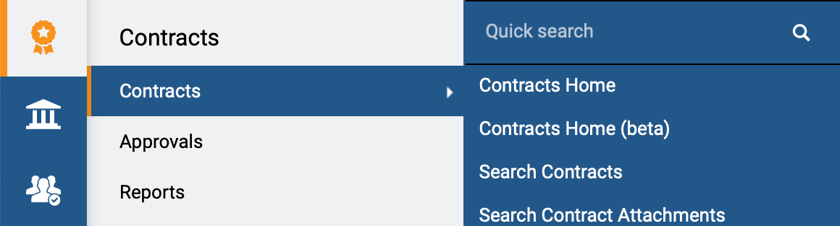
Route a Contract for eSignature (Part 2 of 11)
INSTRUCTIONS
Click Sign On.
Note: The system utilizes Single Sign-On (SSO), no log in information is required.
Access the Contracts module.
Click Contracts.
Click Search Contracts.
4
5
6

Slide 4
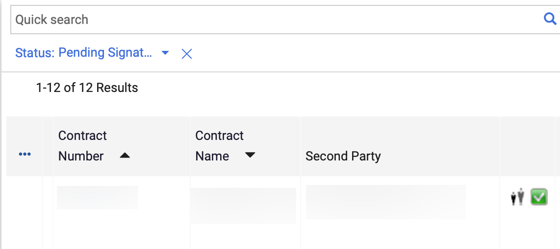
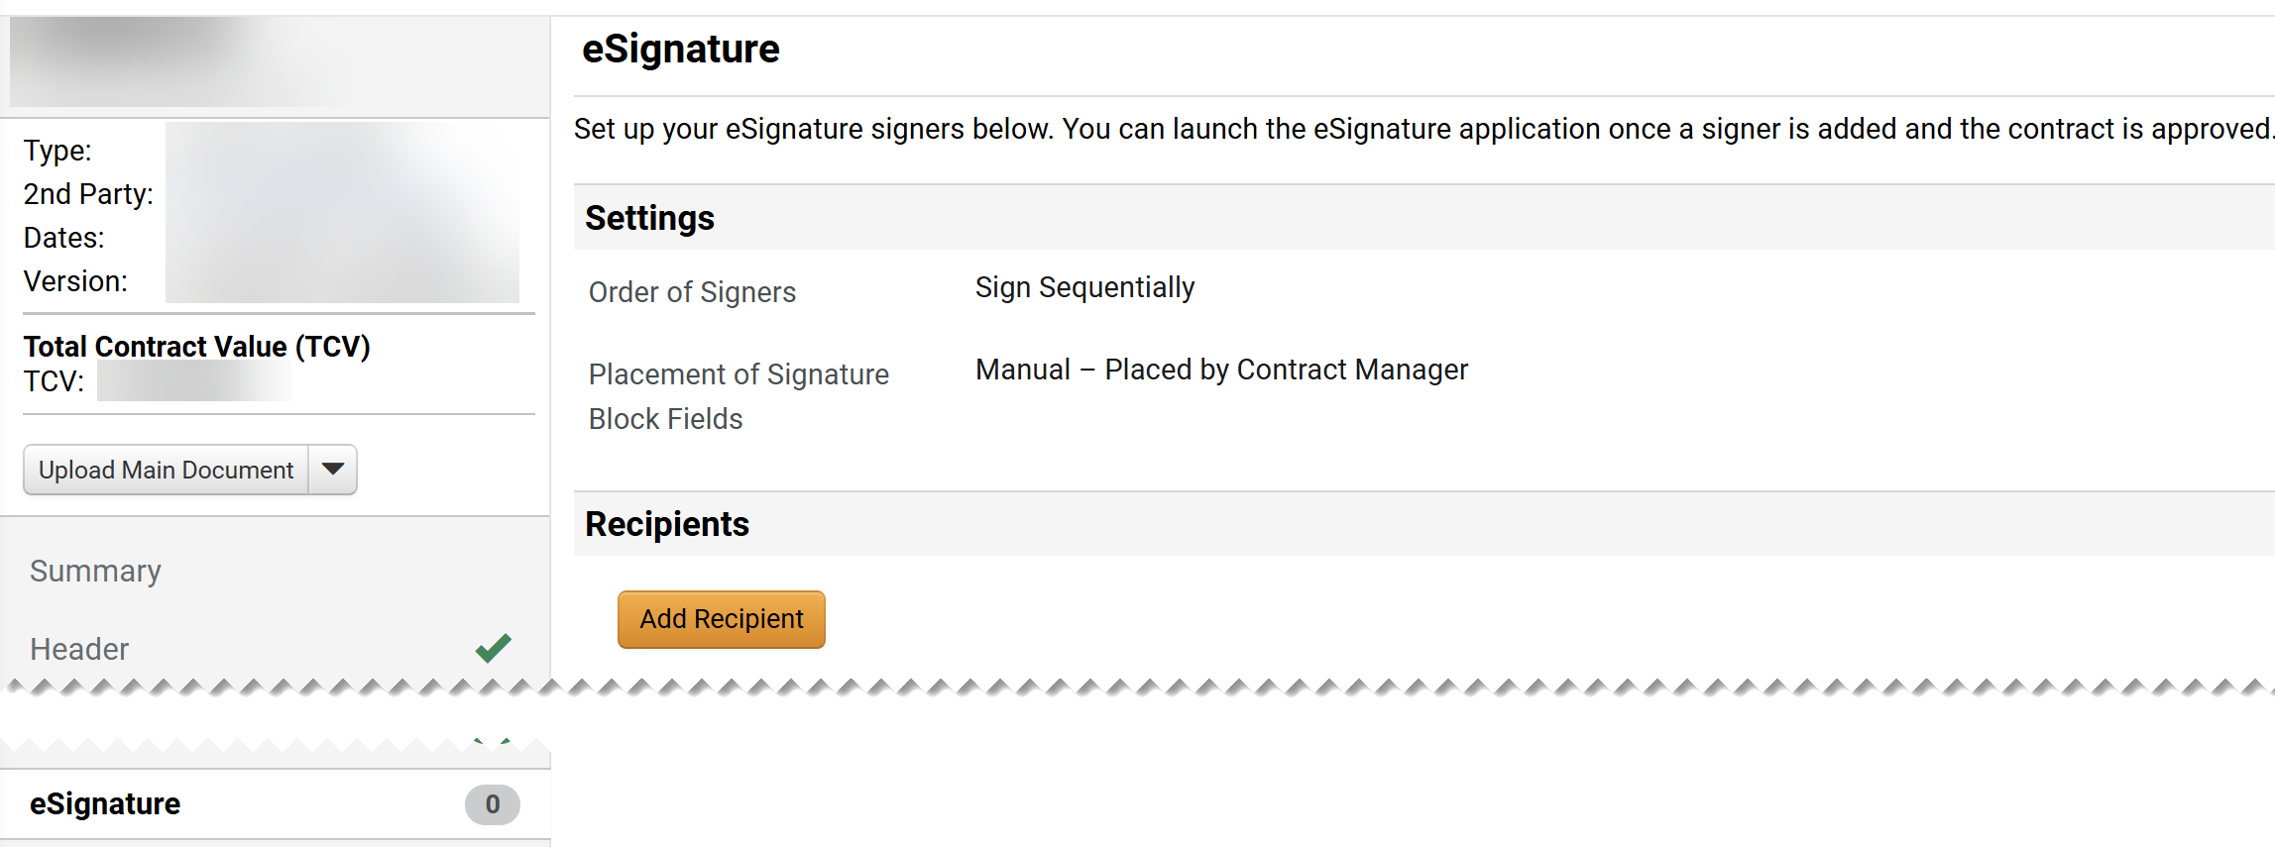
Route a Contract for eSignature (Part 3 of 11)
INSTRUCTIONS
Click Contract Number.
Note: Use the Quick Search and Filters to find the contract.
Click eSignature on the Contract Menu.
Click Add Recipient.
Note: Add a Secondary Party (Supplier/External) as the first recipient, and a Primary Party (Entity/Internal) as the second recipient.
9
8

Slide 5
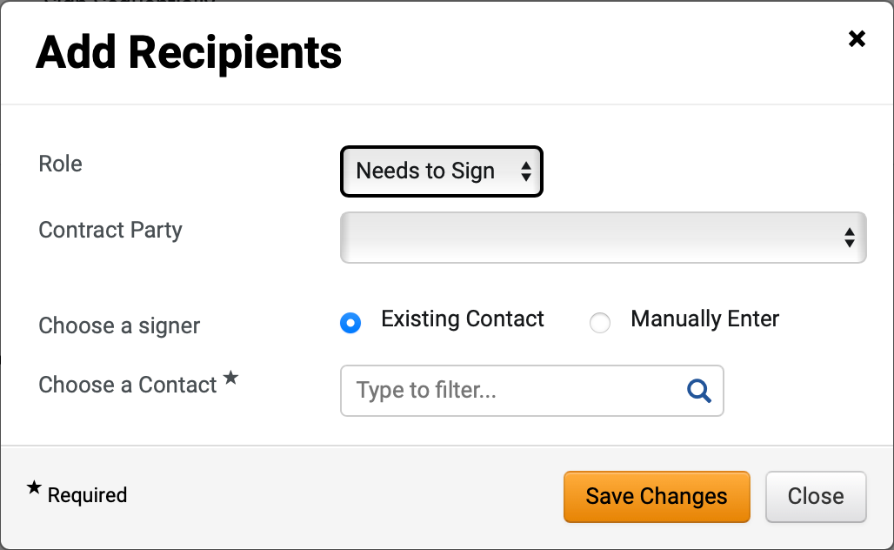
Route a Contract for eSignature (Part 4 of 11)
INSTRUCTIONS
Select Needs to Sign for the Role.
Note: For recipients that require a contract copy, select Receives Copy in Role and follow the same steps.
Select a Contract Party.
  Note: Primary Party and Secondary Party will follow the same steps outlined below.
Select Existing Contact for Choose a signer.
  Note: To Manually Enter a Contact, skip to step 15.
Search for the applicable contact in the Choose a Contact* field.
Click Save Changes.
Note: Skip to step 19.
10
11
12
13
14

Slide 6
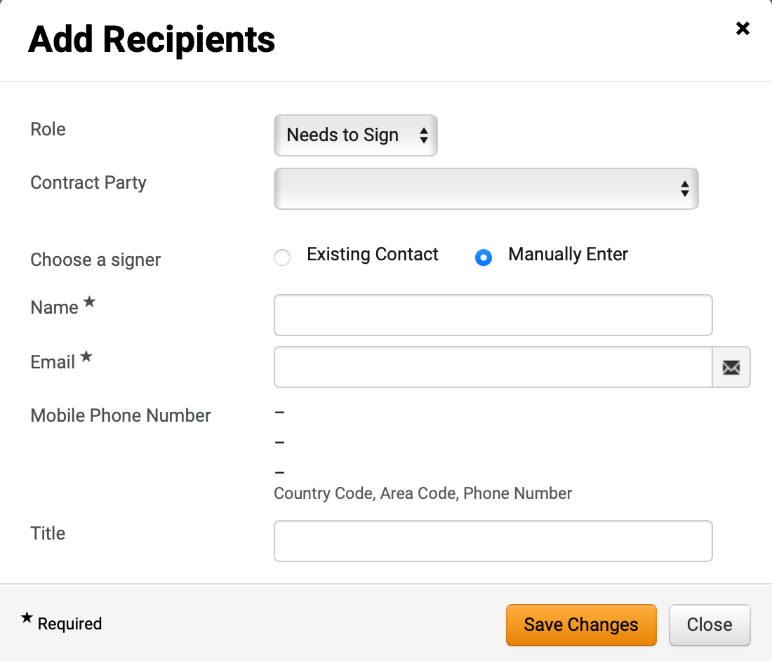
Route a Contract for eSignature (Part 5 of 11)
INSTRUCTIONS
Select Manually Enter for Choose a signer.
Enter a recipient Name*.
Note: Complete all required fields marked with a black star*.
Enter a recipient Email*.
Note: Mobile Phone Number and Title are optional fields.
Click Save Changes.
15
16
17
18

Slide 7
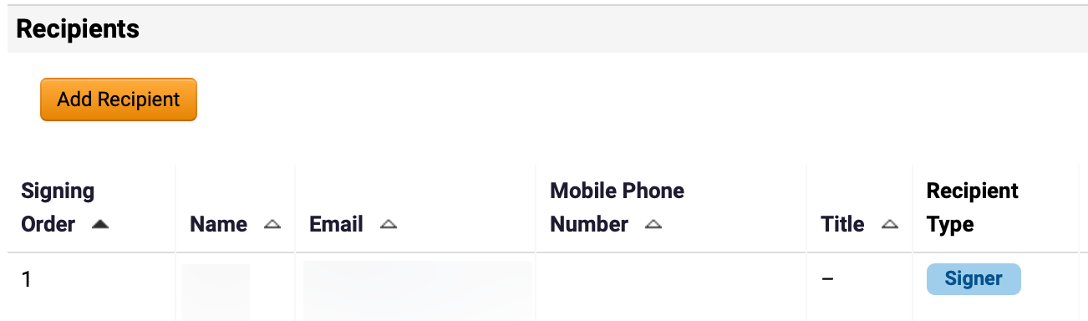
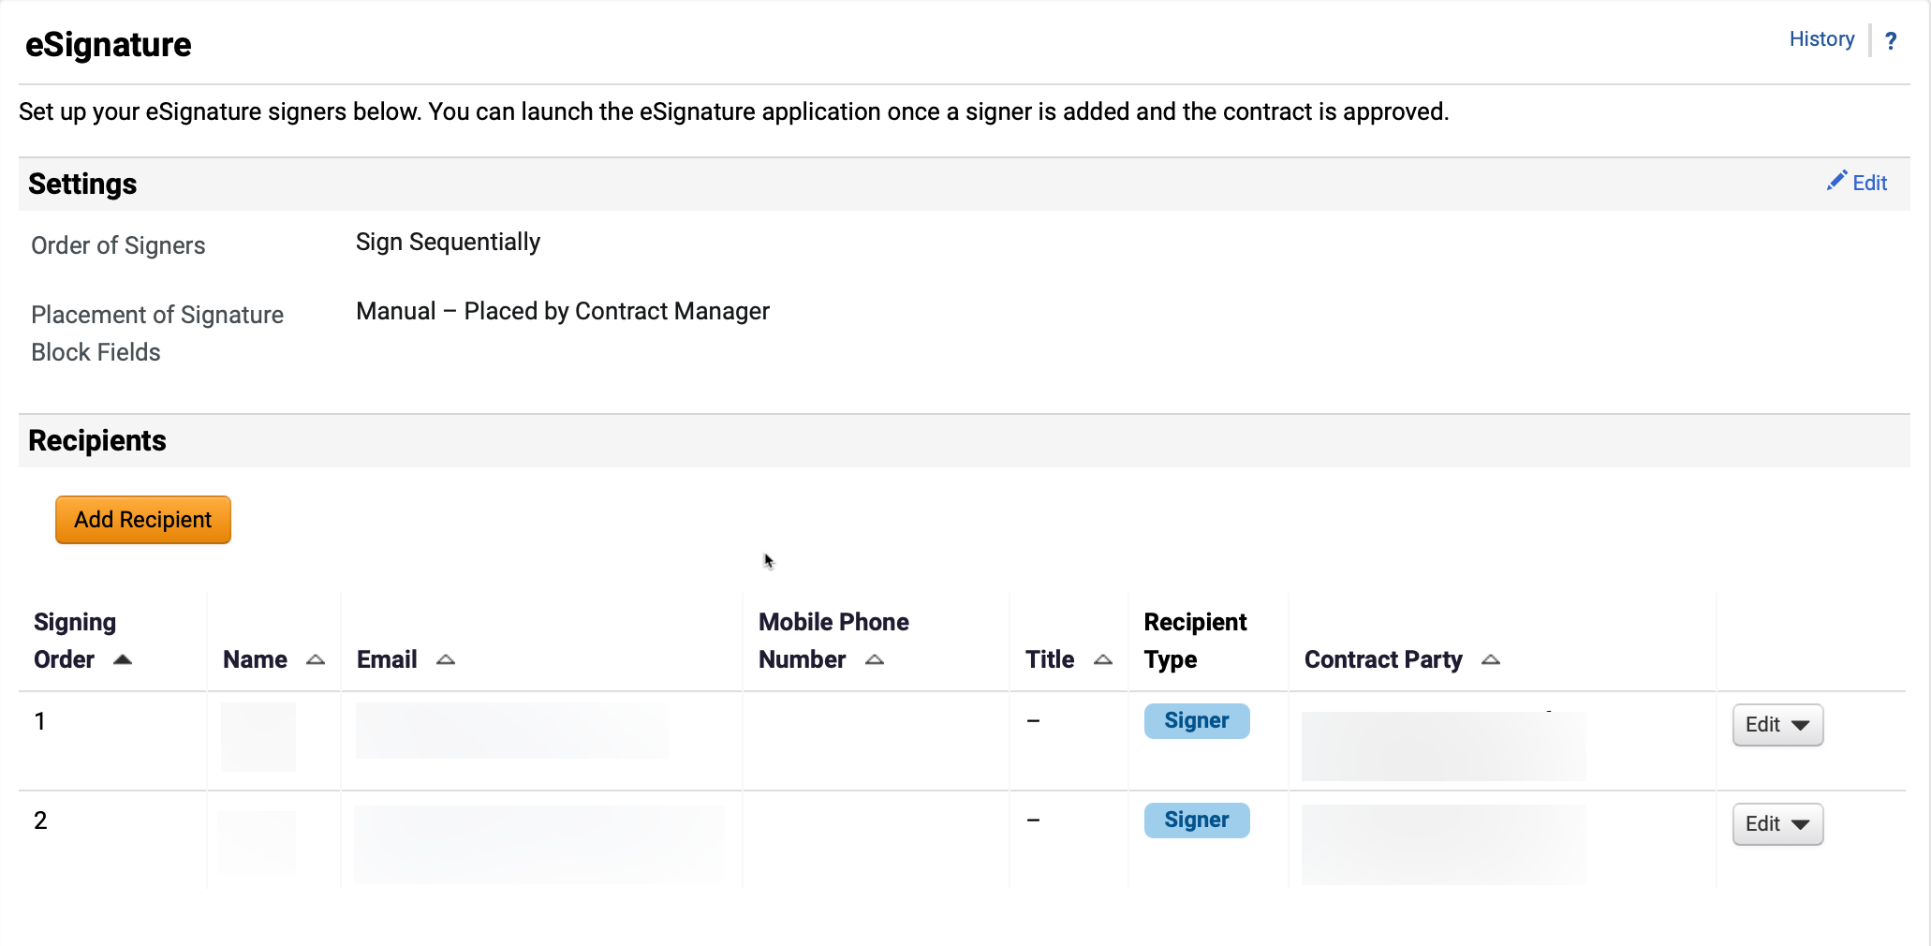
Route a Contract for eSignature (Part 6 of 11)
INSTRUCTIONS
Click Add Recipient to add a second Signer.
Note: Two Signers should be listed with the signing order of an External User as Signing Order 1 and an Internal User as Signing Order 2.
Both eSignature recipients will appear in Signing Order.

Slide 8
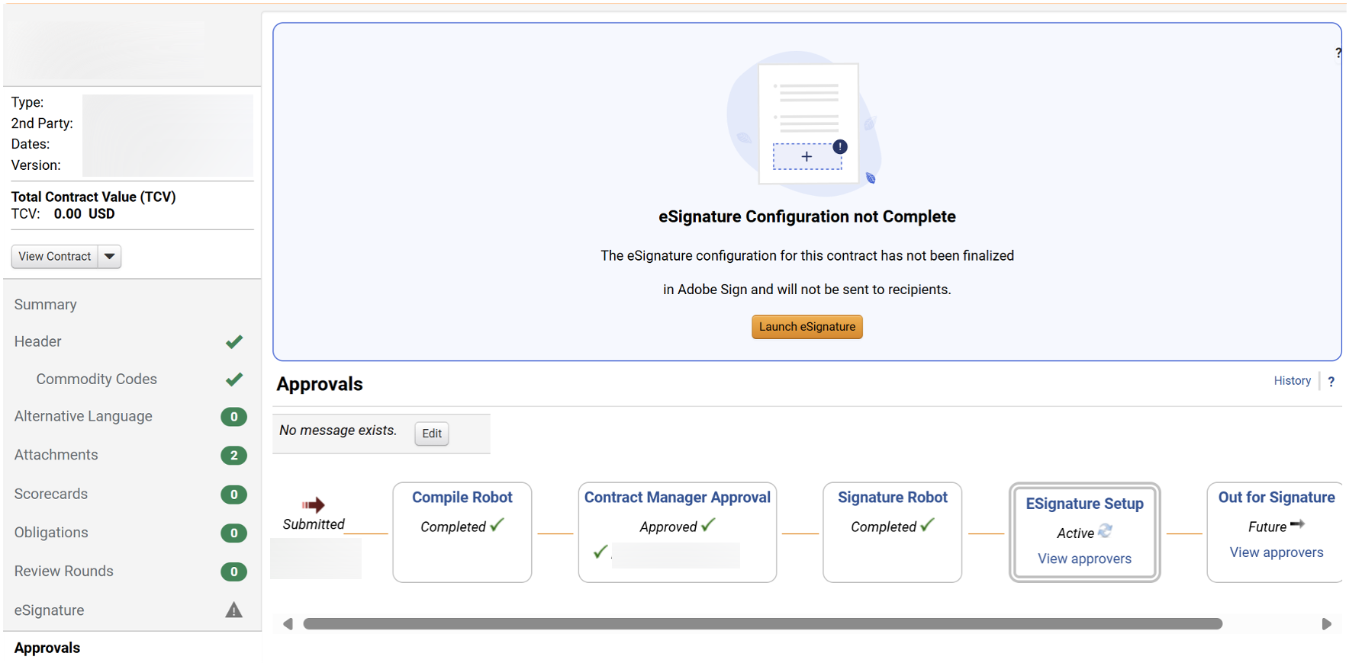
Route a Contract for eSignature (Part 7 of 11)
INSTRUCTIONS
Click Approvals to view the approval workflow.
Click Launch eSignature.
Note: This is available only once the Contract Manager has Approved. Contract should be in Pending Signature status.
22
21

Slide 9
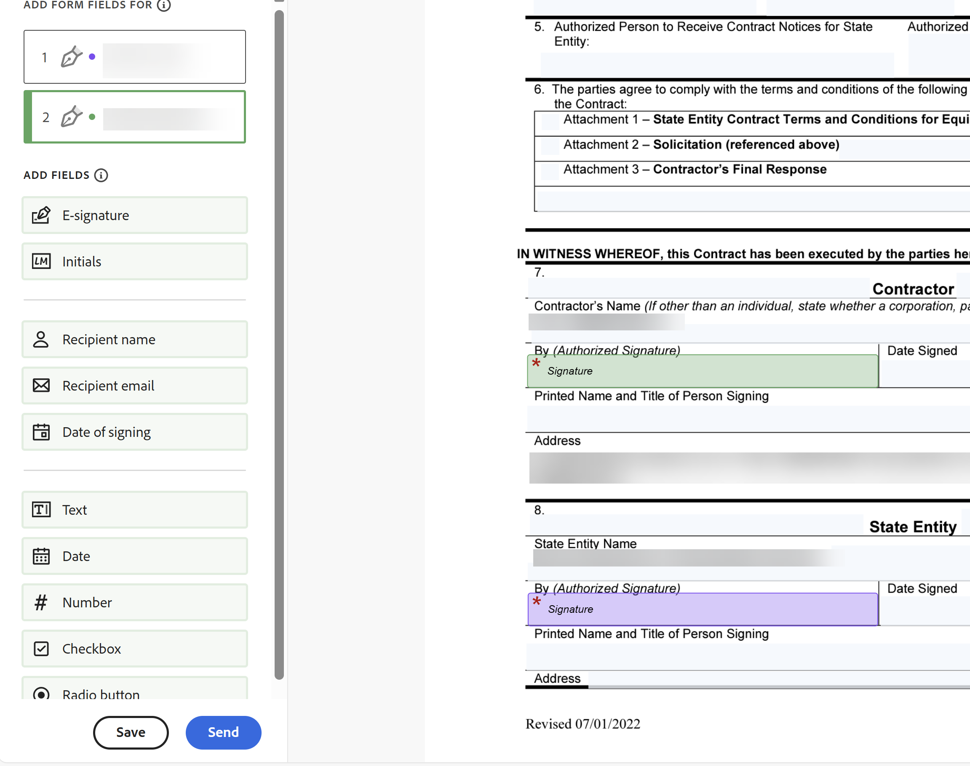
Route a Contract for eSignature (Part 8 of 11)
INSTRUCTIONS
In Adobe Sign, select the Signee(s).
Note: Each signee would be identified with a different color.
Drag and drop E-Signature to the Contract.
Note: Both internal and external eSignature fields should be on the Contract form. Other fields for each signee can be added following the same steps.
Click Send.
23
24
25

Slide 10
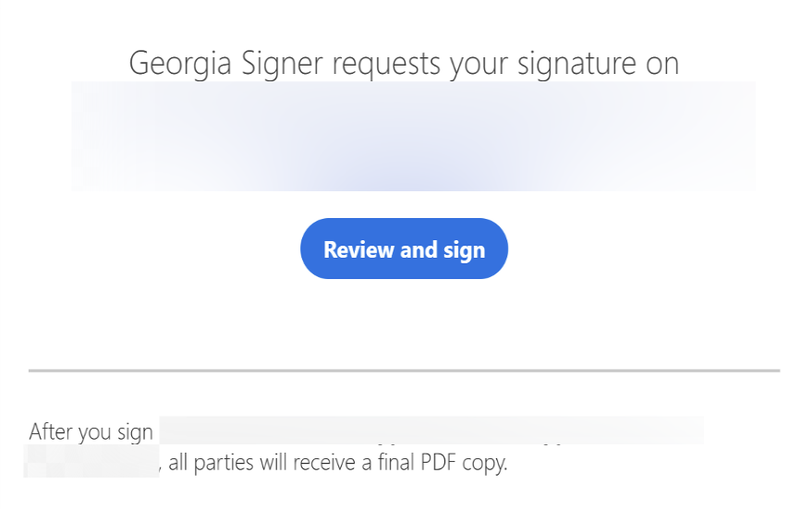
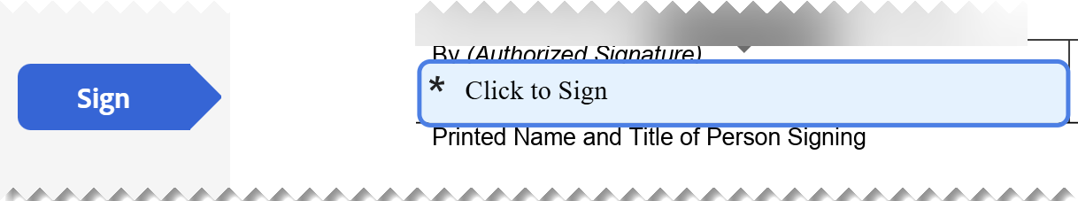
Route a Contract for eSignature (Part 9 of 11)
INSTRUCTIONS
When Signers receive an email, they will open it and click Review and Sign.
Follow the Click to Sign prompts to complete the eSignature.

Slide 11
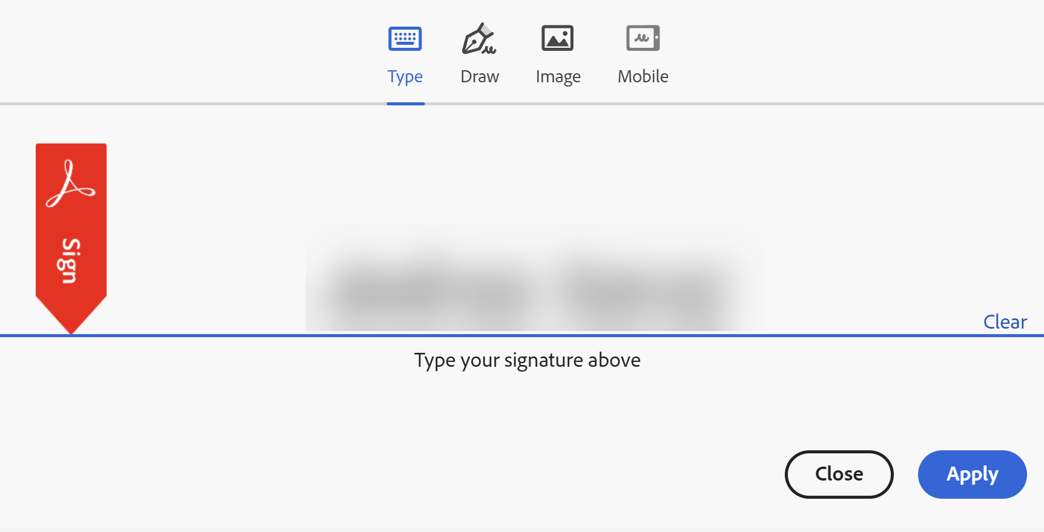
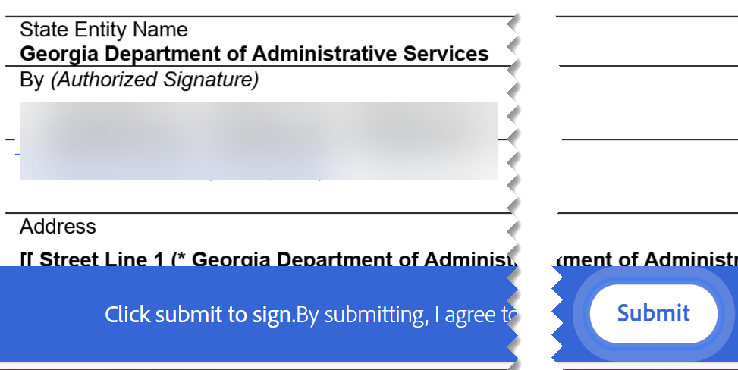
Route a Contract for eSignature (Part 10 of 11)
INSTRUCTIONS
Enter your Signature.
Click Apply.
28
29
Click Submit.

Slide 12
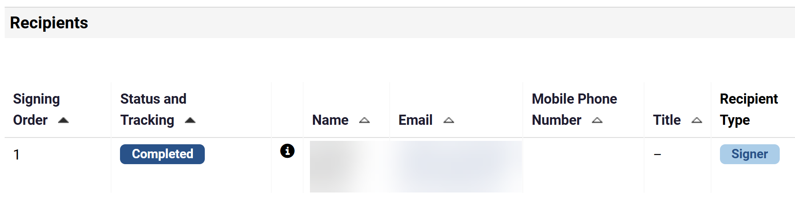
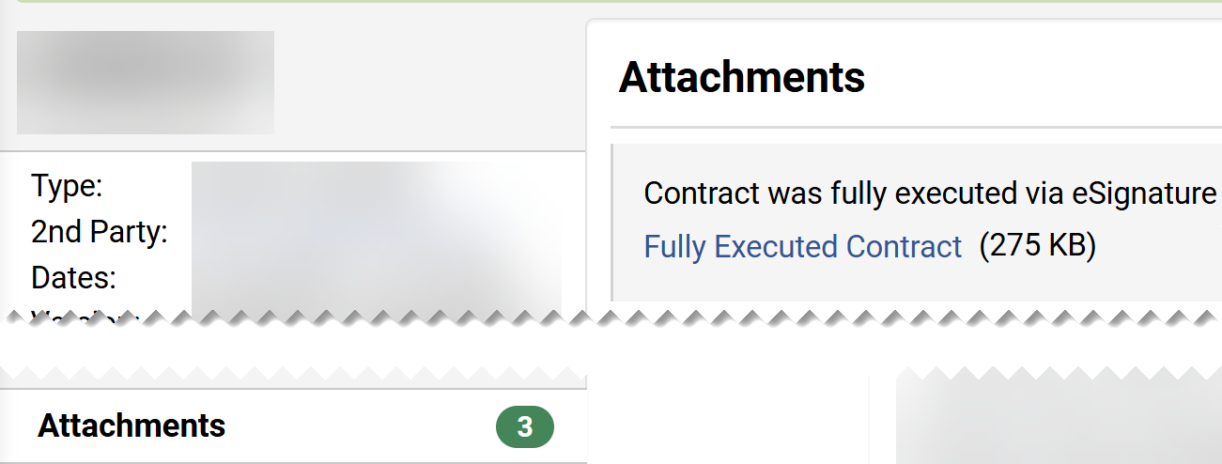
Route a Contract for eSignature (Part 11 of 11)
INSTRUCTIONS
Once signed, a Completed status will appear beside Recipient Name.
To review the Contract, click Attachments.
Click Fully Executed Contract.
33
32
You have successfully Routed a Contract for eSignature.

