Slide 1
Ad-Hoc Approval of
Contract Request
DESCRIPTION
This guide will show Contract Request Approver how to Ad-Hoc Approval of Contract Request.
OVERVIEW
The key steps in the process are below:
Access the Contracts module.
Select Contract Requests to Approve.
Add Ad-Hoc Step.
Contract is Routed to Ad-Hoc Approval.
Business Process:
Access Contracts Module
Select Contract Requests to Approve
Add Ad-Hoc Step
Contract Request is Routed for Ad-Hoc Approval

Slide 2


Ad-Hoc Approval of Contract Request
(Part 1 of 5)
INSTRUCTIONS
Click the Global Navigation Menu.
Note: University System of Georgia (USG) users complete local logon and then proceed to Step 4.
Click Sourcing, Contracts & Supplier Management.
Notes:
Link for USG log in: <insert link>
For log in issues, users should go to Agency Super User first. Call Help Desk if needed. T1 should know (have a list) log in selections to advise user of correct selection to make.
If the app, Sourcing, Contracts & Supplier Management, is not in the list of apps, click on the Add Apps button at the bottom, find the Sourcing, Contracts, & Supplier Management app, then click on the + to add it to your list of Apps.

Slide 3

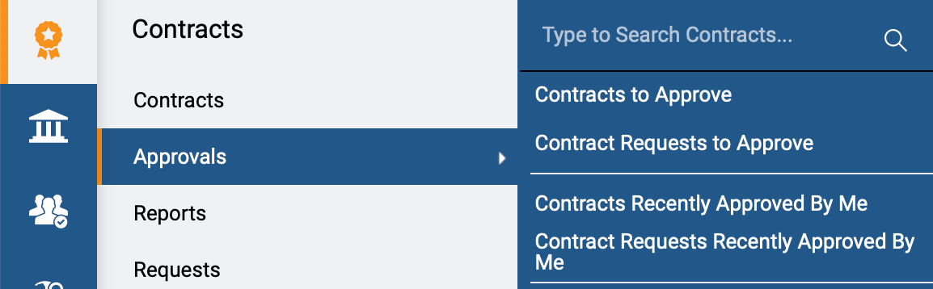
Ad-Hoc Approval of Contract Request
(Part 2 of 5)
INSTRUCTIONS
Click Sign On.
Note: The system utilizes Single Sign-On (SSO) capabilities
and no log in information is required.
Access the Contracts module.
Click Approvals.
Click Contracts Requests to Approve.
4
5
6
Notes:
Clicking Sign on will take the user out of GA@WORK and into the GA@WORK Marketplace.
Click on Contracts, then Approvals. Clicking on Contracts Requests to Approve will provide a list of contracts that need approval.

Slide 4
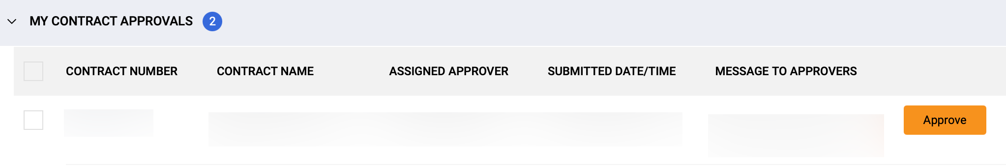
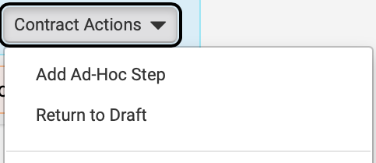
Ad-Hoc Approval of Contract Request
(Part 3 of 5)
INSTRUCTIONS
Click the Contract Number hyperlink.
Note: Use Filters to find the contract.
Click Contract Actions.
Click Add Ad-Hoc Step.
8
9
Notes:
Click on the Contract Request Number that needs approval.
Click on the dropdown Contract Actions in the upper right and select the option Add Ad-Hoc Step.

Slide 5
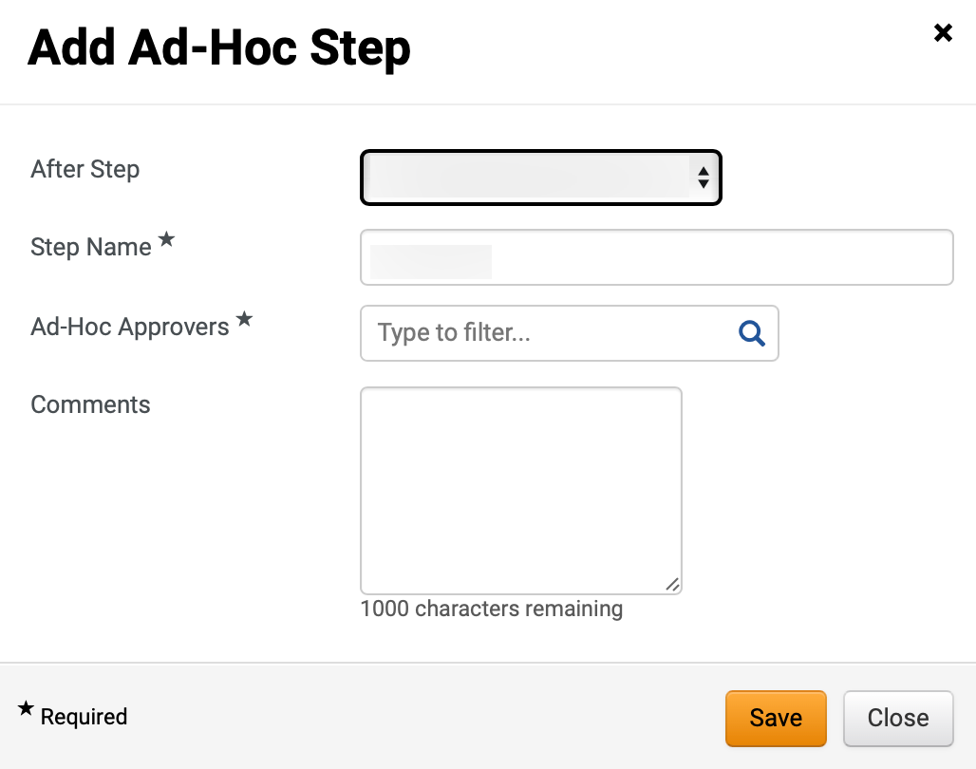
Ad-Hoc Approval of Contract Request
(Part 4 of 5)
INSTRUCTIONS
Select After Step.
Enter Step Name*.
Note: Complete all required fields marked with a black star*.
Select the Ad-Hoc Approvers*.
Note: Start typing in the field to filter results or click the magnifying glass to search.
Enter Comments (Optional).
Click Save.
Note: Follow steps 8 – 14 to add multiple Ad Hoc Step (optional).
10
11
12
13
14
Notes:
Fields marked with a black star are required.
After Step: Identify the person that will be before the added approver.
Name the step.
Click the magnifying glass to search for the approver that you wish to add. More than one approver can be added for this step if there is more than one person that can approve this step. When one of the approvers added approves, then the approval workflow will go to the next person in the workflow.
Enter any comments for this added approver.
Click Save.
To add additional approvers that come before or after this first Ad-Hoc, go through the Add Ad-Hoc Step process again.

Slide 6
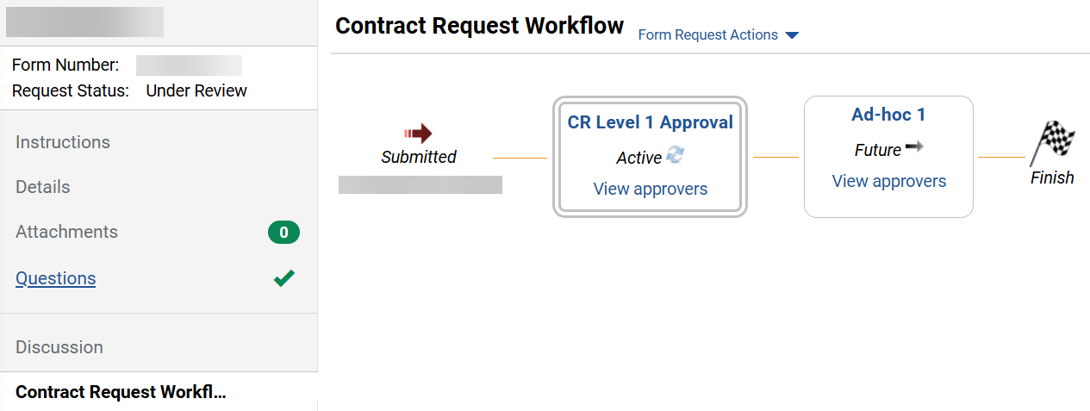
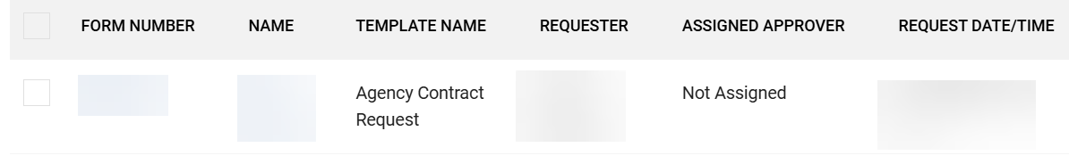

Ad-Hoc Approval of Contract Request
(Part 5 of 5)
INSTRUCTIONS
Click Contract Request Workflow.
Review the Ad-Hoc step added.
16
15
Click on the Form Number > Approve Ad-Hoc step.
Note: This will be visible for the Ad-Hoc Approver only after the previous step is approved. For approval steps review Approve a Contract Request job aid.
You have successfully Ad-Hoc Approved a Contract Request.
You have successfully Ad-Hoc Routed a Contract for Approval.
Notes:
Click on Contract Request Workflow on the left – the options for the contract.
This will display the Contract Request Workflow for the contract request. The Ad-Hoc approver should appear in the flow.
To Edit or Delete the Ad-Hoc step, use the Contract Actions menu on the upper right and select either Edit Ad-Hoc Step or Delete Ad-Hoc Step.

