Slide 1
Ad-Hoc a Contract for Approval
DESCRIPTION
This guide will show Contract Approver how to Ad-Hoc Route a Contract for Approval only. Added Approver only has the capacity to Approve/Reject the contract and will not be able to make contract changes.
OVERVIEW
The key steps in the process are below:
Access the Contracts module.
Select Contracts to Approve.
Add Ad-Hoc Step.
Contract is Routed to Ad-Hoc Approval.
Business Process:
Access Contracts Module
Select Contracts to Approve
Add Ad-Hoc Step
Contract is Routed for Ad-Hoc Approval

Slide 2


Ad-Hoc a Contract for Approval (Part 1 of 5)
INSTRUCTIONS
Click the Global Navigation Menu.
Note: University System of Georgia (USG) users complete local logon and then proceed to Step 4.
Click Sourcing, Contracts & Supplier Management.

Slide 3

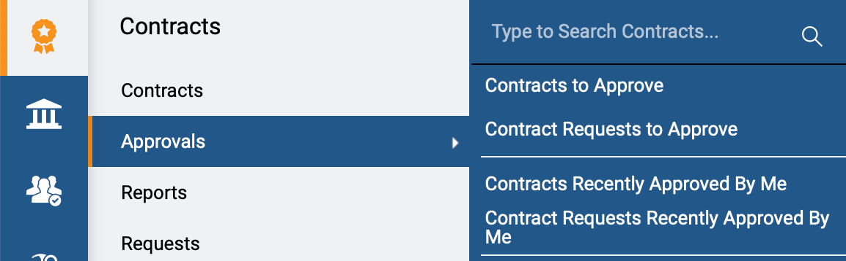
Ad-Hoc a Contract for Approval (Part 2 of 5)
INSTRUCTIONS
Click Sign On.
Note: The system utilizes Single Sign-On (SSO) capabilities
and no log in information is required.
Access the Contracts module.
Click Approvals.
Click Contracts to Approve.
4
6
5

Slide 4
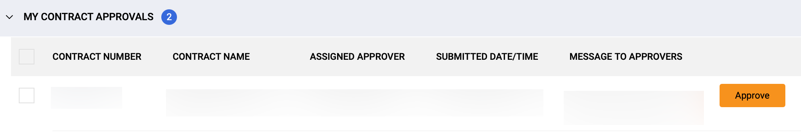
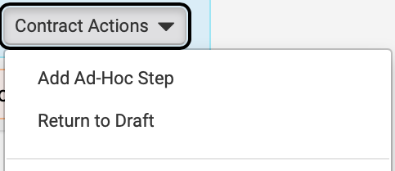
Ad-Hoc a Contract for Approval (Part 3 of 5)
INSTRUCTIONS
Click the Contract Number hyperlink.
Note: Use Filters to find the contract.
Click Contract Actions.
Click Add Ad-Hoc Step.
8
9

Slide 5
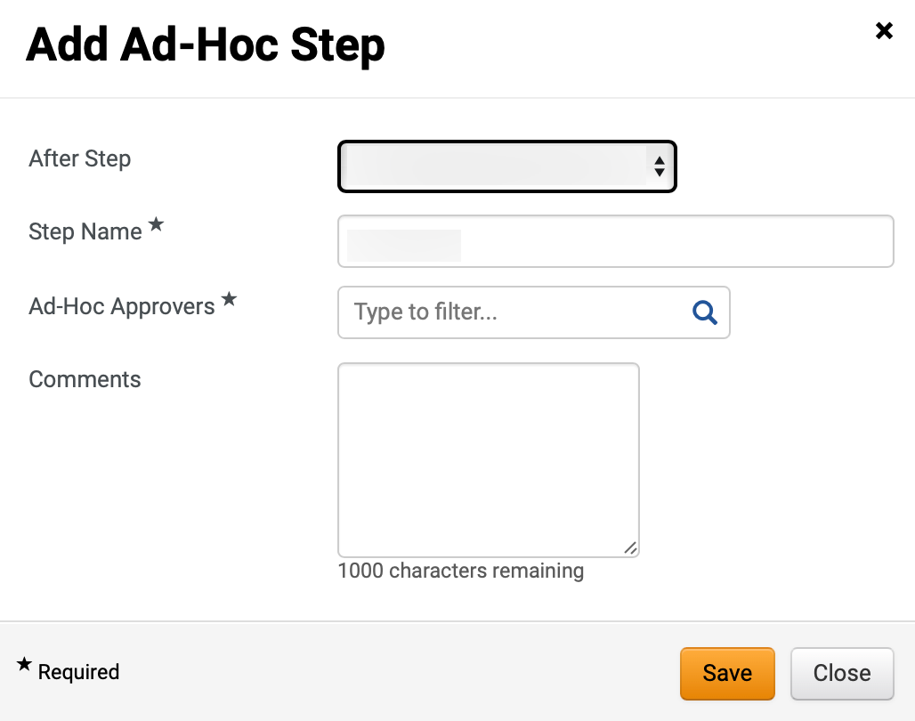
Ad-Hoc a Contract for Approval (Part 4 of 5)
INSTRUCTIONS
Select After Step.
Note: Select Contract Manager Approval, eSignature Setup, or Out for Signature to identify after which step the Contract will be routed for the Ad-Hoc process.
Enter a Step Name*.
Note: Complete all required fields marked with a black star*.
Click Ad-Hoc Approvers*.
Note: Enter information in the field or click the magnifying glass to search.
Enter Comments.
Click Save.
Note: Follow steps 8 – 14 to add multiple Ad Hoc Step (optional).
10
11
12
13
14

Slide 6
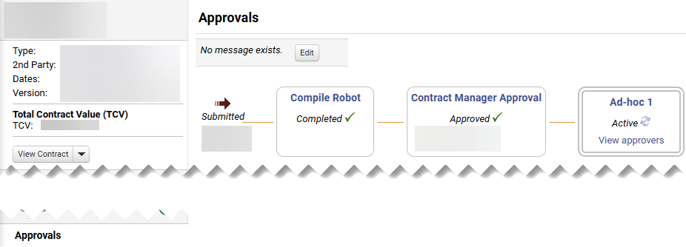
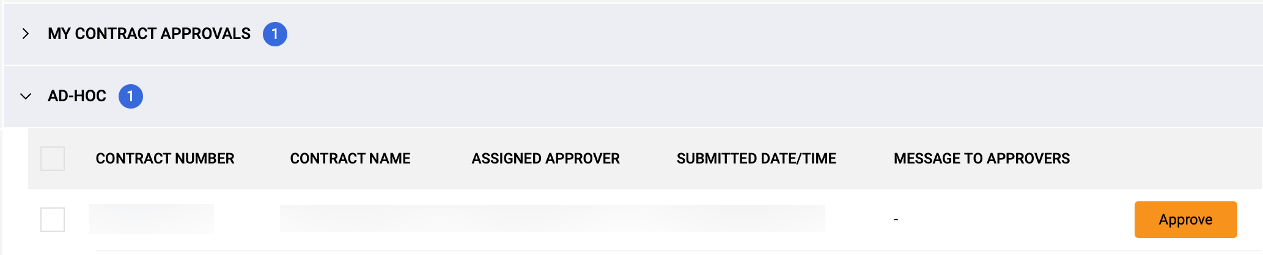

Ad-Hoc a Contract for Approval (Part 5 of 5)
INSTRUCTIONS
Click Approvals.
Review the Ad-Hoc step added.
16
15
Approve The Ad-Hoc step.
Note: This will be visible for the Ad-Hoc Approver only after the previous step is approved.
You have successfully Ad-Hoc Routed a Contract for Approval.

