Slide 1
Administrative Change to a Contract
DESCRIPTION
This guide will show a Contract Administrator how to make Administrative Changes to a Contract.
Note: Administrative Changes are changes that do not need to be communicated to the supplier. Otherwise, an Amendment or Renewal is required.
OVERVIEW
The key steps in the process are below:
Access the Contracts module.
Select Contract.
Select Check Out Contract.
Edit Contract.
Note: Throughout the system, click on the Question Mark to access the help text. In addition, any field with a Star is a mandatory field.
Business Process:
Access Contracts Module
Select Contract
Check Out Contract
Edit Contract

Slide 2
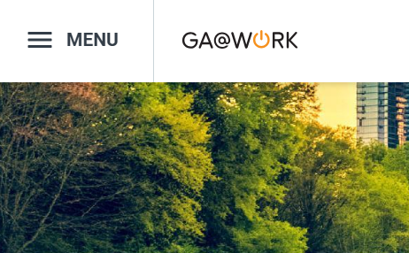

Administrative Change to a Contract
(Part 1 of 11)
INSTRUCTIONS
Click the Global Navigation Menu.
Note: University System of Georgia (USG) users complete local logon and then proceed to Step 4.
Click Sourcing, Contracts & Supplier Management.

Slide 3

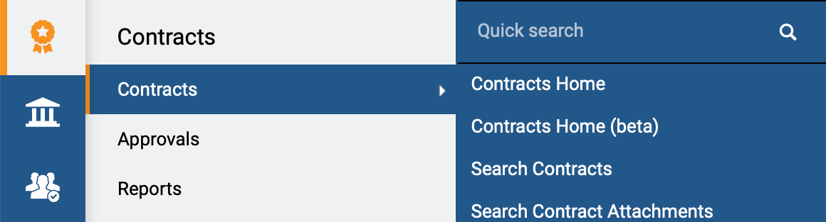
Administrative Change to a Contract
(Part 2 of 11)
INSTRUCTIONS
Click Sign On.
Note: The system utilizes Single Sign-On (SSO), no log in information is required.
Access the Contracts module.
Click Contracts.
Click Search Contracts.
4
5
6

Slide 4
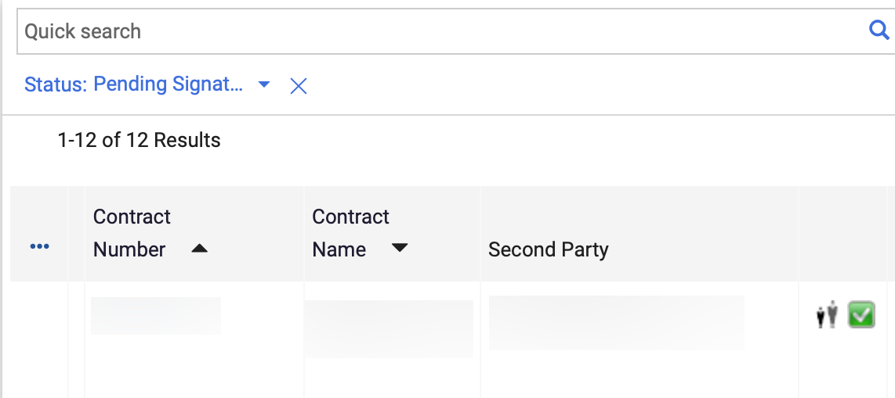
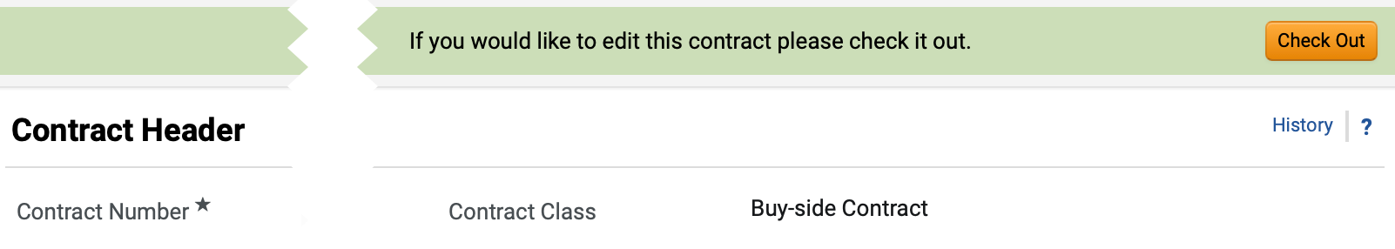
Administrative Change to a Contract
(Part 3 of 11)
INSTRUCTIONS
Click the Contract Number.
Note: Use the Quick Search and Filters to find the contract.
Click Check Out.
Note: You can also check out the Contract by clicking Contract Actions and selecting Check out for Internal Edit.

Slide 5
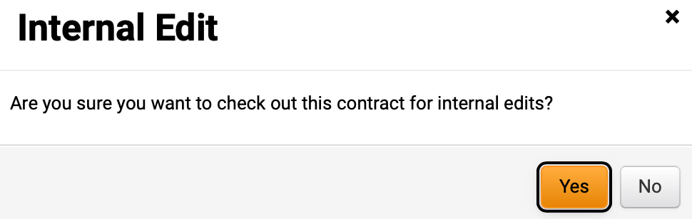
Administrative Change to a Contract
(Part 4 of 11)
INSTRUCTIONS
Click Yes.

Slide 6
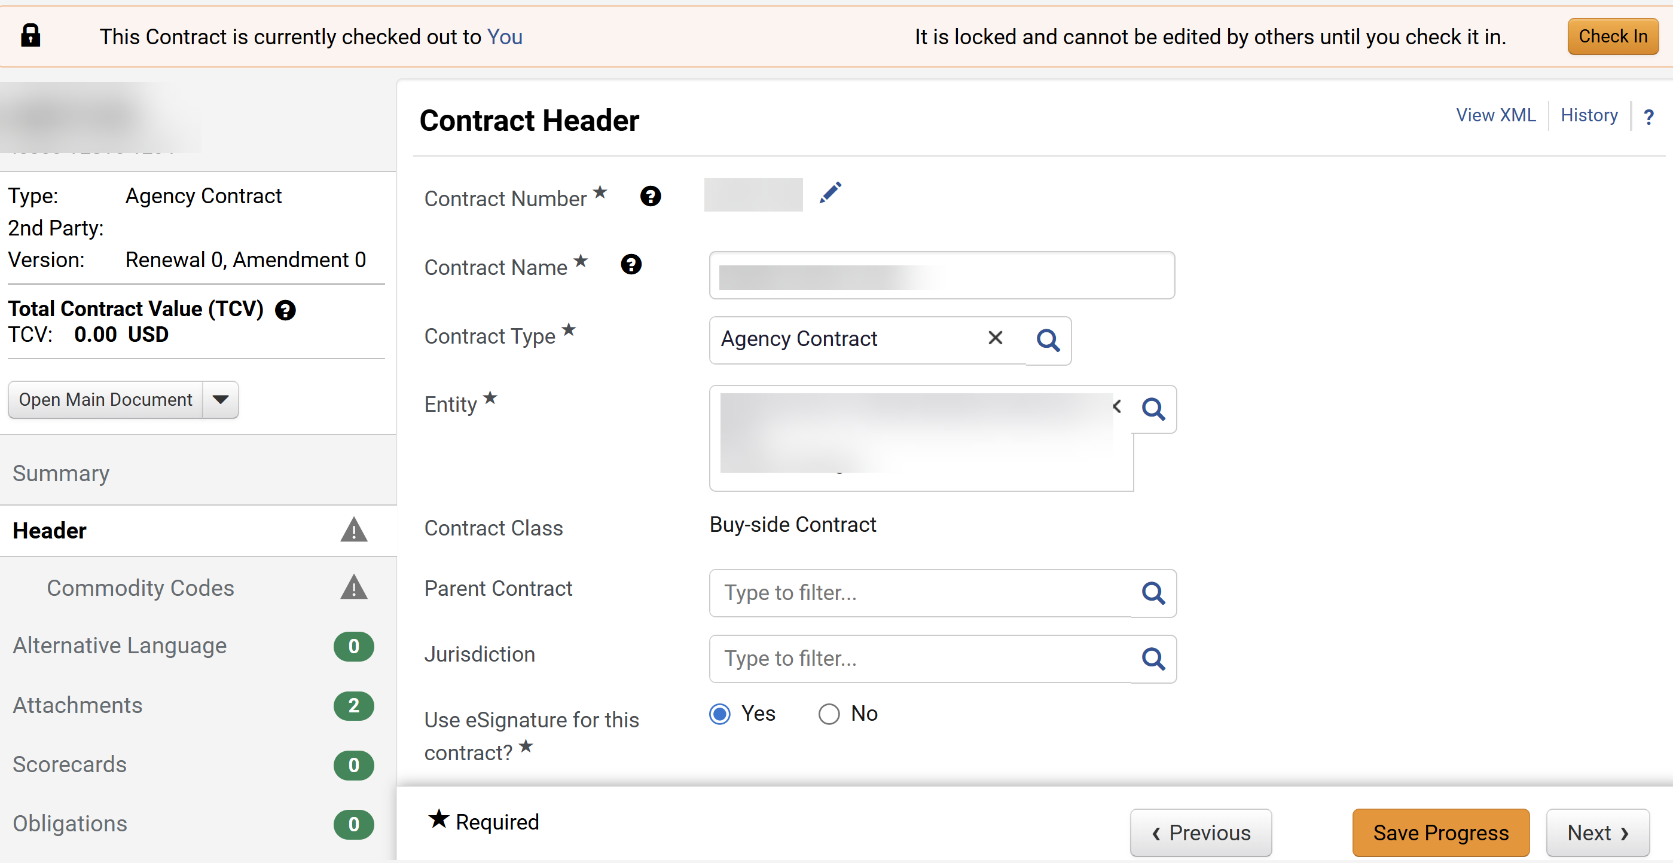
Administrative Change to a Contract
(Part 5 of 11)
INSTRUCTIONS
The Contract Header displays and is open for editing.
  Note: Changes can be made to fields open for editing while the contract is Checked Out. Review Rounds and eSignature cannot be edited; the contract would need to be amended to make those sections available.
  Click Save Progress.
10
11

Slide 7
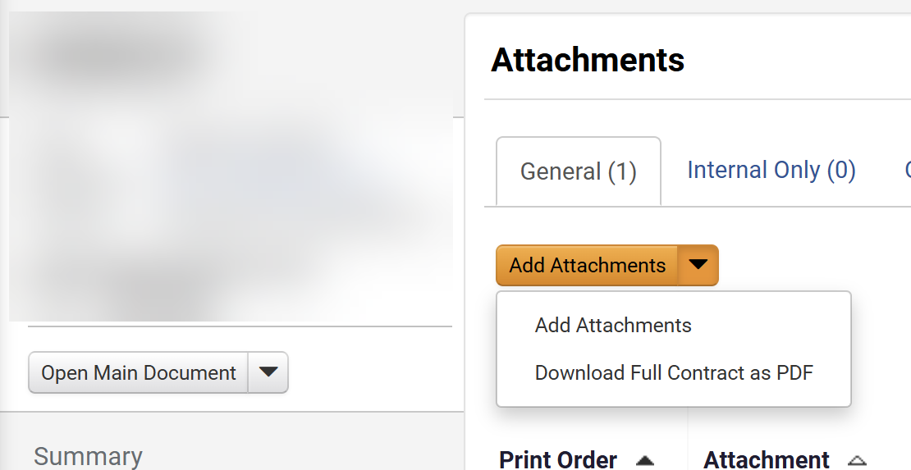
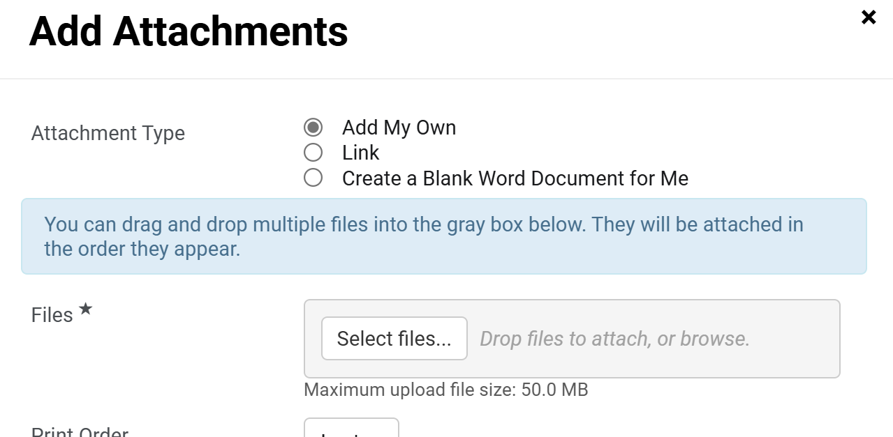
Administrative Change to a Contract
(Part 6 of 11)
INSTRUCTIONS
​Add Attachments is open for editing.
Note: Following your organization's guidance, upload any files relevant to the contract such as a scope of work or supplier quote. If no files or URLs to add, then skip to Step 36.
Select Add My Own as Attachment Type.
Note: If Add My Own is selected, continue to Step 14. If Link is selected, skip to Step 23. If Create a Blank Word Document for Me is selected, skip to Step 29.
Click Select Files.
13
14

Slide 8
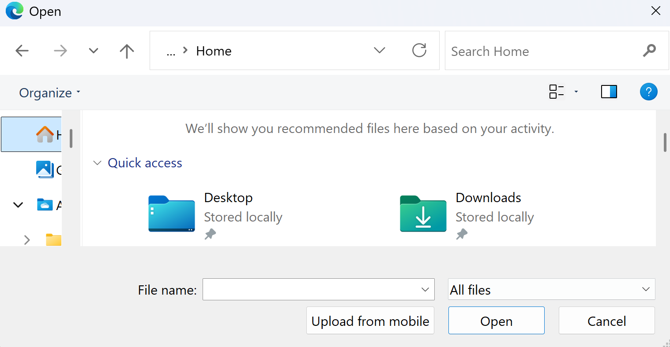
Administrative Change to a Contract
(Part 7 of 11)
INSTRUCTIONS
Select the applicable File from your computer.
Click Open.
15
16

Slide 9
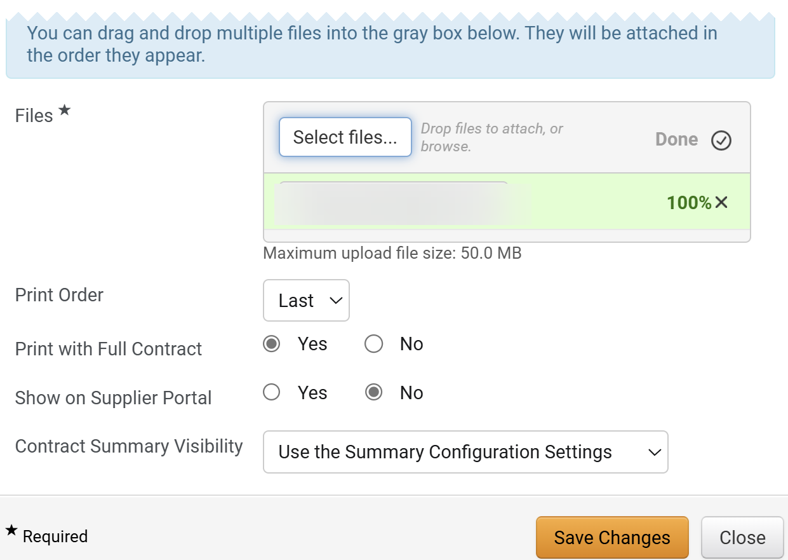
Administrative Change to a Contract
(Part 8 of 11)
INSTRUCTIONS
The uploaded File* is visible.
Note: Complete all Required* fields.
Select the Print Order.
Select an option for Print with Full Contract.
Note: If Yes is selected, then this attachment will be combined in a pdf with the Main Document.
Select an option for Show on Supplier Portal.
Note: If Yes selected, then attachment will be visible to the suppler in the Supplier Portal.
Select an option for Contract Summary Visibility.
Click Save Changes.
Note: To continue skip to Step 36.
17
18
19
20
21
22

Slide 10
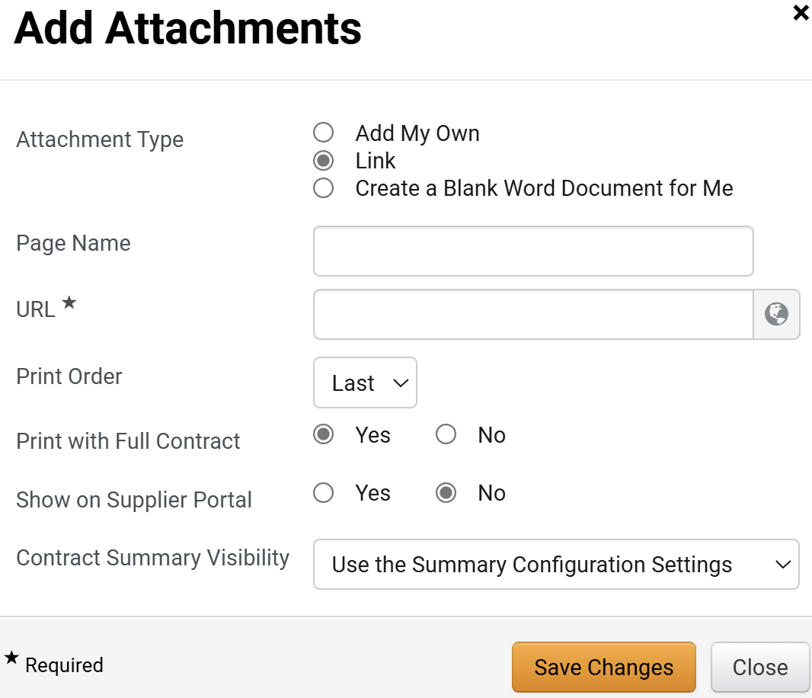
Administrative Change to a Contract
(Part 9 of 11)
INSTRUCTIONS
Select Link as the Attachment Type.
Enter a Page Name and the URL*.
Select and option for Print Order and Print with Full Contract.
Select an option for Show on Supplier Portal.
Select Contract Summary Visibility.
Click Save Changes.
Note: To continue skip to Step 36.
23
24
25
26
27
28

Slide 11
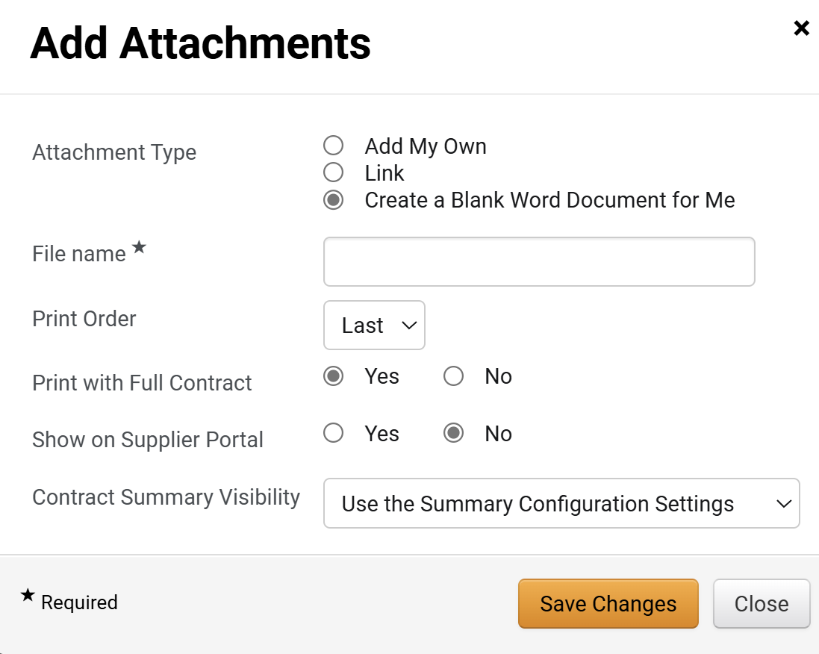
Administrative Change to a Contract
(Part 10 of 11)
INSTRUCTIONS
You may also select Create a Blank Word Document for Me as Attachment Type.
Enter a File Name.
Select a Print Order.
Select an option for Print with Full Contract.
Select an option for Show on Supplier Portal.
Select an option for Contract Summary Visibility.
Click Save Changes.
Note: To continue skip to Step 36.
29
30
31
32
33
34
35

Slide 12
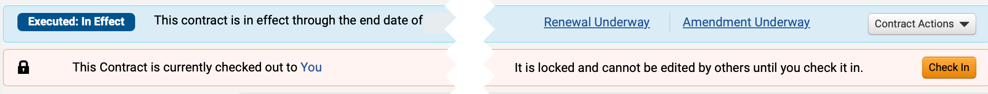

Administrative Change to a Contract
(Part 11 of 11)
INSTRUCTIONS
Click Check In.
Note: Once the changes are complete, check in the contract. The contract will be locked while checked out and cannot be edited by others until you check it in. In addition, checking in the contract will allow systems integrations.
You have successfully made Administrative Changes to a Contract.

