Slide 1
Amend a Statewide Contract
DESCRIPTION
This guide will show State Purchasing Division Contract Administrator how to Amend a Statewide Contract only.
OVERVIEW
The key steps in the process are below:
Access the Contracts module.
Select Statewide Contract to amend.
Amend Contract.
​Contract is Amended.
Business Process:
Access Contracts Module
Select Contract
Amend Contract
Contract is Amended

Slide 2


Amend a Statewide Contract (Part 1 of 11)
INSTRUCTIONS
Click the Global Navigation Menu.
Click Sourcing, Contracts & Supplier Management.

Slide 3

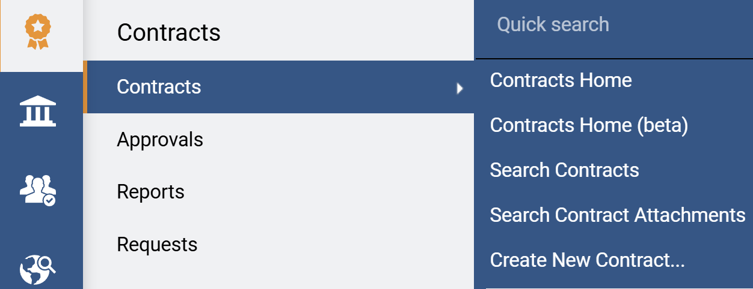
Amend a Statewide Contract (Part 2 of 11)
INSTRUCTIONS
Click Sign On.
Note: The system utilizes Single Sign-On (SSO), no log in information is required.
Access the Contracts module.
Click Contracts.
Click Search Contracts.
4
5
6

Slide 4
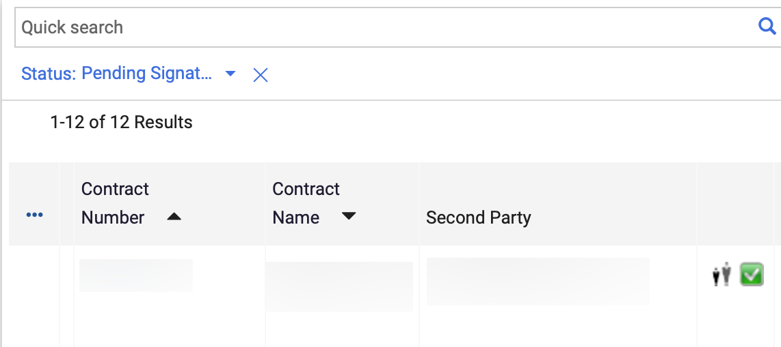
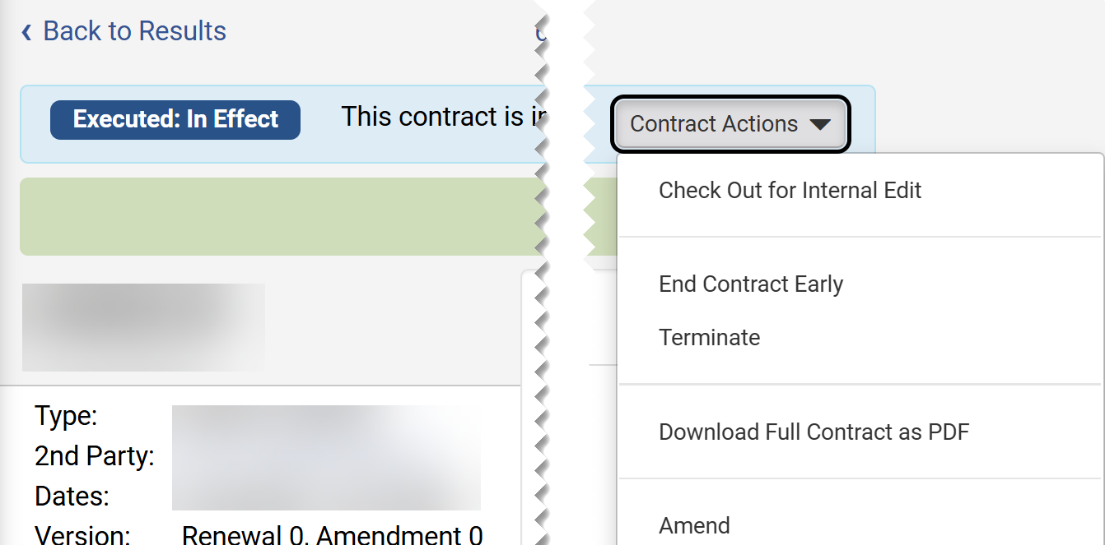
Amend a Statewide Contract (Part 3 of 11)
INSTRUCTIONS
Click the Contract Number.
Note: Use the Quick Search and Filters to find the contract.
Click Contract Actions.
Click Amend.
Note: Amend is only visible if the contract is Check In.
8
9

Slide 5
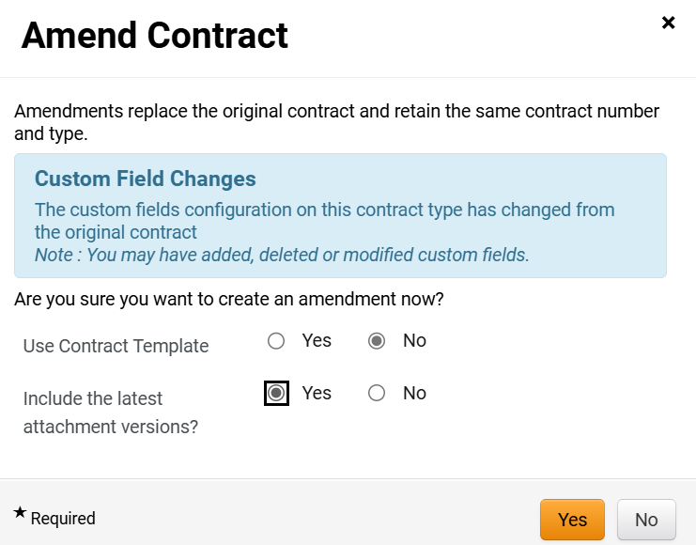
Amend a Statewide Contract (Part 4 of 11)
INSTRUCTIONS
Select No for Use Contract Template*.
Note: Complete all required fields marked with a black star*.
Select Yes to Include the latest attachment versions?.
Click Yes.
10
11
12

Slide 6
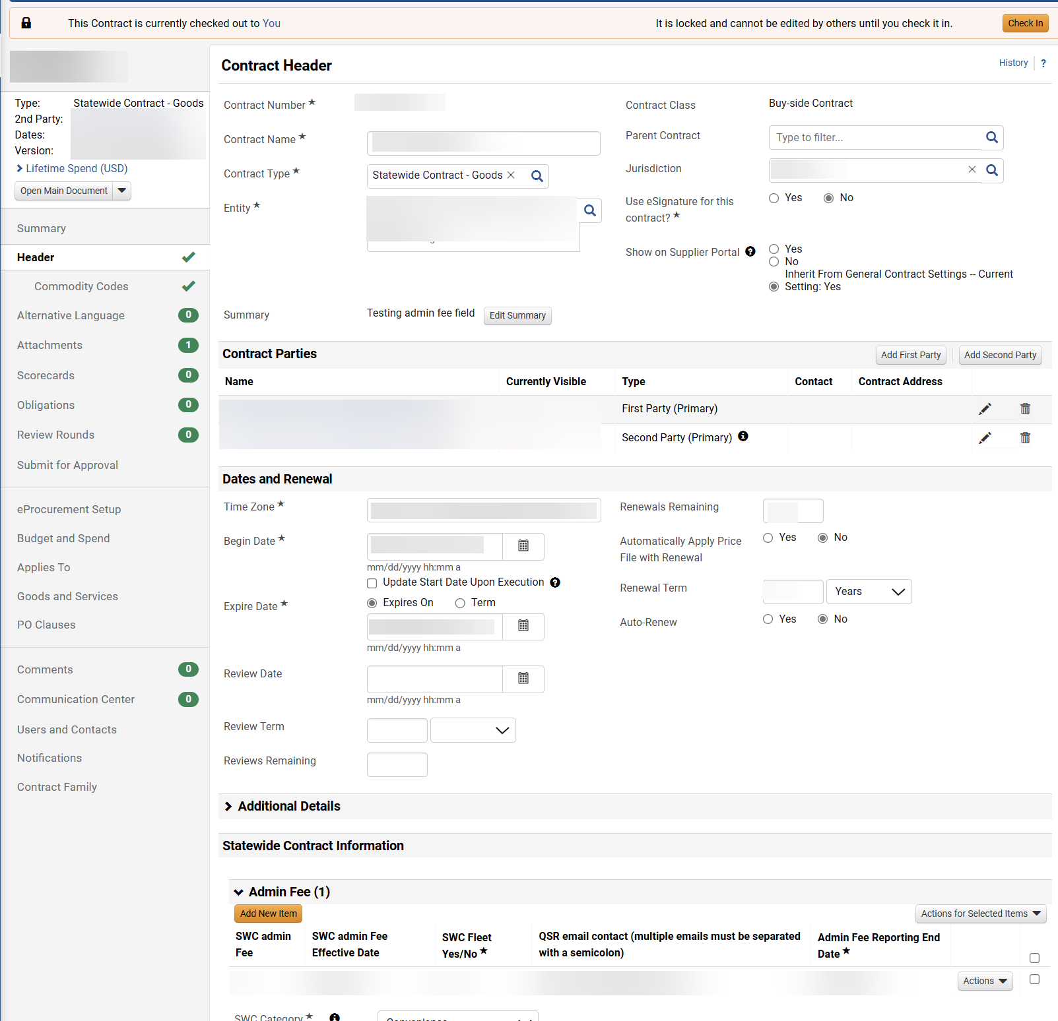
Amend a Statewide Contract (Part 5 of 11)
INSTRUCTIONS
The Contract Header is open for editing.
  Note: Changes can be made to fields open for editing while the contract is Checked Out.

Slide 7
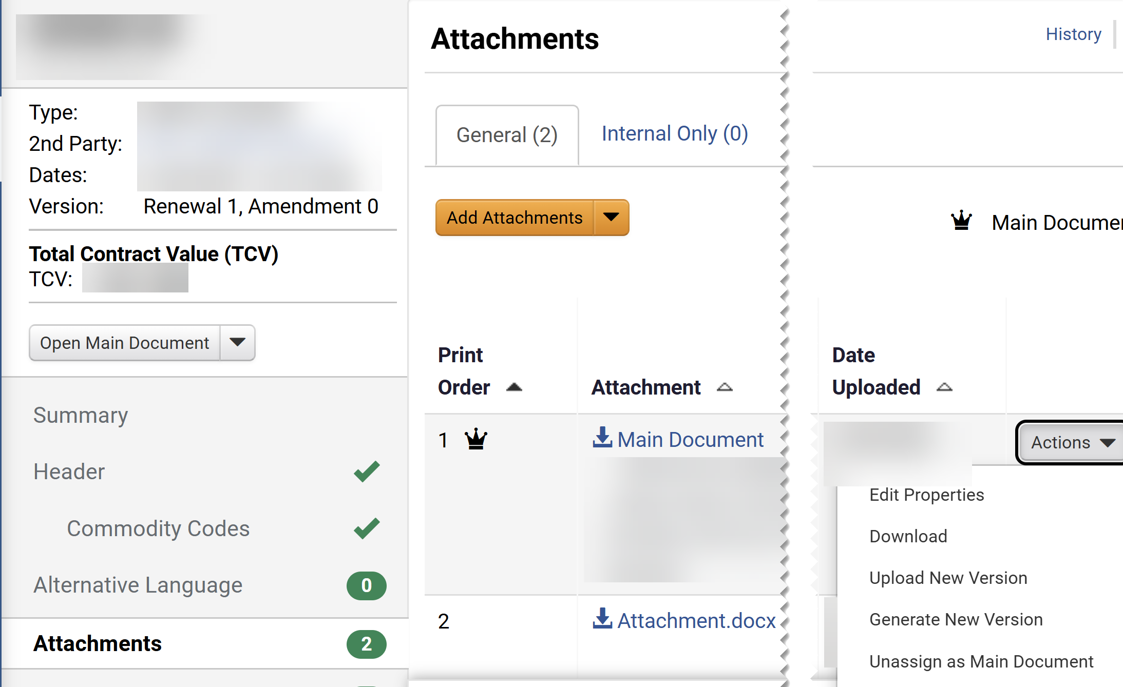
Amend a Statewide Contract (Part 6 of 11)
INSTRUCTIONS
Click Attachments.
Click Actions on the Main Document.
Select Unassign as Main Document.
Note: This action is required for the amend actions to be visible.
15
14
16

Slide 8
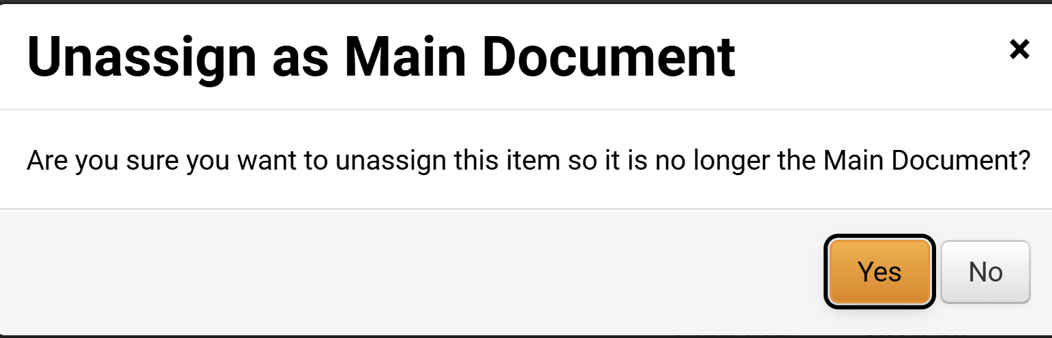
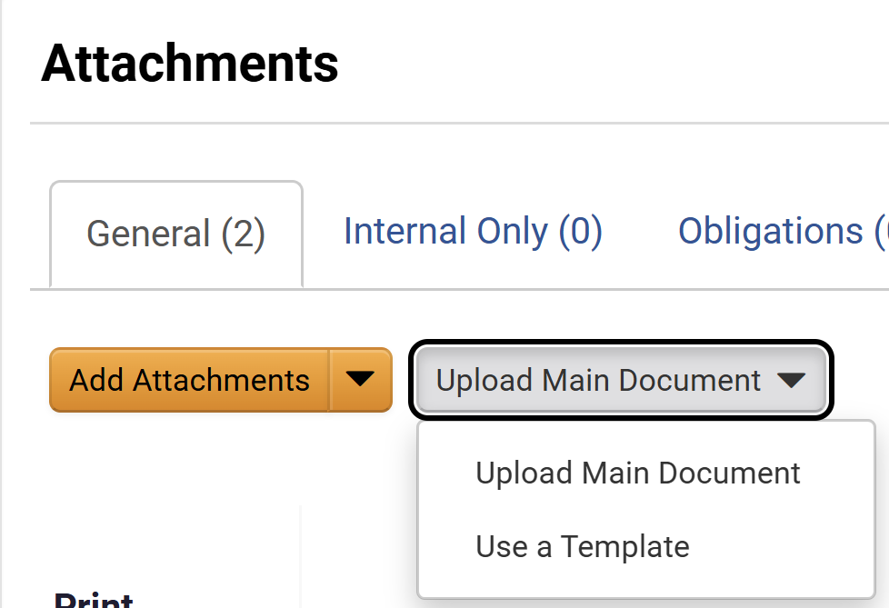
Amend a Statewide Contract (Part 7 of 11)
INSTRUCTIONS
Click Yes.
Click Upload Main Document.
Click Use a Template.
18
19

Slide 9
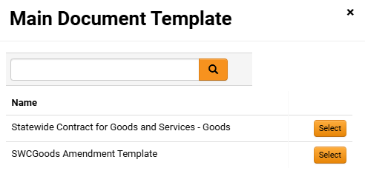
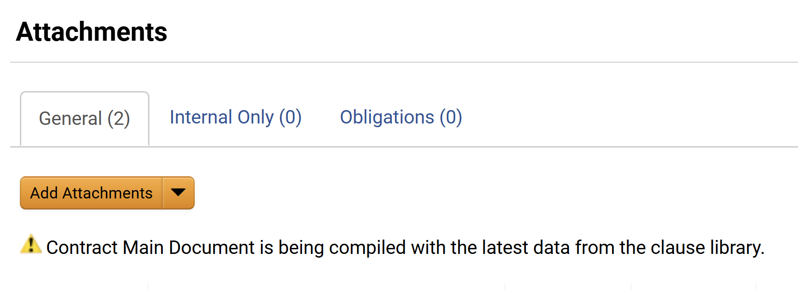
Amend a Statewide Contract (Part 8 of 11)
INSTRUCTIONS
Select Main Document Template. Click Select.
Note: Select the Amendment Template.
Confirmation of Contract Main Document is being compiled with the latest data from the clause library.

Slide 10
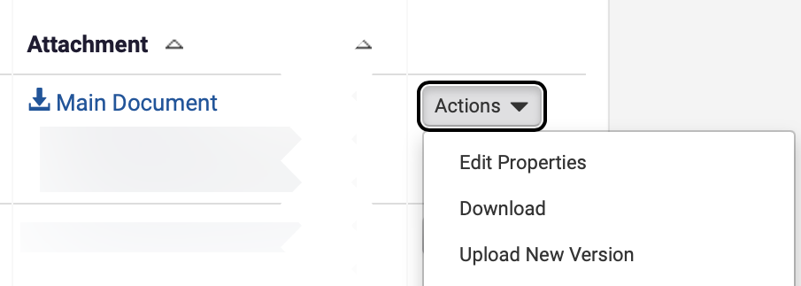
Amend a Statewide Contract (Part 9 of 11)
INSTRUCTIONS
Click Actions on the Main Document.
Select Edit Properties.
22
23

Slide 11
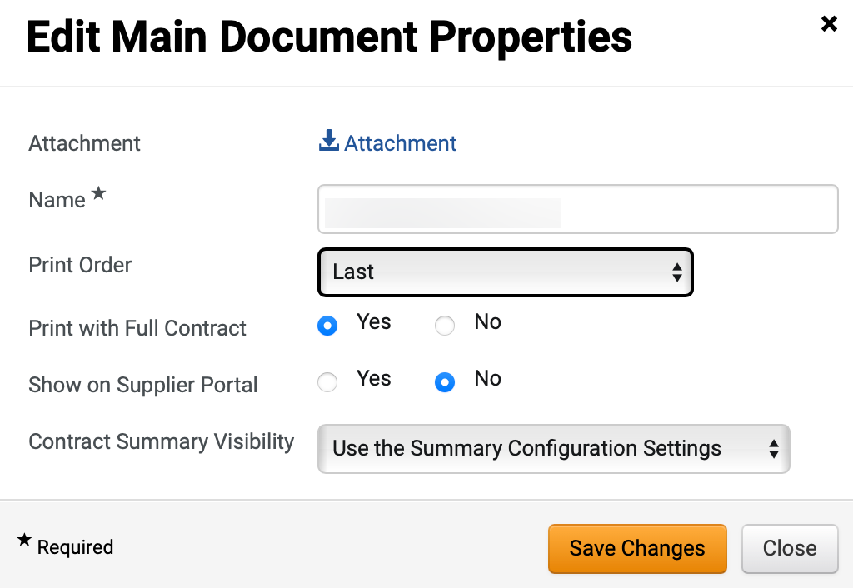
Amend a Statewide Contract
(Part 10 of 11)
INSTRUCTIONS
The uploaded File* is visible, select the Print Order.
Select an option for Print with Full Contract.
Note: If Yes is selected, then this attachment will be combined in a pdf with the Main Document.
Select an option for Show on Supplier Portal.
Note: If Yes selected, then attachment will be visible to the suppler in the Supplier Portal.
Select an option for Contract Summary Visibility.
Click Save Changes.
24
25
26
27
28
Notes:
10. Start Internal Review
a. Click the Review Rounds menu item
b. Click Create Manual Internal Round button
c. On the Add Reviewer search for a user in your organization where you will be able to Proxy as them in Workday.
d. Click Select button next to the user you have searched for, ensure they appear into the Selected Values field and click Save Changes.
e. Click the Begin Round button
f. Enter a message for your Reviewer and click Begin Internal Review button
Close the Jaggaer window and return to Workday. Proxy as the Reviewer you just started Internal Review as
a. Click on the Actions Items Flag in the upper right corner.
b. Click on Contracts to Review (Internal Review)
c. Click on the blue Contract id to open the contract.
d. Click on the Attachments link in the left menu. (You may need to scroll down)
Click on the blue Check Out button.
14. Modify the Main Document template - which is the amendment template
a. From the Actions button next to Main Document attachment (crown) choose Download and once the file downloads click Open file or open the file from where it was saved. The file should open in Word.
b. Click Enable Editing in Word and modify the verbiage you previously entered.
Save the word document where you can find it later to upload and close the document. You may want to save it on your desktop.
15. Upload the revised Main Document template
a. From the Actions button next to Main Document attachment (crown) choose upload new version.
b. On the Upload New Version page Click the Select file button and upload the new document you saved in step above. Enter comments in the comments field for any changes you want to explain. Click Save Changes button once the status is 100%.
c. From the Amendment Actions button choose Done with My Review.
d. Enter comments that you are done with your review and click Done with My Review.
e. Click Cancel Punchout in the upper right corner, then close that browser window.
f. Once back in Workday type 'Stop Proxy' in the Search task field and click Enter.
Click the Stop Proxy link, then OK.
16. Access Jaggaer from Workday
From the Workday click Menu > Apps > Jaggaer > Sign on
17. Open the contract in Jaggaer
a. Click the Contracts > Search Contracts
b. Enter your contract name (CONT-0004) in the Quick Search field and press Enter
Select the Contract Number to open the contract, make sure you have selected the Draft contract which is the amendment and NOT the executed contract.
18. Check out the Contract
Click the blue Check Out button
19. Submit for Approval
a. Click on Submit For Approval from the left menu
b. Click Submit for Approval button.
Enter a message to approvers and click Submit for Approval.
20. Approve the contract
a. Under the Next Steps section, click on the View the Contract link
b. From the Amendment Actions button select Approve
Refresh the brower until the status changes to Out for Signature. There is not a refresh button on the page, refresh the browser .
21. Upload Fully Executed Contract
a. From the Amendment Actions button Select Upload Fully Executed Contract
b. Click the Select file button, navigate to a file on your computer, click Open.
Once the status is 100% click Save Changes

Slide 12
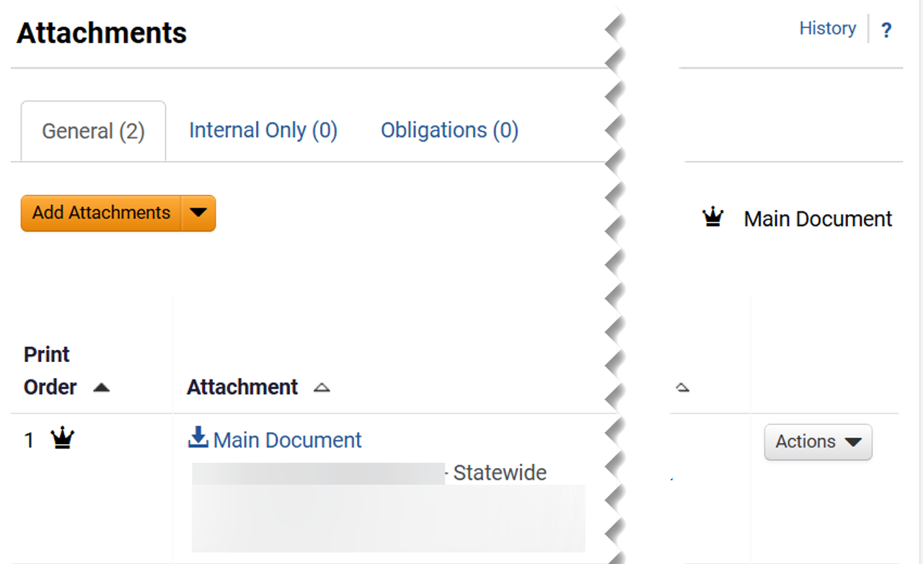
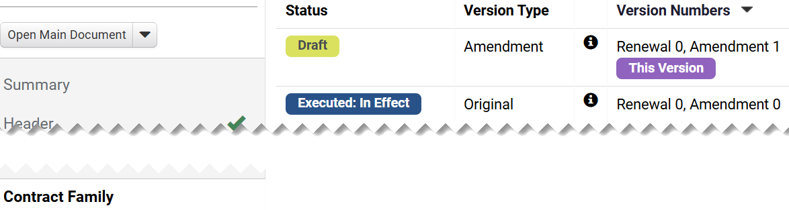

Amend a Statewide Contract
(Part 11 of 11)
INSTRUCTIONS
Review the Main Document.
To review the amendment version, click Contract Family.
Note: The Contract Versions displays the Status, Version Type, and Version Numbers information. Version will remain on Draft Status until is routed for approval and signature collections. Review the eSignature job aid and required job aids for those activities.
You have successfully Amended a Statewide Contract.

