Slide 1
Approve a Contract Request
DESCRIPTION
This guide will show Contract Request Approvers how to Approve a Contract Request via Approvals only.
OVERVIEW
The key steps in the process are below:
Access the Contracts module.
Click Approvals.
Click Contract Requests to Approve.
Note: Throughout the system, click on the Question Mark to access the help text. In addition, any field with a Gray Star is a mandatory field.
Business Process:
Access Contracts Module
Click Contract Request to Approve
Select Contract Request to Approve
Contract Request is Approved

Slide 2
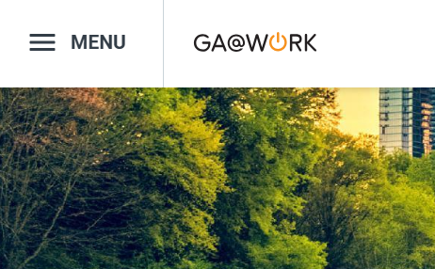

Approve a Contract Request (Part 1 of 4)
INSTRUCTIONS
Click the Global Navigation Menu.
Note: University System of Georgia (USG) users complete local logon and then proceed to Step 4.
Click Sourcing, Contracts & Supplier Management.

Slide 3

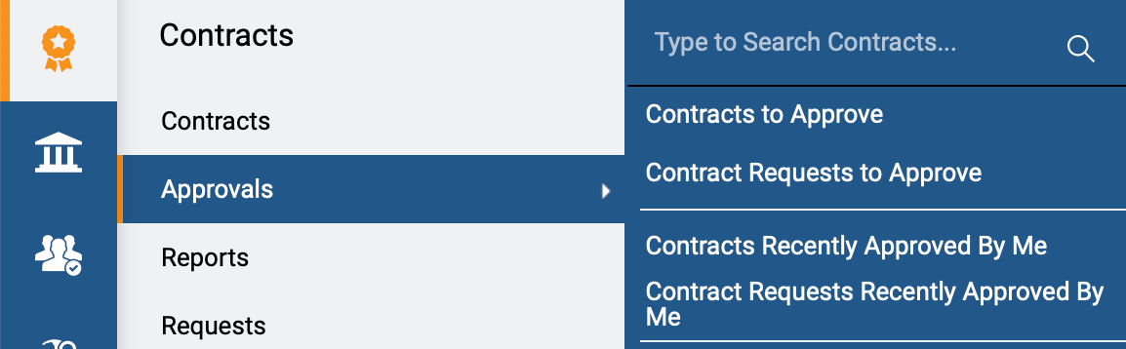
Approve a Contract Request (Part 2 of 4)
INSTRUCTIONS
Click Sign On.
Note: The system utilizes Single Sign-On (SSO) capabilities
and no log in information is required.
Access the Contracts module.
Click Approvals.
Click Contract Requests to Approve.
4
5
6

Slide 4
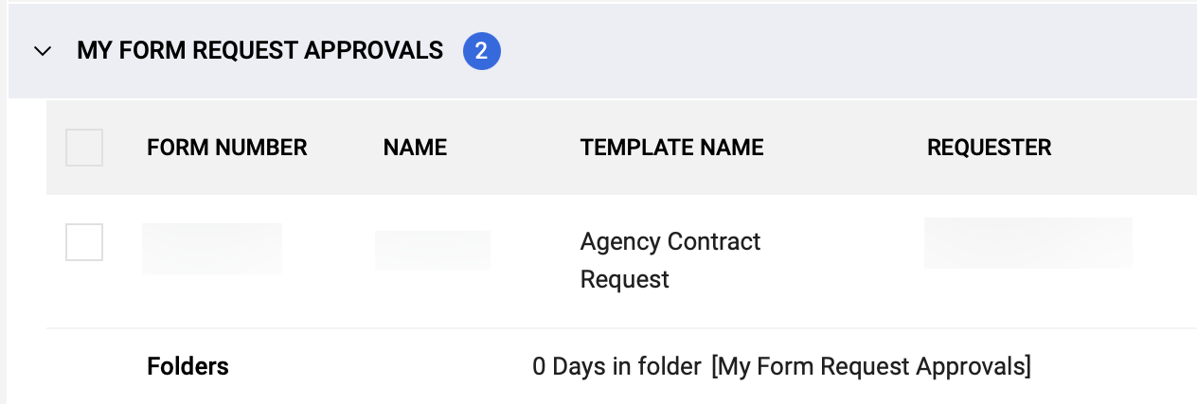
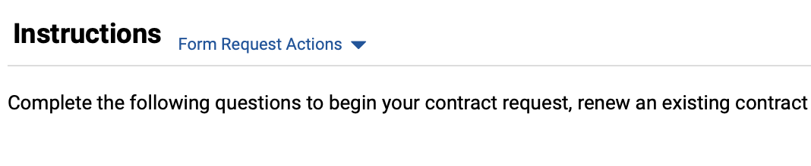
Approve a Contract Request (Part 3 of 4)
INSTRUCTIONS
Select the Form Number hyperlink.
Click Form Request Actions.
Note: Perform this step only after the review of Attachments, Questions, and navigated to the Contract Request Workflow page is complete.

Slide 5
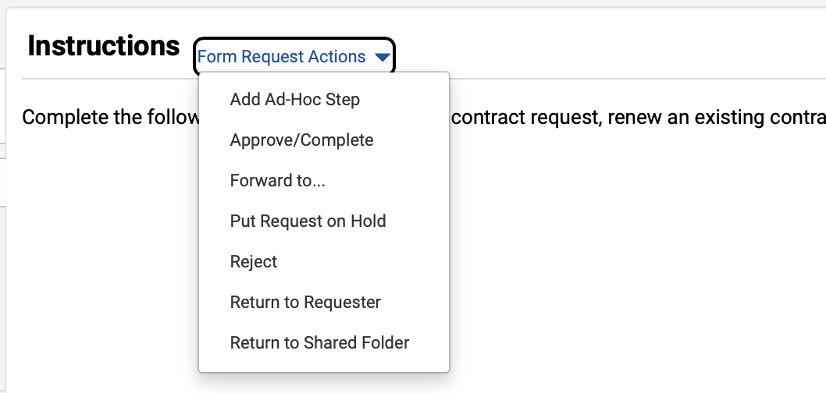
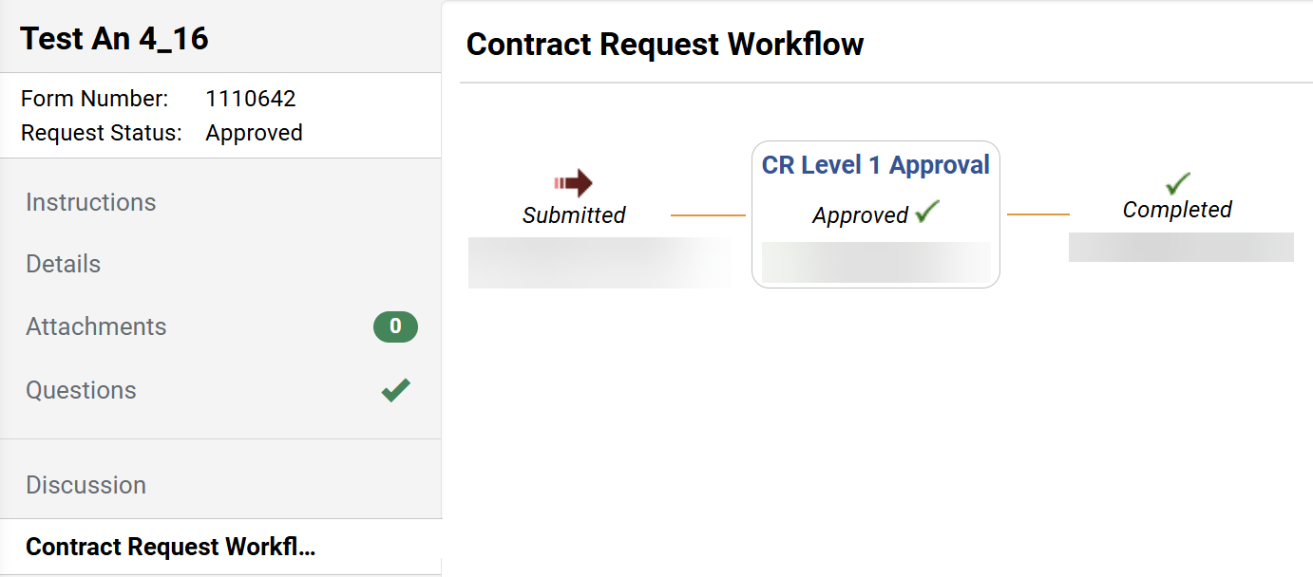
Approve a Contract Request (Part 4 of 4)
INSTRUCTIONS
Select Approve/Complete.
Click Contract Request Workflow to review the complete approval.
Note: The approval levels are based on the Agency Information.
You have successfully approved a Contract Request.

