Slide 1
Approve a Contract
DESCRIPTION
This guide will show Contract Approvers how to Approve a Contract via Approvals only.
OVERVIEW
The key steps in the process are below:
Access the Contracts module.
Click Approvals.
Click Contracts to Approve.
Note: Throughout the system, click on the Question Mark to access the help text. In addition, any field with a Gray Star is a mandatory field.
Business Process:
Access Contracts Module
Click Contracts to Approve
Select Contract to Approve
Contract is Approved

Slide 2
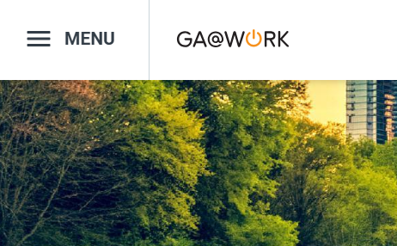

Approve a Contract (Part 1 of 4)
INSTRUCTIONS
Click the Global Navigation Menu.
Note: University System of Georgia (USG) users complete local logon and then proceed to Step 4.
Click Sourcing, Contracts & Supplier Management.
Notes:
Link for USG log in: <insert link>
For log in issues, users should go to Agency Super User first. Call Help Desk if needed. T1 should know (have a list) log in selections to advise user of correct selection to make.
If the app, Sourcing, Contracts & Supplier Management, is not in the list of apps, click on the Add Apps button at the bottom, find the Sourcing, Contracts, & Supplier Management app, then click on the + to add it to your list of Apps.

Slide 3

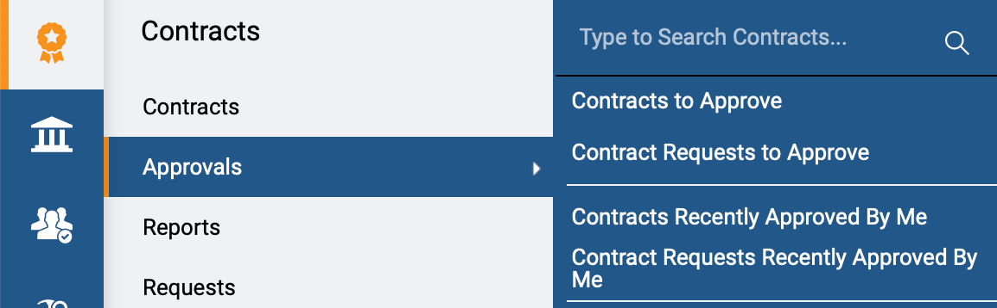
Approve a Contract (Part 2 of 4)
INSTRUCTIONS
Click Sign On.
Note: The system utilizes Single Sign-On (SSO), no log in information is required.
Click Contracts.
Select Approvals.
Select Contracts to Approve.
4
6
5
Notes:
Clicking Sign on will take the user out of GA@WORK and into the GA@WORK Marketplace.
Access the Contracts module by clicking on the Contracts icon on the left. Click on Approvals and select Contract to Approve. The Contract that are awaiting approval will display.
The status of the contract should be Pending Approval.

Slide 4
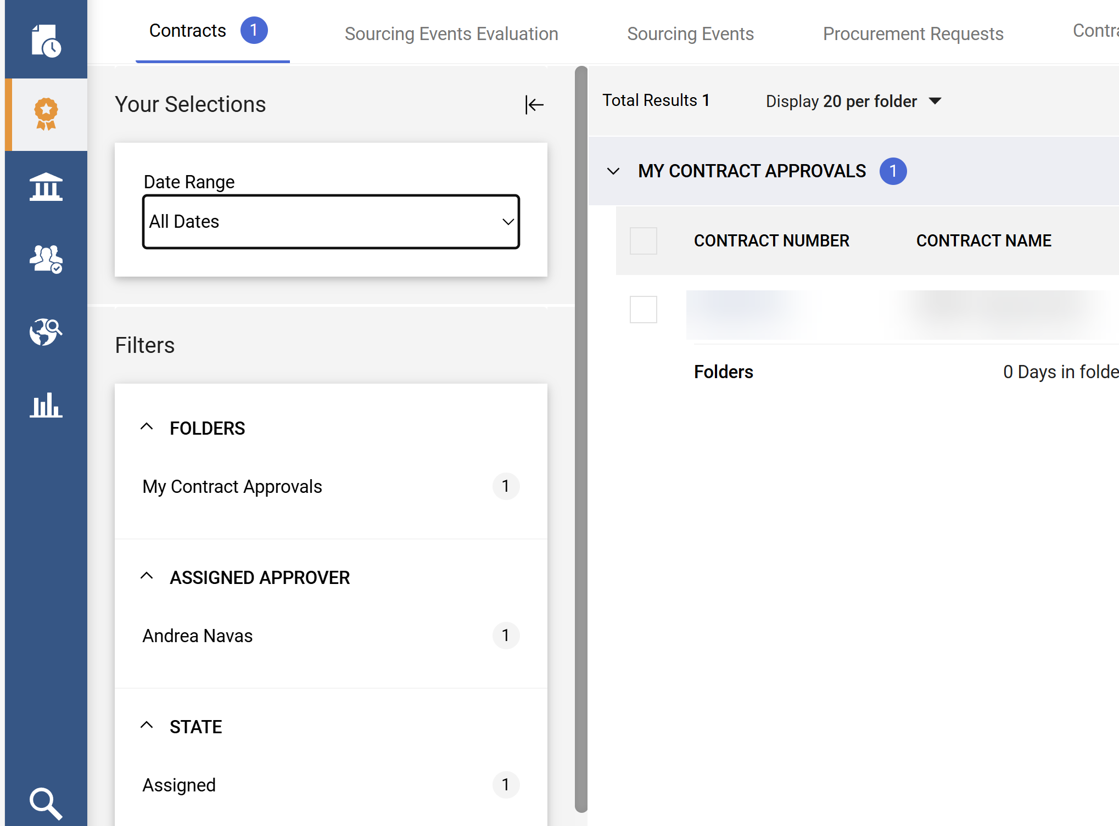
Approve a Contract (Part 3 of 4)
INSTRUCTIONS
Use the available Filters to find Contracts.
Notes:
To narrow down the search results, the filters on the left can be used. Under status, Pending Approval status can be selected. This will bring up contracts in a Pending Approval status.

Slide 5
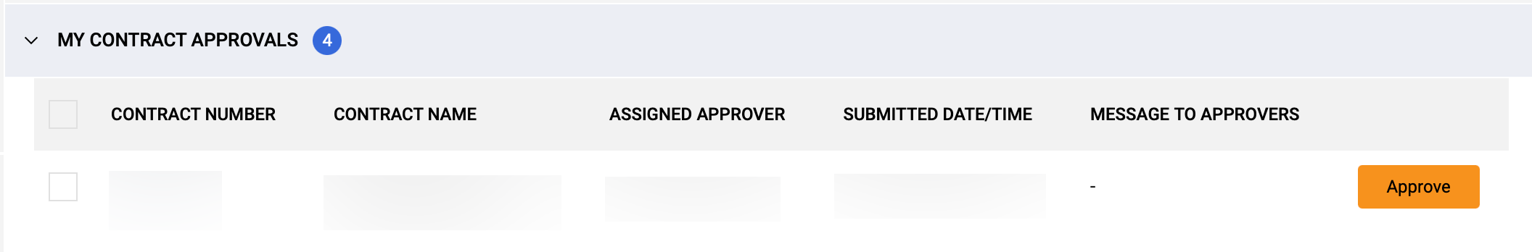
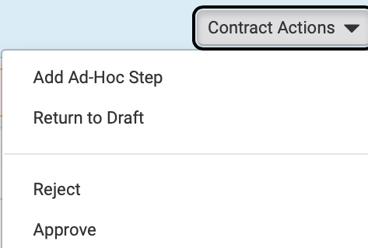
Approve a Contract (Part 4 of 4)
INSTRUCTIONS
Click the Contract Number hyperlink.
Note: If you have previously reviewed the Contract, you can click Approve on the right side of the page.
Click Contract Actions.
Select Approve.
9
10
You have successfully Approved a Contract.
Notes:
Click on the Contract Number.
Using the Contract Actions dropdown, select the options to Approve.

