Slide 1
Confidential Contracts
DESCRIPTION
This guide will show Contract Administrator how to make Confidential Contracts only.
OVERVIEW
The key steps in the process are below:
Access the Contracts module.
Select Contract.
Click Make Confidential.
Review Contract is Confidential.
Business Process:
Access Contracts Module
Select Contract
Click Make Confidential
Contract is Confidential

Slide 2


Confidential Contracts (Part 1 of 4)
INSTRUCTIONS
Click the Global Navigation Menu.
Note: University System of Georgia (USG) users complete local logon and then proceed to Step 4.
Click Sourcing, Contracts & Supplier Management.

Slide 3

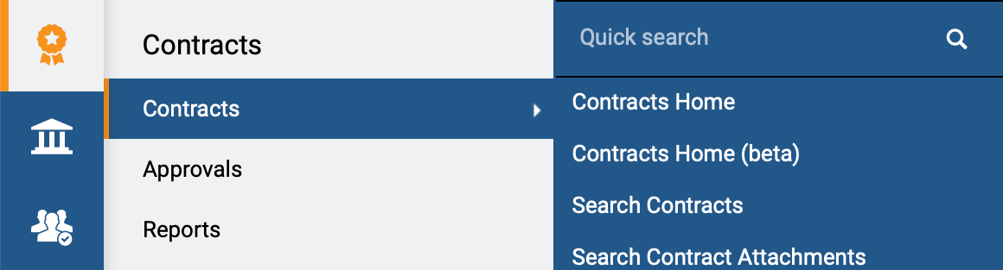
Confidential Contracts (Part 2 of 4)
INSTRUCTIONS
Click Sign On.
Note: The system utilizes Single Sign-On (SSO), no log in information is required.
Access the Contracts module.
Click Contracts.
Click Search Contracts.
4
5
6

Slide 4
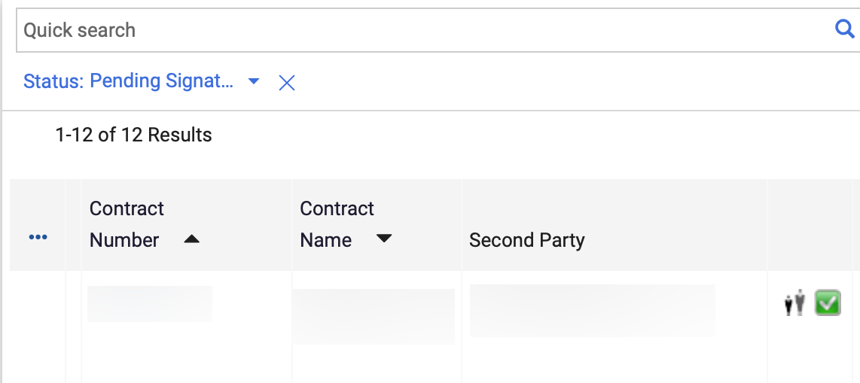
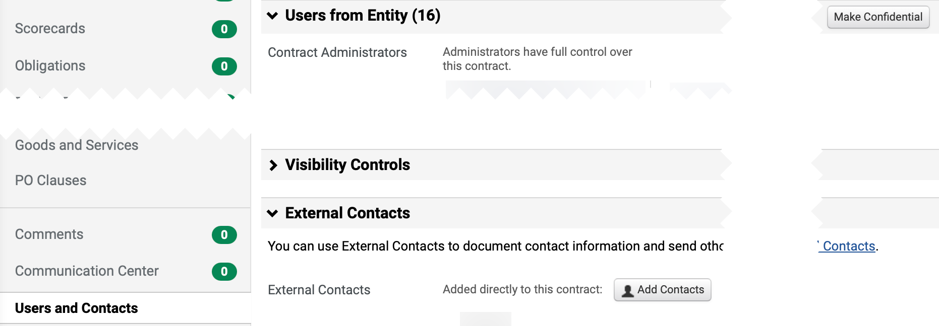
Confidential Contracts (Part 3 of 4)
INSTRUCTIONS
Click the Contract Number.
Note: Use the Quick Search and Filters to find the contract.
Click Users and Contacts.
Click Make Confidential.
Note: To view Contract Administrator role and contact information, click on each name hyperlink under Users from Entity.
9
8

Slide 5
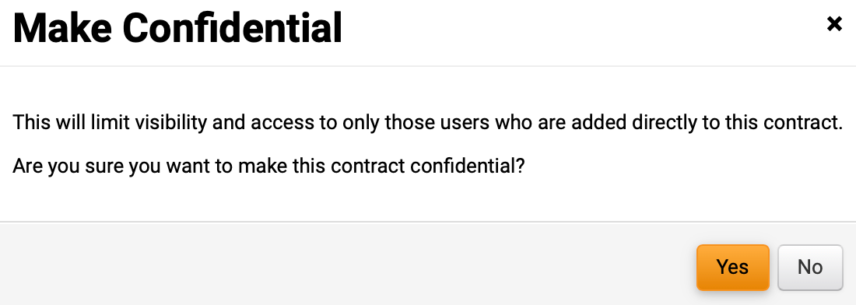
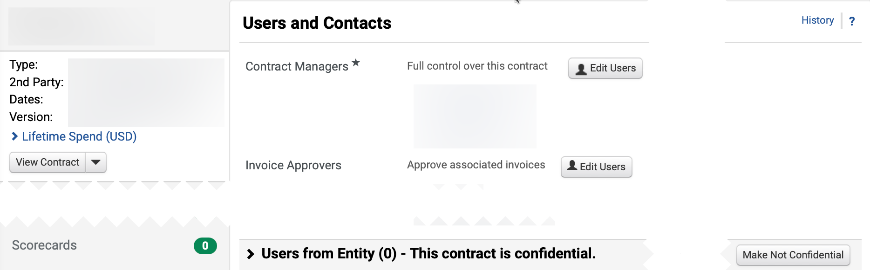

Confidential Contracts (Part 4 of 4)
INSTRUCTIONS
Click Yes.
Note: Confidential Contracts can only be seen by Contract Managers and Stakeholders on the Users and Contact of the contract and not any users listed under the User from Entity section.
Review This contract is confidential.
Note: You can revert change and Make Not Confidential under Users from Entity.
You have successfully made a Confidential Contract.

