Slide 1
Create a Contract Request for a Contract Renewal
DESCRIPTION
This guide will show Contract Requesters how to create and submit a contract renewal request only.
OVERVIEW
The key steps in the process are below:
Access the Contracts module.
Click Requests > Request Contract.
Complete renewal required fields.
Click Complete Request.
Business Process:
Access Contracts Module
Create Request
Fill Out Information
Contract Renewal Request is Submitted

Slide 2


Create a Contract Request for a Contract Renewal (Part 1 of 20)
INSTRUCTIONS
Click the Global Navigation Menu.
Note: University System of Georgia (USG) users complete local logon and then proceed to Step 4.
Click Sourcing, Contracts & Supplier Management.
Notes:
Link for USG log in: <insert link>
For log in issues, users should go to Agency Super User first. Call Help Desk if needed. T1 should know (have a list) log in selections to advise user of correct selection to make.
If the app, Sourcing, Contracts & Supplier Management, is not in the list of apps, click on the Add Apps button at the bottom, find the Sourcing, Contracts, & Supplier Management app, then click on the + to add it to your list of Apps.

Slide 3

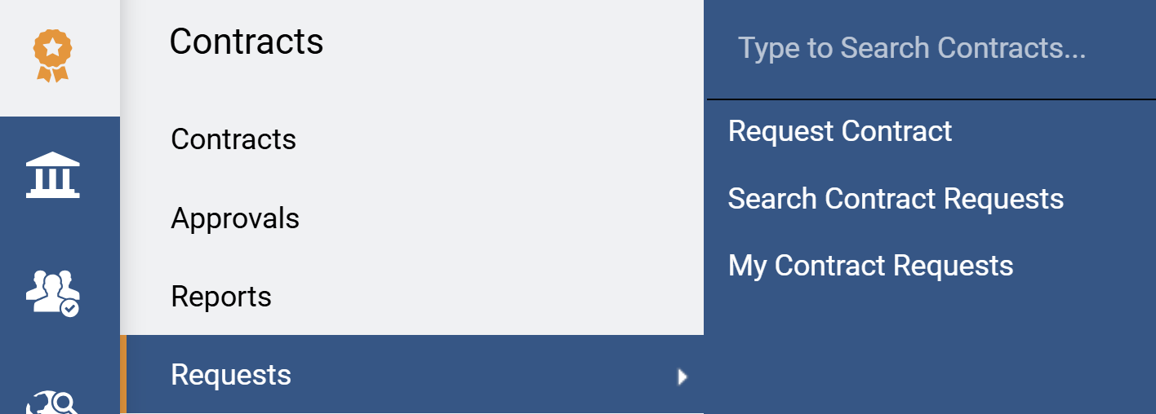
Create a Contract Request for a Contract Renewal (Part 2 of 20)
INSTRUCTIONS
Click Sign On.
Note: The system utilizes Single Sign-On (SSO) capabilities and no log in information is required.
Access the Contracts module.
Click Requests.
Click Request Contract.
4
6
5
Notes:
Clicking Sign on will take the user out of GA@WORK and into the GA@WORK Marketplace.
Access the Contracts module by clicking on the Contracts icon on the left.
Select Request then Request Contract.

Slide 4
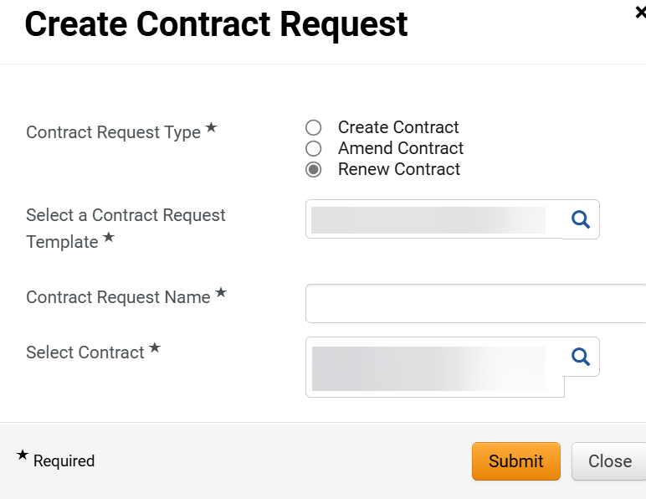
Create a Contract Request for a Contract Renewal (Part 3 of 20)
INSTRUCTIONS
Select Renew Contract as the Contract Request Type*.
Note: Complete all required fields marked with a black star*.
Select a Contract Request Template*.
Enter a Contract Request Name*.
Enter or search to Select Contract*.
Note: Use the magnifying glass to search. Search the contact by the contract name keywords to reduce the number of results displayed.
Click Submit.
7
8
9
10
11

Slide 5
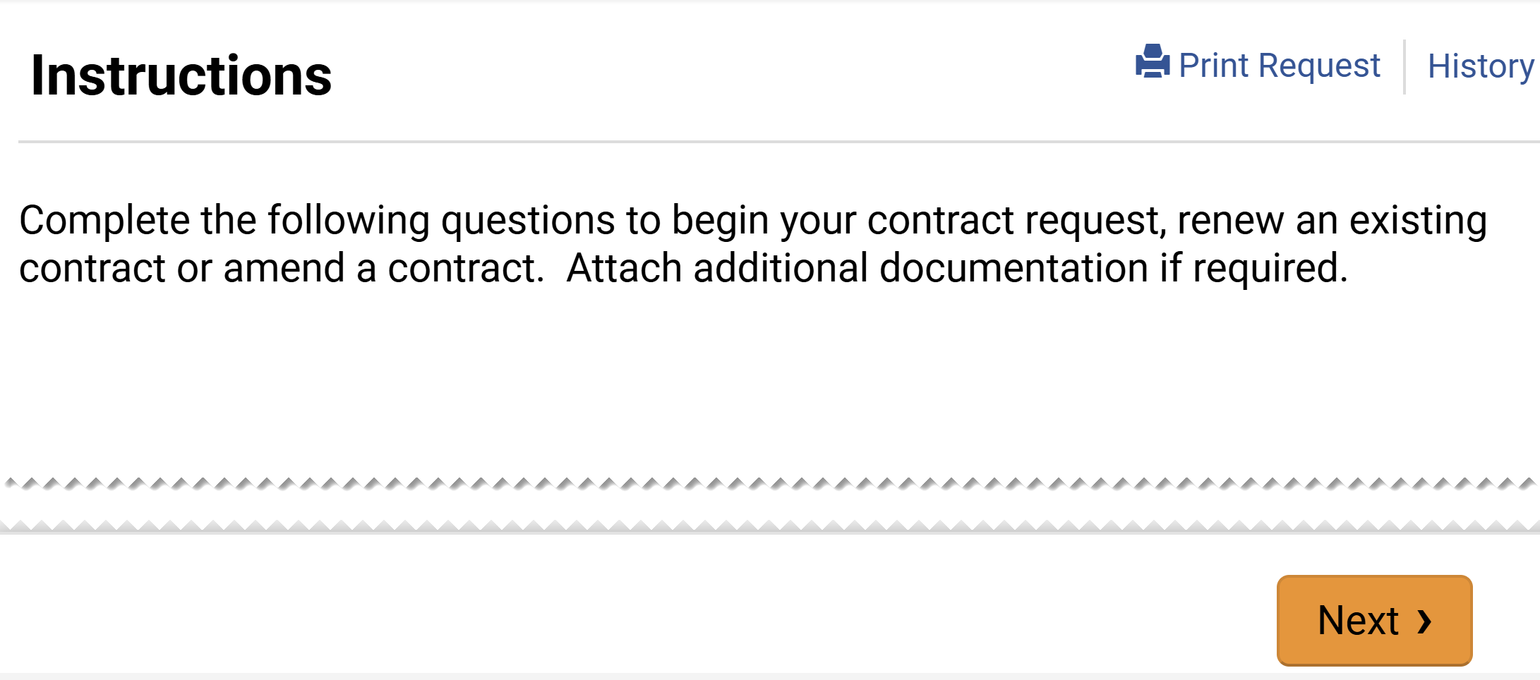
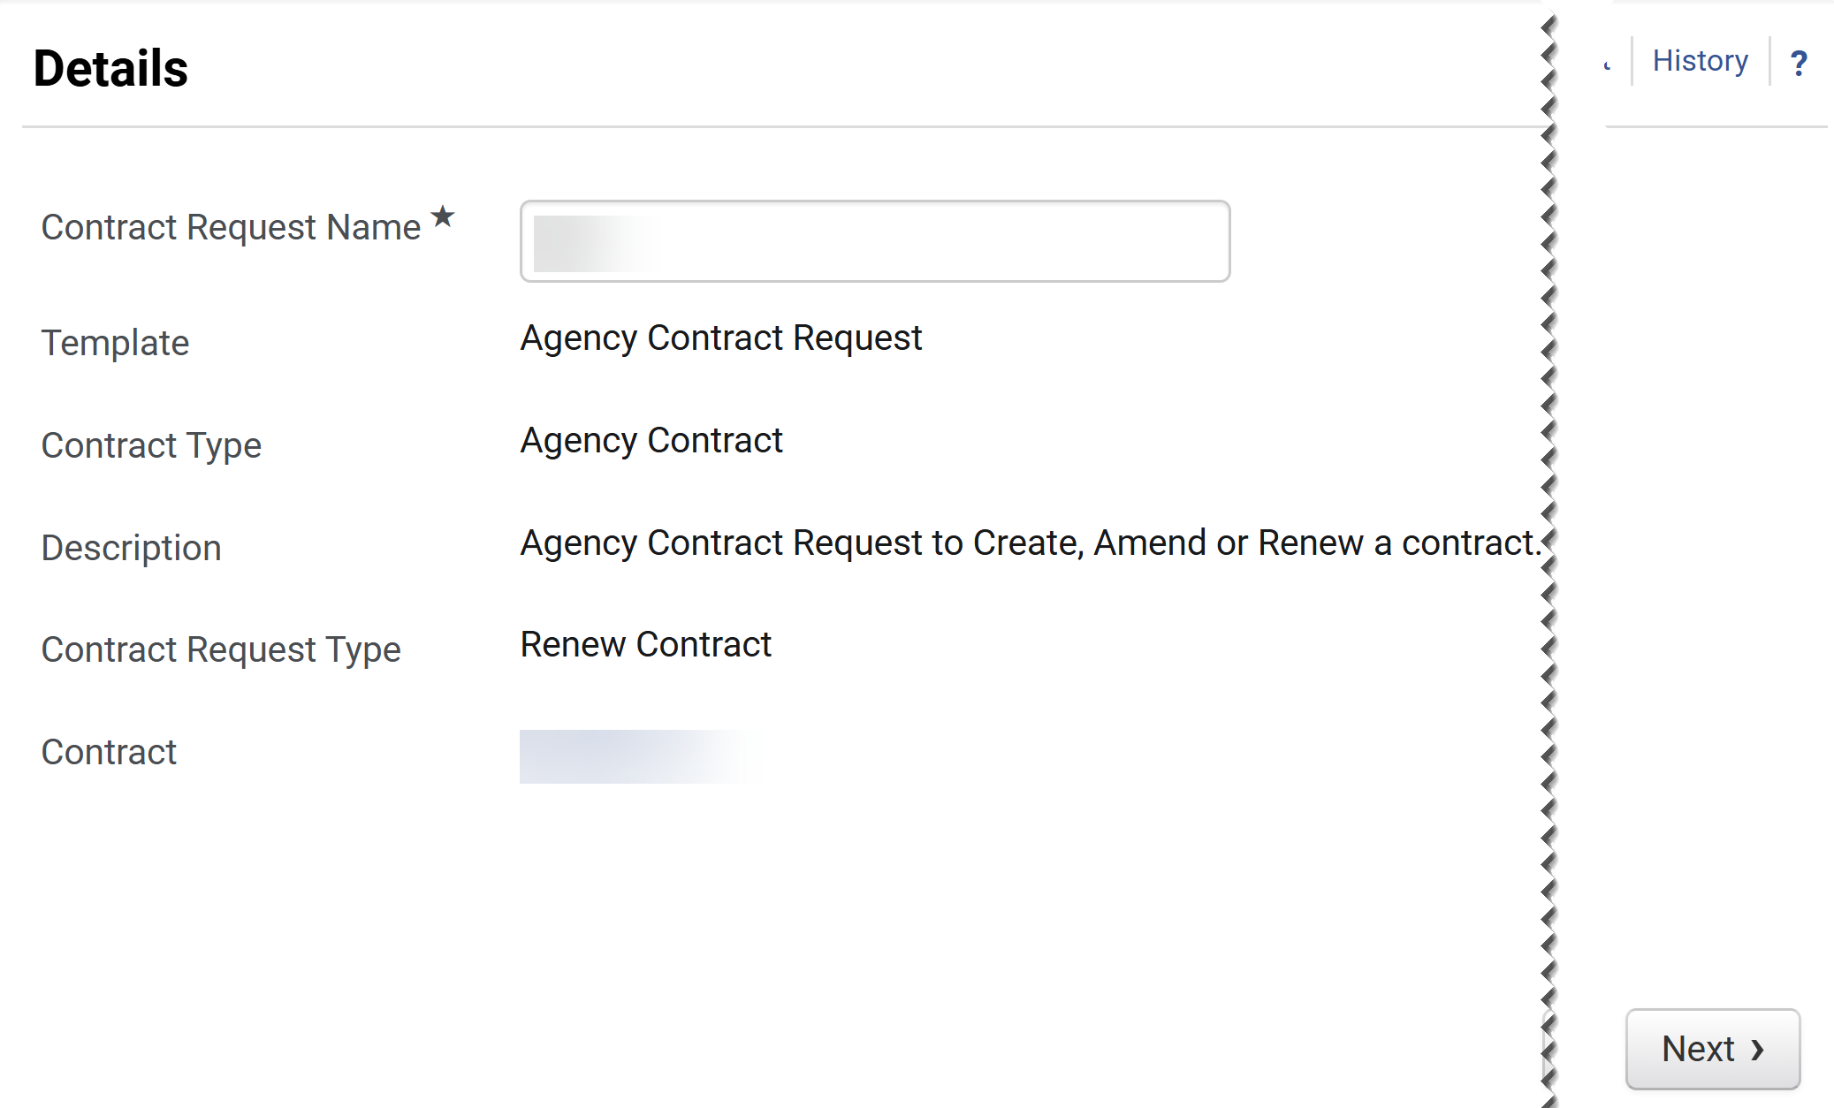
Create a Contract Request for a Contract Renewal (Part 4 of 20)
INSTRUCTIONS
Click Next.
Click Next.
Note: All fields are read-only based on previous selection, except for Contract Request Name*.

Slide 6
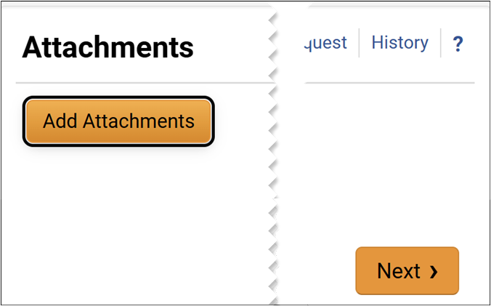
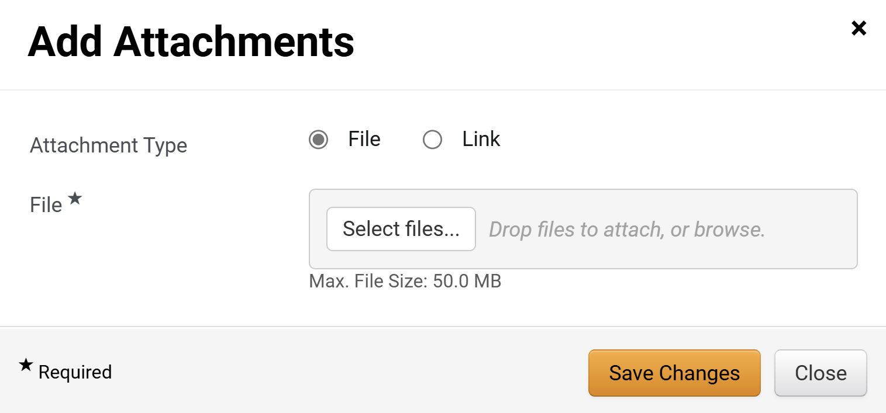
Create a Contract Request for a Contract Renewal (Part 5 of 20)
INSTRUCTIONS
Click Add Attachments.
Note: Following your organization's guidance, upload any files relevant to the contract request such as a scope of work or supplier quote. If no Files or URLs to add, then click Next and skip to step 24.
Select Attachment Type as File or Link.
Note: For the purposes of this guide, we will select File. If Attachment Type is Link skip to step 20.
Click Select Files… to attach the applicable file.
15
16

Slide 7

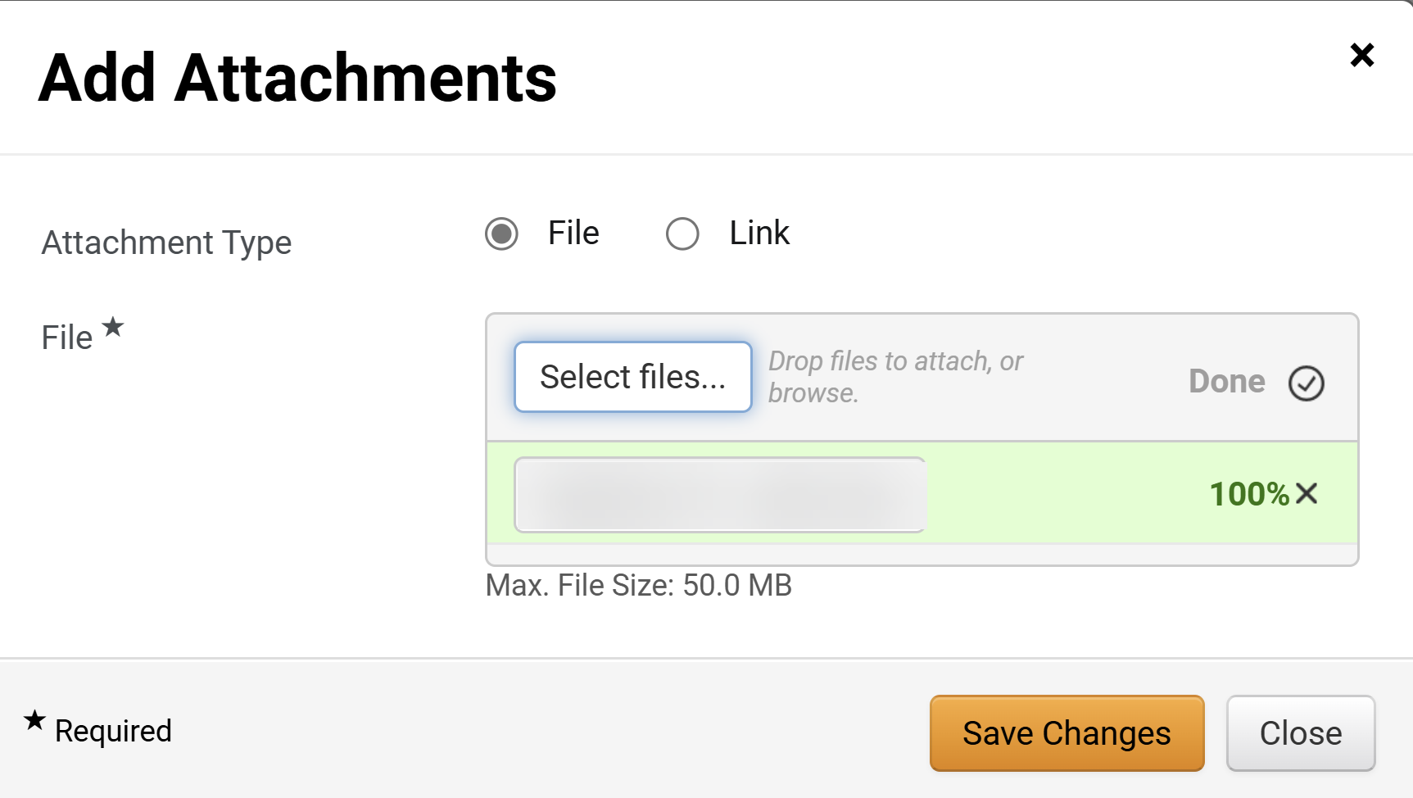
Create a Contract Request for a Contract Renewal (Part 6 of 20)
INSTRUCTIONS
Select the applicable File from your computer.
Click Open.
17
18
Click Save Changes.

Slide 8
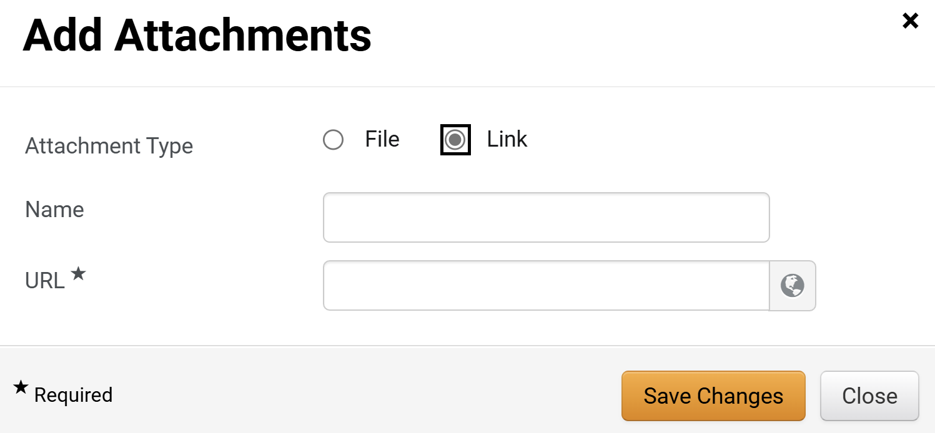
Create a Contract Request for a Contract Renewal (Part 7 of 20)
INSTRUCTIONS
If attaching a link, select Link for the Attachment Type.
Enter a Name.
Enter the URL*.
Click Save Changes.
20
21
22
23

Slide 9
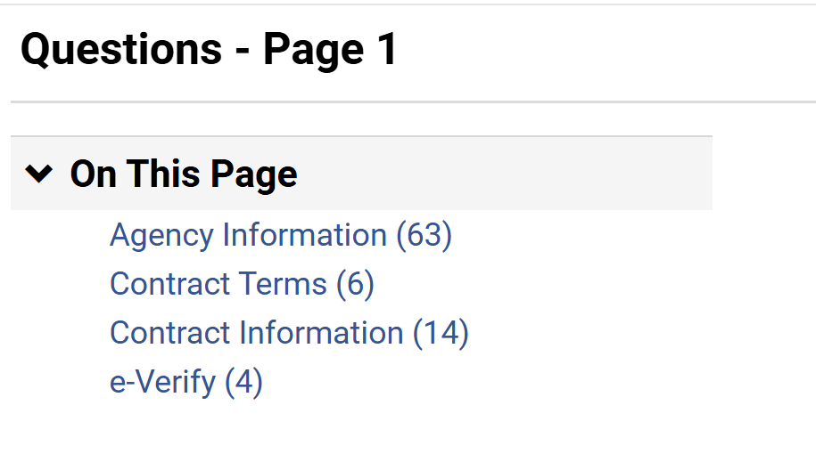
Create a Contract Request for a Contract Renewal (Part 8 of 20)
INSTRUCTIONS
Click Agency Information.

Slide 10
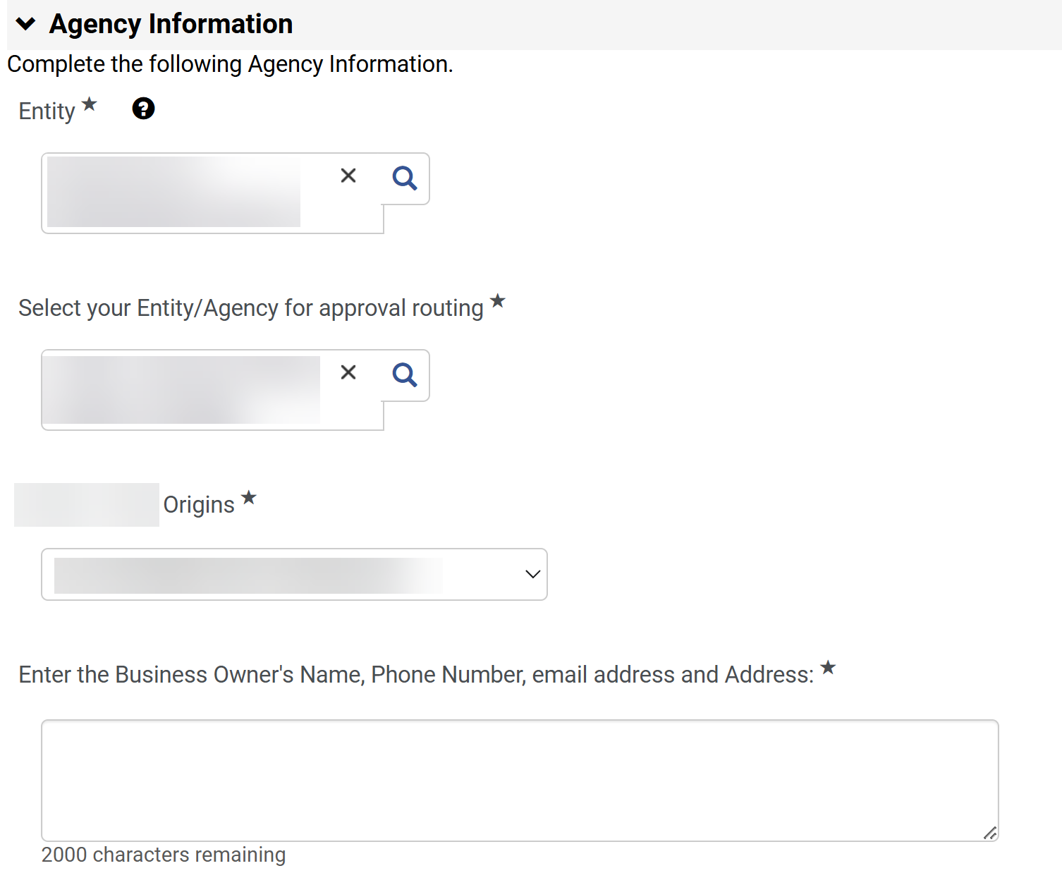
Create a Contract Request for a Contract Renewal (Part 9 of 20)
INSTRUCTIONS
Select the Entity*.
Select your Entity/Agency for approval routing*.
Note: Use the magnifying glass to search.
Enter or search for the entity Origins*.
Finally, Enter the Business Owner's Name, Phone Number, email address and Address:*.
Note: Agency Information would have information auto populated based on the contract selected. Also, the selected Entity/Agency and Origins* will determine the request workflow.
25
26
27
28

Slide 11
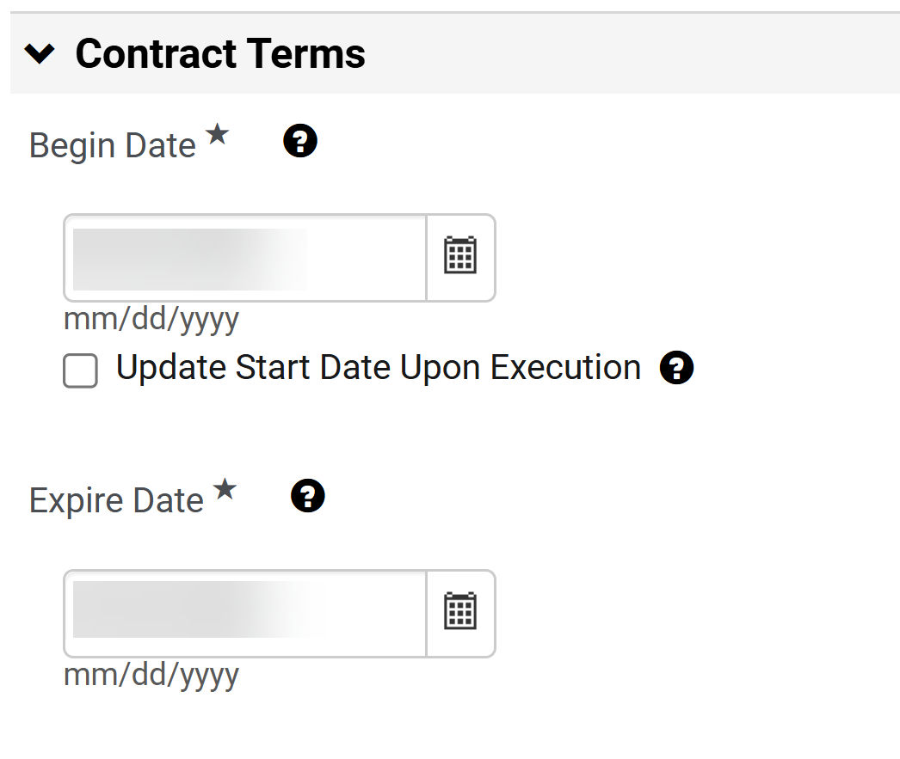
Create a Contract Request for a Contract Renewal (Part 10 of 20)
INSTRUCTIONS
A Begin Date* is auto populated with contract data.
An Expire Date* is auto populated with contract data and selection.
Note: Contract Terms data can be overwritten. However, Expire Date format can not be changed.
29
30

Slide 12
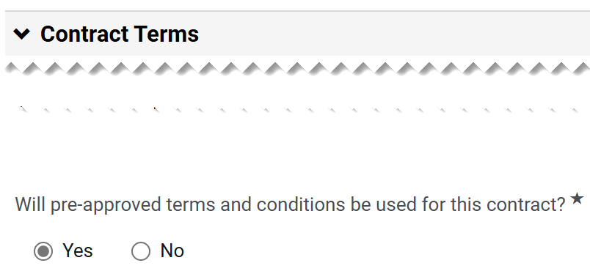
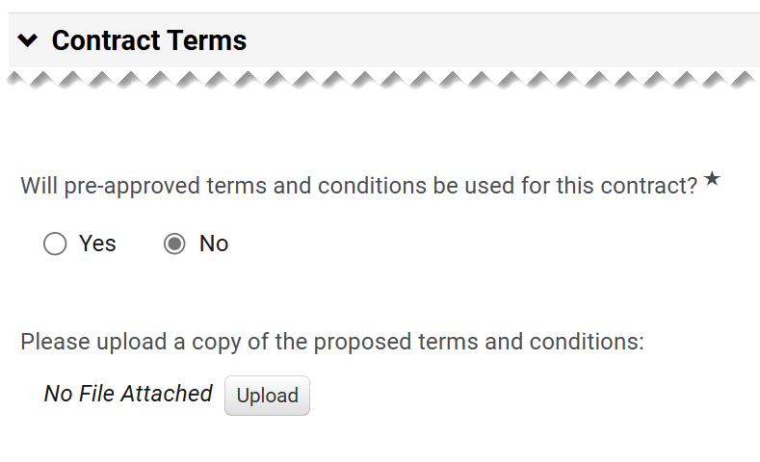
Create a Contract Request for a Contract Renewal (Part 11 of 20)
INSTRUCTIONS
Answer Will pre-approved terms and conditions be used for this contract?*.
Note: If No is selected, continue to step 32. If Yes is selected, skip to step 38.
Click Upload for Please upload a copy of the proposed terms and conditions.

Slide 13
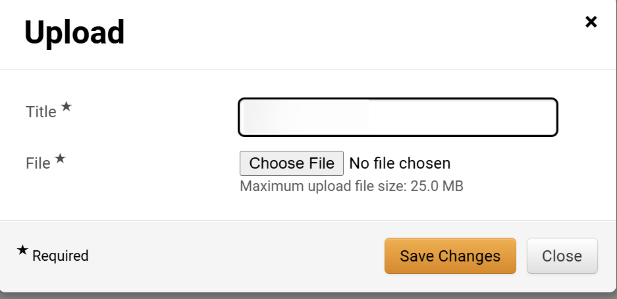
Create a Contract Request for a Contract Renewal (Part 12 of 20)
INSTRUCTIONS
Enter the Title*.
Click Choose File.
33
34
Select file from your local computer.
Click Open.
35
36

Slide 14
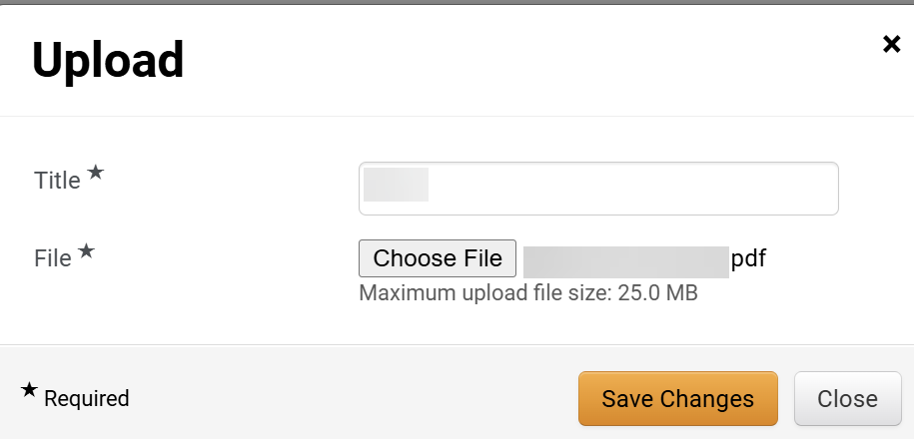
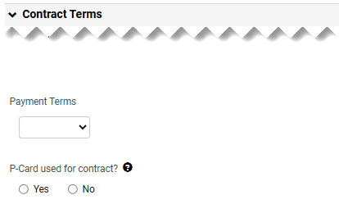
Create a Contract Request for a Contract Renewal (Part 13 of 20)
INSTRUCTIONS
Click Save Changes.
Select the Payment Terms.
Select if P-Card used for contracts?.
38
39

Slide 15
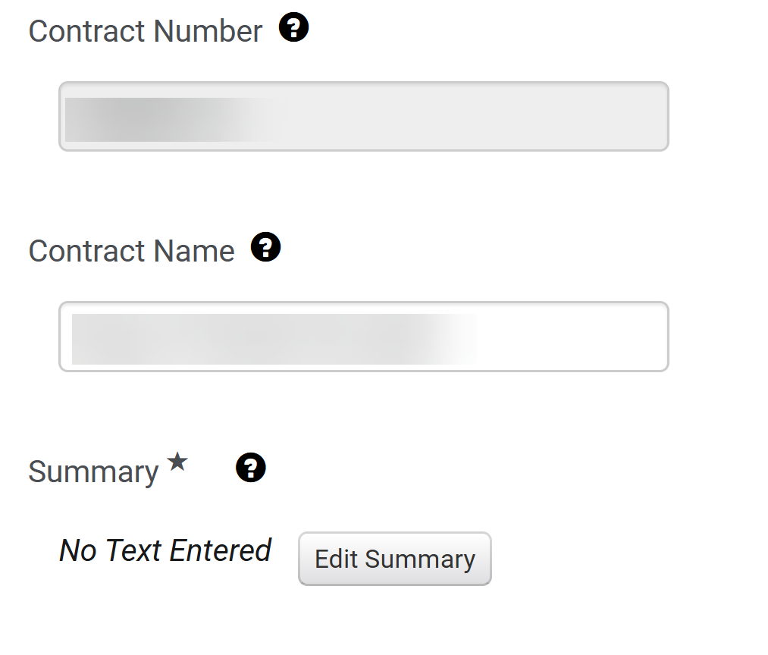
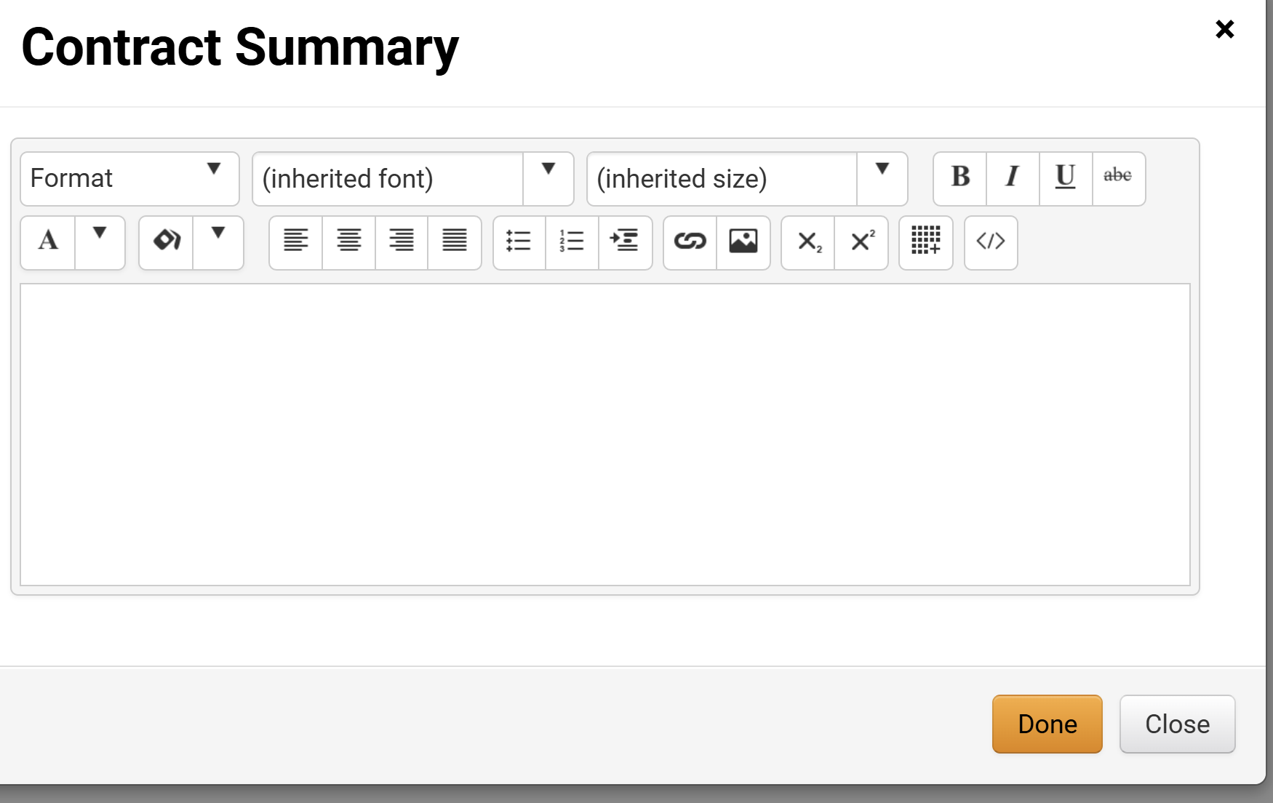
Create a Contract Request for a Contract Renewal (Part 14 of 20)
INSTRUCTIONS
The Contract Number is read-only.
The Contract Name is auto populated.
Click Edit Summary.
40
41
42
Enter the Contract Summary then click Done.
43

Slide 16
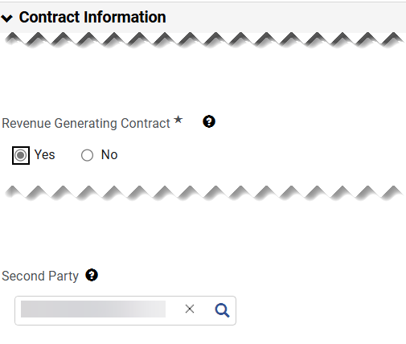
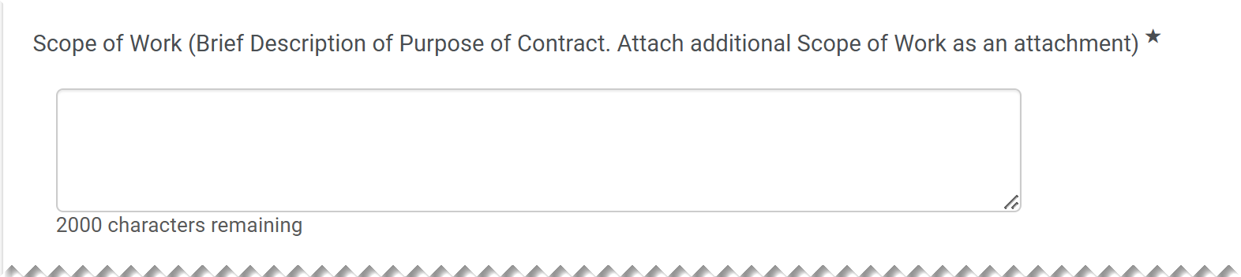
Create a Contract Request for a Contract Renewal (Part 15 of 20)
INSTRUCTIONS
Select Revenue Generating Contract*.
The Second Party is auto populated from the contract.
44
45
Enter Scope of Work (Brief Description of Purpose of Contract. Attach additional Scope of Work as an attachment)*.

Slide 17
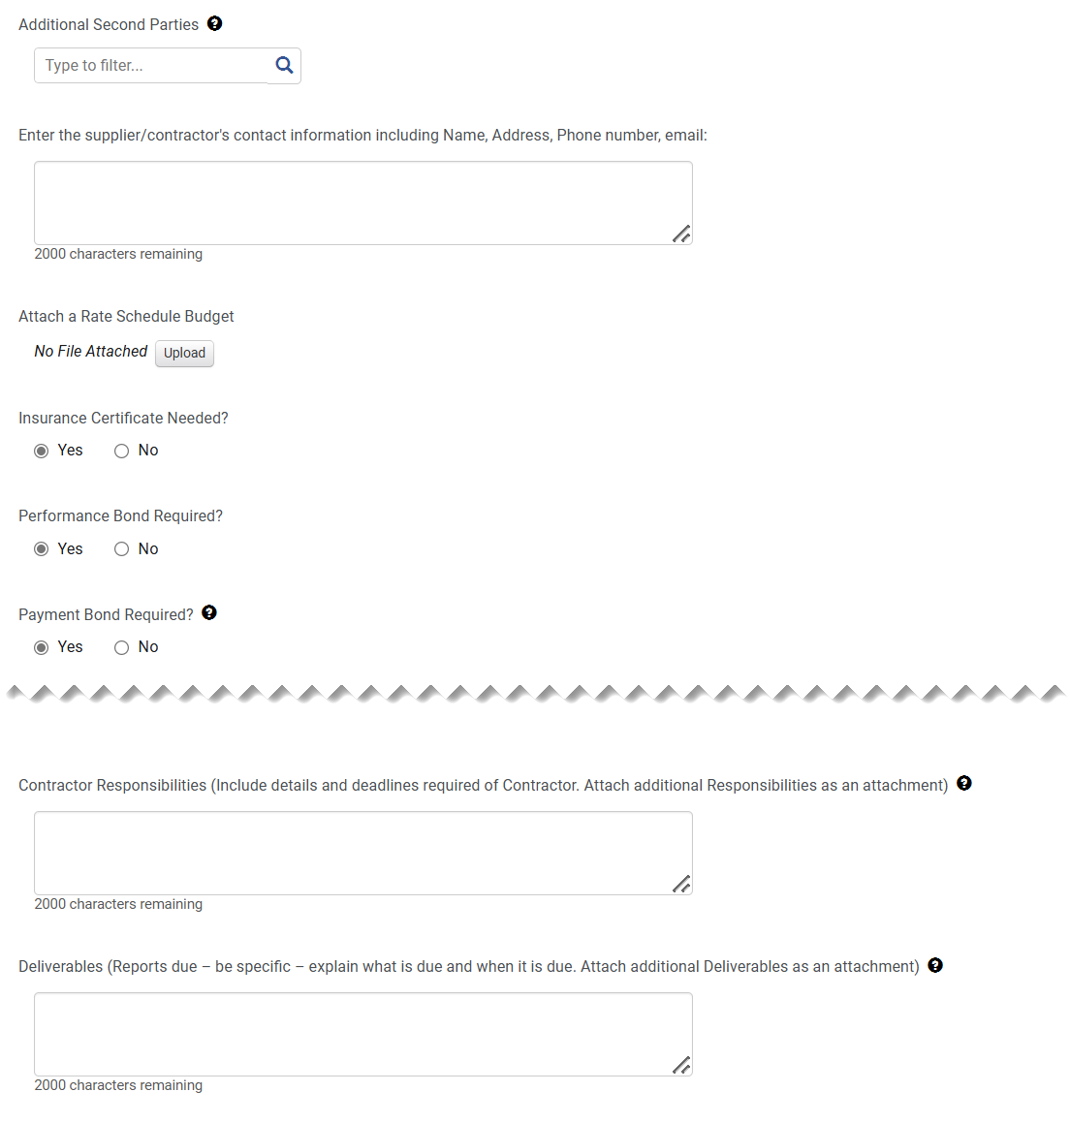
Create a Contract Request for a Contract Renewal (Part 16 of 20)
INSTRUCTIONS
Complete relevant fields for Contract Information (optional).

Slide 18
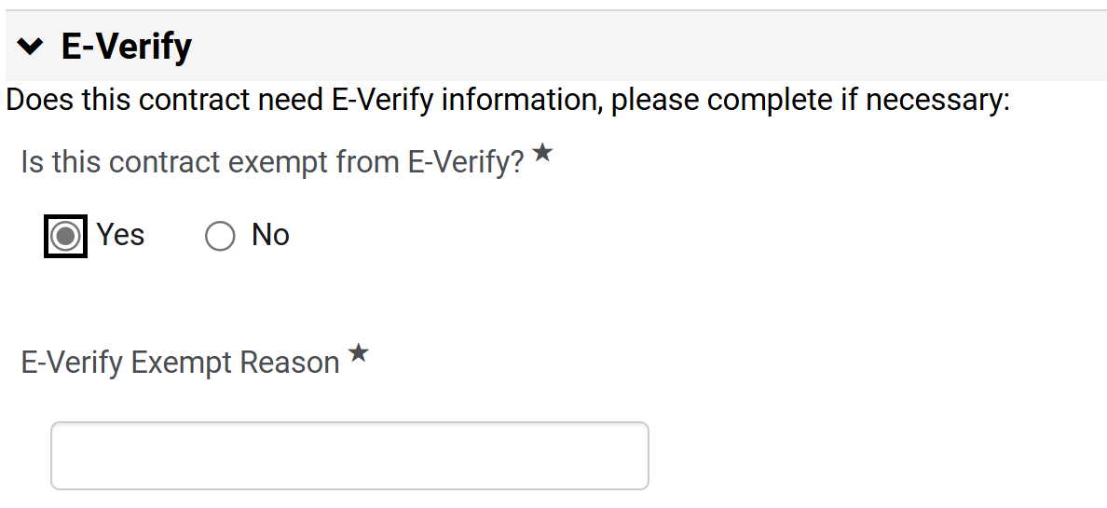
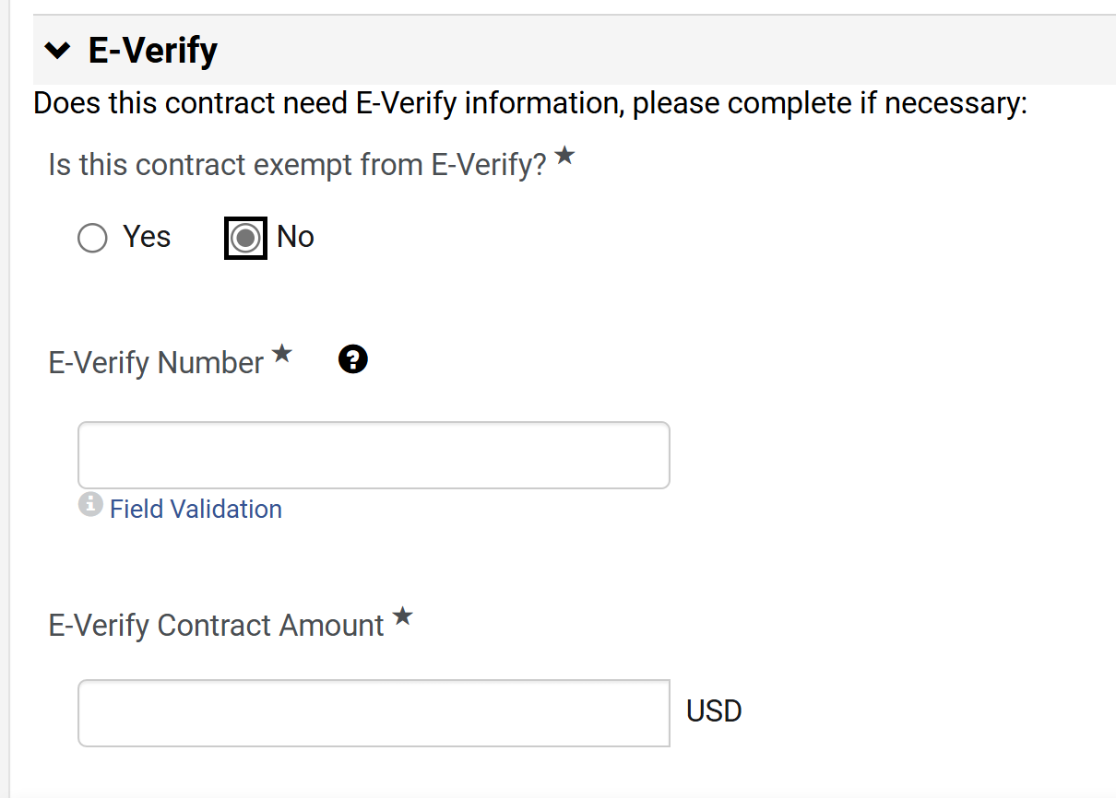
Create a Contract Request for a Contract Renewal (Part 17 of 20)
INSTRUCTIONS
Answer Is this company exempt from e-Verity?*.
Note: If Yes is selected, continue to step 49. If No is selected, skip to step 50.
If Yes, enter the E-Verify Exempt Reason*.
48
49
If No is selected, enter the E-Verify Number*.
Include E-Verify Contract Amount*.
50
51

Slide 19
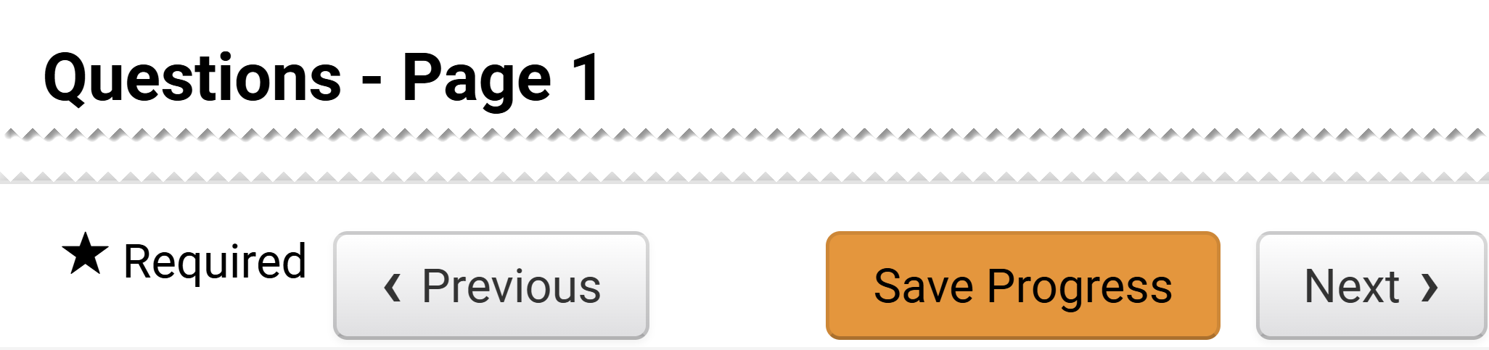
Create a Contract Request for a Contract Renewal (Part 18 of 20)
INSTRUCTIONS
Click Next.
Note: It is possible to Save Progress and exit the contract request and complete the information later.

Slide 20
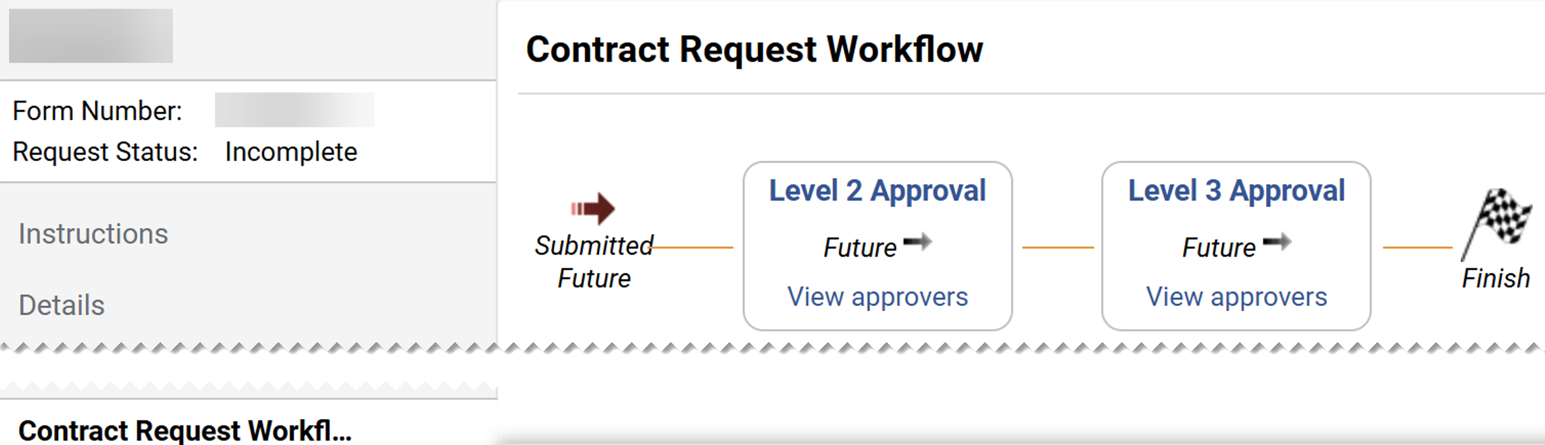
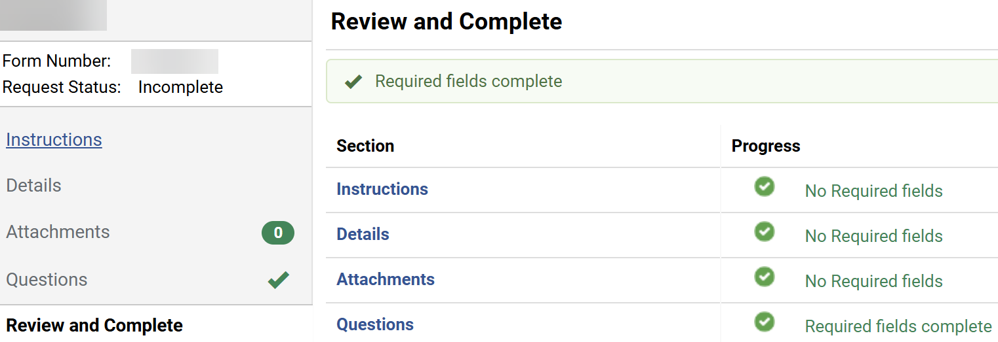
Create a Contract Request for a Contract Renewal (Part 19 of 20)
INSTRUCTIONS
Click Contract Request Workflow to review the approvals.
Note: The approval levels are based on the Entity and Origins selected in the Agency Information.
Click Review and Complete.

Slide 21
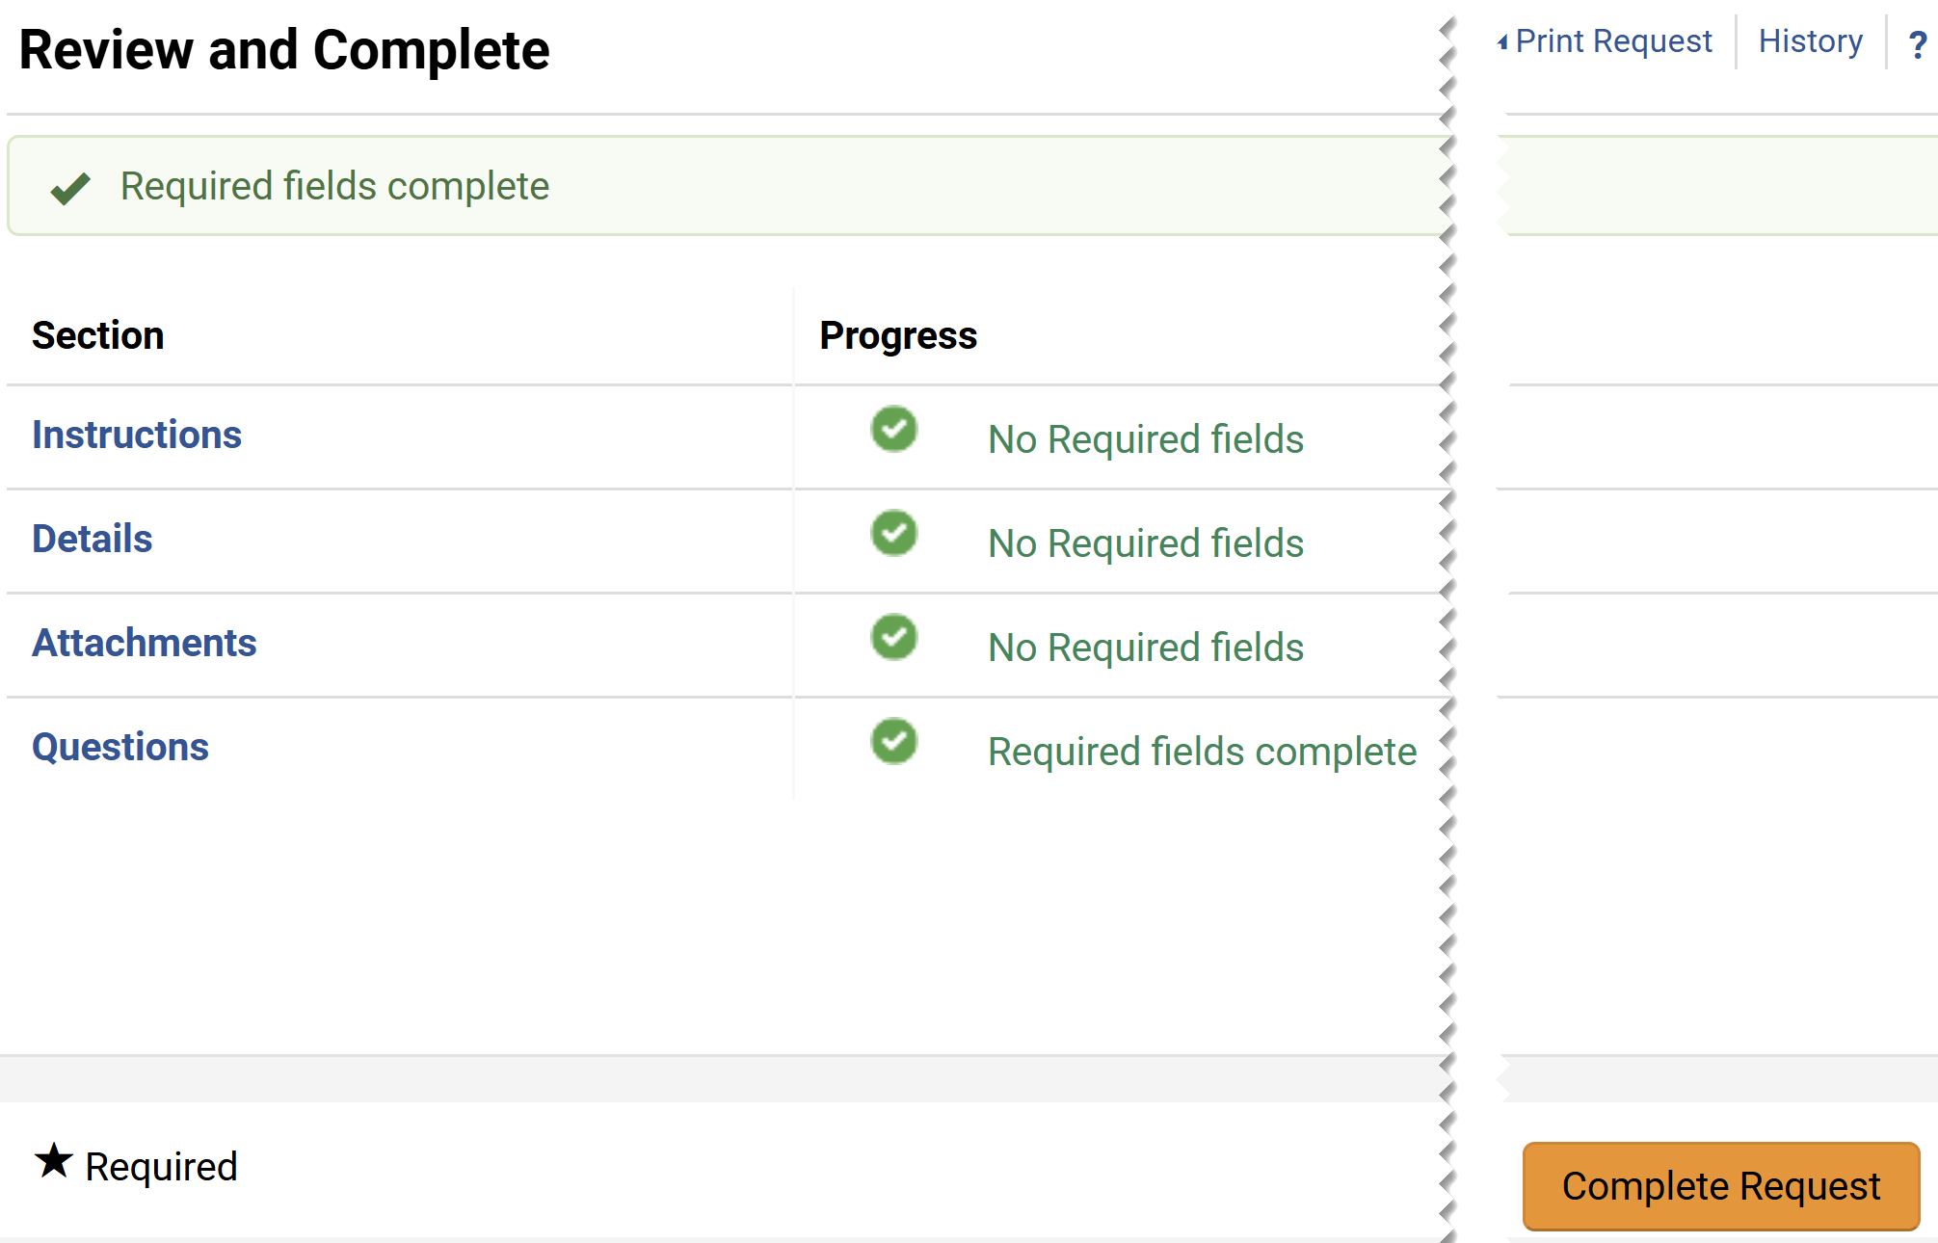
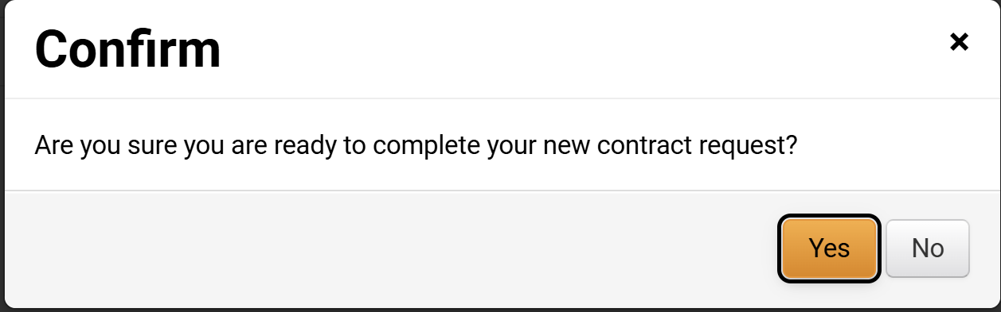
Create a Contract Request for a Contract Renewal (Part 20 of 20)
INSTRUCTIONS
Click Complete Request.
Click Yes to complete the Contract Request.
You have successfully submitted a Contract Request for Renewal.

