Slide 1
Create a Contract Request for an Exempt Contract
DESCRIPTION
This guide will show Contract Requesters how to Create a Contract Request for an Exempt Contract that will not be competitively bid only.
OVERVIEW
The key Steps in the process are below:
Access the Contracts module.
Click Requests > Request Contract.
Complete required fields.
Click Complete Request.
Business Process:
Access Contracts Module
Create Request
Fill Out Information
Contract Request is Submitted

Slide 2


Create a Contract Request for an Exempt Contract (Part 1 of 24)
INSTRUCTIONS
Click the Global Navigation Menu.
Note: University System of Georgia (USG) users complete local logon and then proceed to Step 4.
Click Sourcing, Contracts & Supplier Management.

Slide 3

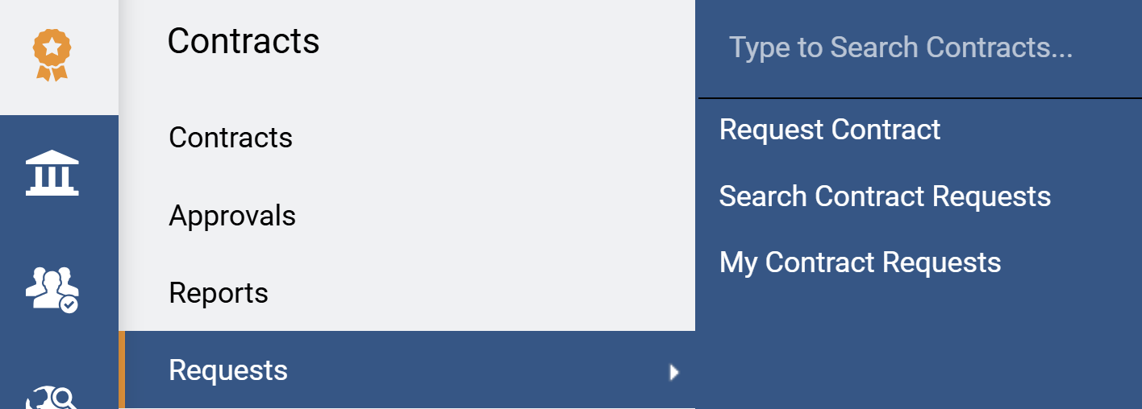
Create a Contract Request for an Exempt Contract (Part 2 of 24)
INSTRUCTIONS
Click Sign On.
Note: The system utilizes Single Sign-On (SSO) capabilities and no log in information is required.
Access the Contracts module.
Select Requests.
Select Request Contract.
4
6
5

Slide 4
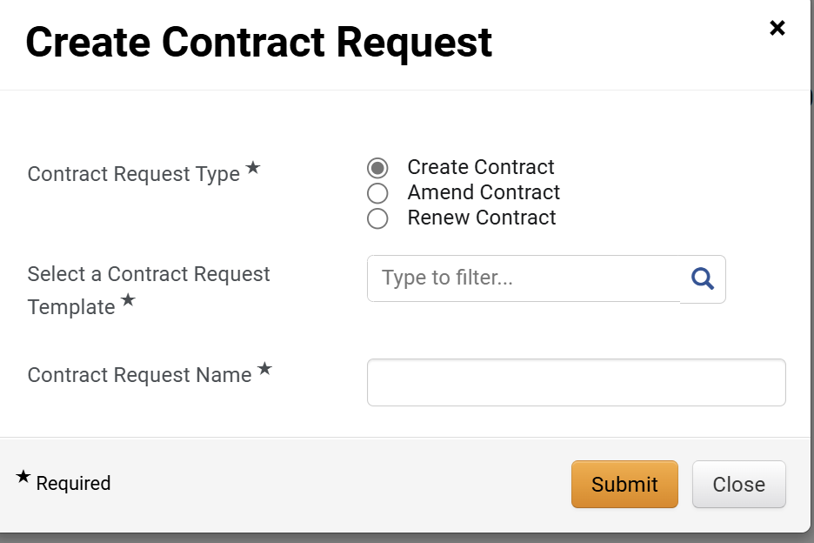
Create a Contract Request for an Exempt Contract (Part 3 of 24)
INSTRUCTIONS
Select Create Contract as the Contract Request Type*.
Note: Complete all Required fields.
͏Select a Contract Request Template*.
Enter a Contract Request Name*.
Note: Suggested name for Contract Request Name* is the supplier's name and the service/good being requested. However, your organization may have specific requirements for the naming convention.
Click Submit.
7
8
9
10

Slide 5
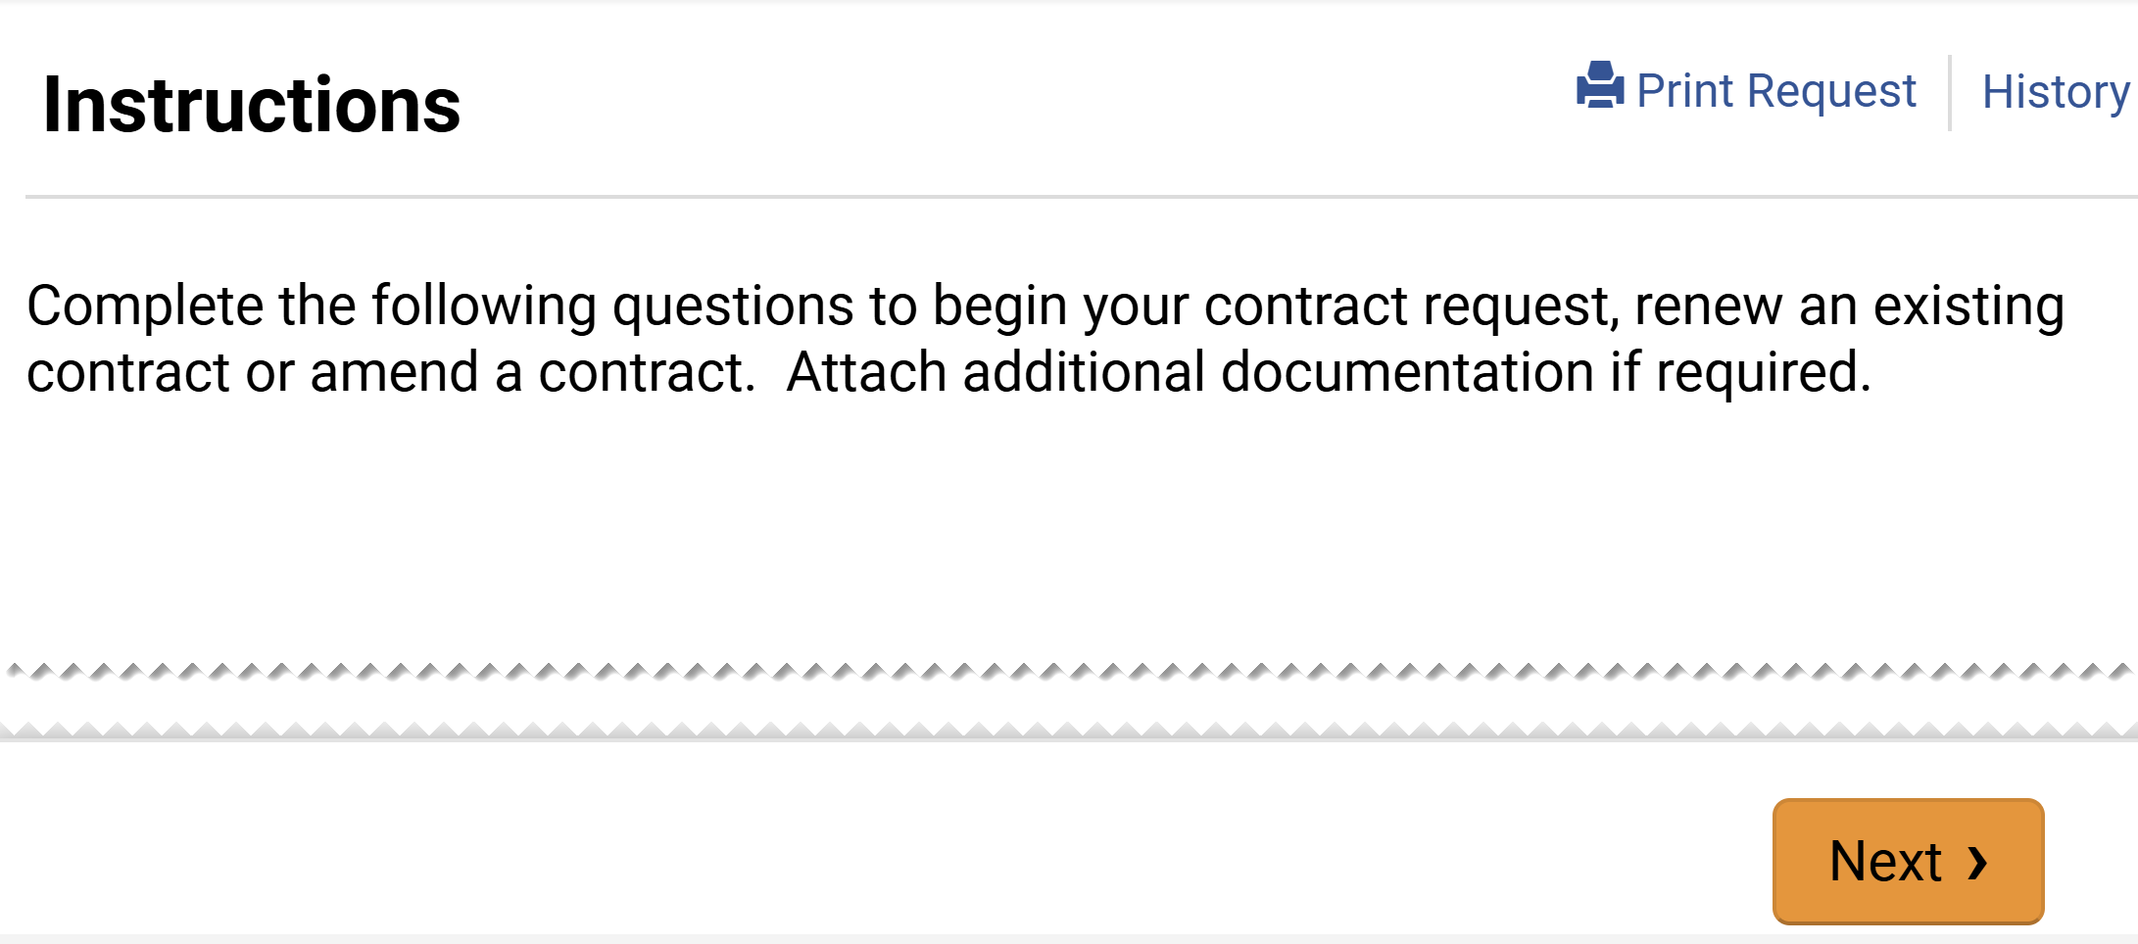
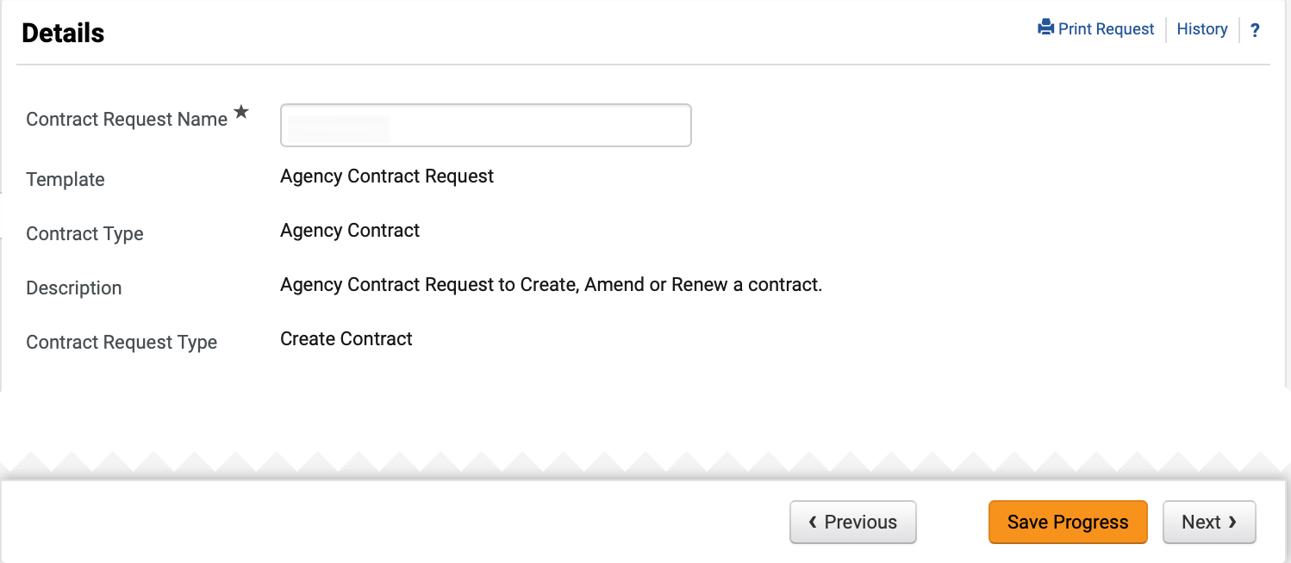
Create a Contract Request for an Exempt Contract (Part 4 of 24)
INSTRUCTIONS
Click Next.
Review Details and click Next.
Note: All fields are read-only based on previous selection, except for Contract Request Name.
12

Slide 6
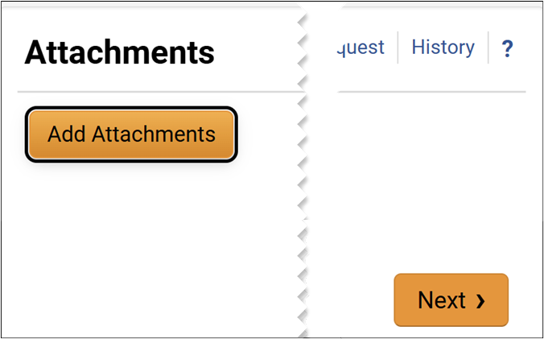
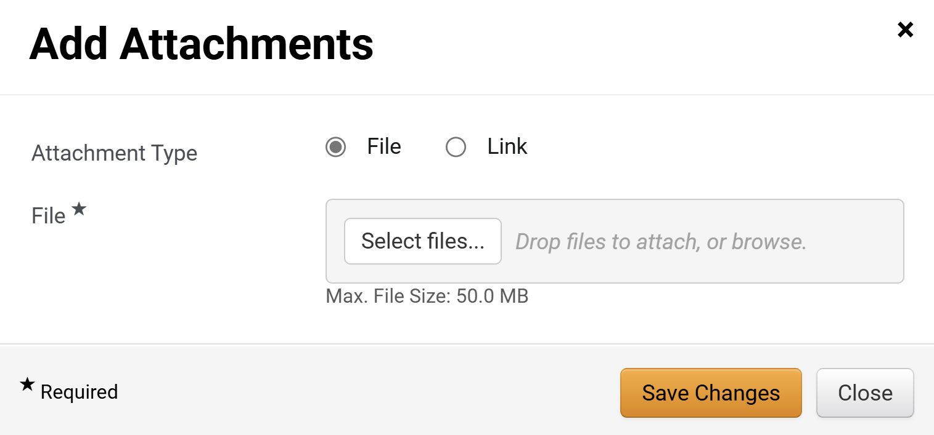
Create a Contract Request for an Exempt Contract (Part 5 of 24)
INSTRUCTIONS
Click Add Attachments.
Note: Following your organization's guidance, upload any files relevant to the contract request such as a scope of work or supplier quote. If no files or URLs to add, then click Next and skip to Step 23.
Select Attachment Type.
Note: For the purposes of this guide, we will select File. If Attachment Type is Link skip to Step 19.
Click Select Files… to include an attachment.
14
15

Slide 7

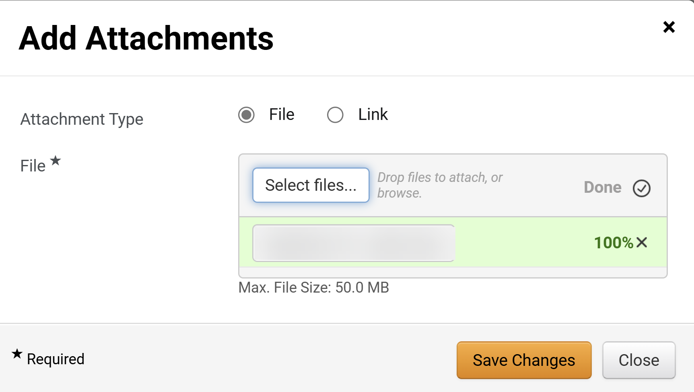
Create a Contract Request for an Exempt Contract (Part 6 of 24)
INSTRUCTIONS
Select the applicable File from your computer.
Click Open.
16
17
Click Save Changes.
Note: Skip to Step 23 to continue to Agency Information.

Slide 8
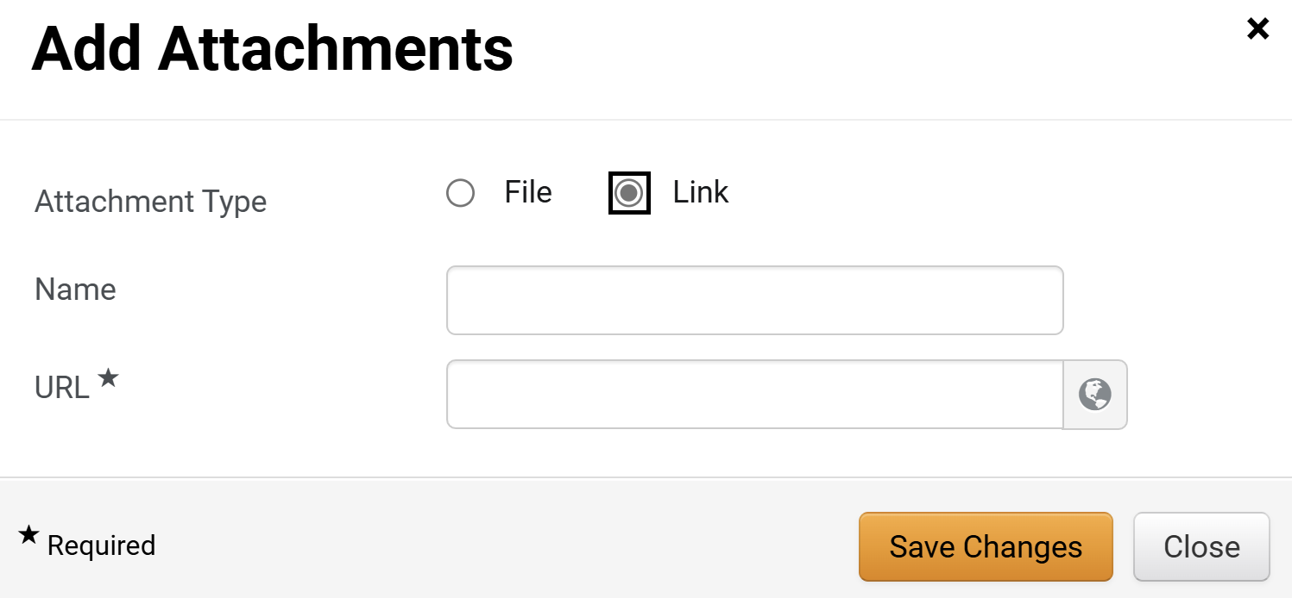
Create a Contract Request for an Exempt Contract (Part 7 of 24)
INSTRUCTIONS
If attaching a link, select Link for the Attachment Type.
Enter a Name.
Enter the URL*.
Click Save Changes.
19
20
21
22

Slide 9
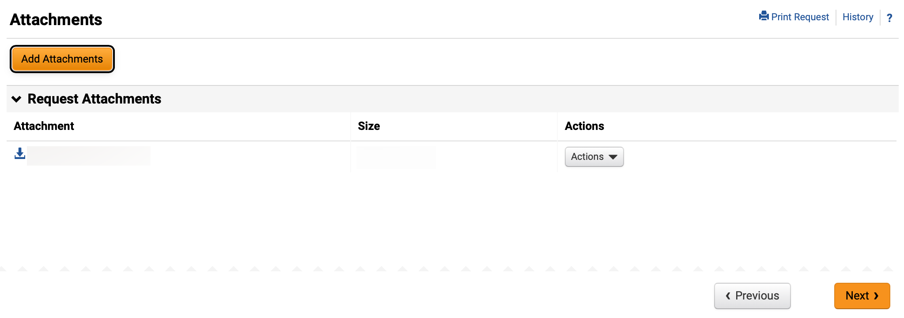
Create a Contract Request for an Exempt Contract (Part 8 of 24)
INSTRUCTIONS
Click Next to complete Agency Information.

Slide 10
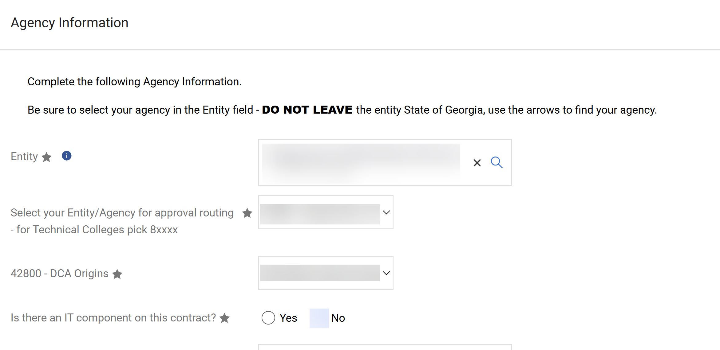
Create a Contract Request for an Exempt Contract (Part 9 of 24)
INSTRUCTIONS
Select the Entity*.
Note: Always select your agency rather than the top-level State of Georgia.
Select your Entity/Agency for approval routing*.
Note: Use the magnifying glass to search. If your organization has chosen to route contract requests by origin follow Step 26, otherwise continue to Step 27.
Select the entity Origins*.
Select Is there an IT Component on this contract?.
24
25
26
27

Slide 11
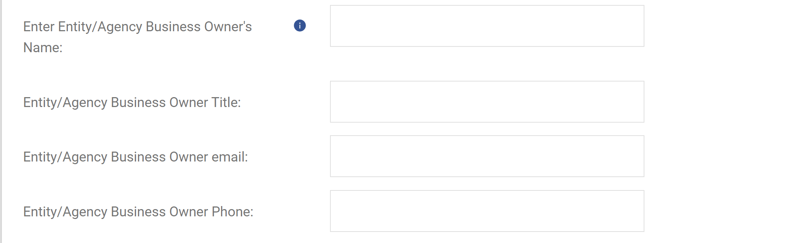
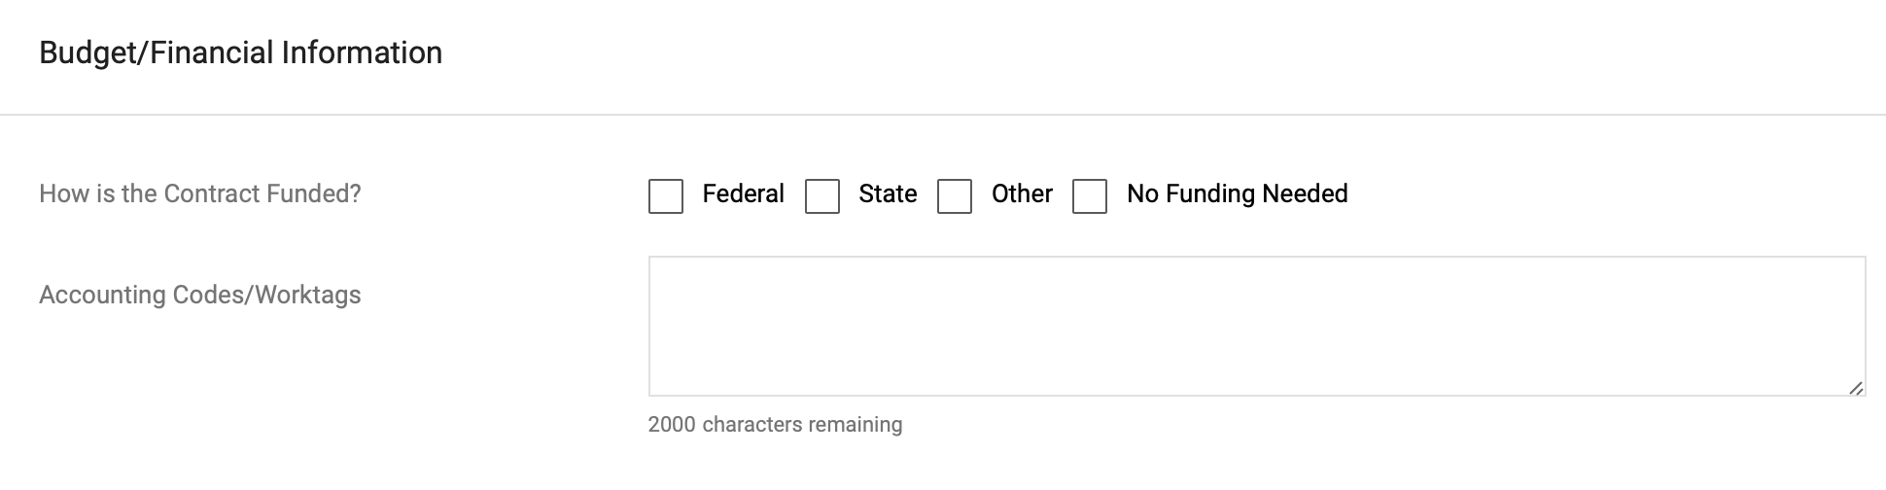
Create a Contract Request for an Exempt Contract (Part 10 of 24)
INSTRUCTIONS
Enter Entity/Agency Business Owner’s Name.
Enter Entity/Agency Business Owner Title.
Enter Entity/Agency Business Owner email.
Enter Entity/Agency Business Owner Phone.
28
29
30
31
Select How is the Contract Funded?.
Note: Multiple funding options can be selected. If selecting Federal, follow Steps 33 – 35, if selecting State follow Steps 36 – 39, and if selecting Other, follow Steps 40 – 42. If selecting No Funding Needed, skip to Step 43.

Slide 12
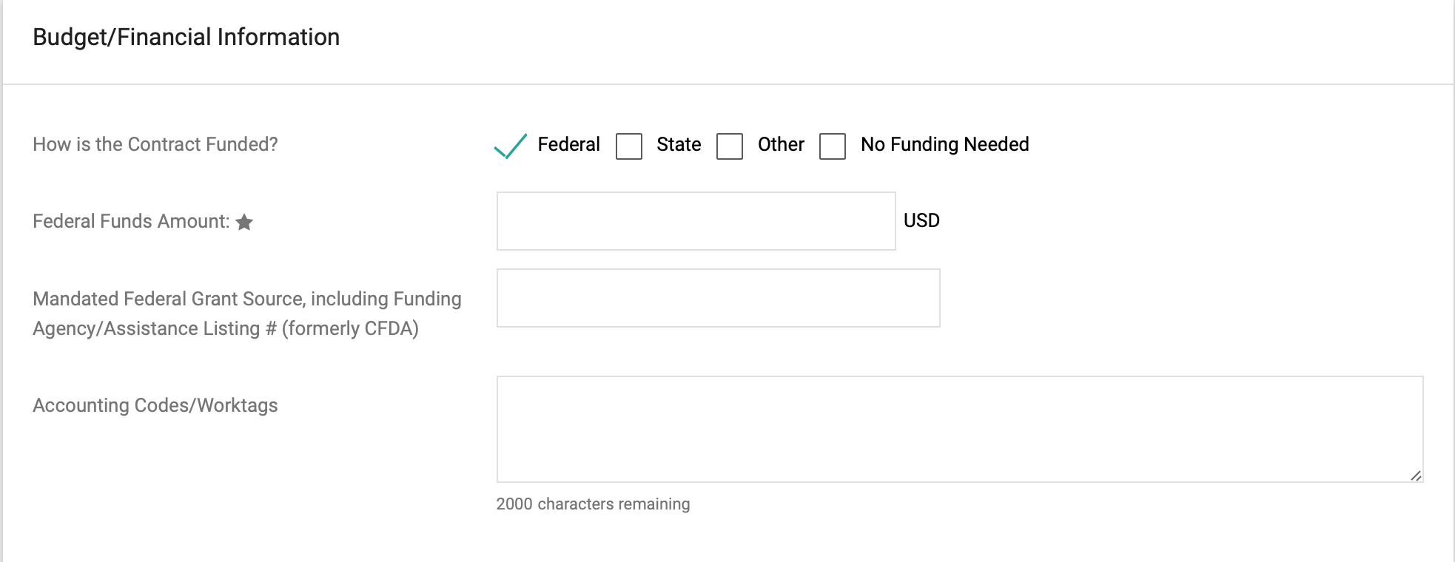
Create a Contract Request for an Exempt Contract (Part 11 of 24)
INSTRUCTIONS
If selecting Federal, enter Federal Funds Amount*.
Enter Mandated Federal Grant Source, including Funding Agency/Assistance Listing # (formerly CFDA) (optional).
Enter Accounting Codes/Worktags (optional).
33
34
35

Slide 13
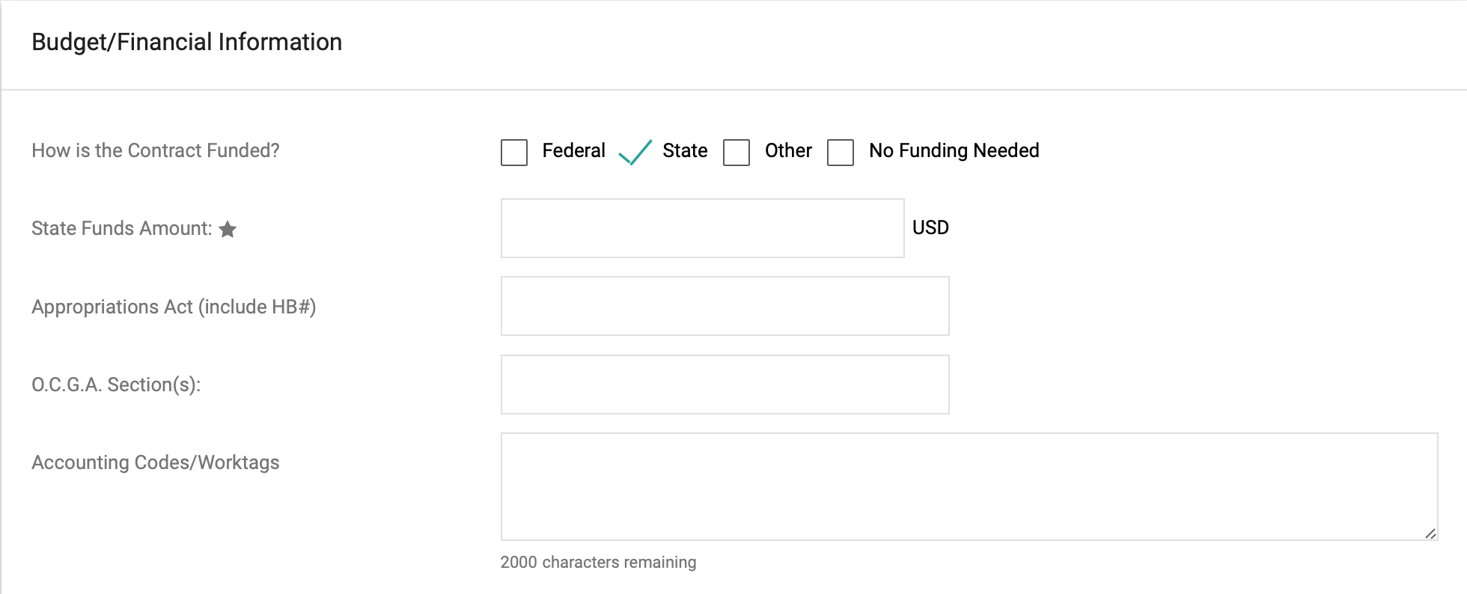
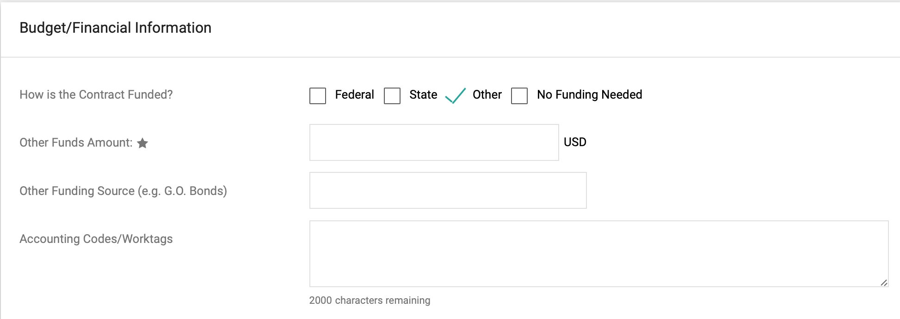
Create a Contract Request for an Exempt Contract (Part 12 of 24)
INSTRUCTIONS
If selecting State, enter State Funds Amount*.
Enter Appropriations Act (include HB#) (optional).
Enter O.C.G.A Section(s) (optional).
Enter Accounting Codes/Worktags (optional).
36
37
38
39
If selecting Other, enter Other Funds Amount*.
Enter Other Funding Source (e.g. G.O. Bonds) (optional).
Enter Accounting Codes/Worktags (optional).
40
41
42

Slide 14
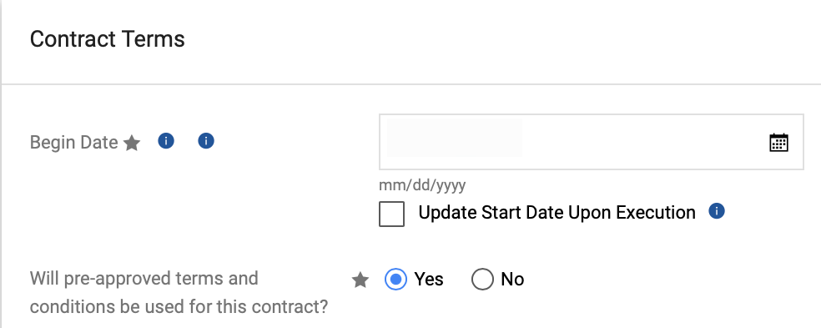
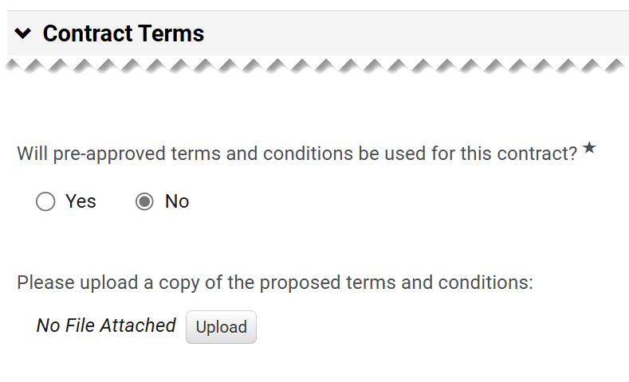
Create a Contract Request for an Exempt Contract (Part 13 of 24)
INSTRUCTIONS
Verify the Begin Date*.
Select an option for Will pre-approved terms and conditions be used for this contract?*.
Note: If Yes is selected, skip to Step 51. If answer is No, continue to Step 45.
43
44
Click Upload under Please upload a copy of the proposed terms and conditions.

Slide 15
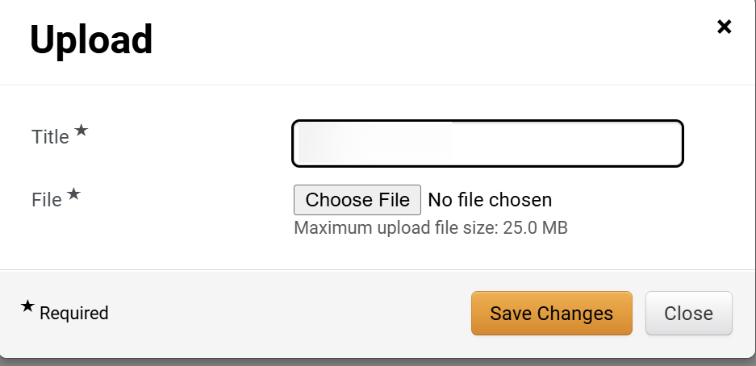
Create a Contract Request for an Exempt Contract (Part 14 of 24)
INSTRUCTIONS
Enter the Title*.
Click Chose File.
46
47
Select File from local computer.
Click Open.
48
49

Slide 16
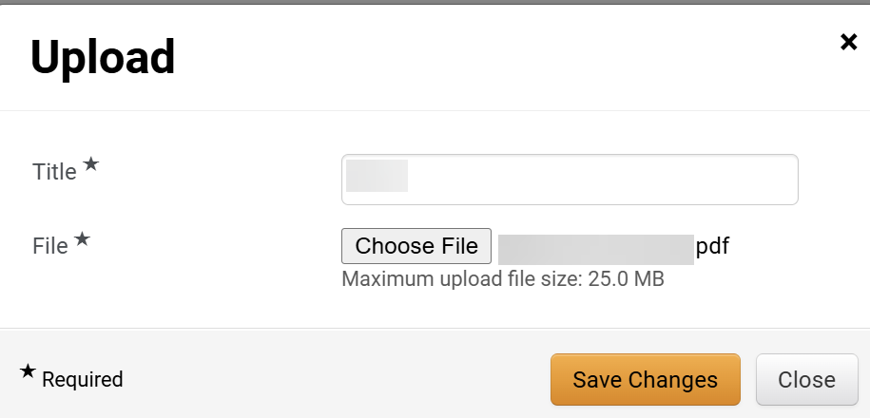
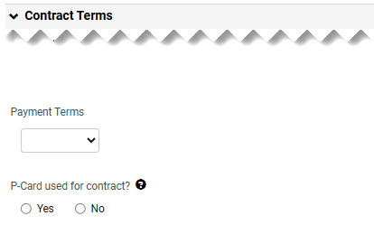
Create a Contract Request for an Exempt Contract (Part 15 of 24)
INSTRUCTIONS
Click Save Changes.
Select the Payment Terms.
Select if P-Card used for contract?.
51
52

Slide 17
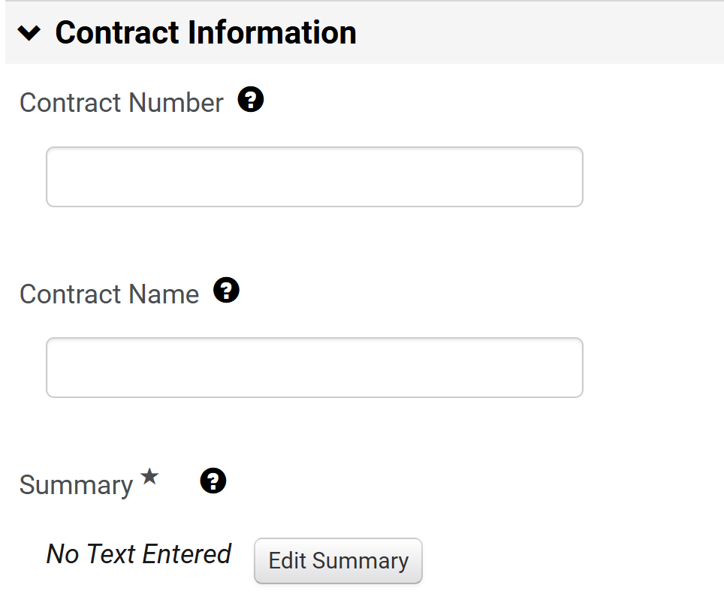
Create a Contract Request for an Exempt Contract (Part 16 of 24)
INSTRUCTIONS
Enter the Contract Number, if available.
Enter the Contract Name, if available.
Note: Step 53 - Step 54 are not required for a new contract, your organization may choose to number and name the contract at time of contract creation.
Click Edit Summary.
53
54
55

Slide 18
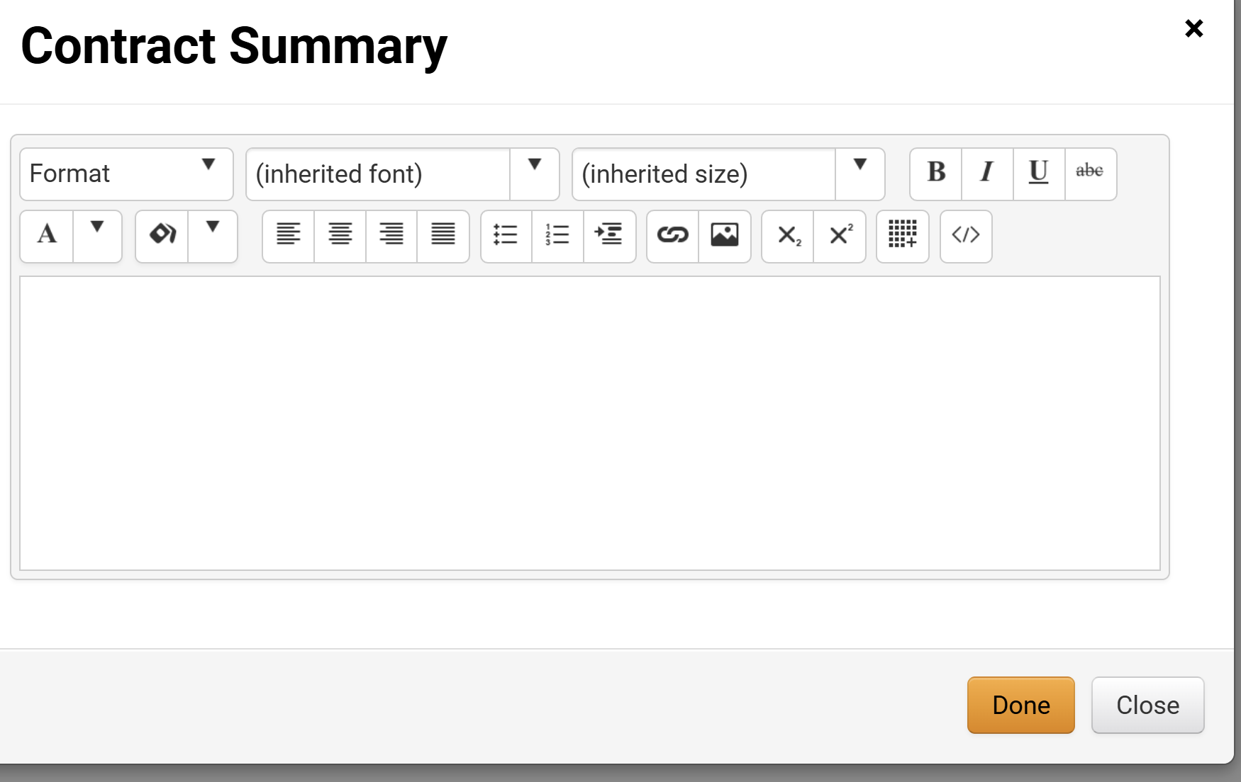
Create a Contract Request for an Exempt Contract (Part 17 of 24)
INSTRUCTIONS
Enter the Contract Summary.
Click Done.
56
57

Slide 19
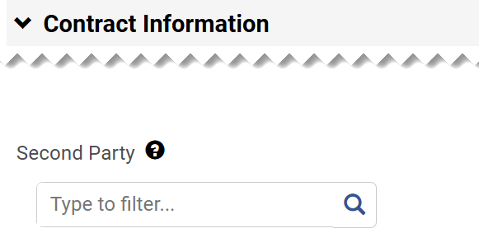
Create a Contract Request for an Exempt Contract (Part 18 of 24)
INSTRUCTIONS
Enter or search Second Party.
Note: To search for a Second Party, click on the Magnifying Glass.

Slide 20
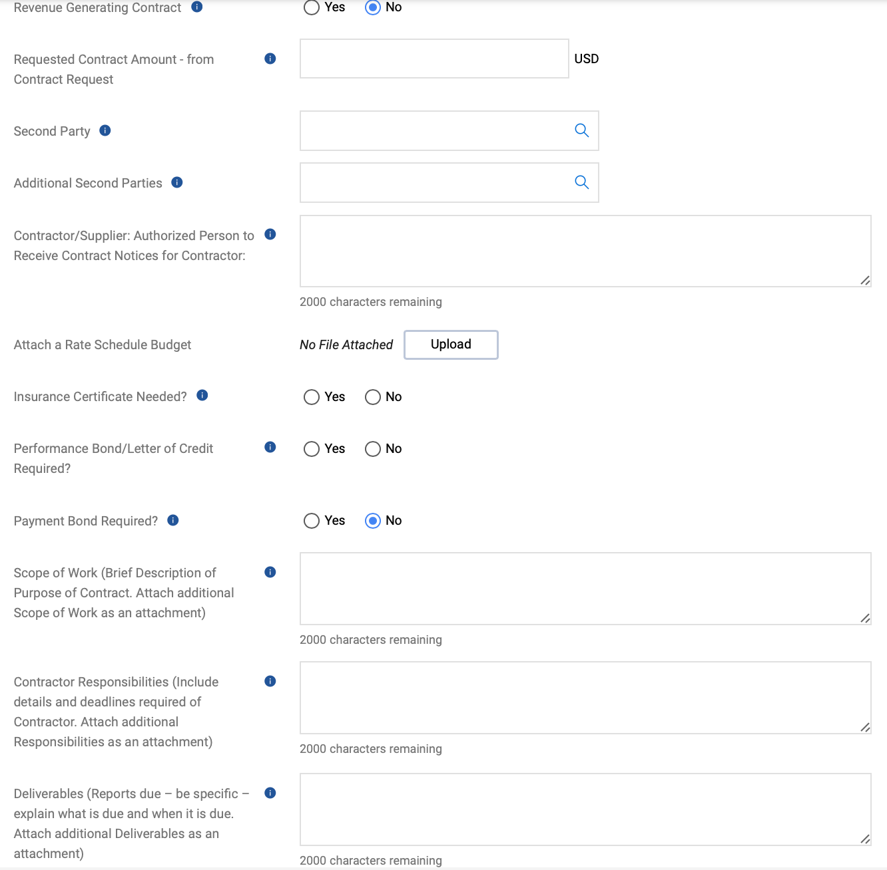
Create a Contract Request for an Exempt Contract (Part 19 of 24)
INSTRUCTIONS
Complete relevant fields for Contract Information (optional).
Note: On an exempt contract, the Second Party will usually be entered. Otherwise proceed to Step 60.

Slide 21
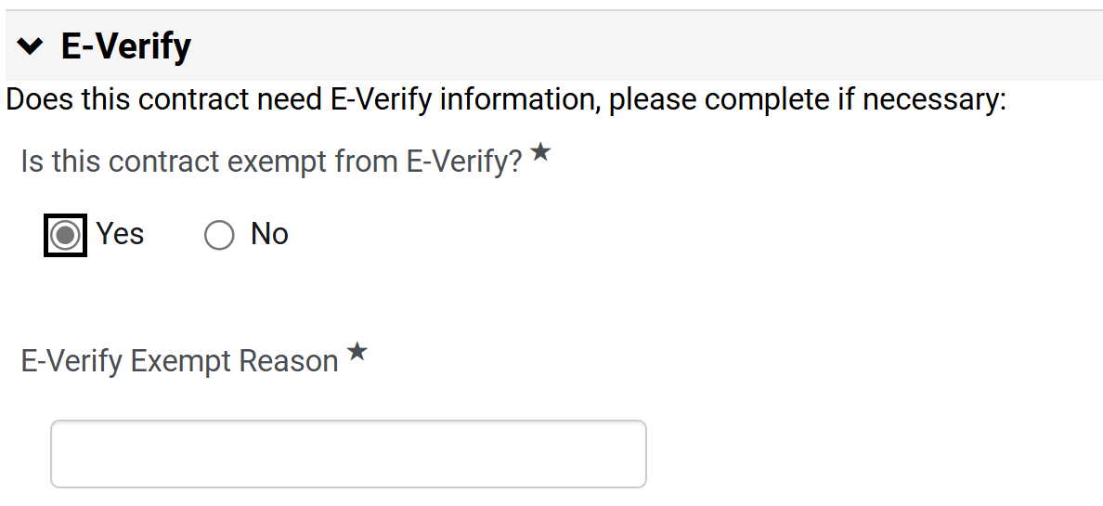
Create a Contract Request for an Exempt Contract (Part 20 of 24)
INSTRUCTIONS
Select an option for Is this company exempt from e-Verity?*.
Note: If Yes is selected, continue to Step 61 and skip to Step 64. If No is selected, skip to Step 62.
If Yes, enter the E-Verify Exempt Reason*.
Note: Skip to Step 64 to continue to Sub-recipient or Vendor/Contractor.
60
61

Slide 22
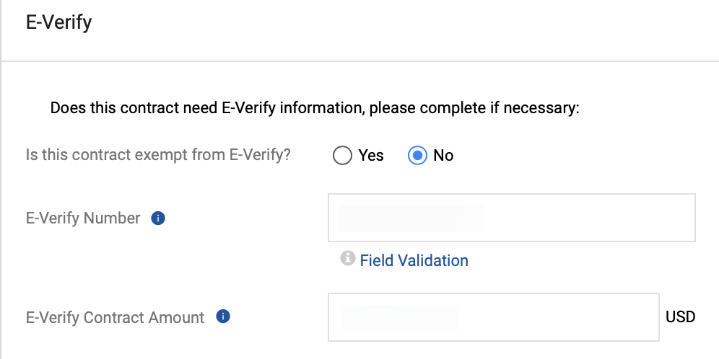
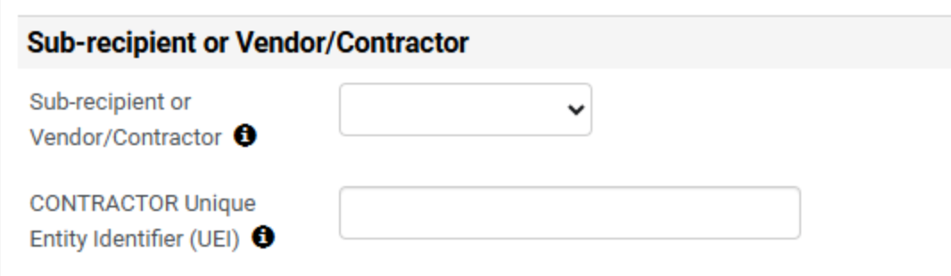
Create a Contract Request for an Exempt Contract (Part 21 of 24)
INSTRUCTIONS
If No is selected, enter the E-Verify Contract Amount.
Enter an E-Verify Number.
62
63
Select Sub-recipient or Vendor/Contractor.
Note: The default selection is Vendor/Contractor.
Enter CONTRACTOR Unique Entity Identifier (UEI).
64
65

Slide 23
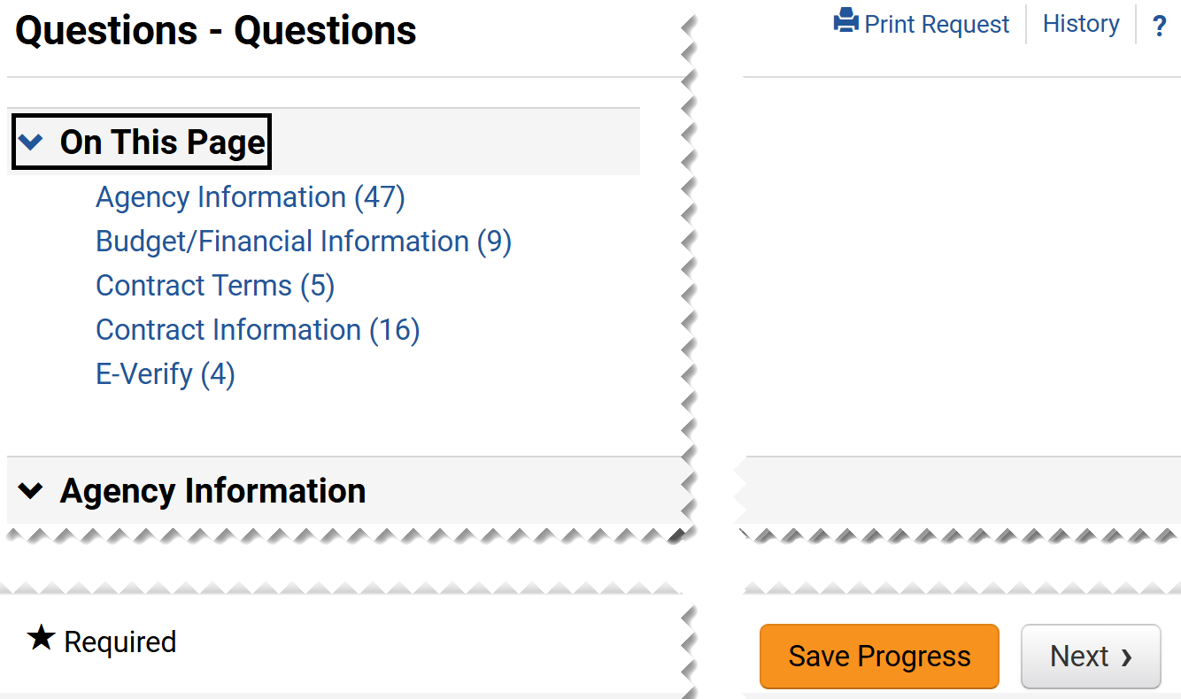
Create a Contract Request for an Exempt Contract (Part 22 of 24)
INSTRUCTIONS
Click Next.
Note: It is possible to Save Progress and exit the contract request and complete the information later.

Slide 24
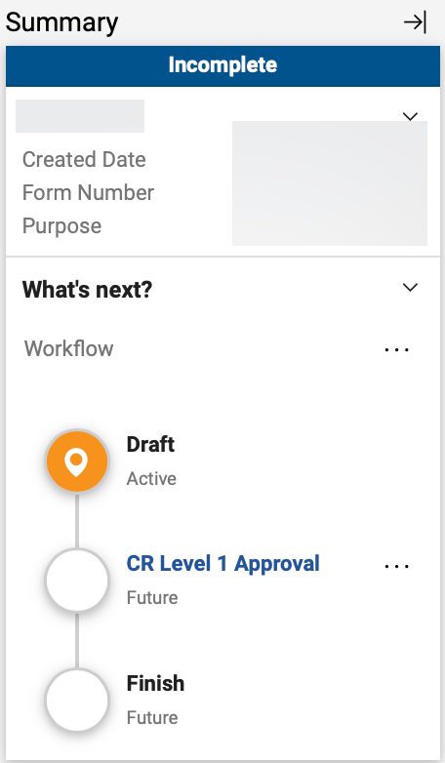
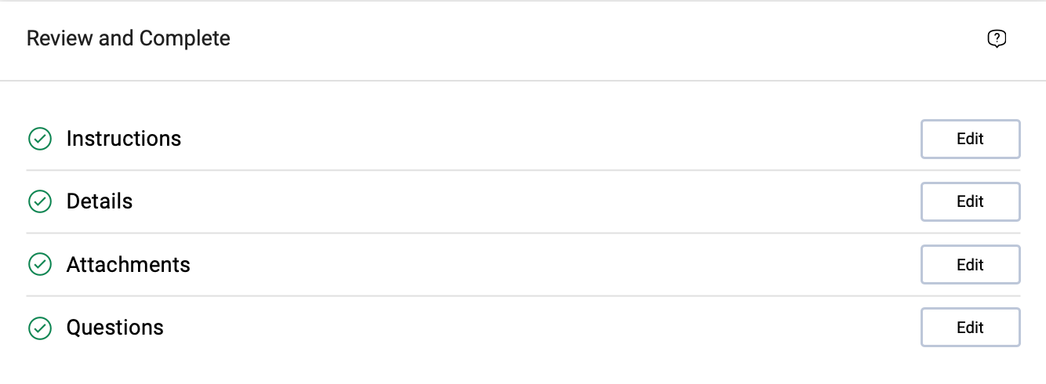
Create a Contract Request for an Exempt Contract (Part 23 of 24)
INSTRUCTIONS
Review Summary to review the approvals.
Note: The approval levels are based on the Entity and Origins selected in the Agency Information.
Review Review and Complete section.
Note: Click Edit if changes need to be made.

Slide 25
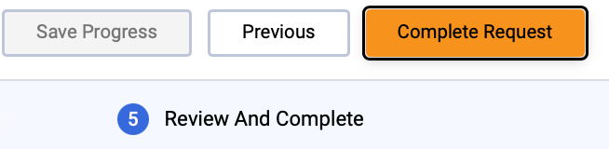
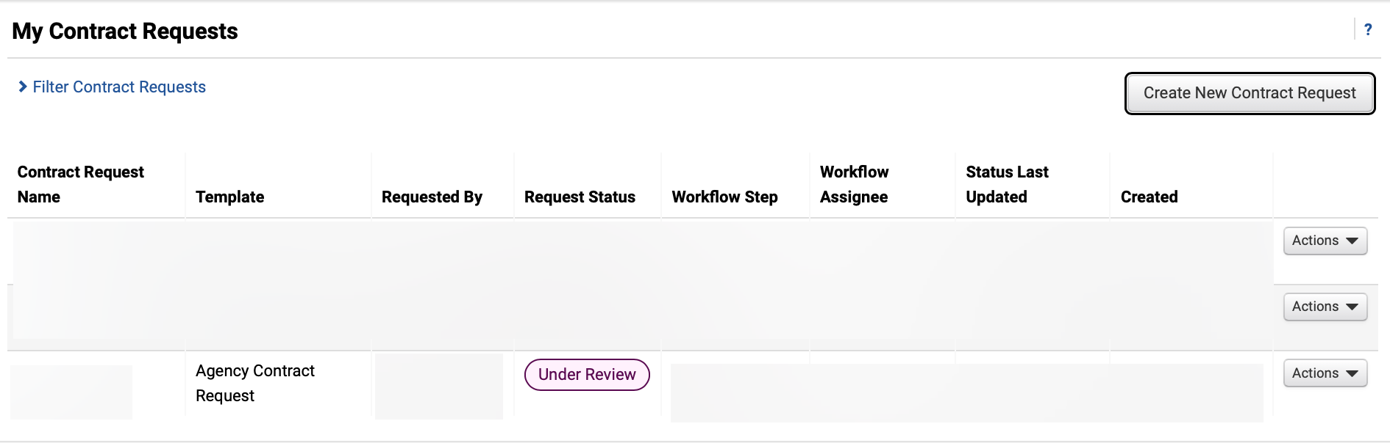

Create a Contract Request for an Exempt Contract (Part 24 of 24)
INSTRUCTIONS
Click Complete Request to complete the Contract Request.
Review Request Status for the completed Contract Request.
You have successfully submitted contract request for an exempt contract.

