Slide 1
Create a Contract Request for an Amendment
DESCRIPTION
This guide will show Contract Requesters how to create a contract request for an amendment via the contract request process.
OVERVIEW
The key steps in the process are below:
Access the Contracts module.
Click Requests, then click Request Contract.
Complete amendment required fields.
Click Complete Request.
Business Process:
Access Contracts Module
Create Request
Fill Out Information
Contract Amendment Request is Submitted

Slide 2


Create a Contract Request for an Amendment (Part 1 of 21)
INSTRUCTIONS
Click the Global Navigation Menu.
Note: University System of Georgia (USG) users complete local logon and then proceed to Step 4.
Click Sourcing, Contracts & Supplier Management.

Slide 3

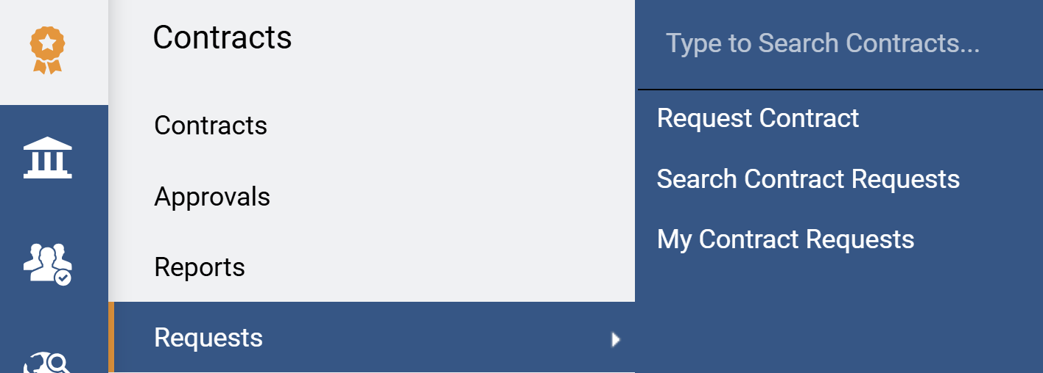
Create a Contract Request for an Amendment (Part 2 of 21)
INSTRUCTIONS
Click Sign On.
Note: The system utilizes Single Sign-On (SSO) capabilities and no log in information is required.
Access the Contracts module.
Select Requests.
Select Request Contract.
4
6
5

Slide 4
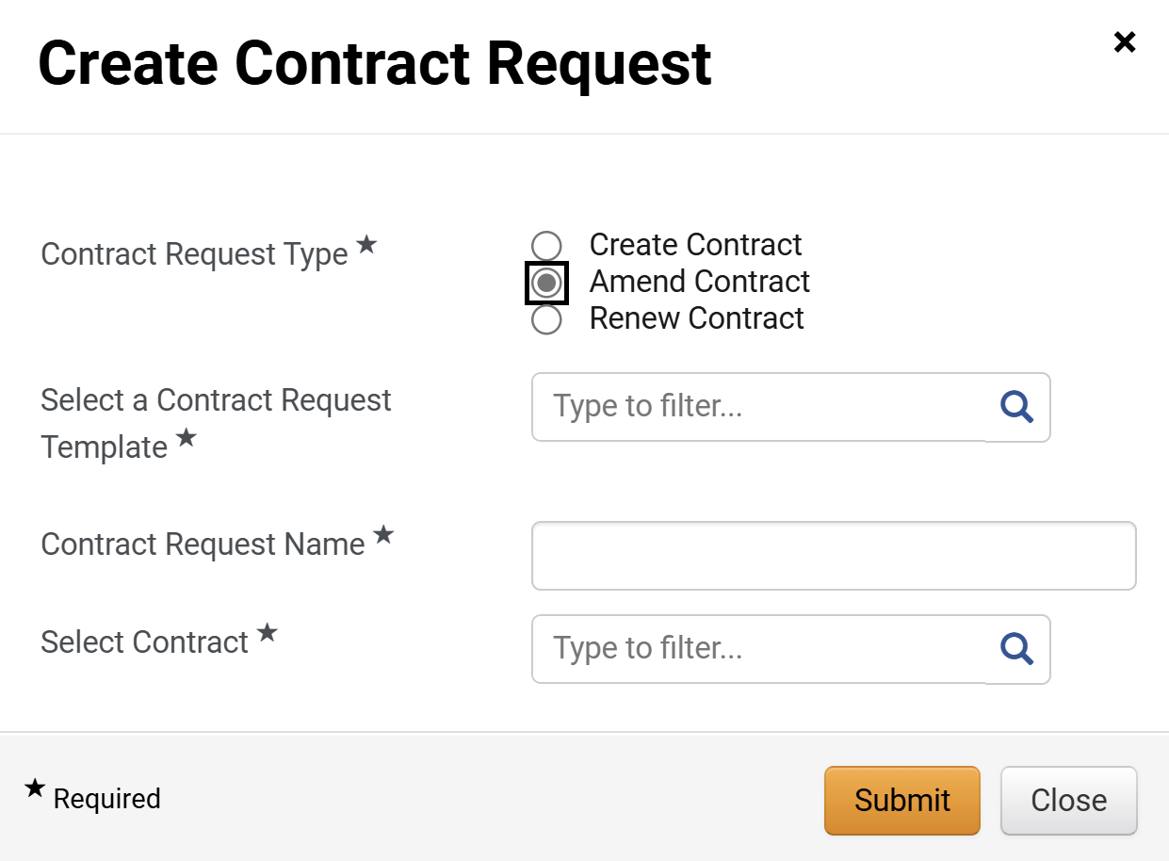
Create a Contract Request for an Amendment (Part 3 of 21)
INSTRUCTIONS
Select Amend Contract as the Contract Request Type*.
Note: Complete all required fields marked with a black star*.
Select the Contract Request Template*.
Enter a Contract Request Name*.
Type or search to Select Contract*.
Note: Use the magnifying glass to search. Search the contact by the contract name keywords to reduce the number of results displayed.
Click Submit.
7
8
9
10
11

Slide 5
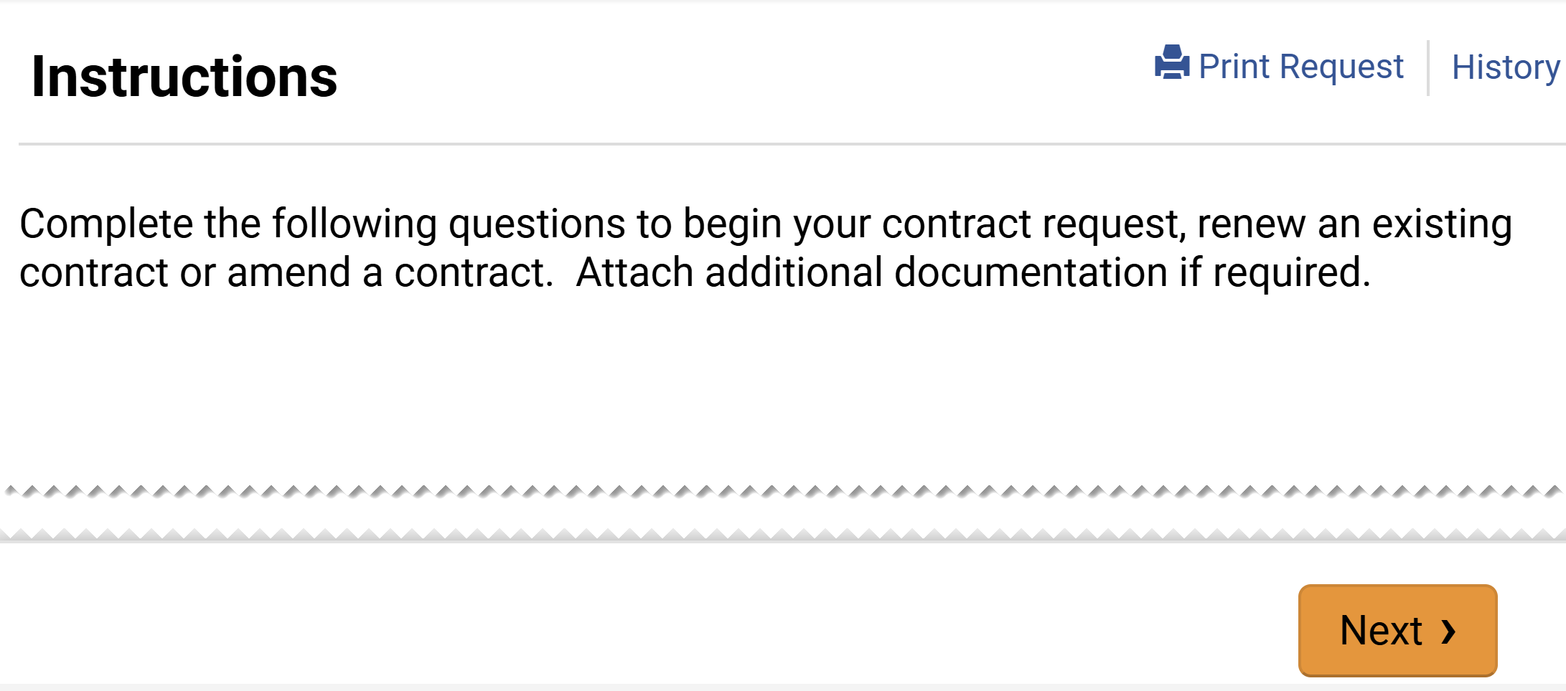
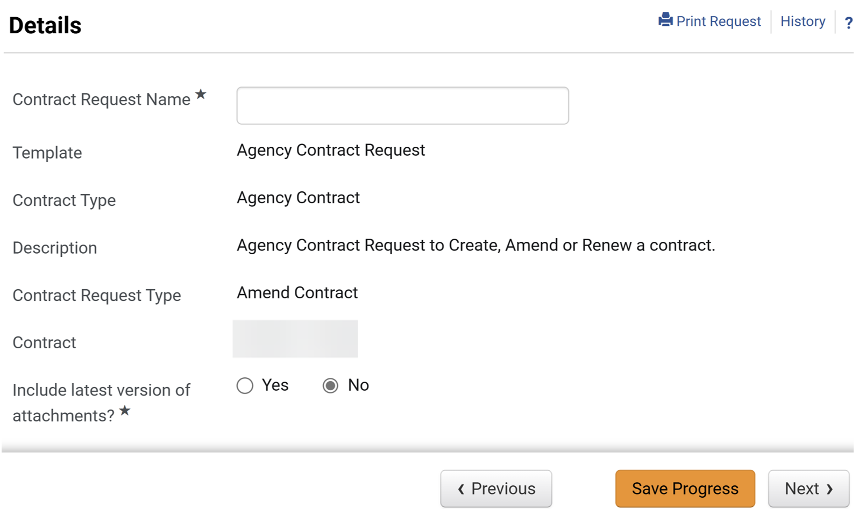
Create a Contract Request for an Amendment (Part 4 of 21)
INSTRUCTIONS
Click Next.
Select Include latest version of attachments?*.
Click Next.
Note: All fields are read-only based on previous selection, except for Contract Request Name*.
13
14

Slide 6
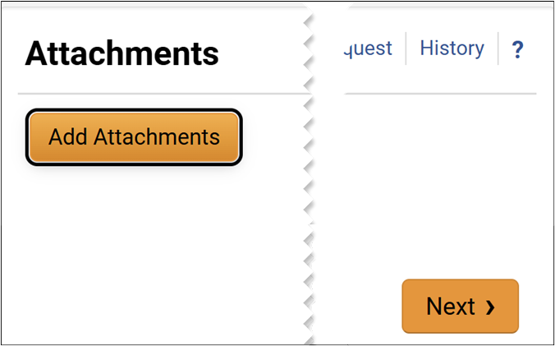
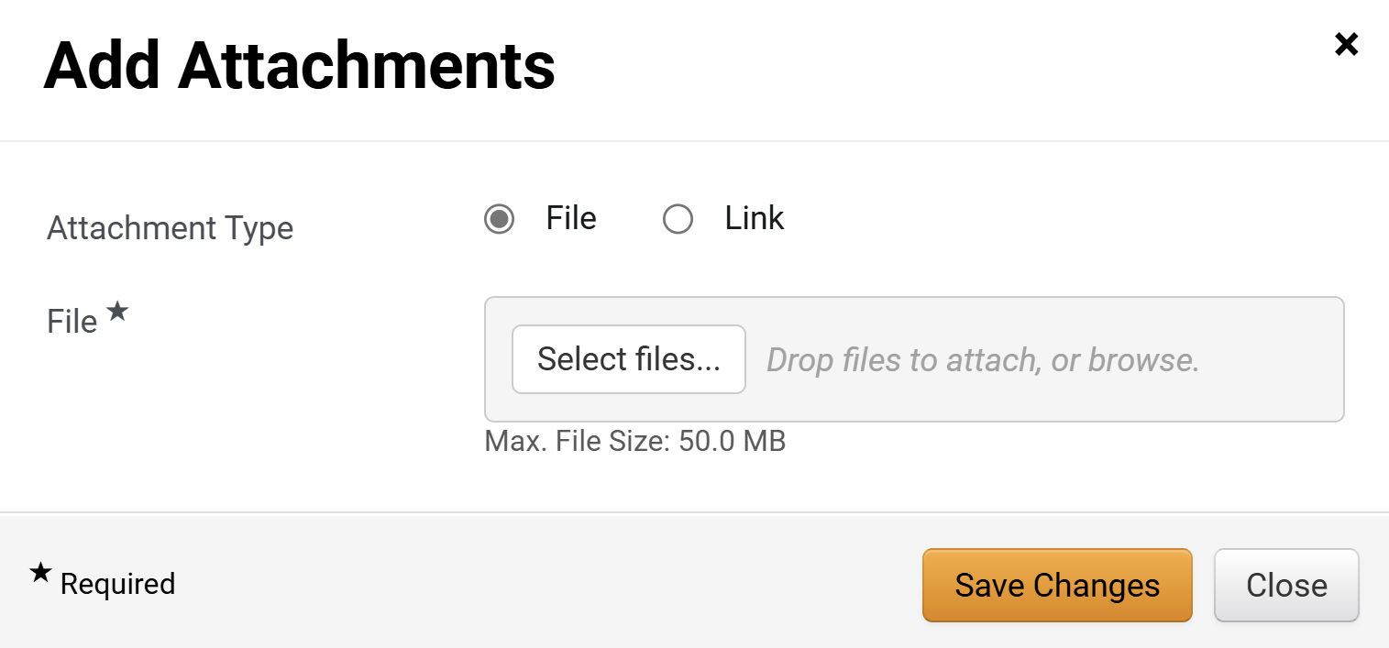
Create a Contract Request for an Amendment (Part 5 of 21)
INSTRUCTIONS
Click Add Attachments.
Note: Following your organization's guidance, upload any files relevant to the contract request such as a scope of work or supplier quote. If no Files or URLs to add, then click Next and skip to step 25.
15
Select Attachment Type as File.
Note: If Attachment Type is Link skip to step 21.
Click Select Files… to include a file.
16
17

Slide 7

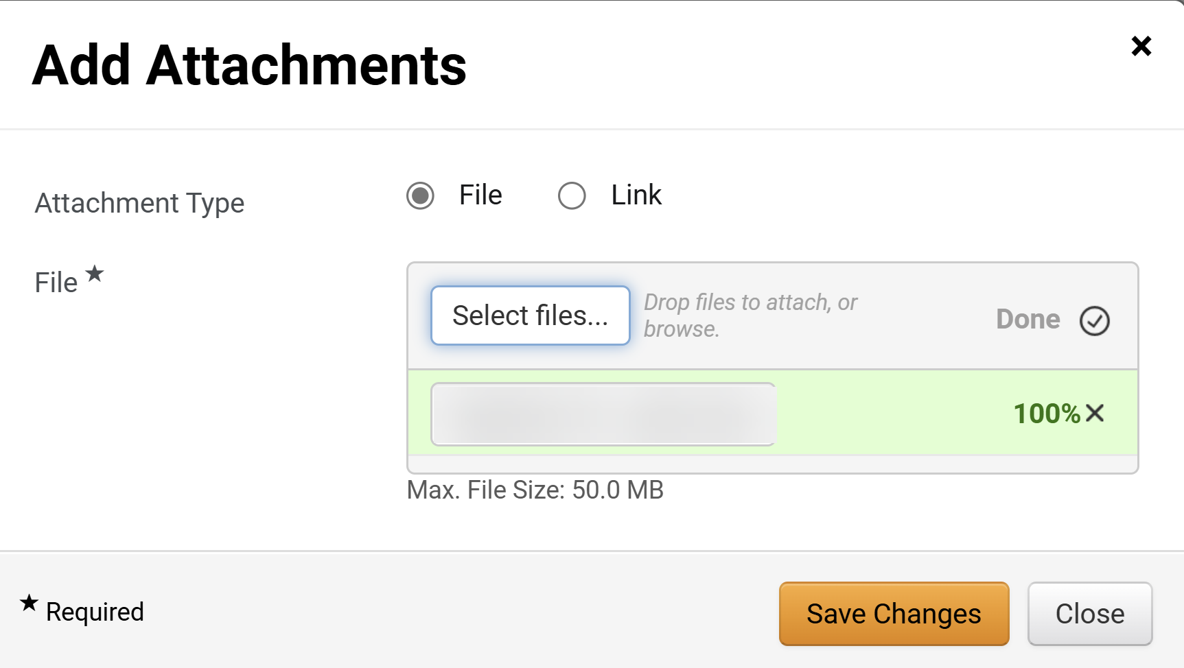
Create a Contract Request for an Amendment (Part 6 of 21)
INSTRUCTIONS
Select a file from your local computer.
Click Open.
18
19
Click Save Changes.
Note: If no Attachments as Link skip to step 25.

Slide 8
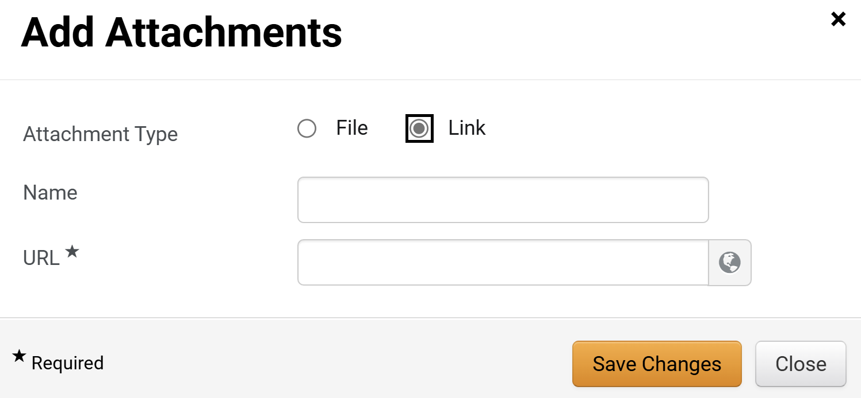
Create a Contract Request for an Amendment (Part 7 of 21)
INSTRUCTIONS
Select Attachment Type as File.
Enter a Name.
Enter the URL*.
Click Save Changes.
21
22
23
24

Slide 9
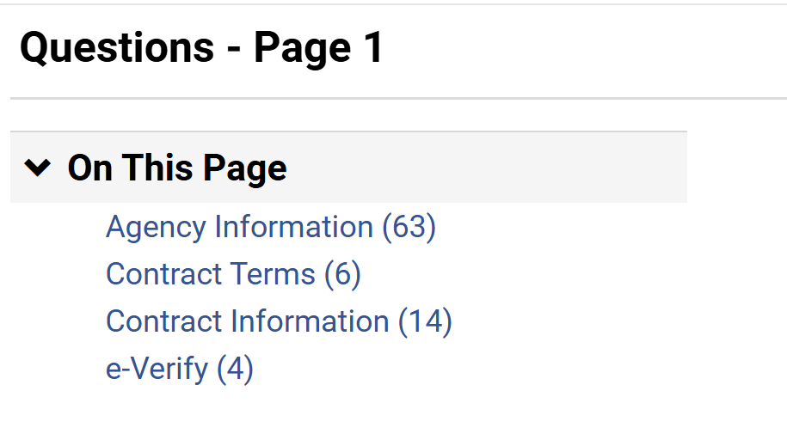
Create a Contract Request for an Amendment (Part 8 of 21)
INSTRUCTIONS
Click Agency Information.

Slide 10
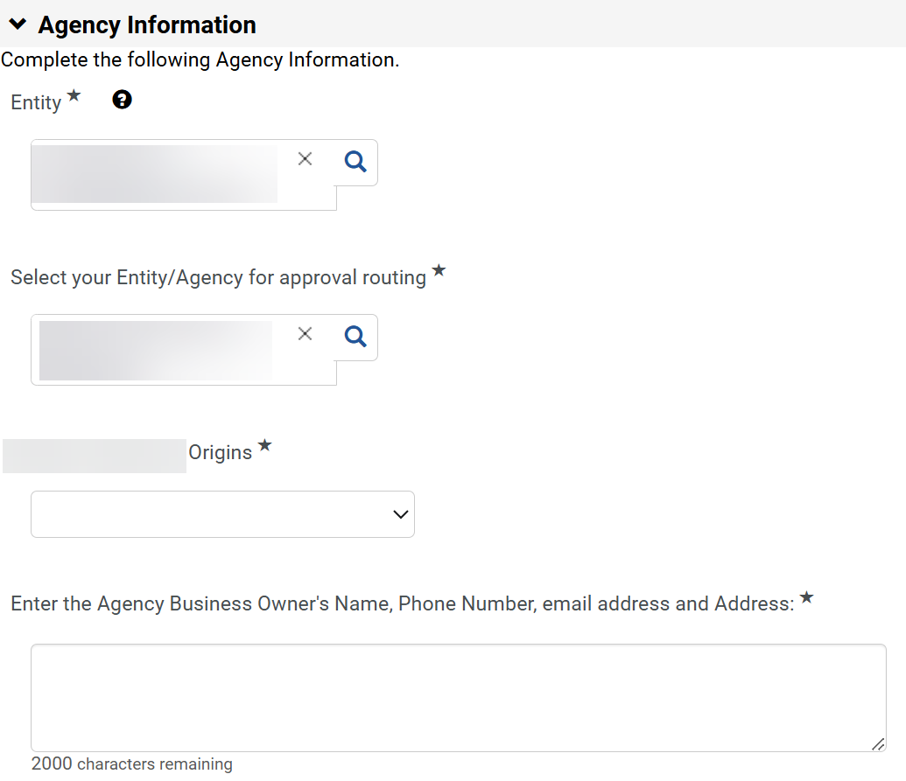
Create a Contract Request for an Amendment (Part 9 of 21)
INSTRUCTIONS
Select the Entity*.
Note: The Entity should be your entity/agency not the State of Georgia.
Select the Entity/Agency for approval routing*.
Note: Use the magnifying glass to search.
Enter or search for the entity Origins*.
Note: Origins might only be applicable to certain Entities.
Next, Enter the Agency Business Owner's Name, Phone Number, email address and Address:*.
Note: Agency Information would have information auto populated based on the contract selected. Also, the selected Entity/Agency and Origins* will determine the request workflow.
26
27
28
29

Slide 11
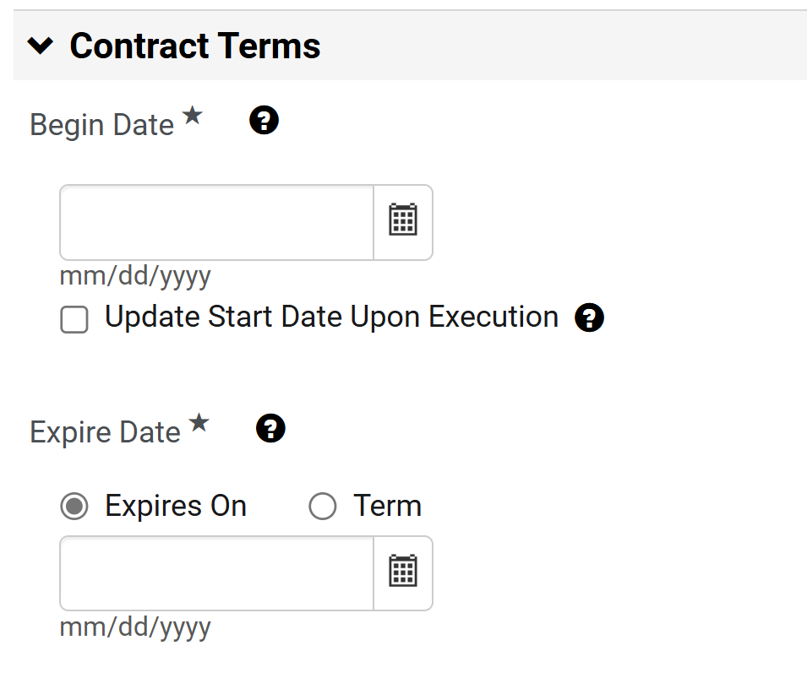
Create a Contract Request for an Amendment (Part 10 of 21)
INSTRUCTIONS
Select the Begin Date*.
Note: For Expire Date* if Expires On is selected, continue to step 31. If Term is selected, skip to step 32.
Select an Expires On date.
30
31

Slide 12
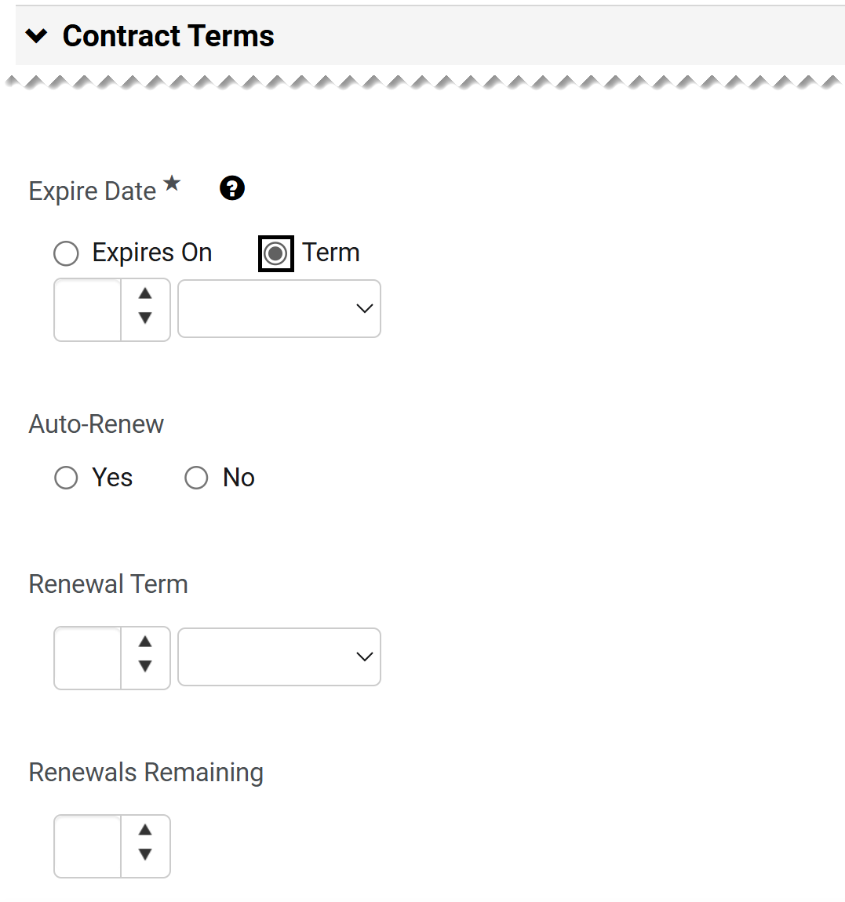
Create a Contract Request for an Amendment (Part 11 of 21)
INSTRUCTIONS
If term for Expire Date* is selected, enter the Term.
Select No for Auto-Renew, unless otherwise recommended by your agency.
Select the Renewal Term.
Select Renewals Remaining.
Note: Steps 33 through 35 are not mandatory fields, however, include the information if available.
32
33
34
35

Slide 13
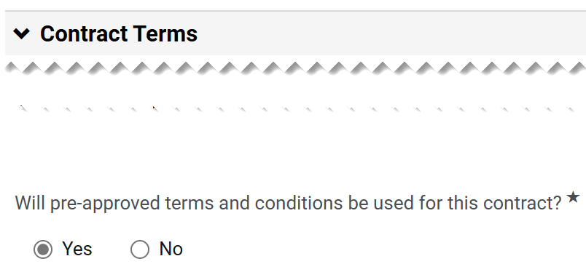
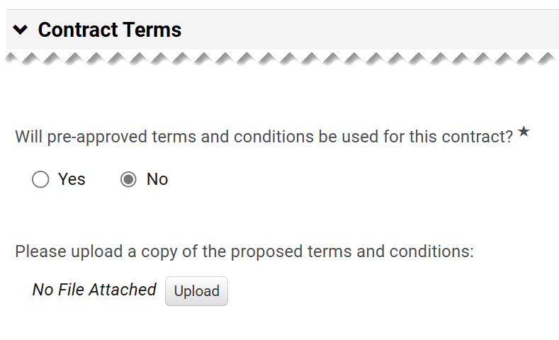
Create a Contract Request for an Amendment (Part 12 of 21)
INSTRUCTIONS
Answer Will pre-approved terms and conditions be used for this contract?*.
Note: If answer is No, continue to step 37. If Yes is selected, skip to step 43.
Click on Upload for Please upload a copy of the proposed terms and conditions.

Slide 14
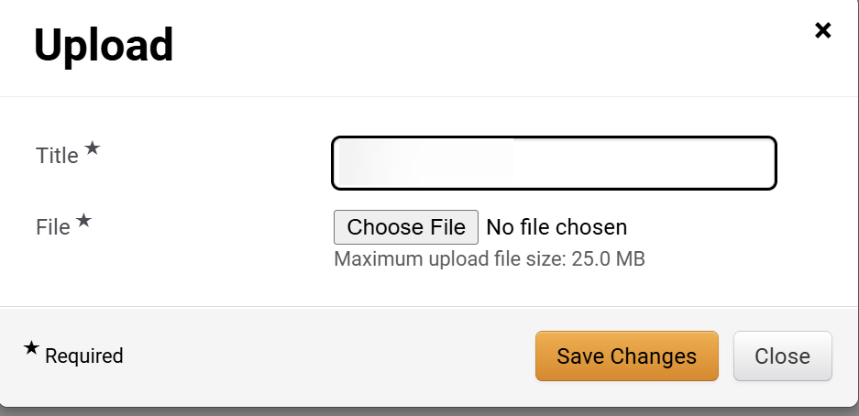
Create a Contract Request for an Amendment (Part 13 of 21)
INSTRUCTIONS
Enter the Title*.
Click Chose File.
38
39
Select a File from your local computer.
Click Open.
40
41

Slide 15
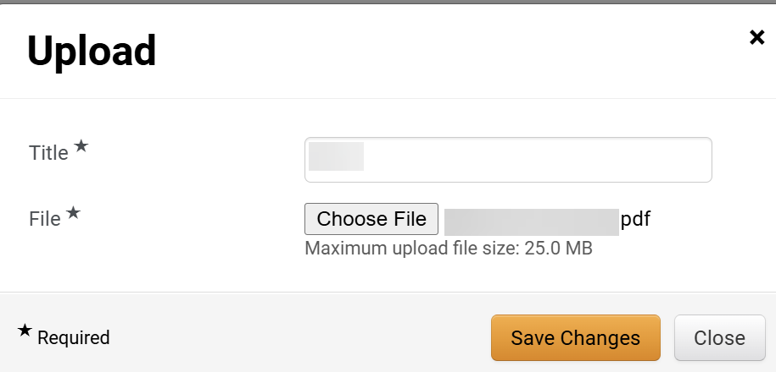
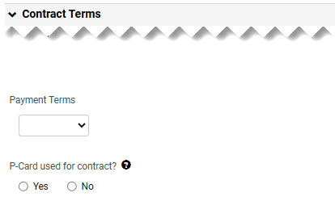
Create a Contract Request for an Amendment (Part 14 of 21)
INSTRUCTIONS
Click Save Changes.
Select the Payment Terms.
Select if P-card used for contracts?.
43
44

Slide 16
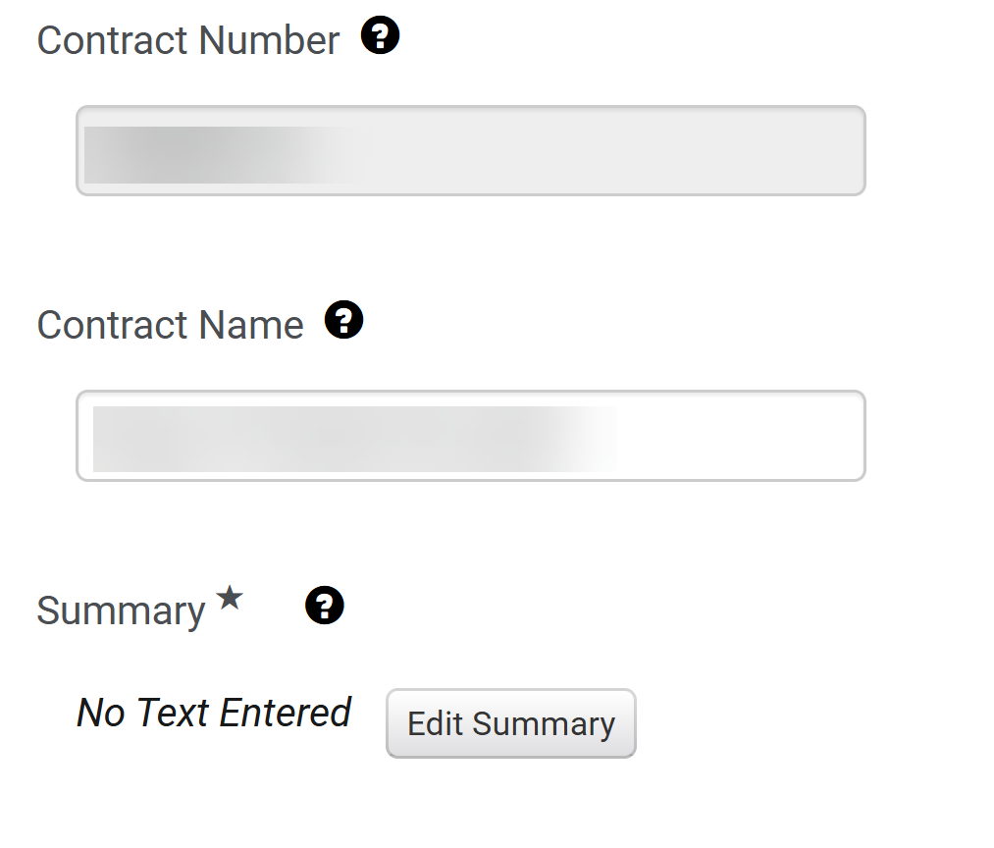
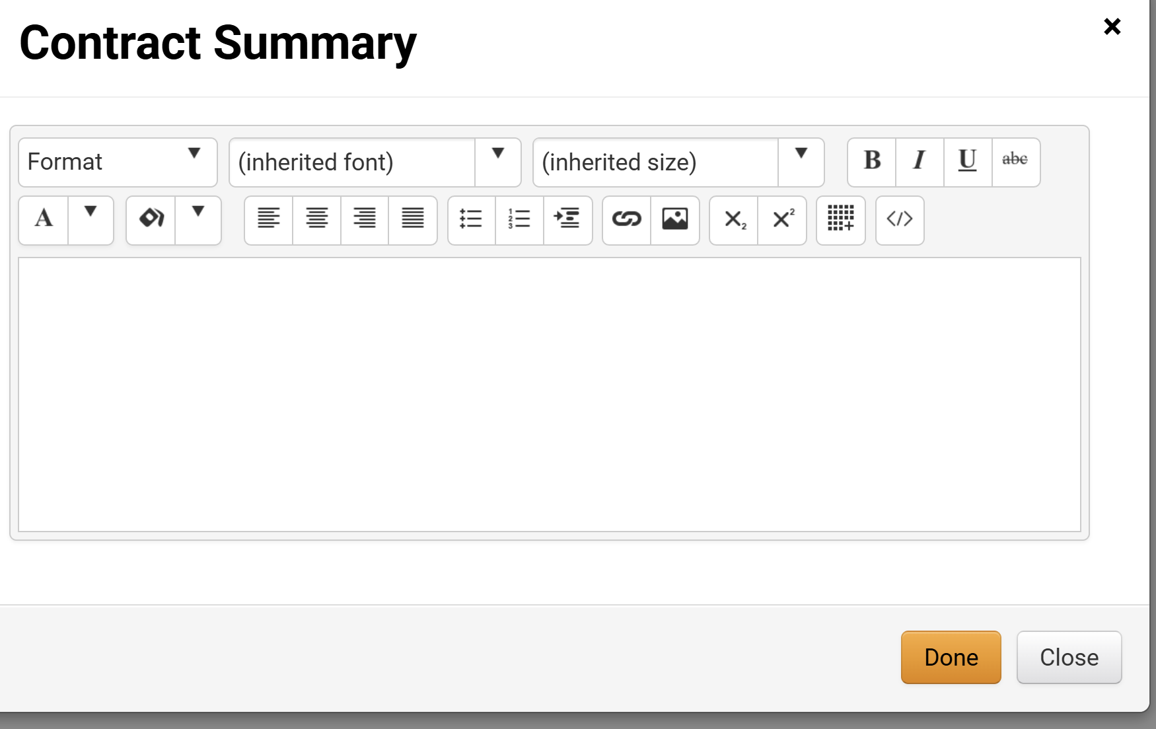
Create a Contract Request for an Amendment (Part 15 of 21)
INSTRUCTIONS
The Contract Number is read-only.
The Contract Name is auto populated.
Click Edit Summary.
45
46
47
Enter the Contract Summary, click Done.

Slide 17
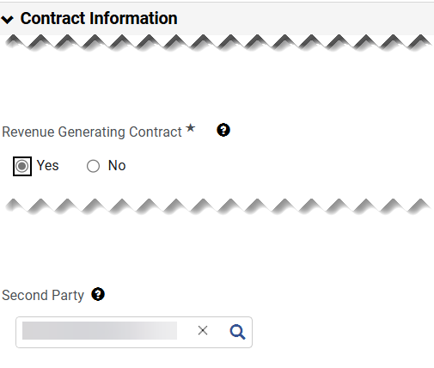
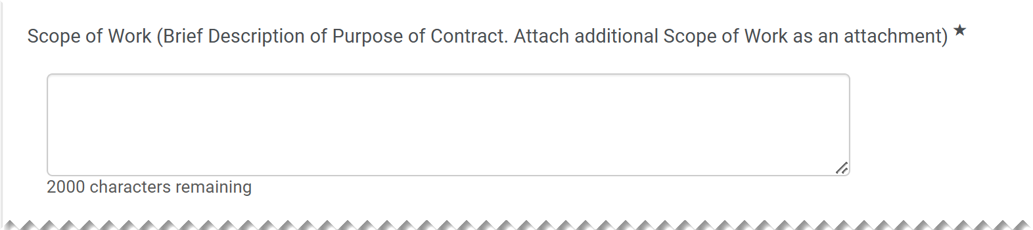
Create a Contract Request for an Amendment (Part 16 of 21)
INSTRUCTIONS
Select Revenue Generating Contract*.
The Second Party is auto populated.
49
50
Enter the Scope of Work (Brief Description of Purpose of Contract. Attach additional Scope of Work as an attachment)*.

Slide 18
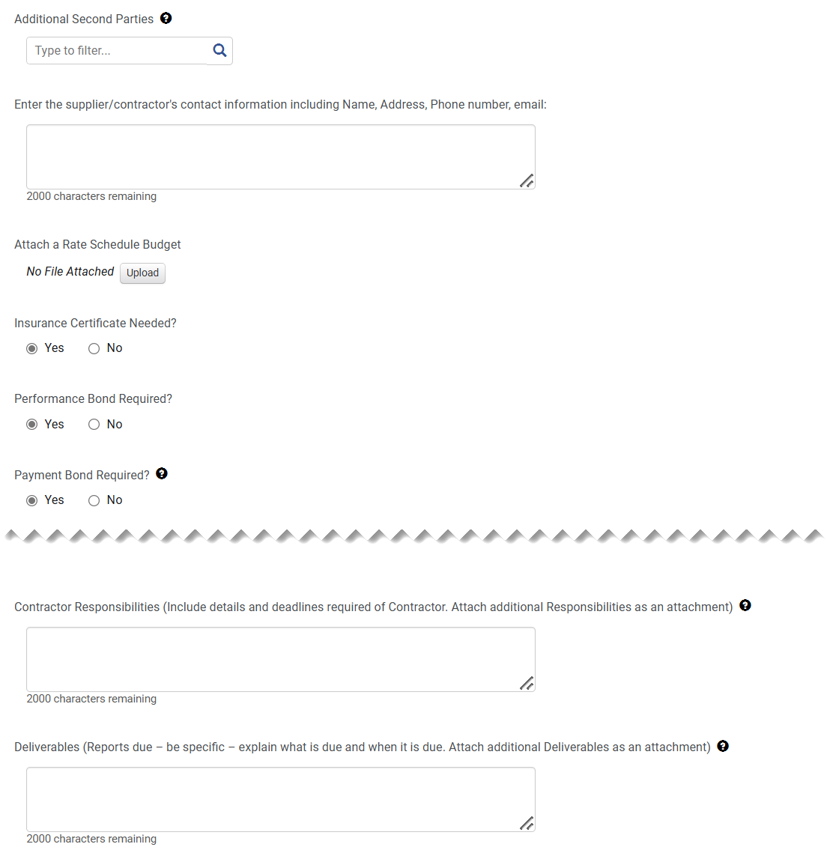
Create a Contract Request for an Amendment (Part 17 of 21)
INSTRUCTIONS
Complete relevant fields for Contract Information (optional).

Slide 19
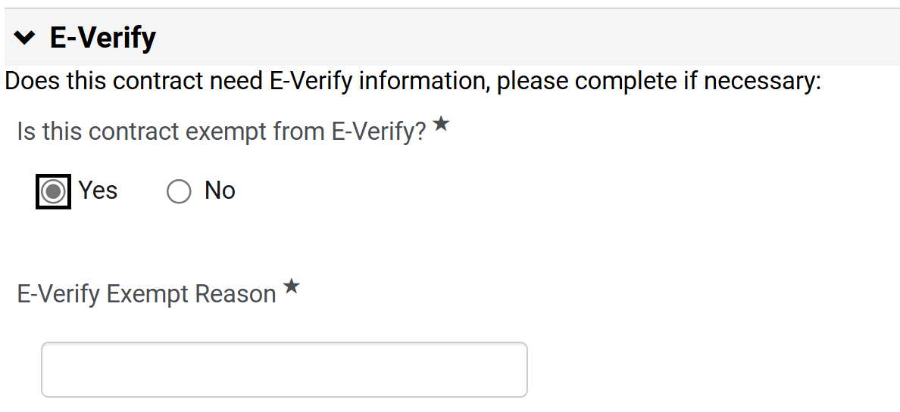
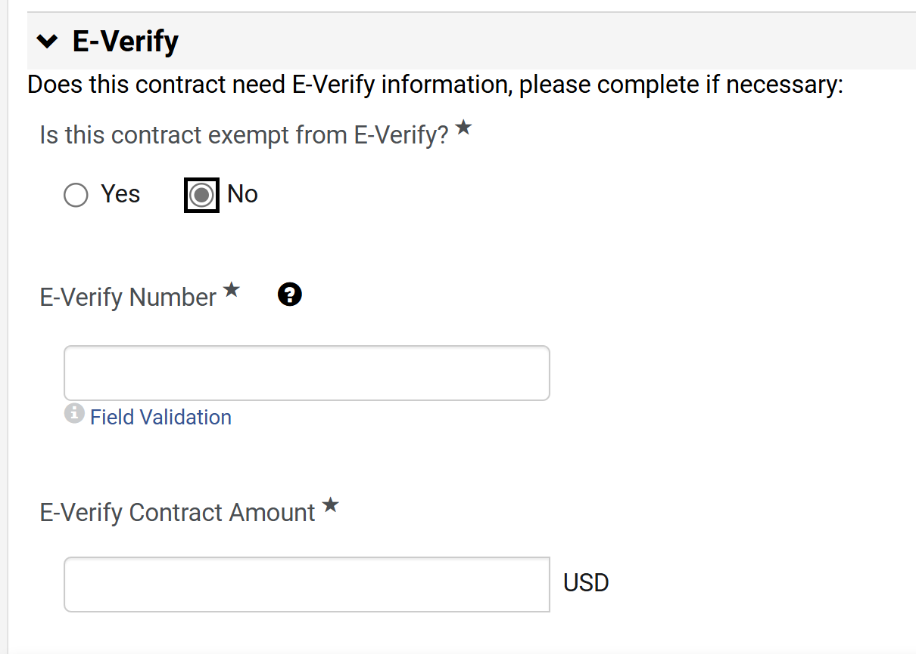
Create a Contract Request for an Amendment (Part 18 of 21)
INSTRUCTIONS
Answer Is this company exempt from e-Verity?*.
Note: The information is auto populated based on the contract. If Yes is selected, continue to step 54. If No is selected, skip to step 55.
If Yes, enter the E-Verify Exempt Reason*.
53
54
If No is selected, enter the E-Verify Number*.
Include E-Verify Contract Amount*.
55
56

Slide 20
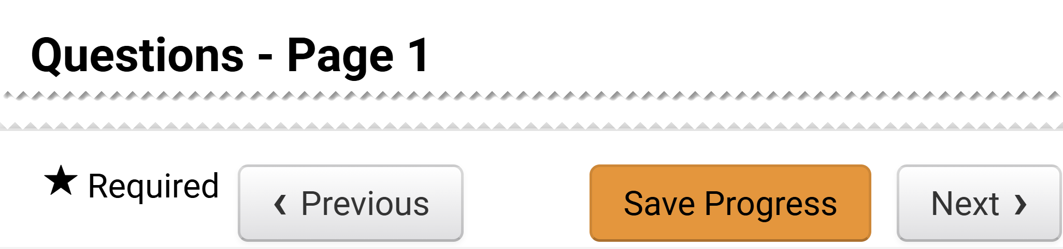
Create a Contract Request for an Amendment (Part 19 of 21)
INSTRUCTIONS
Click Next.
Note: It is possible to Save Progress and exit the contract request and complete the information later.

Slide 21
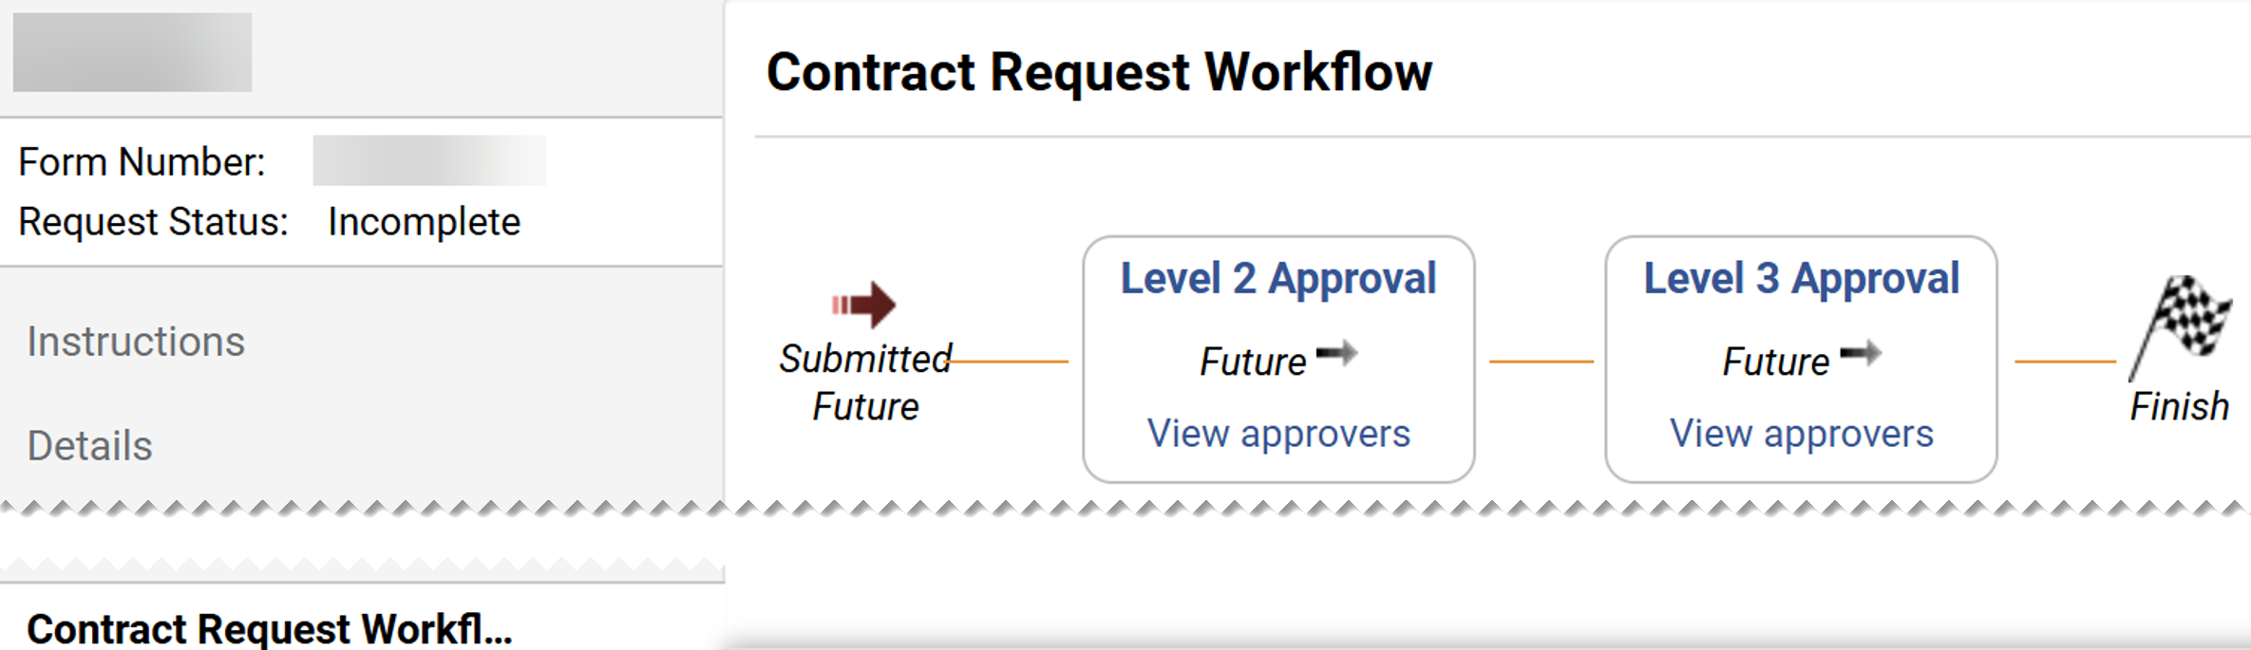
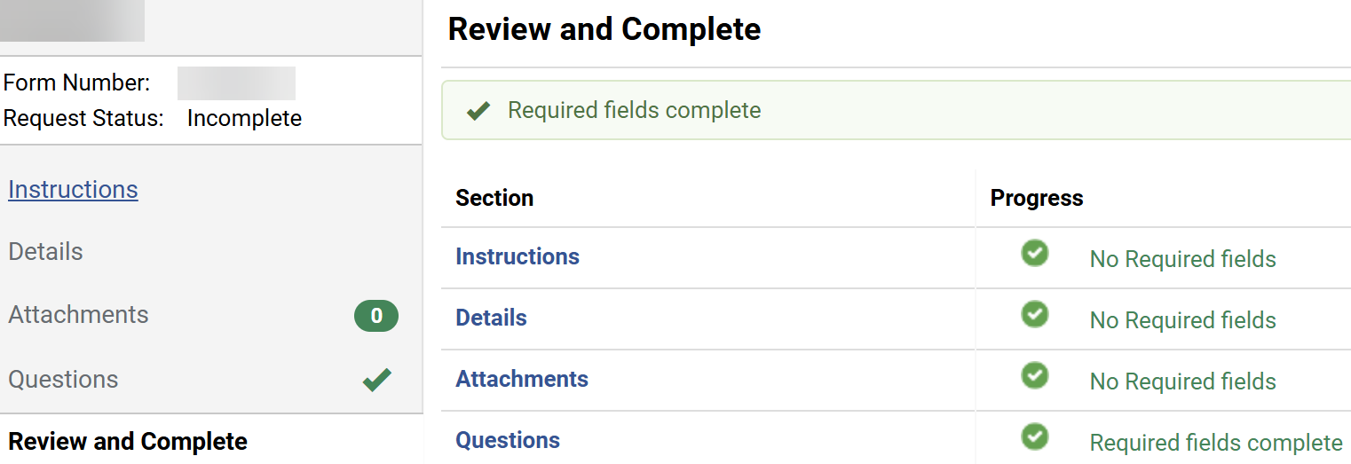
Create a Contract Request for an Amendment (Part 20 of 21)
INSTRUCTIONS
Click Contract Request Workflow to review the approvals.
Note: The approval levels are based on the Entity and Origins selected in the Agency Information. If your entity does not have approval set up by origin, the step will have the name Contract Request Approver, follow the guide Ad Hoc Approval for Contract Request.
Click Review and Complete.

Slide 22
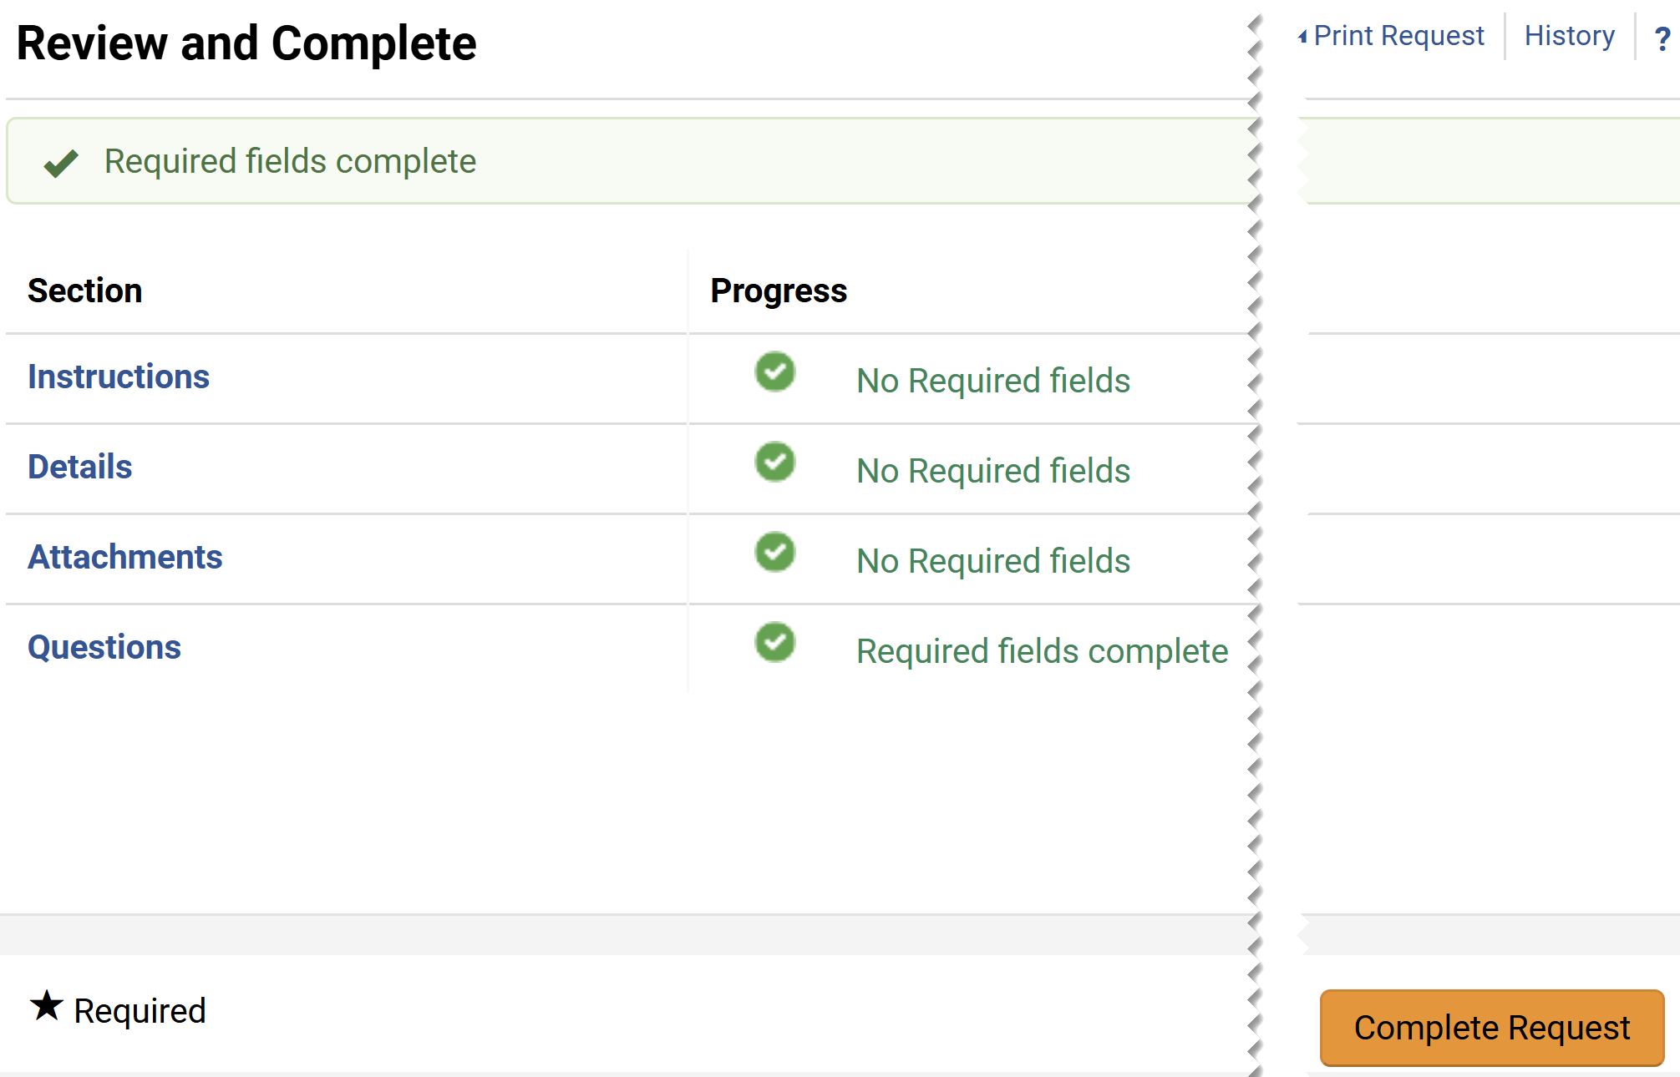
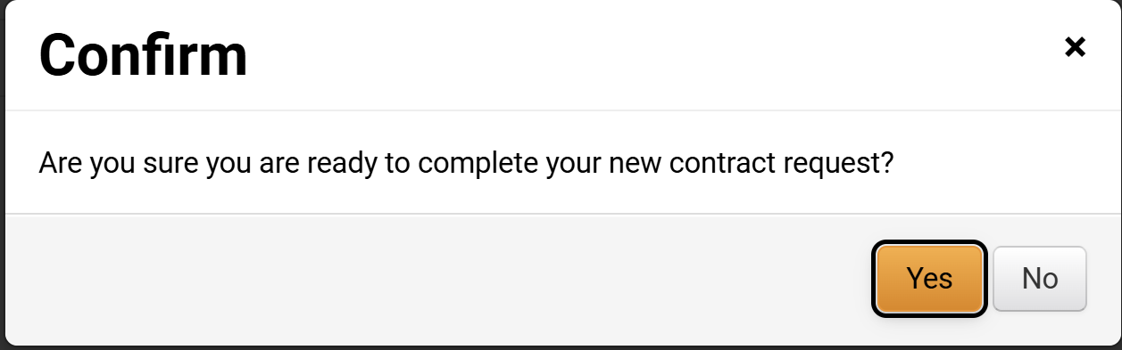

Create a Contract Request for an Amendment (Part 21 of 21)
INSTRUCTIONS
Click Complete Request.
Click Yes to complete the contract request.
You have successfully submitted a Contract Request Amendment.

