Slide 1
Create an Agency Contract
DESCRIPTION
This guide will show Agency Contract Administrators how to Create an Agency Contract without Contract Request only.
OVERVIEW
The key steps in the process are below:
Access the Contracts module.
Click Create New Contract.
Complete required fields.
Click Submit for Approval.
Business Process:
Access Contracts Module
Create Contract
Complete Information
Contract is Submitted

Slide 2
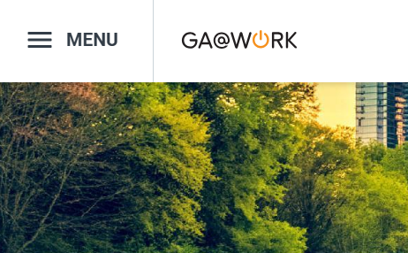

Create an Agency Contract (Part 1 of 37)
INSTRUCTIONS
Click the Global Navigation Menu.
Note: University System of Georgia (USG) users complete local logon and then proceed to Step 4.
Click Sourcing, Contracts & Supplier Management.

Slide 3

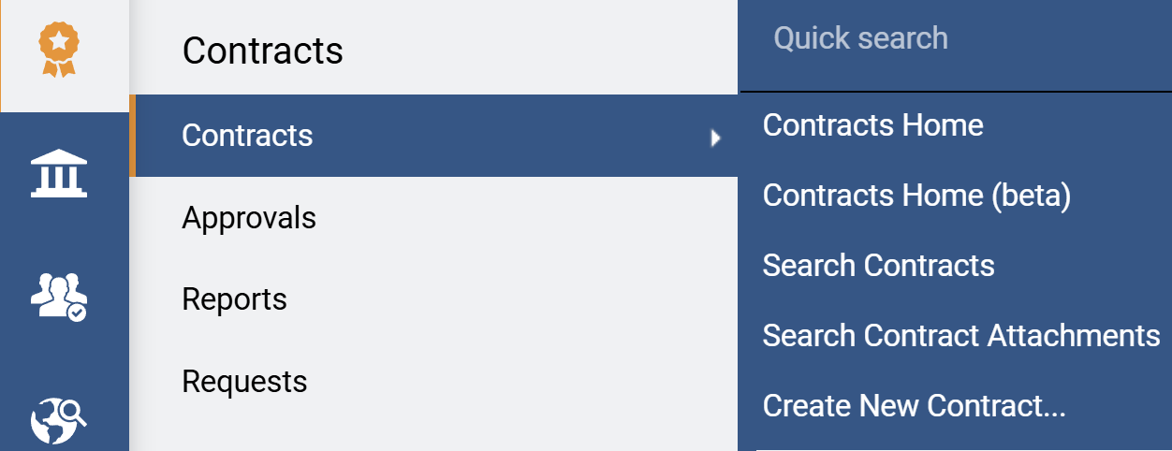
Create an Agency Contract (Part 2 of 37)
INSTRUCTIONS
Click Sign On.
Note: The system utilizes Single Sign-On (SSO) capabilities and no log in information is required.
Access the Contracts module.
Select Contracts.
Select Create New Contract.
4
5
6

Slide 4
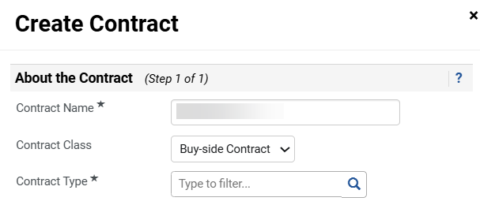
Create an Agency Contract (Part 3 of 37)
INSTRUCTIONS
Enter a Contract Name*.
Select a Contract Class.
Note: Contract Class should be buy-side for procurement contracts and sell-side for revenue contracts.
Select a Contract Type*.
Note: For Contract Type select the appropriate contract type based on the type of contract you are entering.
7
8
9

Slide 5
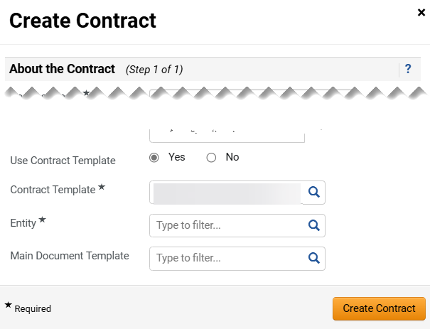
Create an Agency Contract (Part 4 of 37)
INSTRUCTIONS
Select Yes to Use Contract Template.
Select Contract Template*.
Select an Entity*.
Select the Main Document Template.
Click Create Contract.
Note: For these fields select the entity per your profile.
10
11
12
13
14

Slide 6
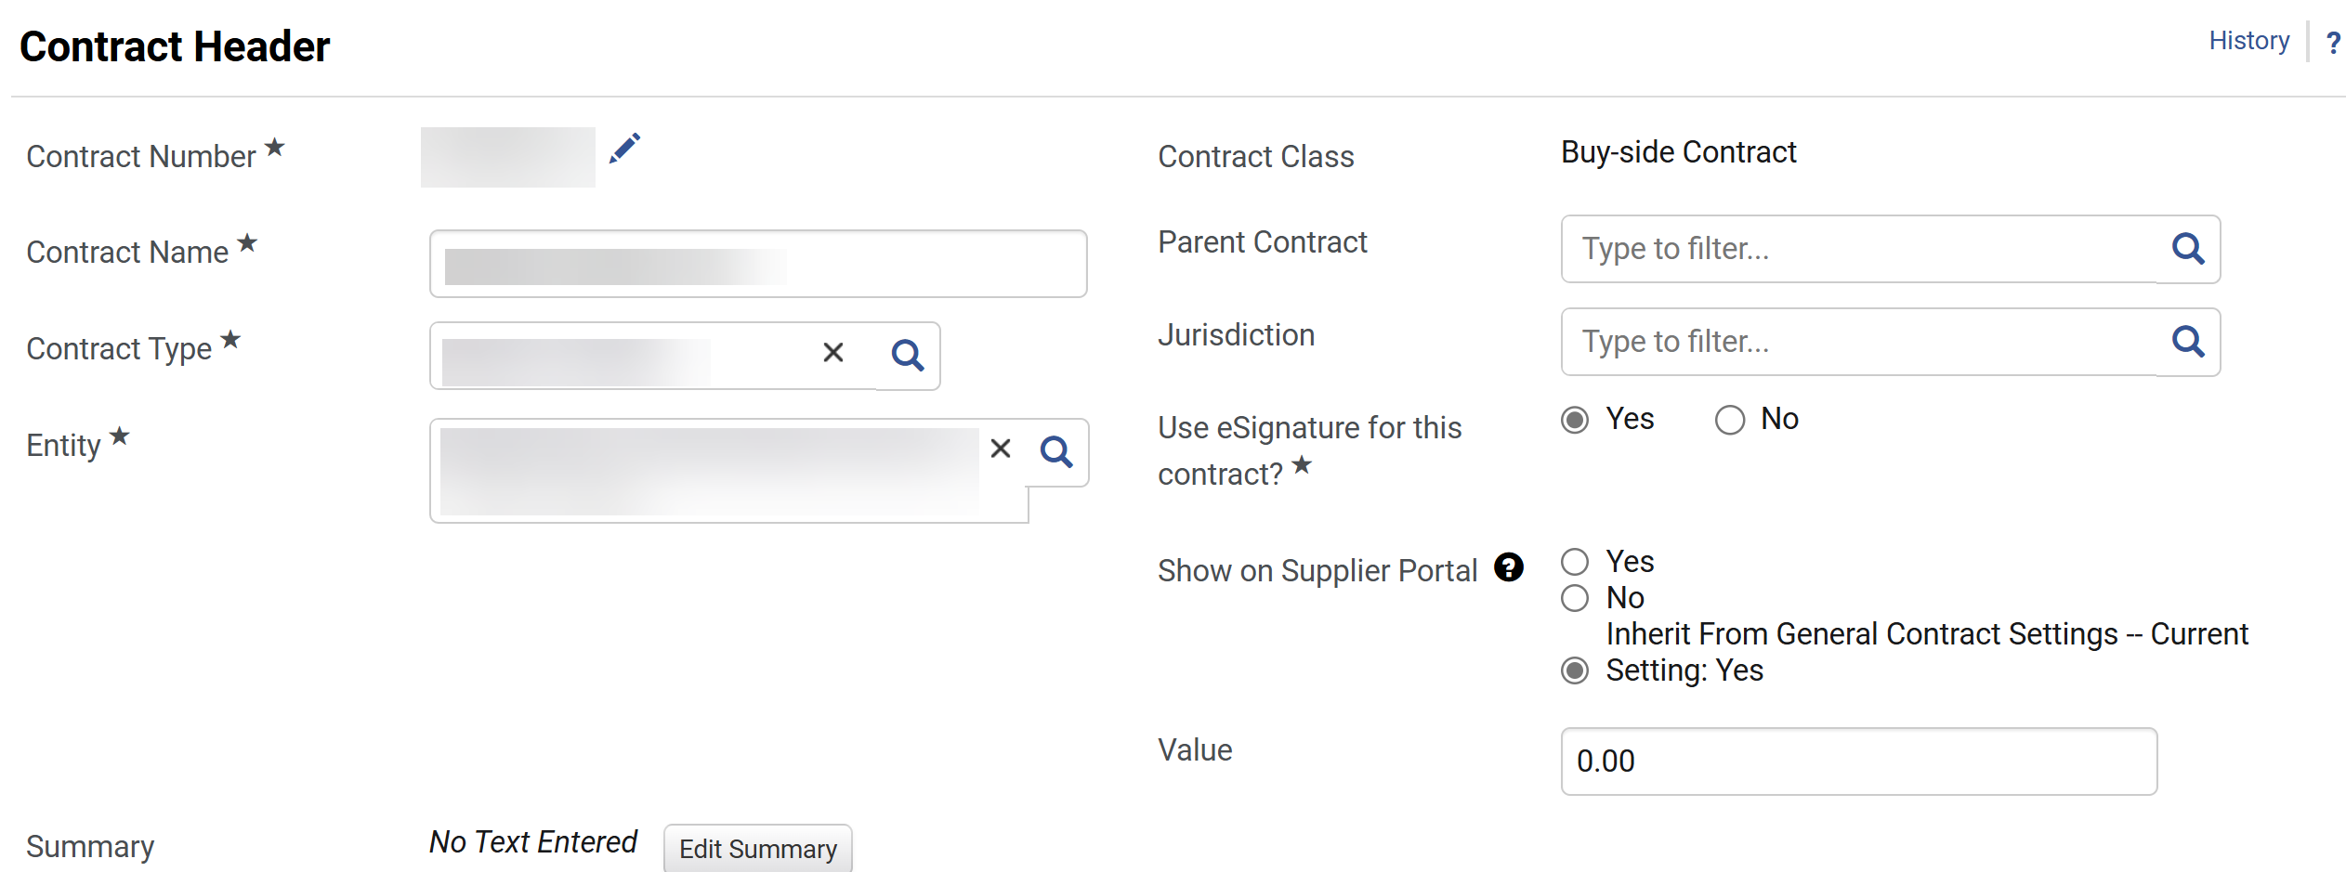
Create an Agency Contract (Part 5 of 37)
INSTRUCTIONS
Enter Contract Header information. Reference the table for guidance on each field.
​Contract Header Field | ​Description
 | ​
 | ​
Contract Number*
Sequential number per system, however it can be overwritten by clicking on the “Pencil”.
​Contract Name*
Name given to contract per previous step “Create Contract.”
​Contract Type*
“Contract Type” per previous step “Create Contract,” however it can be overwritten by clicking on the “Magnifying Glass.”
Entity*
​“Entity” per previous step “Create Contract,” however it can be overwritten by clicking on the “Magnifying Glass.”
Contract Class
Read-only “Contract Class” per previous step “Create Contract.”
Parent Contract
Able to link Contracts by typing or clicking on the “Magnifying Glass” to look for approved contracts. The selected contract will be visible in the “Contract Header.”
Jurisdiction
Location able to select by clicking on the “Magnifying Glass.”
Use eSignature for this contract?*
Select eSignature requirements.
Show on Supplier Portal
If the contract is configured to be shared with Second Parties.
Value
For multi-year contracts, enter value of single contract term only.
Summary > Edit Summary
Click “Edit Summary” to include summary information of contract, click “Done” once completed.

Slide 7
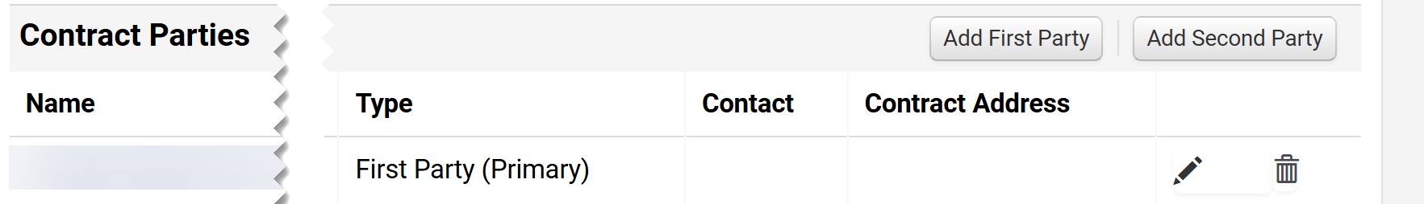
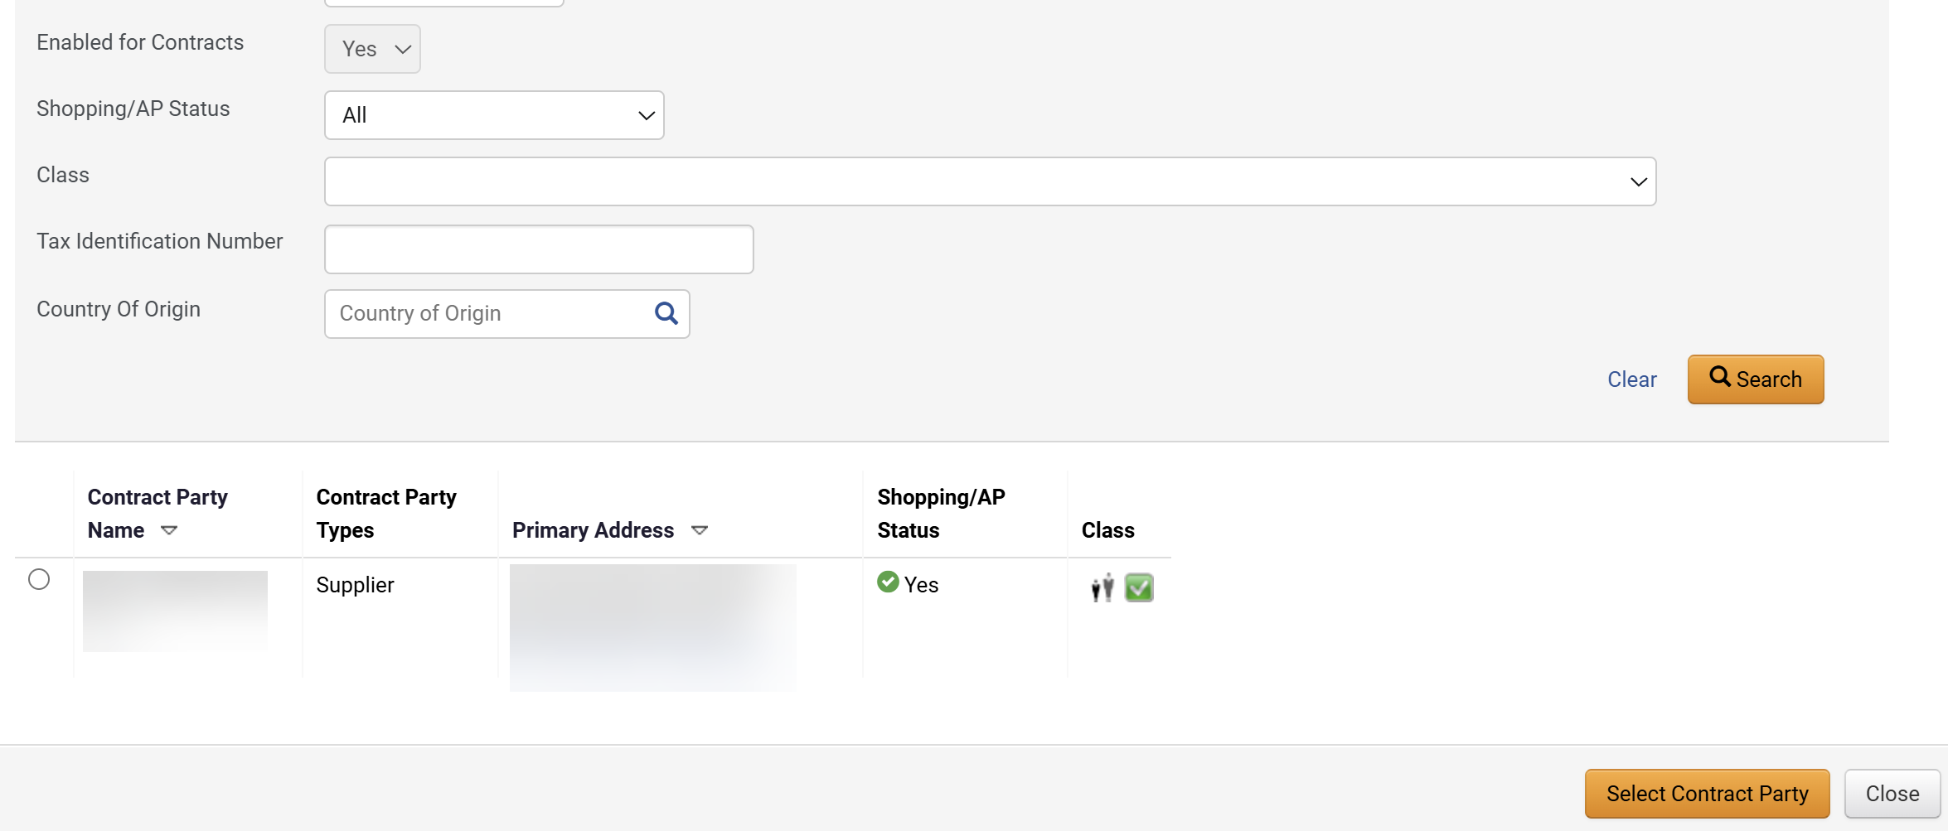
Create an Agency Contract (Part 6 of 37)
INSTRUCTIONS
Confirm that the First Party Primary defaults based on the Entity selected.
Click Add Second Party.
Note: Selecting a Secondary Party that is not Approved for Payment in GA@WORK will prevent the contract from being submitted for approval until the supplier is approved.
17
16
Define filters for the Second Party, then click Search.
Check the Second Party box.
Click Select Contract Party.
18
19
20

Slide 8
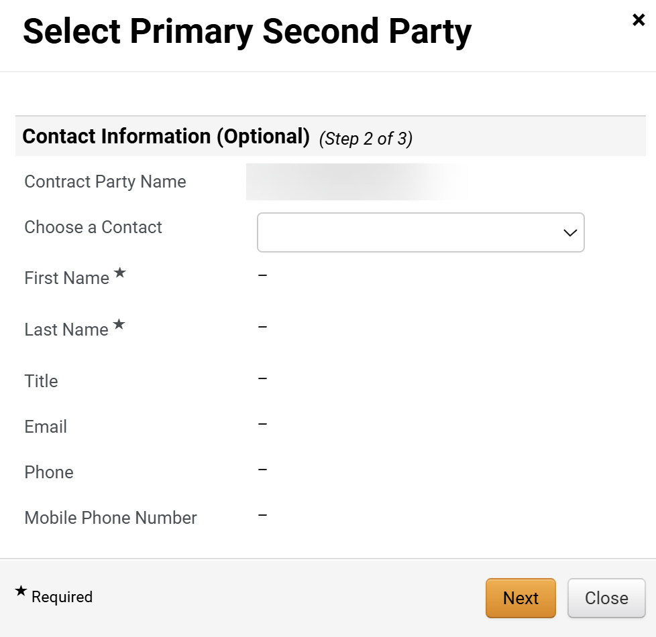
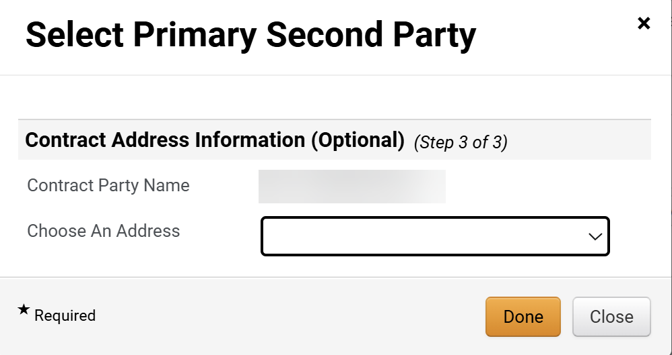
Create an Agency Contract (Part 7 of 37)
INSTRUCTIONS
Select an option under Choose a Contact.
Click Next.
21
22
Select a Choose An Address option.
Note: Both Contact and Address are optional fields.
Click Done.
23
24

Slide 9
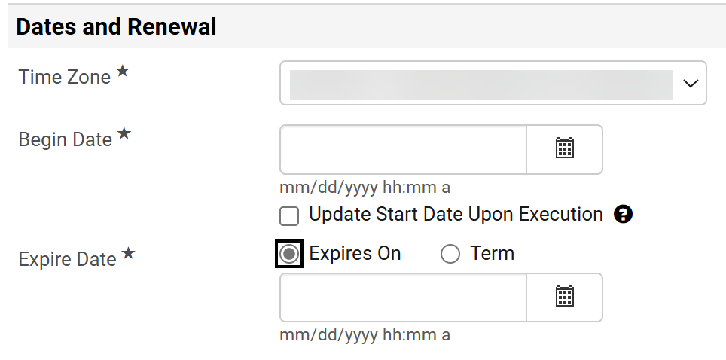
Create an Agency Contract (Part 8 of 37)
INSTRUCTIONS
Select a Time Zone*.
Select the Begin Date*.
Note: For Expire Date* if Expires On is selected, continue to Step 27. If Term is selected, skip to Step 28.
Select Expires On and enter an Expire Date.
Note: If Term for Expire Date* is selected, enter the Term.
25
26
27

Slide 10
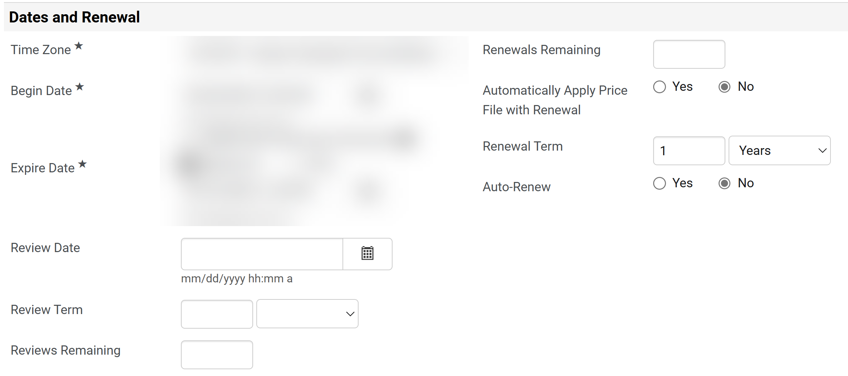
Create an Agency Contract (Part 9 of 37)
INSTRUCTIONS
Complete the relevant fields for review and renewals where applicable for Data and Renewal (optional).

Slide 11
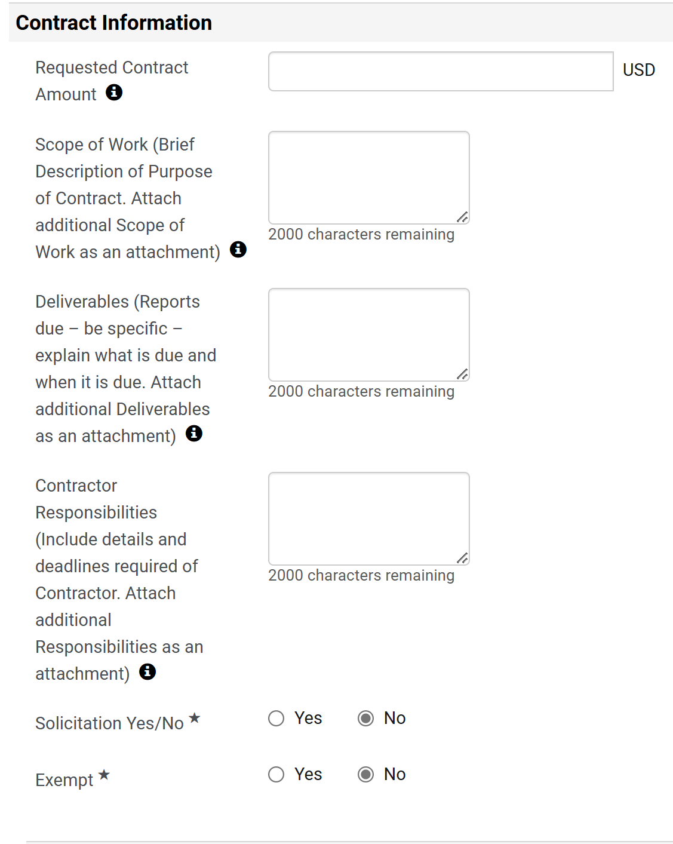
Create an Agency Contract (Part 10 of 37)
INSTRUCTIONS
Verify Requested Contract Amount.
Note: The Requested Contract Amount will only have a value if the contract is created from a Contract Request.
Enter the Scope of Work, Deliverables and Contractor Responsibilities.
Select an option for Solicitation Yes/No* and select an option for Exempt*.
Note: For Solicitation* if Yes is selected, continue to Step 32. If No is selected, skip to Step 35.
29
30
31

Slide 12
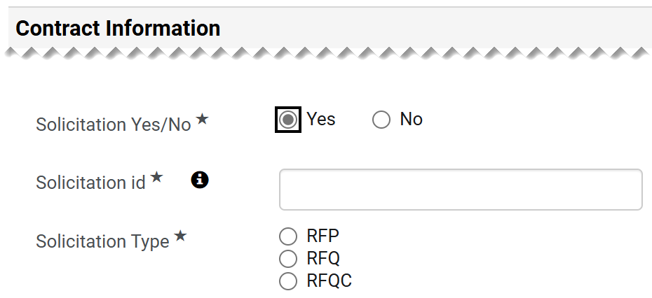
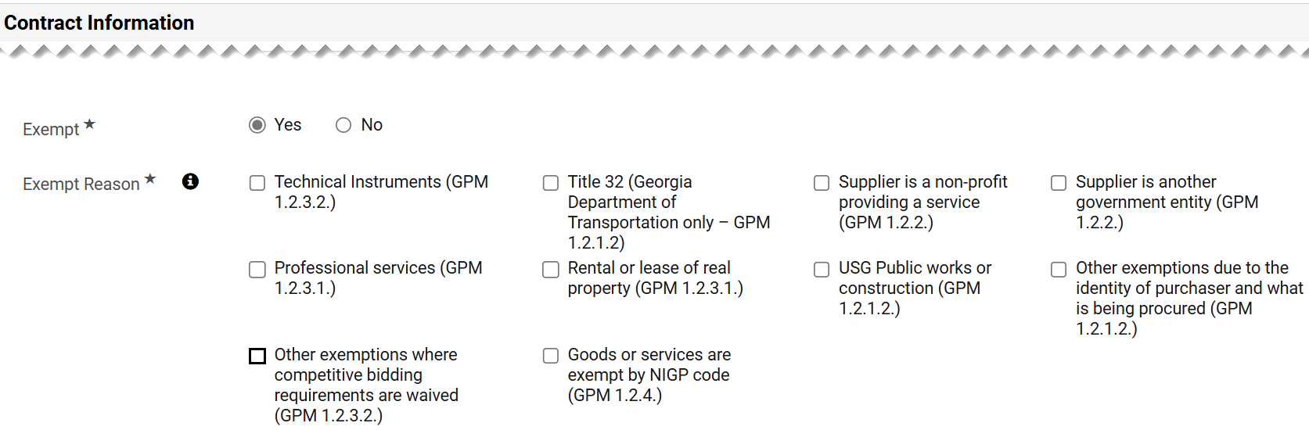
Create an Agency Contract (Part 11 of 37)
INSTRUCTIONS
Enter the Solicitation id*.
Select the Solicitation Type*.
32
33
Check the Exempt Reason* box, as applicable.
Note: Can select more than one answer for Exempt Reason.

Slide 13
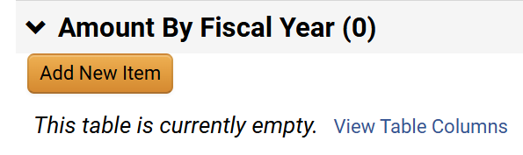
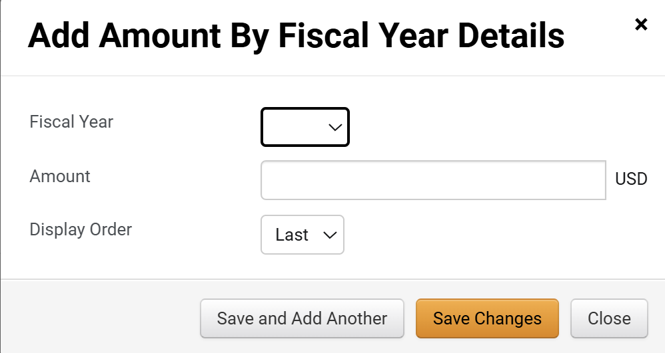
Create an Agency Contract (Part 12 of 37)
INSTRUCTIONS
Click Add New Item.
Note: Fiscal Year information is a non-mandatory field, however, include information if available. Best practice is to identify dollar value per contract term for multi-year contracts.
Select the Fiscal Year.
Enter the Amount.
Select a Display Order.
Click Save Changes.
36
37
38
39

Slide 14
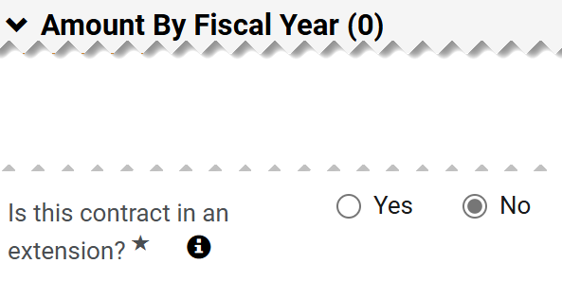
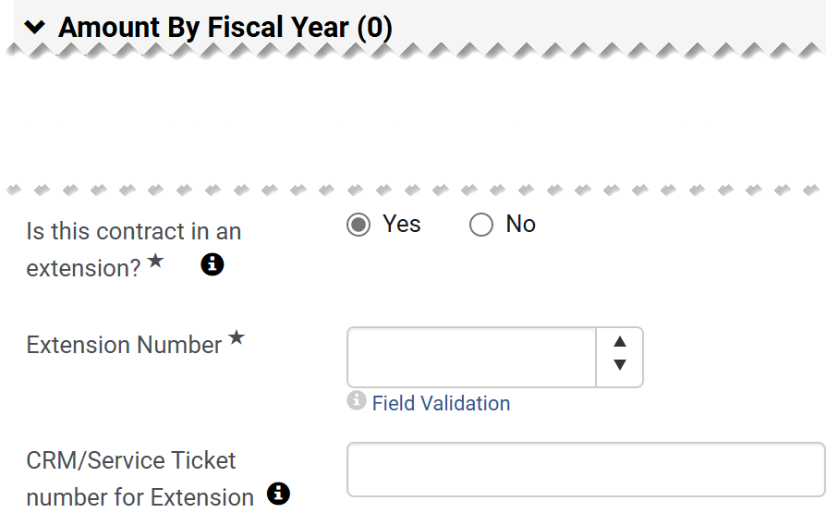
Create an Agency Contract (Part 13 of 37)
INSTRUCTIONS
Select an option for Is this contract in an extension?*.
Note: If Yes is selected, proceed to Steps 41 - 42. If No is selected, skip to Step 43.
Select an Extension Number*.
Enter a CRM/Service Ticket number for Extension (Optional).
41
42

Slide 15
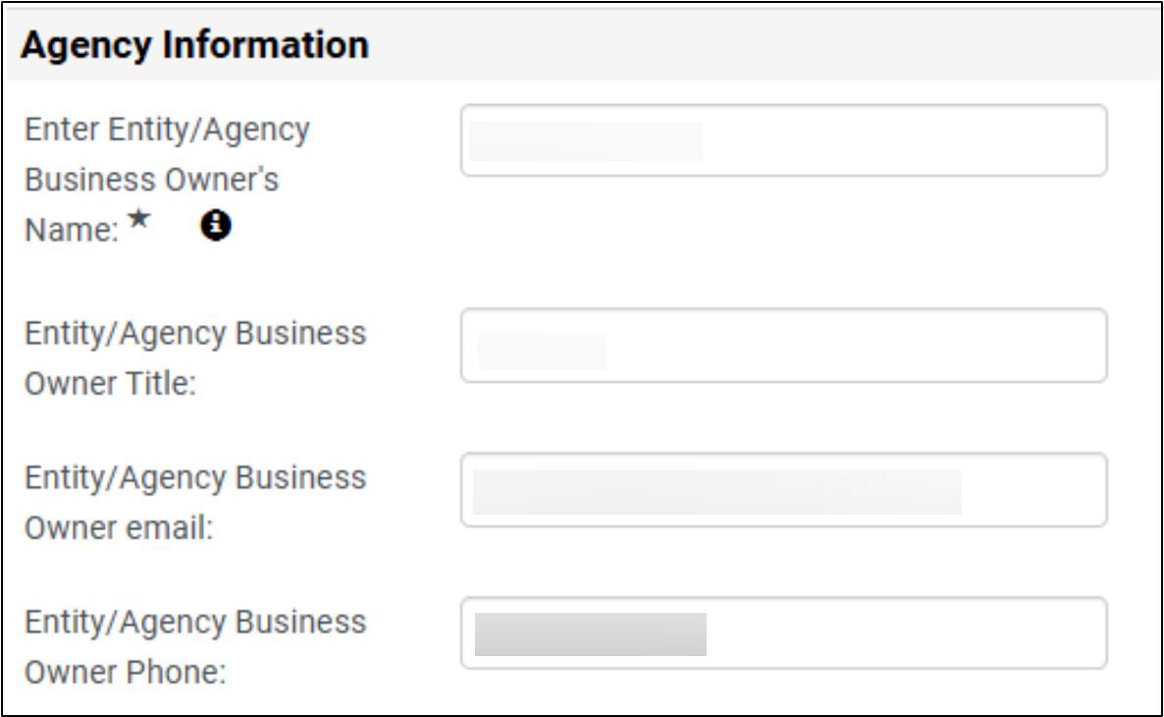
Create an Agency Contract (Part 14 of 37)
INSTRUCTIONS
Enter Entity/Agency Business Owner’s Name*.
Enter Entity/Agency Business Owner Title.
Enter Entity/Agency Business Owner email.
Enter Entity/Agency Business Owner Phone.
43
44
45
46

Slide 16
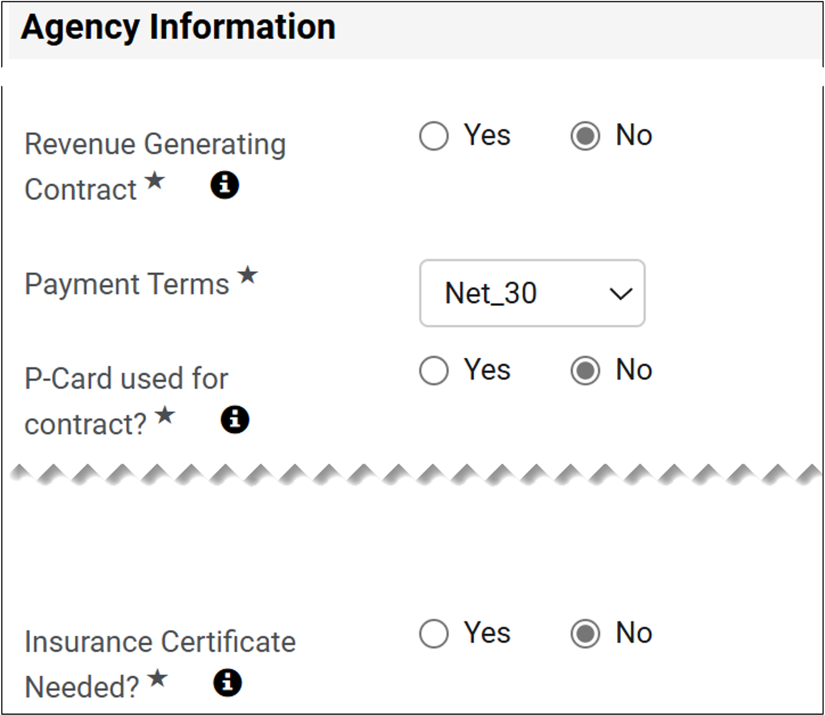
Create an Agency Contract (Part 15 of 37)
INSTRUCTIONS
Select an option for Revenue Generating Contract*.
Select the Payment Terms*
Select an option for P-Card used for contract?*.
Select an option for Insurance Certificate Needed*.
47
48
49
50

Slide 17
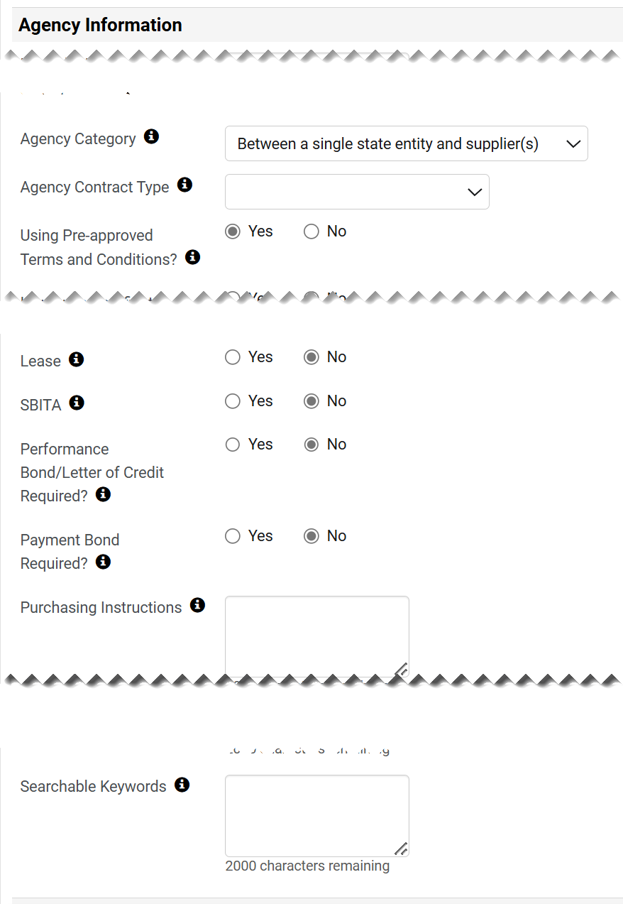
Create an Agency Contract (Part 16 of 37)
INSTRUCTIONS
Complete the Contract Information (Optional).

Slide 18
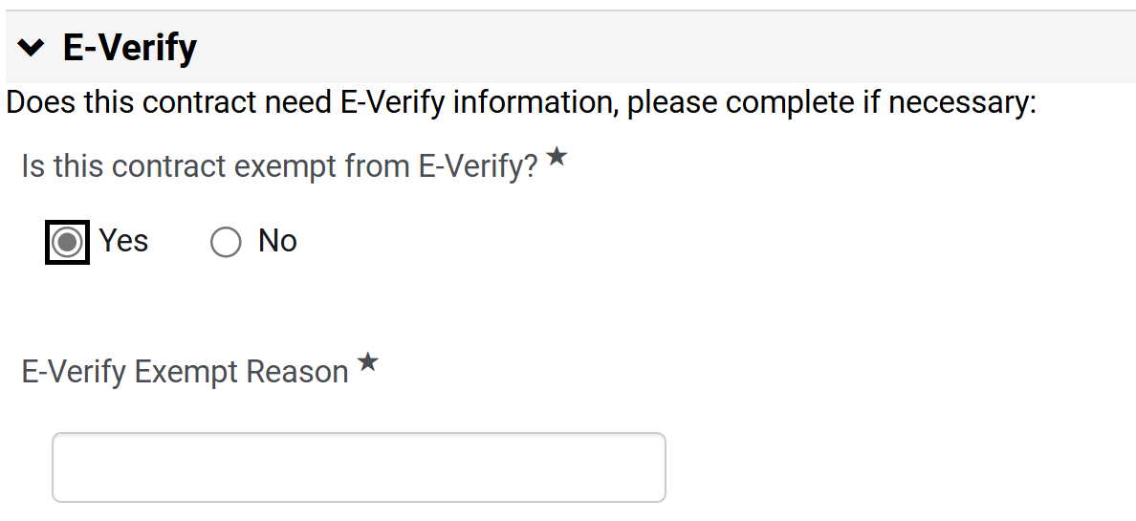
Create an Agency Contract (Part 17 of 37)
INSTRUCTIONS
Select an option for Is this company exempt from e-Verify?*.
Note: If Yes is selected, continue to Step 53. If No is selected, skip to Step 54.
If Yes, enter the E-Verify Exempt Reason*.
Note: If Yes is selected, skip to Step 56 to continue to Sub-recipient or Vendor/Contractor.
52
53

Slide 19
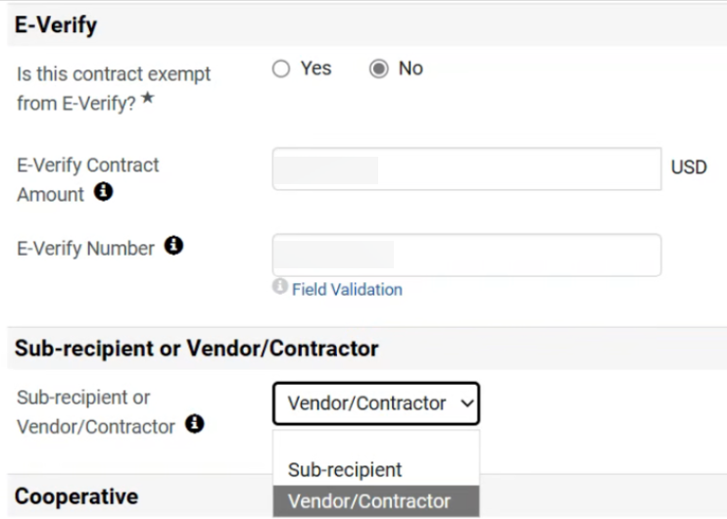
Create an Agency Contract (Part 18 of 37)
INSTRUCTIONS
If No is selected, enter the E-Verify Contract Amount.
Enter an E-Verify Number.
Select Sub-recipient or Vendor/Contractor.
Note: The default selection is Vendor/Contractor.
54
55
56

Slide 20
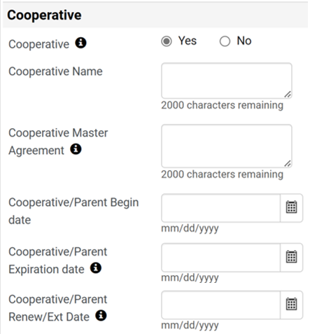
Create an Agency Contract (Part 19 of 37)
INSTRUCTIONS
Select Cooperative.
Note: If Yes is selected, continue to Step 58 and all fields are mandatory. If No is selected, skip to Step 60.
Enter a Cooperative Name and a Cooperative Master Agreement.
Enter a Cooperative/Parent Begin date, a Cooperative/Parent Expiration date and a Cooperative/Parent Renew/Ext Date.
Note: If entering Piggyback information, follow Steps 60 - 62 or skip to Step 63 to select First Signature Completed.
57
58
59

Slide 21
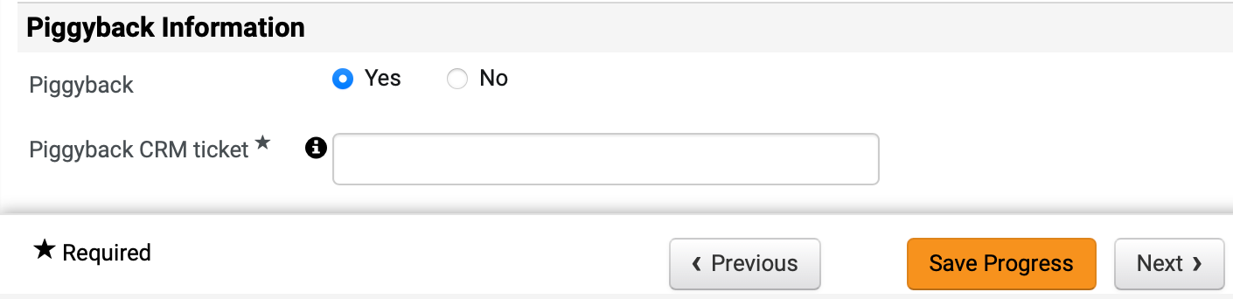
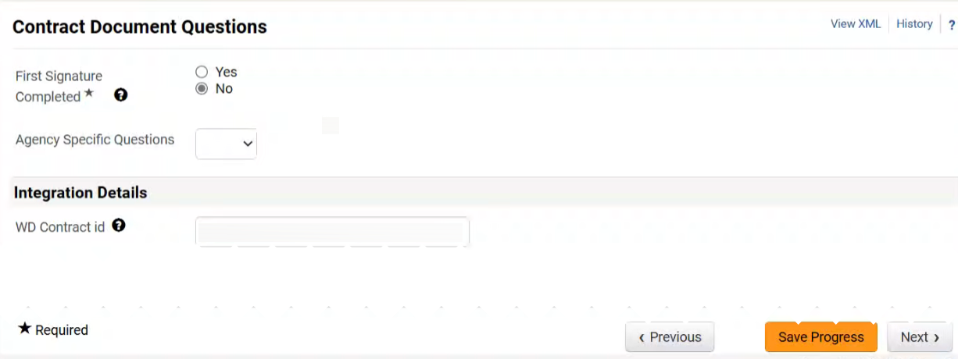
Create an Agency Contract (Part 20 of 37)
INSTRUCTIONS
Select an option for Piggyback.
Note: If Yes is selected, continue to Step 61. If No is selected, skip to Step 62.
If Yes, enter the Piggyback CRM ticket*.
Click Next.
60
61
62
Select No for First Signature Completed*.
Select Agency Specific Questions (Optional).
63
64

Slide 22
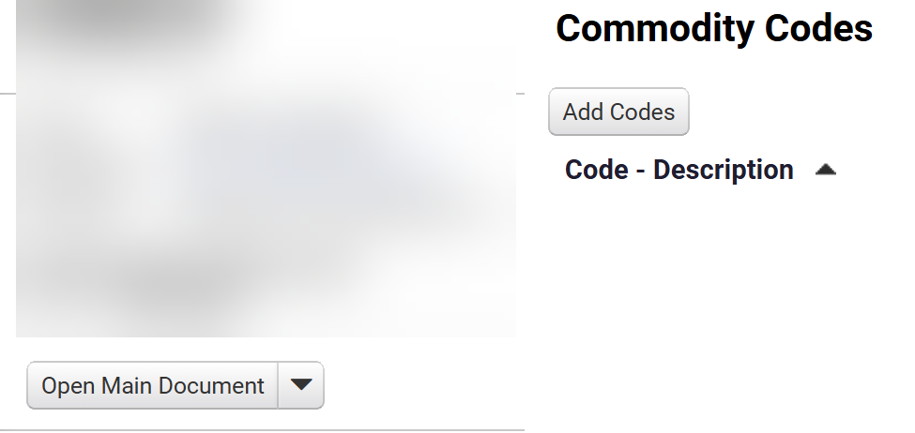
Create an Agency Contract (Part 21 of 37)
INSTRUCTIONS
Verify that the WD Contract id has been left blank.
Note: Do not enter any information in this field. Once the contract is integrated with GA@WORK this field will be populated.
Click Next.
65
66
Click Add Codes.

Slide 23
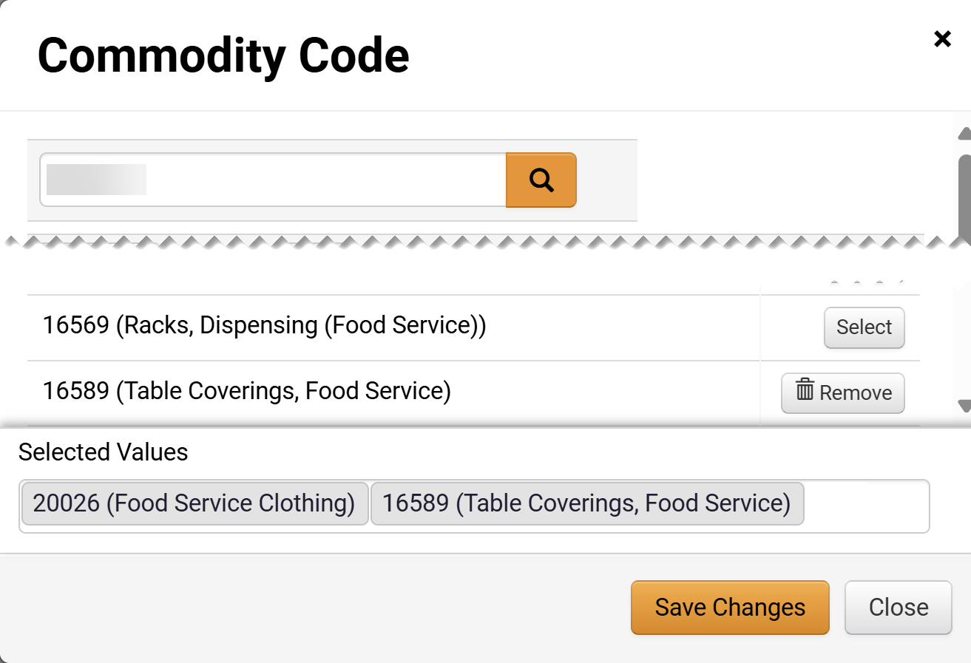
Create an Agency Contract (Part 22 of 37)
INSTRUCTIONS
Select the Commodity Code.
Click Select.
Note: Search by Name or Code. Multiple codes can be selected and are visible on the Selected Values section and can be removed by clicking Remove.
Click Save Changes.
68
69
70

Slide 24
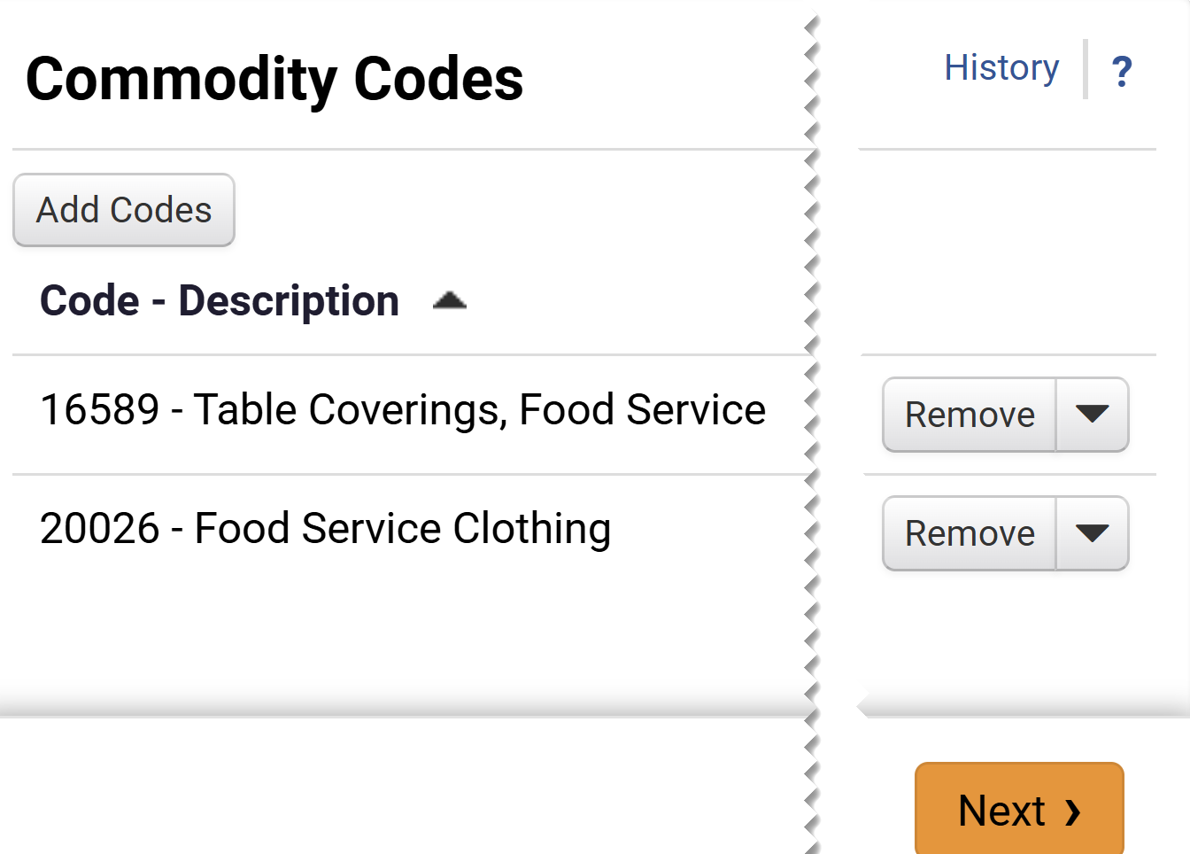
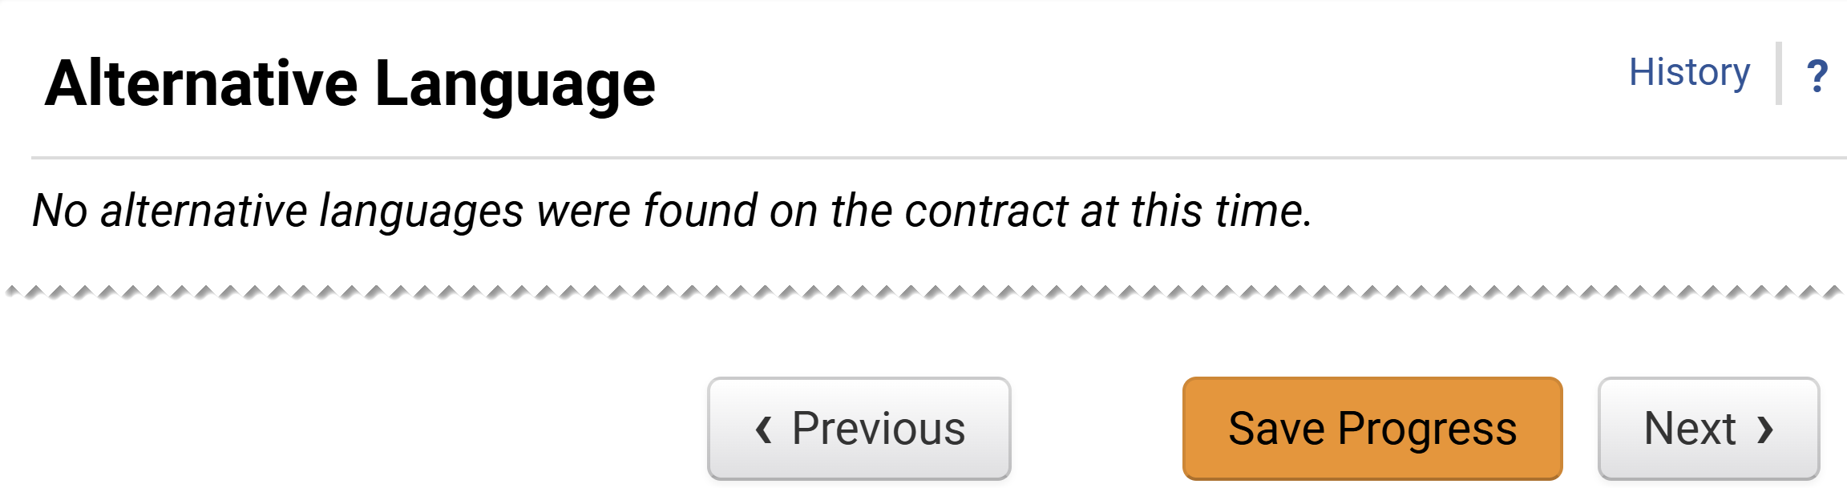
Create an Agency Contract (Part 23 of 37)
INSTRUCTIONS
Review Code Description and click Next.
Click Next on the Alternative Language page.

Slide 25
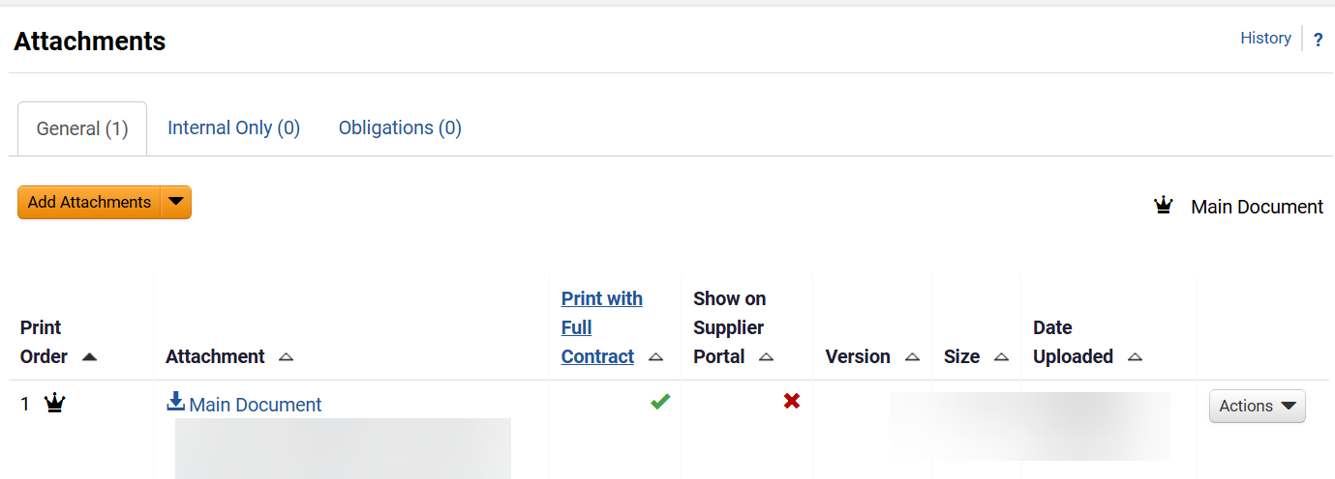
Create an Agency Contract (Part 24 of 37)
INSTRUCTIONS
Review Main Document hyperlink and description.
Note: If a Main Document Template was selected when creating the Contract in Step 13, then proceed to Step 74 to continue to review how to add Attachments. If no template was selected, then skip to Step 97 to add Main Document.

Slide 26
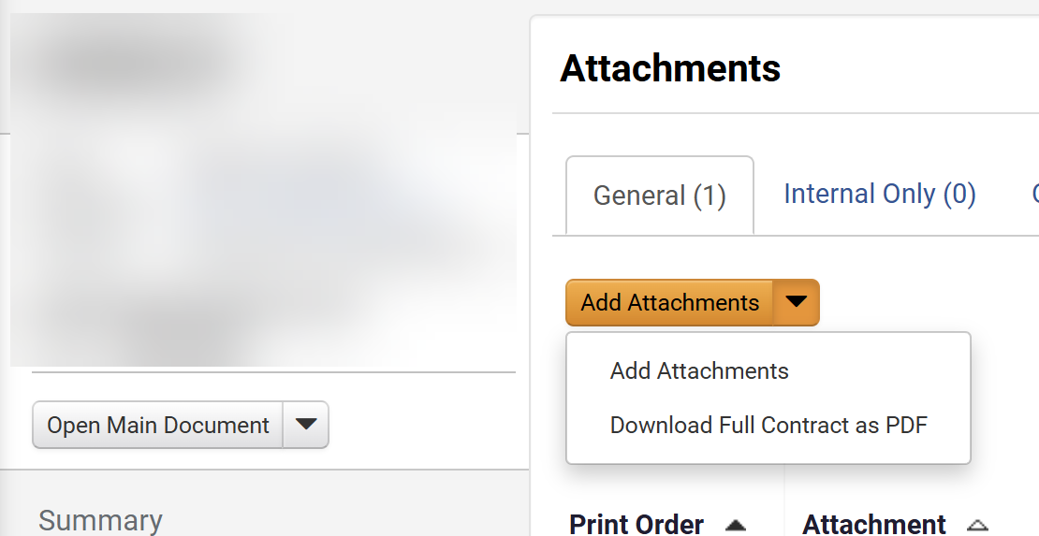
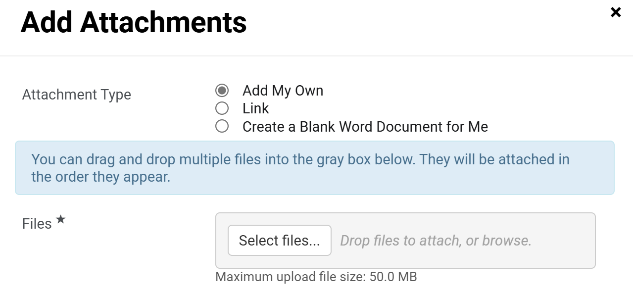
Create an Agency Contract (Part 25 of 37)
INSTRUCTIONS
Click Add Attachments and select Add Attachments.
Note: Following your organization's guidance, upload any files relevant to the contract such as a scope of work or supplier quote. If no files or URLs to add, skip to Step 97.
Select Add My Own as Attachment Type.
Note: If Add My Own is selected, continue to Step 76 – 84 and skip to Step 97. If Link is selected, follow Step 85 – 90, and skip to Step 97 . If Create a Blank Word Document for Me is selected, skip to Step 91.
Click Select Files.
75
76

Slide 27
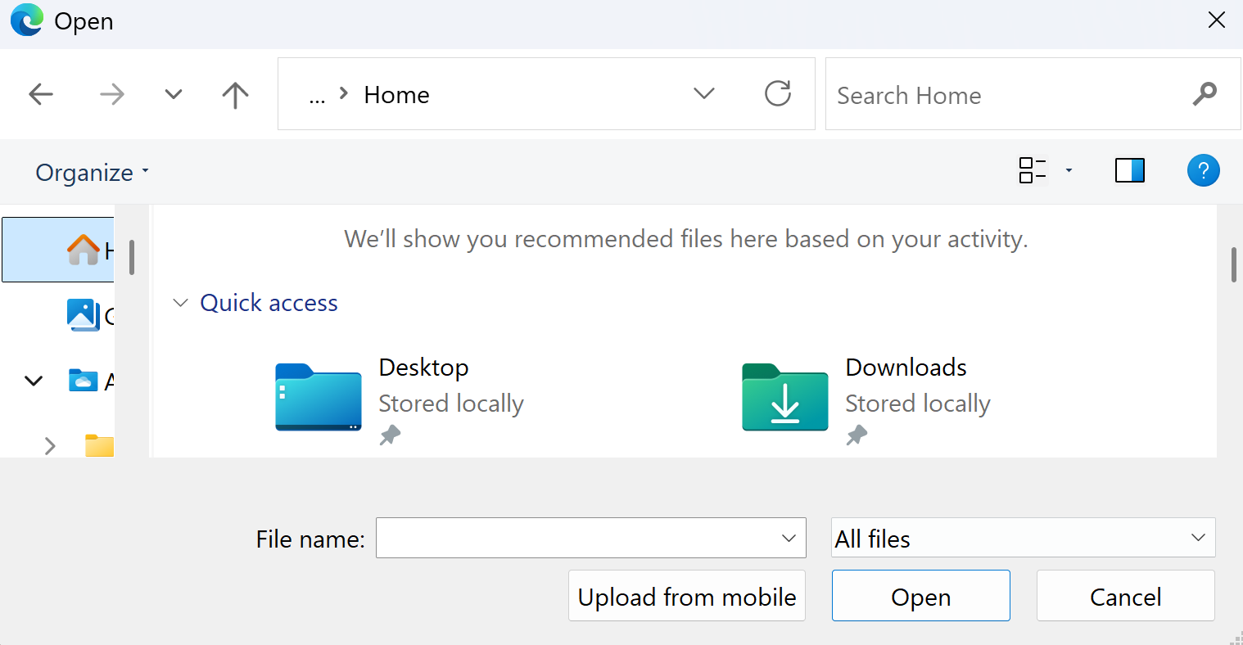
Create an Agency Contract (Part 26 of 37)
INSTRUCTIONS
Select the applicable File from local computer.
Click Open.
77
78

Slide 28
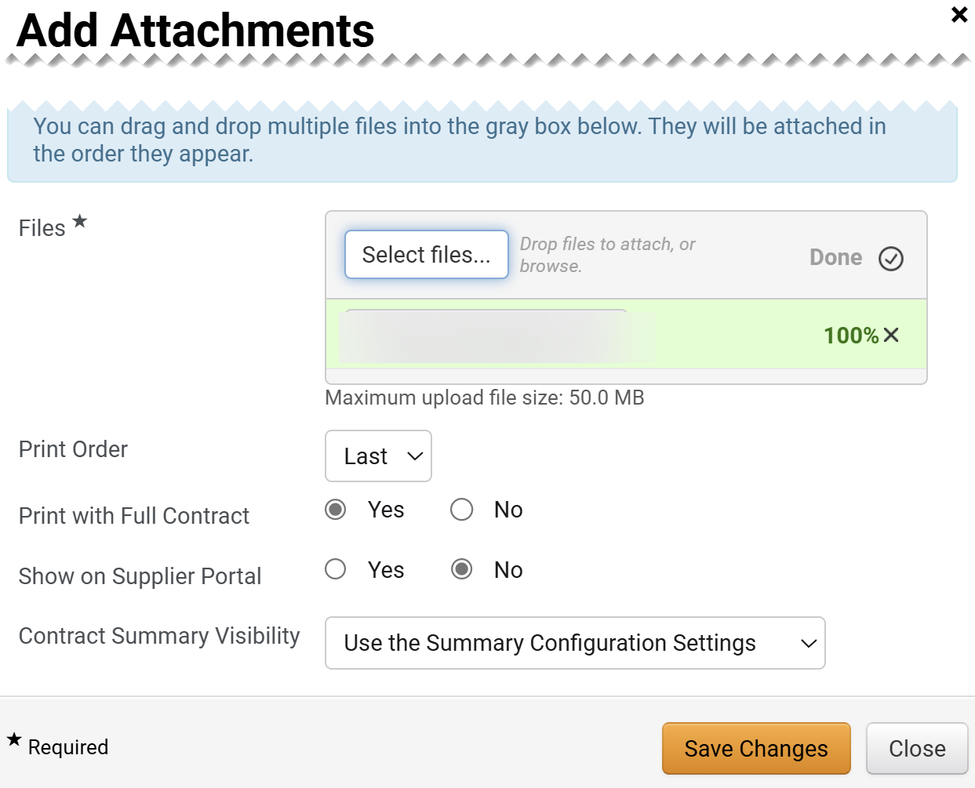
Create an Agency Contract (Part 27 of 37)
INSTRUCTIONS
Verify uploaded File* is visible.
Select a Print Order.
Select an option for Print with Full Contract.
Note: If Yes is selected, then this attachment will be combined in a PDF with the Main Document.
Select an option for Show on Supplier Portal.
Note: If Yes selected, then attachment will be visible to the suppler in the Supplier Portal.
Select an option for Contract Summary Visibility.
Click Save Changes.
79
80
81
82
83
84

Slide 29
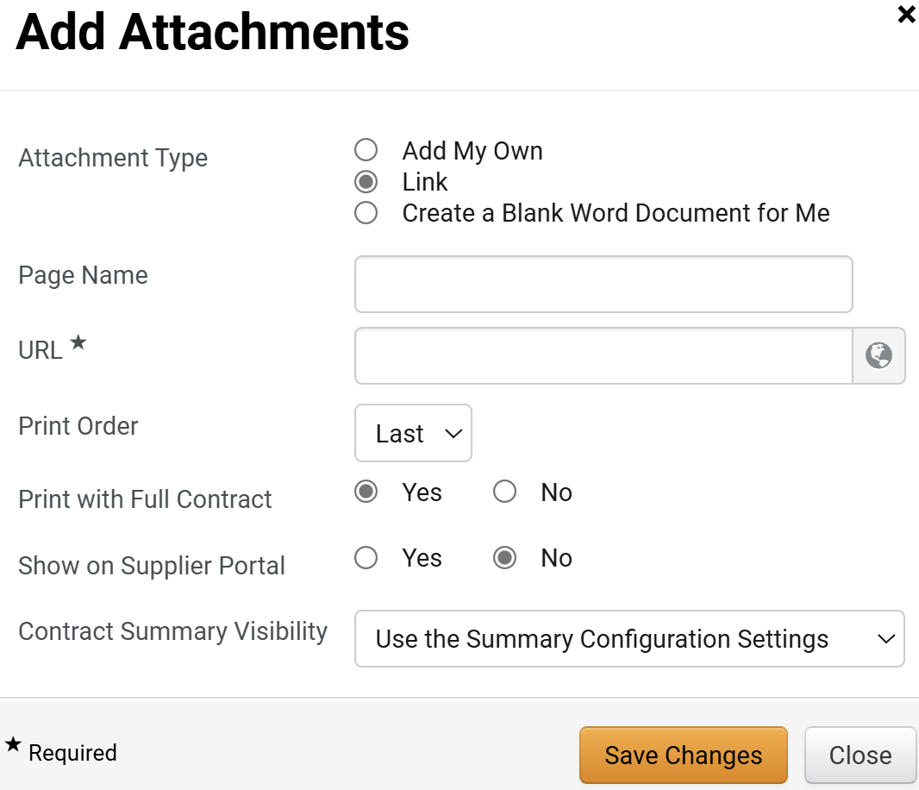
Create an Agency Contract (Part 28 of 37)
INSTRUCTIONS
Select Link as the Attachment Type.
Enter a Page Name and the URL*.
Select options for Print Order and Print with Full Contract.
Select an option for Show on Supplier Portal.
Select Contract Summary Visibility.
Click Save Changes.
85
86
87
88
89
90

Slide 30
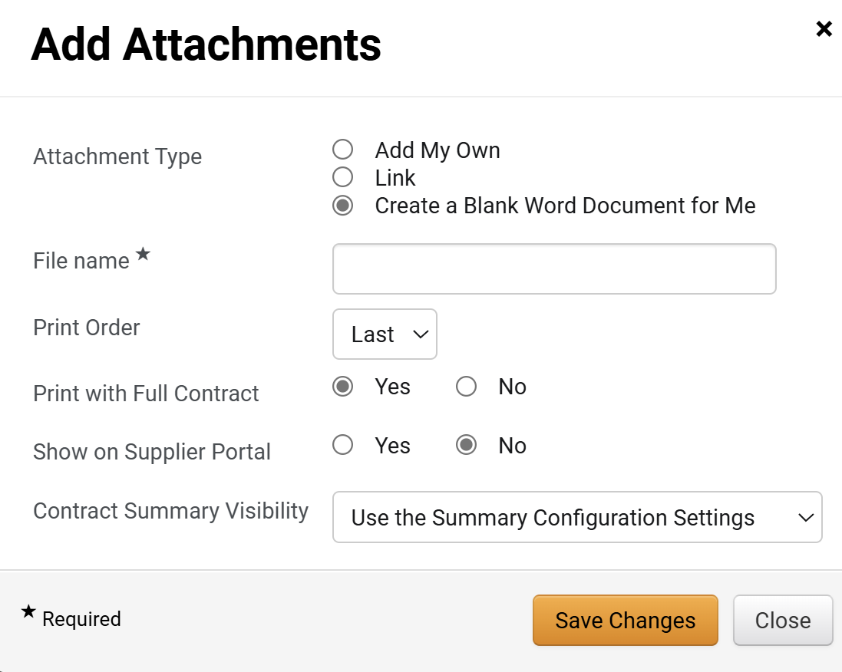
Create an Agency Contract (Part 29 of 37)
INSTRUCTIONS
You may select Create a Blank Word Document for Me as the Attachment Type.
Enter a File Name.
Select a Print Order.
Select options for Print with Full Contract and Show on Supplier Portal.
Select an option for Contract Summary Visibility.
Click Save Changes.
91
92
93
94
95
96

Slide 31
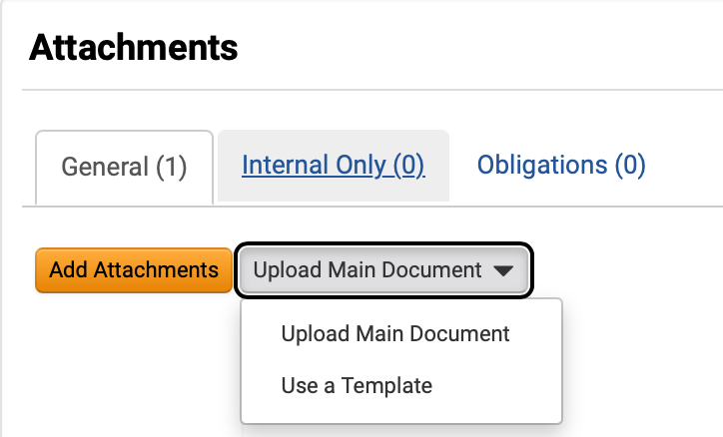
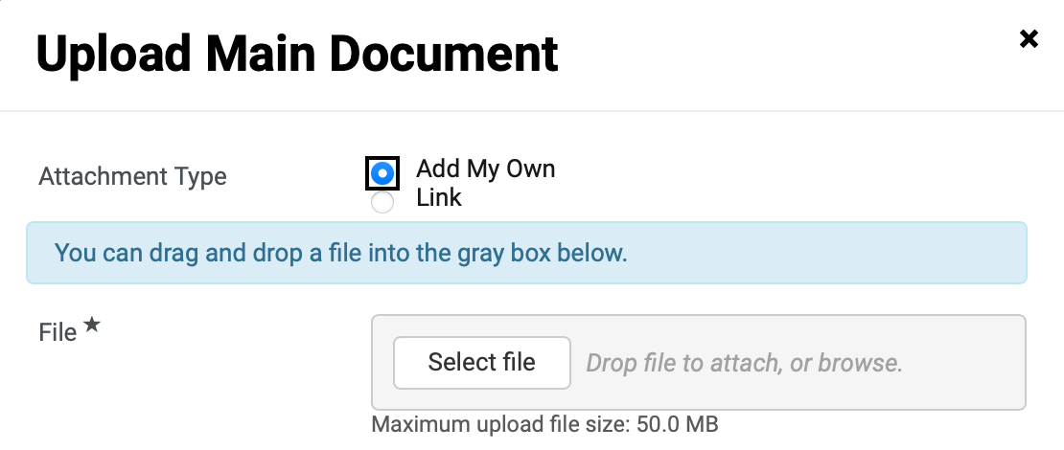
Create an Agency Contract (Part 30 of 37)
INSTRUCTIONS
To add a Main Document, click Upload Main Document.
Note: Upload Main Document option is only visible when a Main Document needs to be included.
Select Upload Main Document.
97
98
Select Add My Own as Attachment Type.
Click Select file.
99
100

Slide 32
Create an Agency Contract (Part 31 of 37)
INSTRUCTIONS
Select the applicable File from local computer.
Click Open.
101
102

Slide 33
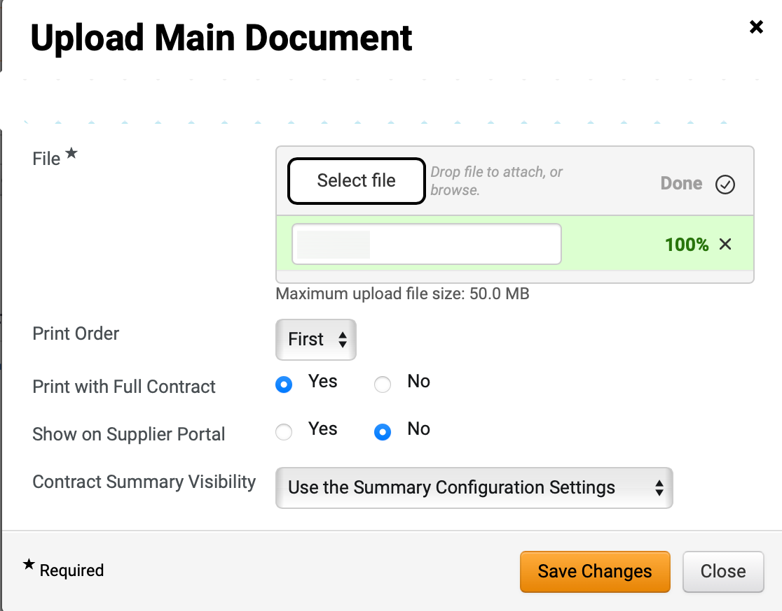
Create an Agency Contract (Part 32 of 37)
INSTRUCTIONS
Verify uploaded File* is visible.
Select a Print Order.
Select an option for Print with Full Contract.
Note: If Yes is selected, then this attachment will be combined in a PDF with the Main Document.
Select an option for Show on Supplier Portal.
Note: If Yes selected, then attachment will be visible to the suppler in the Supplier Portal.
Select an option for Contract Summary Visibility.
Click Save Changes.
103
104
105
106
107
108

Slide 34
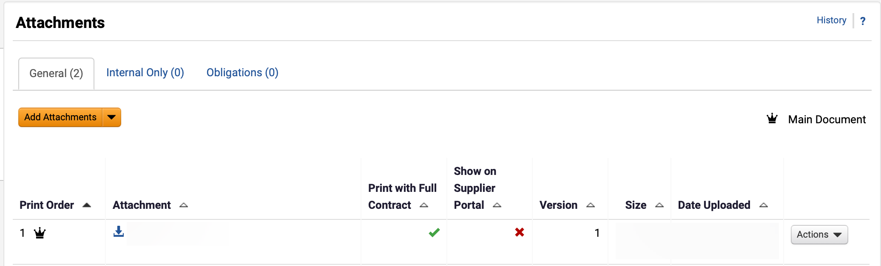
Create an Agency Contract (Part 33 of 37)
INSTRUCTIONS
Verify Main Document information.
Note: A Crown icon is displayed once the Main Document is uploaded.

Slide 35
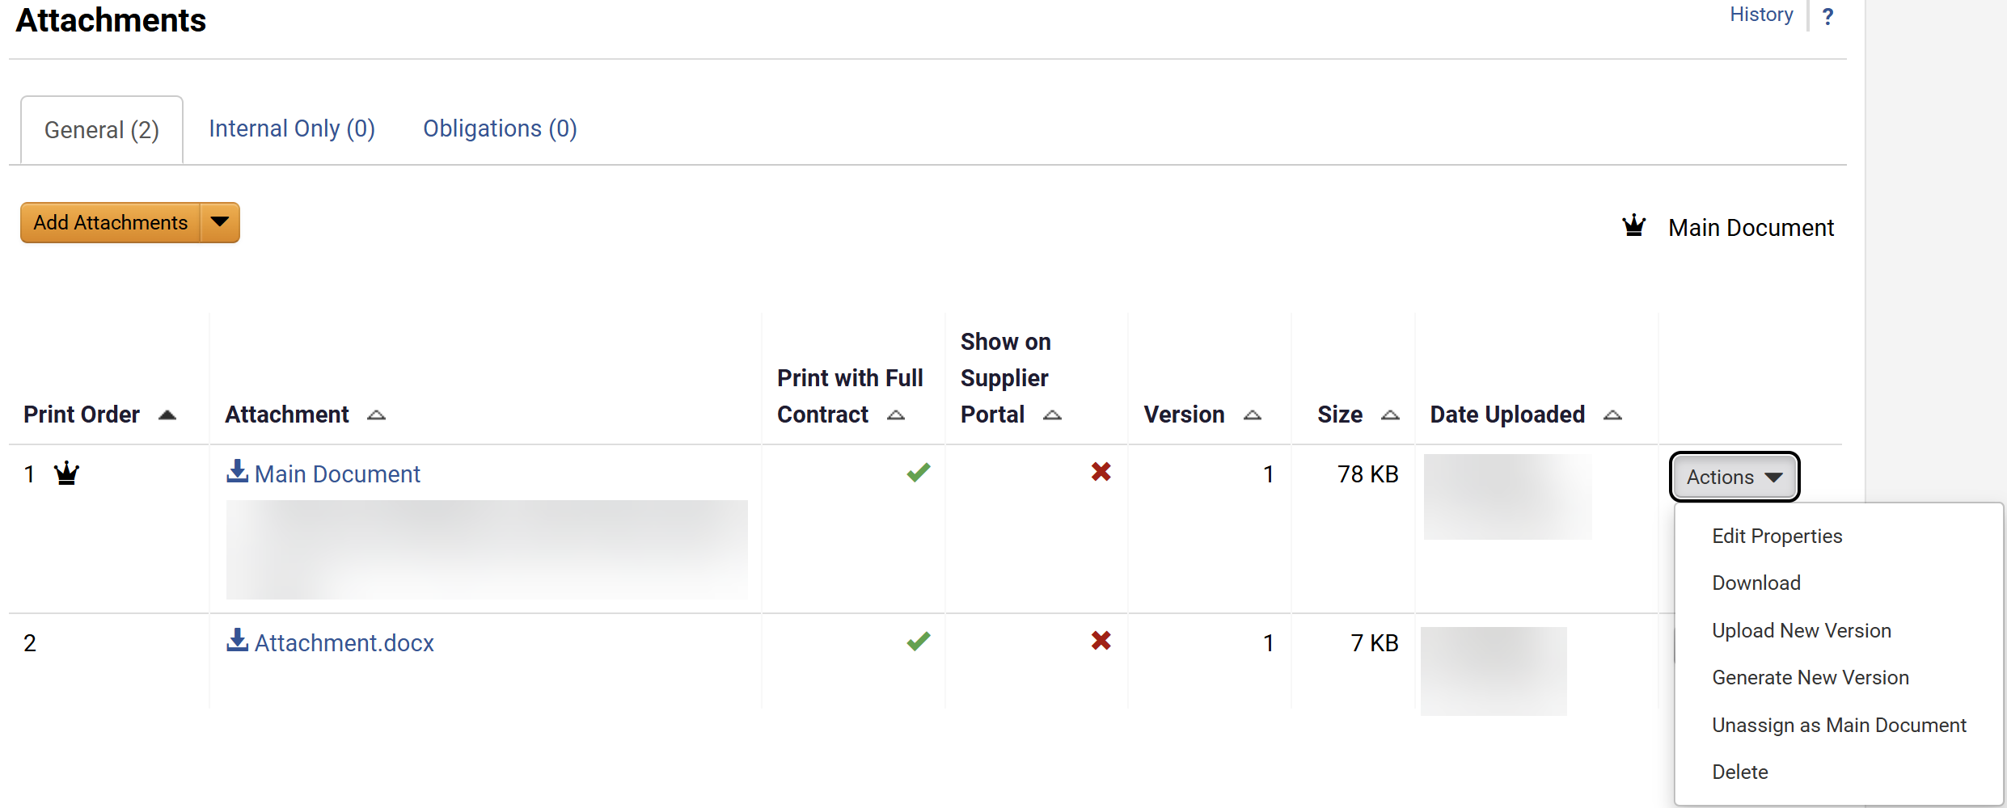
Create an Agency Contract (Part 34 of 37)
INSTRUCTIONS
Use the Main Document table to learn more about each field in the section.
Note: The Main Document should always be the latest signed contract, renewal or amendment.
Main Document Field | ​Description
Crown Icon
This icon helps user identify the attachment as the main document.
Attachment > Attachment hyperlink
Click on the hyperlink or download icon to download the main document.
Actions
Open main document actions
Actions > Edit Properties
Able to change the document name, printing order, printing properties, and supplier visibility.
Actions > Download
Download the document.
Actions > Upload New Version
Able to upload a new version of the document and include comments.
Actions > Generate New Version
Able to change version of the document.
Actions > Unassign as Main Document
Unassign the current document as the main document. The crown icon would be removed as well.
Actions > Delete
Remove document from attachment list.

Slide 36
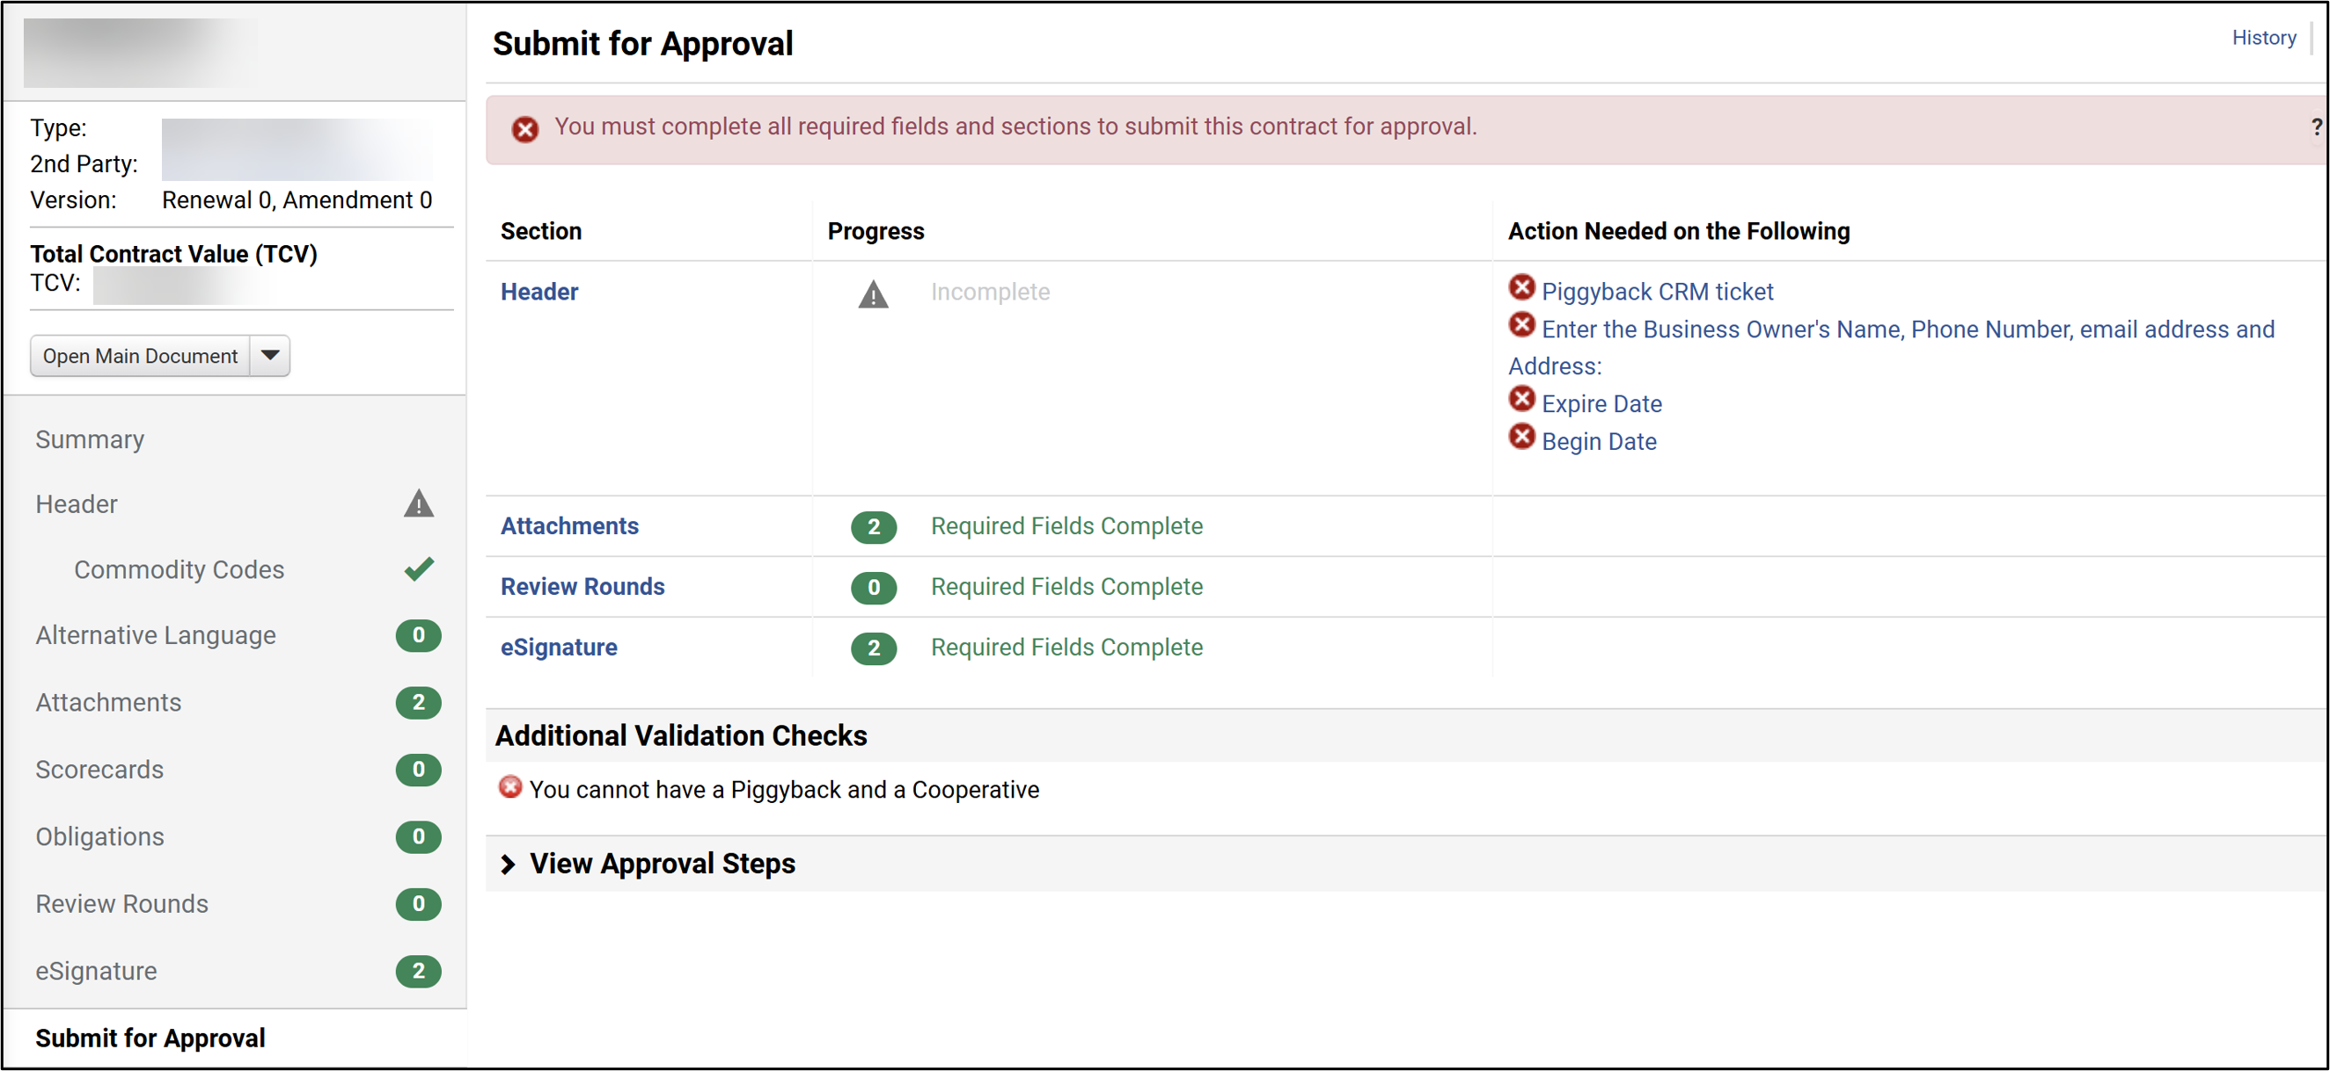
Create an Agency Contract (Part 35 of 37)
INSTRUCTIONS
Select the Submit for Approval tab.
Review the Progress in each section.
112
111

Slide 37
Create an Agency Contract (Part 36 of 37)
INSTRUCTIONS
Review any Action Needed on the Following section.
Review any Additional Validation Checks section.
Note: The contract can not be submitted with pending actions, validation checks, or incomplete sections, ensure to clear issues and that all progress is displayed either with a checkbox or green status.
113
114

Slide 38
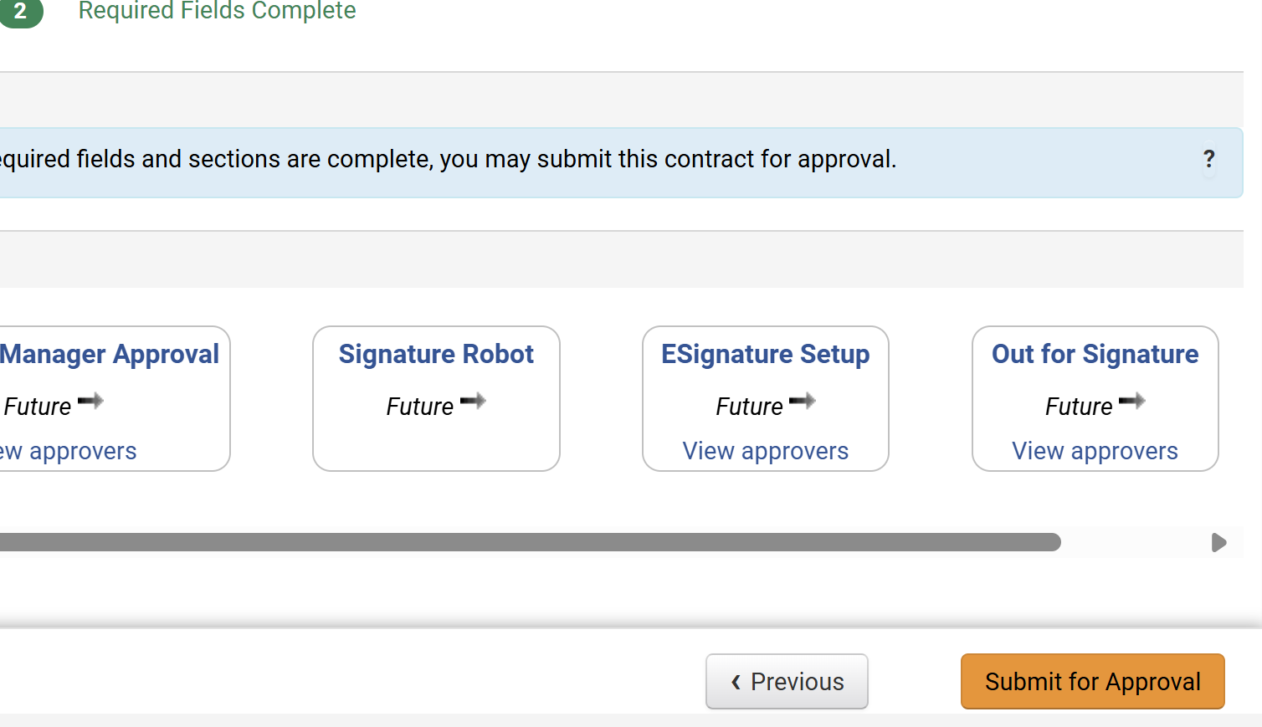
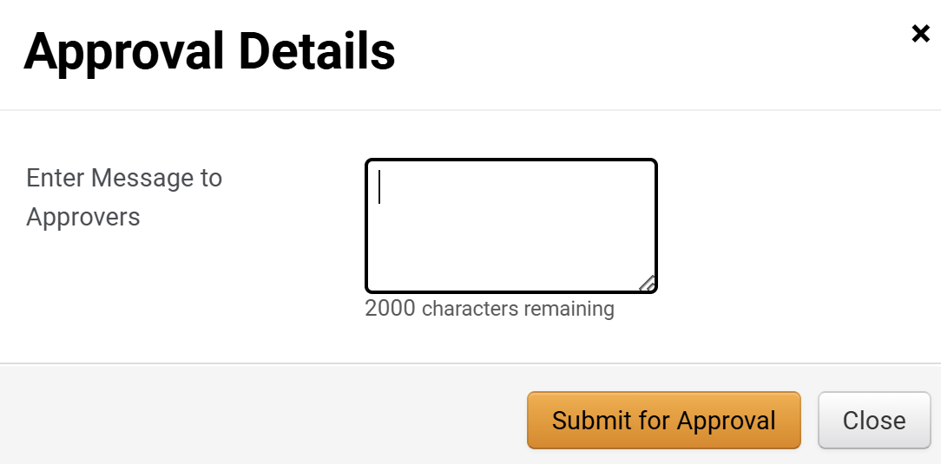
Create an Agency Contract (Part 37 of 37)
INSTRUCTIONS
Click Submit for Approval.
Note: This approval will route to the user who has the contract checked out to approve.
You may Enter Message to Approvers.
Click Submit for Approval.
Note: Follow job aids for Scorecards, Obligations, Review Rounds, Approvals, Ad-Hoc Approvers and eSignature for details on each of those sections prior to execution.
116
117
You have successfully created an Agency Contract.

