Slide 1
Navigating Reports in
GA@WORK Marketplace (JAGGAER)
DESCRIPTION
This guide will show Contract Administrator how to Navigate the Reports in GA@WORK (JAGGAER) only.
OVERVIEW
The key steps in the process are below:
Access the Contracts module.
Search Contracts.
Select Filters.
Run Report.
Business Process:
Access Contracts Module
Search Contracts
Select Filters
Run Report

Slide 2
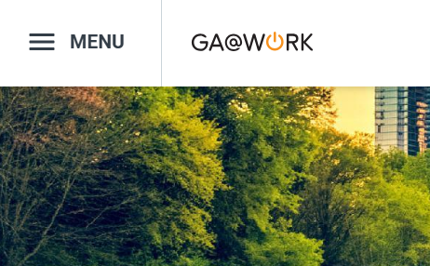

Navigating Reports in GA@WORK (JAGGAER) (Part 1 of 13)
INSTRUCTIONS
Click the Global Navigation Menu.
Note: University System of Georgia (USG) users complete local logon and then proceed to Step 4.
Click Sourcing, Contracts & Supplier Management.

Slide 3

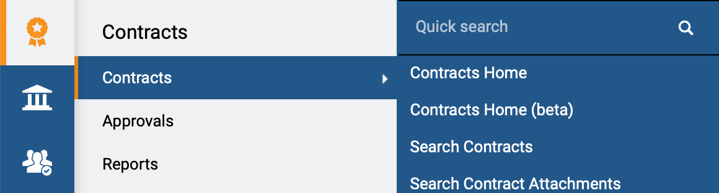
Navigating Reports in GA@WORK (JAGGAER) (Part 2 of 13)
INSTRUCTIONS
Click Sign On.
Note: The system utilizes Single Sign-On (SSO) capabilities
and no log in information is required.
Access the Contracts module.
Click Contracts.
Click Search Contracts.
4
5
6

Slide 4
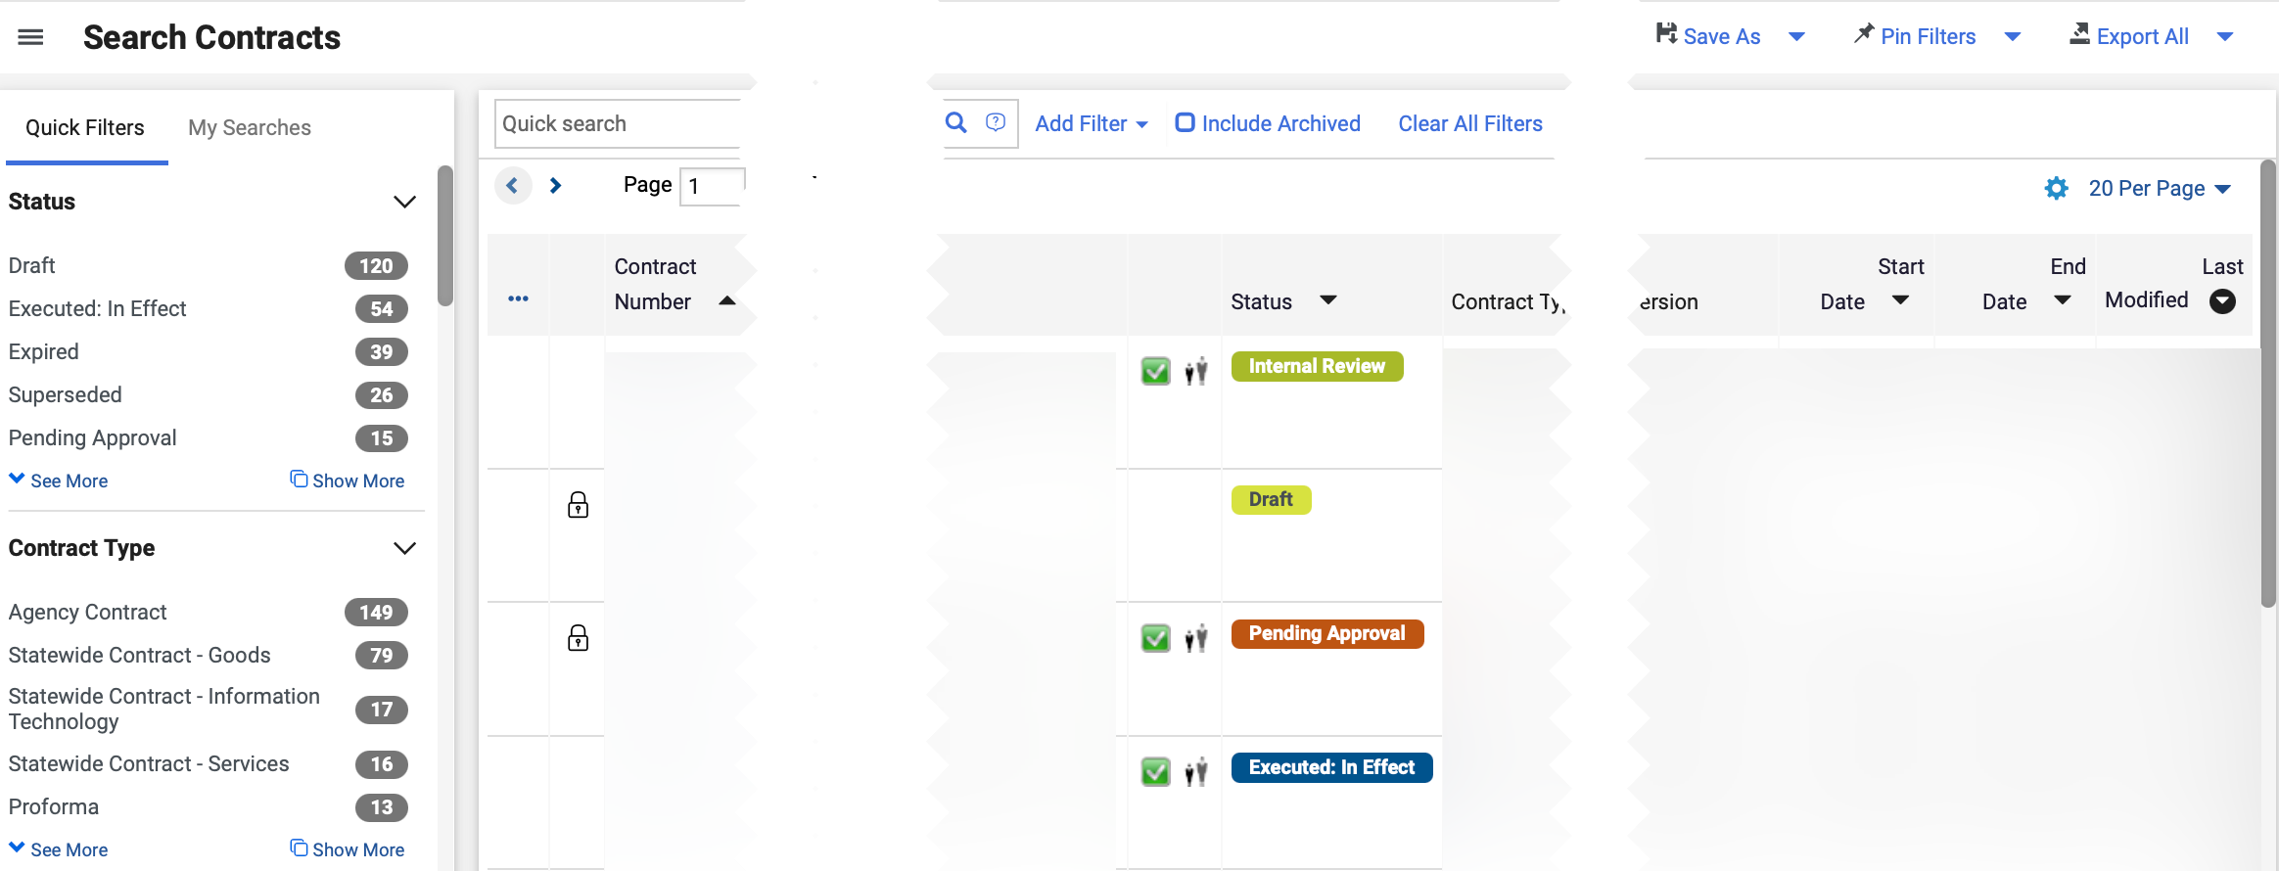
Navigating Reports in GA@WORK (JAGGAER) (Part 3 of 13)
INSTRUCTIONS
Review Search Contracts.
Note: No filters are required to display the complete list of documents. Clicking the Contract Number hyperlink will open the contract page. The Main Document and other attachments can be downloaded.

Slide 5
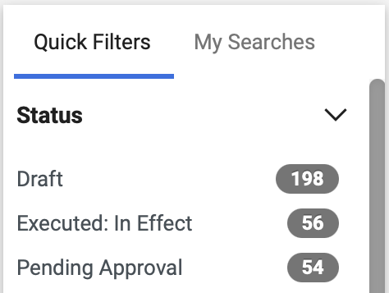
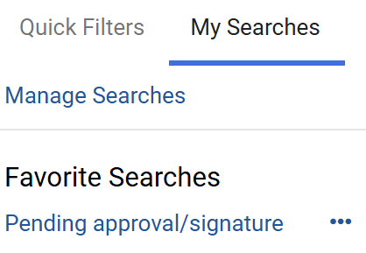
Navigating Reports in GA@WORK (JAGGAER) (Part 4 of 13)
INSTRUCTIONS
Click Quick Filters.
Note: Quick Filters are the default filter automatically provided by the system. Clicking on any of the Quick Filters will add them to the filter search.
Click My Searches.
Note: To add Searches, follow steps 14-16.

Slide 6
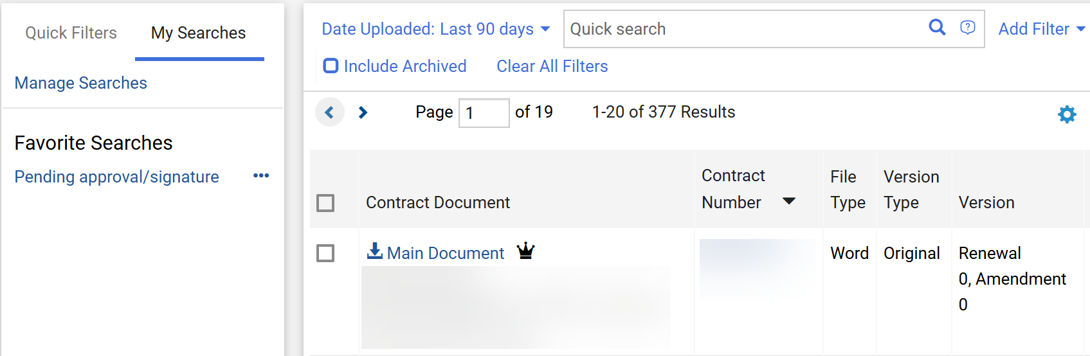
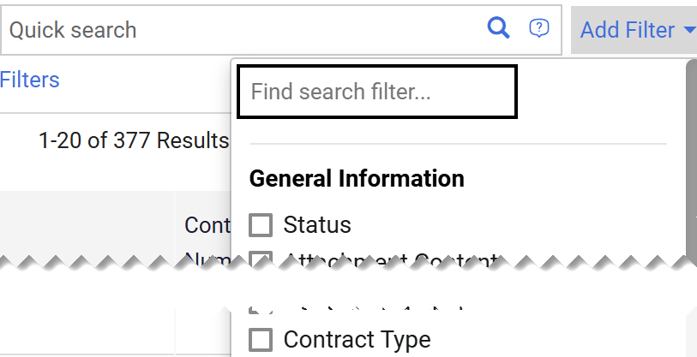
Navigating Reports in GA@WORK (JAGGAER) (Part 5 of 13)
INSTRUCTIONS
Click Add Filter.
Check the applicable Filter box(s) under General Information.
Note: It is possible to add multiple filters.

Slide 7
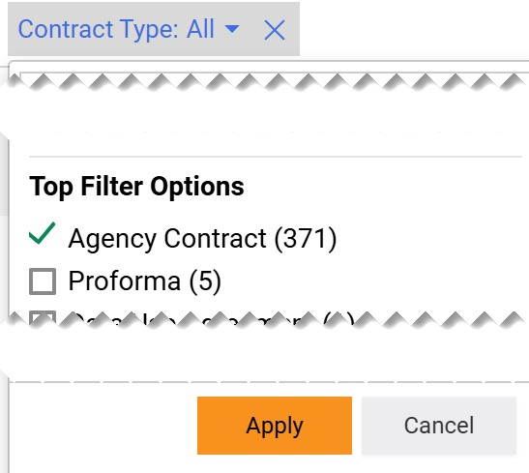
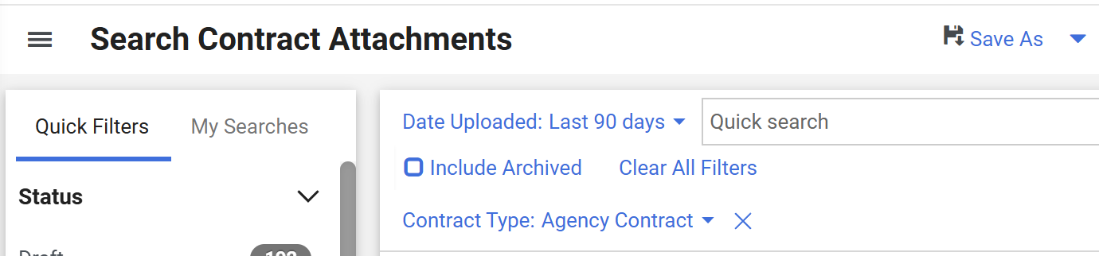
Navigating Reports in GA@WORK (JAGGAER) (Part 6 of 13)
INSTRUCTIONS
Click the Filter menu.
Note: For this job aid, the filter used was Contract Type.
Check Top Filter Options, as applicable.
Click Apply.
Note: Filtered contract results will display.
11
12
13
Click Save As (optional).
Note: Saving Filters enables quick access by preserving data views for future use.

Slide 8
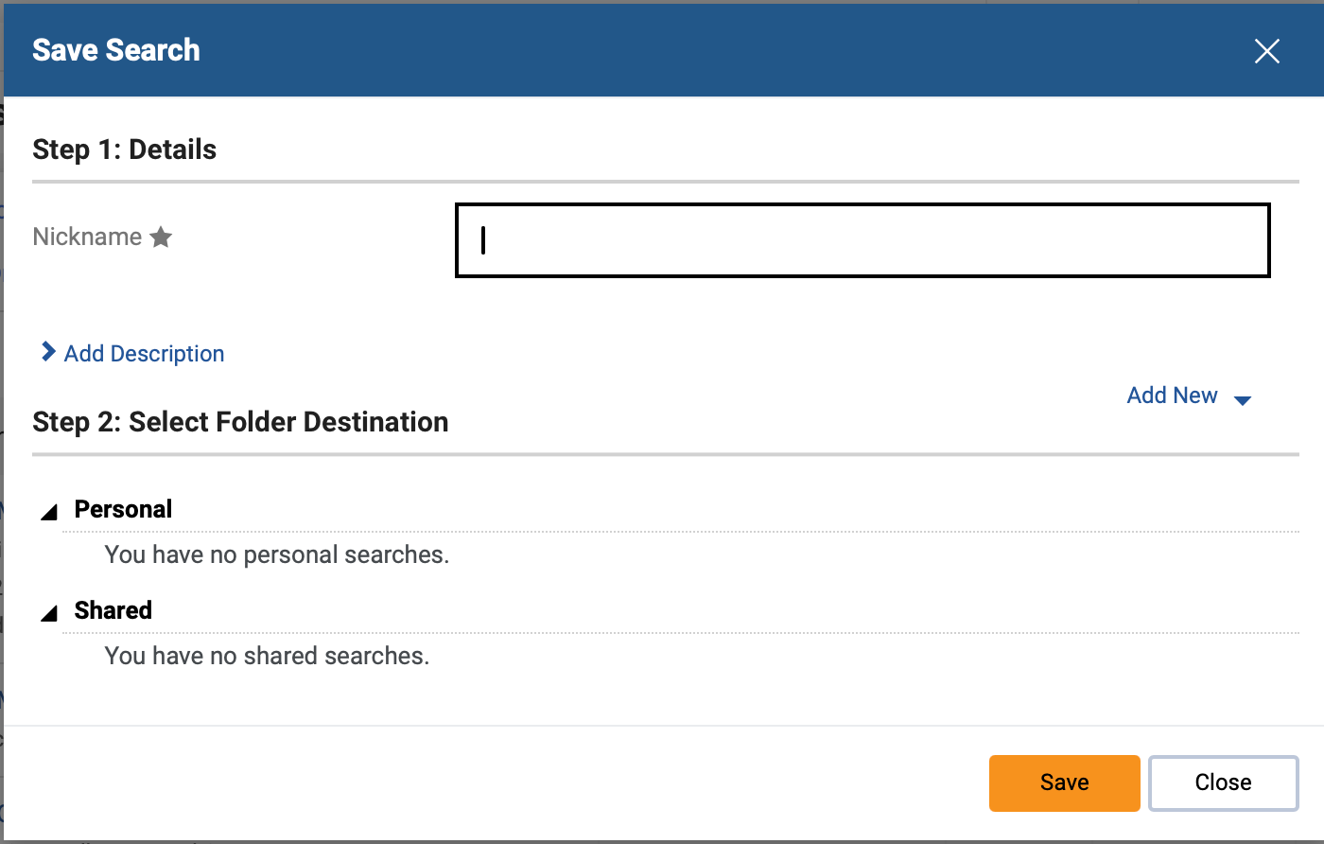
Navigating Reports in GA@WORK (JAGGAER) (Part 7 of 13)
INSTRUCTIONS
Enter a Nickname*.
Note: Complete all required fields marked with a black star*.
Click Save.
Note: You can access saved filters from My Searches menu.
15
16

Slide 9
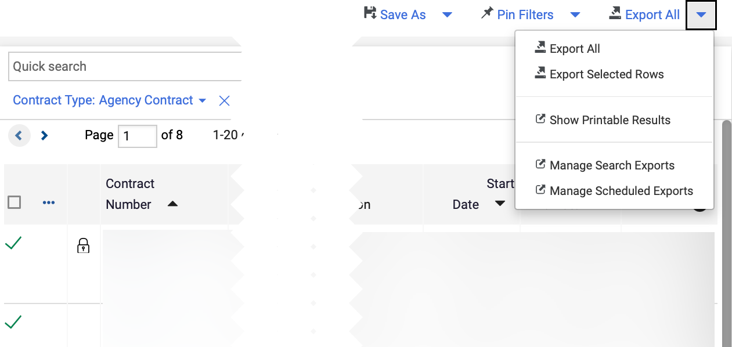
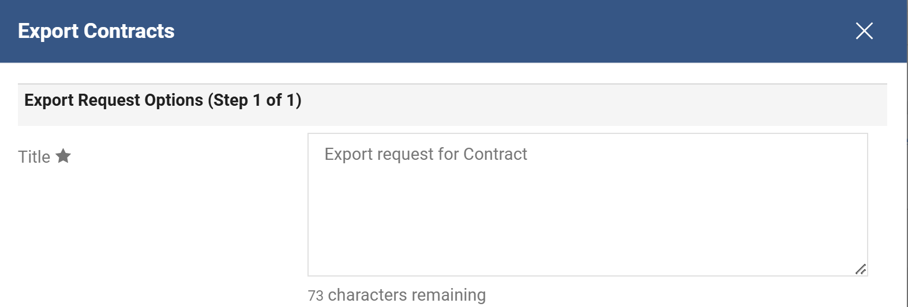
Navigating Reports in GA@WORK (JAGGAER) (Part 8 of 13)
INSTRUCTIONS
Click Export All.
Note: Export All will export all filtered results. To export specific contracts, select the Checkbox next to the contract> click the arrow next to Export All>select Export Selected Rows.
Enter a Title*.
Note: Title* will auto-populate, however, it can be edited.

Slide 10
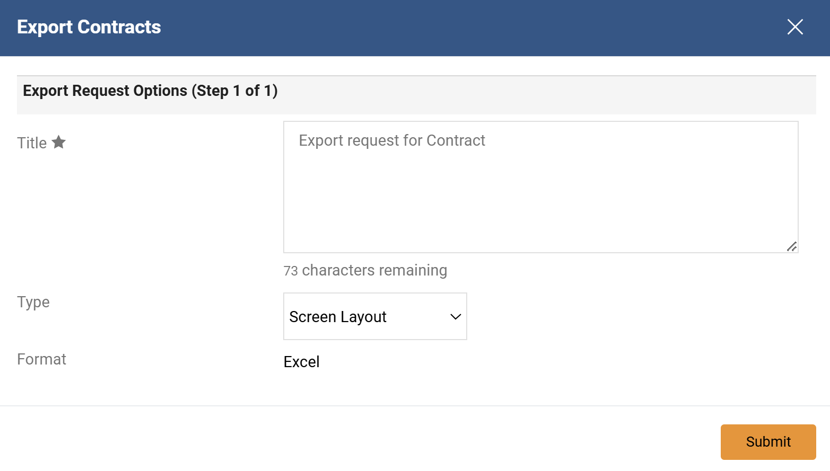
Navigating Reports in GA@WORK (JAGGAER) (Part 9 of 13)
INSTRUCTIONS
Select Type. Reference the table for guidance on each field.
Click Submit.
19
20
Type | ​Action
 | ​
 | ​
Screen Layout
Excel is the only available export format, therefore is read-only. Screen layout will export only the columns and data in the search results.
Full Export
Able to select export format, either CSV or Excel. Full export will export all contract header and custom fields.
Able to select export format, either CSV or Excel. The option “Choose Template” is visible, The user can select existing template or create a new template. To create a new template, click “Next” to include the fields to be displayed in the report, and then click “Next” to create and save the template.
User Defined Template
Summary
Excel is the only available export format, therefore is read-only. Able to include custom fields in the report. Summary will export the fields visible on the contract header, contract users, second party information and custom fields.
Table Custom Fields
Excel is the only available export format, therefore is read-only. Mandatory field display to “Choose Table”.

Slide 11
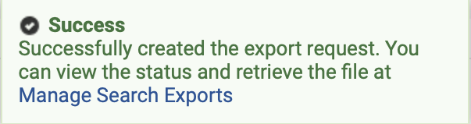
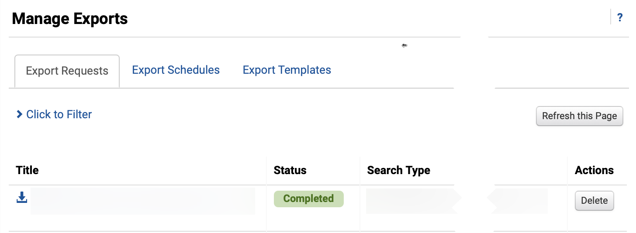
Navigating Reports in GA@WORK (JAGGAER) (Part 10 of 13)
INSTRUCTIONS
Review Success notification.
Click Manage Search Exports.
21
22
Select the Export Title hyperlink.
Note: The file will download on your browser. You can also view the file by clicking Manage Searches from the User Profile icon.

Slide 12
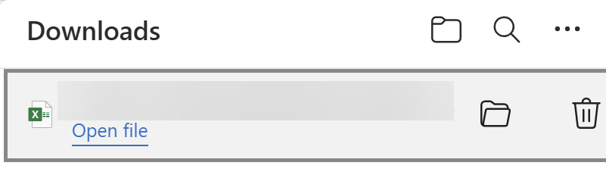
Navigating Reports in GA@WORK (JAGGAER) (Part 11 of 13)
INSTRUCTIONS
Click Open file.
Note: The document will open as a Microsoft Word document. Once you export the Excel file, the file is not a live document and will not reflect any subsequent change done in the system.

Slide 13
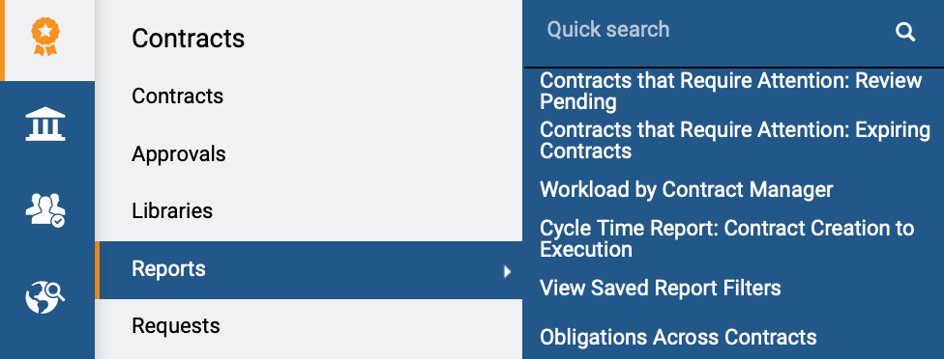
Navigating Reports in GA@WORK (JAGGAER) (Part 12 of 13)
INSTRUCTIONS
Access the Contract module.
Click Reports.
Click Report Title.
Note: For this job aid, the report exampled here is Workload by Contract Manager; the results would be the same regardless of the Report selected.
25
27
26

Slide 14
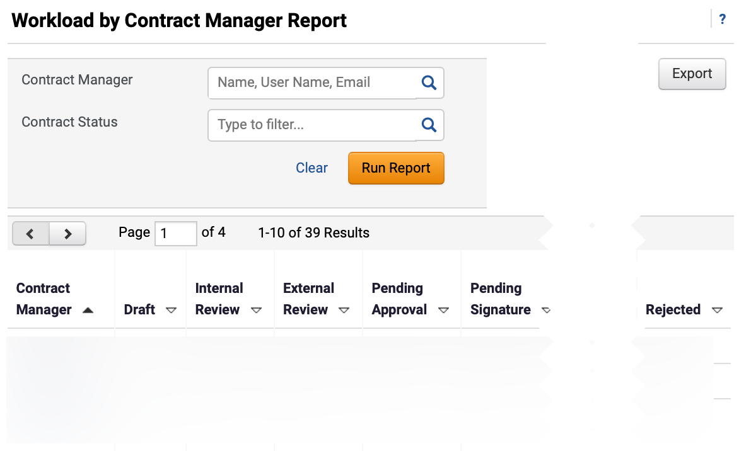

Navigating Reports in GA@WORK (JAGGAER) (Part 13 of 13)
INSTRUCTIONS
Select Contract Manager (optional).
Note: Enter in the field or use the magnifying glass to search.
Select Contract Status (optional).
Click Run Report.
Note: Data will display below. Click Export to export the report.
28
29
30
You have successfully Navigated Reports.

