Slide 1
Renew a Statewide Contract
DESCRIPTION
This guide will show State Purchasing Division Contract Administrator how to Renew a Statewide Contract only.
OVERVIEW
The key steps in the process are below:
Access the Contracts module.
Select Contract for renewal.
​Renew Contract.
​Contract is Renewed.
Business Process:
Access Contracts Module
Select Contract
Renew Contract
Contract is Renewed
Notes:
9. Upload the modified contract amendment template a. From the Actions menu of the amendment template select 'Upload New Version' b. Click Select File c. Navigate to where you save the modified template, select it and click Open. d. Click Save Changes once the file is at 100%.”
10. Submit for Approval a. Click on Submit For Approval from the left menu b. Click Submit for Approval button. c. Enter a message to approvers and click Submit for Approval.”
"11. Approve the contract a. Under the Next Steps section, click on the View the Contract link b. From the Renewal Actions button select Approve c. Refresh the brower until the status changes to Out for Signature. There is not a refresh button on the page, refresh the browser .”
"12. Upload Fully Executed Contract - you are assuming this renewal is signed outside of the system. a. From the Renewal Actions button Select Upload Fully Executed Contract b. For 'Which file would you like to use?' select Use Full Contract PDF and click Save Changes”

Slide 2


Renew a Statewide Contract (Part 1 of 13)
INSTRUCTIONS
Click the Global Navigation Menu.
Click Sourcing, Contracts & Supplier Management.

Slide 3

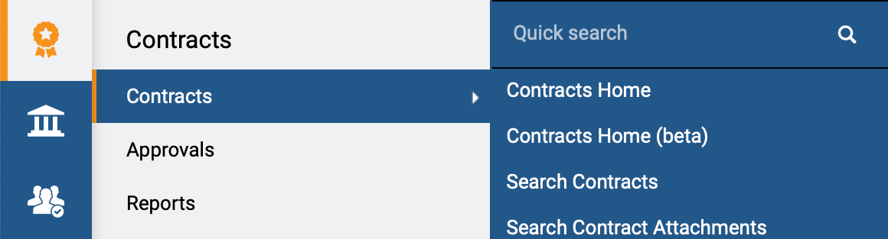
Renew a Statewide Contract (Part 2 of 13)
INSTRUCTIONS
Click Sign On.
Note: The system utilizes Single Sign-On (SSO), no log in information is required.
Access the Contracts module.
Click Contracts.
Click Search Contracts.
4
5
6

Slide 4
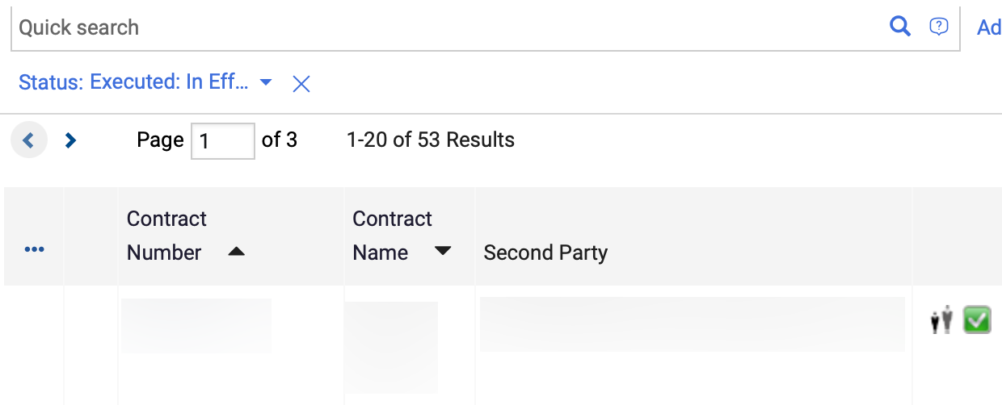
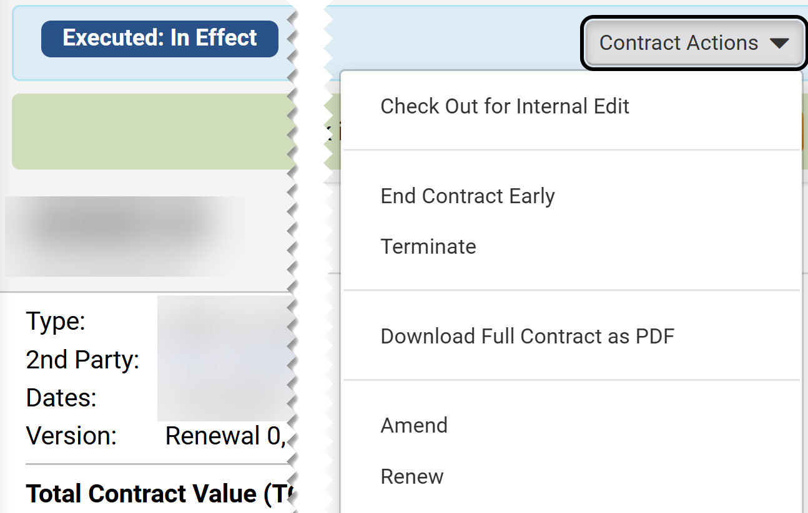
Renew a Statewide Contract (Part 3 of 13)
INSTRUCTIONS
Click Contract Number.
Note: Use the Quick Search and Filters to find the contract.
Click Contract Actions
Click Renew.
Note: Renew is only visible if the contract has Renewals Remaining.
8
9

Slide 5
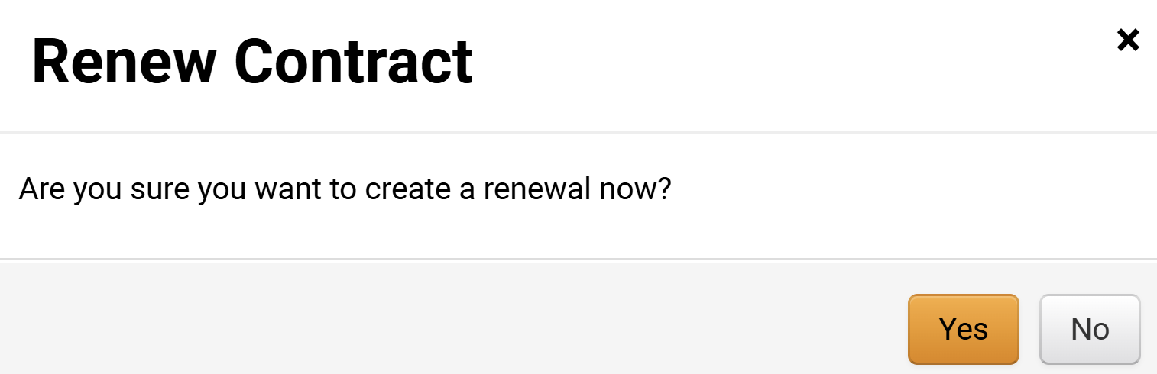
Renew a Statewide Contract (Part 4 of 13)
INSTRUCTIONS
Click Yes.
Note: The Contract Renewal will open only after clicking Yes.

Slide 6
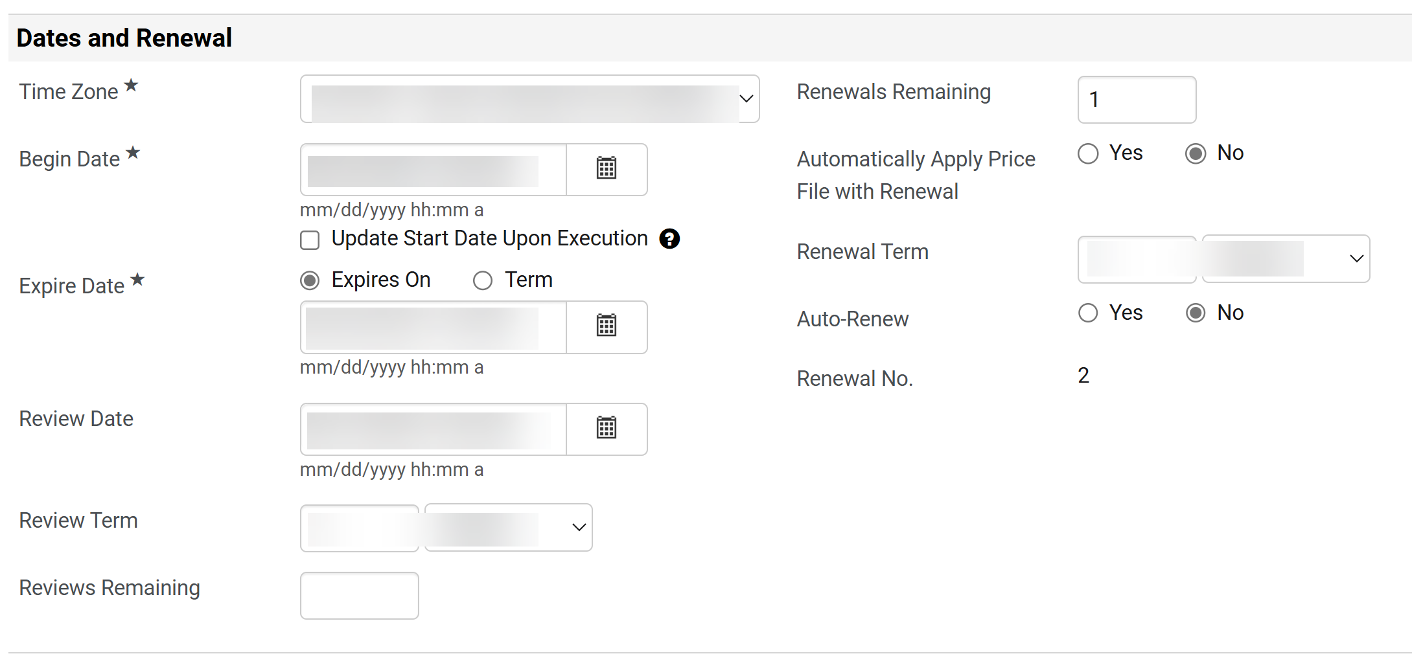
Renew a Statewide Contract (Part 5 of 13)
INSTRUCTIONS
Review the Dates and Renewal data auto-populated from the Statewide Contract.
Confirm Renewals Remaining.
Note: Renewals remaining will decrease to the number of remaining renewals.
Confirm Renewal No. read-only field of running renewals.
11
12
13

Slide 7
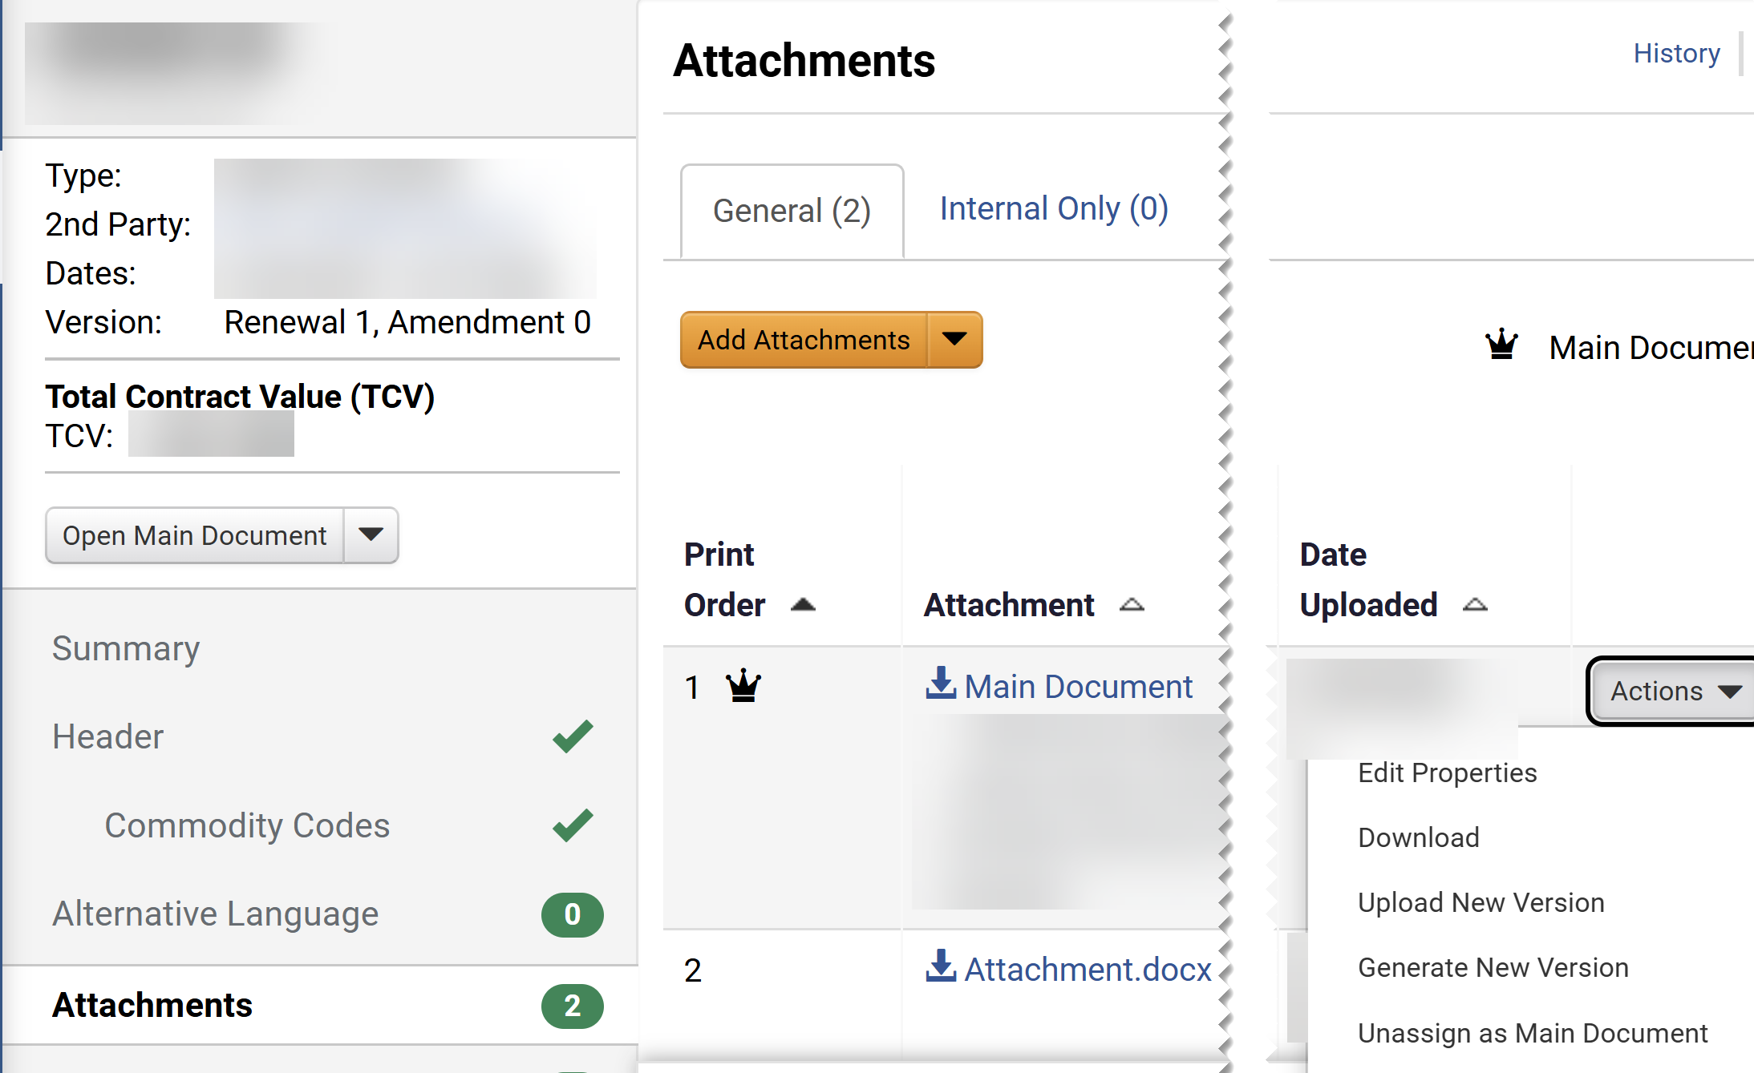
Renew a Statewide Contract (Part 6 of 13)
INSTRUCTIONS
Click Attachments on Contract Menu.
Click Actions on the Main Document.
Select Unassign as Main Document.
Note: This step is required for the renewal actions to be visible.
15
14
16

Slide 8
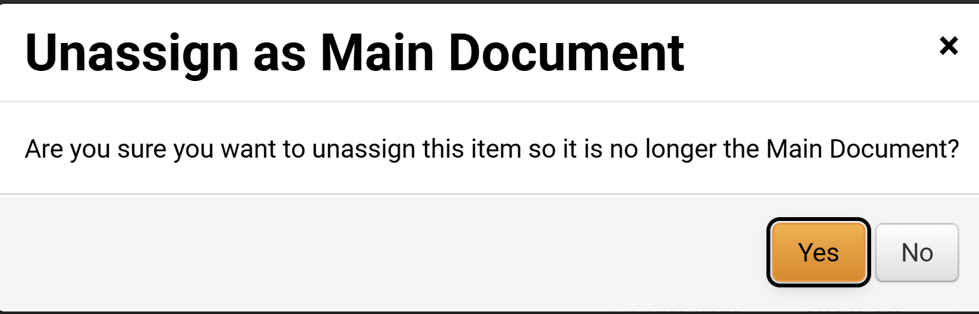
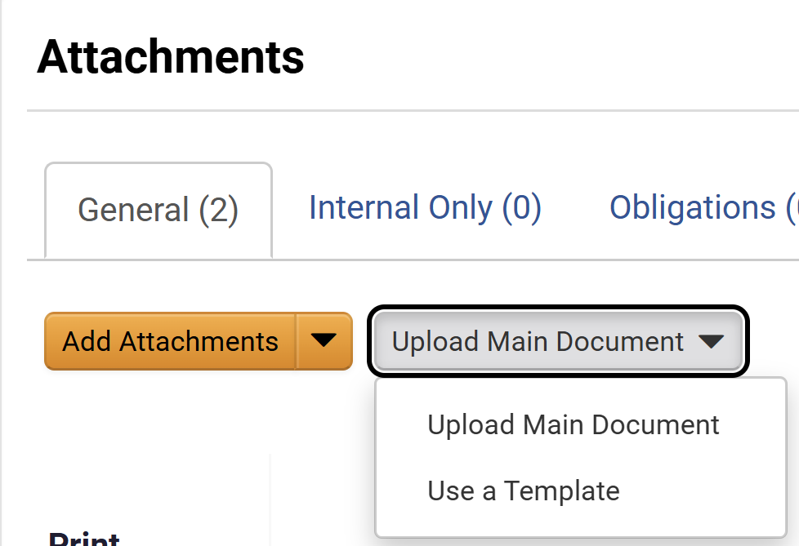
Renew a Statewide Contract (Part 7 of 13)
INSTRUCTIONS
Click Yes.
Click Upload Main Document.
Click Use a Template.
18
19

Slide 9
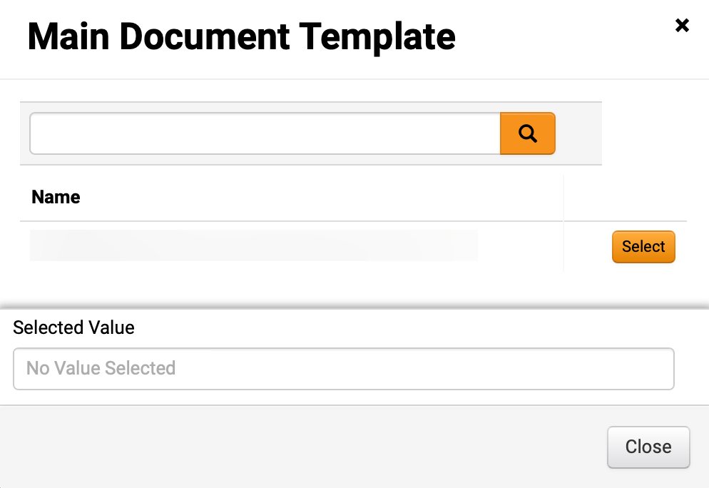
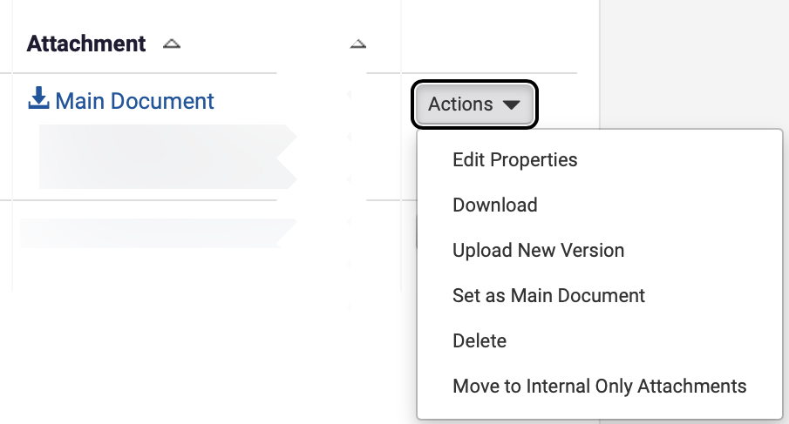
Renew a Statewide Contract (Part 8 of 13)
INSTRUCTIONS
Select Main Document Renewal Template.
Note: You can also use magnifying glass to search.
Click Actions on the Main Document.
Select Edit Properties.
21
22
Notes:
d. Select a Renewal Template e. From the Actions Menu of the Main Document select Edit Properties f. Rename the file Contract Renewal Template1 g. Choose Print with Full Contract Yes and Show on Supplier Portal Yes, Click Save Changes.”
8. Modify the Renewal Template a. From the Actions Menu of the Renewal Template select Download. b. Open the file in Word. c. In Word Click Enable Editing d. Modify the contract renewal template by changing the renewal No from 1 to 2 (continue to increase renewal number for testing). e. Save the file to your desktop in Word (or somewhere it can be easily found) f. Close the file in Word and return to Jaggaer Contracts.”

Slide 10
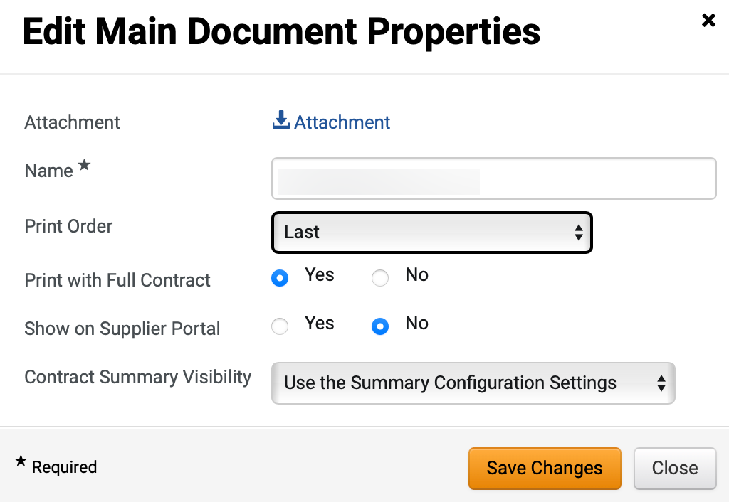
Renew a Statewide Contract (Part 9 of 13)
INSTRUCTIONS
The uploaded File* is visible, select Print Order.
Select an option for Print with Full Contract.
Note: If Yes is selected, then this attachment will be combined in a pdf with the Main Document.
Select an option for Show on Supplier Portal.
Note: If Yes selected, then attachment will be visible to the suppler in the Supplier Portal.
Select an option for Contract Summary Visibility.
Click Save Changes.
23
24
25
26
27
Notes:
10. Start Internal Review
a. Click the Review Rounds menu item
b. Click Create Manual Internal Round button
c. On the Add Reviewer search for a user in your organization where you will be able to Proxy as them in Workday.
d. Click Select button next to the user you have searched for, ensure they appear into the Selected Values field and click Save Changes.
e. Click the Begin Round button
f. Enter a message for your Reviewer and click Begin Internal Review button
Close the Jaggaer window and return to Workday. Proxy as the Reviewer you just started Internal Review as
a. Click on the Actions Items Flag in the upper right corner.
b. Click on Contracts to Review (Internal Review)
c. Click on the blue Contract id to open the contract.
d. Click on the Attachments link in the left menu. (You may need to scroll down)
Click on the blue Check Out button.
14. Modify the Main Document template - which is the amendment template
a. From the Actions button next to Main Document attachment (crown) choose Download and once the file downloads click Open file or open the file from where it was saved. The file should open in Word.
b. Click Enable Editing in Word and modify the verbiage you previously entered.
Save the word document where you can find it later to upload and close the document. You may want to save it on your desktop.
15. Upload the revised Main Document template
a. From the Actions button next to Main Document attachment (crown) choose upload new version.
b. On the Upload New Version page Click the Select file button and upload the new document you saved in step above. Enter comments in the comments field for any changes you want to explain. Click Save Changes button once the status is 100%.
c. From the Amendment Actions button choose Done with My Review.
d. Enter comments that you are done with your review and click Done with My Review.
e. Click Cancel Punchout in the upper right corner, then close that browser window.
f. Once back in Workday type 'Stop Proxy' in the Search task field and click Enter.
Click the Stop Proxy link, then OK.
16. Access Jaggaer from Workday
From the Workday click Menu > Apps > Jaggaer > Sign on
17. Open the contract in Jaggaer
a. Click the Contracts > Search Contracts
b. Enter your contract name (CONT-0004) in the Quick Search field and press Enter
Select the Contract Number to open the contract, make sure you have selected the Draft contract which is the amendment and NOT the executed contract.
18. Check out the Contract
Click the blue Check Out button
19. Submit for Approval
a. Click on Submit For Approval from the left menu
b. Click Submit for Approval button.
Enter a message to approvers and click Submit for Approval.
20. Approve the contract
a. Under the Next Steps section, click on the View the Contract link
b. From the Amendment Actions button select Approve
Refresh the brower until the status changes to Out for Signature. There is not a refresh button on the page, refresh the browser .
21. Upload Fully Executed Contract
a. From the Amendment Actions button Select Upload Fully Executed Contract
b. Click the Select file button, navigate to a file on your computer, click Open.
Once the status is 100% click Save Changes

Slide 11
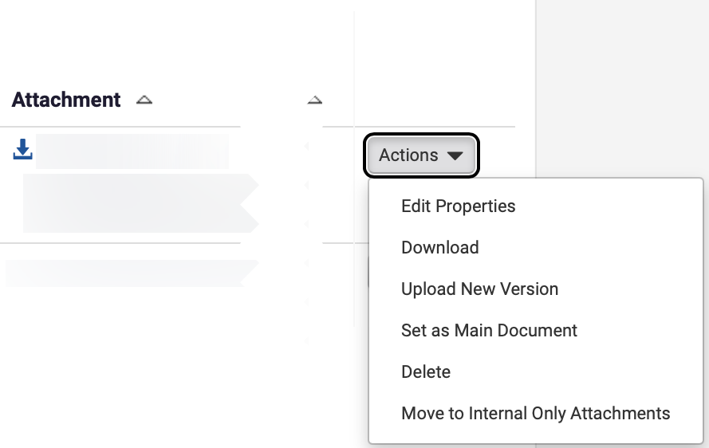
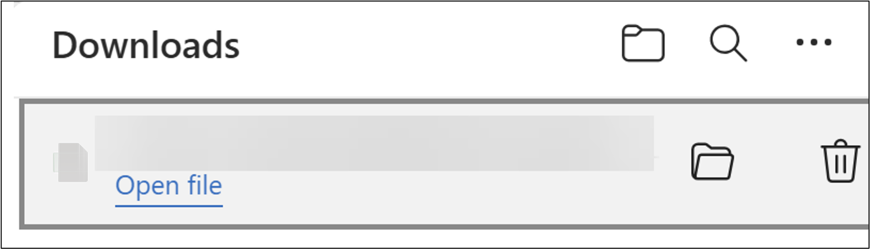
Renew a Statewide Contract (Part 10 of 13)
INSTRUCTIONS
Click Actions on the Renewal Template.
Select Download.
28
29
Click Open File.
Note: The file will open in Microsoft Word. Enable making changes to the document and save it to your computer for upload.

Slide 12
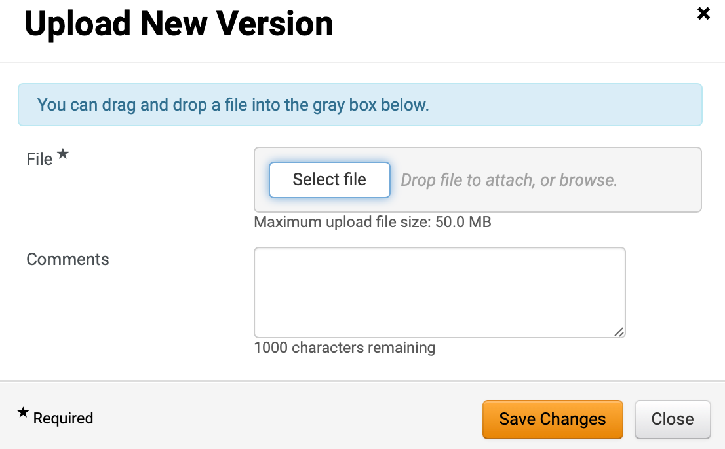
Renew a Statewide Contract (Part 11 of 13)
INSTRUCTIONS
Click Actions on the Renewal Template.
Select Upload New Version.
31
32
Click a Select file.
Click Save Changes.
33
34
Notes:
10. Submit for Approval a. Click on Submit For Approval from the left menu b. Click Submit for Approval button. c. Enter a message to approvers and click Submit for Approval.”
"11. Approve the contract a. Under the Next Steps section, click on the View the Contract link b. From the Renewal Actions button select Approve c. Refresh the brower until the status changes to Out for Signature. There is not a refresh button on the page, refresh the browser .”
"12. Upload Fully Executed Contract - you are assuming this renewal is signed outside of the system. a. From the Renewal Actions button Select Upload Fully Executed Contract b. For 'Which file would you like to use?' select Use Full Contract PDF and click Save Changes”

Slide 13
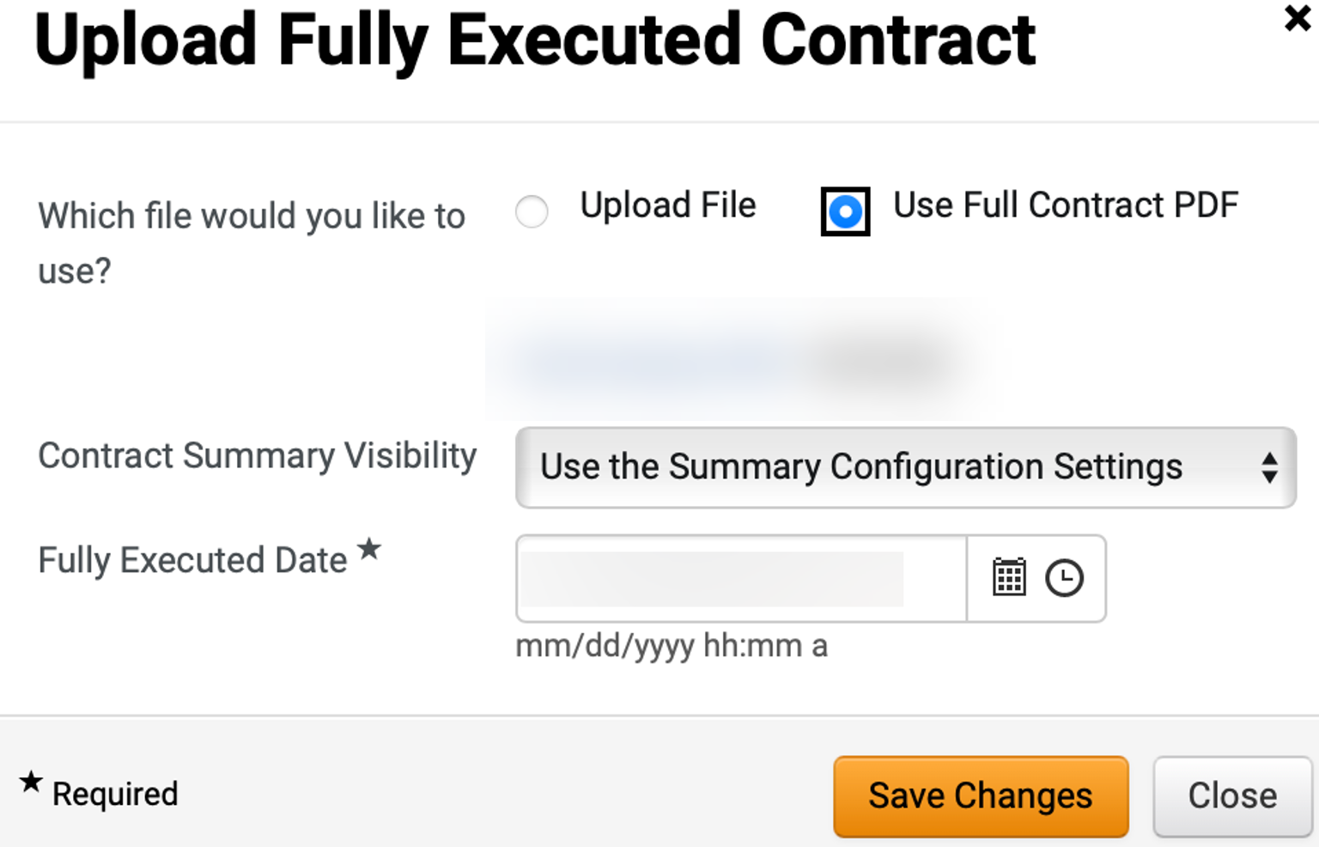
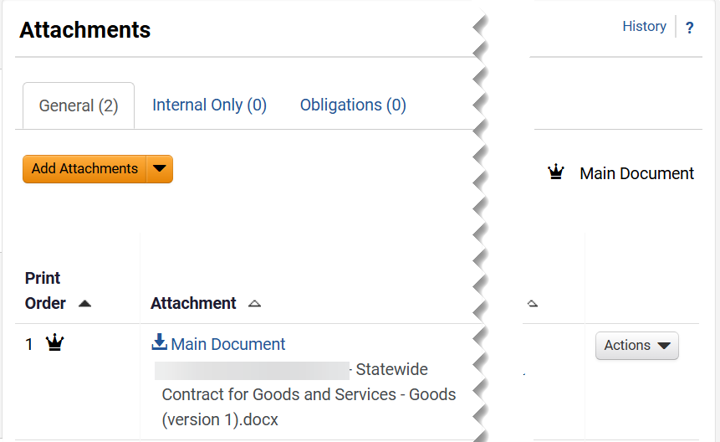
Renew a Statewide Contract (Part 12 of 13)
INSTRUCTIONS
Select Which file would you like to use?.
Review the Fully Executed Date*.
Click Save Changes.
35
36
37
Review the Main Document.

Slide 14
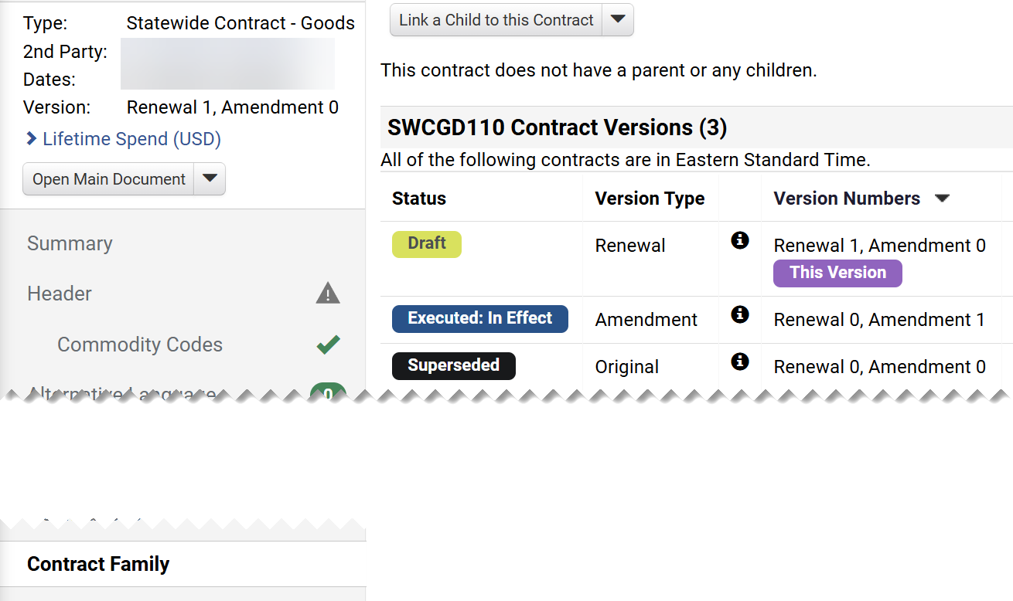
Renew a Statewide Contract (Part 13 of 13)
INSTRUCTIONS
Click Contract Family.
Note: The Contract Versions displays the Status, Version Type, and Version Numbers information. Version will remain on Draft Status until is routed for approval and signature collections. Review the required job aids for those activities.
You have successfully Renewed a Statewide Contract.

