Slide 1
Routing a Contract for Review
(Internal and External)
DESCRIPTION
This guide will show Contract Administrator how to Route a Contract for Internal and External Review only.
OVERVIEW
The key steps in the process are below:
Access the Contracts module.
Select Contract for Review.
Begin Review Rounds.
Contract is Routed for Review.
Note: Throughout the system, click on the Question Mark to access the help text. In addition, any field with a Gray Star is a mandatory field.
Business Process:
Access Contracts Module
Select Contract for Review
Begin Review Rounds
Contract is Reviewed

Slide 2


Routing a Contract for Review
(Part 1 of 16)
INSTRUCTIONS
Click the Global Navigation Menu.
Note: University System of Georgia (USG) users complete local logon and then proceed to Step 4.
Click Sourcing, Contracts & Supplier Management.
Notes:
Link for USG log in: <insert link>
For log in issues, users should go to Agency Super User first. Call Help Desk if needed. T1 should know (have a list) log in selections to advise user of correct selection to make.
If the app, Sourcing, Contracts & Supplier Management, is not in the list of apps, click on the Add Apps button at the bottom, find the Sourcing, Contracts, & Supplier Management app, then click on the + to add it to your list of Apps.

Slide 3

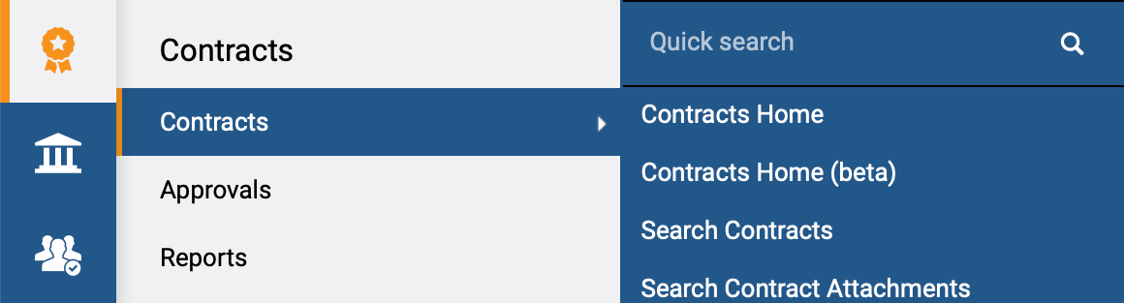
Routing a Contract for Review
(Part 2 of 16)
INSTRUCTIONS
Click Sign On.
Note: The system utilizes Single Sign-On (SSO) capabilities
and no log in information is required.
Access the Contracts module.
Click Contracts.
Click Search Contracts.
4
5
6
Notes:
Clicking Sign on will take the user out of GA@WORK and into the GA@WORK Marketplace.
Click on Contracts then Search Contracts

Slide 4
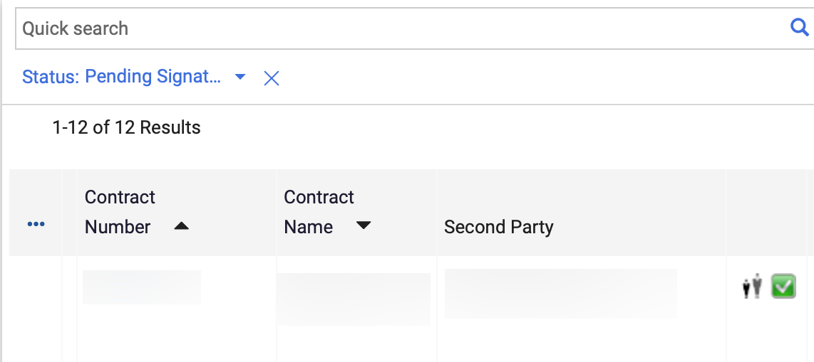
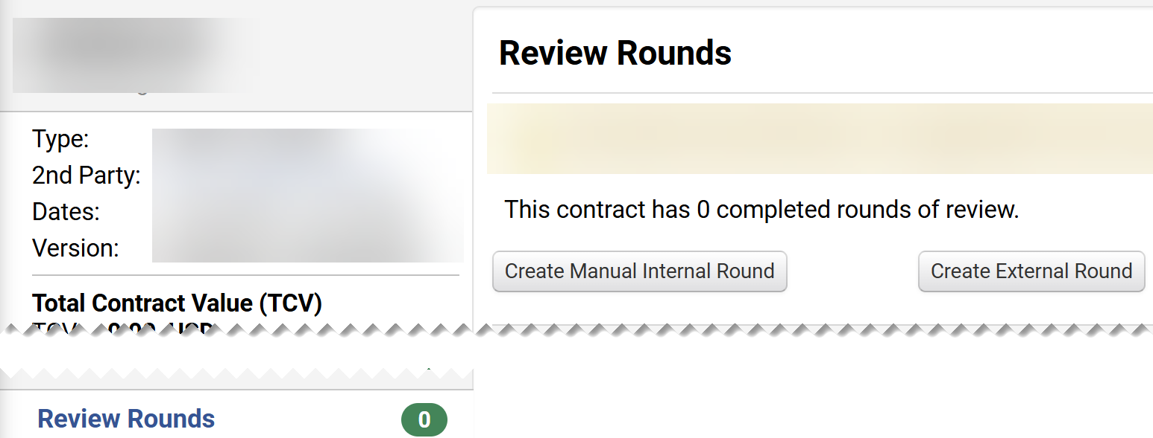
Routing a Contract for Review
(Part 3 of 16)
INSTRUCTIONS
Select the Contract Number hyperlink.
Note: Use the Quick Search and Filters to find the contract.
Click Review Rounds on the Contract menu.
Note: To Create Manual Internal Round, follow Steps 9-32. To Create External Round, follow Steps 33 – 45.
Click Create Manual Internal Round.
9
8
Notes:
Using Quick and filters, locate the contract that needs a review.

Slide 5
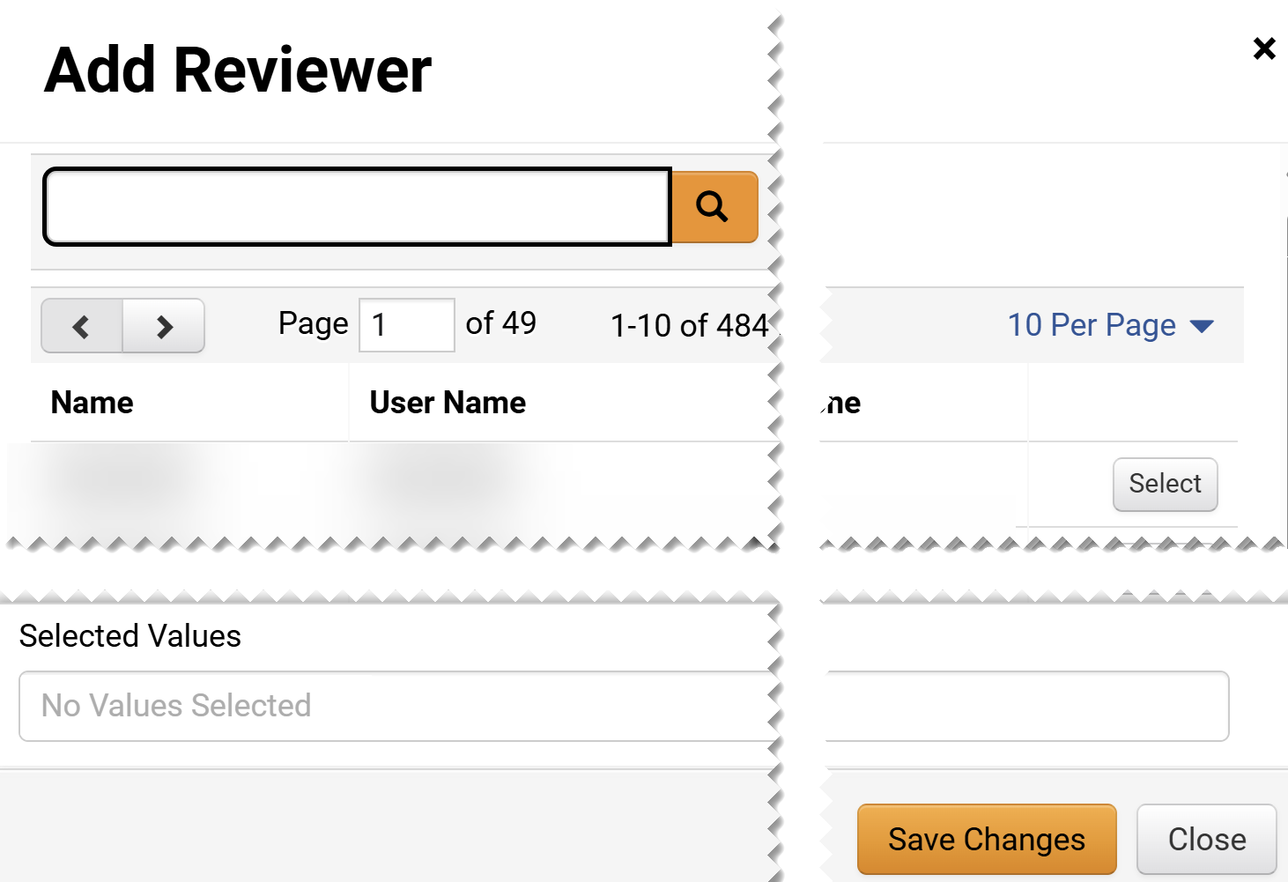
Routing a Contract for Review
(Part 4 of 16)
INSTRUCTIONS
Click Add Reviewer.
Note: You can add multiple Internal reviewers.
Select the applicable Reviewer(s).
Click Save Changes.
11
12

Slide 6
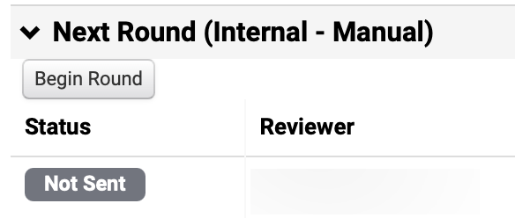
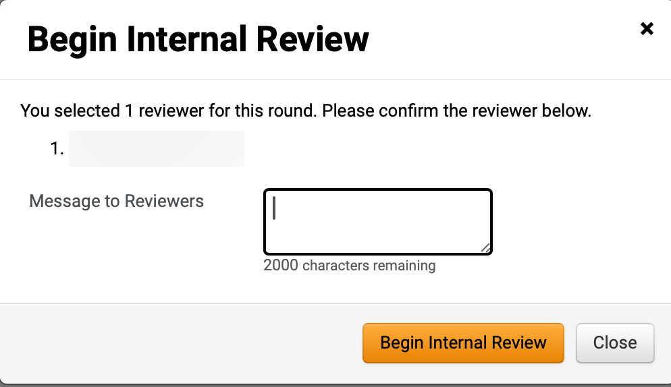
Routing a Contract for Review
(Part 5 of 16)
INSTRUCTIONS
Click Begin Round.
Note: The selected Reviewer/s Name will appear under the Next Round (Internal - Manual) with Status Not Sent.
Enter a Message to Reviewers (Optional).
Click Begin Internal Review.
14
15

Slide 7
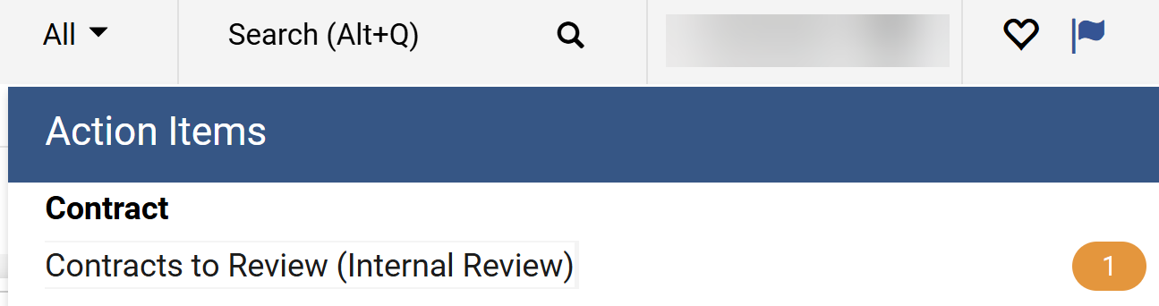
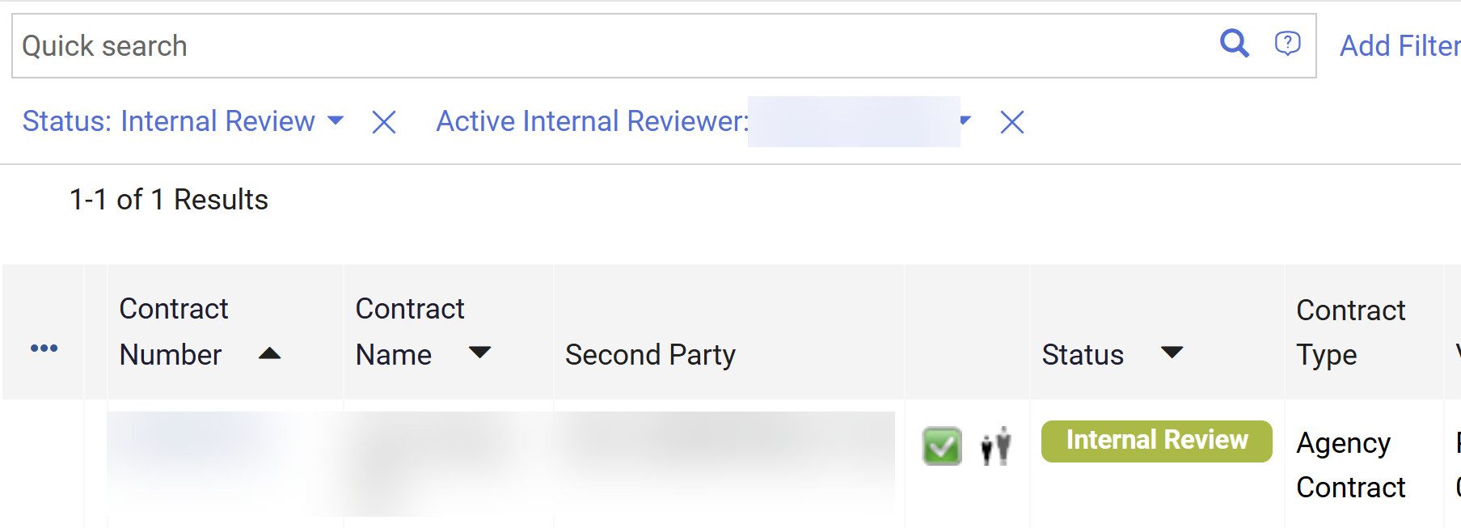
Routing a Contract for Review
(Part 6 of 16)
INSTRUCTIONS
Click the Flag.
Note: Reviewer will also receive a system email notification.
Click Contracts to Review (Internal Review) in Action Items.
Note: Reviewer can also follow Steps 3 - 7 to find the contract.
16
17
Select the Contract Number hyperlink.

Slide 8
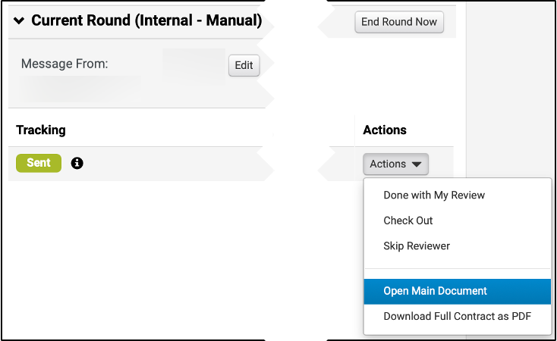
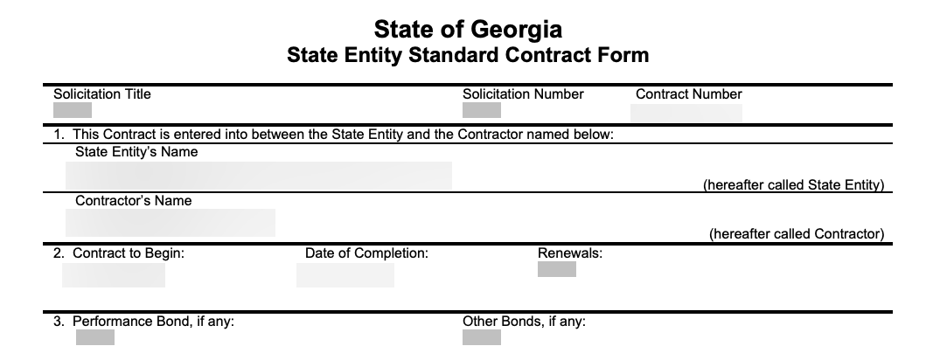
Routing a Contract for Review
(Part 7 of 16)
INSTRUCTIONS
As a reviewer, select Open Main Document from the Actions menu.
Review the Contract and make required changes.
Note: The file should open in Microsoft Word. Save the document on your desktop where you can find it to upload.

Slide 9
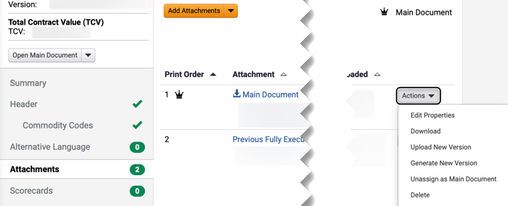
Routing a Contract for Review
(Part 8 of 16)
INSTRUCTIONS
Click Attachments on the Contract menu.
Click Actions.
Select Upload New Version.
Note: Use the table below to learn more about each Actions tab in this section.
22
23
21
Action Tab Field | Description
Actions
Open main document actions
Actions > Edit Properties
Able to change the document name, printing order, printing properties, and supplier visibility.
Actions > Download
Download the document.
Actions > Upload New Version
Able to upload new version of the document and include comments.
Actions > Generate New Version
Able to change version of the document.
Actions > Unassing as Main Document
Unassing current document as the main document. The crown icon would be removed as well.
Actions > Delete
Remove document from attachment list.

Slide 10
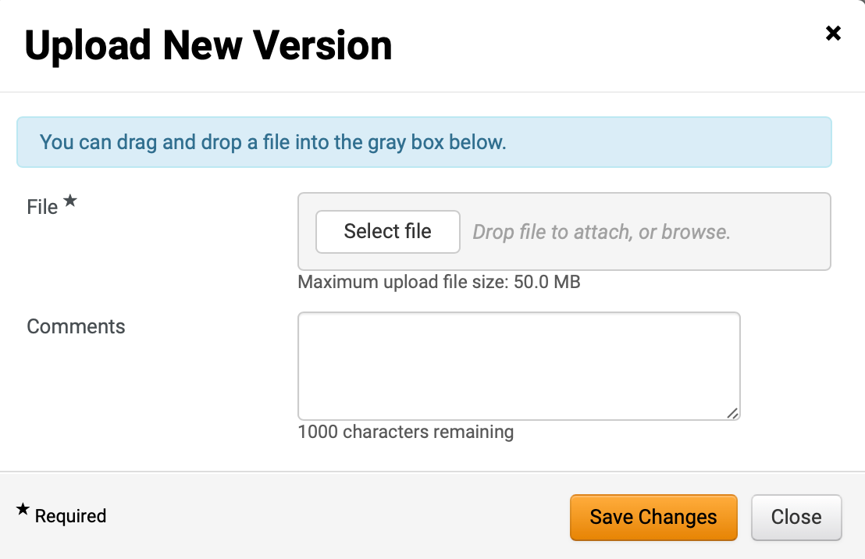
Routing a Contract for Review
(Part 9 of 16)
INSTRUCTIONS
Click Select file for File*.
Note: Upload the Word document you saved in Step 20 by clicking Select file or drag and drop the file. Complete all Required* fields.
Enter Comments (optional).
Click Save Changes.
24
25
26

Slide 11
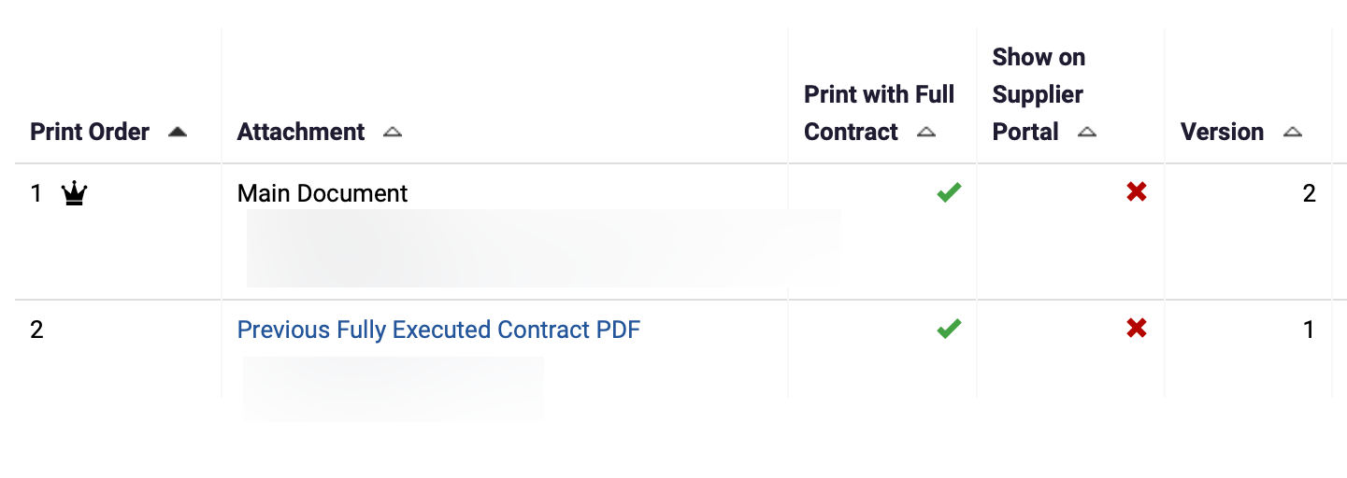
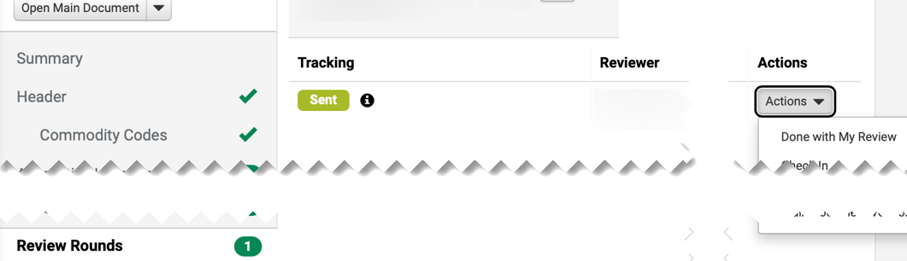
Routing a Contract for Review
(Part 10 of 16)
INSTRUCTIONS
The uploaded document will appear as Version 2 on the Attachments page.
Select Review Rounds on the Contract menu.
Click Actions and select Done with My Review.
29
28

Slide 12
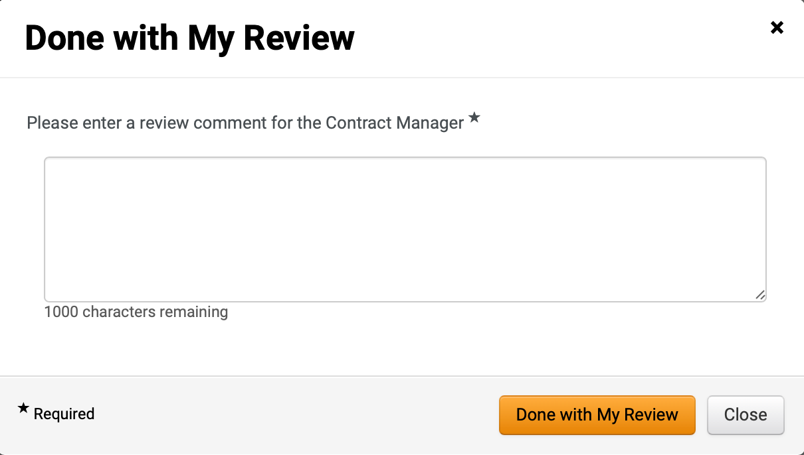
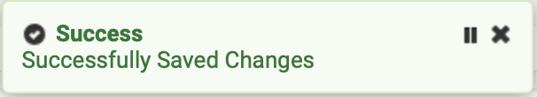
Routing a Contract for Review
(Part 11 of 16)
INSTRUCTIONS
Complete the Please enter a review comment for the Contract Manager* field.
Click Done with My Review.
30
31
A Successfully Saved Changes notification will appear.

Slide 13
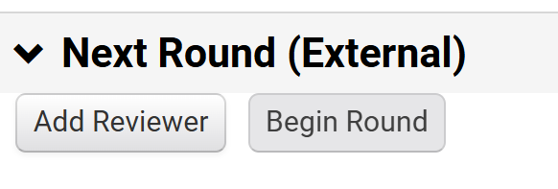
Routing a Contract for Review
(Part 12 of 16)
INSTRUCTIONS
Select Review Rounds on the Contract menu.
Note: A Contract Administrator may begin the Review Rounds.
Click Create External Round.
34
33
Click Add Reviewer.

Slide 14
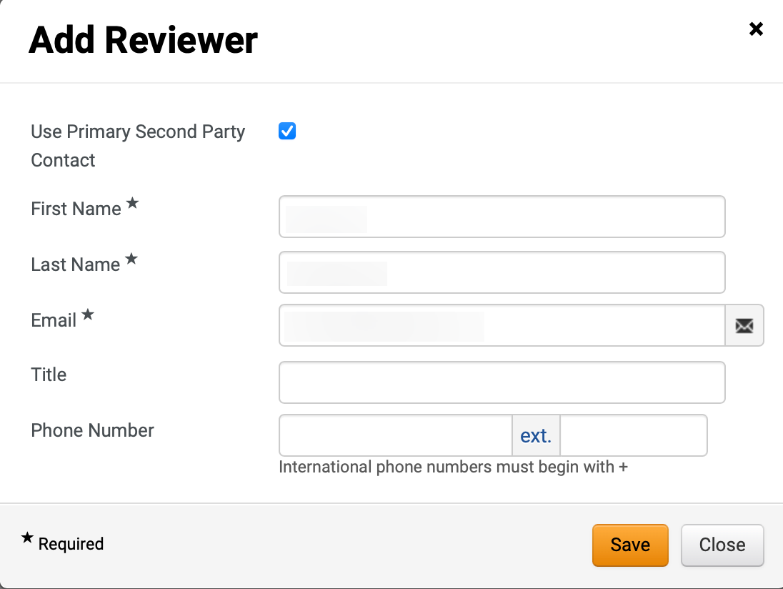
Routing a Contract for Review
(Part 13 of 16)
INSTRUCTIONS
Enter a First Name*.
Enter a Last Name*.
Enter an Email*.
Note: Title and Phone Number are optional fields.
Click Save.
36
37
38
39

Slide 15
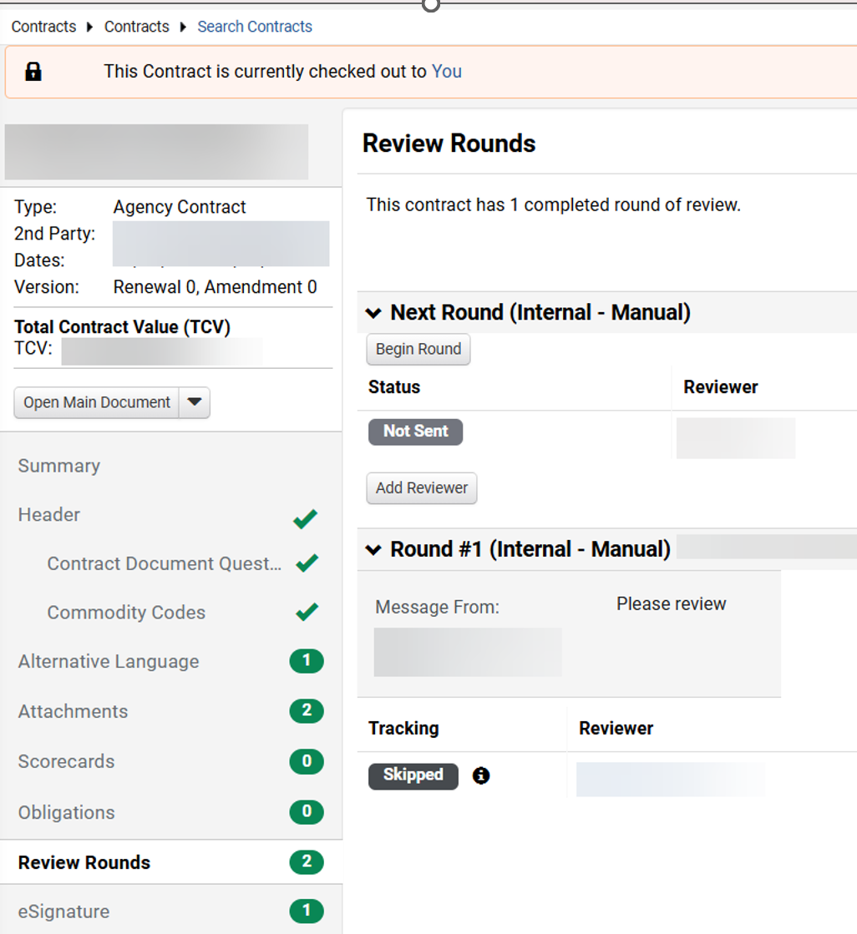
Routing a Contract for Review
(Part 14 of 16)
INSTRUCTIONS
Select Review Rounds on the Contract menu.
Click Begin Round.
41
40

Slide 16
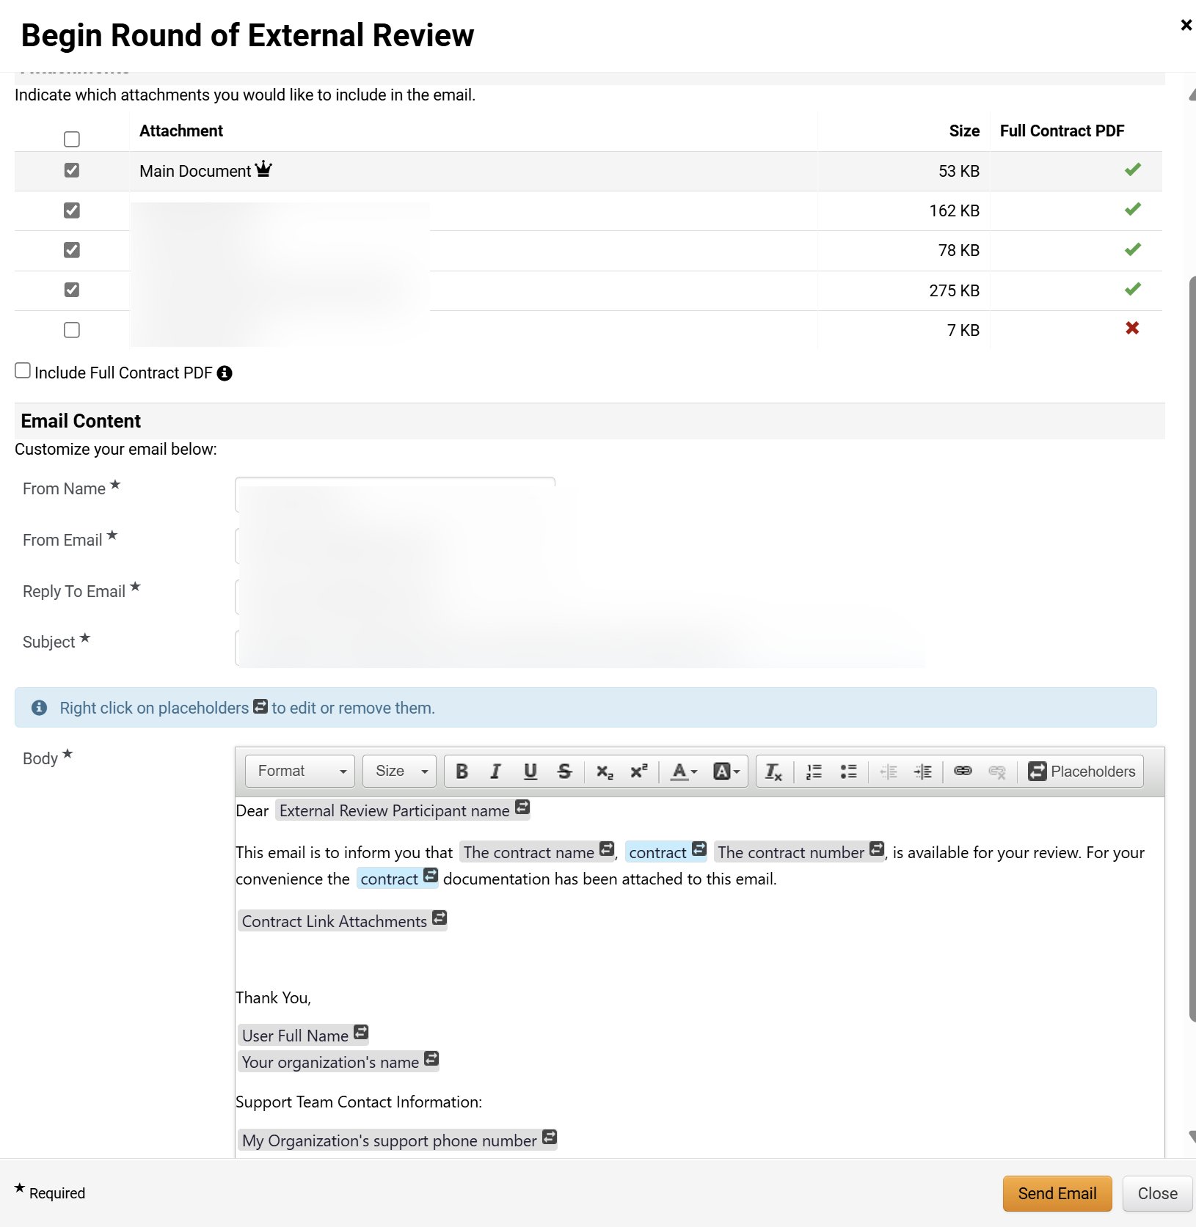
Routing a Contract for Review
(Part 15 of 16)
INSTRUCTIONS
Check the box to include Attachments, as applicable.
Review Email Content sender.

Slide 17

Routing a Contract for Review
(Part 16 of 16)
INSTRUCTIONS
Populate the email Body*.
Note: External Reviewer information can be added.
Click Send Email.
44
45
You have successfully Routed a Contract for Review.

