Slide 1
Create a Contract Amendment from a Contract Request
DESCRIPTION
This guide will show Contract Requesters how to Create a Contract Amendment from an approved Contract Request form only.
OVERVIEW
The key steps in the process are below:
Access the Contracts module.
Click Requests > Search Contract Request.
Review required fields.
Click Create Amendment.
Note: Throughout the system, click on the Question Mark to access the help text. In addition, any field with a Gray Star is a mandatory field.
Business Process:
Access Contracts Module
Find Contract Request
Review fields
Accept Amend from Contract Request

Slide 2
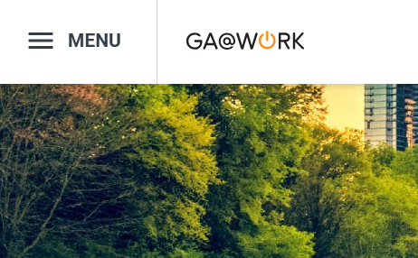
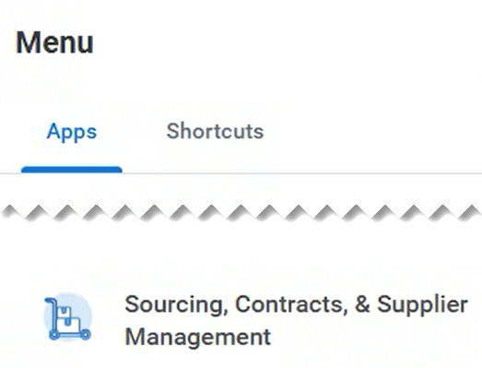
Create a Contract Amendment from a Contract Request (Part 1 of 5)
INSTRUCTIONS
Click the Global Navigation Menu.
Note: University System of Georgia (USG) users complete local logon and then proceed to Step 4.
Click Sourcing, Contracts & Supplier Management.

Slide 3
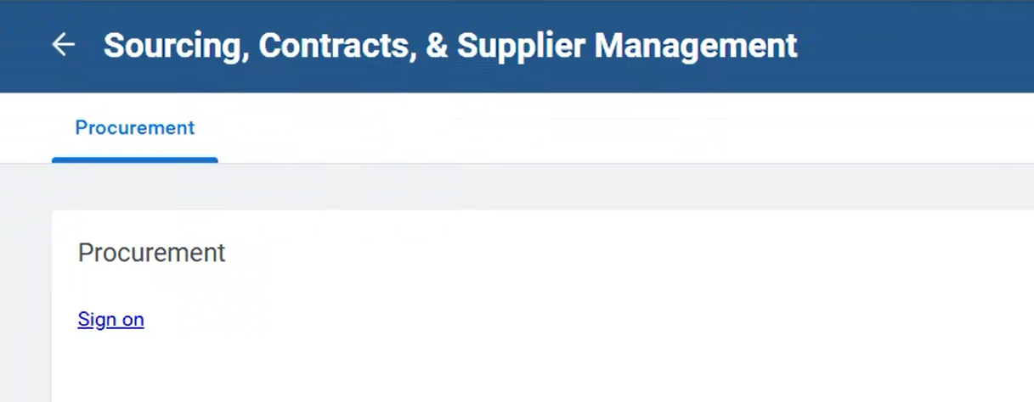
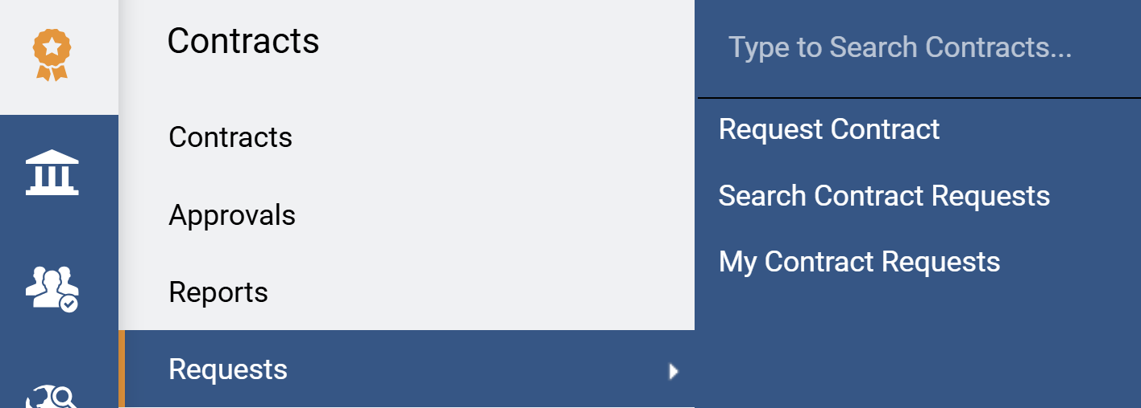
Create a Contract Amendment from a Contract Request (Part 2 of 5)
INSTRUCTIONS
Click Sign On.
Note: The system utilizes Single Sign-On (SSO) capabilities and no log in information is required.
Access the Contracts module.
Select Requests.
Select Search Contract Requests.
4
6
5

Slide 4
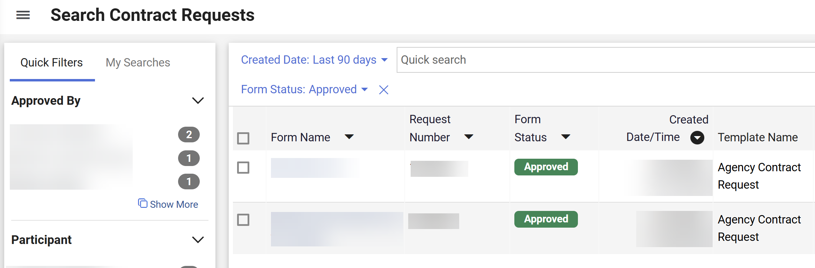
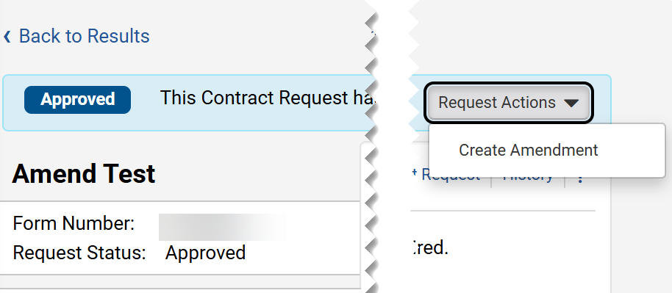
Create a Contract Amendment from a Contract Request (Part 3 of 5)
INSTRUCTIONS
Use the Quick Filters or Quick Search tool to search for Approved Contract Request.
Click the Form Name hyperlink.
7
8
Click Request Actions.
Click Create Amendment.
9
10

Slide 5
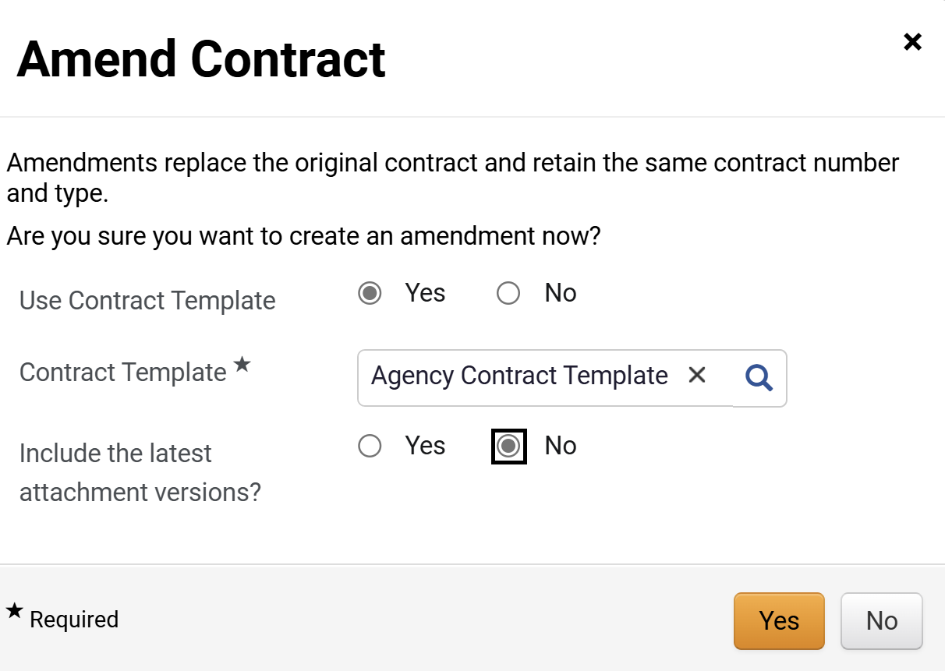
Create a Contract Amendment from a Contract Request (Part 4 of 5)
INSTRUCTIONS
Select Use Contract Template.
Note: If Yes is selected, continue to step 12. If No is selected, skip to step 13. Some fields are auto populated with contract data. Recommendation to select No, so the Template used to create the original contract is selected.
Select Contract Template*.
Note: Complete all required fields marked with a black star*.
Select Include the latest attachment versions?
Note: If Yes is selected, the attachments included in the Amendment Request will be included in the Amendment Contract. If No is selected, skip to step 15.
Click Yes.
11
12
13
14

Slide 6
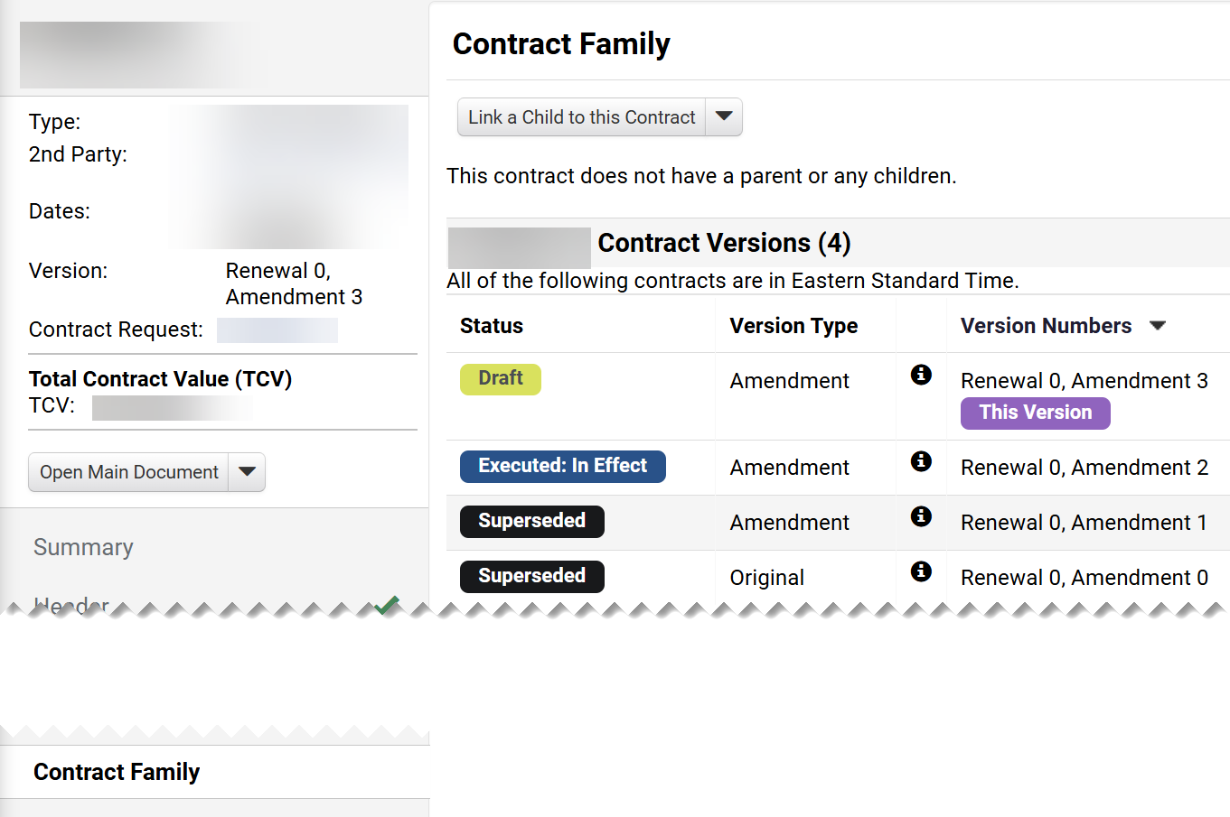
Create a Contract Amendment from a Contract Request (Part 5 of 5)
INSTRUCTIONS
Click Contract Family​.
The Contract Version will include Status, Version Type, and Version Numbers.
The Version will show the Amendment count information.​
The Contract Amendment Request is linked to the Contract.
17
18
16
15
You have successfully created a Contract Amendment from a Contract Request.

