Slide 1
Cardholder Approval and Action Options on P-Card Requisitions & Purchase Orders
This guide will explain action options available to P-Card Cardholders acting as Requesters on Requisitions, or as Contact Buyers on Purchase Orders and Change Orders that are routed to them.
Note: Transactions follow the designated business process and are routed to cardholders for review when the cardholder is not the initiator. Additionally, cardholders (and initiators) may receive requests for further review and action from approvers through the Send Back action option.
The key steps in the process are below:
Click My Tasks.
Select the Requisition or Purchase Order Review task.
Review Requisition or Purchase Order Detail and revise as needed.
Click Approve, Send Back, Add Approvers, Save for Later, or Cancel.
Click Submit.
Business Process:
My Tasks
Select Requisition/Purchase Order Task
Approve or Select Other Action Options
Submit

Slide 2
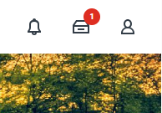
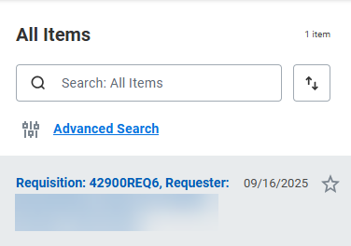
Cardholder Approval and Action Options on P-Card Reqs & POs (Part 1 of 7)
Click My Tasks.
Select the Requisition task.
  Note: For this guide, a Requisition task was selected.

Slide 3
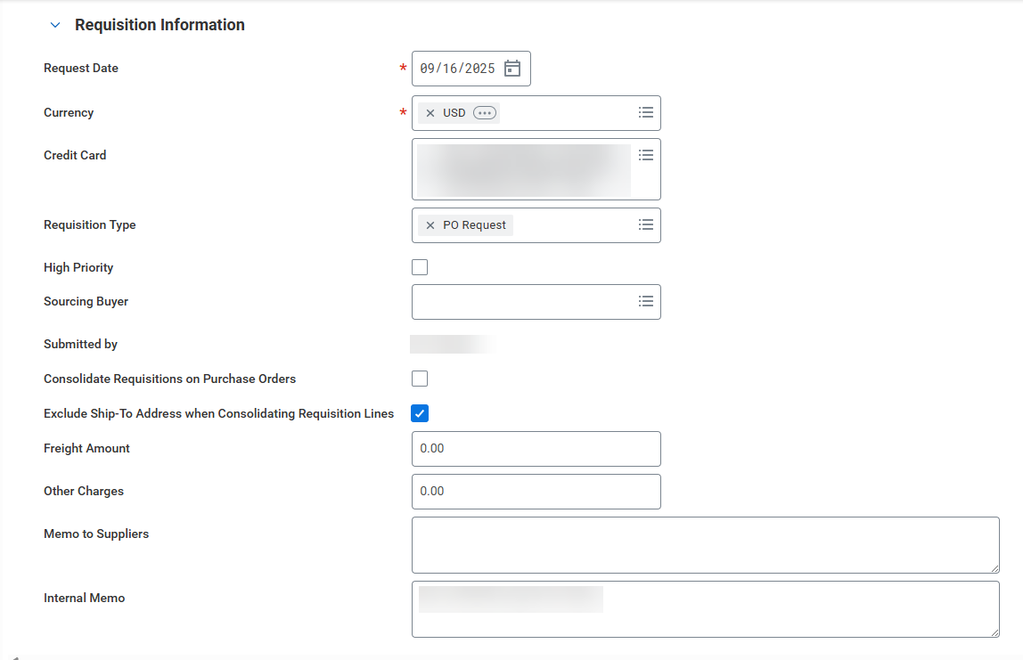

Cardholder Approval and Action Options on P-Card Reqs & POs (Part 2 of 7)
Review Requisition Information fields and modify as needed.
To approve the task, click Approve.
Note: To Send Back, skip to Step 6. To Add Approvers, skip to Step 11. To Save for Later, skip to Step 16.

Slide 4
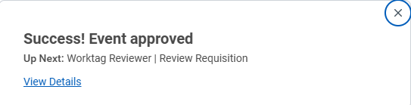
Cardholder Approval and Action Options on P-Card Reqs & POs (Part 3 of 7)
View the confirmation of Approval and which workflow step is Up Next for the Requisition or Purchase Order.
  Note: Click View Details to view transaction details and workflow routing (based on user security) for the transaction.
To send back the task, click Send Back.
Note: The Send Back action taken by the cardholder will return the transaction to the initiator for revisions the cardholder is unable to make or to request the initiator to cancel the transaction. To Add Approvers, skip to Step 11. To Save for Later, skip to Step 16.

Slide 5
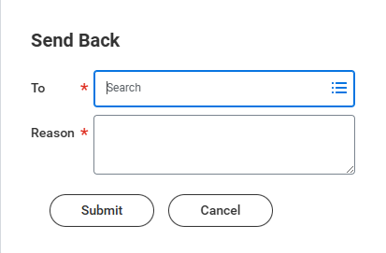
Cardholder Approval and Action Options on P-Card Reqs & POs (Part 4 of 7)
Select the Initiator in the To* field.
  Note: Requisition approvers can use Send Back to select either the cardholder or initiator to make revisions. However, for POs and PO Change Orders, approvers can Send Back only to the initiator. If the initiator revises and resubmits a PO or Change Order, the approval workflow restarts and routes again to the cardholder listed as the Contact Buyer for review and approval.
Enter a Reason*.
Click Submit.
7
8
9

Slide 6

Cardholder Approval and Action Options on P-Card Reqs & POs (Part 5 of 7)
View the confirmation of Event Sent Back.
To add approvers, click Add Approvers.
Note: You can add either a single approver or multiple approvers. When multiple approvers are added, the routing occurs simultaneously for all. Therefore, while approval action will be required by each added approver, they are not separate routings or dependent on one occurring before another. To Save for Later, skip to Step 16.

Slide 7
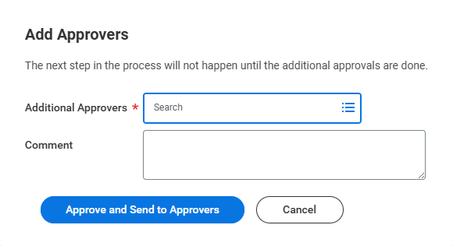
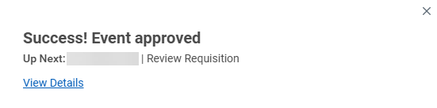
Cardholder Approval and Action Options on P-Card Reqs & POs (Part 6 of 7)
Select Additional Approvers*.
Enter Comment, if applicable.
Click Approve and Send to Approvers.
12
13
14
View the confirmation of Event Approval.
  Note: Click View Details for more information regarding the event approval.

Slide 8
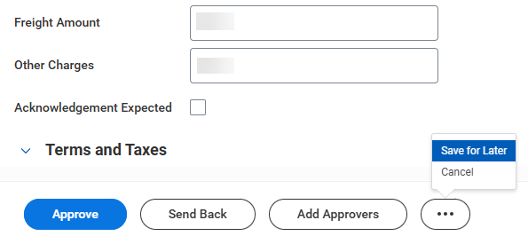

Cardholder Approval and Action Options on P-Card Reqs & POs (Part 7 of 7)
Click Save for Later if you wish to save any changes made (e.g., comments) and take action later. Click Cancel if you do not wish to save changes or take action. Regardless of which action you take, the transaction will remain in your My Tasks until further action is completed.
  Note: Clicking Cancel will not cancel the requisition or purchase order.
You have successfully completed Cardholder Approvals and other Action Options on P-Card Requisitions and Purchase Orders.

