Slide 1
Prepare for P-Card Settlement
Administrator Review
DESCRIPTION
This guide will show P-Card Administrators how to Prepare for settlement processing of agency's monthly bank statement payment (in full) by reconciling it to the total verified transaction count and amount in GA@WORK.
OVERVIEW
The key steps in the process are below:
Enter CRPROC - PCARD - Find Credit Card Transactions in Search field.
Click CRPROC – PCARD – Find Credit Card Transactions report.
Utilize report to Match Transaction count and total amount with Bank Statement.
Click Excel icon to export report, if helpful.
Troubleshoot transaction or amount differences to reconcile.
Email Procurement Settlement Specialist once preparation is complete.
Business Process:
Review P-Card Transactions
Reconcile Credit Card Transactions to Statement
Email Settlement Specialist

Slide 2
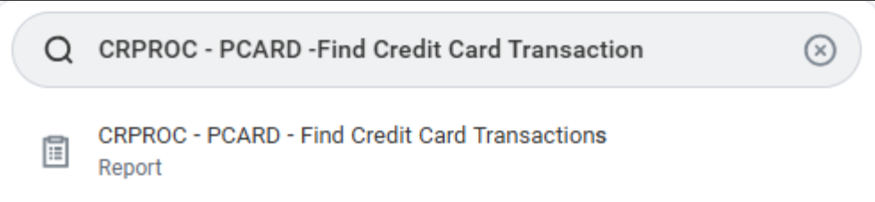
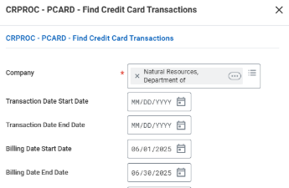
Prepare for P-Card Settlement -Administrator Review (Part 1 of 6)
INSTRUCTIONS
Enter CRPROC – PCARD - Find Credit Card Transactions in Search field.
Click the CRPROC – PCARD - Find Credit Card Transactions report.
1
2
Enter the Company* and Search Criteria, as applicable.
Note: Suggest a defined Billing Date range to ensure all transactions from the billing statement are included.

Slide 3
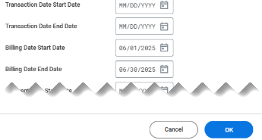
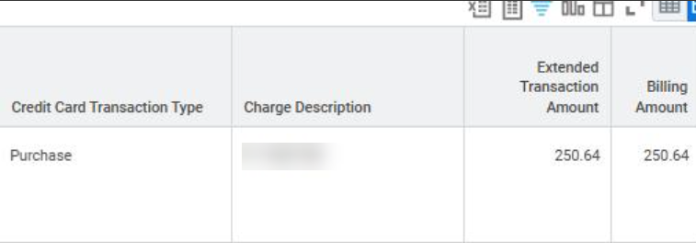
Prepare for P-Card Settlement -Administrator Review (Part 2 of 6)
INSTRUCTIONS
Once Search criteria is selected, click OK.
Review the Credit Card Transactions report.
Utilize results to match total Billing Amount of all Verified Transactions with Bank Statement.

Slide 4
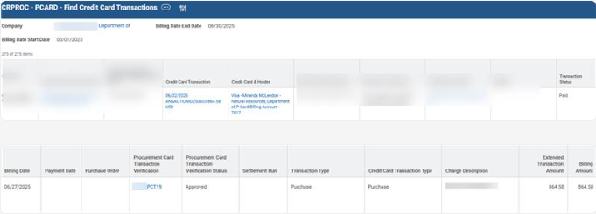
Prepare for P-Card Settlement – Administrator Review (Part 3 of 6)
INSTRUCTIONS
Utilize export options to complete analysis and troubleshoot differences between Bank Statement and credit card transactions. Some helpful fields to filter are:
  Credit Card Transaction
  Credit Card & Holder
  Transaction Date
  Transaction Status
  Billing Date
  Procurement Card Transaction Verification & Status
  Settlement Run
  Billing Amount

Slide 5
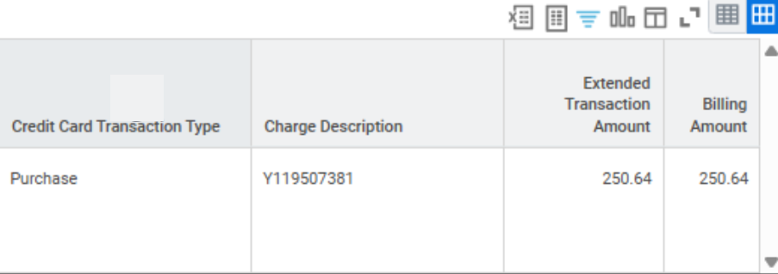
Prepare for P-Card Settlement Administrator Review (Part 4 of 6)
INSTRUCTIONS
Click Excel to export for thorough analysis and reconciliation, including ability to sum by Billing Amount.
If GA@WORK total of Verified Transactions do not match total amount due per Bank Statement, investigate. Some potential causes to consider are:
  Report criteria is incorrect.
  Results are filtered.
  Budget Check status is not valid.
  Credit card transaction(s) not verified.
  Verification document(s) not approved.
  Transactions in error.
  Note: Continue to Step 10 for detailed guidance on reconciliation.

Slide 6
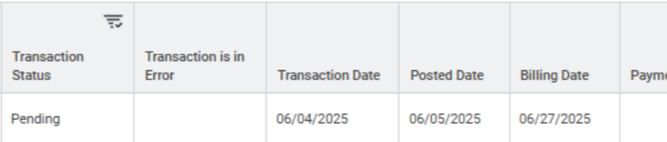
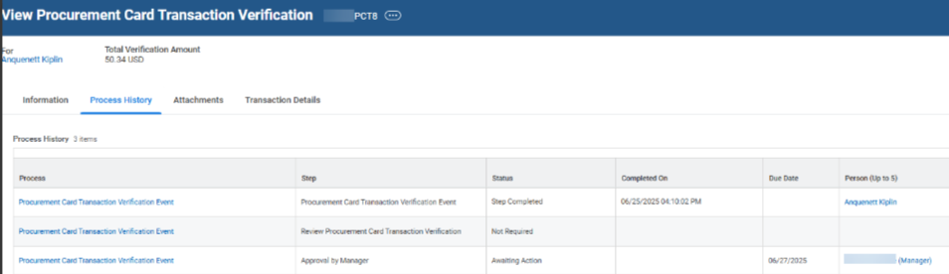
Prepare for P-Card Settlement – Administrator Review (Part 5 of 6)
INSTRUCTIONS
Tips for reconciling a difference in total of Verified Transactions in GA@WORK compared to a monthly Bank Statement:
Card & Cardholder – Export and filter to get the sum of the field.
Report Criteria – Specify the Billing Date range to capture all transactions for that period. Click Change Selection to adjust criteria and re-run report. If results include statuses other than Verified, follow up is needed.
  Contact Cardholder/Reconciler
    New Status – Not verified, no PCT ID exists.
    Draft Status – Verification PCT ID exists but not submitted for approval.
  Contact Approver - Pending Status – PCT ID awaits Approver action. Right-click on the PCT ID, Click See in New Tab. Select Process Tab to view step in Awaiting Action Status.
    Contact Settlement Spend Specialist for transactions in Paid Status.

Slide 7

Prepare for P-Card Settlement – Administrator Review (Part 6 of 6)
INSTRUCTIONS
If the transaction is in error or does not exist in GA@WORK, send an email to procurementhelp@doas.ga.gov
Email your Settlement Specialist once Verified Transactions in GA@WORK for a specified Billing Date equal the monthly Bank Statement total amount due. The email will need to include the following detail:
  Billing Date(s) ready for settlement.
  Bank Statement total amount due.
  Confirmation that GA@WORK total of verified transactions matches monthly Bank Statement total due.
  Settlement Processing is authorized for the Bank Statement Billing date.
You have successfully Prepared for P-Card Settlements.

