Slide 1
Procurement Card Transaction Verification Review and Approval
DESCRIPTION
This guide will show Managers and Approvers how to locate, review and take action on a submitted Procurement Card Transaction Verification document (referencing a verified credit card transaction) that routes to them.
OVERVIEW
The key steps in the process are below:
Click My Tasks.
Select Procurement Card Transaction Verification: [Transaction Number] – Employee Name.
Review and act on Credit Card Transaction and Verification Transaction Document details, as needed.
Enter Comments and select appropriate action.
Select Add Approvers to add an Additional Approver, if applicable.
Business Process:
Locate P-Card Transaction Verification Document
Review Transaction Verification Details
Take Action on P-Card Transaction Verification Document

Slide 2

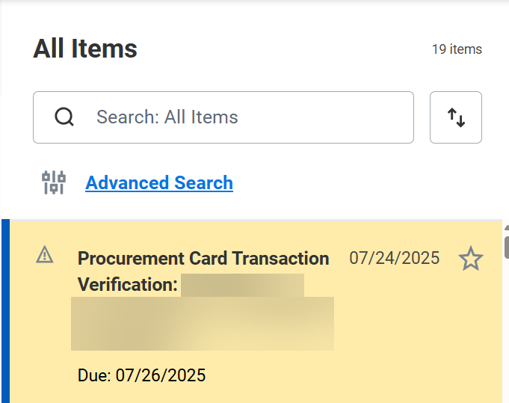
Procurement Card Transaction Verification Review and Approval (Part 1 of 3)
INSTRUCTIONS
Click My Tasks in the top right of your Homepage.
Select Procurement Card Transaction Verification: [Transaction Number] – Employee Name.

Slide 3
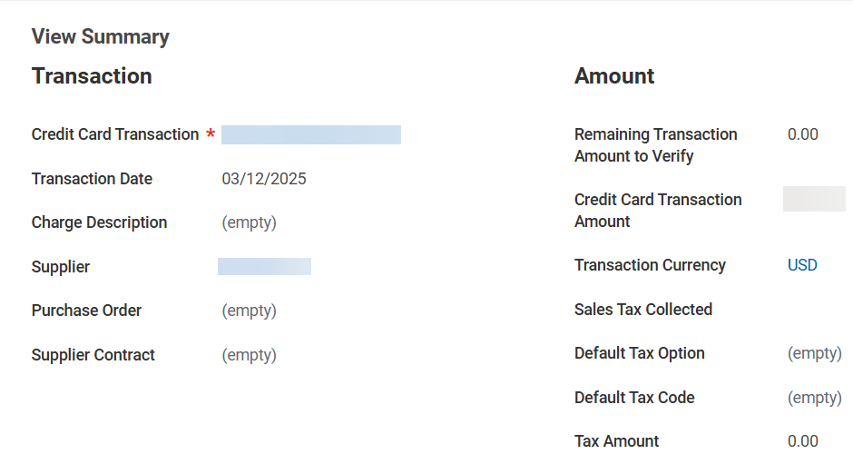
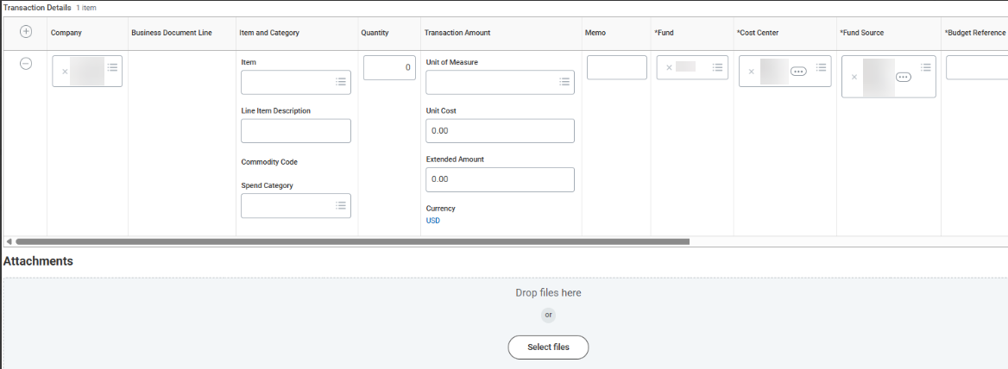
Procurement Card Transaction Verification Review and Approval (Part 2 of 3)
INSTRUCTIONS
Review the Transaction Summary to include a review of the Credit Card Transaction and Verification Transaction Document details, as needed, to determine what action is appropriate to take.
Note: Credit Card Transaction details can be reviewed by placing your mouse over the hyperlink to reveal Related Actions (…).

Slide 4
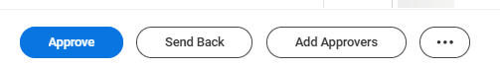

Procurement Card Transaction Verification Review and Approval (Part 3 of 3)
INSTRUCTIONS
Once review is complete, multiple action options are available to each approver, including:
  Add Approvers: to insert one or more specific approvers to route to upon your approval, prior to routing to the next approval step defined in the related business process.
  Approve: to approve the transaction without inserting an approver, allowing the transaction to route on to the next approval step defined in the related business process.
  Send Back: to send the transaction back to either the Initiator (Revise step) for correction and resubmit, or a Prior Reviewer (Review step) for additional review only (ex. to a Worktag Reviewer to determine whether the document requires correction and should be sent back to initiator to revise).
  Save for Later: to save changes without acting. The transaction will remain in your queue for acting later unless there are multiple approvers and another acts, first.
  Close: to close the current (Review or Approve) Procurement Card Transaction Verification page without saving changes if you wish to take no action. The transaction will remain in your queue for acting later unless there are multiple approvers and another acts, first.
You have successfully Reviewed and taken Approval action on a Procurement Card Transaction Verification document.

