Slide 1
Find P-Card Requisition Lines with Credit Card
DESCRIPTION
This guide will show P-Card Holders how to locate, run and analyze results of the CRPROC – PCARD – Find Requisition Lines with Credit Card report.
OVERVIEW
The key steps in the process are below:
Enter CRPROC – PCARD - Find Requisition Lines with Credit Card in Search field.
Click the CRPROC – PCARD – Find Requisition Lines with Credit Card search result.
Enter Search Parameters.
Review the report results.
Export to Excel or PDF, if applicable.
Business Process:
Locate P-Card Requisitions Report
Enter Search Parameters
Review P-Card Requisitions Report Results

Slide 2

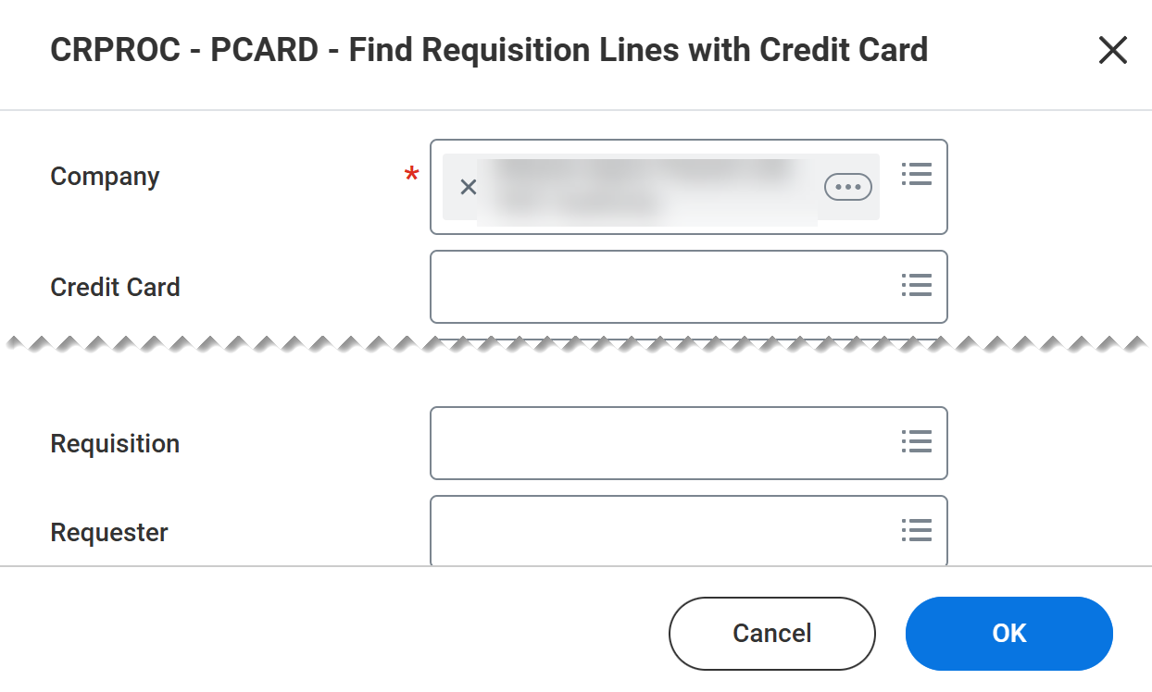
Find P-Card Requisition Lines with Credit Card (Part 1 of 4)
INSTRUCTIONS
Enter CRPROC – PCARD - Find Requisition Lines with Credit Card in Search field.
Click CRPROC – PCARD – Find Requisition Lines with Credit Card report.
1
2
Enter your Company*.
Enter additional Search Criteria, if applicable.
Click OK.
3
4

Slide 3
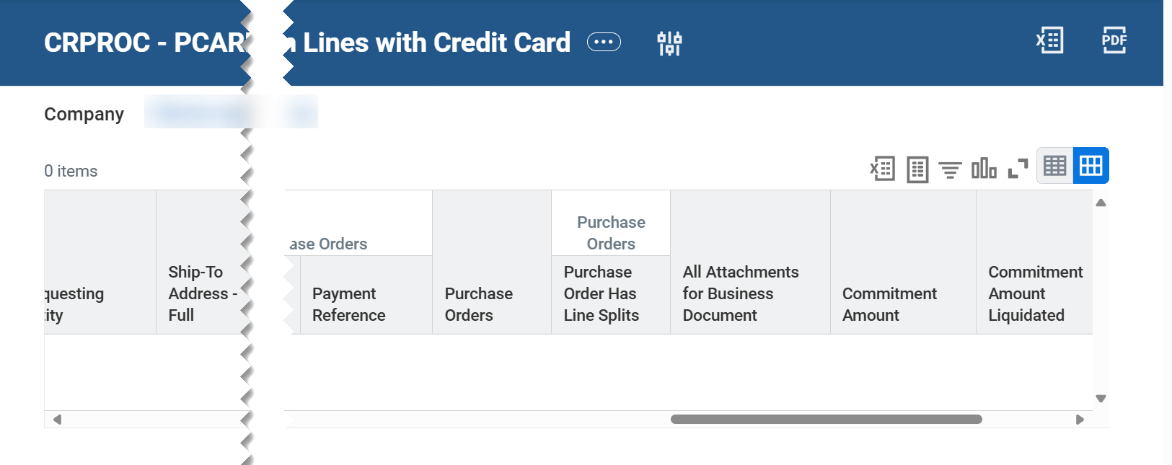
Find P-Card Requisition Lines with Credit Card (Part 2 of 4)
INSTRUCTIONS
Review report results and use report options to assist with data analysis, including:
  Related Actions (…) to preview limited line details for a specific Requisition. Also, other report options available based on security (example: Favorite>Add/Remove).
  Note: The Procurement>Add to Cart option is not recommended to avoid error.
  Change Selection to revise report criteria and re-run.

Slide 4
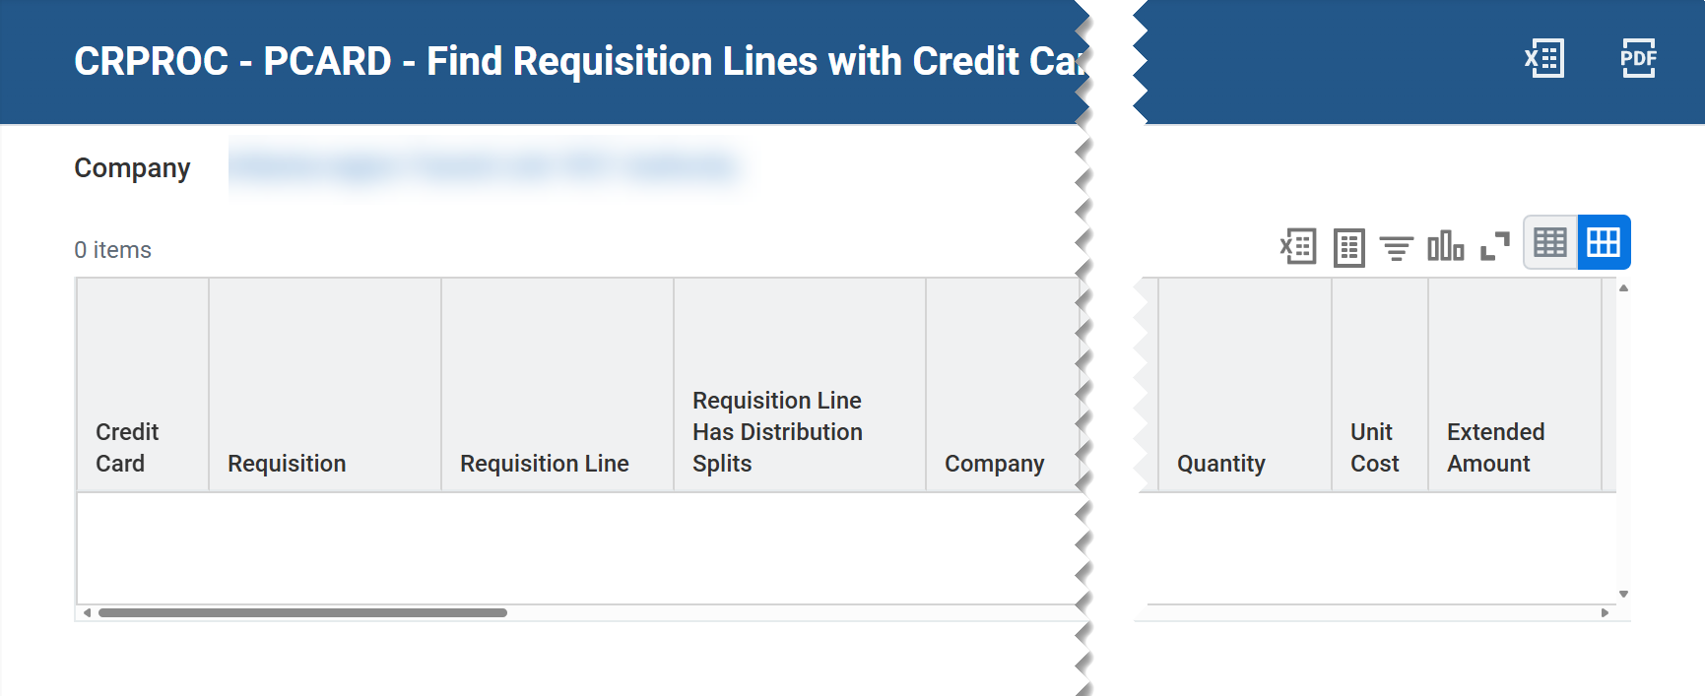
Find P-Card Requisition Lines with Credit Card (Part 3 of 4)
INSTRUCTIONS
The following report options (from left to right) are available to help with data analysis:
  Export results to an Excel file
  Export results to a Worksheets file
  Filter column results
  Modify view of data by expanding rows and charts
  Expand or collapse view of results

Slide 5

Find P-Card Requisition Lines with Credit Card (Part 4 of 4)
INSTRUCTIONS
Click the Excel or PDF to export results, if applicable.
You have successfully located, run, and reviewed Requisition Lines with Credit Card details.

