Slide 1
Procurement Card
Transaction Verification
DESCRIPTION
This guide will show P-Card Holders and Delegate Workers (if assigned) how to Verify Procurement Card Transactions.
OVERVIEW
The key steps in the process are below:
Click the Verify Procurement Card Transactions task.
Select a Transaction to verify and click OK.
Determine whether a related Purchase Order exists and link, if applicable.
Verify Transaction Details and add Transaction Lines, as needed.
Review Amount section to confirm transaction document is balanced. Click Submit.
Business Process:
Select Verify Procurement Card Transactions Task
Select a Transaction to Verify
Complete Required Transaction Verification Actions
Submit

Slide 2
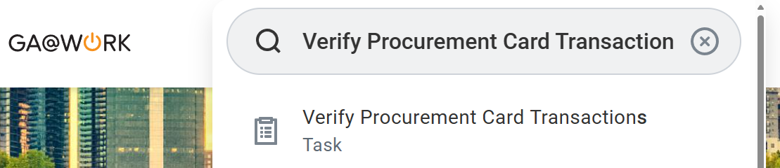
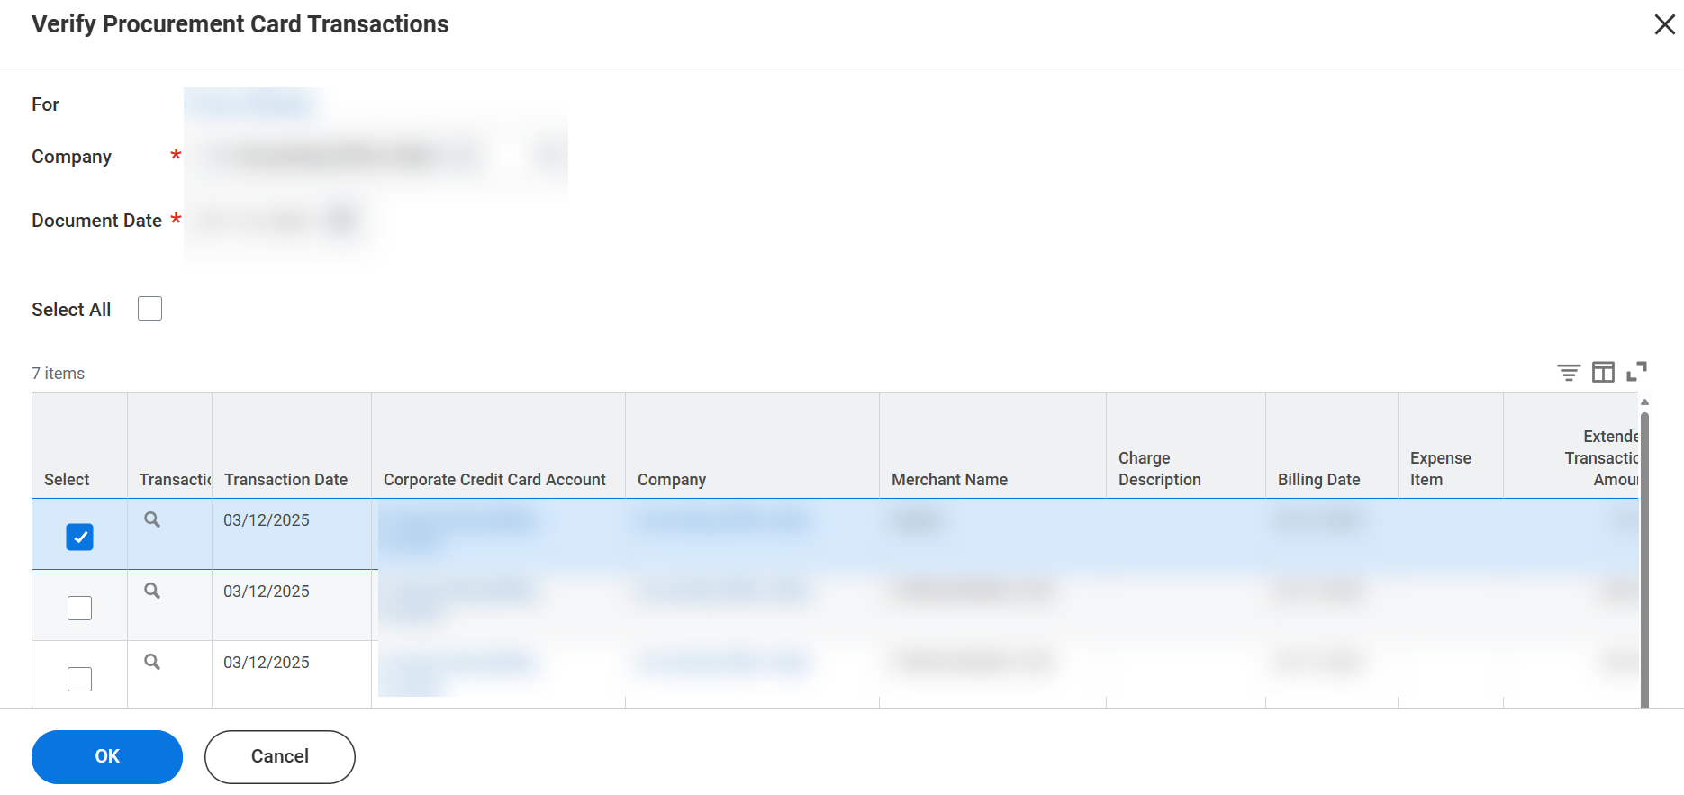
Procurement Card Transaction
Verification (Part 1 of 9)
INSTRUCTIONS
Enter Verify Procurement Card Transaction in the Search field.
Click the Verify Procurement Card Transactions task.
1
2
Verify the Company and default Document Date, typically no change required. Ask Agency Procurement Officer if unsure.
Select the single Transaction to verify.
Click OK.
3
4
5

Slide 3
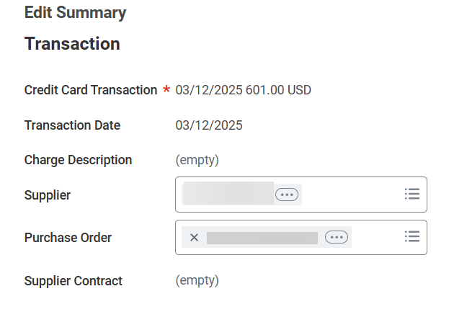
Procurement Card Transaction
Verification (Part 2 of 9)
INSTRUCTIONS
Review Supplier if it auto-populates. It is not required but may default and, on some transactions, may not be a true GA@WORK Supplier.
Note: If the Supplier field auto-populates and does not match the Supplier on a related Purchase Order, the Supplier value should be cleared on the verification document to successfully search and select the related Purchase Order.
If a related Purchase Order exists, search for and select it in the Purchase Order field.
  Note: If the vendor provides the Purchase Order data with the charge, the Purchase Order will automatically populate.
6
7

Slide 4
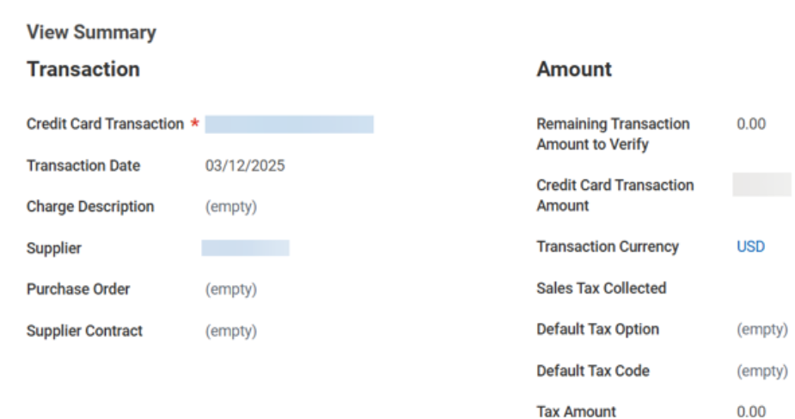
Procurement Card Transaction
Verification (Part 3 of 9)
INSTRUCTIONS
Review the Remaining Transaction Amount to Verify in the Amount section to confirm the transaction amount is balanced.
Note: If PO is linked and the amount is not 0.00, this indicates the related PO lines do not total the exact transaction amount. In this scenario, analysis and manual intervention is required to balance the verification document by either:
Determining which transaction detail lines require adjustment of either amount or quantity
Or, inserting new Transaction detail line(s) for the difference.
Or, working with the PO Buyer to adjust PO line(s) linked in the Business Document Line field.

Slide 5
Procurement Card Transaction
Verification (Part 4 of 9)
INSTRUCTIONS
Verify the following Transaction Details in the Transaction Grid and adjust as needed.
  Verify Number of Items is correct
  Verify the Company field is populated with the Company to which the cardholder is assigned.
  Line Item Description & Spend Category fields should be entered manually, if no PO line is linked
  Quantity will auto-populate if a Goods PO line is linked. If transaction is associated with a Services PO line or no PO line at all, this field can be blank.
  Transaction Amount - Unit of Measure and Unit Cost will populate if a Goods PO line is linked. If transaction is associated with a Services PO line or no PO line. Values can be adjusted or left blank.
  Extended Amount will auto-populate, regardless of whether a PO is linked. Adjust the amount as needed.
  Memo field (P-Card verification comment required - even if comment copies from linked PO line). Input P-Card related comment, (ex: to indicate receipt, P-Card Prior Approval document, or other document is attached). Input P-Card Prior Approval (PCPA) Document ID if transaction authorized by creating and submitting a Prior Approval Request.
  Worktags (required & non-required). Manual entry of all Worktags (including Spend Category) is required, if no related PO is linked. Review of all Worktags (including Spend Category) for accuracy required on transaction detail lines with a PO linked.
  Note: Contact PO Buyer with questions or to request corrections. Confirm all required & non-required Worktag fields are populated, as appropriate, to define a valid budget. Budget Reference cannot be a future budget year.

Slide 6
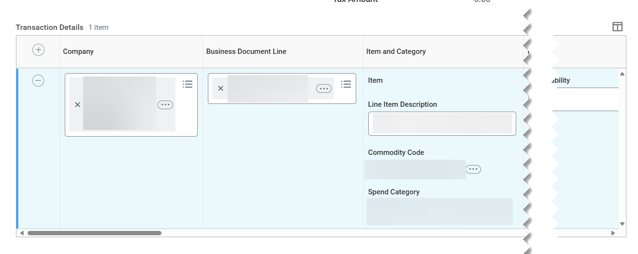
Procurement Card Transaction
Verification (Part 5 of 9)
INSTRUCTIONS
Verify the following Transaction Details in the Transaction Grid and adjust as needed. (Continued)
  Additional Worktags - The Employee Worktag should be selected to search for and link the employee traveling for any travel related credit card charges.
  Splits - create split lines as appropriate for accurately charging transaction across multiple budgets.
  Attachments - Upload of related receipt is required. Upload all other purchase related documents, as appropriate.
  Enter a Comment - this field is optional and can be used to add related comments intended to be seen by approvers.
  Click Submit.
  Note: You may also Save for Later or Close the without saving changes.

Slide 7
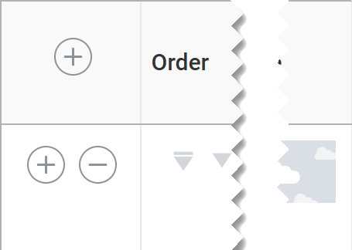
Procurement Card Transaction
Verification (Part 6 of 9)
INSTRUCTIONS
Click Add (+) to add a Transaction Line, if applicable. Click Remove (-) to remove transaction detail lines. Alternative options for balancing an overage on a verification document include:
  Increasing the Extended Amount
  Requestion the PO Buyer increase the PO line amount through a Change Order
Note: Additional transaction detail lines could be needed (ex: to balance a verification document where the transaction amount includes shipping, causing the transaction to exceed the total PO lines where no shipping charge was included).

Slide 8
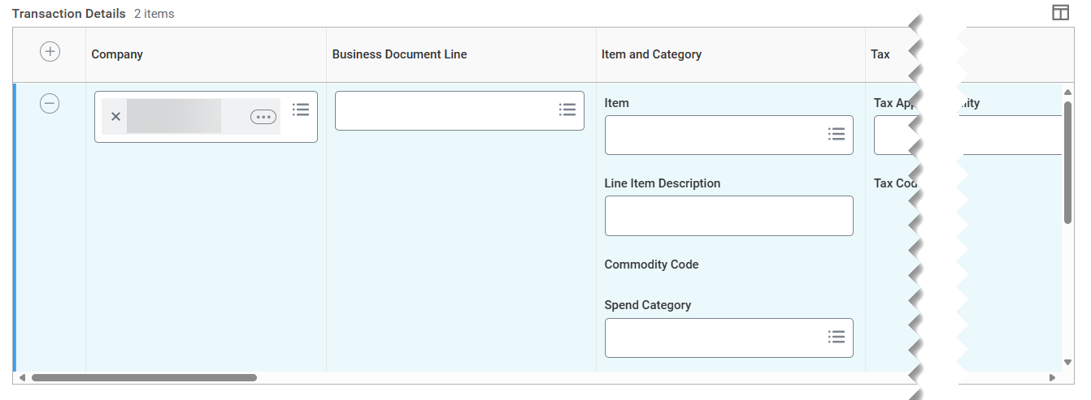
Procurement Card Transaction
Verification (Part 7 of 9)
INSTRUCTIONS
Verify manually added Transaction Details lines, including coding with correct Worktags and creating splits, as appropriate.

Slide 9
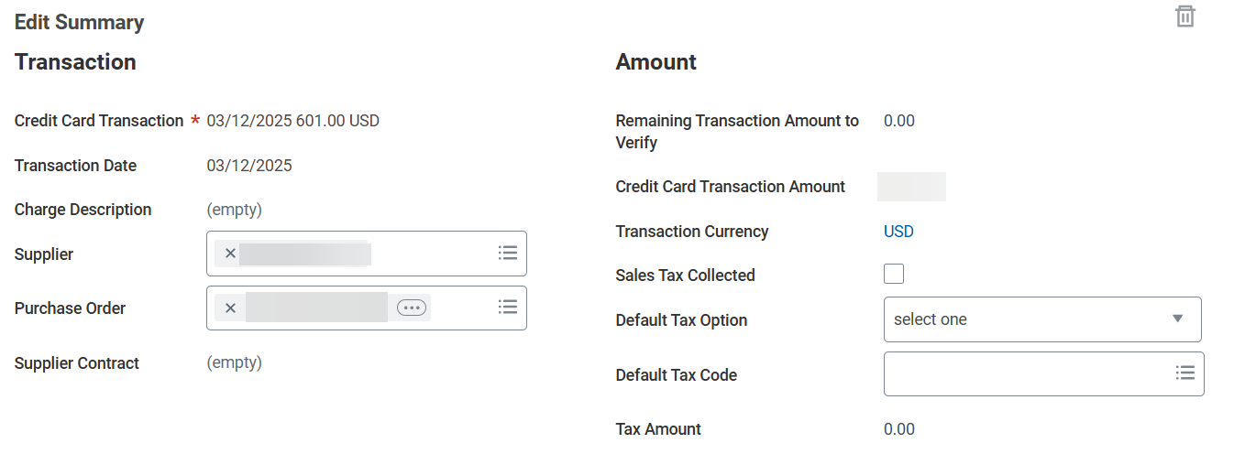
Procurement Card Transaction
Verification (Part 8 of 9)
INSTRUCTIONS
Review Transaction section to confirm PO related to the transaction being verified is linked, if applicable.
Review the Amount section to confirm that the Remaining Transaction Amount is 0.00, indicating the total of all transaction details line amounts equal the Credit Card Transaction Amount. If 0.00, the verification document is balanced successfully.
  Note: If the Remaining Transaction Amount to Verify is not 0.00, analyze the transaction details lines (considering PO line amounts, if linked), to determine which line amount(s) should be adjusted, removed, or added, to balance the Credit Card Transaction Amount to the Procurement Card Verification Transaction Details line(s) appropriately.
13
12

Slide 10
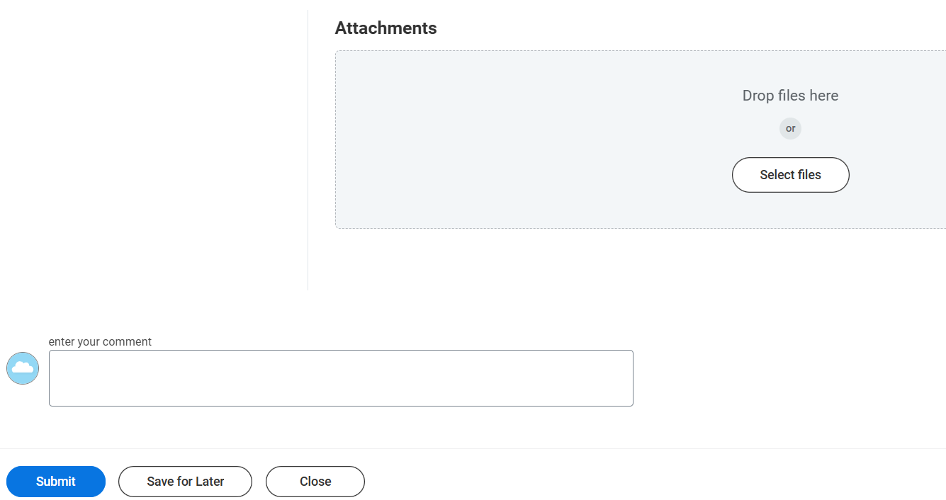

Procurement Card Transaction
Verification (Part 9 of 9)
INSTRUCTIONS
​Drop files here or click Select files to include Attachments, if applicable.
Note: at least one receipt attachment is required for each transaction. Include others as needed, for example, the P-Card Prior Approval Request document can be attached for transactions authorized through the P-Card Prior Approval Request form, if your company requires.
You may enter your comment for approvers, if applicable.
Click Submit.
Note: Click Save for Later to save progress for follow-up at a later date or time.
14
15
16
You have successfully verified a credit card transaction and submitted a Procurement Card Transaction Verification Document for approval.

