Slide 1
Revise P-Card Prior Approval
Request on Send Back
DESCRIPTION
This guide will show P-Card Holders or Workers on Behalf of P-Card holders how to receive and handle a P-Card Prior Approval Request that has been sent back.
Note: The cardholder (non-initiator on behalf of) is the ONLY one of the two possible send back recipients that will have the option to 'Send Back' since the initiator has no one to 'send back' to.
OVERVIEW
The key steps in the process are below:
Click on My Tasks.
Select Request Process: Request | P-Card Prior Approval task.
View Comments.
Add Approvers (if needed) and Approve, or Send Back to initiator for revision, as applicable.
Note: If a request was submitted by a worker (initiator) on behalf of another (non-initiator) and is sent back by an approver, the non-initiator may receive a request to review while the initiator may receive a request to revise.
Business Process:
Locate Prior Approval Request
Review Prior Approval Request
Approve or Send Back Prior Approval Request

Slide 2

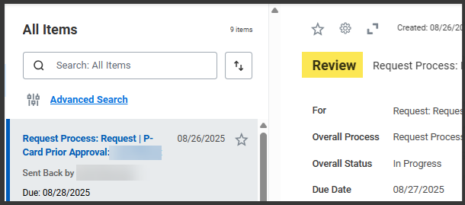
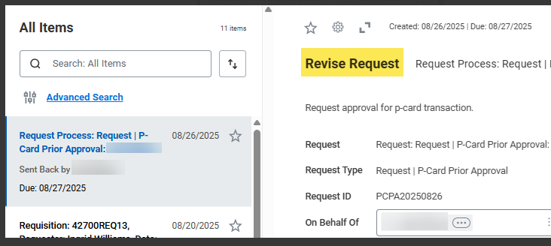
Revise P-Card Prior Approval Request on Send Back (Part 1 of 6)
INSTRUCTIONS
Click on My Tasks from the top-right corner of your Homepage.
Select Request Process: Request | P-Card Prior Approval task to review or revise.
  Note: The task will have a sub note with Send Back by, specifying either Review or Revise of existing Prior Approval Request.

Slide 3
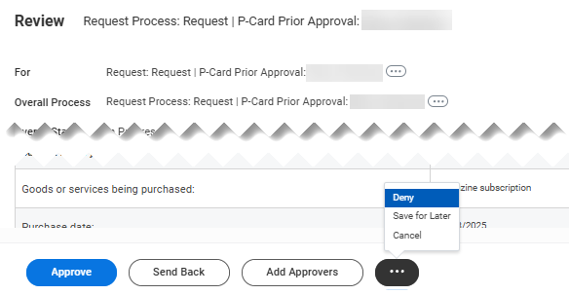
Revise P-Card Prior Approval Request on Send Back (Part 2 of 6)
INSTRUCTIONS
Review details of the request to determine which of the following action(s) to take:
  Click Approve – reference steps 4-5
  Note: If you need to Add Approvers, this must be done prior to clicking Approve or Submit.
  Click Send Back (to Revise) – reference steps 6-9
  Note: The cardholder the request was created on behalf of will have ability to send back to the initiator to revise.
  Click Add Approvers – reference steps 10-12
  Note: Click Related Actions (…) and select Deny (permanently terminates request), Save for Later or Cancel, if appropriate. Cancel will exit the task, not cancel the actual request.

Slide 4
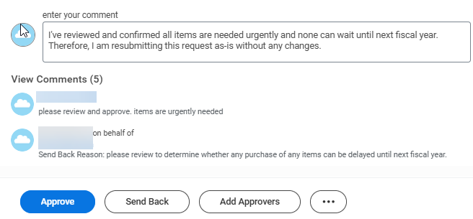
Revise P-Card Prior Approval Request on Send Back (Part 3 of 6)
INSTRUCTIONS
If the request is correct and no changes are needed. Add a Comment indicating that the request has been reviewed and there is no need for revision.
Click Approve to send for manager approval.
Note: This action is available to (on behalf of) Cardholder reviewing request on Send Back and should be taken if cardholder determines no changes are required. Remember to Add Approvers, if needed, prior to approving.
The remainder of this guide covers the Send Back & Add Approvers processes.
4
5

Slide 5
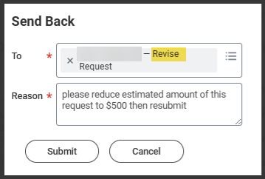
Revise P-Card Prior Approval Request on Send Back (Part 4 of 6)
INSTRUCTIONS
Click Send Back if changes are needed.
Note: The Send Back – Revise action is available only to the cardholder reviewing a request created 'On Behalf Of' the cardholder, upon Send Back by a request approver.
The Cardholder reviewing the request will have the Send Back option available to send the request back to the Initiator to Revise. Select the Initiator in the To* field.

Slide 6
Revise P-Card Prior Approval Request on Send Back (Part 5 of 6)
INSTRUCTIONS
Enter a Reason* for the Send Back.
Click Submit.
8
9
If additional approvers are needed, click Add Approvers.

Slide 7
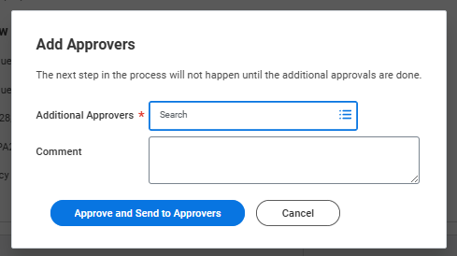

Revise P-Card Prior Approval Request on Send Back (Part 6 of 6)
INSTRUCTIONS
Select Additional Approvers* and enter a Comment for the approvers.
Note: A single Approver or multiple Approvers may be added. The request will route to all Approvers simultaneously.
Click Approve and Send to Approvers for routing the reviewed or revised request for approval.
11
12
You have successfully responded to a P-Card Prior Approval Request on Send Back.

