Slide 1
Find P-Card Purchase Orders
DESCRIPTION
This guide will show P-Card Holders, Buyers and Agency P-Card Administrators how to locate, run, and review results of the reports, designed to return details of Purchase Orders having a Payment Type of Credit Card.
Note: Cardholders who do not have a Buyer role will only have access to Related Actions (…) for POs that have their credit card linked.
OVERVIEW
The key steps in the process are below:
Select the CRPROC – PCARD – Find Purchase Order report you want to run.
  CRPROC-PCARD-Find Purchase Orders with Credit Card–Summary
  CRPROC-PCARD-Find Purchase Order Lines with Credit Card–Detail
  CRPROC-PCARD-Find Purchase Order Lines with Obligation Remaining
Enter required/optional Search Parameters, as needed.
Click OK and review and filter results, as appropriate.
Export results using Excel or PDF options for analysis, if needed.
Business Process:
Locate P-Card Purchase Order Reports
Select Report and Enter Search Parameters
Review P-Card Purchase Orders

Slide 2
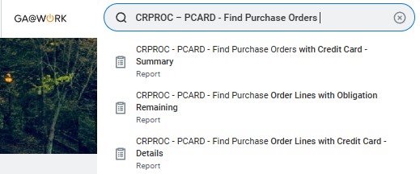
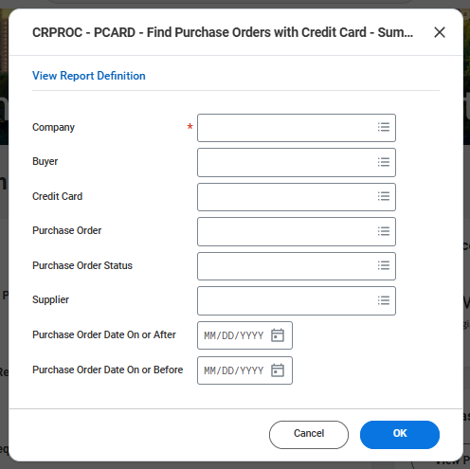
Find P-Card Purchase Orders (Part 1 of 6)
INSTRUCTIONS
Enter CRPROC - PCARD-Find Purchase Orders in the Search field.
Click the CRPROC - PCARD - Find Purchase Orders with Credit Card-Summary report.
Note: Skip to Step 7 for the CRPROC-PCARD-Find Purchase Orders Lines with Credit Card Details report. Skip to Step 12 for the CRPROC-PCARD-Find Purchase Orders Lines with Obligation Remaining report.
1
2
Select a Company*.
Enter additional search criteria, as needed and click OK.
3
4

Slide 3
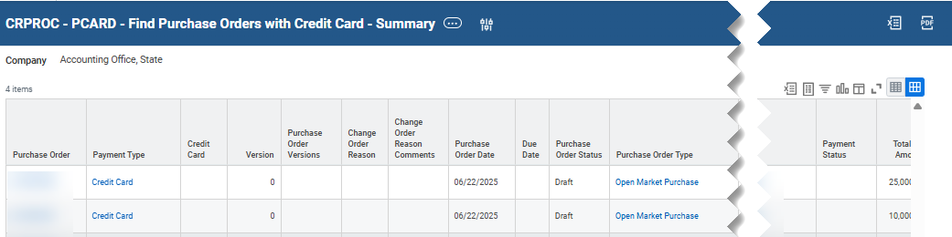
Find P-Card Purchase Orders (Part 2 of 6)
INSTRUCTIONS
Review the CRPROC – PCARD - Find Purchase Orders with Credit Card-Summary report results and use report options to assist with data analysis.
Note: You may export the report to Excel or PDF format, if needed, for further analysis.​
Use Related Actions (…) to preview limited details for PO Line(s) using this option. Other Related Actions (…) options include Favorite which creates a link for the PO under Profile>Favorites and may be helpful for POs you access frequently. Lastly, the Receipt>Create option is available for receiving against a specific PO.
Change Selection - use this option to revise report criteria and re-run.​

Slide 4
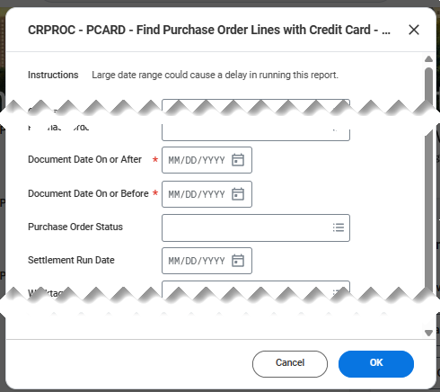
Find P-Card Purchase Orders (Part 3 of 6)
INSTRUCTIONS
Enter CRPROC – PCARD - Find Purchase Orders in the Search field.
Click the CRPROC - PCARD - Find Purchase Order Lines with Credit Card Details report.
Note: Skip to Step 11 for the CRPROC-PCARD-Find Purchase Orders Lines with Obligation Remaining report.
6
7
Select Document Date On or After* and Document Date On or Before*.
Enter additional search criteria, as needed and click OK.
8
9

Slide 5
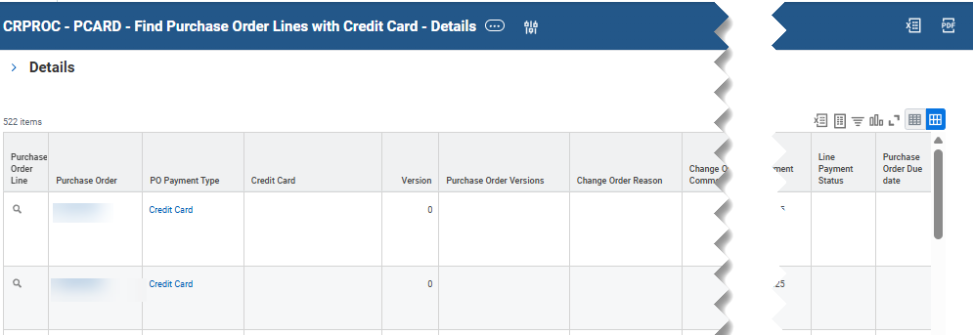
Find P-Card Purchase Orders (Part 4 of 6)
INSTRUCTIONS
Review the CRPROC – PCARD - Find Purchase Orders Lines with Credit Card Details report results and use report options to assist with data analysis.
Note: You may export the report to Excel or PDF format, if needed, for further analysis.​ This report includes multiple lines for POs with Splits defined.
  Use Purchase Order Related Actions (…) options to preview limited PO Header details, generate printable PDF of PO (Printable Version), add or remove a PO (Favorite), or receive against a specific PO (Receipt).
  Change Selection - use this option to revise report criteria and re-run.

Slide 6
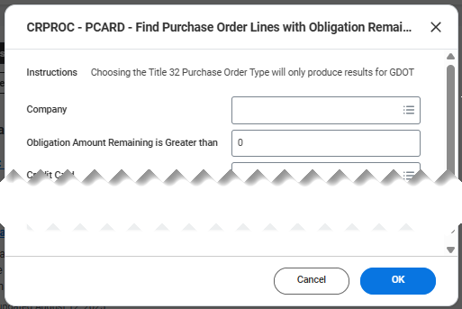
Find P-Card Purchase Orders (Part 5 of 6)
INSTRUCTIONS
Enter CRPROC-PCARD-Find Purchase Orders in the Search field.
Click the CRPROC – PCARD - Find Purchase Order Lines with Obligation Remaining report.
11
12
Enter your Search parameters, as needed and click OK.

Slide 7
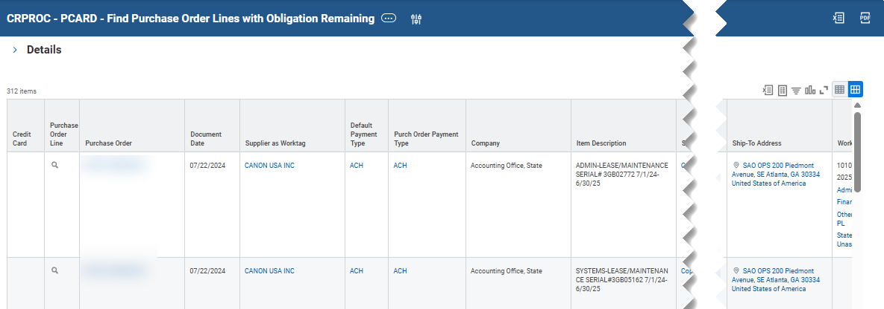

Find P-Card Purchase Orders (Part 6 of 6)
INSTRUCTIONS
Review the CRPROC – PCARD - Find Purchase Order Lines with Obligations Remaining report results and use report options to assist with data analysis.
Note: You may export the report to Excel or PDF format, if needed, for further analysis.​ This report includes multiple lines for POs with Splits defined.
Use Purchase Order Related Actions (…) options to preview limited PO Header details, generate PDF of PO (printable version), add or remove a PO (Favorite), or receive against a specific PO (Receipt).​
  Change Selection - use this option to revise report criteria and re-run.
You have successfully located and reviewed p-card purchase orders.

