Slide 1
Run Reports – Credit Card
Transactions for Cardholders
DESCRIPTION
This guide will show P-Card Holders how to run the CRPROC - PCARD - My Credit Card Transactions report. This report returns all cardholder credit card transactions and includes details helpful for transaction verification, specific to linking related Purchase Order lines.
OVERVIEW
The key steps in the process are below:
Select the CRPROC – PCARD - My Credit Card Transactions report.
Note: You may access the report on the P-Card Cardholder Dashboard. Select the Credit Card Transactions & Procurement Card Verifications tab to locate the report.
Review report results and filter as needed.
Export results to the desired format, as needed.
Locate Report
Review & Filter Results
Export Results

Slide 2

Credit Card Transactions (Part 1 of 3)
INSTRUCTIONS
Enter CRPROC – PCARD – My Credit Card Transactions in the Search field.
Note: You may also access this report through the P-Card Cardholder Dashboard. Select the Credit Card Transactions & Procurement Card Verifications tab to locate the report.
Select the CRPROC – PCARD – My Credit Card Transactions report.
1
2

Slide 3
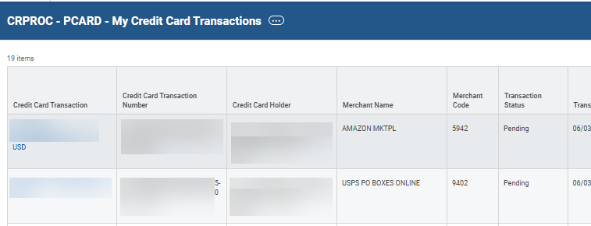
Credit Card Transactions (Part 2 of 3)
INSTRUCTIONS
Review and analyze results. Suggestions for fields to filter, helpful for verification, include but are not limited to:
  Credit Card Transaction Number,
  Credit Card Holder,
  Transaction Status,
  Billing Date
  Purchase Order
  Note: Credit Card Transaction Line fields do not allow for filtering.

Slide 4
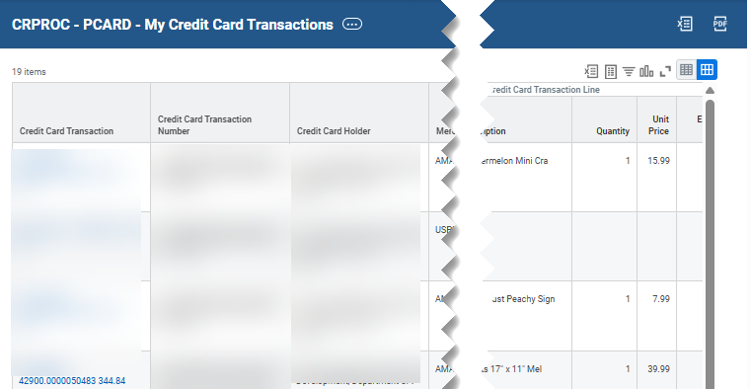

Credit Card Transactions (Part 3 of 3)
INSTRUCTIONS
Click the Excel or PDF options to export the results, as applicable.
You have successfully run the CRPROC – PCARD – My Credit Card Transactions report.

