Slide 1
Run Reports – Procurement Card Transaction Verification
DESCRIPTION
This guide will show Agency P-Card Administrators how to locate and review results of Procurement Card Transaction Verification reports.
OVERVIEW
The key steps in the process are below:
Enter CRPROC – PCARD – Find Procurement Card Transaction Verifications in the Search field.
Click on either CRPROC – Find Procurement Card Transaction Verifications Summary or Details report.
Select your Company.
Click OK.
Review report results.
Export results to Excel or PDF for analysis, if needed.
Business Process:
Locate Procurement Card Transaction Verification Report
Enter Report Parameters
Review Procurement Card Transaction Verification Report

Slide 2
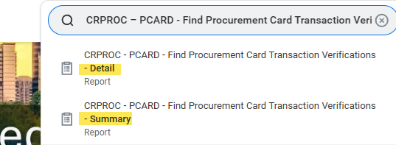
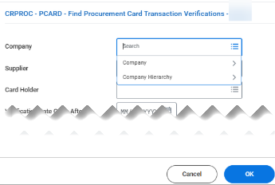
Run Reports – Procurement Card
Transaction Verification (Part 1 of 4)
INSTRUCTIONS
Enter CPROC – PCARD – Find Procurement Transaction Verifications in the Search field.
Click either CRPROC – PCARD - Find Procurement Card Transaction Verifications Detail or Summary report.
1
2
Select one or more Companies for which you are authorized to view related transactions.
Click OK.
3
4

Slide 3
Run Reports – Procurement Card
Transaction Verification (Part 2 of 4)
INSTRUCTIONS
Review and analyze report results. Options for filtering and analysis of the CRPROC – PCARD – Find Procurement Card Transaction Verifications – SUMMARY report include, but are not limited to:
  Credit Card Billing Date: Filter on this column header to view all verification documents for a specific Credit Card Billing Date.
  Card Holder: Filter to focus on verification documents belonging to a specific card holder.
  Verification Status: Filter on this column header (in conjunction with the Credit Card Billing Date) to ensure all verification documents are in 'Approved' status, eligible for settlement processing or analyze verification documents remaining 'In Progress' status for longer than usual.
  Settlement Run: Filter to identify transactions that do or do not have a Settlement Run associated with them, indicating transactions have been paid.
  Attachments: Filter to identify all verification documents that do not have an attachment.
Version 1
3

Slide 4
Run Reports – Procurement Card
Transaction Verification (Part 3 of 4)
INSTRUCTIONS
Review and analyze report results. Options for filtering and analysis of the CRPROC – PCARD – Find Procurement Card Transaction Verifications – DETAIL report include, but are not limited to:
  Credit Card Billing Date: Filter on this column header to view all verification documents for a specific Credit Card Billing Date.
  Line Memo: Filter on this column header to identify all P-Card Prior Approval related transactions.
  Worktags: Filter on various Worktags, including Spend Category as Worktag, Cost Center, or Budget Reference to analyze transactions against a specific budget.
Version 1
4

Slide 5
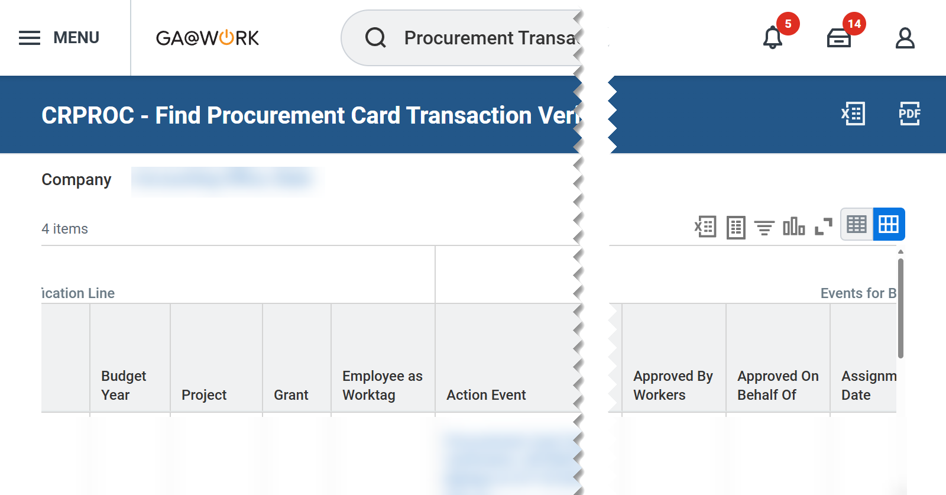


Run Reports – Procurement Card
Transaction Verification (Part 4 of 4)
INSTRUCTIONS
Click the Excel or PDF options to export report results for further analysis, as needed.
Click Change Selection to update report criteria as needed and re-run the report based on the new criteria.
You have successfully run the CRPROC-PCARD-Find Procurement Card Transaction Verifications (Summary/Detail) Report options.

