Slide 1
Run Reports
P-Card Prior Approval Requests
DESCRIPTION
This guide will help P-Card Holders locate, run and review the P-Card Prior Approval Requests report.
OVERVIEW
The key steps in the process are below:
Enter CRPROC – PCARD - My P-Card Prior Approval Requests into the Search field.
Click the CRPROC – PCARD – My P-Card Prior Approval Requests report.
Review P-Card Prior Approval Requests.
Filter option on Column Headers to analyze results.
Export report to Excel or PDF, as applicable.
Business Process:
Locate Prior Approval Request Report
Filter & Analyze Results
Export as Needed

Slide 2

Run Reports - P-Card Prior Approval Requests (Part 1 of 3)
INSTRUCTIONS
Enter CRPROC – PCARD - My P-Card Prior Approval Requests into the Search field.
Click CRPROC – PCARD – My P-Card Prior Approval Requests report.
1
2

Slide 3
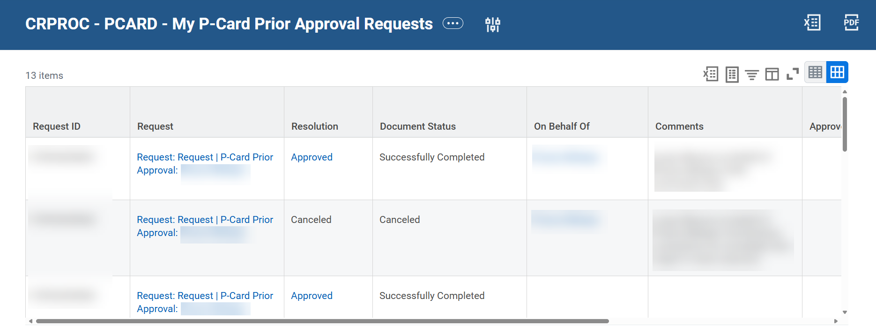
Run Reports - P-Card Prior Approval Requests (Part 2 of 3)
INSTRUCTIONS
Analyze report results using the Filter option, as needed.
  Note: The filter is completed for column headers.

Slide 4

Run Reports - P-Card Prior Approval Requests (Part 3 of 3)
INSTRUCTIONS
Click Excel or PDF, to export the report in the desired format.
You have successfully run and reviewed results of the CRPROC- PCARD – My Prior Approval Requests Report.

