Slide 1
Send Back Options for P-Card Prior Approval Request Approvers
DESCRIPTION
This guide will show P-Card Prior Approval Request Approvers how to use Send Back options to ask Initiators to Revise or Cardholders (on behalf of) to Review prior to Approval.
OVERVIEW
The key steps in the process are below:
Click My Tasks (current approver only).
Select appropriate Request | P-Card Prior Approval.
Click Send Back.
Select appropriate recipient and action.
Enter reason for Send Back.
Click Submit.
Business Process:
Select and Review P-Card Request
Determine Send Back Action Required
Click Send Back and add Recipient

Slide 2

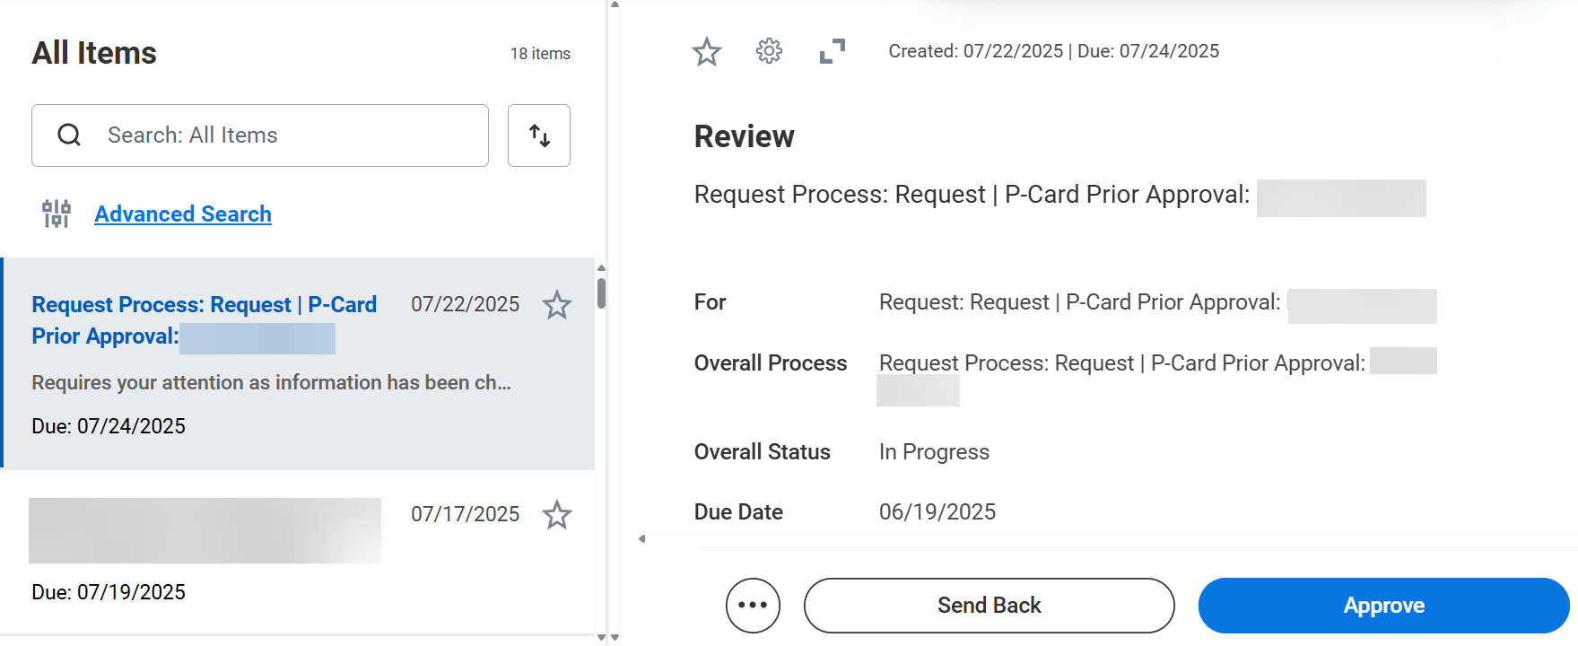
Send Back Options for P-Card Prior Approval Request Approvers (Part 1 of 3)
INSTRUCTIONS
Click My Tasks in the top-right corner of your Homepage.
Select Review Process: Request | P-Card Prior Approval: (Card Holder Name).

Slide 3
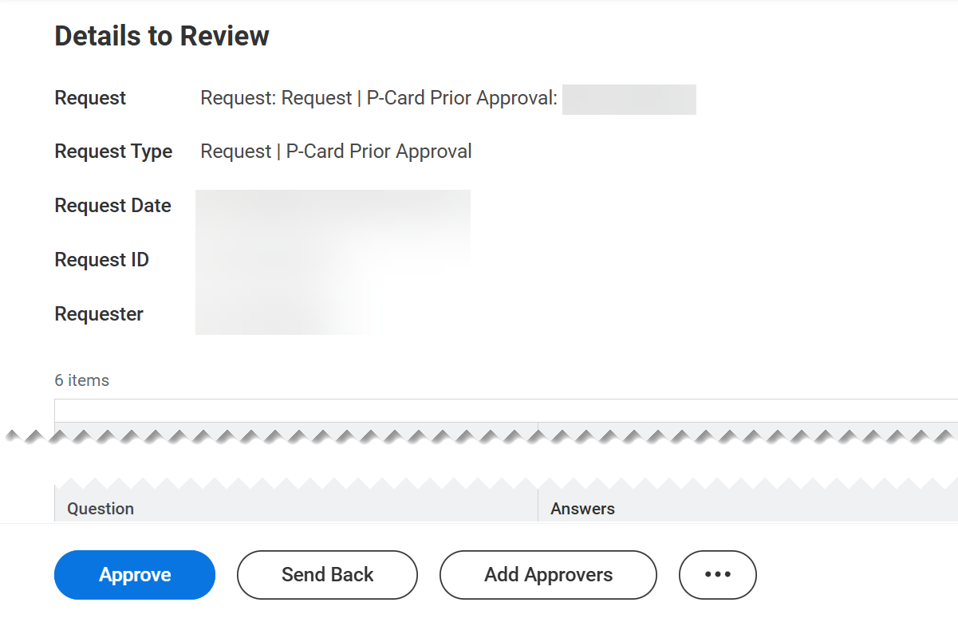
Send Back Options for P-Card Prior Approval Request Approvers (Part 2 of 3)
INSTRUCTIONS
Click Send Back if determination is made that the request requires further review or revision prior to approval.
  Note: Prior Approval Request can be reviewed (by cardholder on behalf of) or revised (by initiator) on Send Back until the Cardholder Manager closes the request.

Slide 4
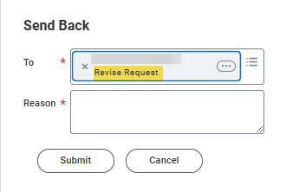
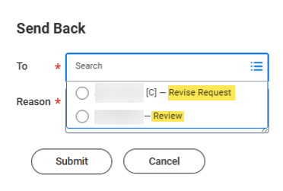

Send Back Options for P-Card Prior Approval Request Approvers (Part 3 of 3)
INSTRUCTIONS
Select an option in the To* field and enter the Reason* for Send Back.
Note: If request 'on behalf of' the approver has multiple options to select based on action required. Only Initiators can Revise a Request. If needed, selecting the On Behalf Of cardholder will allow for their Review first to determine what specific changes (if needed) are necessary. The Cardholder can then comment on changes required and take Send Back action to the Initiator to Revise.
Click Submit. The request will then route to the selected recipient for review and/or revision.
4
5
4
5
You have successfully Sent Back a Prior Approval Request.

