Slide 1
Prepare for P-Card Settlement
Settlement Review
DESCRIPTION
This guide offers Procurement Settlement Specialists a high-level overview of the P-Card Settlement Process.
Note: For detailed instructions on how to complete a Settlement Run, reference the Banking and Settlement Run Event job aid.
OVERVIEW
The key steps in the process are below:
Review e-mail from P-Card Administrator and confirm P-Card Statement balance due.
Specify Billing Date Criteria to search and select transactions matching monthly P-Card Statement for Settlement.
Reconcile selected Transaction Count & Sum against P-Card Statement from the bank to ensure all statement transactions are settled each month.
Procurement Settlement Specialist processes monthly settlement run to generate Payment in full to bank.
Business Process:
Receive Email from P-Card Administrator
Search Transactions & Reconcile Statement
Submit Settlement Run for Processing Payment to Bank

Slide 2
Prepare for P-Card Settlement – Settlement Review (Part 1 of 3)
OVERVIEW
Email from Agency P-Card Administrator
Agency P-Card Admin emails the Procurement Settlement Specialist that all transactions for a monthly billing statement are eligible for settlement and payment processing to Bank.
Review and Verify Email
Procurement Settlement Specialist creates a settlement run, selecting all eligible transactions for the statement date. See steps to run the CRPROC-PCARD – Find Credit Card Transactions Report.
Create Settlement Run for P-Card Transactions
Procurement Settlement Specialist selects all verified transactions for a specific billing date to settle.
Settlement Processing
Organization pays the Bank for the total amount due in the billing cycle.
Reporting and Compliance
Procurement Settlement Specialist maintains reports and records of completed settlement processing for policy compliance.

Slide 3
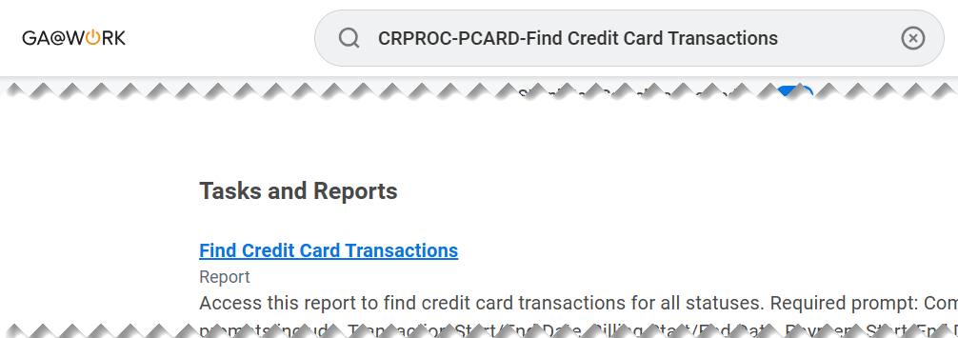
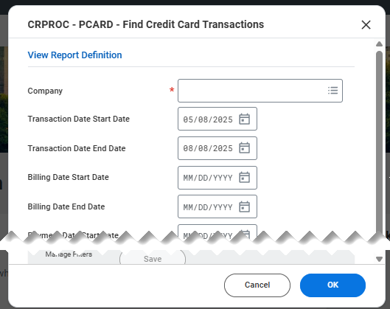
Prepare for P-Card Settlement – Settlement Review (Part 2 of 3)
INSTRUCTIONS
Enter CRPROC – PCARD - Find Credit Card Transactions in Search field.
Click Find Credit Card Transactions report.
1
2
Enter the Company*.
Enter Billing Date Start Date and Billing Date End Date.
Click OK.
3
4
5

Slide 4
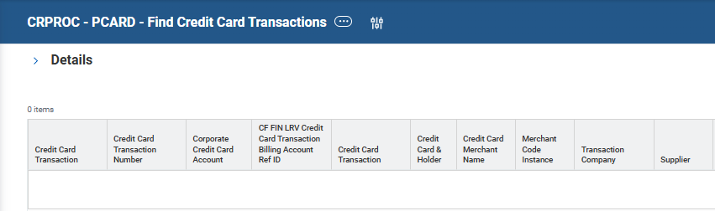

Prepare for P-Card Settlement – Settlement Review (Part 3 of 3)
INSTRUCTIONS
Analyze the Credit Card Transactions returned by the report. Confirm total of verified transactions eligible for settlement matches Billing Statement total due per email from P-Card Administrator.
  Filter on Billing Date: confirm all transactions have the single billing date that is being prepared for settlement.
  Filter on Transaction Status: confirm all transactions for billing statement date are 'Verified’.
  Export results to Excel: Sum the Billing Amount Column to verify transaction total for all verified transactions eligible for payment.
Note: If filters do not return expected results, work with the Agency P-Card Administrator to ensure all transactions are eligible for settlement prior to initiating the 'Create Settlement' task. For detailed instructions on how to complete a Settlement Run, reference the Banking and Settlement Run Event job aid.
You have successfully prepared for P-Card Settlement Processing.

