Slide 1
Reqs/PO Custom Validations
(Errors & Warnings)
DESCRIPTION
This guide will help Requesters review and correct Reqs/PO Custom Validations (Errors & Warnings).
OVERVIEW
The key steps in the process are below:
Edit Requisitions to review Errors.
Click Error Banner.
Review Errors and Warnings.
Correct Errors, as applicable.
Business Process:
Access Requisition
Review Errors & Warnings
Correct Errors
Finalize Requisition

Slide 2
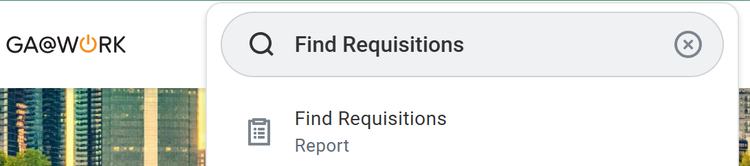
Requisition Type - Catalog SWC Error
(Part 1 of 6)
INSTRUCTIONS
Enter Find Requisitions in the Search field.
Click Find Requisitions report
  Note: This action can be done to review all errors.
1
2

Slide 3
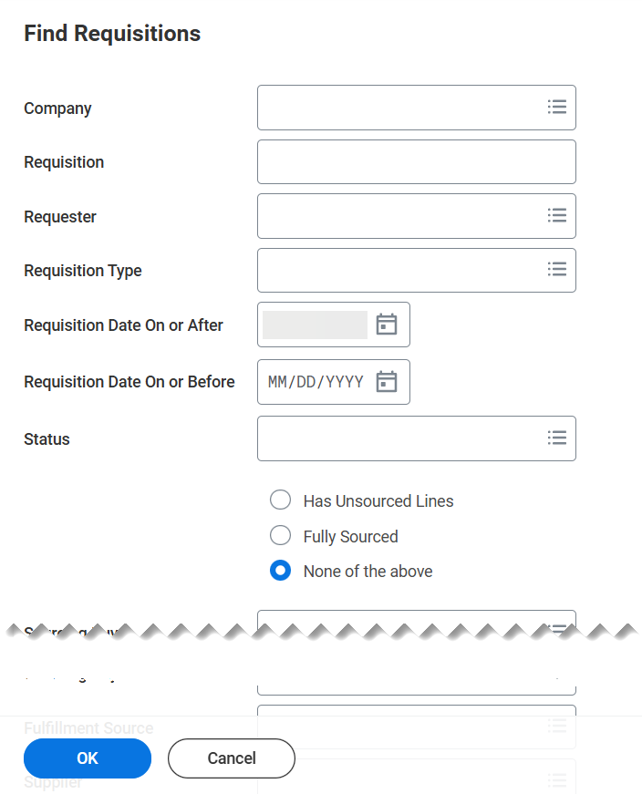
Requisition Type - Catalog SWC Error
(Part 2 of 6)
INSTRUCTIONS
Enter Search Criteria, if applicable.
Click OK.
3
4

Slide 4
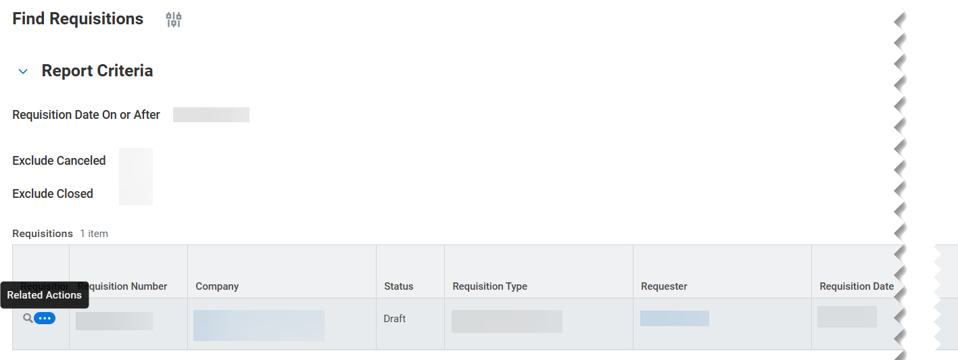
Requisition Type - Catalog SWC Error
(Part 3 of 6)
INSTRUCTIONS
Click Related Actions in the Requisition column.

Slide 5
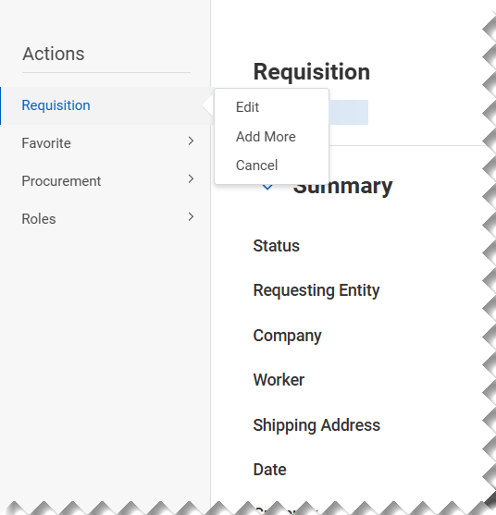
Requisition Type - Catalog SWC Error
(Part 4 of 6)
INSTRUCTIONS
Click Requisition > Edit.

Slide 6
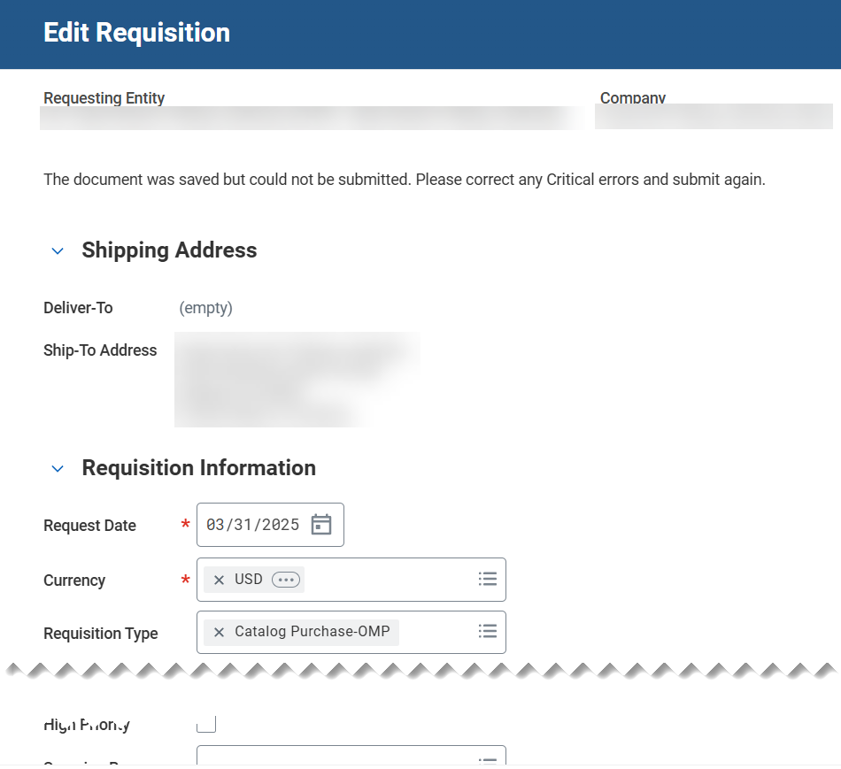
Requisition Type - Catalog SWC Error
(Part 5 of 6)
INSTRUCTIONS
When editing a requisition, ensure the Requisition Type is correct based on requirements.

Slide 7

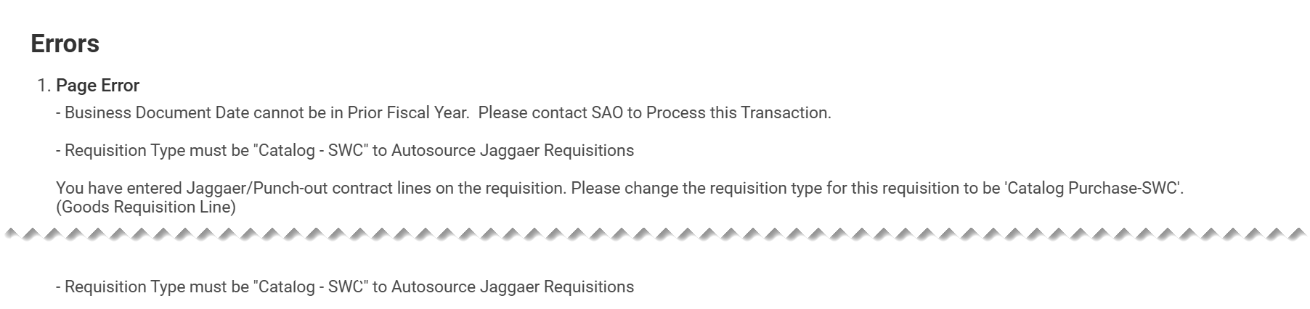
Requisition Type - Catalog SWC Error
(Part 6 of 6)
INSTRUCTIONS
Click the Error banner.
  Note: For Custom Validations Errors and alerts, you will need to click on View Exceptions prior to viewing error or alert.
Review the list of errors. Be aware of the Requisition Type must be “Catalog – SWC” to Autosource Jaggaer Requisitions.
Note: Make corrections, as applicable to clear errors.

Slide 8
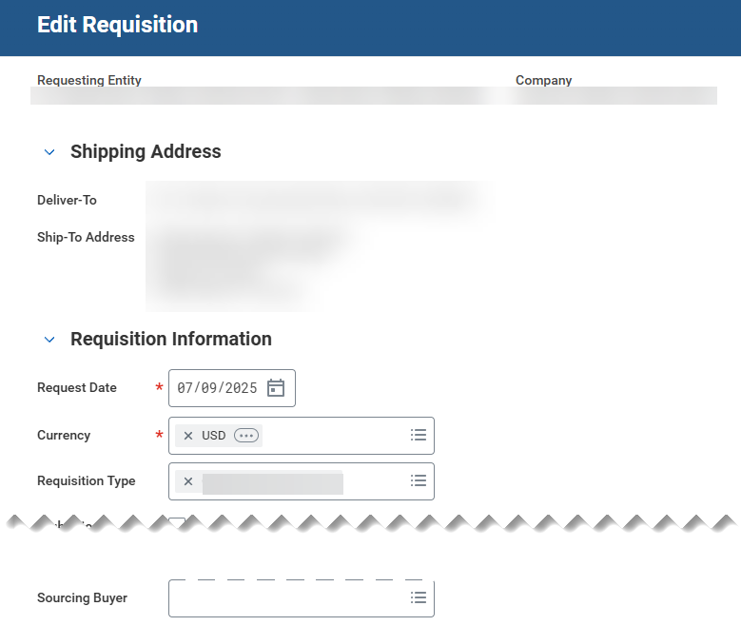
Requisition Type – Catalog OMP Error
(Part 1 of 2)
INSTRUCTIONS
When editing a requisition, ensure the Requisition Type is correct based on requirements.

Slide 9
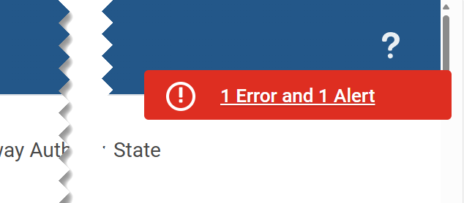
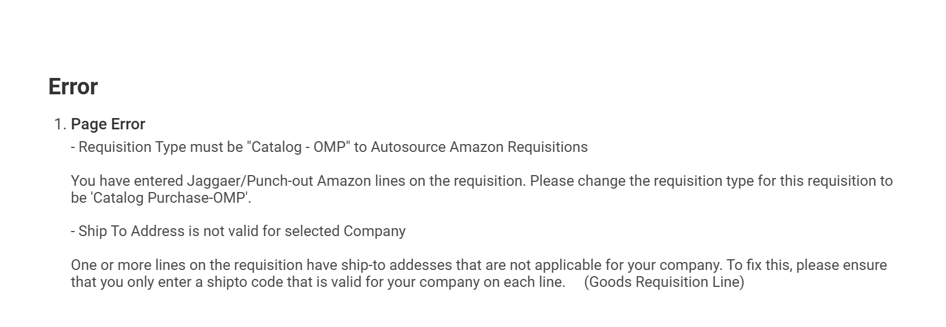
Requisition Type - Catalog OMP Error
(Part 2 of 2)
INSTRUCTIONS
Click the Error banner.
  Note: For Custom Validations Errors and alerts, you will need to click on View Exceptions prior to viewing error or alert. The Error Banner will appear when any error occurs.
View exceptions and review the list of errors. Be aware of the Requisition Type must be “Catalog – OMP” to Autosource Jaggaer Requisitions.
Note: Make corrections, as applicable to clear errors. Some Agencies may not want to Autosource Catalog Requisitions.

Slide 10

Ship-To Address is Not Valid Error
(Part 1 of 2)
INSTRUCTIONS
When editing a requisition, ensure the Ship-To Address is correct based on requisition requirements.

Slide 11
Ship-To Address is Not Valid Error
(Part 2 of 2)
INSTRUCTIONS
Click the Error banner.
  Note: The error banner will appear when any error occurs.
Review the list of errors. Be aware of the Ship-To Address is not valid for selected company error.
Note: To find Ship-To Address for agency, type Agency Code-PO. Only your Agency Specific Ship-To Addresses will populate.

Slide 12
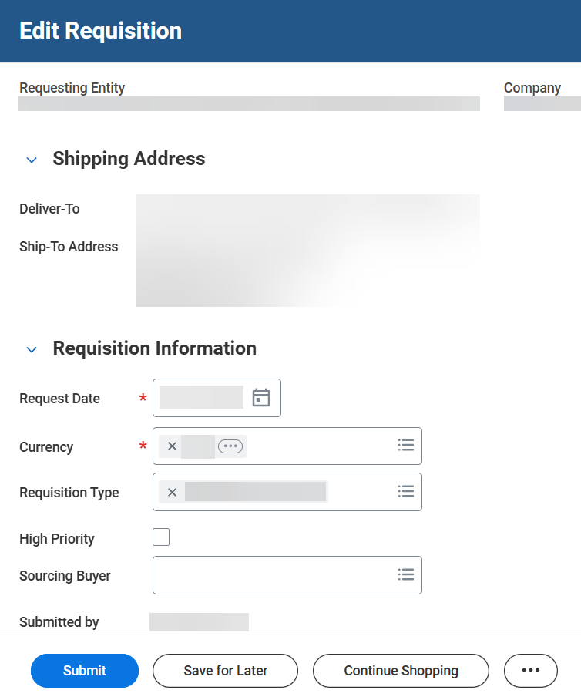

Ship-To Address is Not Valid Error
(Part 3 of 3)
INSTRUCTIONS
Click Submit to confirm error is corrected.
  Note: This action must be completed to clear an error.
You have successfully reviewed and corrected errors and warnings.

