Slide 1
View Purchase Order Additional Data
DESCRIPTION
This guide will show Buyers how to access purchase orders and View Purchase Order Additional Data.
OVERVIEW
The key steps in the process are below:
Enter Find Purchase Orders in the Search field.
Click the Find Purchase Orders report.
Select Related Actions (…) and hover over Additional Data.
Select View All.
Review Additional Data.
Business Process:
Enter Find Purchase Orders
Access Purchase Orders
Click Related Actions
View PO Additional Data

Slide 2

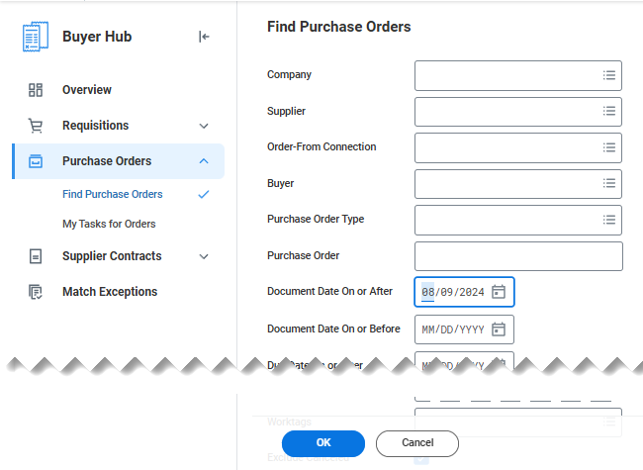
View Purchase Order Additional Data
(Part 1 of 4)
Enter Find Purchase Orders in the Search field.
Click the Find Purchase Orders report.
1
2
Narrow your Search using available fields.
Click OK.
3
4

Slide 3
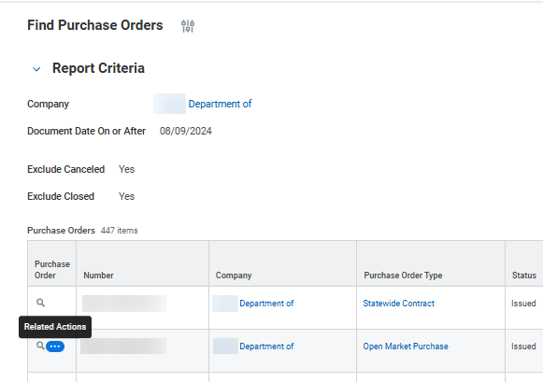
View Purchase Order Additional Data
(Part 2 of 4)
INSTRUCTIONS
View the search results and locate the desired Purchase Order.
Click Related Actions (…) in the Purchase Orders column.
  Note: Related Actions can be accessed if you are already in Purchase Order by clicking on (…) by Purchase Order Number.
5
6

Slide 4
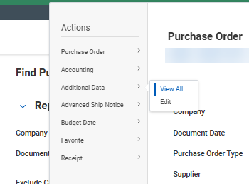
View Purchase Order Additional Data
(Part 3 of 4)
INSTRUCTIONS
Click Additional Data.
Click View All.
7
8

Slide 5
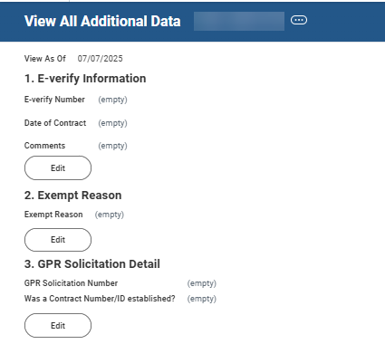

View Purchase Order Additional Data
(Part 4 of 4)
INSTRUCTIONS
Review additional data, as applicable. Additional data includes the following:
  E-Verify Information and Exempt Reason
  GPR Solicitation Detail
  Requesting Entity and Lease (Purchase Order)
  Long-Term Commitment Type
  Subscription Based Information Technology Agreement
  DNU Requesting Entity and Single Use Account
Note: Click Edit in any section to update purchase order Additional Data. Click on Purchase Order ID link to return to PO details. After successfully accessing additional data, there is no other option to return to the Purchase Order after viewed.
You have successfully accessed Purchase Orders and viewed additional data.

