Slide 1
Approve, Send Back or
Add Approvers to a Requisition
DESCRIPTION
This guide will show the Approver the steps to Approve, Send Back or Add Approvers to a Requisition.
OVERVIEW
The key steps in the process are below:
Locate the Requisition in need of Approval.
Review and verify all Requisition Lines for accuracy.
​Approve, Send Back or Add Approvers, as applicable.
Verify the routing for Approval.
Business Process:
Locate Requisition
Review and Verify
Approve, Send Back or Add Approvers
Verify Routing

Slide 2

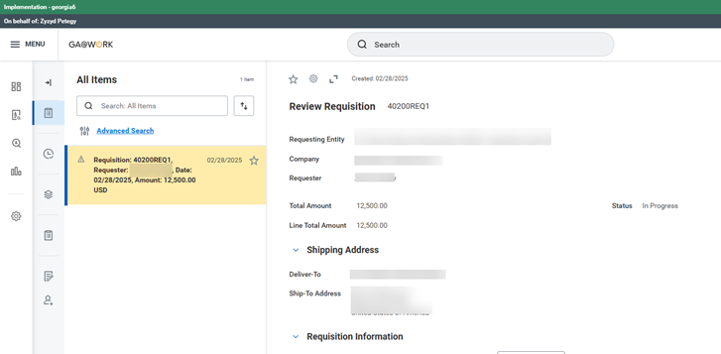
Approve, Send Back or Add Approvers to a Requisition (Part 1 of 4 )
INSTRUCTIONS
1. Click My Tasks.
2. Select the Requisition pending review.

Slide 3

Approve, Send Back or Add Approvers to a Requisition (Part 2 of 4 )
INSTRUCTIONS
Review the Requisition Line(s) for accuracy.
Note: Worktag Reviewer will focus on spend category, fund, fund source, program. Cost Center Manager will focus on cost center and worktags/amounts, as needed. Asset Approver will-focus on spend category/item(s) being purchased. P-Card Approver will review P-Card threshold and requisition amount.
Click, Approve, Send Back or Add Approvers, as applicable.

Slide 4
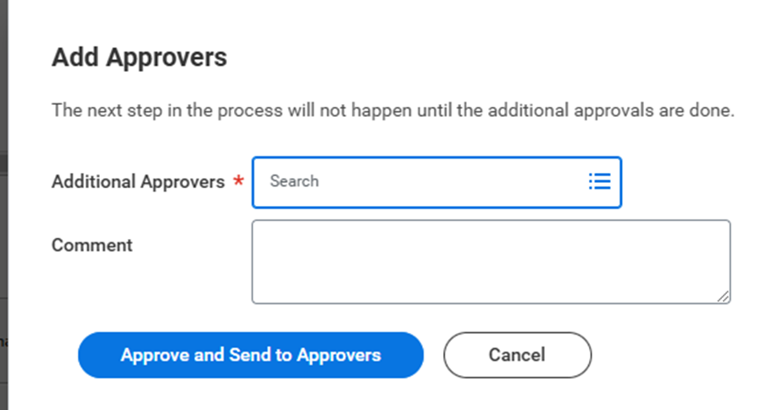
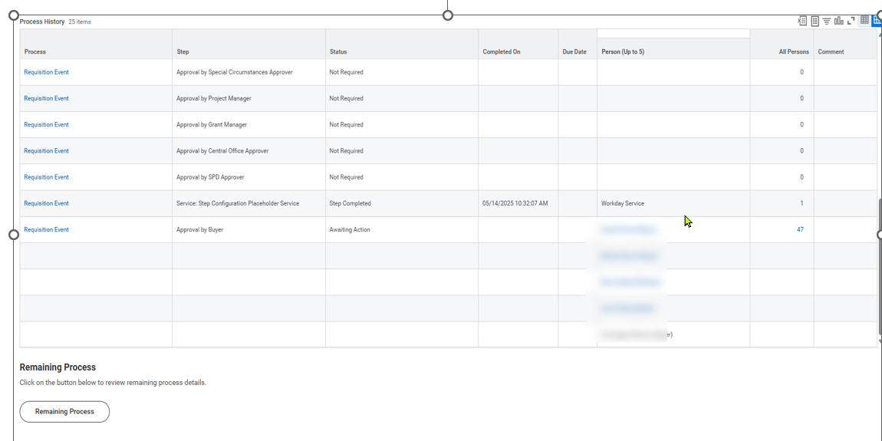
Approve and Send Back or Add Approvers to a Requisition (Part 3 of 4)
INSTRUCTIONS
Select Additional Approvers*, as applicable.
Note: Add a Comment to inform added Approvers why they were included.
Click Approve and Send to Approvers
5
6
Verify requisition routing. Scroll to Process History to view approvers currently Awaiting Action.

Slide 5
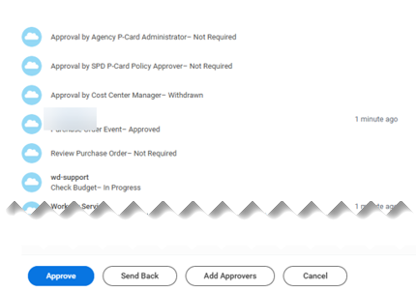

Approve and Send Back or Add Approvers to a Requisition (Part 4 of 4)
INSTRUCTIONS
Approvers shown before Withdrawn have approved the requisition. Approver listed after Withdrawn still need to approve.
Note: Withdrawn will only be visible if transactions are sent back.
You have successfully approved, sent back or added approvers to a requisition.

