Slide 1
Create a Catalog Requisition
DESCRIPTION
This guide will show Requesters how to create and submit a Catalog Requisition.
Note: A Catalog Requisition is used when shopping the Georgia Virtual Catalog of statewide contract suppliers.
OVERVIEW
The key steps in the process are below:
Connect to the Supplier Website.
Click Edit Details, edit requisition details.
Click Save Changes.
Shop the Virtual Catalog.
Verify required fields on the checkout page and click Submit.
Business Process:
Connect to Supplier Website
Create Catalog Requisition
Checkout
Submit Catalog Requestion

Slide 2

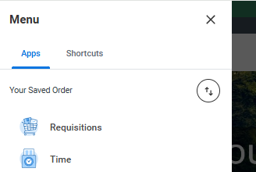
Create a Catalog Requisition (Part 1 of 8)
INSTRUCTIONS
Click the Global Navigation Menu.
Click Requisitions.
  Note: You can click Add Apps to add missing applications.

Slide 3
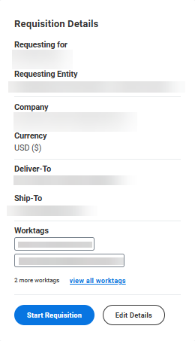
Create Catalog Requisition (Part 2 of 8)
INSTRUCTIONS
Click Edit Details.

Slide 4
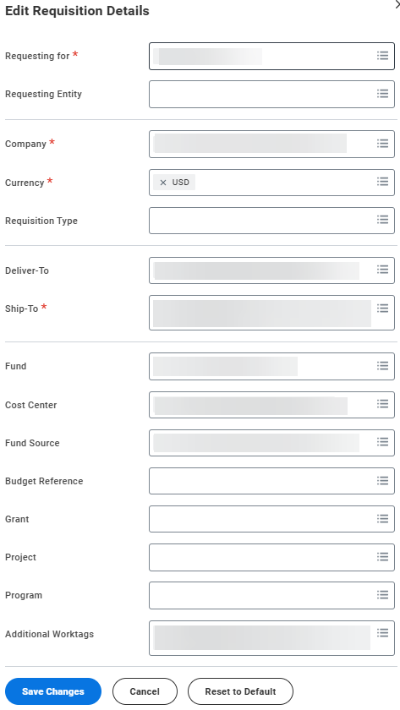
Create Catalog Requisition (Part 3 of 8)
INSTRUCTIONS
Review and edit requisition details, as applicable, then click Save Changes.

Slide 5
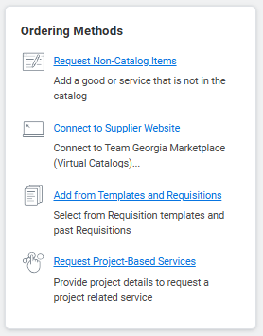

Create Catalog Requisition (Part 4 of 8 )
INSTRUCTIONS
Click Connect to Supplier Website.
Click Connect.

Slide 6
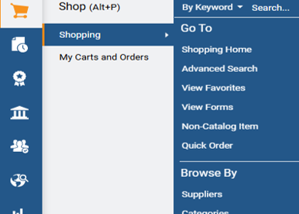
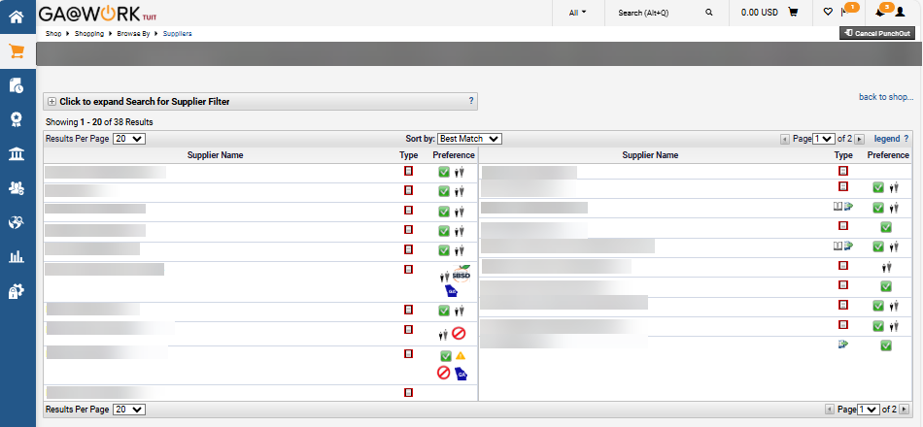
Create a Catalog Requisition (Part 5 of 8 )
INSTRUCTIONS
Click Shopping Cart and hover over Shopping.
Click Suppliers.
7
8
Select the applicable Supplier to shop.

Slide 7
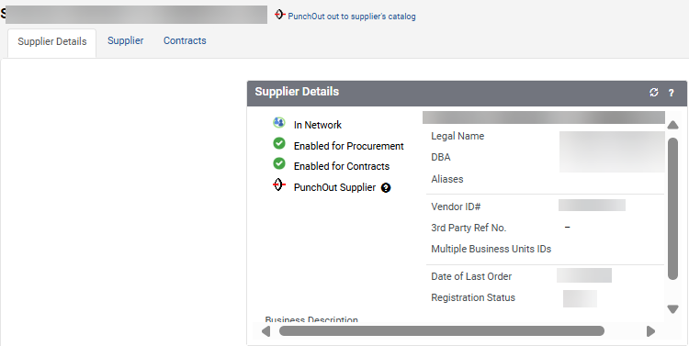
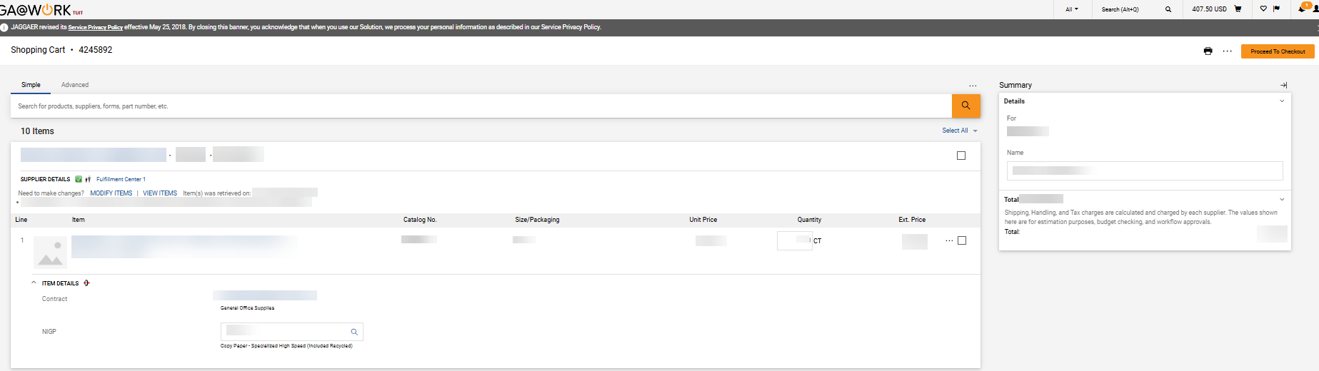
Create a Catalog Requisition (Part 6 of 8)
INSTRUCTIONS
Click PunchOut to supplier’s catalog.
Note: The shopping experience will be based on the Supplier Catalog selected.
Verify Item Details and click Proceed To Checkout.
Note: Shoppers can modify and view items prior to proceeding to checkout.

Slide 8
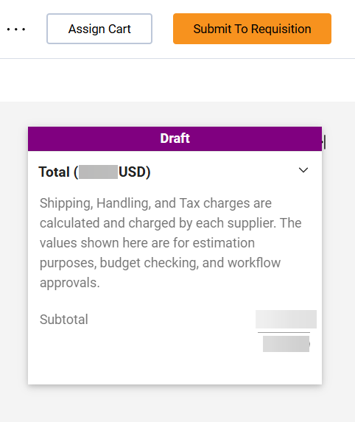
Create a Catalog Requisition (Part 7 of 8)
Conduct a final review and click Submit To Requisition.

Slide 9
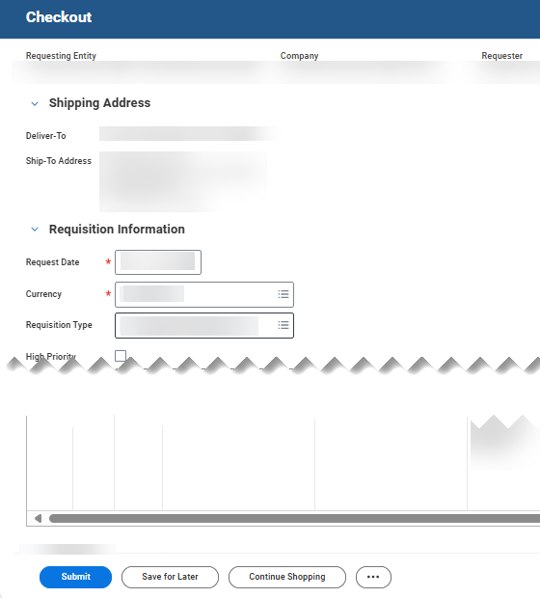

Create a Catalog Requisition (Part 8 of 8)
INSTRUCTIONS
Verify information on the Checkout page and click Submit.
Note: Review the Additional Goods, Services, Attachments and Tax information lines before submitting to verify no additional edits or information is needed.
You have successfully created a catalog requisition.

