Slide 1
Create a Non-Catalog Requisition
DESCRIPTION
This guide will show Requesters how to create and submit a Non-Catalog Requisition.
Note: A Non-Catalog Requisition is used when not shopping the Georgia virtual catalog of statewide contract suppliers.
OVERVIEW
The key steps in the process are below:
Locate Non-Catalog Requisition Task.
Click Edit Details and edit requisition details.
Click Save Changes.
Verify required fields to request Non-Catalog Items.
Click Add to Cart.
Verify required fields on the Checkout Page.
Click Submit.
Business Process:
Locate Non-Catalog Requisition Task
Create Non-Catalog Requisition
Checkout
Submit Non-Catalog Requisition

Slide 2
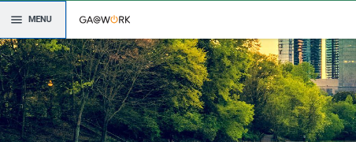
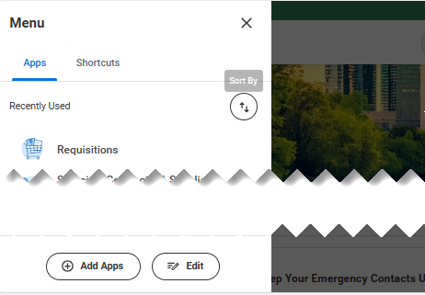

Create a Non-Catalog Requisition
(Part 1 of 9)
INSTRUCTIONS
Click the Global Navigation Menu.
Click Requisitions.
  Note: You can click Add Apps to add additional apps.

Slide 3
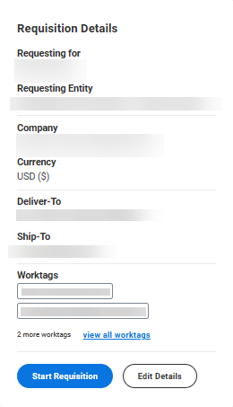
Create a Non-Catalog Requisition
(Part 2 of 9)
INSTRUCTIONS
Click Edit Details.
Note: Requisition Type, Requesting Entity, Ship-To and Cost Center are required, or you will receive an error on submission. You must ensure the Ship-To address is within your agency. To accomplish this, enter your Agency Code - PO (Example: 40300-PO) and press Enter and select your Ship-To address.

Slide 4
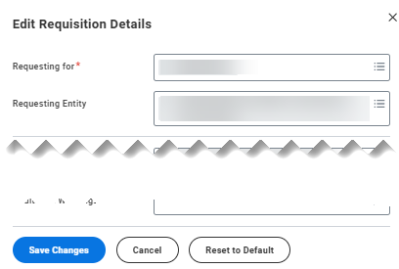
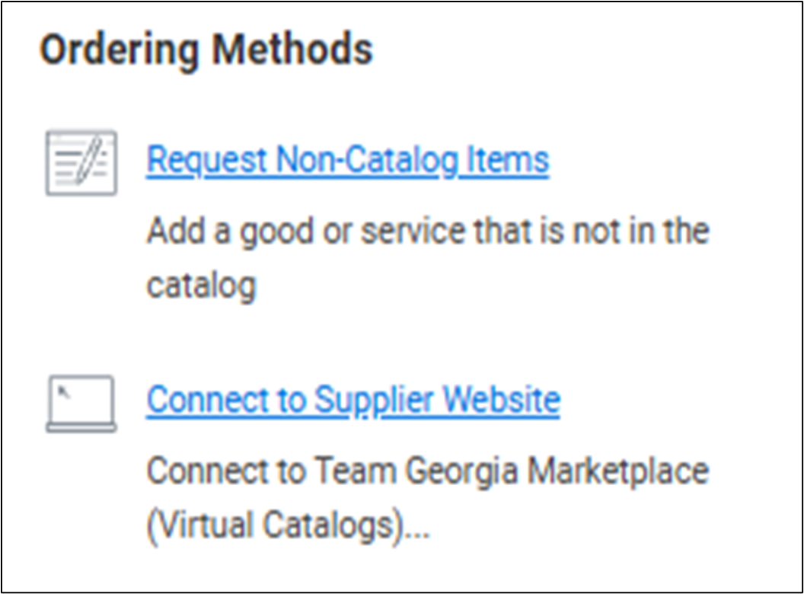
Create a Non-Catalog Requisition
(Part 3 of 9)
INSTRUCTIONS
Review all fields and click Save Changes.
Note: Review each field to verify and make optional changes to the requisition details.
Select Request Non-Catalog Items under Ordering Methods.

Slide 5
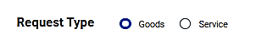
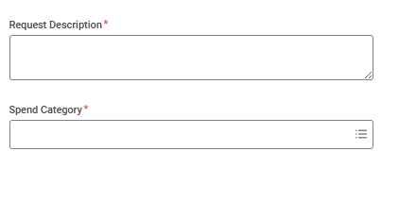
Create a Non-Catalog Requisition
(Part 4 of 9)
INSTRUCTIONS
Select a Request Type.
Note: If Goods is selected continue to Step 7. If Services is selected Skip to Step 13.
Enter the Request Description*.
Select the Spend Category*.
Note: You may Search for the Spend Category as needed. Supplier Item Identifier and Supplier are not required on this page.
7
8

Slide 6

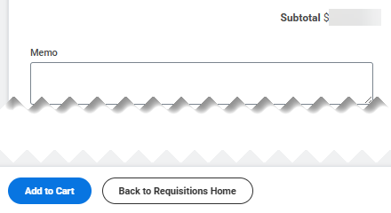
Create a Non-Catalog Requisition
(Part 5 of 9)
INSTRUCTIONS
Enter a Quantity*.
Select the Unit of Measure*.
Enter the Price.
8
9
10
Click Add to Cart.
Note: Proceed to Step 18, skipping the Service request steps.

Slide 7
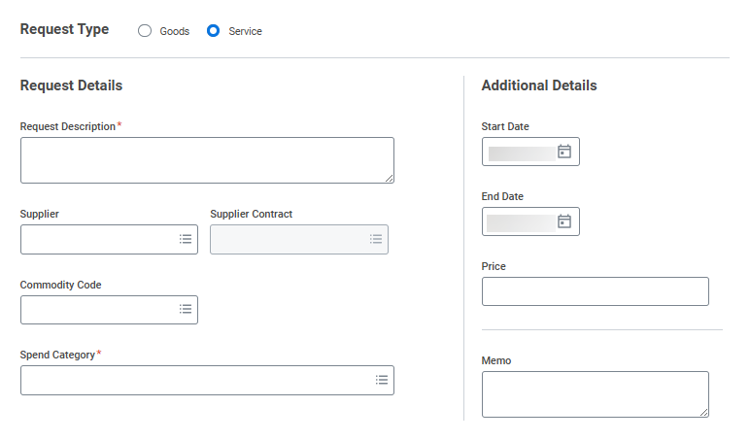
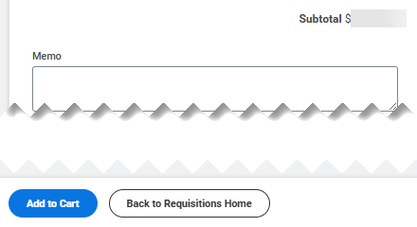
Create a Non-Catalog Requisition
(Part 6 of 9)
INSTRUCTIONS
Enter the Request Description*.
Enter the Spend Category*.
Enter the Start Date and End Date, if known.
Enter a Price (Required).
13
15
16
14
Click Add to Cart.

Slide 8
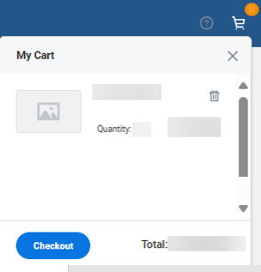
Create a Non-Catalog Requisition
(Part 7 of 9)
INSTRUCTIONS
Click the Shopping Cart.
  Note: The number above the Shopping Cart identifies the number of items in your cart.
Click Checkout.
18
19

Slide 9
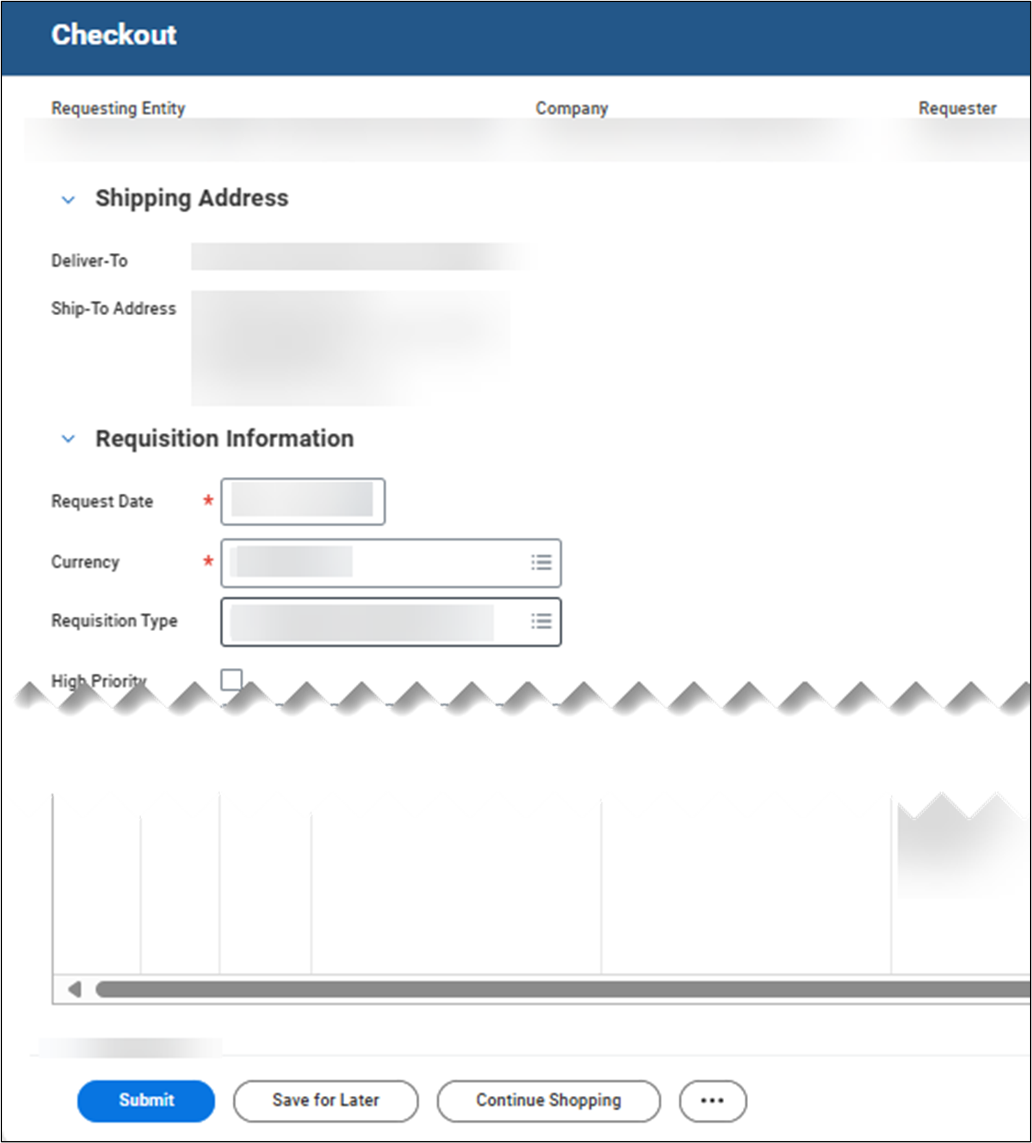

Create a Non-Catalog Requisition
(Part 8 of 9)
INSTRUCTIONS
Click Submit.
  Note: Review the Goods, Services, Attachments and Activity lines before submitting to verify no additional edits or information is needed.
You have successfully created a Non-Catalog Item Requisition.

