Slide 1
Create a Receipt
DESCRIPTION
This guide will show Requesters how to Create a Receipt.
OVERVIEW
The key steps in the process are below:
Search Create Receipt.
Click the Create Receipt task.
Note: Alternately, you can use Find Purchase Orders task and use the purchase order’s Related Action menu.
Update the Goods Lines or Service Lines.
Click Submit.
Business Process:
Locate the Create Receipt Task
Create a Receipt
Submit

Slide 2
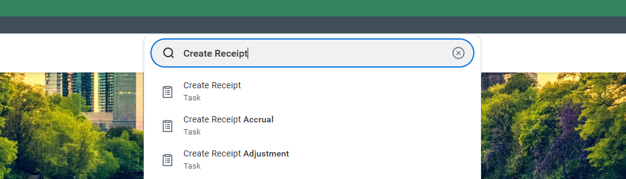
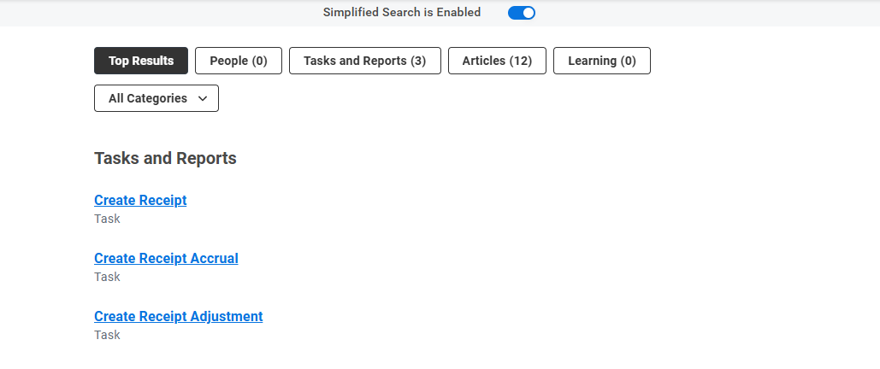
Create a Receipt (Part 1 of 3)
INSTRUCTIONS
Enter Create Receipt in the Search field and press Enter.
Click the Create Receipt task.

Slide 3
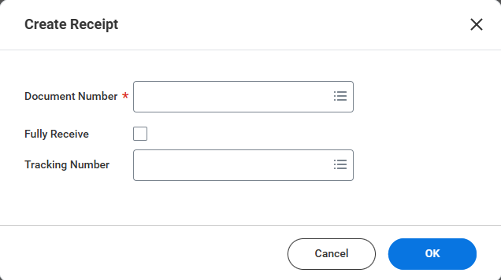
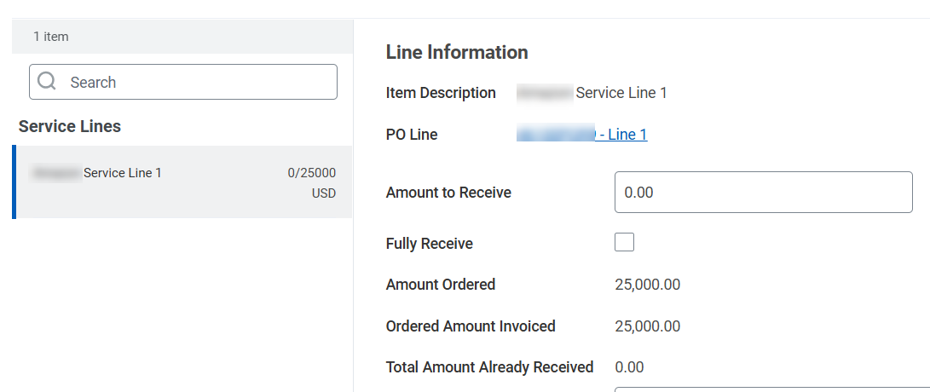
Create a Receipt (Part 2 of 3)
INSTRUCTIONS
Enter the Purchase Order Number as the Document Number*.
Note: The Purchase Order must have a status of Issued.
Click OK.
3
4
Enter the Amount to Receive for Service Lines or the Quantity to Receive for Goods Lines.
Note: If the purchase order has multiple lines review and update each line for receipt. You can also add comments in the memo field and upload attachments such as packing slips.

Slide 4
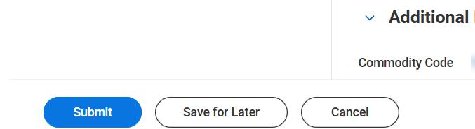
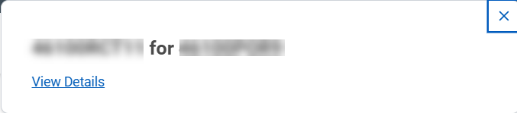

Create a Receipt (Part 3 of 3)
INSTRUCTIONS
Click Submit.
View the confirmation of Submission.
Note: Click View Details for more information regarding your submission.
You have successfully created a receipt.

