Slide 1
Create and Submit a Change Order
DESCRIPTION
This guide will show PO Buyers how to Create and Submit a Change Order.
OVERVIEW
The key steps in the process are below:
Search Find Purchase Orders.
Locate the purchase order and click Create Change Order.
Add and/or update the Goods Lines or Services Lines.
Click Submit.
Business Process:
Locate Purchase Order
Create Change Order
Review Change Order
Submit

Slide 2

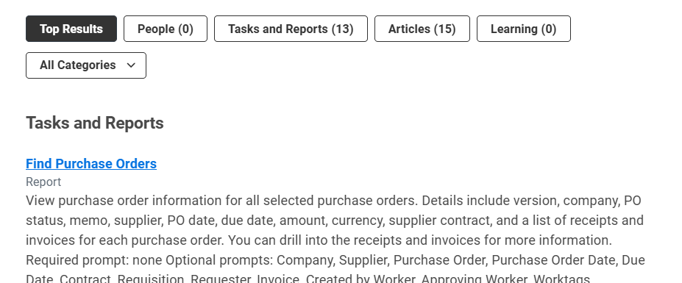
Create and Submit a Change Order
(Part 1 of 5)
INSTRUCTIONS
Enter Find Purchase Orders in the Search field and press Enter.
Click the Find Purchase Orders report.

Slide 3
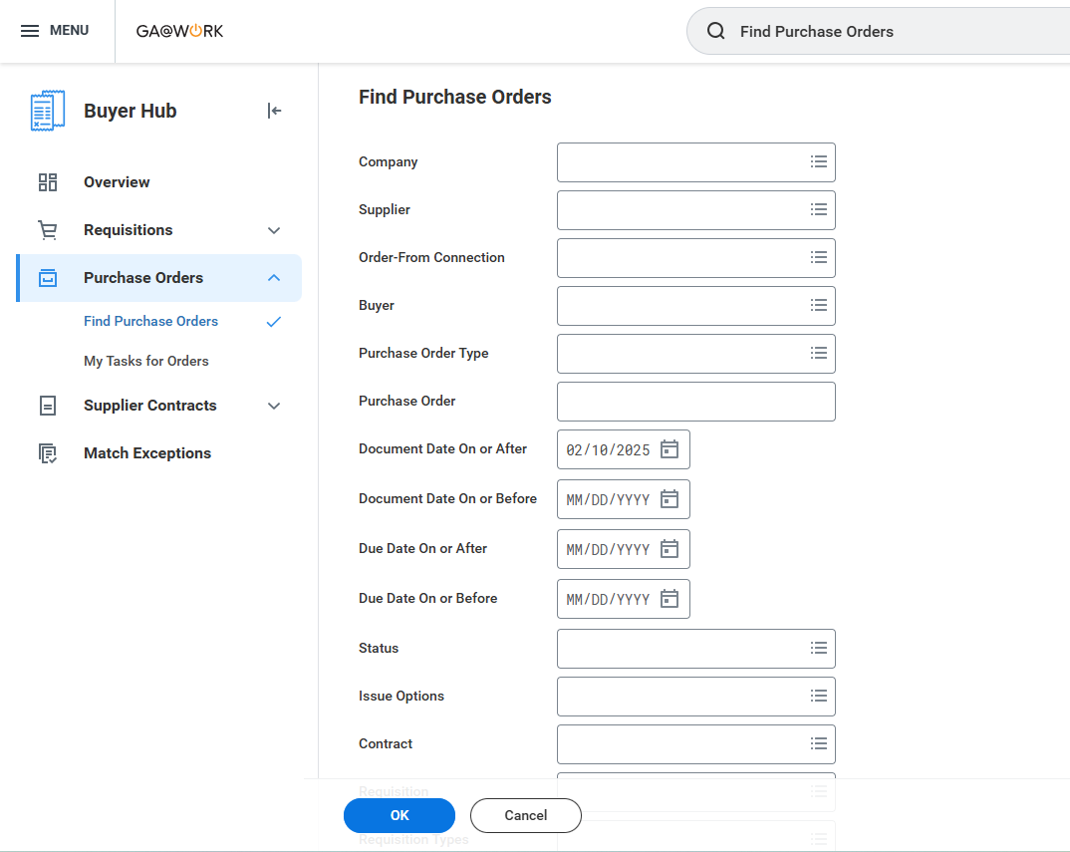
Create and Submit a Change Order
(Part 2 of 5)
INSTRUCTIONS
Enter parameters in applicable fields under Find Purchase Orders to refine your search.
Click OK.
3
4

Slide 4
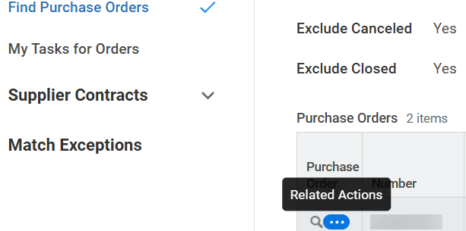
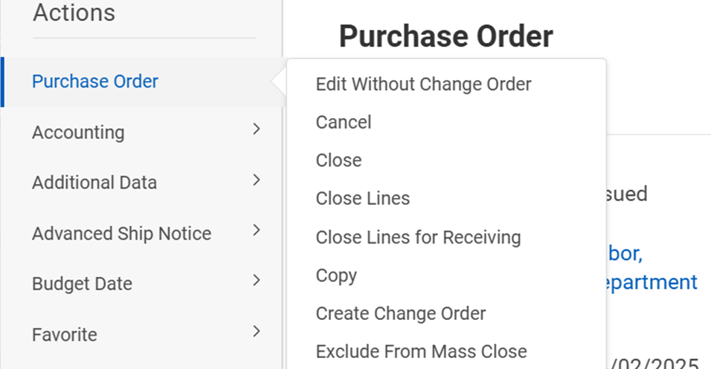
Create and Submit a Change Order
(Part 3 of 5)
INSTRUCTIONS
Click Related Actions (…).
Note: Ensure the Purchase Order is in Issued Status, or you will not be able to create change order from related actions.
Select Purchase Order.
Select Create Change Order.
6
7

Slide 5
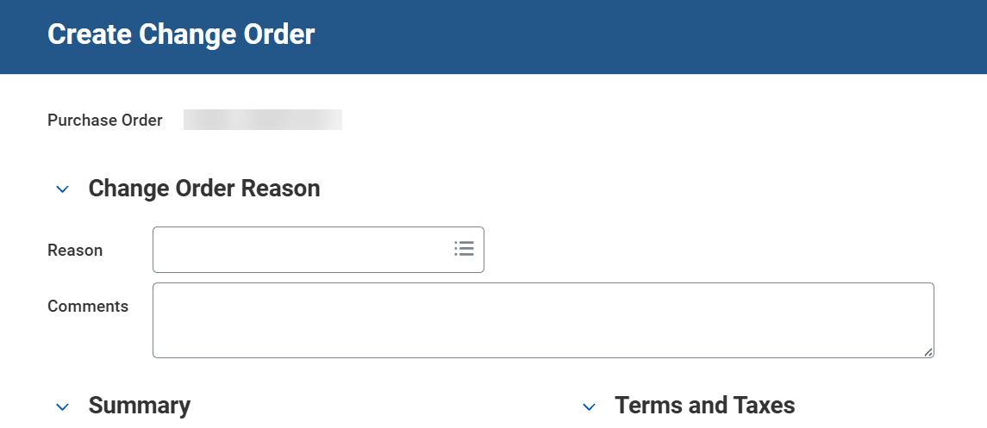
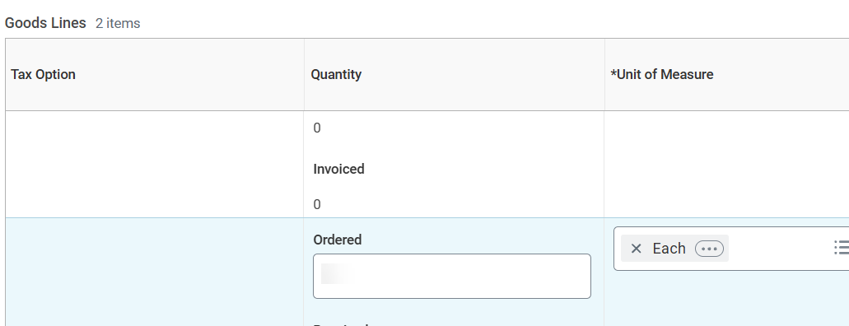
Create and Submit a Change Order
(Part 4 of 5)
INSTRUCTIONS
Enter the Reason.
Enter Comments, as applicable.
8
9
Make necessary changes to purchase order. For example, change quantity, change price, change Worktags, cancel or add lines.
Note: Scroll to the right in the Goods/Services Lines to view all available fields.

Slide 6
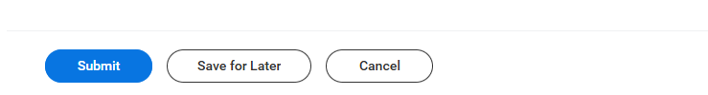
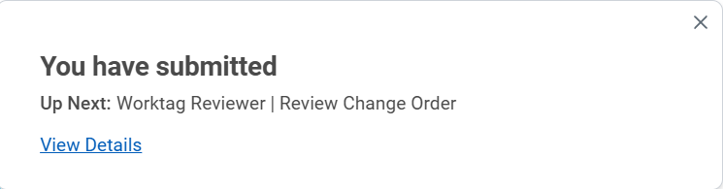

Create and Submit a Change Order
(Part 5 of 5)
INSTRUCTIONS
Review Change Order and click Submit.
View the confirmation of Submission.
Note: Click View Details for more information regarding your submission.
You have successfully created a change order.

