Slide 1
Edit and Submit a Requisition
DESCRIPTION
This guide will show Requesters how to Edit and Submit an Existing Requisition.
Note: Only Requisitions in Draft or In Progress status can be edited.
OVERVIEW
The key steps in the process are below:
Navigate to the Requisitions app.
Locate the desired Requisition.
Edit the Requisition.
Click Submit.
Business Process:
Navigate to the Requisitions App
Edit Details
Submit the Requisition

Slide 2

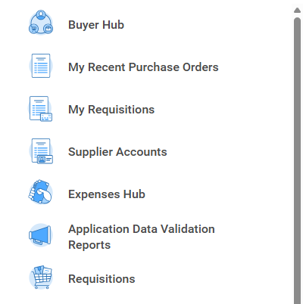
Edit and Submit a Requisition (Part 1 of 4)
INSTRUCTIONS
Click the Global Navigation Menu.
Click Requisitions.

Slide 3
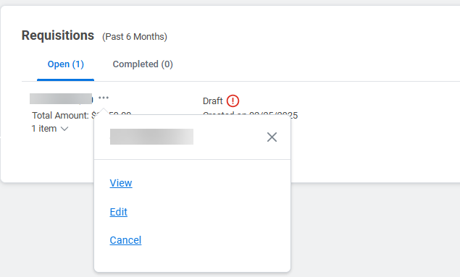
Edit and Submit a Requisition (Part 2 of 4)
INSTRUCTIONS
Click Related Actions (…) on the desired requisition.​
Click Edit.
3
4

Slide 4
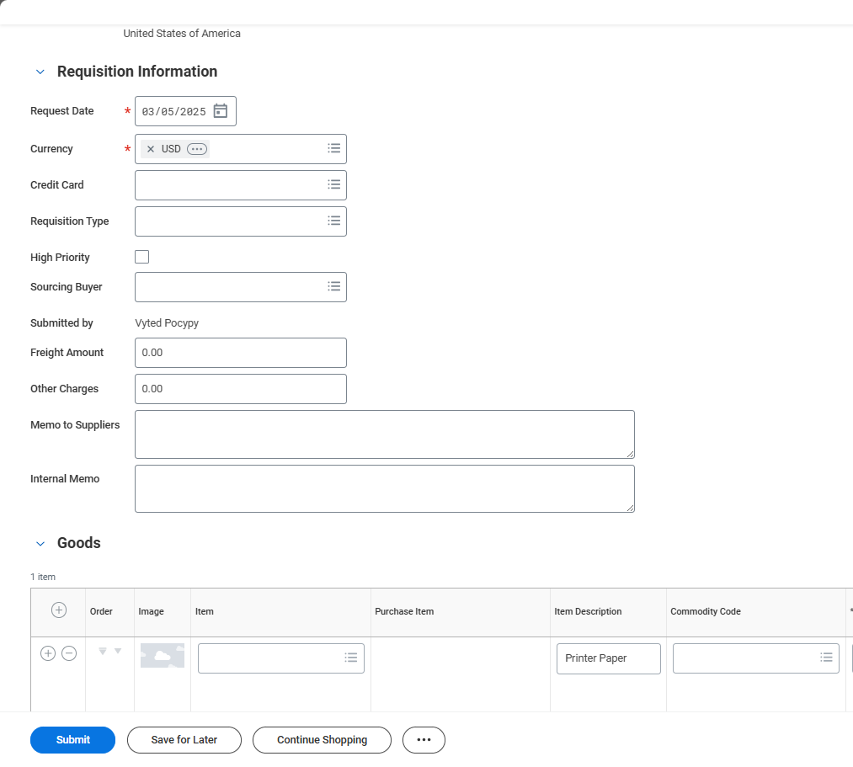
Edit and Submit a Requisition (Part 3 of 4)
INSTRUCTIONS
Edit Requisition Information, as applicable and click Submit.

Slide 5
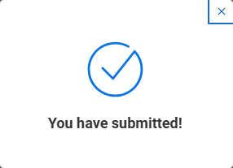

Edit and Submit a Requisition (Part 4 of 4)
INSTRUCTIONS
View the confirmation of Submission.
You have successfully edited and submitted a requisition.

