Slide 1
Mass Cancel
Procurement Documents
DESCRIPTION
This guide will show PO Buyers and Procurement Operations Lead how to Mass Cancel Procurement Documents.
Note: Mass Cancel procurement documents require approval from SAO.
OVERVIEW
The key steps in the process are below:
Enter Mass Cancel Procurement Documents in the Search field.
Select the Mass Cancel Procurement Documents task.
Enter the required information.
Click OK.
Note: Cancelling a PO sourced from a requisition allows it to be sourced to a new PO. Cancelling requisitions and non-requisition POs is a final action and transactions will need to be recreated in cancelled in error.
Business Process:
Select Mass Procurement Documents
Mass Cancel Procurement Documents
Verify Canceled Status

Slide 2

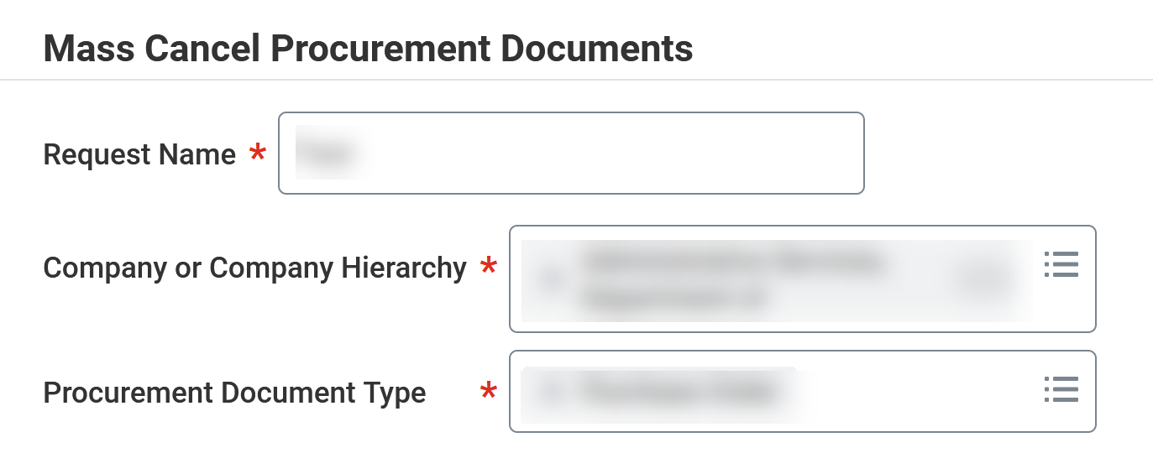
Mass Cancel Procurement Documents
(Part 1 of 4)
INSTRUCTIONS
Enter Mass Cancel Procurement Documents in the Search field.
Select the Mass Cancel Procurement Documents task.
1
2
Enter the Request Name*.
Select the Company or Company Hierarchy*
Select the Procurement Document Type*.
3
4
5

Slide 3
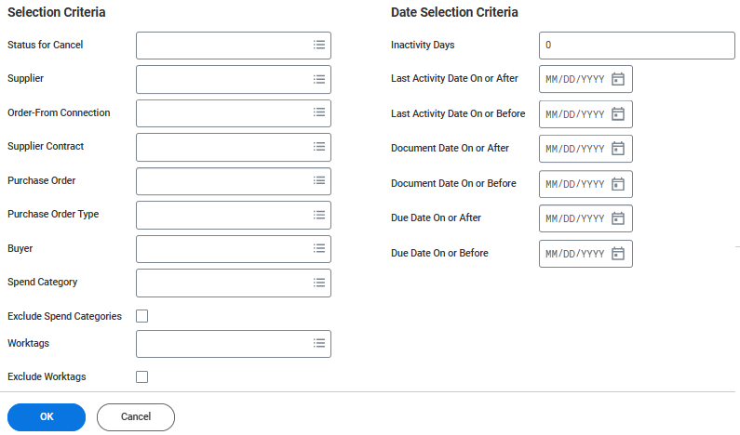
Mass Cancel Procurement Documents
(Part 2 of 4)
INSTRUCTIONS
Select the applicable Selection Criteria to narrow your search,
Click OK.
Note: The Request name, Company or Company Hierarchy and Procurement Document Type will default based on previous entry.
6
7

Slide 4
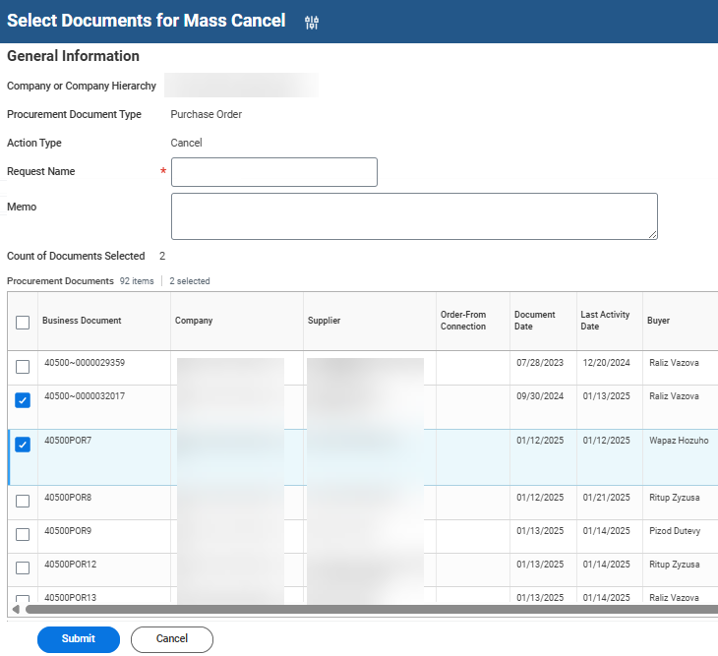
Mass Cancel Procurement Documents
(Part 3 of 4)
INSTRUCTIONS
Check the applicable Business Documents for Mass Cancel.
Click Submit.
8
9

Slide 5
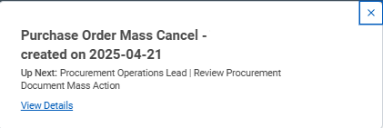

Mass Cancel Procurement Documents
(Part 4 of 4)
INSTRUCTIONS
View the confirmation of Submission.
Note: Click View Details for more information about the submission.
You have successfully completed mass cancel procurement documents.

