Slide 1
Mass Close
Procurement Documents
DESCRIPTION
This guide will show PO Buyers and Procurement Operations Lead how to Mass Close Procurement Documents.
OVERVIEW
The key steps in the process are below:
Enter Mass Close Procurement Documents in the Search field.
Click the Mass Close Procurement Documents task.
Enter and select the required information.
Click OK.
Note: Exercise caution when mass Closing POs. This will liquidate any remaining Obligations and will prevent future Invoices from being processed.
Business Process:
Select Mass Procurement Documents
Mass Close Procurement Documents
Verify Close Status

Slide 2

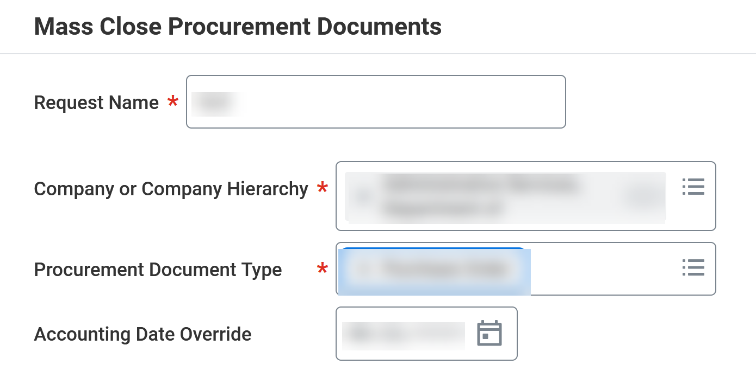
Mass Close Procurement Documents
(Part 1 of 4)
INSTRUCTIONS
Enter Mass Close Procurement Documents in the Search field.
Click Mass Close Procurement Documents task.
1
2
Enter Request Name*.
Select Company or Company Hierarchy*, Procurement Document Type* and Accounting Date Override (Optional).
3
4

Slide 3
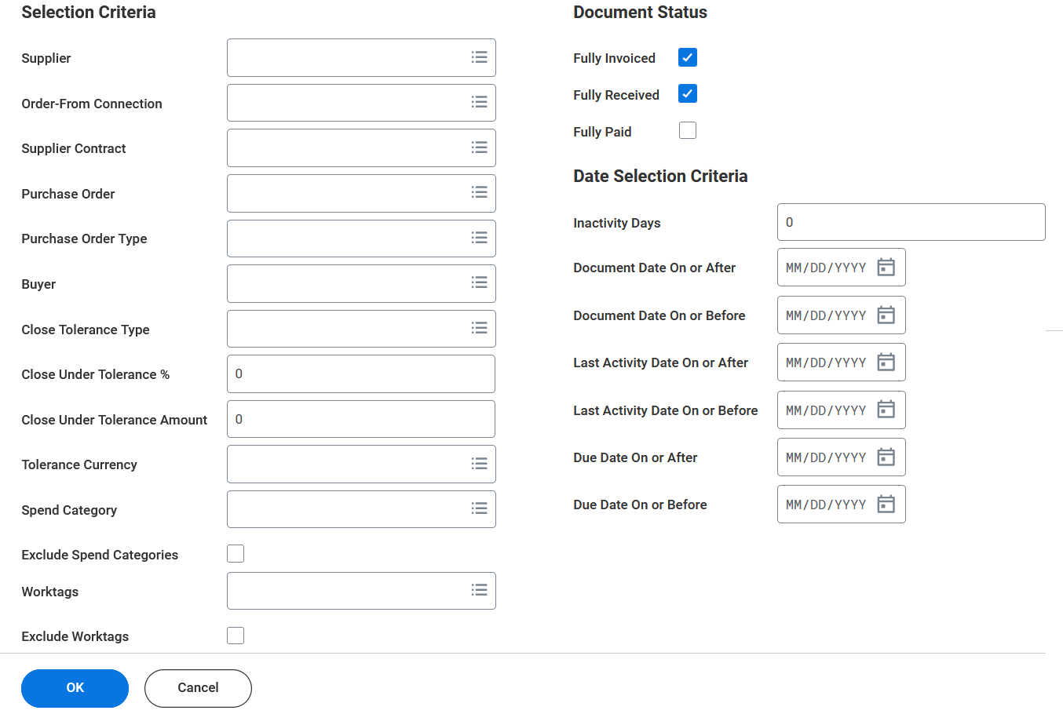
Mass Close Procurement Documents
(Part 2 of 4)
INSTRUCTIONS
Select the applicable Selection Criteria to narrow the search,
Click OK.
5
6

Slide 4
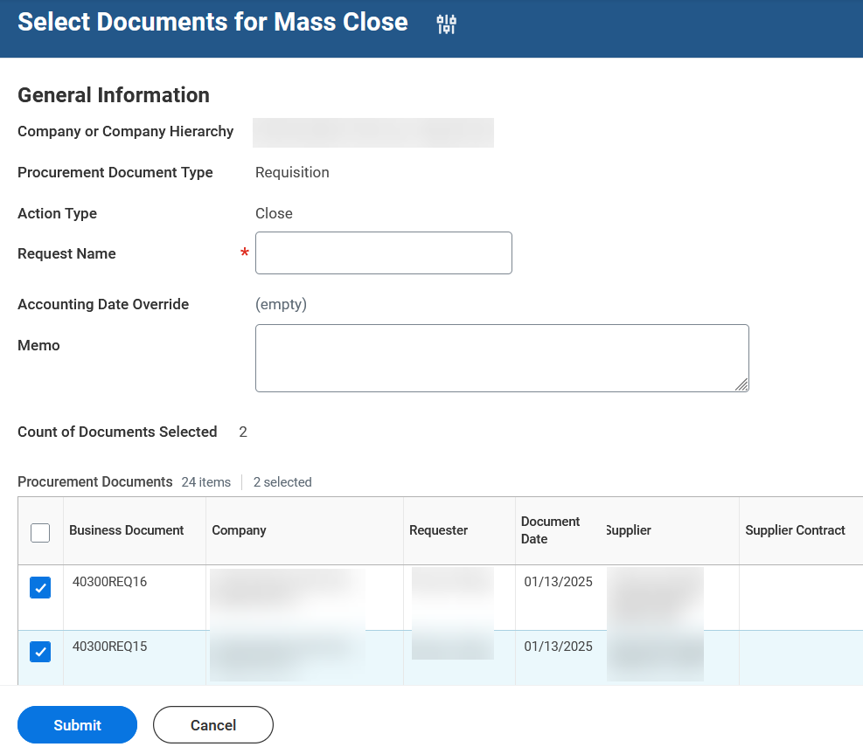
Mass Close Procurement Documents
(Part 3 of 4)
INSTRUCTIONS
Check the applicable Business Documents for Mass Close.
Click Submit.
7
8

Slide 5
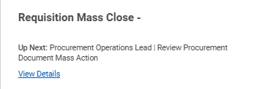

Mass Close Procurement Documents
(Part 4 of 4)
INSTRUCTIONS
View the confirmation of Submission.
Note: Click View Details for more information about the submission.
You have successfully completed a mass close procurement documents.

