Slide 1
Requisition Sourcing
Console Overview
DESCRIPTION
This guide will show Buyers and Requesters how to access and navigate the Requisition Sourcing Console.
OVERVIEW
The key steps in the process are below:
Enter Requisition Sourcing Console in the Search field.
Click the Requisition Sourcing Console report.
Review the Sourcing Console.
Review Requisitions and Actions.
Export console to Excel or PDF, if applicable.

Slide 2
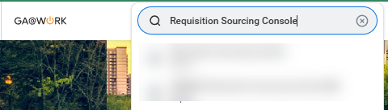
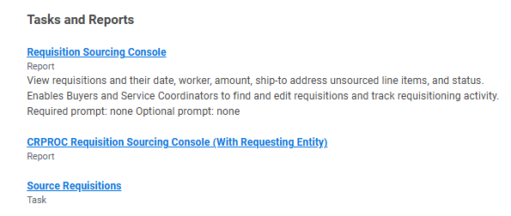
Requisition Sourcing Console (Part 1 of 6)
INSTRUCTIONS
Type Requisition Sourcing Console in the Search field and press Enter.
Click the Requisition Sourcing Console report.

Slide 3
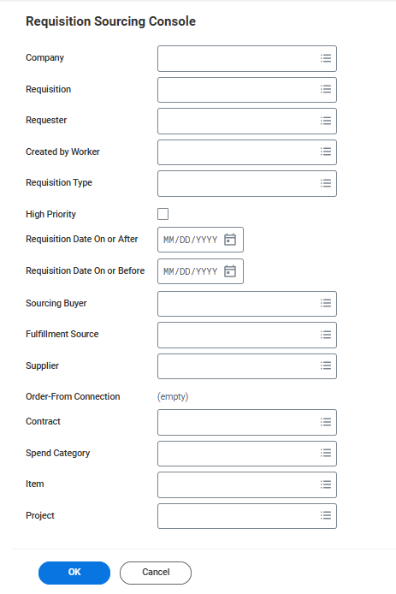
Requisition Sourcing Console (Part 2 of 6)
INSTRUCTIONS
Select a Company to filter the console results that will display.
Note: You may filter by other available fields, if applicable.
Click OK.
3
4

Slide 4
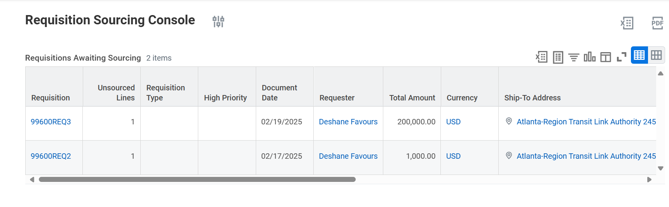
Requisition Sourcing Console (Part 3 of 6)
INSTRUCTIONS
Review the Requisition Sourcing Console. Be aware of the following fields:
  Requisition
  Unsourced Lines
  Requisition Type
  High Priority
  Document Date
  Requester
  Total Amount
  Currency
  Ship-To Address
  Sourcing Buyer
  Action
  Memo to Suppliers
  Internal Memo

Slide 5
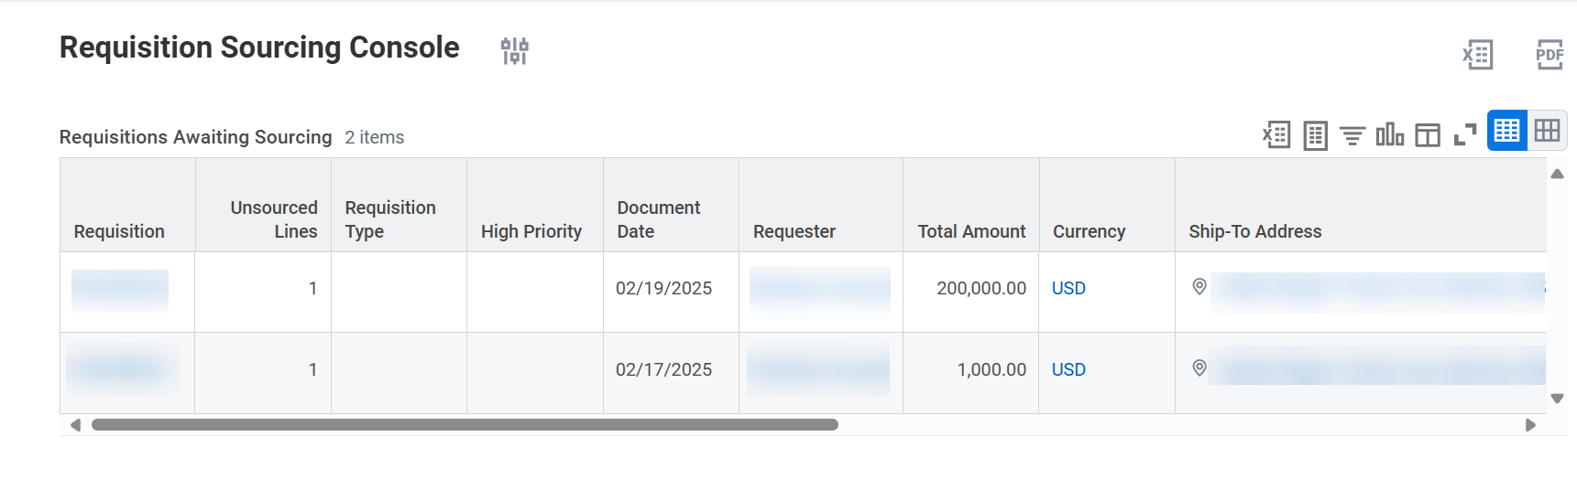
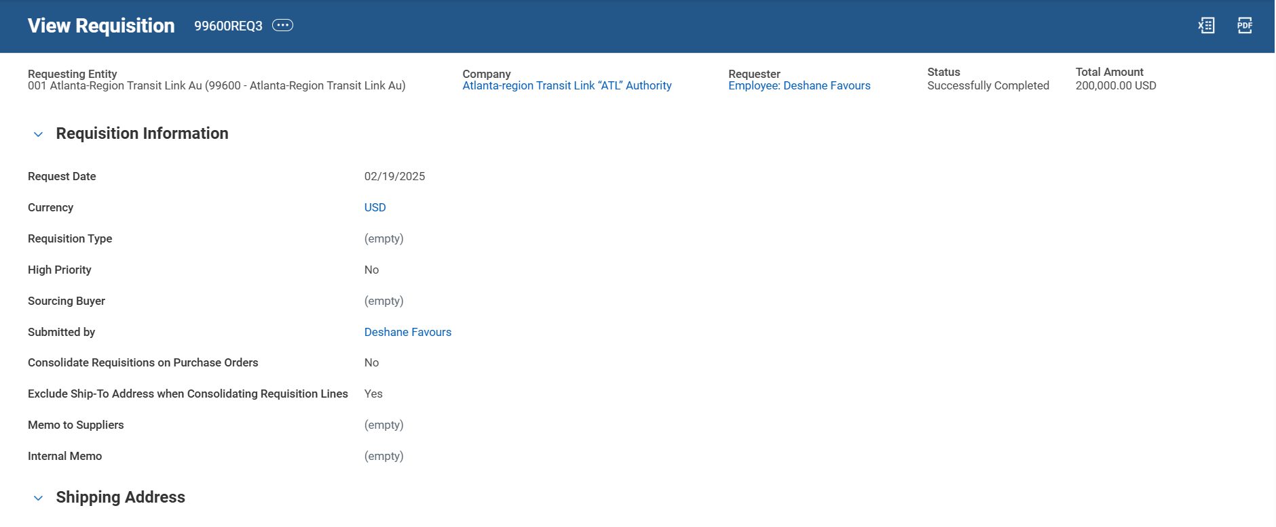
Requisition Sourcing Console (Part 4 of 6)
INSTRUCTIONS
Click the Requisition Number to view a requisition.
  Note: You can also use Related Actions (…) beside Requisition Number to perform any actions available.
View the Requisition, make note of the following sections:
  Requisition Information
  Shipping Address

Slide 6
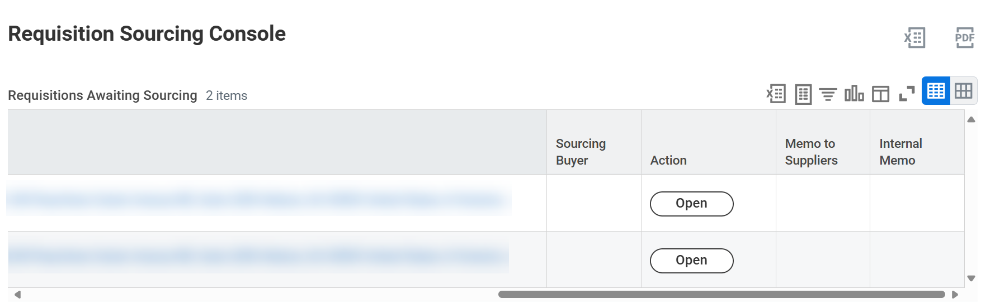
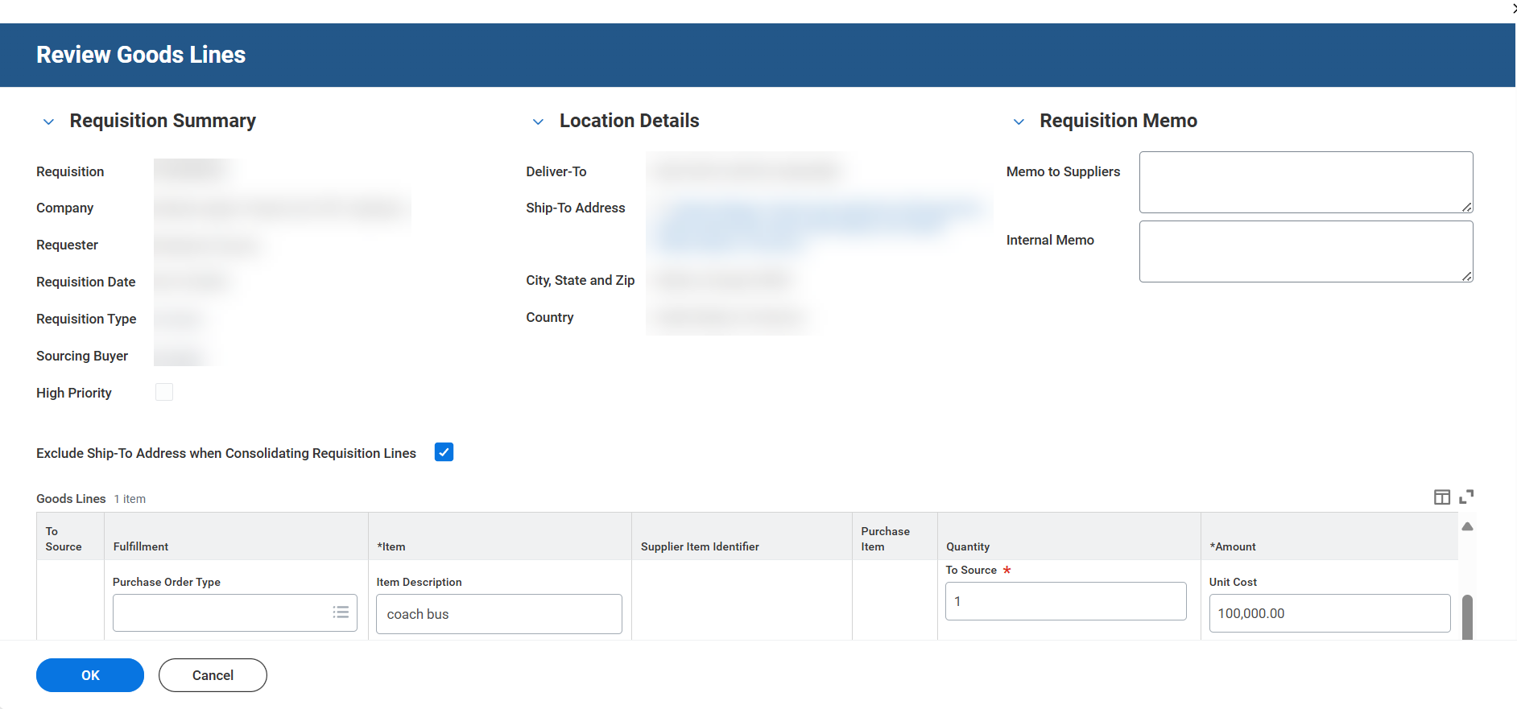
Requisition Sourcing Console (Part 5 of 6)
INSTRUCTIONS
Click Open in the Action column to view activity on a requisition.
View the activity, be aware of the following sections:
  Requisition Summary
  Location Details

Slide 7

Requisition Sourcing Console (Part 6 of 6)
INSTRUCTIONS
Click Excel or PDF to export the console in Excel or PDF format.
You have successfully accessed and reviewed the Requisition Sourcing Console.

