Slide 1
Setup Requester Defaults in
Requisition App
DESCRIPTION
This guide will show the Requisition Requester how to setup requester defaults in Requisition App.
OVERVIEW
The key steps in the process are below:
Click Requisitions from the Menu.
Click Edit Details from the Requisition Details section.
Complete the Requesting for*, Requesting Entity, Company*, Currency*, Ship-To*, Fund, Cost Center, Fund Source, and Budget Reference in the Edit Requisition Details section.
​​Grant, Project, Program, and Additional Worktags are optional depending on agency requirements.
Click Save Changes.
Business Process:
Select Requisitions
Select Edit Requisition Details
Complete Requisition Defaults section
Save Changes

Slide 2

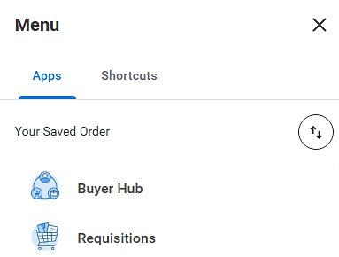
Setup Requester Defaults in Requisition App (Part 1 of 5)
INSTRUCTIONS
Click the Global Navigation Menu.
Click Requisitions from the Menu.

Slide 3
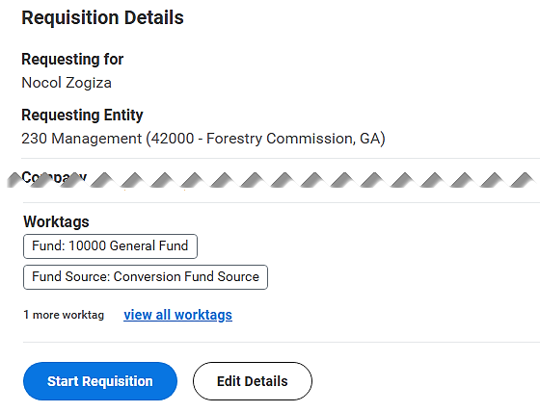
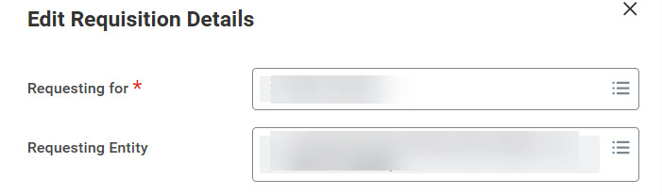
Setup Requester Defaults in Requisition App (Part 2 of 5)
INSTRUCTIONS
Click Edit Details in the Requisition Details section.
Note: If you don’t’ see the Edit Details button or the Requisition Details section you may not have the Requester role.
Select a name for the Requesting for* field.
Select a Requesting Entity.
Note: If a Requesting Entity is not selected it will fail the custom validation.
4
5

Slide 4
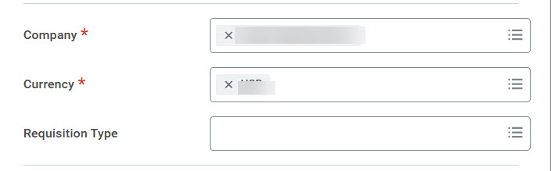
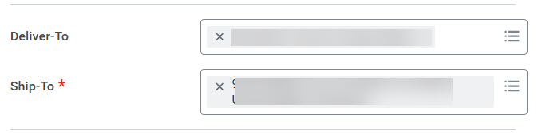
Setup Requester Defaults in Requisition App (Part 3 of 5)
INSTRUCTIONS
Select a Company*.
Verify the Currency*.
Note: A Requisition Type is not needed.
6
7
Select a Ship-To* option.
Note: Enter the specific Agency Code #00000-PO to locate your ship to location.
Note: The Deliver-To option auto-populates.

Slide 5
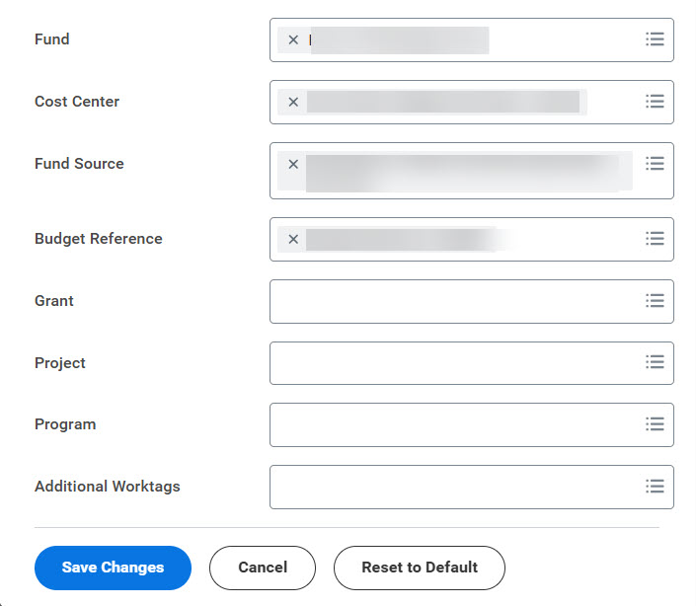
Setup Requester Defaults in Requisition App (Part 4 of 5)
INSTRUCTIONS
Select a Fund.
Select Cost Center.
Note: Select the Active Cost Centers by Cost Center Hierarchy. If user knows the unique cost center code for example (CC0002433) or cost center value for example "4054925011" they can enter it here.
Select Fund Source.
Select Budget Reference.
Click Save Changes.
Note: Make sure the Budget Reference is in the correct year.
9
10
11
12
13

Slide 6


Setup Requester Defaults in Requisition App (Part 5 of 5)
INSTRUCTIONS
The Requisition Details Updates have been completed.
You have successfully completed set up requester defaults in the requisition app.

