Slide 1
Locate and Review Requisitions
Pending Approval
DESCRIPTION
This guide will show Requesters how to Locate and Review Requisitions Pending Approval.
OVERVIEW
The key steps in the process are below:
Enter Find Requisitions in the Search field.
Click the Find Requisitions report.
Narrow search using available fields.
Select In Progress in the Status field.
Select requisition and click Process History.
Review process history to see what action is pending.
Business Process:
Find Requisitions Report
Locate Requisition
Review Requisition
Take Action as Needed

Slide 2
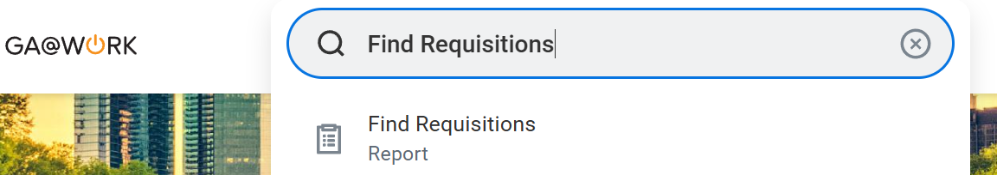
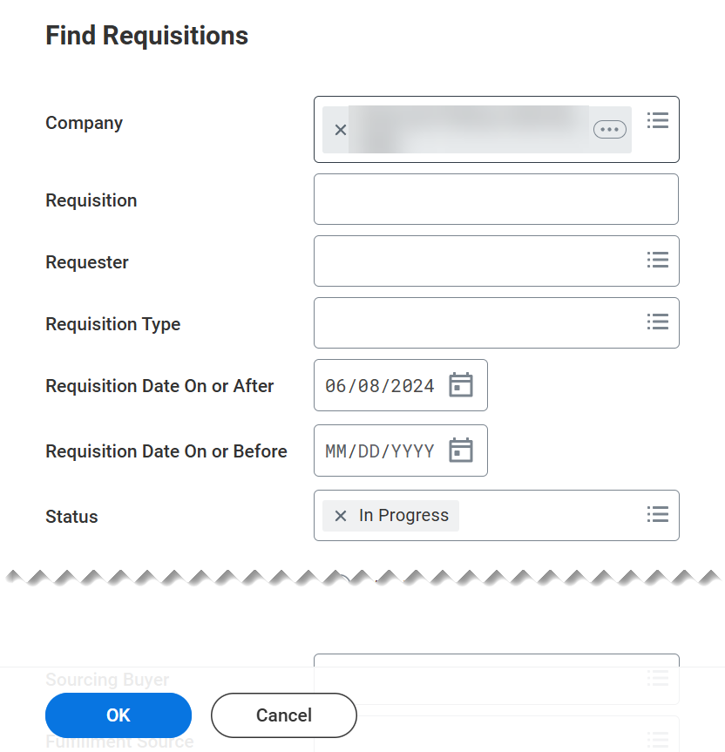
Locate and Review Requisitions Pending Approval (Part 1 of 5)
INSTRUCTIONS
Enter Find Requisitions in the Search field.
  Note: Requesters can also navigate to Requisitions app to search status of requisitions.
Click the Find Requisitions report.
1
2
Narrow your search using the available fields.
Select In Progress in the Status field.
Click OK.
3
4
5

Slide 3
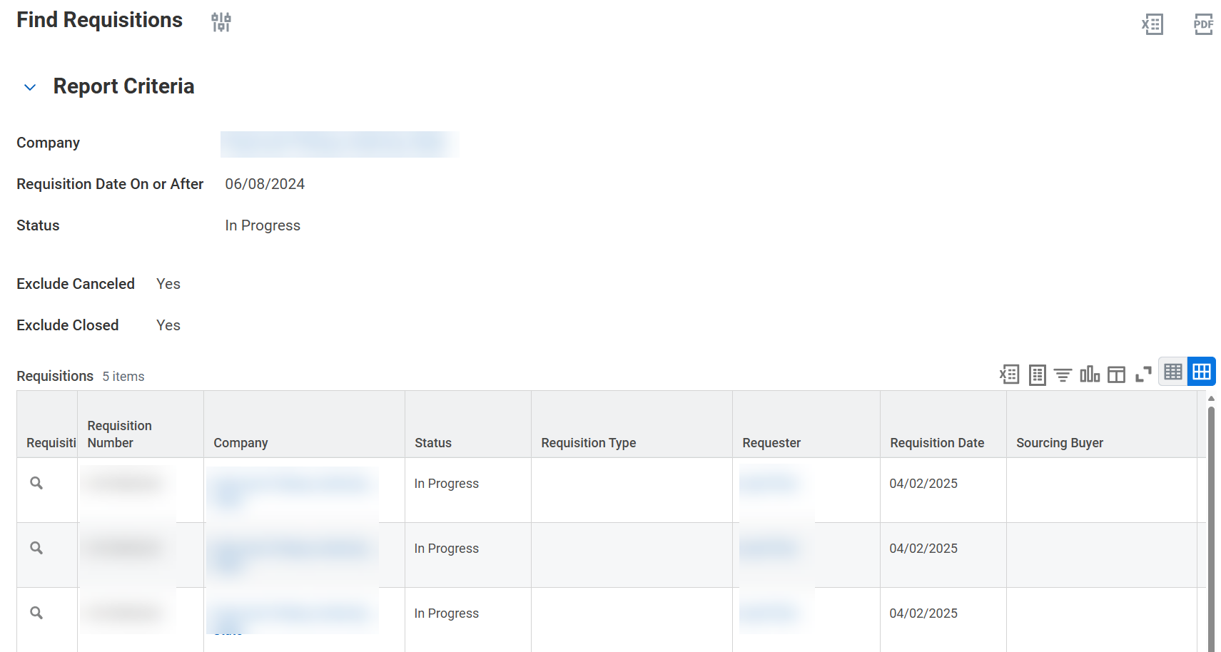
Locate and Review Requisitions Pending Approval (Part 2 of 5)
INSTRUCTIONS
View the search results, be aware of the fields:
  Requisition
  Requisition Number
  Company
  Status
  Requisition Type
  Requester
  Requisition Date
  Sourcing Buyer
  Currency
  Total Amount

Slide 4
Locate and Review Requisitions Pending Approval (Part 3 of 5)
INSTRUCTIONS
Click the magnifying glass to select a Requisition from the results.

Slide 5
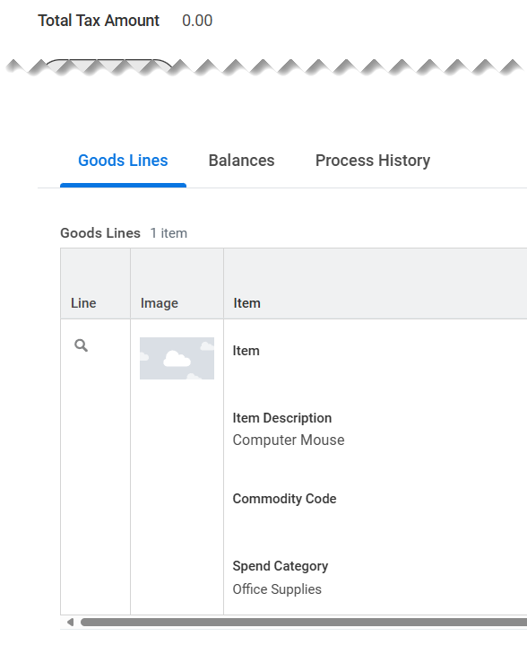
Locate and Review Requisitions Pending Approval (Part 4 of 5)
INSTRUCTIONS
Select the Process History tab on the View Requisition page.

Slide 6
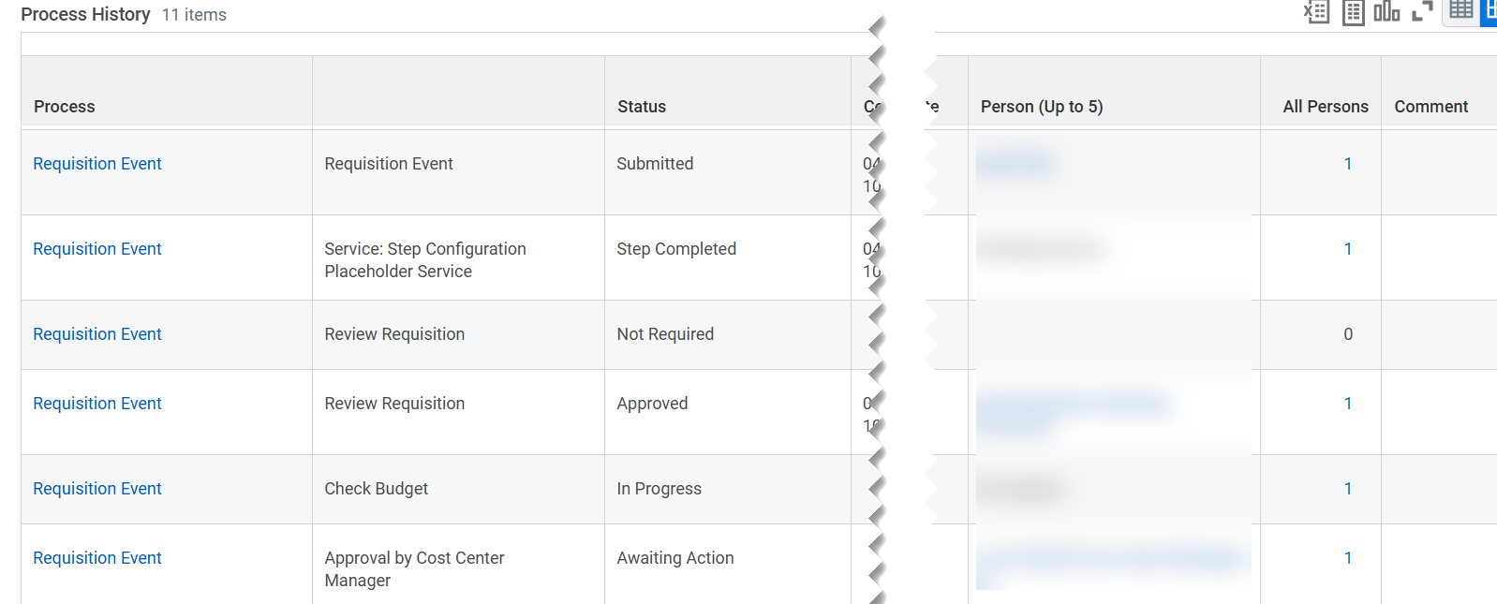

Locate and Review Requisitions Pending Approval (Part 5 of 5)
INSTRUCTIONS
Review Process History to see what actions are pending. Be aware of the following fields:
  Process
  Step
  Status
  Completed On
  Due Date
  Person
  All Persons
  Comment
You have successfully located and reviewed requisitions pending approval.

