Slide 1
Schedule Issue Purchase Order
DESCRIPTION
This guide will show Buyers how to schedule and review Issue Purchase Orders.
OVERVIEW
The key steps in the process are below:
Enter Schedule Issue Purchase Order in the Search field.
Click the Schedule Issue Purchase Orders task.
Set Frequency.
Fill out the Schedule form.
Review Schedule Process.
Business Process:
Schedule Issue Purchase Order Task
Set Frequency
Review Scheduled Purchase Order
Click Done

Slide 2
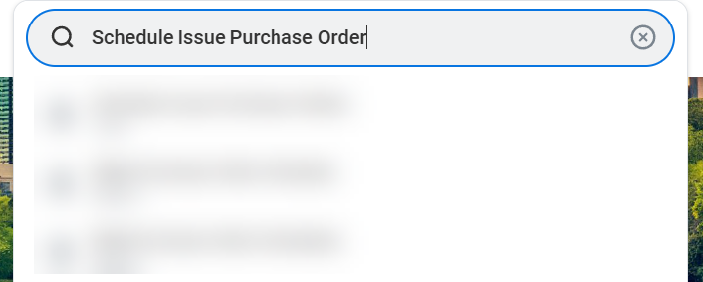
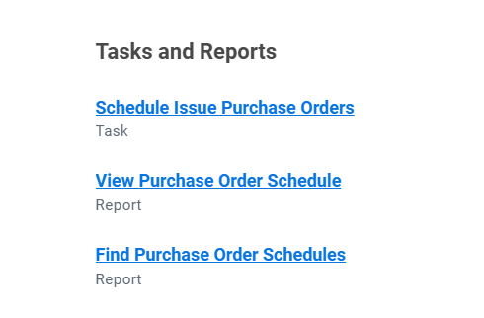
Schedule Issue Purchase Order (Part 1 of 8)
INSTRUCTIONS
Enter Schedule Issue Purchase Orders in the Search field and press Enter.
Click the Schedule Issue Purchase Orders task.

Slide 3
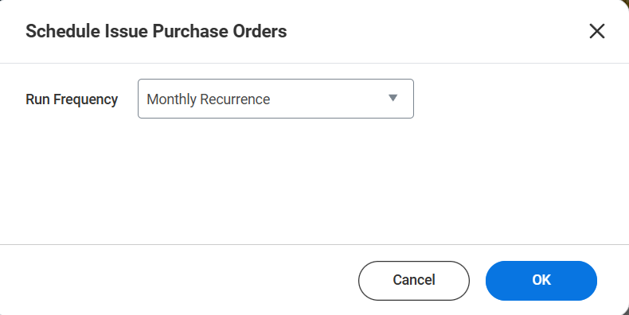
Schedule Issue Purchase Order (Part 2 of 8)
INSTRUCTIONS
Select the Run Frequency.
Note: For the purposes of this guide, we have selected Monthly Recurrence. Your options may vary based on the Run Frequency selected.
Click OK.
3
4

Slide 4
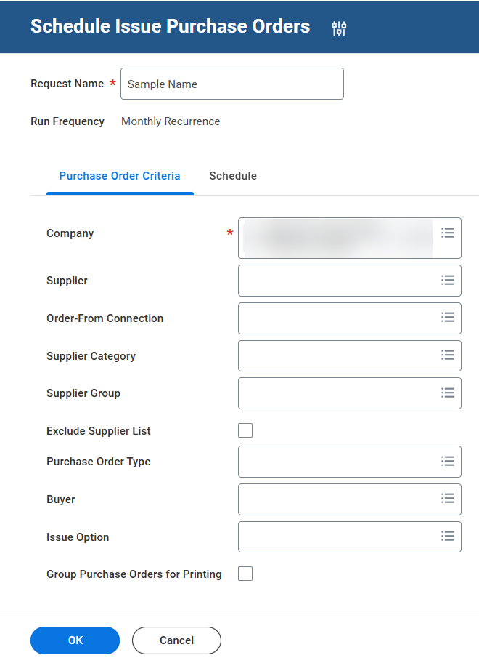
Schedule Issue Purchase Order (Part 3 of 8)
INSTRUCTIONS
Enter a Request Name.
Select a Company* on the Purchase Order Criteria tab.
Complete other fields, as applicable
Select the Schedule tab.
5
8
6

Slide 5
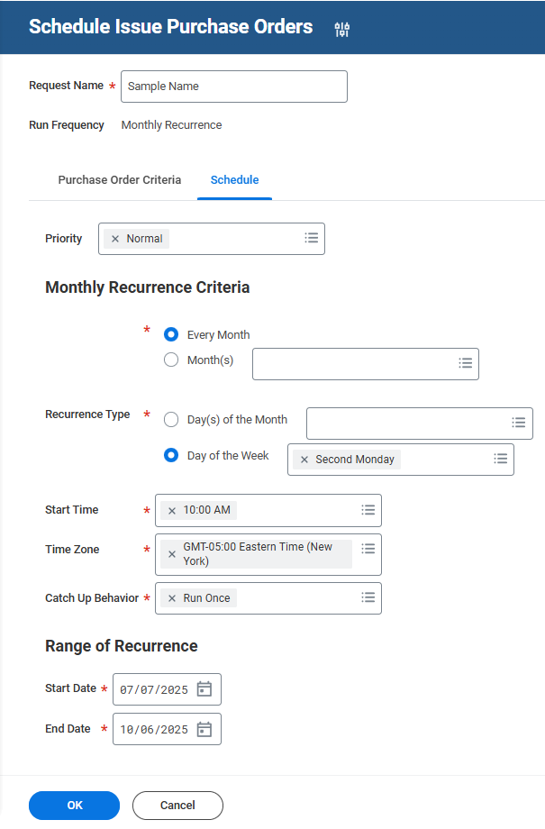
Schedule Issue Purchase Order (Part 4 of 8)
INSTRUCTIONS
Enter Monthly Recurrence Criteria*.
  Note: For the purposes of this guide, we have selected Every Month. Your options may vary based on your needs for Purchase Orders.
Select a Recurrence Type*.
Select a Start Time* and a Time Zone*.
Select a Catch Up Behavior*.
9
10
11
12

Slide 6
Schedule Issue Purchase Order (Part 5 of 8)
INSTRUCTIONS
Select a future Start Date and End Date under Range of Recurrence.
Click OK.
13
14

Slide 7
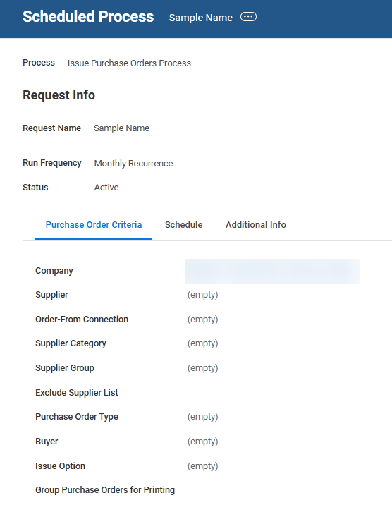
Schedule Issue Purchase Order (Part 6 of 8)
INSTRUCTIONS
Review Purchase Order Criteria. Your review should include the following information:
  Company and Supplier
  Order-From Connection
  Supplier Category and Supplier Group
  Exclude Supplier List
  Purchase Order Type
  Buyer and Issue Option
  Group Purchase Orders for Printing

Slide 8
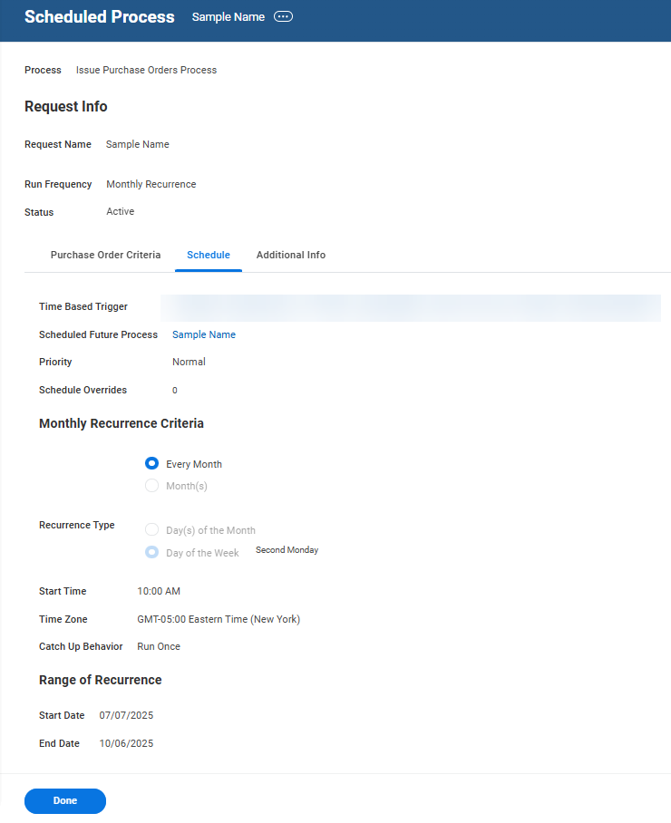
Schedule Issue Purchase Order (Part 7 of 8)
INSTRUCTIONS
Select the Schedule tab and review the following information:
  Monthly Recurrence Criteria
  Recurrence Type
  Start Time and Time Zone
  Catch Up Behavior
  Range or Recurrence
  Start/End Date

Slide 9
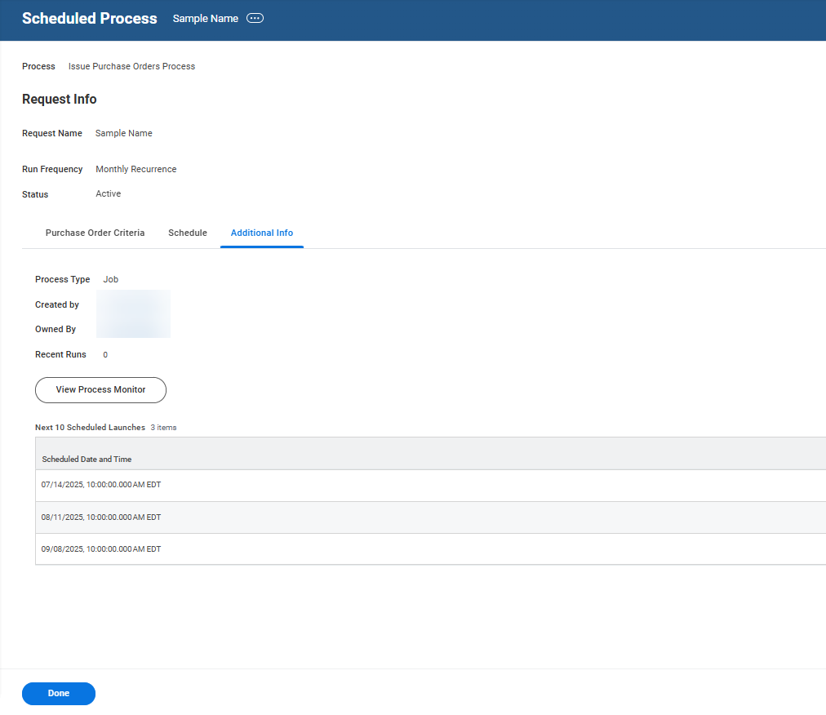

Schedule Issue Purchase Order (Part 8 of 8)
INSTRUCTIONS
Select the Additional Info tab and review the following information:
  Process Type
  Created/Owned By
  Recent Runs
  Schedule Date and Time
Click Done.
17
18
You have successfully scheduled and reviewed an Issued Purchase Order.

