Slide 1
View P-Card Transactions & Run P-Card Reports for Auditors
This guide will show Auditors the steps to View Transactions & Run Reports. Reports in this guide include Procurement Card Transaction Verifications – Detail and Procurement Card Transaction Verifications – Summary.
The key steps in the process are below:
Enter CRPROC – PCARD – Find Procurement Card Transaction Verifications in the Search field.
Select relevant fields to narrow your results and run the report.
Click OK.
Review the report.
Business Process:
Find Procurement Card Transaction Verification
Run Report
Click OK
Review Report

Slide 2
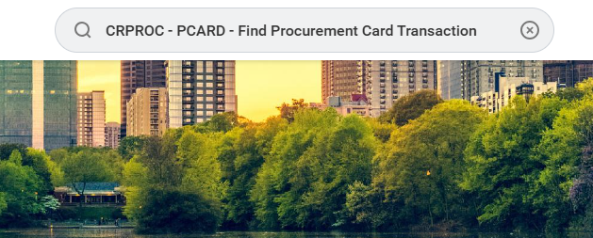
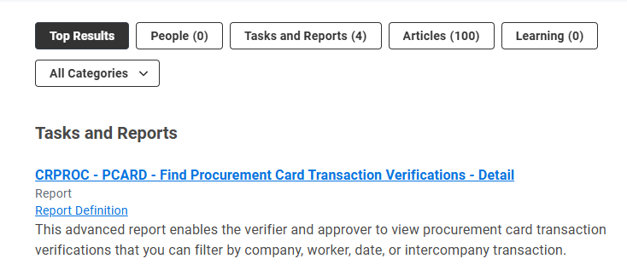
View Transactions & Run Reports for Auditors (Part 1 of 13)
Enter CRPROC – PCARD – Find Procurement Card Transaction Verifications – Detail in the Search field and press Enter.
  Note: To view Procurement Card Transaction Verifications – Summary, skip to Step 17.
Select the CRPROC – PCARD – Find Procurement Card Transaction Verifications – Detail report.

Slide 3
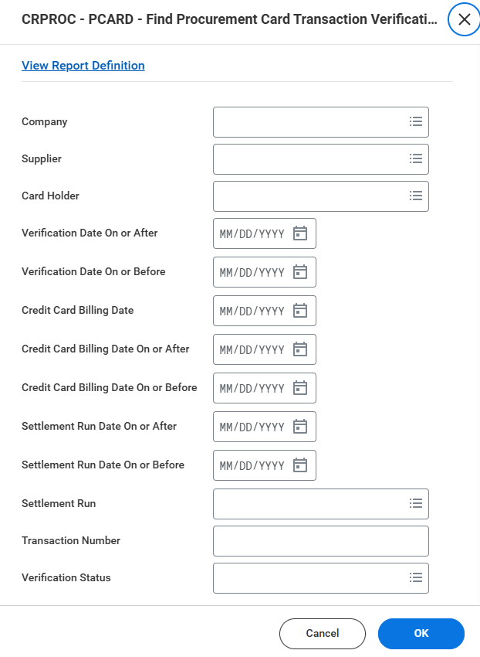
View Transactions & Run Reports for Auditors (Part 2 of 13)
Select relevant fields to narrow your results and run the report.
Click OK.

Slide 4
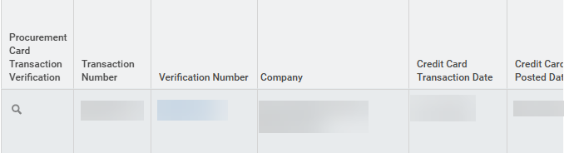
View Transactions & Run Reports for Auditors (Part 3 of 13)
Review Procurement Card Transaction Verification, as applicable. Be aware of the following fields:
  Transaction Number
  Verification Number
  Company
  Credit Card Transaction Date
  Credit Card Posted Date
  Credit Card Billing Date
  Verification Date & Status
  Merchant
  Settlement Run & Run Date
  Merchant & Merchant Code
  Card Holder
  Verification Amount
  Business Document has Line Splits
  Attachments

Slide 5
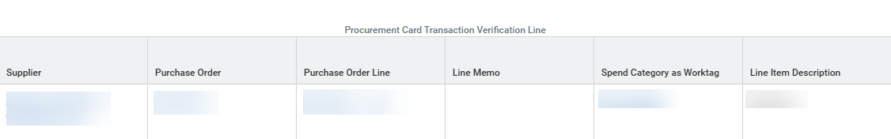
View Transactions & Run Reports for Auditors (Part 4 of 13)
Review Procurement Card Transaction Verification Line, as applicable. Be aware of the following fields:
  Supplier
  Purchase Order
  Purchase Order Line
  Line Memo
  Spend Category as Worktag
  Line Item Description
  Distribution Extended Amount
  Distribution Line is a Line Split
  Fund
  Cost Center
  Budget Reference Year
  Project
  Grant

Slide 6
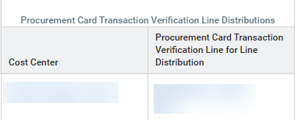
View Transactions & Run Reports for Auditors (Part 5 of 13)
Review Procurement Card Transaction Verification Line Distributions, as applicable. Be aware of the following fields:
  Cost Center
  Procurement Card Transaction Verification Line for Line Distribution
Review Events for Business Document, as applicable. Be aware of the following fields:
  Ad Hoc Approval Recipients
  Approved by Workers
  Approved on Behalf of
  Assignment Date
  Business Process Step Awaiting Action
  Initiator

Slide 7
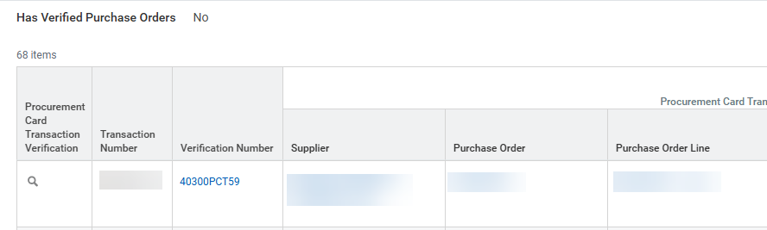
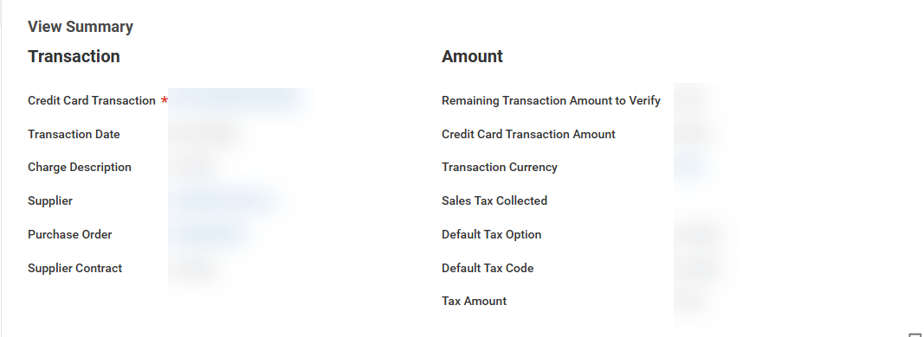
View Transactions & Run Reports for Auditors (Part 6 of 13)
To view Transaction Details, select the Verification Number.
View the Transaction Summary.

Slide 8
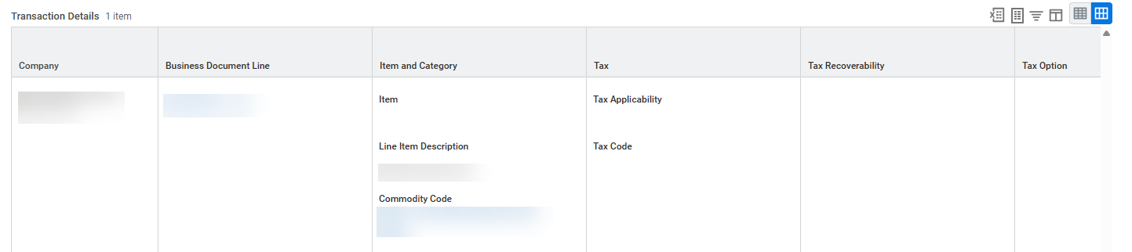
View Transactions & Run Reports for Auditors (Part 7 of 13)
Review the Transaction Details, as applicable. Be aware of the following fields:
  Company
  Business Document Line
  Item and Category
  Tax, Tax Recoverability, and Tax Option
  Quantity
  Transaction & Converted Amounts
  Memo
  *Fund
  *Cost Center
  *Fund Source
  *Budget Reference
  Grant, Project, Program
  Additional Worktags
  Splits
  Note: A memo field is always required. If the memo contains multiple lines, at least one comment must be included.

Slide 9
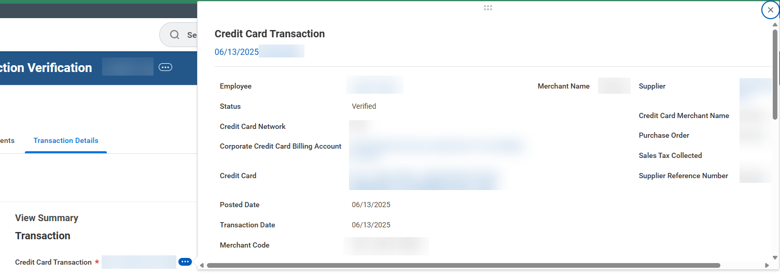
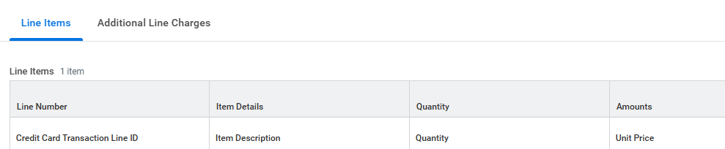
View Transactions & Run Reports for Auditors (Part 8 of 13)
To view Credit Card Transaction* information, Line Items, and Additional Line Charges, click Related Actions (…).
  Note: If the supplier has provided additional details regarding the transaction, it will be displayed on this screen.
Review Line Items, as applicable. Be aware of the following fields:
  Line Number
  Item Details
  Quantity
  Amounts

Slide 10
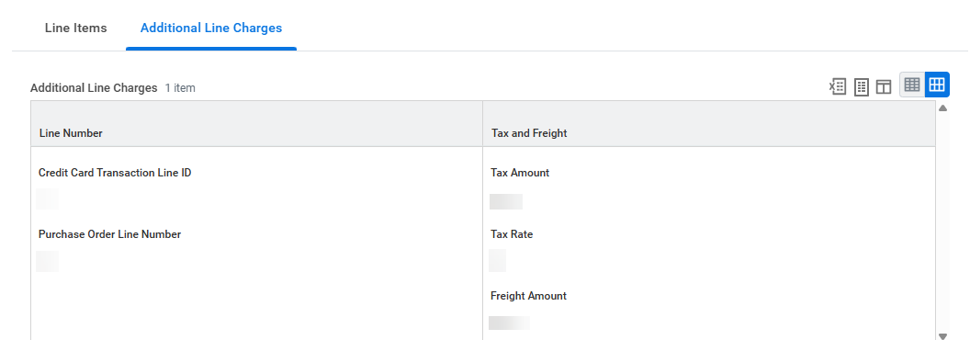
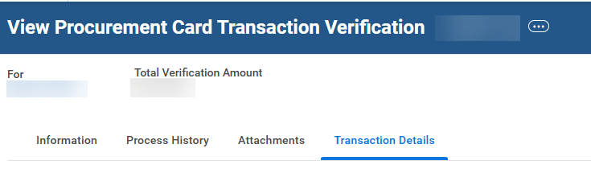
View Transactions & Run Reports for Auditors (Part 9 of 13)
Review Additional Line Charges, as applicable. Be aware of the following fields:
  Line Number
  Tax and Freight
To view basic information related to the company and the status of the transaction, select Information.
To view the approval flow, select Process History.
  Note: Process History allows users to see who approved each step, the times of approval, and any comments made.
15
16

Slide 11
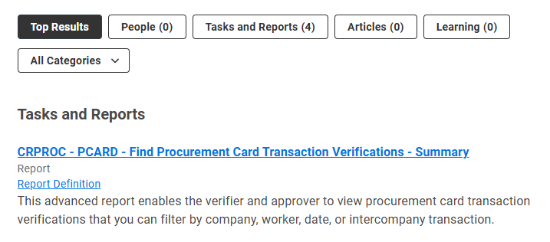
View Transactions & Run Reports for Auditors (Part 10 of 13)
To view a summary and high-level overview of Procurement Card Transaction Verification, enter CRPROC – PCARD – Find Procurement Card Transaction Verifications – Summary in the Search field and press Enter.
Select the CRPROC – PCARD – Find Procurement Card Transaction Verifications – Summary report.

Slide 12
View Transactions & Run Reports for Auditors (Part 11 of 13)
Select relevant fields to narrow your results and run the report.
Click OK.

Slide 13
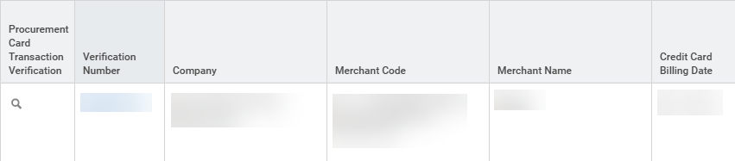
View Transactions & Run Reports for Auditors (Part 12 of 13)
Review Procurement Card Transaction Verification, as applicable. Be aware of the following fields:
  Verification Number
  Company
  Merchant Code & Merchant Name
  Credit Card Billing Date
  Credit Card Transaction Date
  Credit Card Posted Date
  Verification Status
  Settlement Run & Run Date
  Card Holder
  Purchase Order
  Verification Amount
  Attachments
  Business Document has Line Splits
  Note: Only transactions that have been verified by the cardholder appear in this report. Verified transactions are eligible for settlement and payment to the bank; those still in “new” status are excluded.

Slide 14
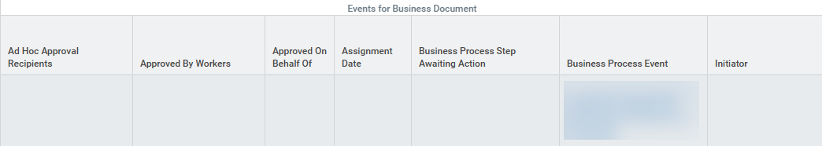

View Transactions & Run Reports for Auditors (Part 13 of 13)
Review Events for Business Document, as applicable. Be aware of the following fields:
  Ad Hoc Approval Recipients
  Approved By Workers
  Approved On Behalf Of
  Assignment Date
  Business Process Step Awaiting Action
  Business Process Event
  Initiator
You have successfully completed View Transactions & Run Reports for Auditors.

