Slide 1
Assign Substitute Approvers for Sourcing Approval
DESCRIPTION
This guide will show Sourcing Event Approver how to Assign Substitute Approvers for Sourcing Approval only.
Note: Sourcing Event Approver refers to any role with the access to approve sourcing events, such as the APO/CUPO, Sourcing Event Buyer, SPD Agency Sourcing Manager or SPD Administrator.
OVERVIEW
The key steps in the process are below:
Access the Sourcing module.
Click Approvals.
Assign Substitute.
Substitute Approver assigned for Sourcing Approval.
Note: By default, the system will only display the users who can perform the task.
Business Process:
Access Sourcing Module
Click Approvals
Assign Substitute
Substitute Approver Assigned for Sourcing Approval
Disclaimer: Due to regular system updates, the screens and features in GA@WORK may differ slightly from those shown in this job aid. For questions or assistance, please contact the Help Desk.

Slide 2


Assign Substitute Approvers for Sourcing Approval (Part 1 of 17)
INSTRUCTIONS
Click the Global Navigation Menu.
Note: University System of Georgia (USG) users complete local logon and then proceed to Step 5.
Click Sourcing, Contracts & Supplier Management.

Slide 3

Assign Substitute Approvers for Sourcing Approval (Part 2 of 17)
INSTRUCTIONS
Review Action and follow the steps in the table below to Assign Substitute Approver.
Action | Description | Step Information
 |  | ​
Assign Substitute Approvers – Sourcing Events
Assign a Substitute Approver to a Sourcing Event for approval
5 - 17
Assign Substitute Approvers – Sourcing Event Evaluations
Assign a Substitute Approver to a Sourcing Event Evaluation for approval
18 - 30
Assign Substitute Approvers – Sourcing Event Requests
Assign a Substitute Approver to a Sourcing Event Request for approval
31 - 43
Click Sign On.
Note: The system utilizes Single Sign-On (SSO) capabilities
and no log in information is required.

Slide 4
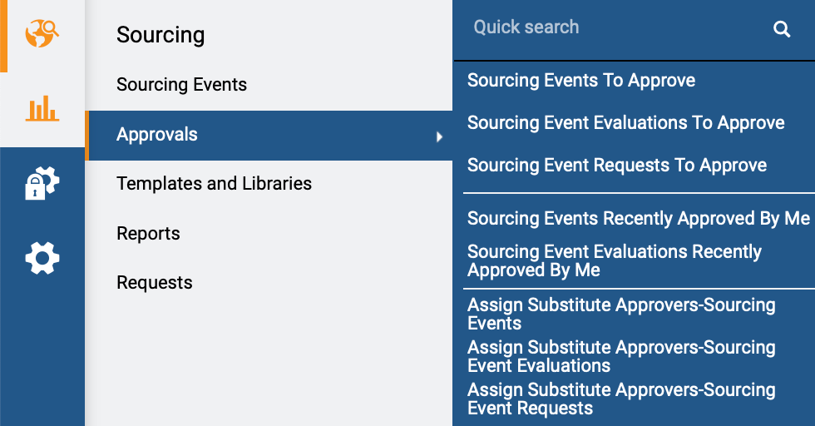
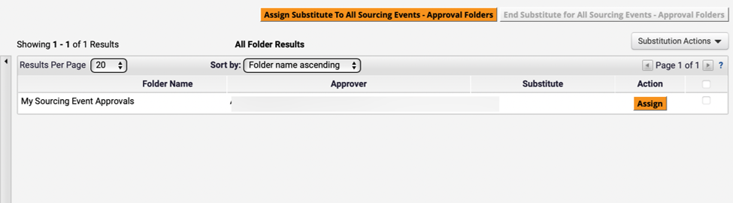
Assign Substitute Approvers for Sourcing Approval (Part 3 of 17)
INSTRUCTIONS
Access the Sourcing module.
Click Approvals.
To assign a Substitute Approver to Sourcing Event, select Assign Substitute Approvers – Sourcing Events.
5
6
7
Review displayed Sourcing Event Approvals.
Note: Select Type to refine search results.
Click Assign.
8
9

Slide 5
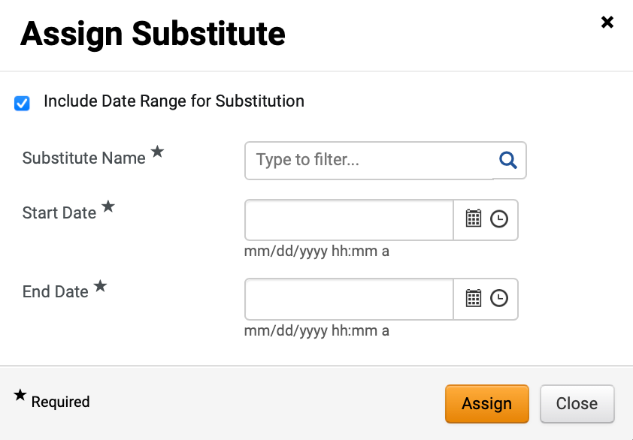
Assign Substitute Approvers for Sourcing Approval (Part 4 of 17)
INSTRUCTIONS
Click Include Date Range for Substitution (Optional).
Note: If selecting this option, Start Date and End Date are mandatory fields.
Select Substitute Name*.
Note: Complete all required fields marked with a black star *. Follow steps 12 if clicking magnifying glass to select Substitute or skip to step 13 if typing Substitute Name. Select the user responsible for approving the specific activity. The selected user should have the same or a higher level of authority.
10
11

Slide 6
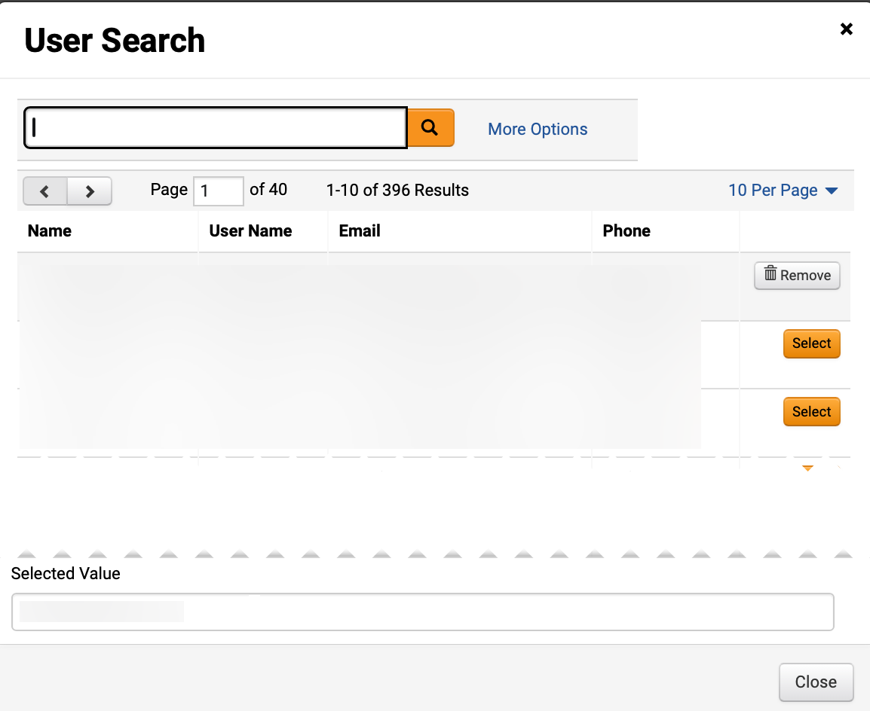
Assign Substitute Approvers for Sourcing Approval (Part 5 of 17)
INSTRUCTIONS
Click Select.
Note: To filter results, type in field, click the magnifying glass to search, or click More Options.

Slide 7
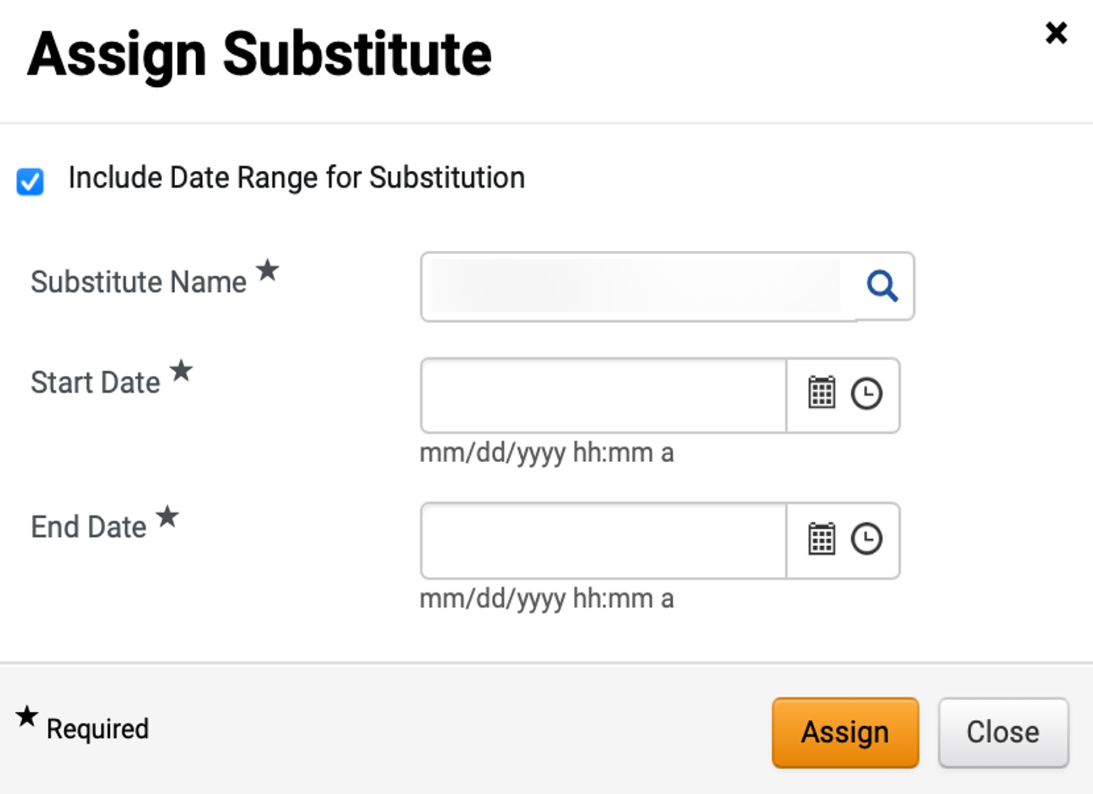
Assign Substitute Approvers for Sourcing Approval (Part 6 of 17)
INSTRUCTIONS
Review added Substitute Name*.
Enter Start Date*.
Enter End Date*.
Click Assign.
13
14
15
16

Slide 8
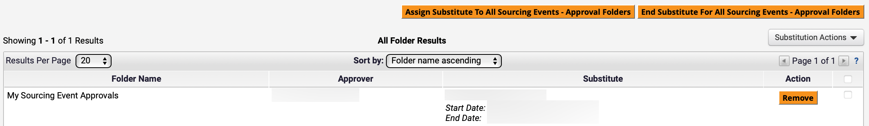
Assign Substitute Approvers for Sourcing Approval (Part 7 of 17)
INSTRUCTIONS
Review Substitute.
Note: To remove Substitute, click Remove.​

Slide 9
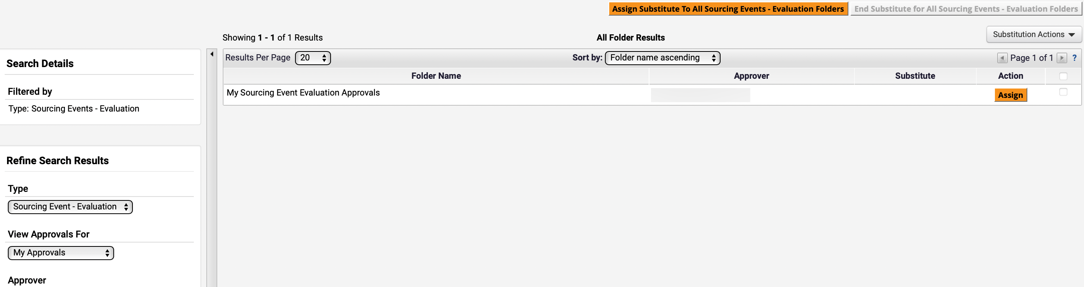
Assign Substitute Approvers for Sourcing Approval (Part 8 of 17)
INSTRUCTIONS
Access the Sourcing module.
Click Approvals.
Select Assign Substitute Approvers – Sourcing Event Evaluations.
18
19
20
Review displayed Sourcing Event Evaluation Approvals.
Note: Select Type to refine search results.
Click Assign.
21
22

Slide 10
Assign Substitute Approvers for Sourcing Approval (Part 9 of 17)
INSTRUCTIONS
Click Include Date Range for Substitution (Optional).
Note: If selecting this option, Start Date and End Date are mandatory fields.
Select Substitute Name*.
Note: Follow steps 25 if clicking magnifying glass to select Substitute or skip to step 26 if typing Substitute Name. Select the user responsible for approving the specific activity. The selected user should have the same or a higher level of authority.
23
24

Slide 11
Assign Substitute Approvers for Sourcing Approval (Part 10 of 17)
INSTRUCTIONS
Click Select.
Note: To filter results, type in field, click the magnifying glass to search, or click More Options.

Slide 12
Assign Substitute Approvers for Sourcing Approval (Part 11 of 17)
INSTRUCTIONS
Review added Substitute Name*.
Enter Start Date*.
Enter End Date*.
Click Assign.
26
27
28
29

Slide 13
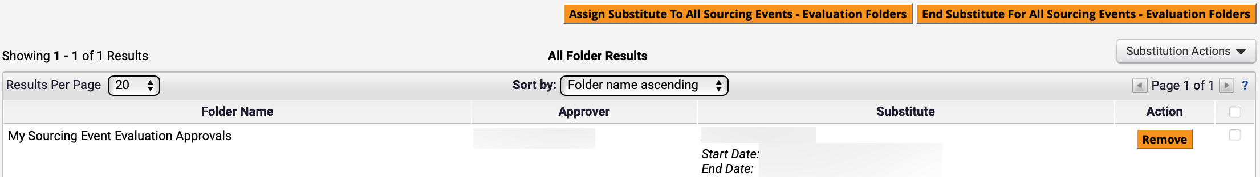
Assign Substitute Approvers for Sourcing Approval (Part 12 of 17)
INSTRUCTIONS
Review Substitute.
Note: To remove Substitute, click Remove.​

Slide 14
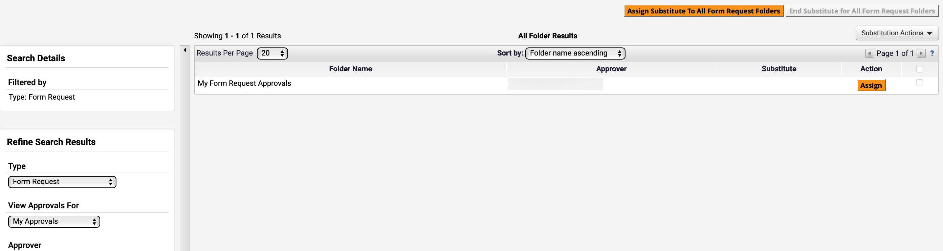
Assign Substitute Approvers for Sourcing Approval (Part 13 of 17)
INSTRUCTIONS
Access the Sourcing module.
Click Approvals.
Select Assign Substitute Approvers – Sourcing Event Requests.
31
32
33
Review displayed Form Request Approvals.
Note: Select Type to refine search results.
Click Assign.
34
35

Slide 15
Assign Substitute Approvers for Sourcing Approval (Part 14 of 17)
INSTRUCTIONS
Click Include Date Range for Substitution (Optional).
Note: If selecting this option, Start Date and End Date are mandatory fields.
Select Substitute Name*.
Note: Follow Step 38 if clicking magnifying glass to select Substitute or skip to Step 39 if typing Substitute Name. Select the user responsible for approving the specific activity. The selected user should have the same or a higher level of authority.
36
37

Slide 16
Assign Substitute Approvers for Sourcing Approval (Part 15 of 17)
INSTRUCTIONS
Click Select.
Note: To filter results, type in field, click the magnifying glass to search, or click More Options.

Slide 17
Assign Substitute Approvers for Sourcing Approval (Part 16 of 17)
INSTRUCTIONS
Review added Substitute Name*.
Enter Start Date*.
Enter End Date*.
Click Assign.
39
40
41
42

Slide 18
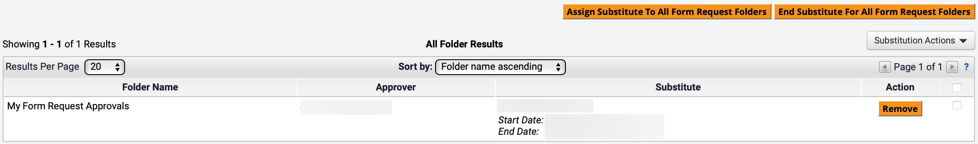

Assign Substitute Approvers for Sourcing Approval (Part 17 of 17)
INSTRUCTIONS
Review Substitute.
Note: To remove Substitute, click Remove.​
You have successfully Assigned Substitute Approvers for Sourcing Approval

