Slide 1
Create Request for Information (RFI)
DESCRIPTION
This guide will show the Sourcing Event Buyer how to create a Request for Information (RFI).
OVERVIEW
The key steps in the process are below:
Navigate to Sourcing.
Select Create New Event.
Select the eRFI Template and complete the necessary fields.
Submit the Sourcing Event.
Business Process:
Navigate to GA@WORK Marketplace
Select Create New Event
Utilize the eRFI Template
Submit the Sourcing Event

Slide 2


Create Request for Information (RFI)
(Part 1 of 41)
INSTRUCTIONS
Click the Global Navigation Menu.
Note: University System of Georgia (USG) and GDOT users complete local logon and then proceed to Step 4.
Click Sourcing, Contracts & Supplier Management.

Slide 3

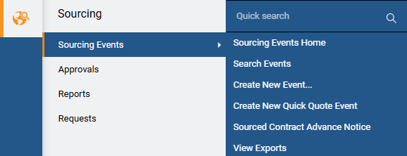
Create Request for Information (RFI)
(Part 2 of 41)
INSTRUCTIONS
Click Sign On.
Note: The system utilizes Single Sign-On (SSO) capabilities and no log in information is required.
Select Sourcing.
Select Sourcing Events.
Select Create New Event.
4
5
6

Slide 4
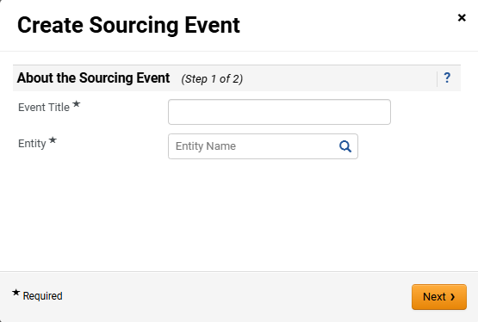
Create Request for Information (RFI)
(Part 3 of 41)
INSTRUCTIONS
Enter the Event Title*.
Note: Including the State Entity Name in Event Title will assist in Sourcing Director event list as there is no column to display state entity’s name (e.g. UGA Consulting Services).
Select Entity*.
Click Next.
7
8
9

Slide 5
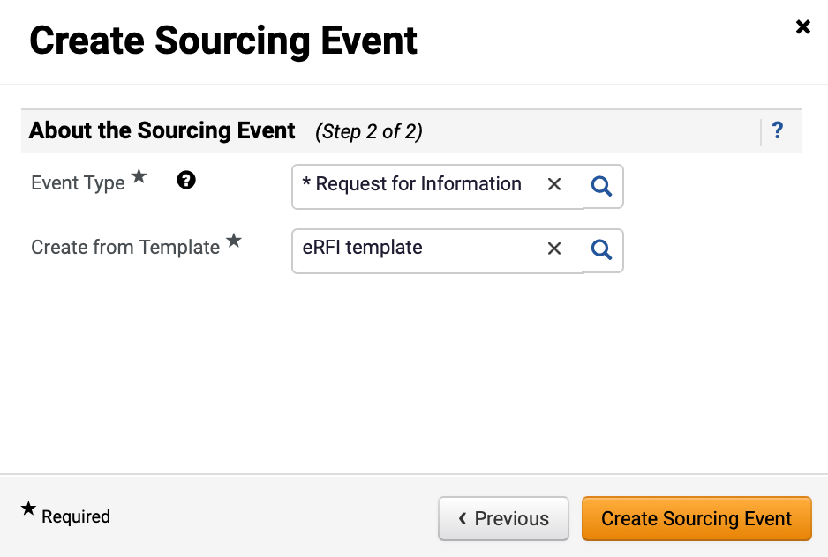
Create Request for Information (RFI)
(Part 4 of 41)
INSTRUCTIONS
Select Request for Information as the Event Type*.
Select eRFI Template for Create from Template*.
Note: eRFI Template will auto-populate in the Create from Template field once Request for Information is selected.
Click Create Sourcing Event.
10
11
12

Slide 6
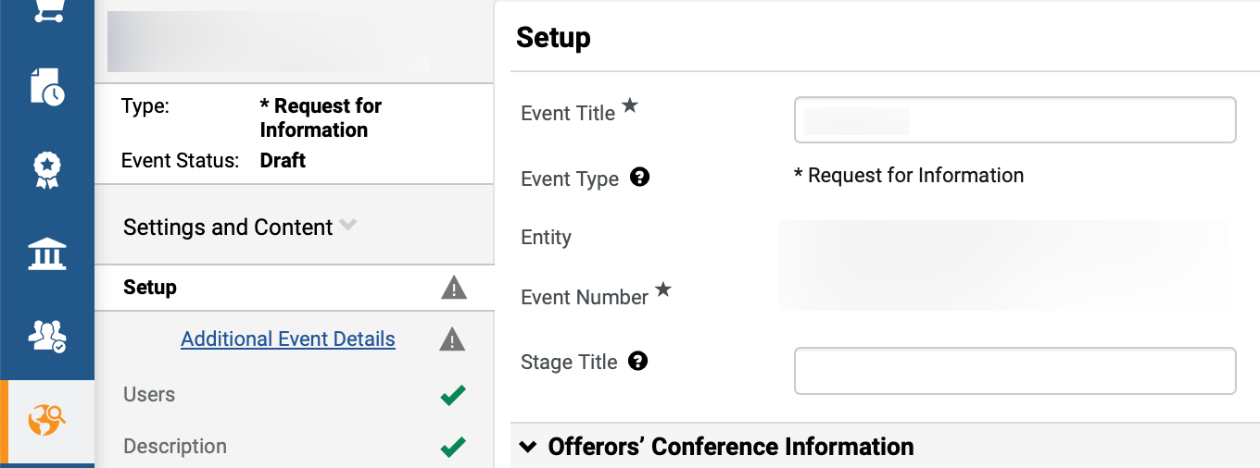
Create Request for Information (RFI)
(Part 5 of 41)
INSTRUCTIONS
Review populated Event information.
Enter Stage Title (Recommended).
Note: Stage Title is only required if an event goes to a second stage and beyond during the evaluation process, such as a round of cost negotiations. It is recommended to enter “Original Solicitation” as the Stage Title for all events during initial set-up. Stage Title and Event Title can be edited; however, the other fields are read-only.
13
14

Slide 7
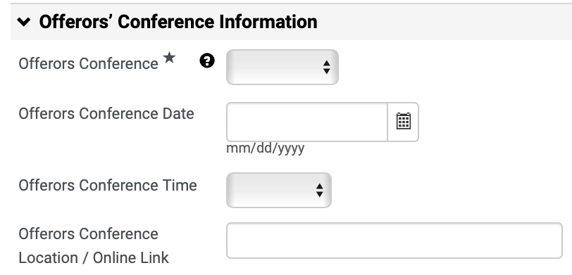
Create Request for Information (RFI)
(Part 6 of 41)
INSTRUCTIONS
Select Offerors Conference*.
Note: If Mandatory or Optional is selected, follow Steps 16 – 22 to complete the fields in this section. If Offerors Conference is N/A, skip to Step 23.
Enter Offerors Conference Date.
Select Offerors Conference Time.
Enter Offerors Conference Location / Online Link.
Note: Indicate whether the conference will be held virtually, and if so, use the link option to provide the virtual meeting information.
15
16
17
18

Slide 8
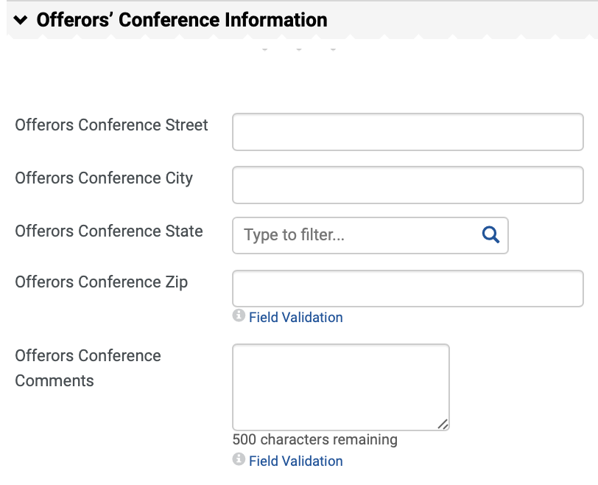
Create Request for Information (RFI)
(Part 7 of 41)
INSTRUCTIONS
Enter Offerors Conference Street and Offerors Conference City.
Select Offerors Conference State.
Note: Click the magnifying glass to view more options.
Enter Offerors Conference Zip.
Enter Offerors Conference Comments.
19
20
21
22

Slide 9
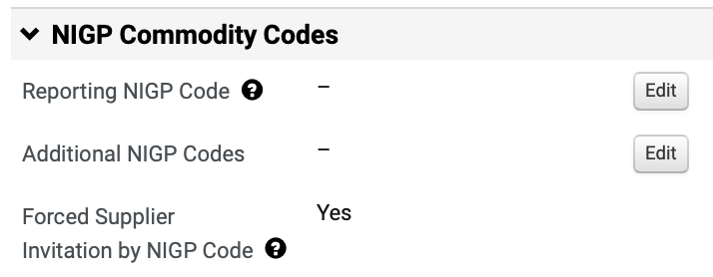
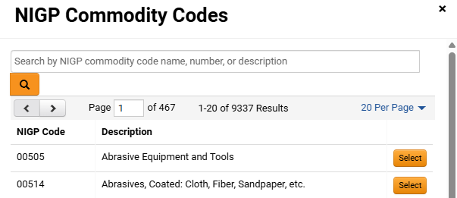
Create Request for Information (RFI)
(Part 8 of 41)
INSTRUCTIONS
Click Edit to add the Reporting NIGP Code.
Enter or search for the Commodity Code.
Note: Search by Name, Code or Description. Commodity Code can be removed by clicking Remove.
Click Select.
24
25

Slide 10
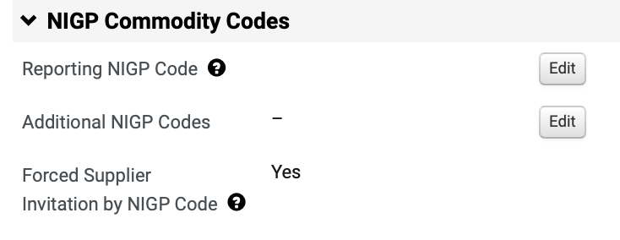
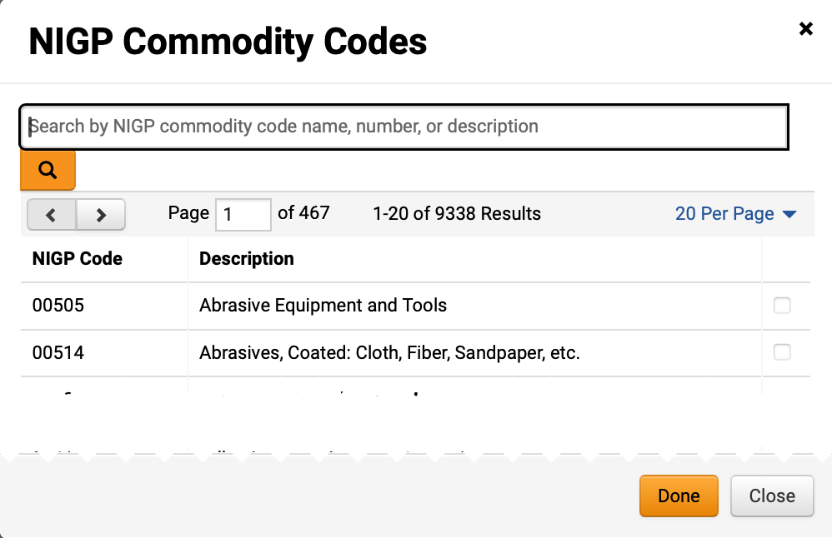
Create Request for Information (RFI)
(Part 9 of 41)
INSTRUCTIONS
Review added Reporting NIGP Code.
To add Additional NIGP Commodity Codes, click Edit.
26
27
Check the NIGP Commodity Code box.
Note: Multiple NIGP Commodity Codes can be selected.
Click Done.
28
29

Slide 11
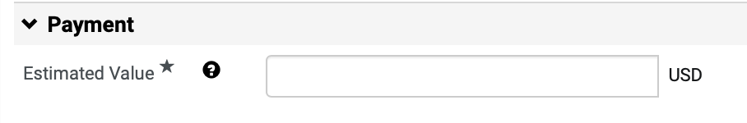
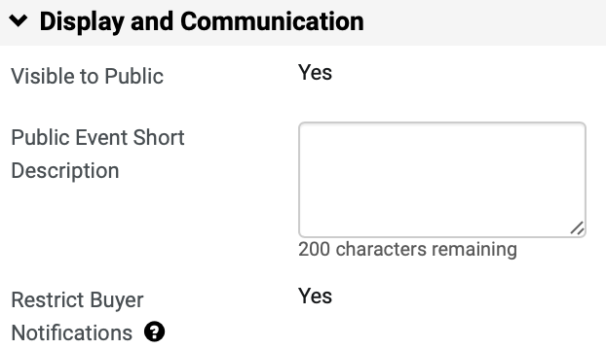
Create Request for Information (RFI)
(Part 10 of 41)
INSTRUCTIONS
Enter the Estimated Value* for the event.
Note: The Estimated Value field is also used to route DPA Approvals.
Enter Public Event Short Description (Optional).
Note: The Public Event Short Description will be displayed on the GA@WORK Marketplace. It is recommended to include the state entity’s full name in the description. Restrict Buyer Notification is set to Yes so that only the Sourcing Event Buyer will receive event related notifications.

Slide 12
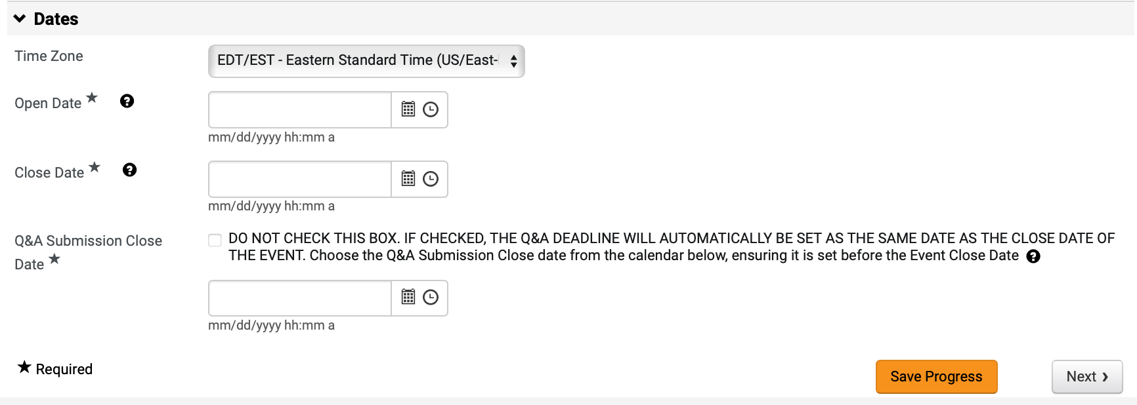
Create Request for Information (RFI)
(Part 11 of 41)
INSTRUCTIONS
Select Time Zone (Optional).
Note: Verify Time Zone is set to Eastern Standard Time.
Enter Open Date* and Close Date*.
Enter Q&A Submission Close Date*.
Note: If clicking the checkbox, the date field does not need to be populated and will automatically be set as the same date as the close date of the event.
Click Save Progress and Next.
32
33
34
35

Slide 13
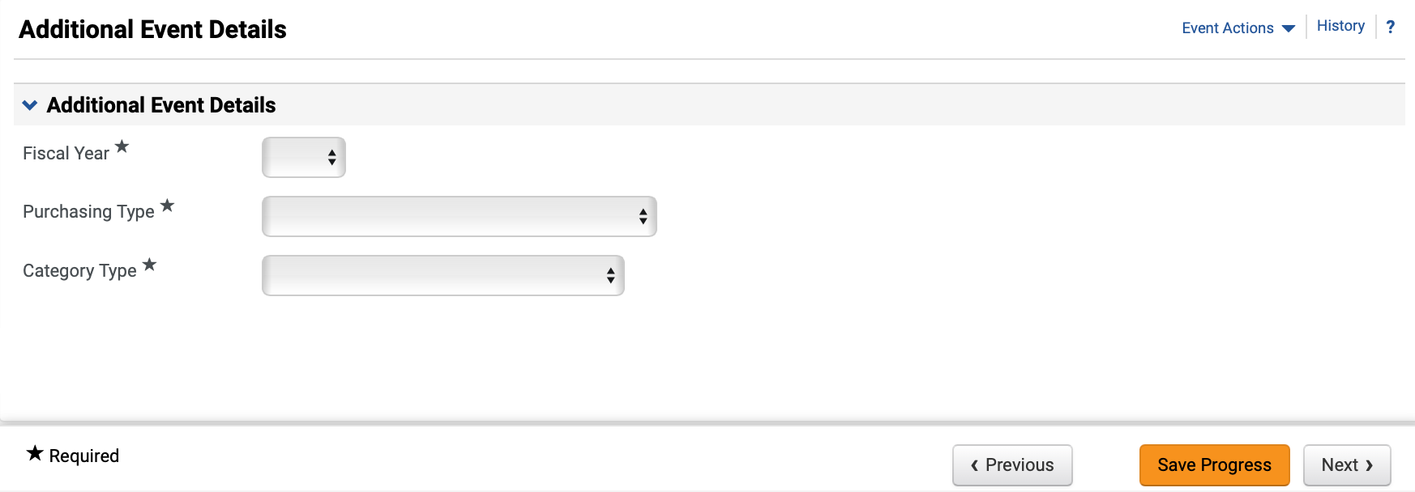
Create Request for Information (RFI)
(Part 12 of 41)
INSTRUCTIONS
Select the Fiscal Year* the event will be awarded.
Select Purchasing Type* and Category Type*.
Click Next.
36
37
38

Slide 14
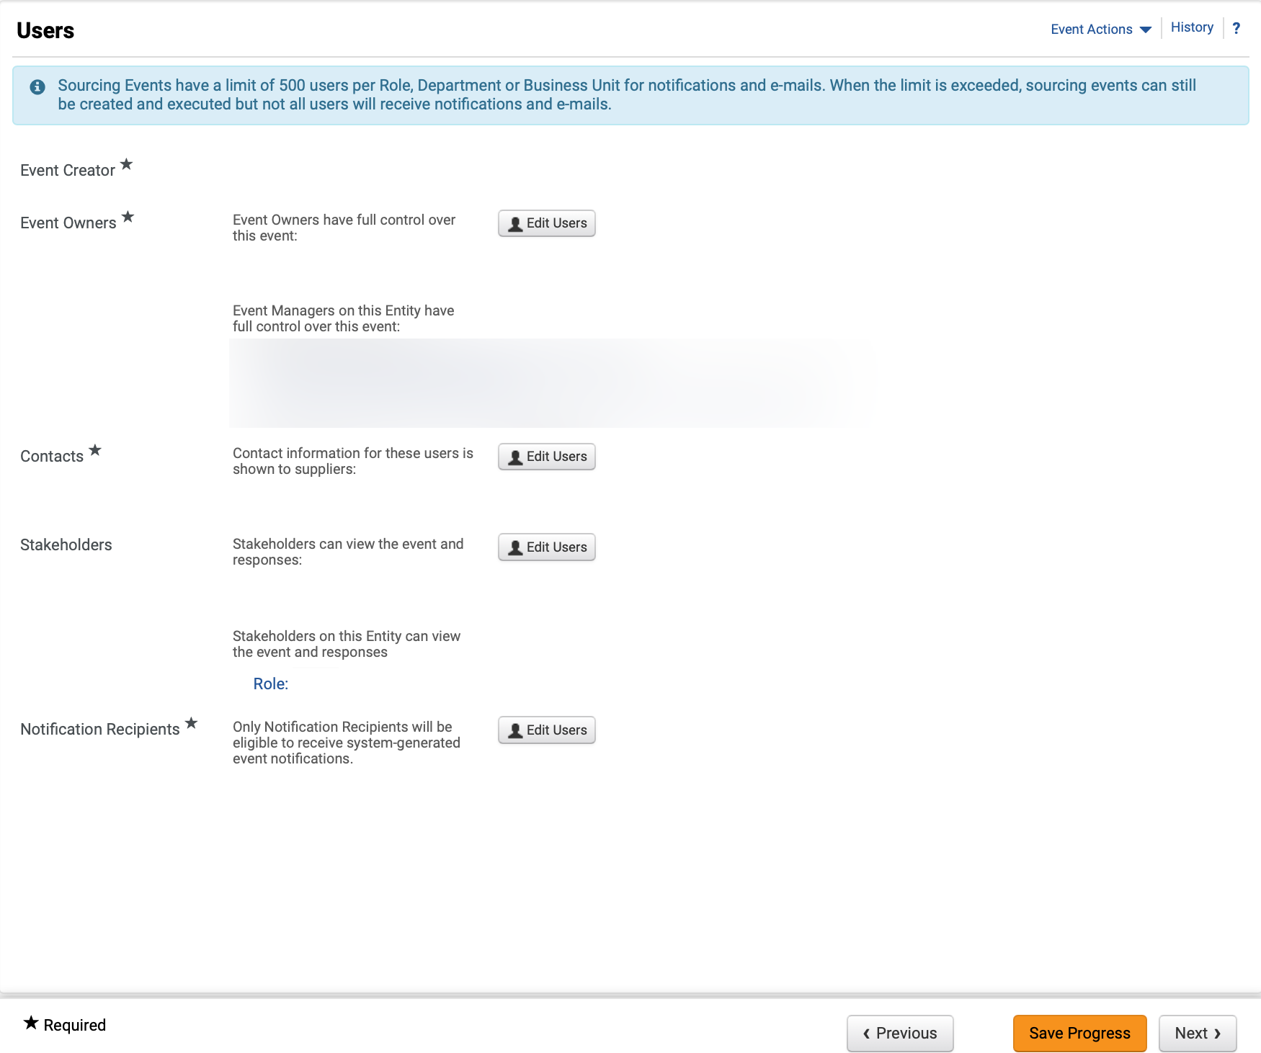
Create Request for Information (RFI)
(Part 13 of 41)
INSTRUCTIONS
Review Event Owners*, Contacts* and Notification Recipients*.
Note: Click Edit Users to update any of the editable fields. Review Managing Administrators, Stakeholders and Contract Managers Job Aid for further details.
Click Next.
39
40

Slide 15
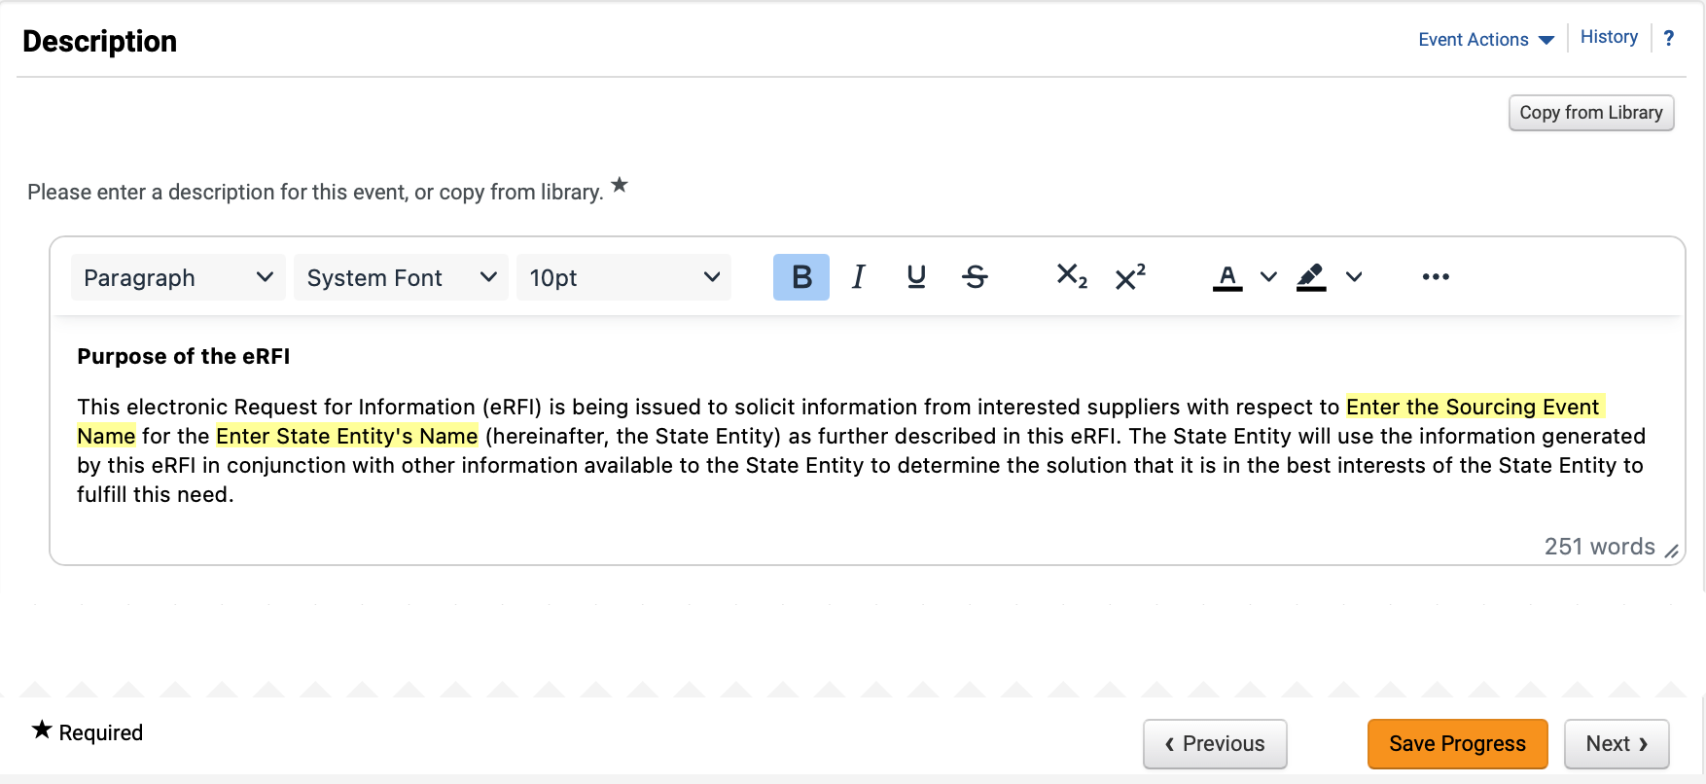
Create Request for Information (RFI)
(Part 14 of 41)
INSTRUCTIONS
Review and edit Description*.
Note: Remove instructions when editing Description this will show up in the Georgia Procurement Registry (GPR). To remove yellow highlighting, select the text and click the Paint Bucket to change the background color. To Copy from Library, follow Steps 42 – 45, or skip to Step 46 to add Stage Description.
To Copy Description from Library, click Copy from Library.
Note: Click magnifying glass to display more options.

Slide 16
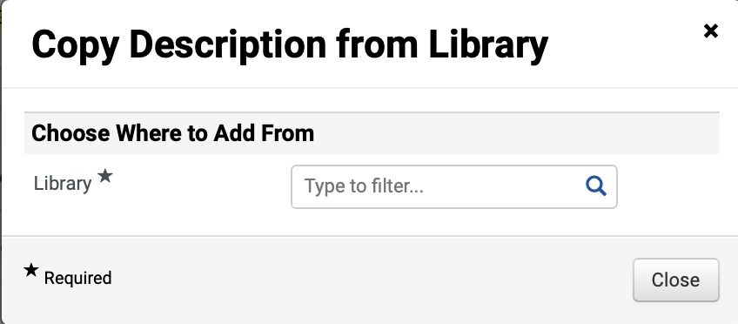
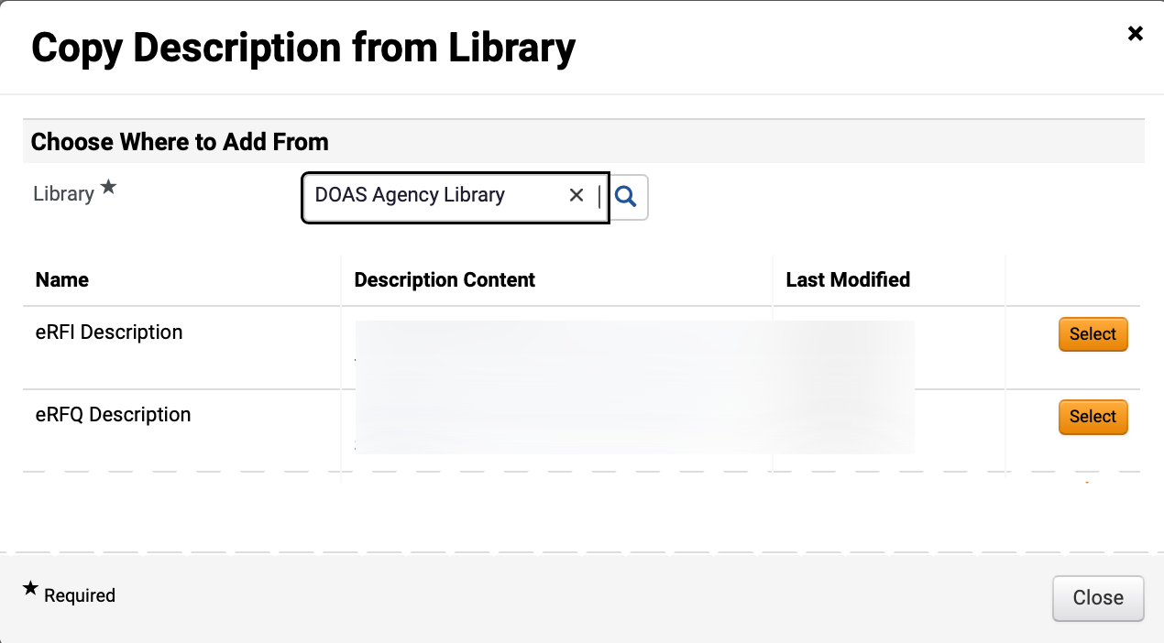
Create Request for Information (RFI)
(Part 15 of 41)
INSTRUCTIONS
Select Library*.
Note: Click magnifying glass to display more options.
Click Select to add Description Content.

Slide 17
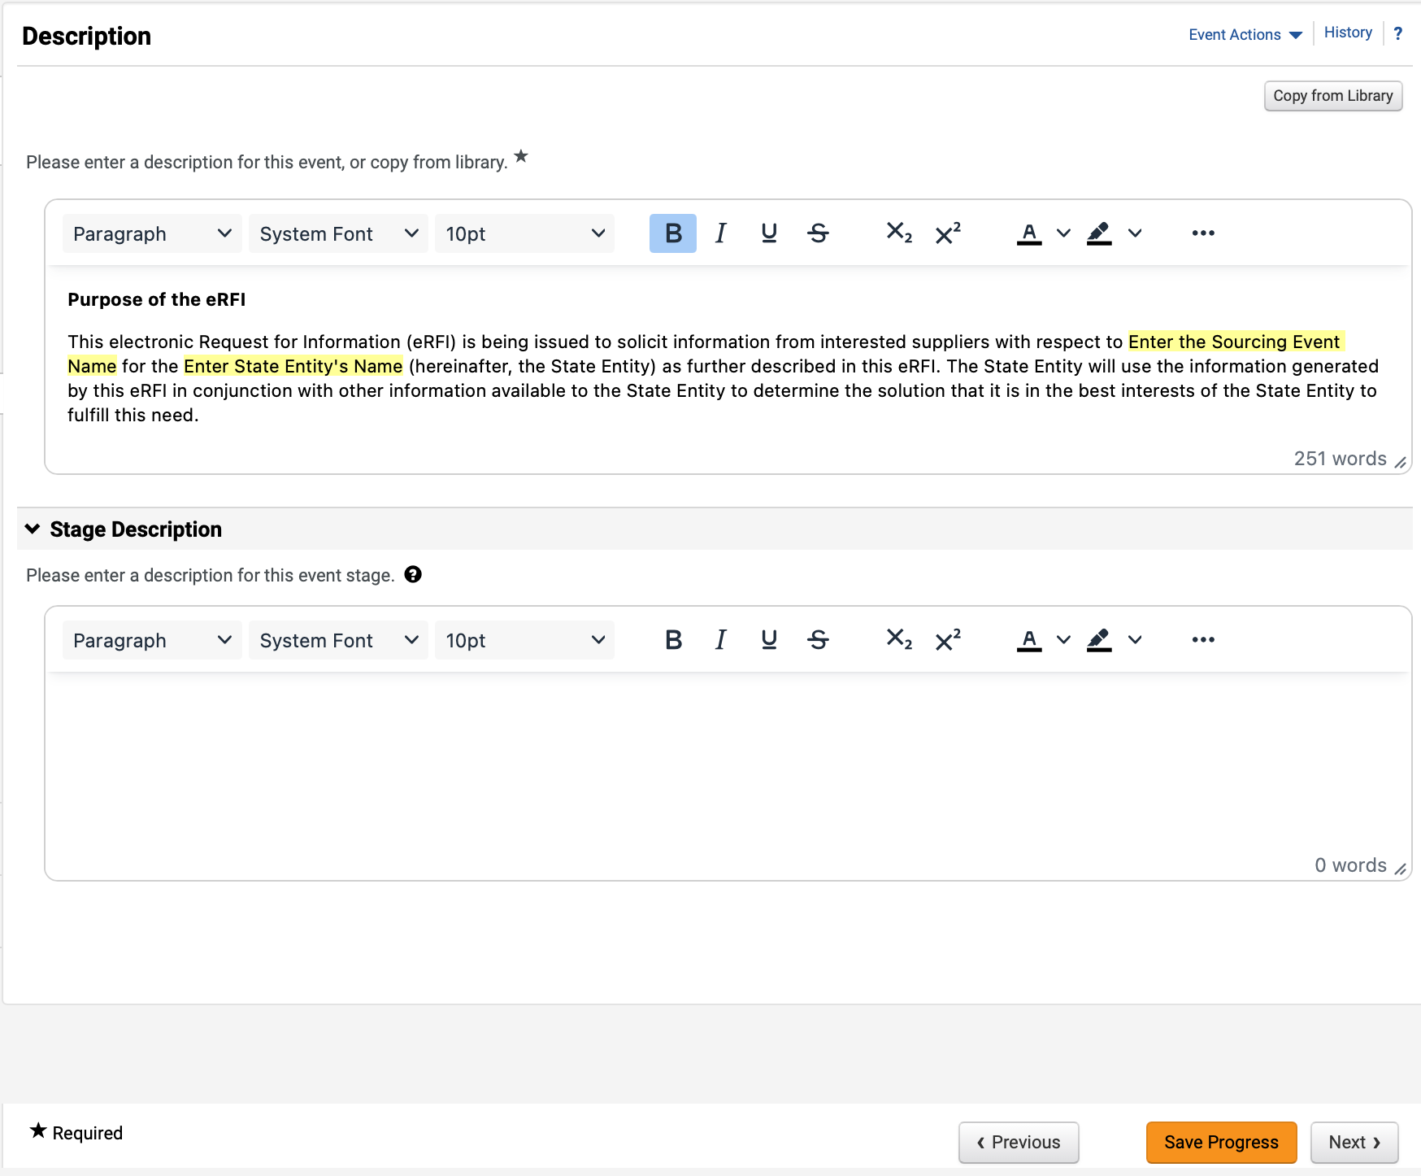
Create Request for Information (RFI)
(Part 16 of 41)
INSTRUCTIONS
Review added Description.
Enter Stage Description (Optional).
Note: Populate this field only if there is a stage included in the event.
Click Save Progress and Next.
45
46
47

Slide 18
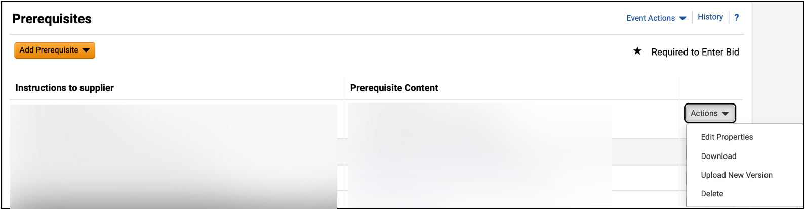
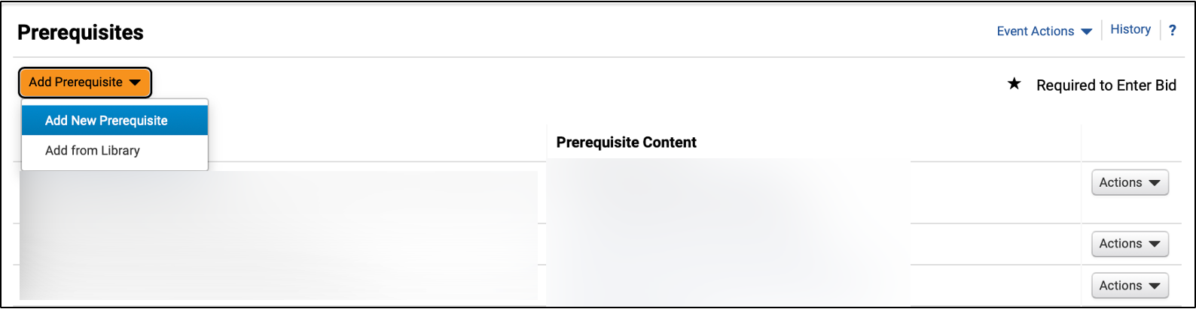
Create Request for Information (RFI)
(Part 17 of 41)
INSTRUCTIONS
Click Actions to edit or delete a Prerequisite (Optional).
Note: All template populated Prerequisites should be reviewed by Sourcing Event Buyers to ensure language and attachments are correct in accordance with what they are sourcing.
Click Add Prerequisite (Optional).
Note: If selecting Add New Prerequisite, follow Steps 50 – 64 and then skip to Step 71 to Add Attachment. If selecting Add from Library, follow Steps 65 – 70.
Select Add New Prerequisite.
49
50

Slide 19
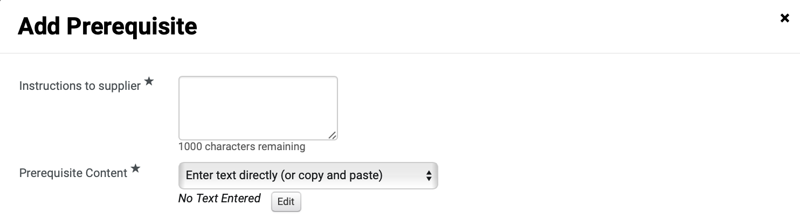
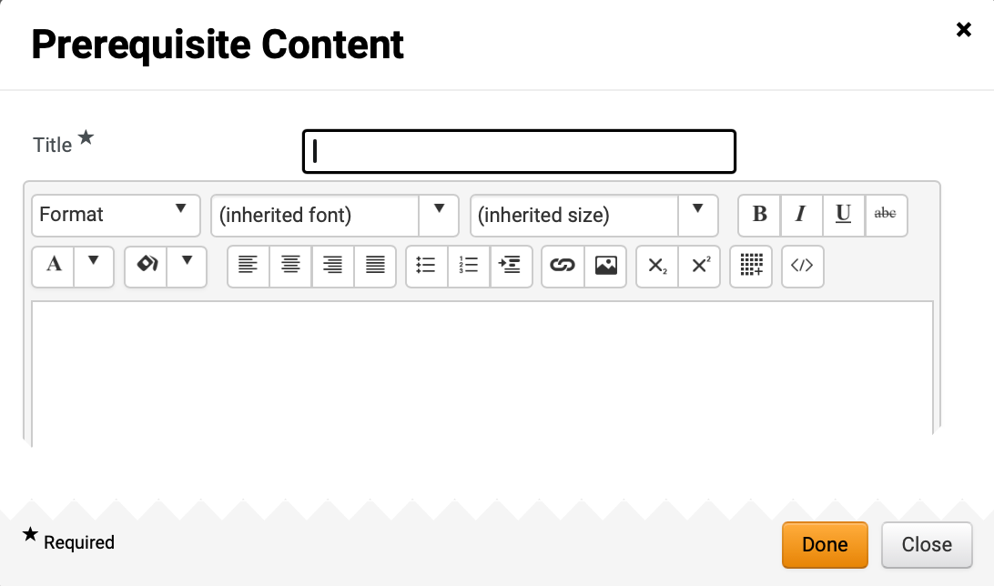
Create Request for Information (RFI)
(Part 18 of 41)
INSTRUCTIONS
Enter Instructions to supplier*.
Select Prerequisite Content*.
Note: If selecting Enter text directly, follow Steps 53 – 56 and skip to Step 60. To Attach File, skip to Step 57.
Click Edit.
51
52
53
Enter Title*.
Enter Prerequisite Content.
Click Done.
54
55
56

Slide 20
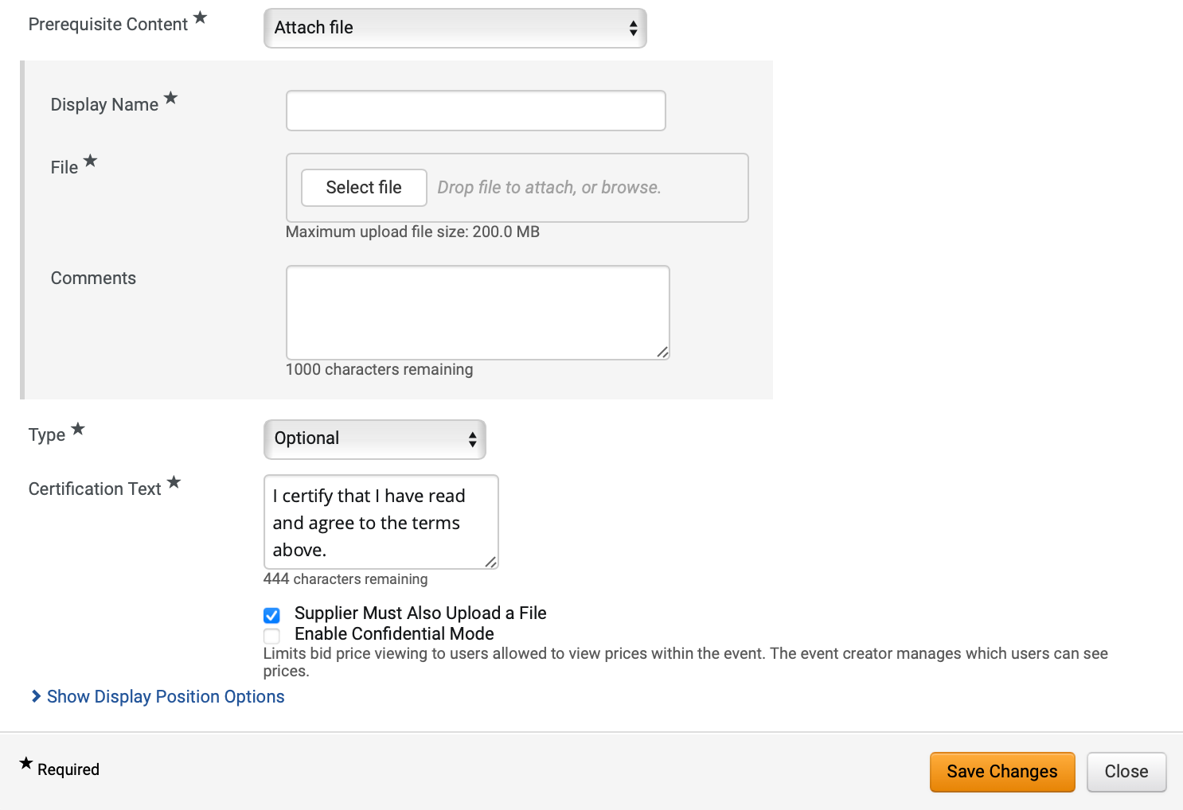
Create Request for Information (RFI)
(Part 19 of 41)
INSTRUCTIONS
If attaching file, enter Display Name*.
Click Select file to attach File*.
Enter Comments (Optional).
Select Type* and enter Certification Text*.
Note: Certification Text will auto-populate but can be edited.
Check Supplier Must Also Upload a File box (Optional).
Note: If checked, Enable Confidential Mode box will display.
Click Show Display Position Options.
57
58
59
60
62
61

Slide 21
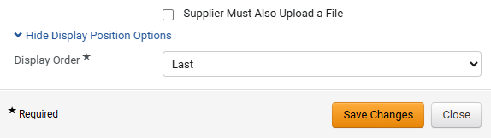
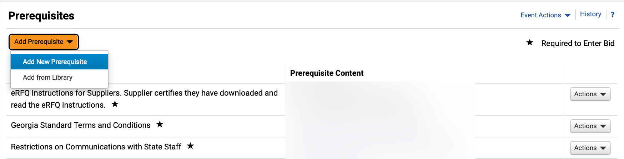
Create Request for Information (RFI)
(Part 20 of 41)
INSTRUCTIONS
Select Display Order*.
Click Save Changes.
Note: Repeat Steps 49 – 64 to add additional custom prerequisites.
63
64
Click Add Prerequisite.
Select Add from Library.
65
66

Slide 22
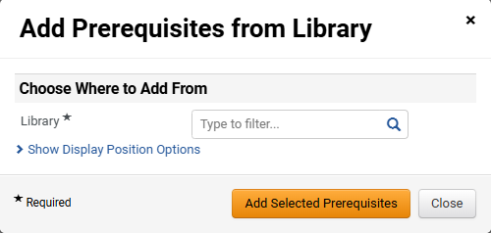
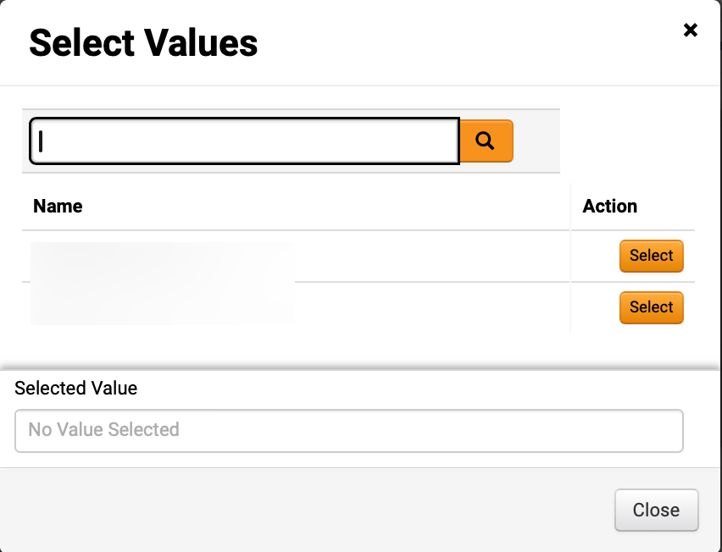
Create Request for Information (RFI)
(Part 21 of 41)
INSTRUCTIONS
Click Search to select Library*.
Note: If selecting Library from dropdown, skip to Step 69.
Click Select for the desired library.

Slide 23
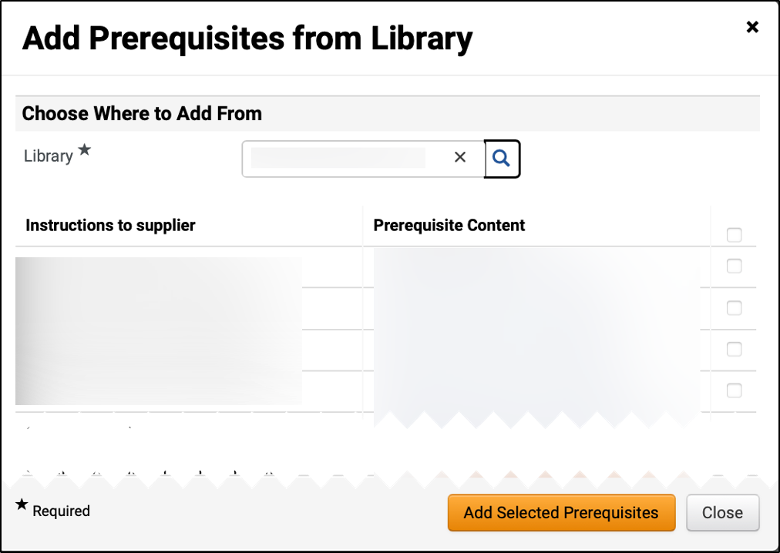
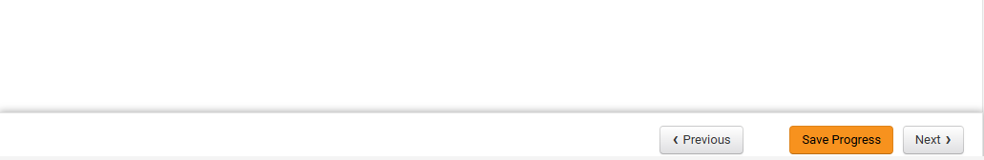
Create Request for Information (RFI)
(Part 22 of 41)
INSTRUCTIONS
Check Prerequisite box.
Note: Multiple Prerequisites can be selected from Library.
Click Add Selected Prerequisites.
69
70
Click Next.

Slide 24
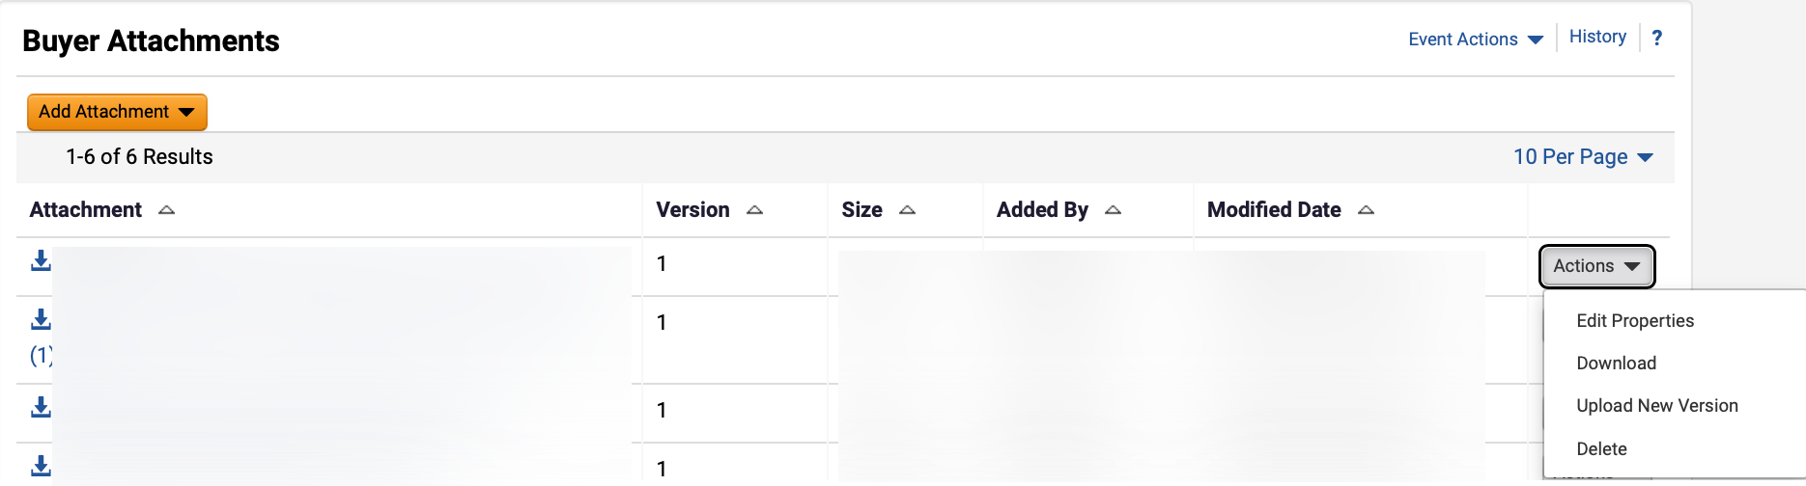
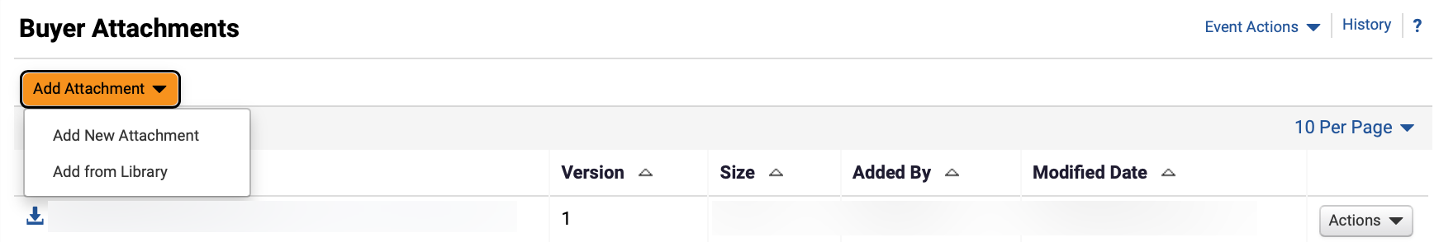
Create Request for Information (RFI)
(Part 23 of 41)
INSTRUCTIONS
Click Actions to edit or delete a Buyer Attachment (Optional).
Click Add Attachment.
Note: Follow Steps 73 – 92 and skip to Step 97 if adding Buyer Attachments or skip to Step 93 to Add from Library. Following your organization's guidance, upload any relevant files to the event. If no files to add, skip to Step 98.
Select Add New Attachment.
73
74

Slide 25
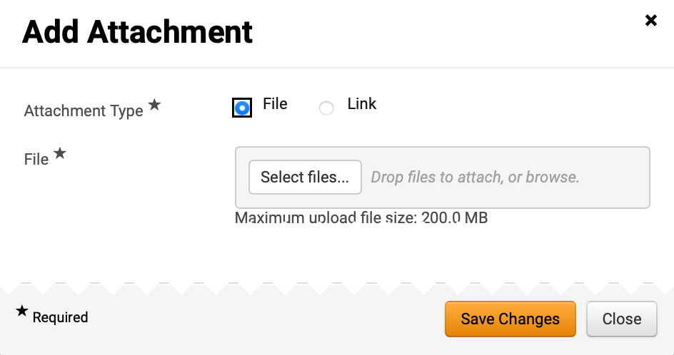
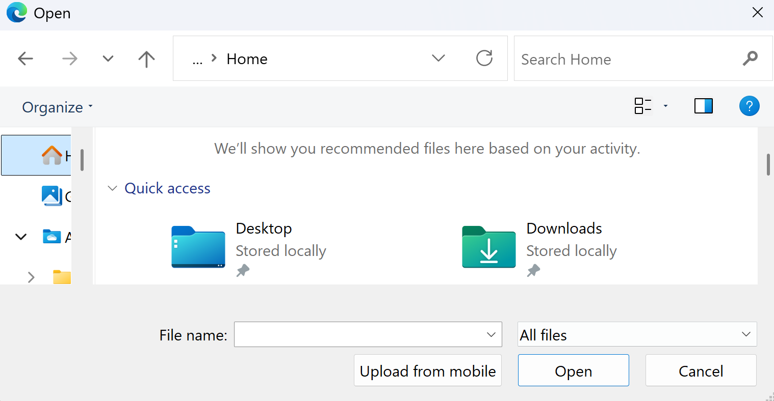
Create Request for Information (RFI)
(Part 24 of 41)
INSTRUCTIONS
Select Attachment Type*.
Note: If selecting File, follow Steps 76 – 82 then skip to Step 87. If selecting Link, skip to Step 83.
Click Select files… to upload File*.
75
76
Select the applicable File from local computer.
Click Open.
77
78

Slide 26
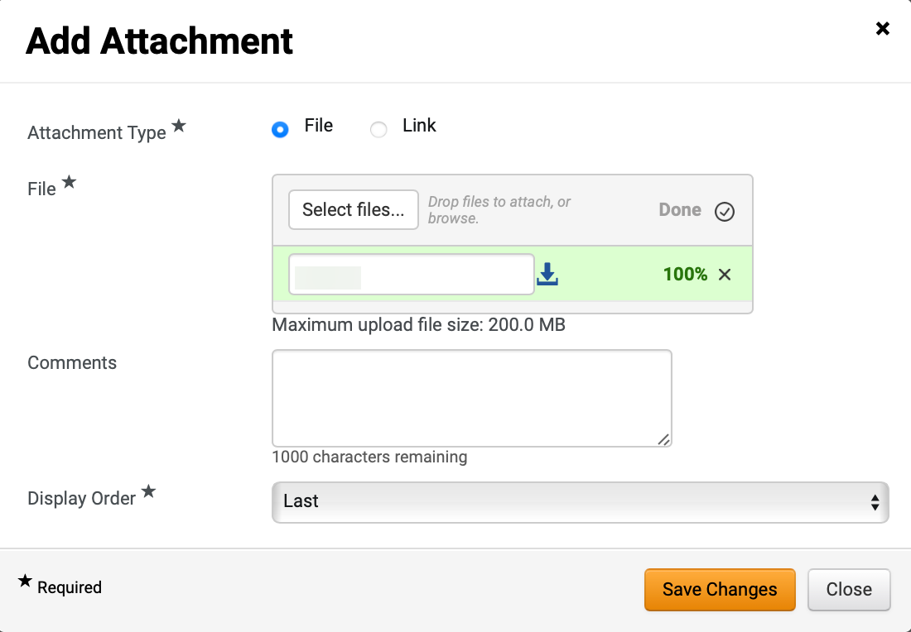
Create Request for Information (RFI)
(Part 25 of 41)
INSTRUCTIONS
Confirm that the uploaded File* was added.
Enter Comments (Optional).
Select Display Order*.
Click Save Changes.
Note: Skip to Step 102 to Add Question.
79
80
81
82

Slide 27
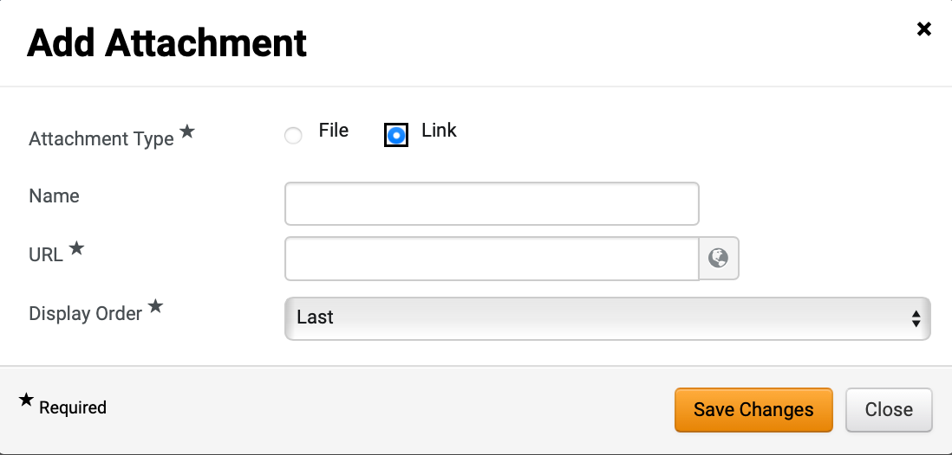
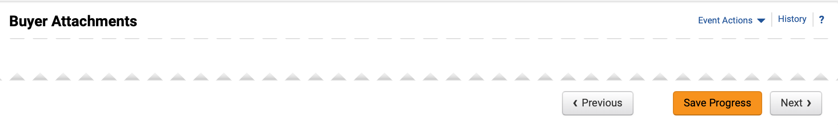
Create Request for Information (RFI)
(Part 26 of 41)
INSTRUCTIONS
Select Link as Attachment Type*.
Enter Name and enter URL*.
Select Display Order*.
Click Save Changes.
83
84
85
86
87
Click Next.

Slide 28
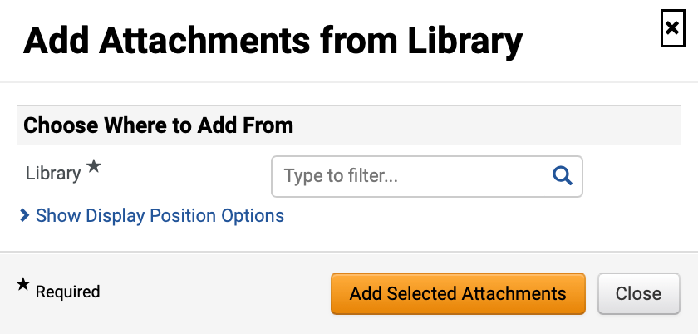
Create Request for Information (RFI)
(Part 27 of 41)
INSTRUCTIONS
To Add Attachment from Library, select Add from Library.
Select Library*.
Note: Use magnifying glass to search for Library.

Slide 29
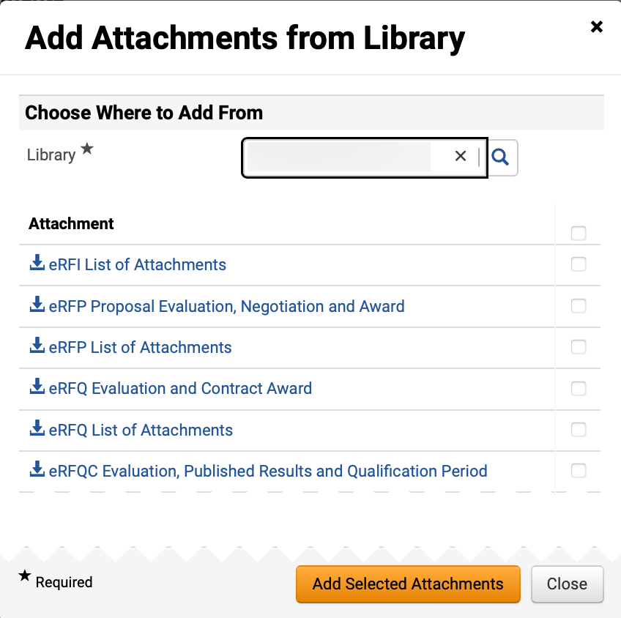
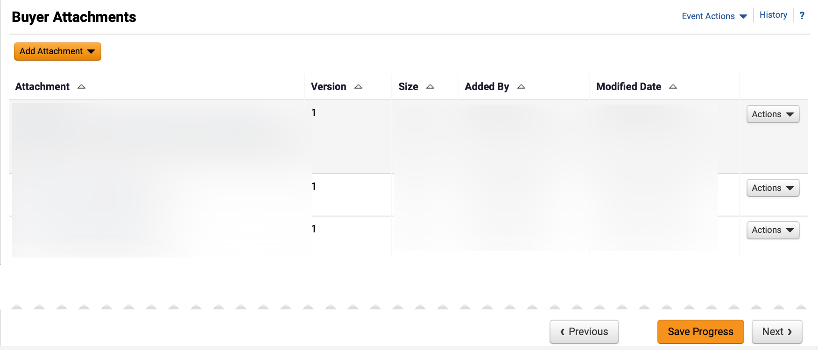
Create Request for Information (RFI)
(Part 28 of 41)
INSTRUCTIONS
Check Add Attachments box.
Note: Multiple Attachments can be selected.
Click Add Selected Attachments.
91
92
Review Buyer Attachments.
Click Next.
93
94

Slide 30
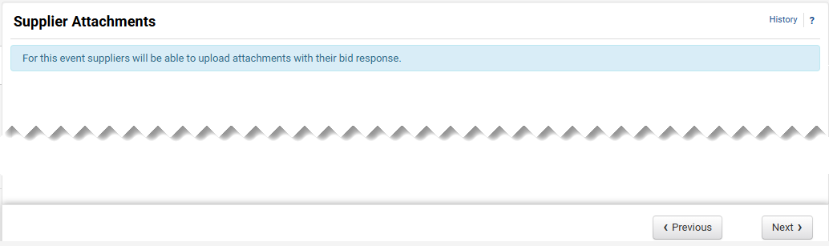
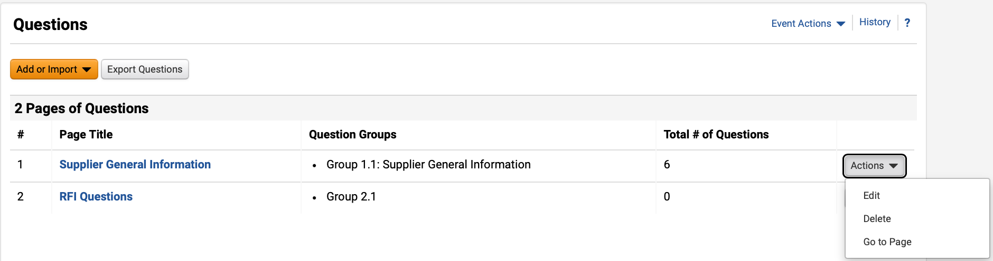
Create Request for Information (RFI)
(Part 29 of 41)
INSTRUCTIONS
Click Next.
Note: All event types are set up to allow suppliers to upload attachments.
To Edit or Delete prepopulated question groups, click Actions (Optional).
Click Page Title hyperlink to view questions.
Note: Review the chart to learn more about Event Questions.
96
97

Slide 31
Create Request for Information (RFI)
(Part 30 of 41)
INSTRUCTIONS
Event Questions
Description
Add New Question
Enter a custom question
Add from Library
Select standard questions
Import from File
Upload previously prepared questions
Question Page
Questions can be organized into separate pages. The RFI template includes two pre-populated question pages:
Supplier General Information
Mandatory Questions
Question Group
Within each page, questions can be further grouped into sections with titles based on user-defined criteria. Instructions for each group can also be entered.
Block Questions with Supplier Profile Content
Questions from Supplier Profile Content can be added in groups.
Note: Users can organize their questions and groups freely.
Options:
Group questions in sections under a single page.
Place each group on a separate page.
Have all questions in a single page without groups

Slide 32
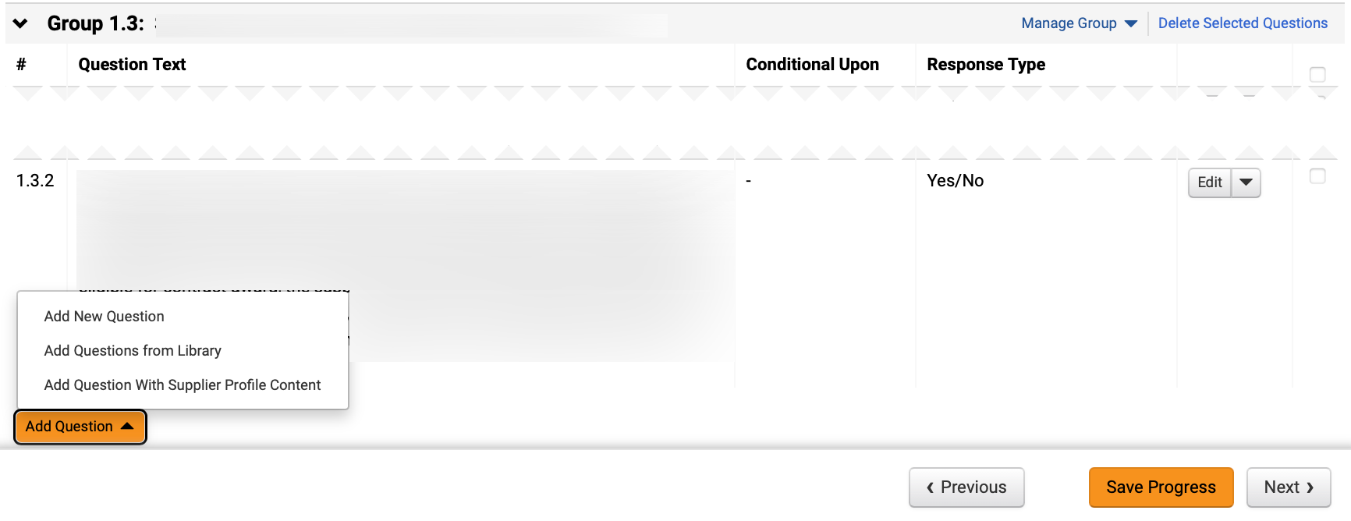
Create Request for Information (RFI)
(Part 31 of 41)
INSTRUCTIONS
Click Add Question.
To add a custom question, select Add New Question.
Note: To Add New Question, follow Steps 100 – 105 and skip to Step 113. To Add Questions from Library, follow Steps 116 – 112.
98
99

Slide 33
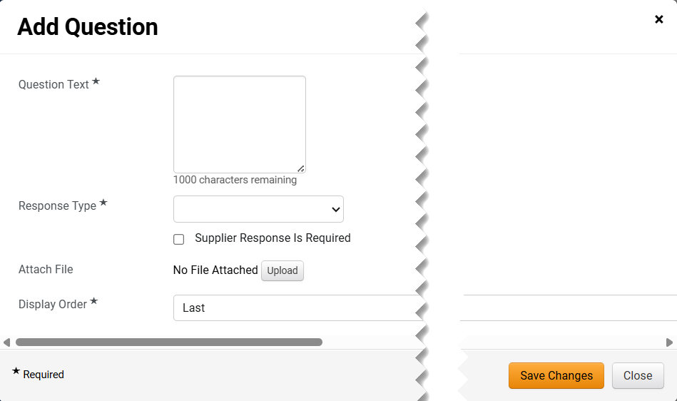
Create Request for Information (RFI)
(Part 32 of 41)
INSTRUCTIONS
Enter Question Text*.
Select Response Type*.
Note: Additional fields may display depending on Response Type selected.
Check the Supplier Response is Required box (Optional).
Click Upload to Attach File (Optional).
Select Display Order*.
Click Save Changes.
100
101
102
103
104
105

Slide 34
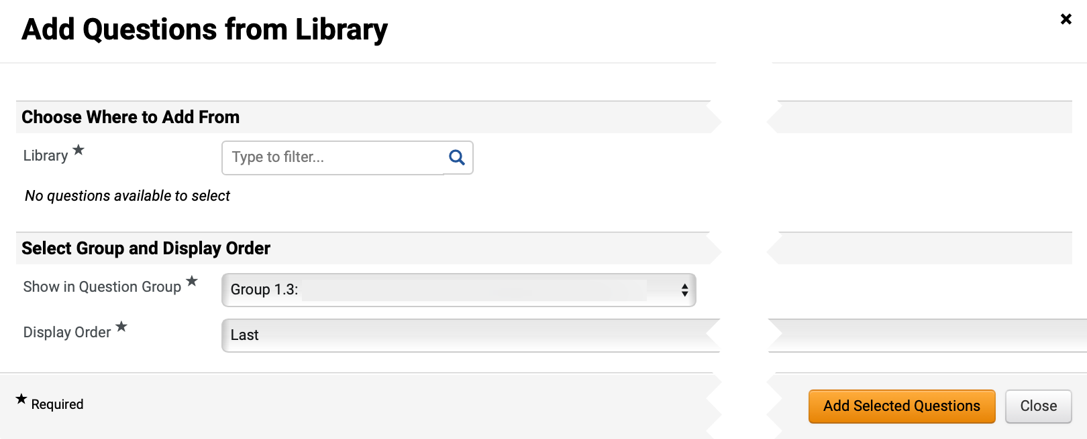
Create Request for Information (RFI)
(Part 33 of 41)
INSTRUCTIONS
Select Add Question from Library.
Note: To Add Questions from Library, follow Steps 107– 112.
Select Library*.
Note: Use magnifying glass to search.

Slide 35
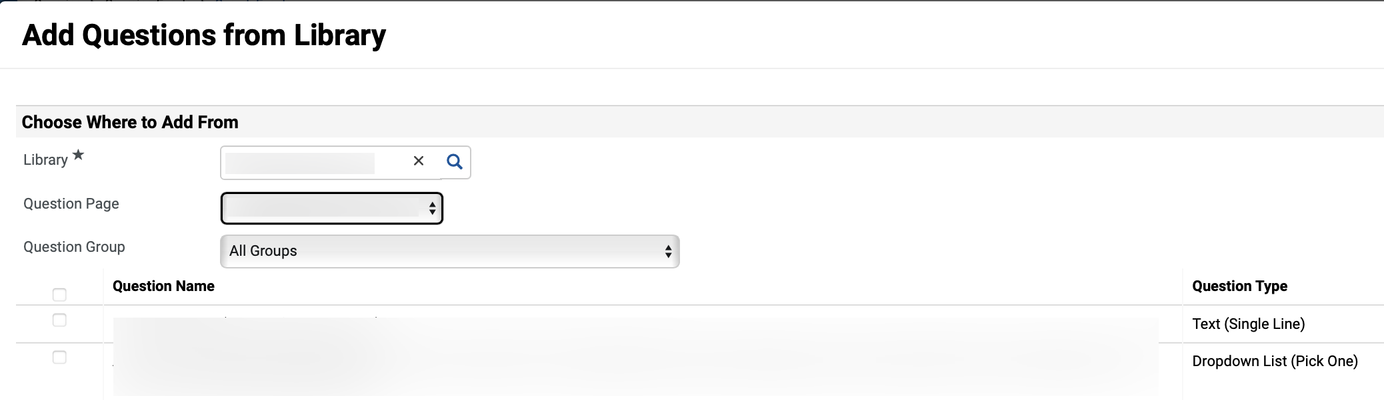
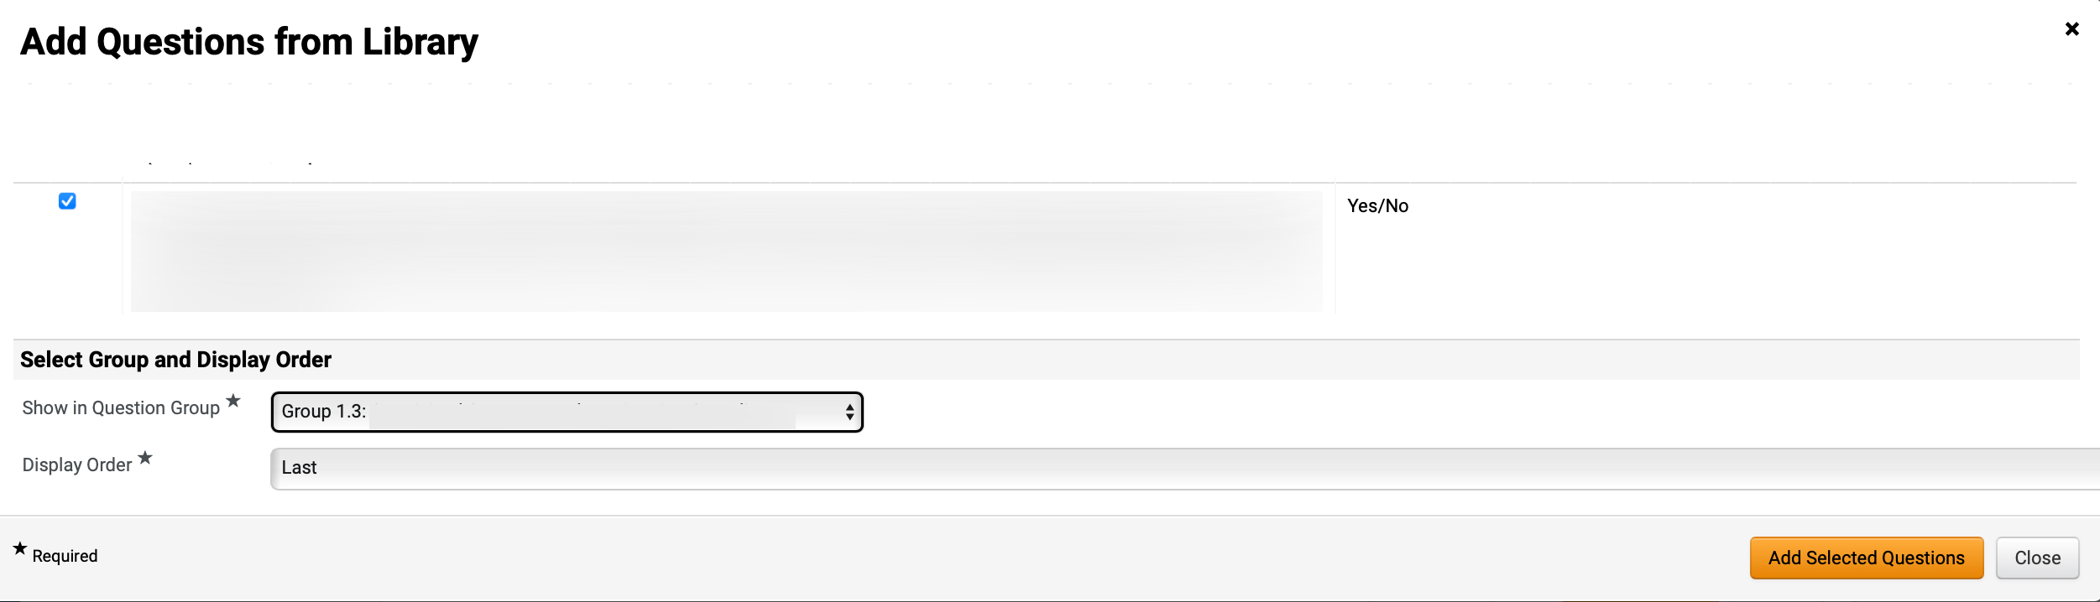
Create Request for Information (RFI)
(Part 34 of 41)
INSTRUCTIONS
Select Question Page and select Question Group.
Note: Question Group can be filtered by All Groups or an individual Question Group.
Check Question Name box.
Note: Multiple Questions can be selected.
108
109
Select Show in Question Group* and select Display Order*.
Click Add Selected Questions.
111
110

Slide 36
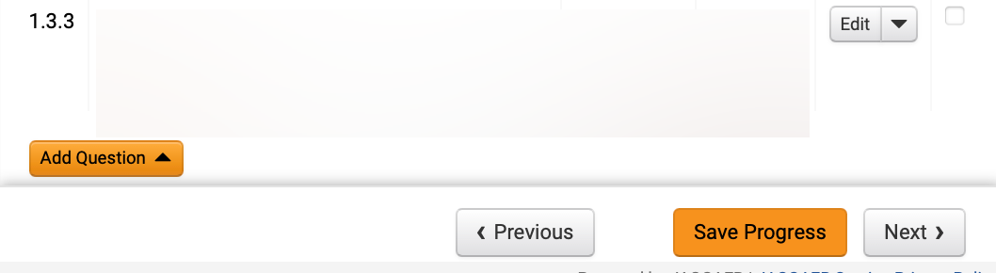
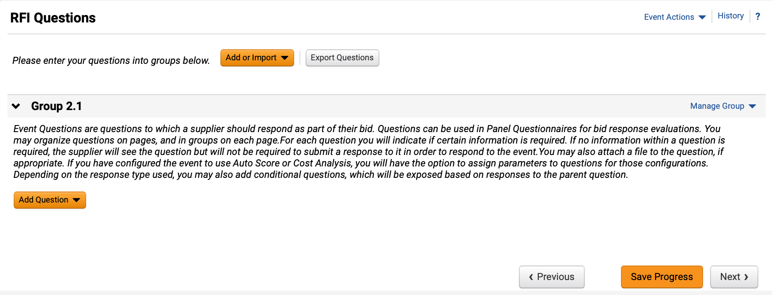
Create Request for Information (RFI)
(Part 35 of 41)
INSTRUCTIONS
Review added Question.
Click Next.
111
112
Review RFI Questions page.
Note: Repeat Steps 100 – 105 to Add New Question or Steps 106 – 112 to Add Questions from Library.
Click Next.
113
114

Slide 37
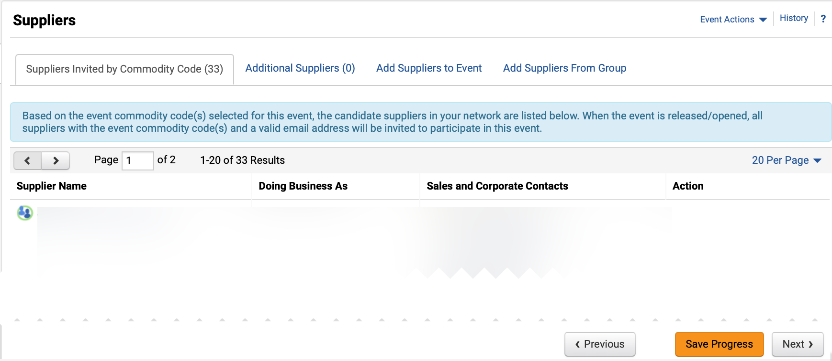
Create Request for Information (RFI)
(Part 36 of 41)
INSTRUCTIONS
Review Suppliers Invited by Commodity Code tab.
Note: From the Suppliers Invited by Commodity Code tab view which registered suppliers will receive an email notification based on the NIGP Codes selected in the Setup section. If the tab is blank, return to the Setup section and select the appropriate NIGP codes.
To invite additional suppliers, click the Add Suppliers to Event tab.
115
116

Slide 38

Create Request for Information (RFI)
(Part 37 of 41)
INSTRUCTIONS
Enter Supplier Name in Quick search to search for Suppliers.
Click Add to Event.
Note: If clicking Add to Event, skip to Step 124. An Added confirmation icon will display
Click Manually Invite Suppliers (Optional).
Note: To Manually Invite Suppliers, follow Steps 120 – 124 or skip to Step 125.
Select Add Supplier to Event.
Note: If adding several suppliers, select Get Import Template.
119
117
120
118

Slide 39


Create Request for Information (RFI)
(Part 38 of 41)
INSTRUCTIONS
Enter Supplier Name* and enter Sales or Corporate Contact Name (Optional).
Enter Email*.
Click Save or Save and Add Another.
121
122
123
Review added Supplier.

Slide 40


Create Request for Information (RFI)
(Part 39 of 41)
INSTRUCTIONS
Click Save Progress and Next.
Review Progress for each section.
Note: Click the Section hyperlink to return to a section if editing is required.
Click Submit.
126
127

Slide 41


Create Request for Information (RFI)
(Part 40 of 41)
INSTRUCTIONS
Review Event Submitted summary page.
Note: If there is workflow surrounding the event, approval steps can be viewed by clicking View Approval Steps.
Click Return to My Event hyperlink.
Click Tools.
Select Approvals.
130
131

Slide 42


Create Request for Information (RFI)
(Part 41 of 41)
INSTRUCTIONS
Review Sourcing Event Approval Workflow and make changes as applicable.
You have successfully created a Request for Information (RFI).

